Slide 1
Secure User Registration System
Post-Quantum Cryptography Implementation
Spring Boot 3.2.0 | Dilithium3 | Protocol Buffers

Slide 2
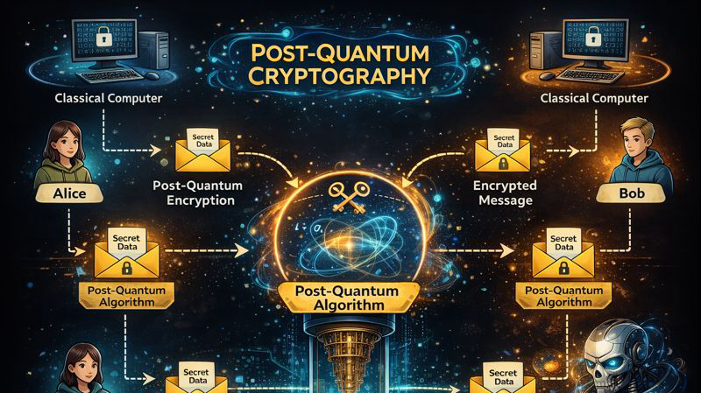

Slide 3
Project Overview
A secure user registration REST API with:
• Post-Quantum Cryptography (Dilithium3 signatures)
• All API responses digitally signed
• Resistant to quantum computing attacks
• Secure registration code generation with checksums
• PBKDF2 password hashing (65,536 iterations)

Slide 4
Technology Stack
Core Technologies:
• Spring Boot 3.2.0 - Core Framework
• Java 17+ - Programming Language
• H2 Database - In-memory Storage
• BouncyCastle 1.77 - Post-Quantum Crypto
• Protocol Buffers - API Serialization
• SpringDoc OpenAPI - API Documentation

Slide 5
System Architecture
Layered Architecture:
• Controller Layer → REST Endpoints
• Service Layer → Business Logic
• Repository Layer → Database Operations
• Crypto Layer → Signing, Hashing, Keys
• Domain Layer → JPA Entities

Slide 6
API Endpoints
POST /api/users
Create new user (Admin) - Returns registration code
POST /api/register
Complete registration with email + code
GET /api/public-key
Get server's public key for signature verification

Slide 7
User Registration Flow
1. Admin creates user with name & email
2. System generates 20-char registration code
3. Code is PBKDF2 hashed and stored
4. User receives code (email in production)
5. User submits email + code to register
6. System validates: integrity → lookup → hash
7. User receives authentication token

Slide 8
Security Implementation
Dilithium3 Digital Signatures
• Lattice-based post-quantum cryptography
• Quantum-resistant security
Registration Code Security
• 16 random + 4 checksum hex characters
• PBKDF2 with 65,536 iterations
• Salted hash storage

Slide 9
Live Demo
Access Points:
• Web UI: http://localhost:8080
• Swagger: http://localhost:8080/swagger-ui.html
• H2 Console: http://localhost:8080/h2-console
Demo Steps:
1. Create a new user (Admin)
2. Copy the registration code
3. Complete registration
4. Verify signature with public key

Slide 10
Thank You!
Questions?

