Slide 1
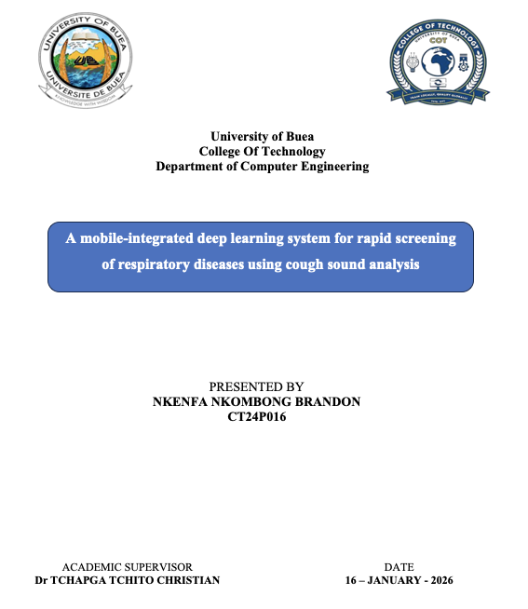
A Mobile-Integrated
Deep Learning System
for Rapid Screening of
Respiratory Diseases
Using Cough Sound Analysis
Proposal / Chapters 1–3 update and implementation progress
Nkenfa Nkombong Brandon | CT24P016
Supervisor: Dr Tchapga Tchito Christian
23 April 2026

Slide 2

Why this project matters
The thesis addresses a public-health access problem with a mobile-first AI screening approach.
Respiratory diseases remain a major global burden, especially where clinical screening infrastructure is limited.
Smartphones already provide microphones, storage, and enough compute to support low-cost preliminary screening.
Cough sounds carry time-frequency patterns that machine learning can analyse more consistently than unaided listening.
The target is not diagnosis, but fast triage and earlier referral using an offline-capable mobile workflow.
Core thesis idea
Capture a cough → convert to log-mel features → classify with a lightweight CNN → prepare for mobile inference.

Slide 3
Scope update: intended system vs implemented milestone
The full project remains multi-stage, but the current implementation is a binary baseline because TB data is still controlled-access.
Original full scope
Specific objectives (current reporting focus)
Multi-class respiratory screening schema: TB, COVID, and HEALTHY_OR_NONTARGET.
Mobile-optimised deep learning model plus TensorFlow Lite export.
Cross-platform app integration and device/environment benchmarking.
Acquire and curate public cough datasets with reproducible splits.
Define an explicit label schema and mapping rules.
Use log-mel spectrograms for compact mobile-aware feature extraction.
Train a lightweight CNN baseline and report screening metrics.
Document deployment constraints and next steps for mobile integration.
Implemented now
Binary milestone: COVID vs HEALTHY_OR_NONTARGET.
Open datasets acquired, metadata unified, splits created, features extracted, CNN trained and evaluated.
Threshold calibration completed; export attempted but unstable in current environment.

Slide 4
Datasets, governance, and current data status
The work emphasises explicit label mapping, traceability, and subject-aware evaluation.
Data sources
Label governance
Reproducible splits
Coswara
Intended schema
Train
17,141
24,716 audio files
2,746 subjects
TB
COVID
HEALTHY_OR_NONTARGET
Validation
754
COUGHVID
27,550 files
healthy/COVID subset retained
Current training milestone
Test
754
TB dataset
COVID vs HEALTHY_OR_NONTARGET
Planned but still controlled-access
not yet integrated
Subject-independent splitting used where possible to reduce leakage and improve evaluation credibility.
Reason: TB data remains pending, but the broader 3-class schema is preserved in the dissertation design.
Unified metadata after cleaning: 18,649 samples

Slide 5
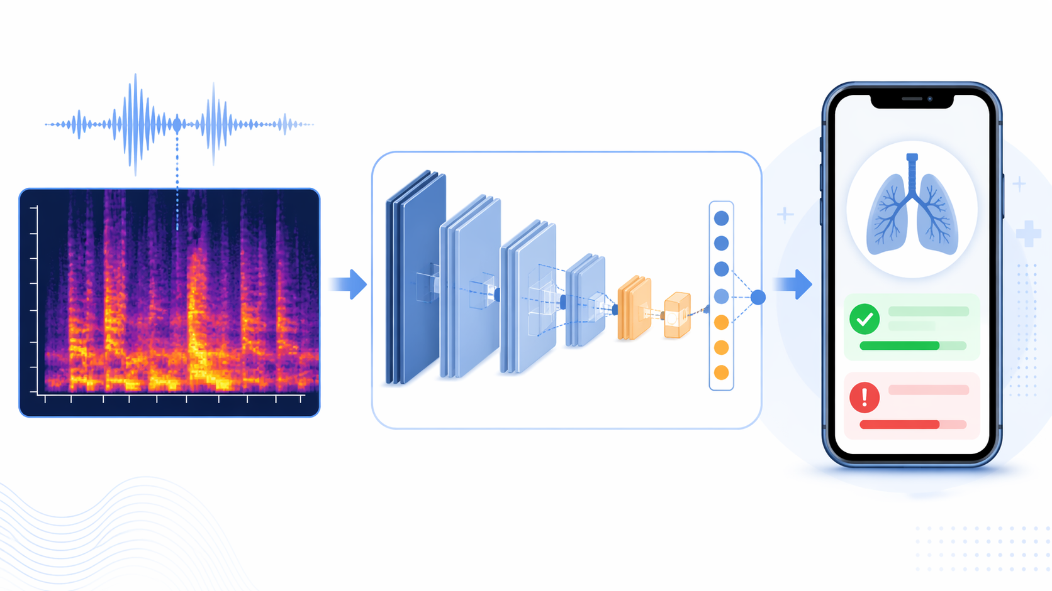
Implemented pipeline
The strongest contribution is the reproducible data-to-model workflow, not just the classifier itself.
Workflow executed
Dataset download and controlled-access handling for TB.
Metadata audit, cleaning, and unified schema construction.
Subject-aware split generation.
Audio preprocessing plus log-mel feature extraction.
Baseline CNN training and evaluation.
Threshold tuning and deployment preparation.
Output artifacts
Unified metadata, split CSVs, cached tensors, checkpoints, evaluation summaries, and deployment notes.

Slide 6
Baseline model and training design
A lightweight 2D CNN was selected to balance reproducibility, efficiency, and future mobile readiness.
Model backbone
Training protocol
Log-mel input
↓
Conv blocks
+ BatchNorm
+ Pooling
↓
Global Average Pooling
↓
Dropout + Dense
↓
Softmax output
Loss: sparse categorical cross-entropy; optimizer: Adam (1e-3).
Batch size 16 with validation monitoring and checkpointing.
Binary label remapping was required for the current COVID vs control milestone.
Weighted and “improved” retraining runs were tested, but the baseline remained the most useful model.
Why threshold tuning mattered
Selected operating threshold
Default predictions favoured the healthy/control class. Validation-based threshold tuning produced a stronger screening operating point using the same baseline model.
0.35
Chosen for screening because it improved COVID sensitivity, even with some loss in overall accuracy and healthy-class recovery.

Slide 7
Key results so far
The best current result comes from the baseline model with a screening threshold of 0.35.
Interpretation
Default-threshold accuracy is higher, but disease recall is too low for a screening scenario.
At threshold 0.35, COVID recall more than doubles compared with the default operating mode.
This is a better screening trade-off: more true positives at the cost of more false alarms.
Best current screening-mode test result
Accuracy 67.24%
COVID recall 55.39%
Healthy recall 71.64%

Slide 8
Current limitations and next steps
The pipeline is credible, but the full thesis scope is not yet complete.
Current limitations
Next steps for Chapters 4–5
TB data is still missing from the implemented training pipeline.
The current milestone is binary, not yet the full multi-class respiratory system.
Control samples are mixed healthy/non-target cases, not perfectly clean “healthy” labels.
TensorFlow Lite export was attempted but failed due to converter instability in the current environment.
Present full experimental results and error analysis clearly in Chapter 4.
Discuss why threshold tuning outperformed weighted retraining for screening.
Document deployment limitations honestly and frame mobile export as future engineering work.
If possible, later integrate TB data and retry TFLite export in a cleaner TensorFlow-only environment.

Slide 9
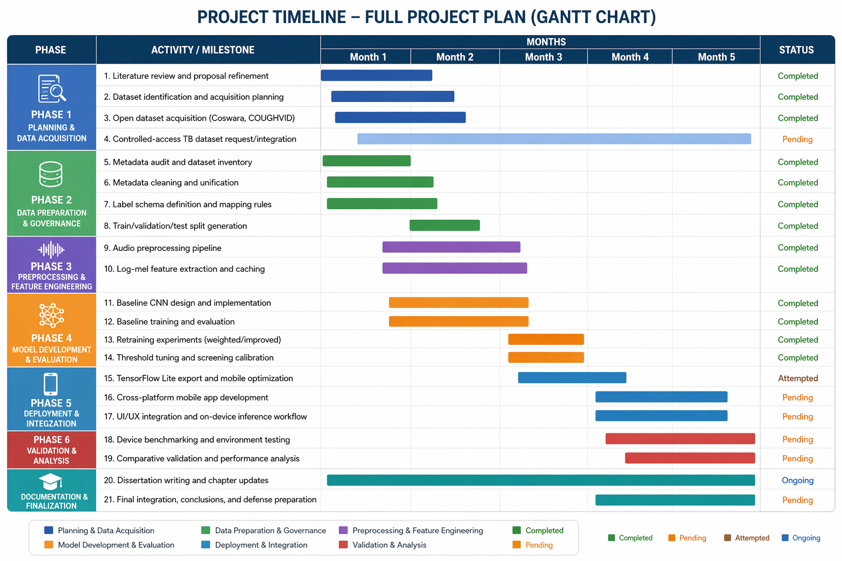
Full project timeline
The dissertation still covers the whole project plan, while showing what has already been completed and what remains pending.

