Slide 1
SOLUCIONES
Complete College Solutions…
Presented by:
Naman Khard

Slide 2
INTRODUCTION
For any organization, administration is the essential part. Without this, organization can’t run successfully and so the work of administrator is not easy especially when the organization is college. So to ease the work of administrator and his associated colleagues , we bring SOLUCIONES.

Slide 3
PURPOSE
Soluciones stores all records in more structural and lucid form. Not only this , users can access them quickly and easily. It maintains three level of users:-
Admin Level
Employee Level
Student Level

Slide 4
SCOPE
This project studies the planning for storing and maintaining data in more efficient form.
This project also provides the medium of communication within organization.
This project also views attendance of the students enrolled in the college.

Slide 5
TECHNOLOGIES TO BE USED
This project is to be a desktop application developed to be in Netbeans having Photoshop and swing as front end and SQL as back end.
Database Design (Ms-SQL Server)
Form Design (Swing)
Coding (Java)

Slide 6
PROJECT REQUIREMENTS
Hardware Requirements -
Processor – Core Duo2 , i3 and higher.
RAM – 2 GB
Disk Space – 150Mb
Software Requirements -
Operating System – Windows XP , Windows 7 , 10.
Database – SQL , JDK 1.8 , JDBC

Slide 7
USER CHARACTERSITICS
Every user should be :
Comfortable of working with computer.
He must have basic knowledge of English too.

Slide 8
CONSTRAINTS
Login and password used for authentication and security.
GUI is in English only.

Slide 9
ER DIAGRAM

Slide 10
Login
Admin
Employee
Student
Attendance
Add
Employee
View
Employee
Assignment
Notice
Notice
View Student
Create
Login
Add
Student

Slide 11
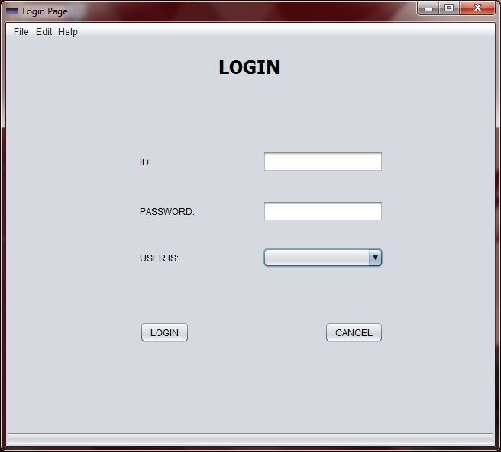

Slide 12
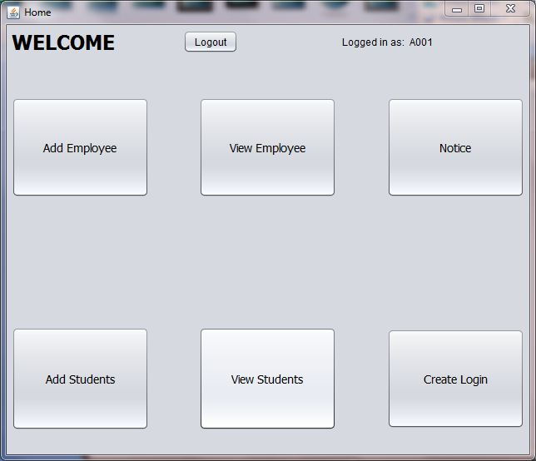

Slide 13
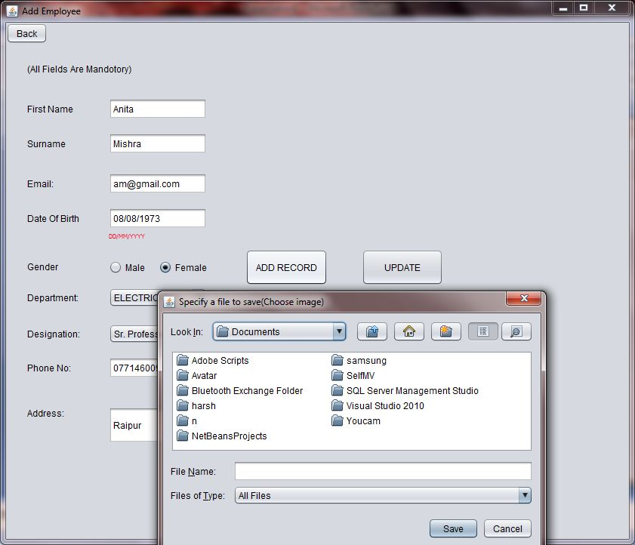

Slide 14
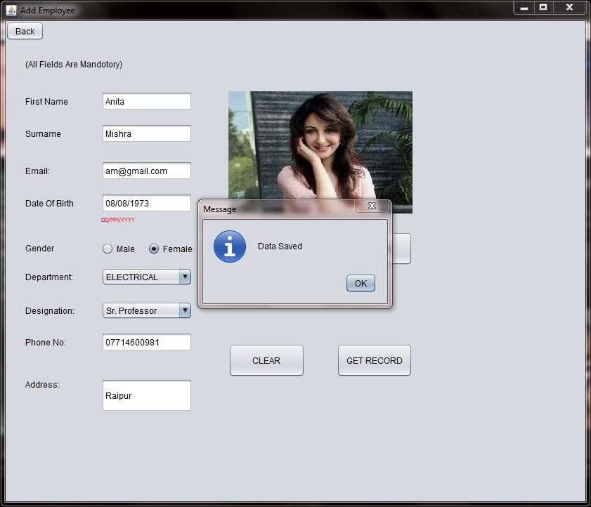

Slide 15
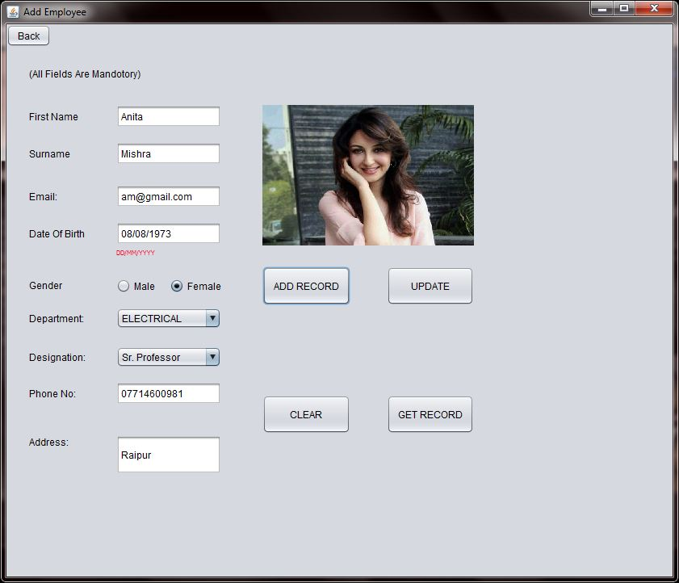

Slide 16
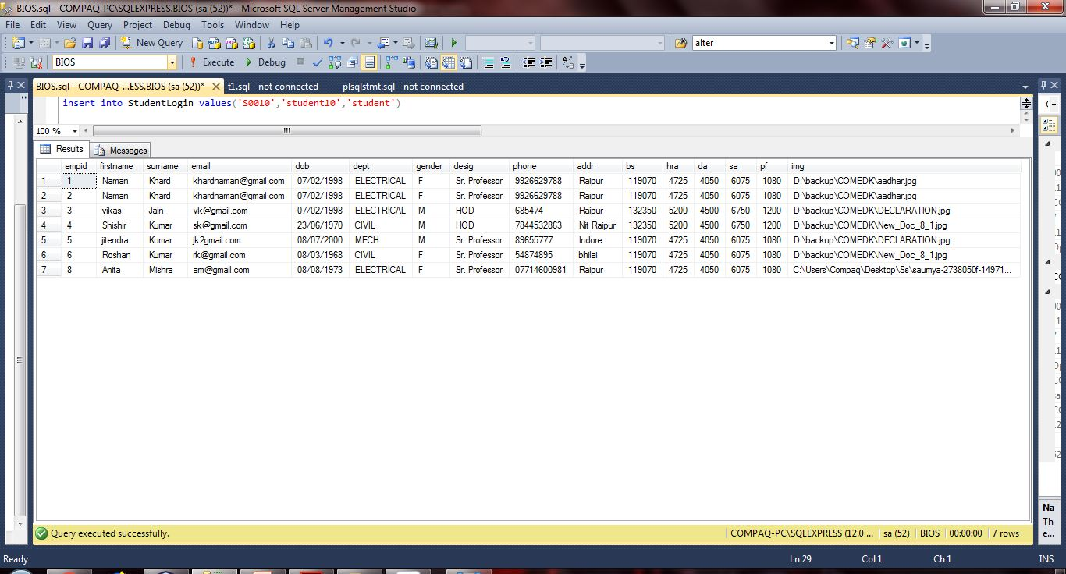

Slide 17
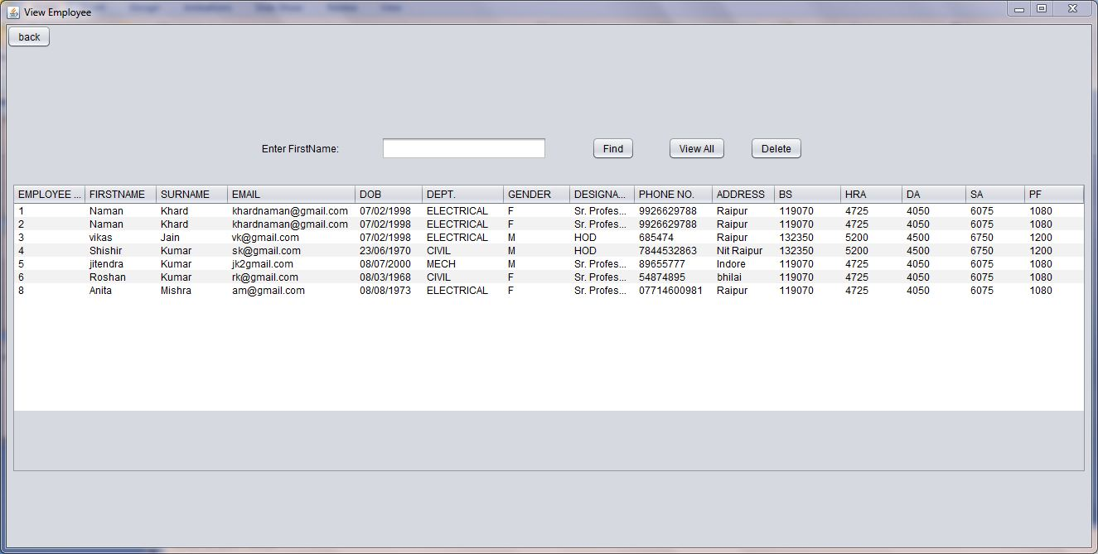

Slide 18
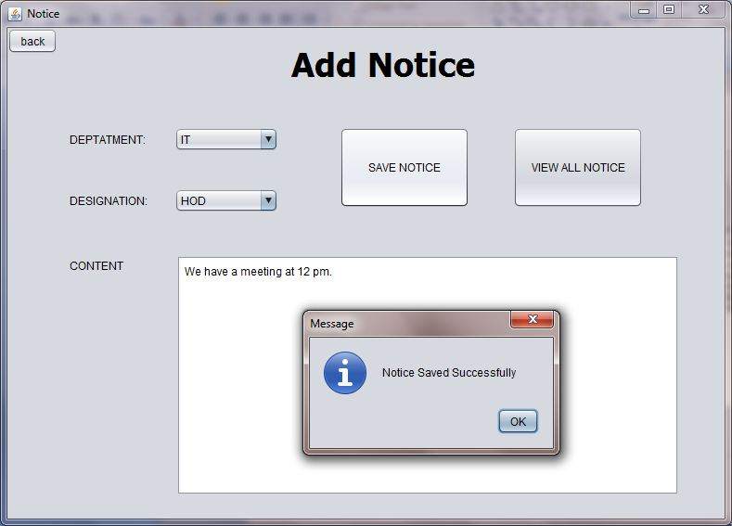

Slide 19
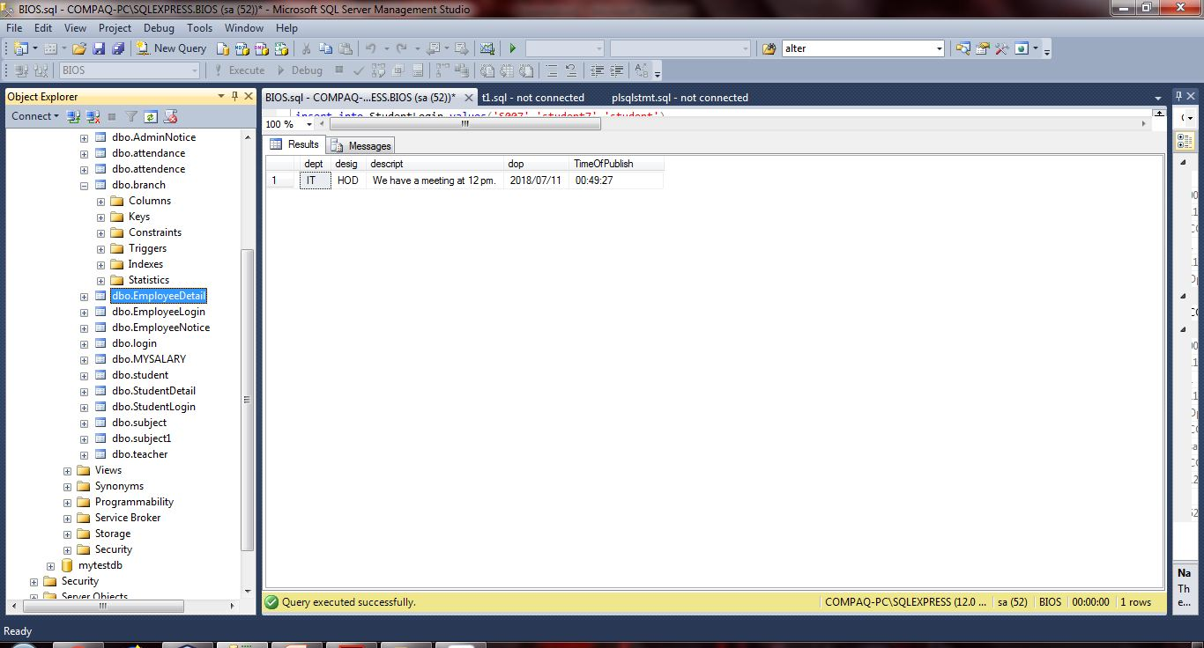

Slide 20
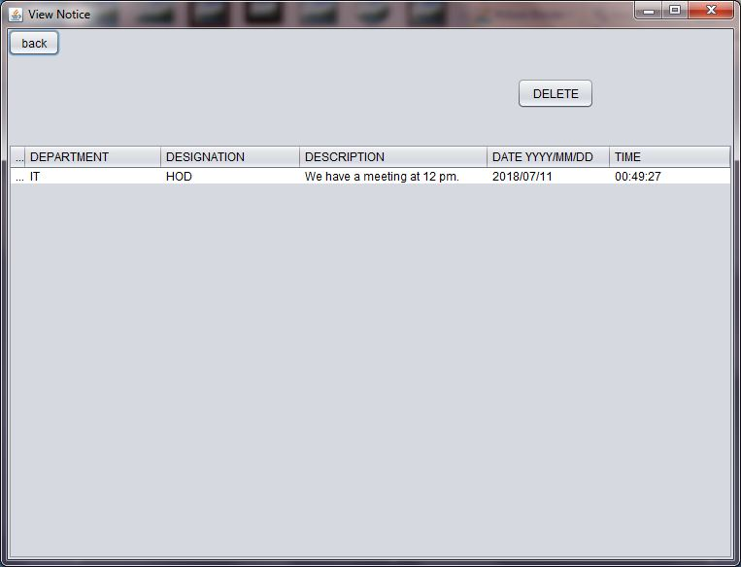

Slide 21
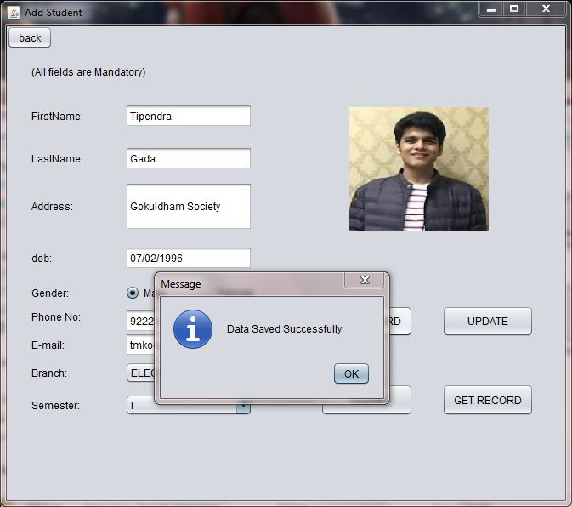

Slide 22
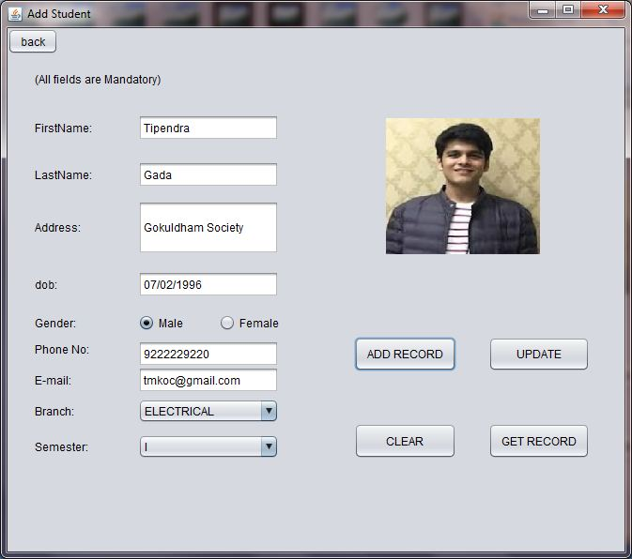

Slide 23
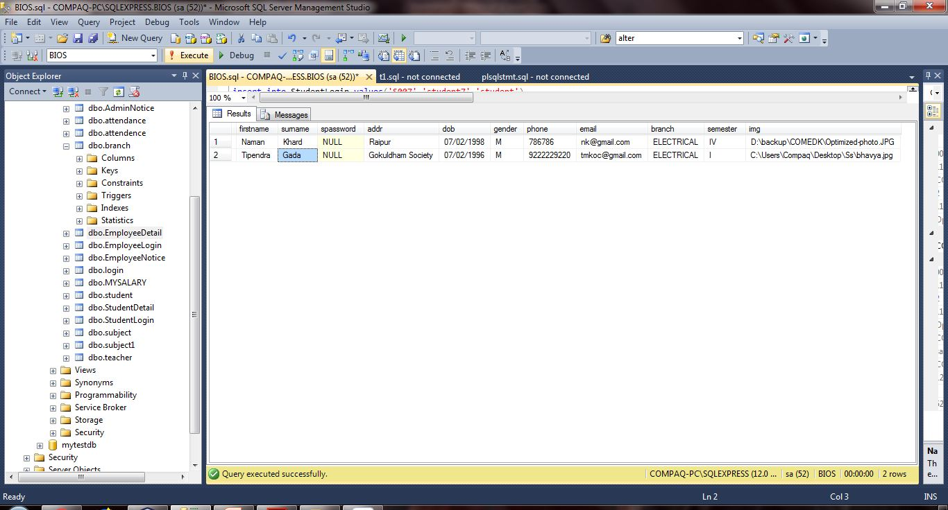

Slide 24
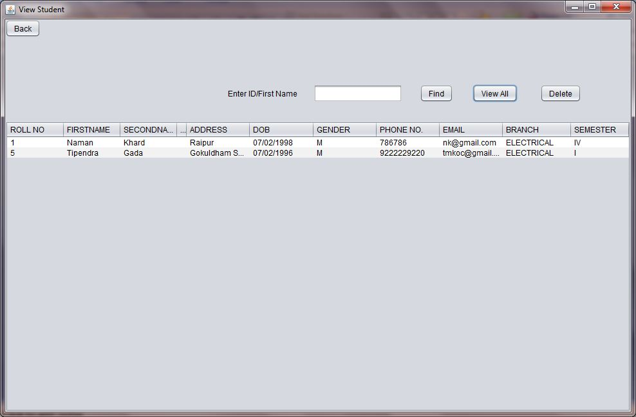

Slide 25
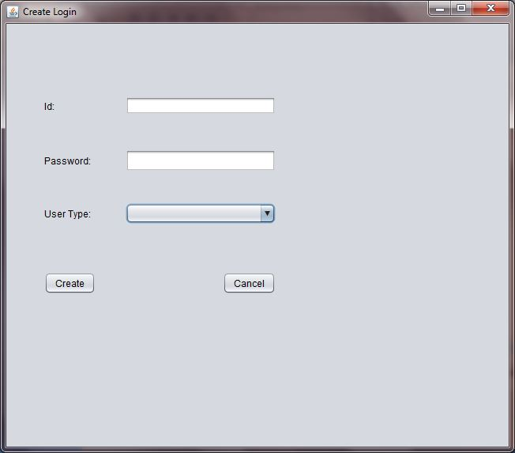

Slide 26
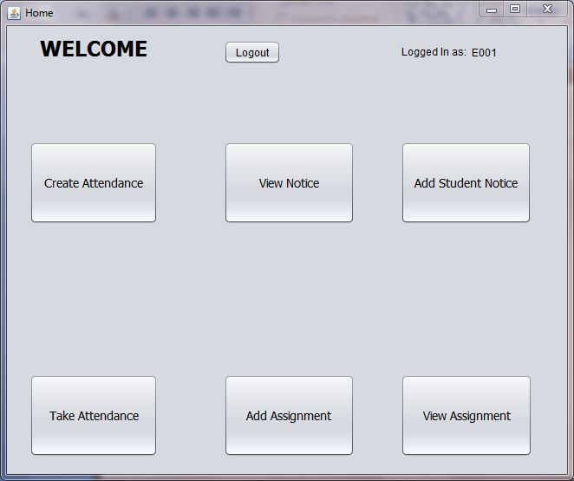

Slide 27
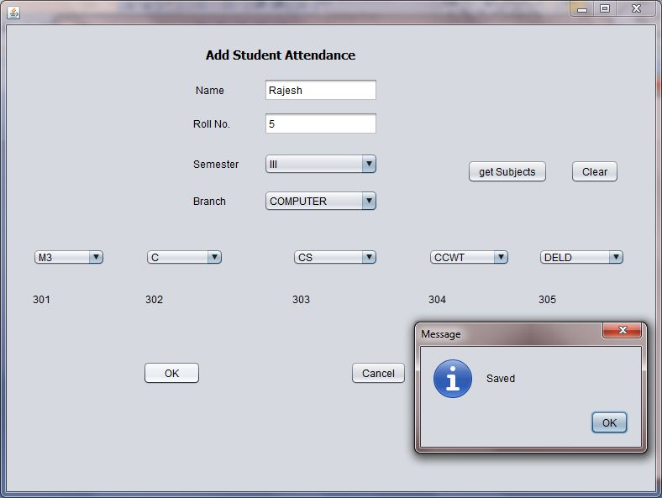

Slide 28
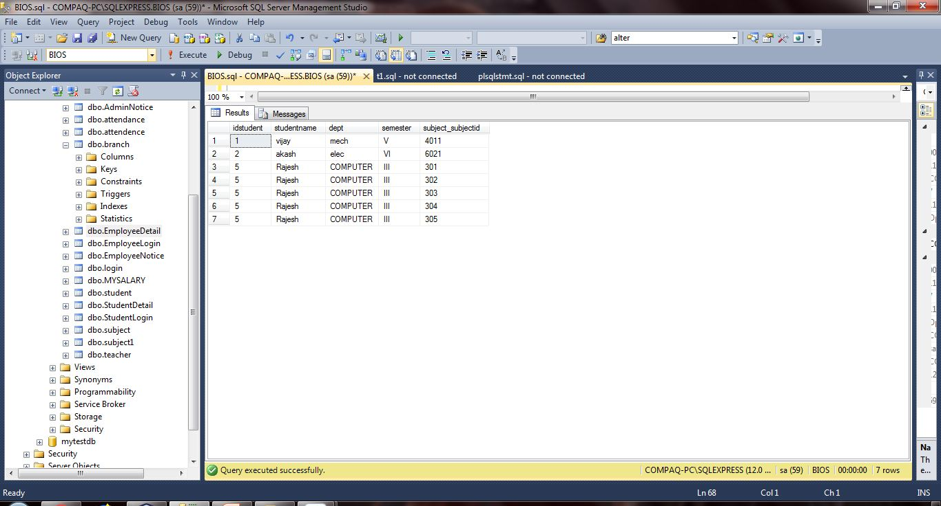

Slide 29
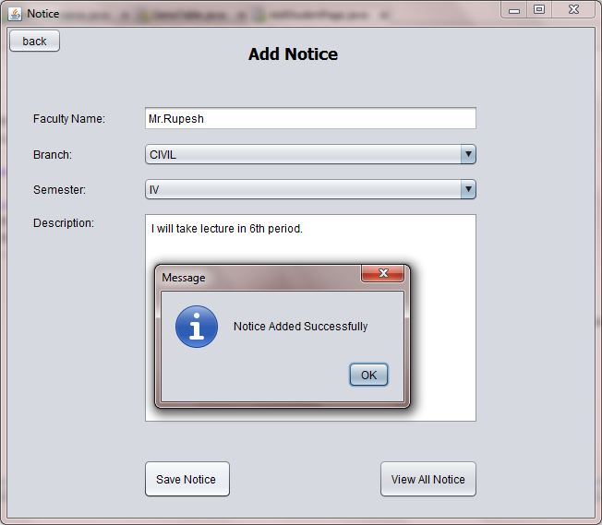

Slide 30
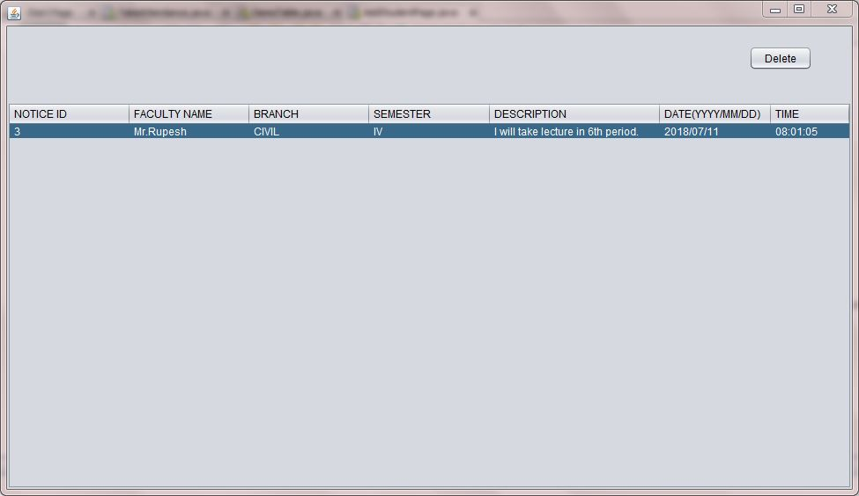

Slide 31
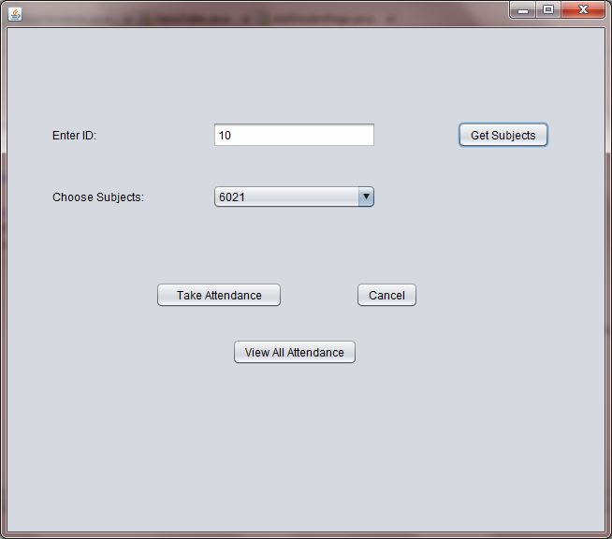

Slide 32
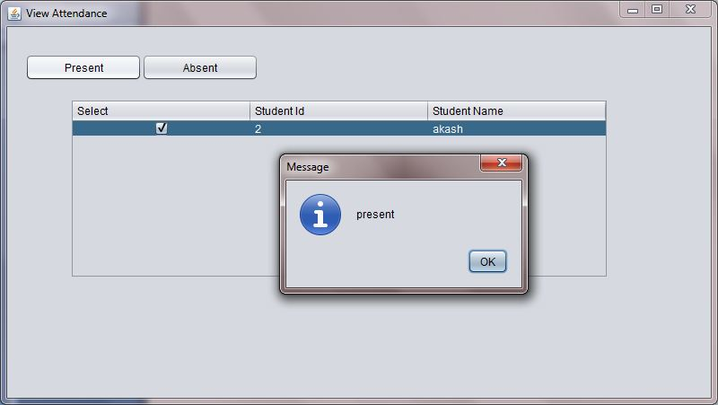

Slide 33
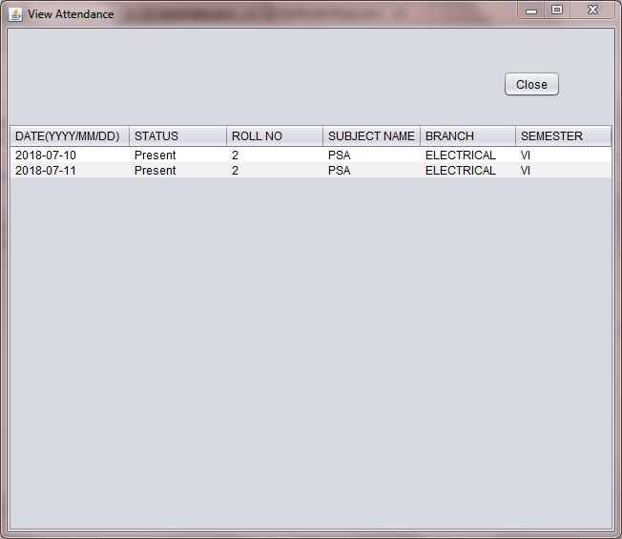

Slide 34
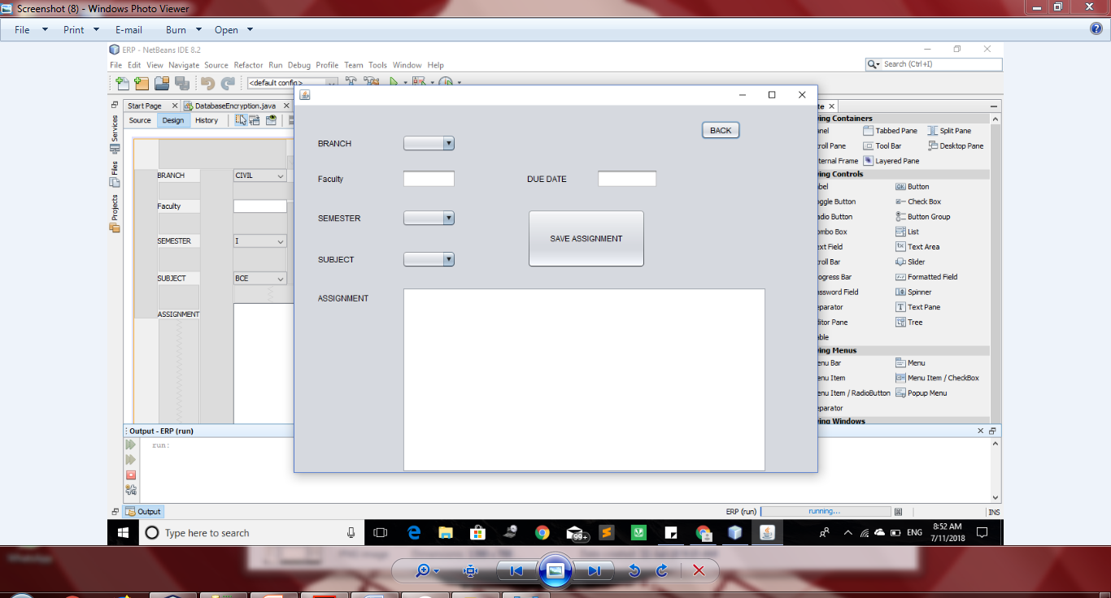

Slide 35
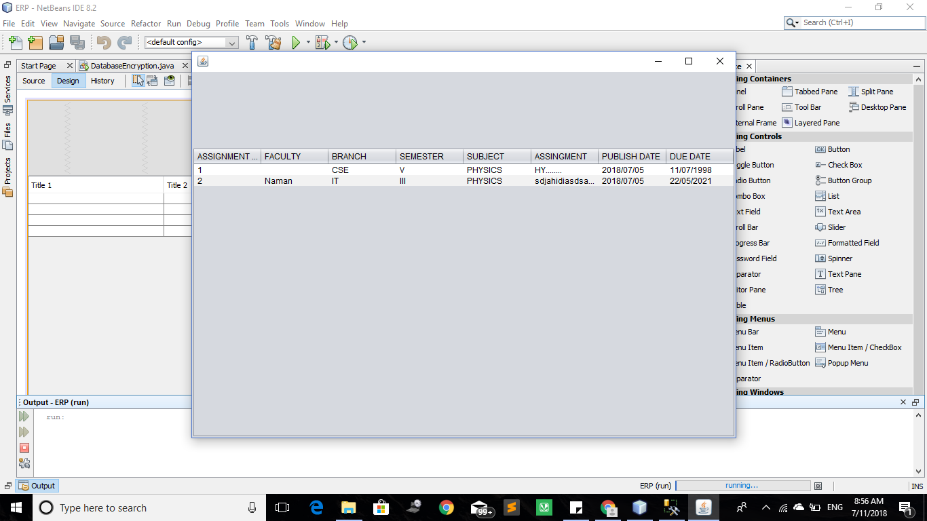

Slide 36
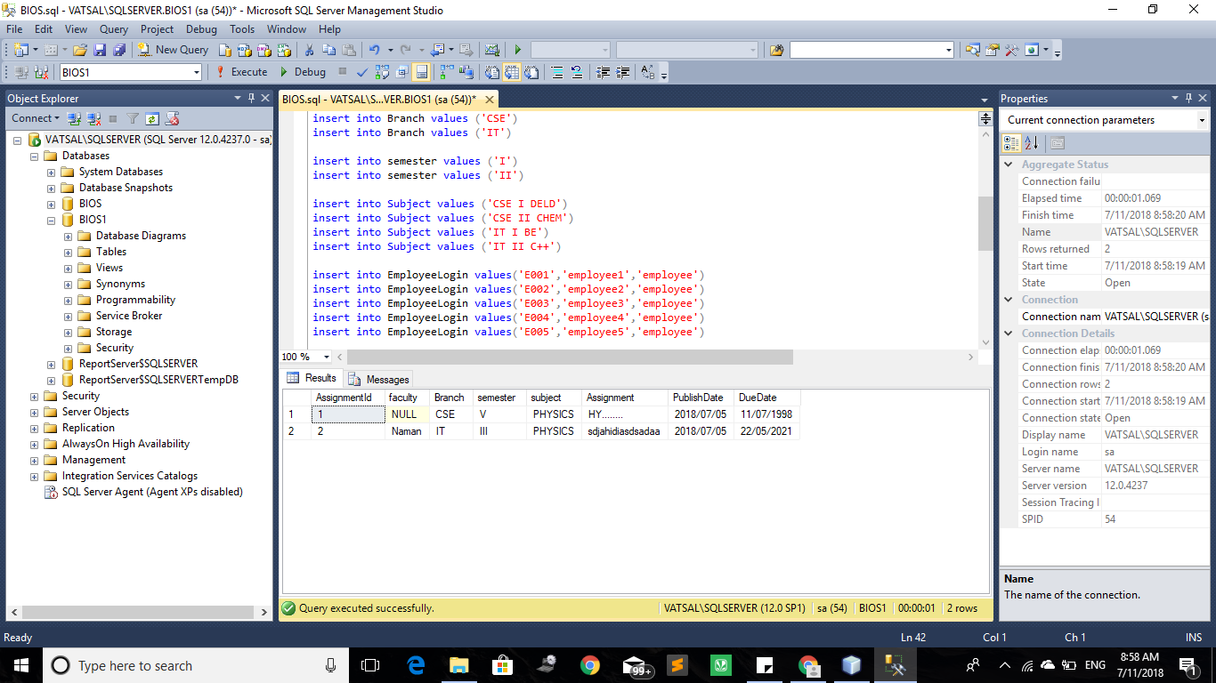

Slide 37
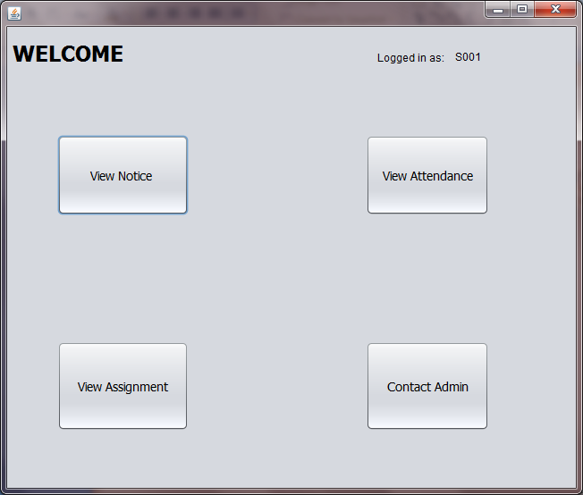

Slide 38
CONCLUSION
This project will make the work of user much
more easier and faster with enhanced security.

Slide 39
THANK YOU

