Slide 1

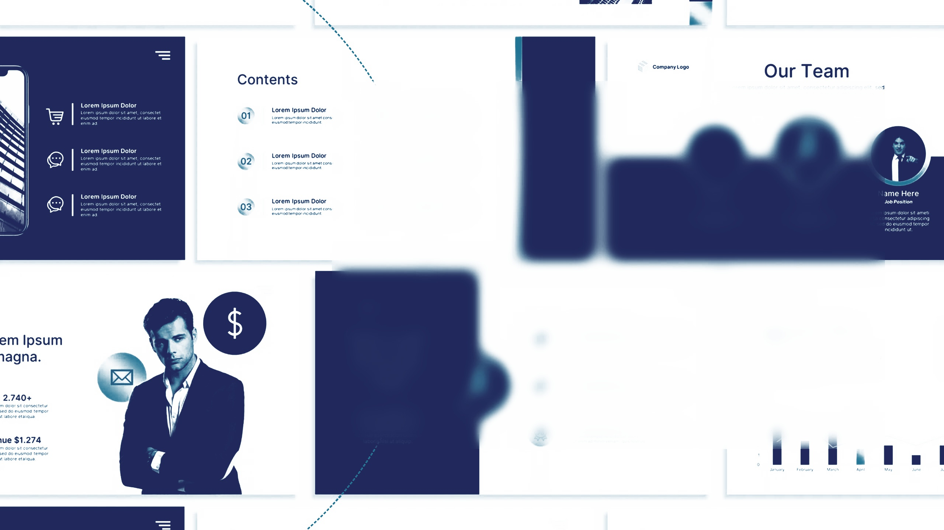

ICT UNIVERSITY
Faculty of Information and Communication Technologies
UNITRADE MARKET: A Student-to-Student Marketplace Integrating Real-Time Communication, Escrow Payment Order Management and AI-Assisted Trading
PRESENTED BY
SUPERVISOR
Nkinyam Praises Ncha
Engr. Tekoh Palma
Matricule: ICTU20233776
Academic Year: 2025–2026

Slide 2

01
Motivational Example
02
Aim and Objectives
03
Research Questions
PRESENTATION
04
Review of Similar Projects
PLAN
05
Research Methodology
06
Results and Discussion
07
Conclusion

Slide 3





Motivational Example
New Arrival: Students arriving in a new city struggle to find affordable essentials like beds and study tables.
High Costs: Moving between markets incurs transport costs and prices far beyond a student budget.
The Gap: Graduating students have items to sell but lack a trusted way to reach those in need.
THE INSPIRATION
"What if there was a secure platform built specifically to connect these students?"
Platform Risks: WhatsApp and Facebook groups are rife with scammers and disappearing messages.
UNITRADE MARKET

Slide 4





Aim and Objectives
OBJECTIVE 01
OBJECTIVE 02
Identify challenges faced by students when buying and selling items. from local markets and when using WhatsApp groups
Design and implement a dedicated student marketplace platform with verified profiles, structured listings, and secure authentication.
PRIMARY AIM
To design, develop and evaluate a secure student-to-student marketplace that enables safe, efficient, and reliable transactions among university students in Cameroon.
OBJECTIVE 03
OBJECTIVE 04
Integrate real-time communication and escrow payment transaction management system.
Evaluate the effectiveness, usability, and security of the platform through functional testing and feedback from student users.

Slide 5






Research Questions
QUESTION 01
QUESTION 02
What features should a dedicated marketplace provide?
What challenges do students face during student-to-student trading?
MAIN RESEARCH QUESTION
How can a student-to-student marketplace integrating real-time communication, payment, and AI improve security, efficiency, and reliability of transactions among university students in Cameroon?
QUESTION 03
QUESTION 04
How can trust and transaction security be
improved through escrow payment
management and real-time
communication?
How effective is the proposed Unitrade
Market system in meeting the needs and
expectations of university students?

Slide 6








REVIEW OF SIMILAR PROJECTS
PLATFORM
LISTINGS
CHAT
A/V
ESCROW
ADMIN
AI
Campus Stalls
RESEARCH GAP
Existing campus marketplaces solve only part of the problem. None combines real-time communication, escrow protection, AI assistance, administration, and dispute management in a single platform.
Connect Sphere
Campus Bazaar
Unitrade Market
Unitrade Market is designed specifically for university students to fill this critical void.

Slide 7

RESEARCH METHODOLOGY
RESEARCH APPROACH
Mixed-Methods Design
Conducted a student survey using Google Forms
Quantitative analysis of survey responses
Qualitative analysis of user feedback and opinions
Systematic literature review of existing marketplace solutions
Requirements Analysis
Identified 34 Functional
Requirements
Identified 14 Non-Functional Requirements
Defined system requirements
based on survey findings and
literature review

Slide 8
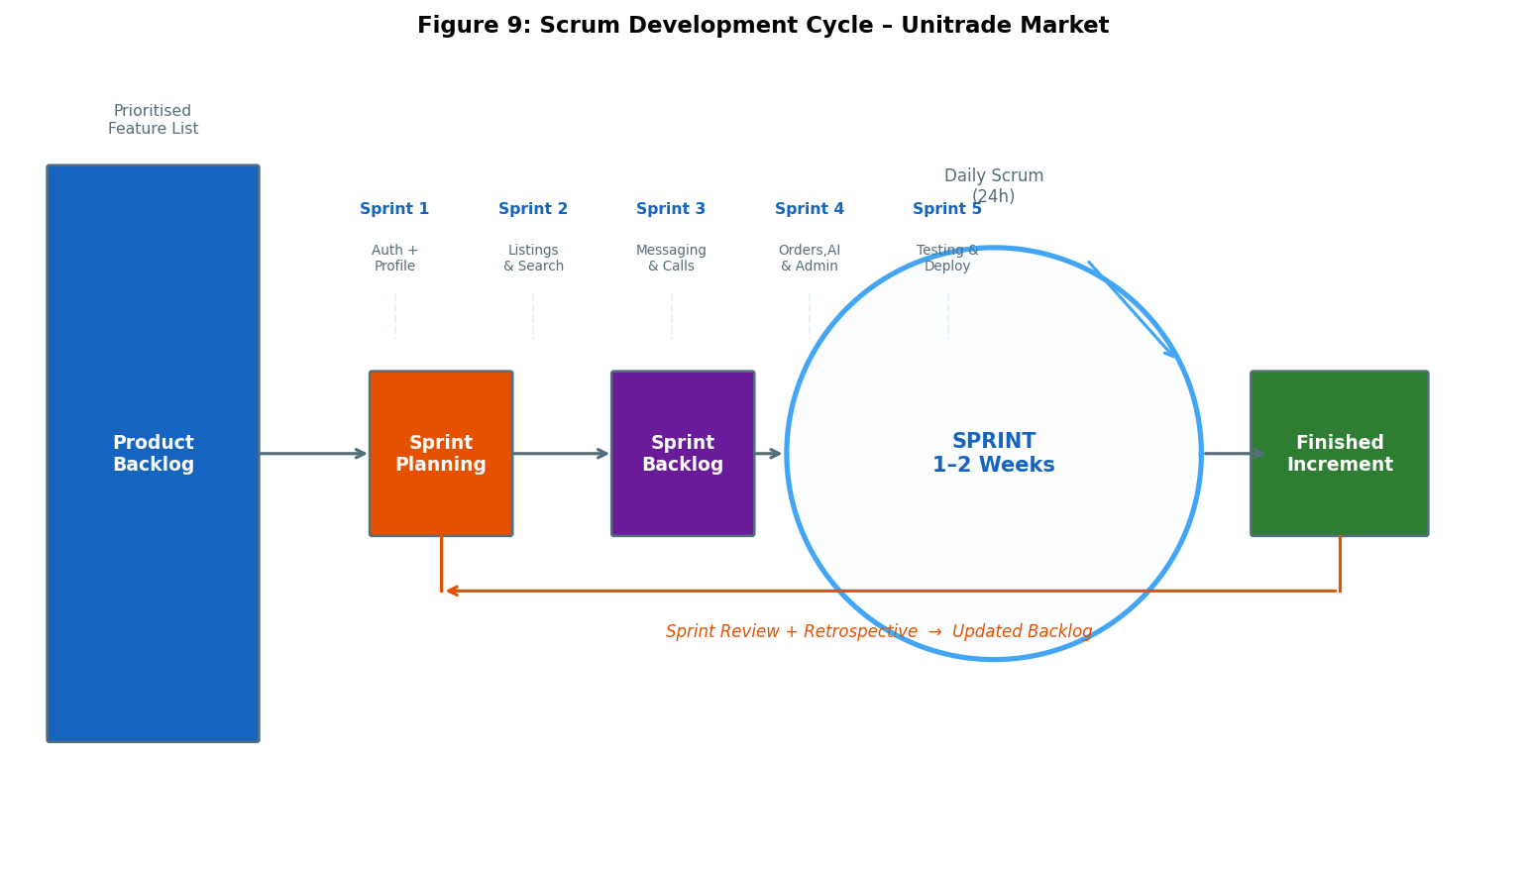
Agile Scrum methodology
Iterative Agile Development Cycle

Slide 9
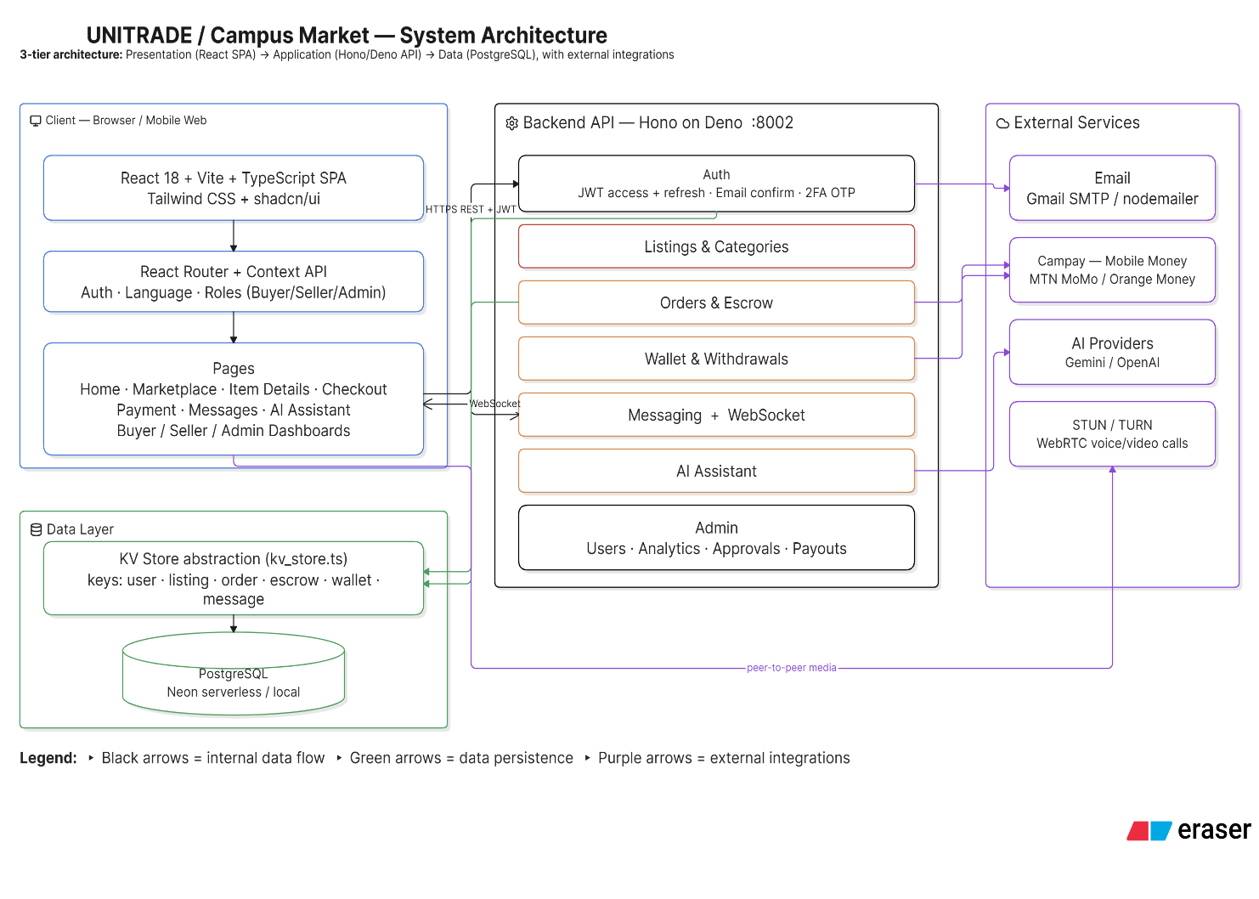
SYSTEM ARCHITECTURE: CLEINT –SERVER

Slide 10





IMPLEMENTED FEATURES
TECHNOLOGY STACK
Authentication & Verification
Marketplace Listings
FRONTEND
BACKEND
Search & Filtering
React 18, TypeScript, Tailwind CSS, Vite
Hono Framework, Deno.js
Real-Time Messaging
Audio & Video Calling
Escrow Payment Transactions
Wallet Management
DATABASE
COMMUNICATION
Reviews & Ratings
PostgreSQL KV Store
WebRTC, WebSocket,
STUN/TURN
AI Assistant
Admin Dashboard
AI & PAY
HOSTING & DOMAIN NAME
OpenAI, Gemini, Fapshi Mobile Money API
Vercel , Render,
NameCheap
Native app
Progressive web app

Slide 11
RESULTS & DISCUSSION LIVE DEMO

Slide 12


Conclusion
THANK YOU
"Innovation distinguishes between a leader and a follower."
— STEVE JOBS
Questions & Answers
Unitrade Market was developed to address a real challenge faced by university students: the difficulty of buying and selling essential items in a secure, affordable, and trustworthy manner. Through the integration of real-time communication, escrow order management, AI-assisted trading, and administrative governance, the platform transforms informal student trading into a structured digital marketplace designed specifically for the university community.

