Slide 1
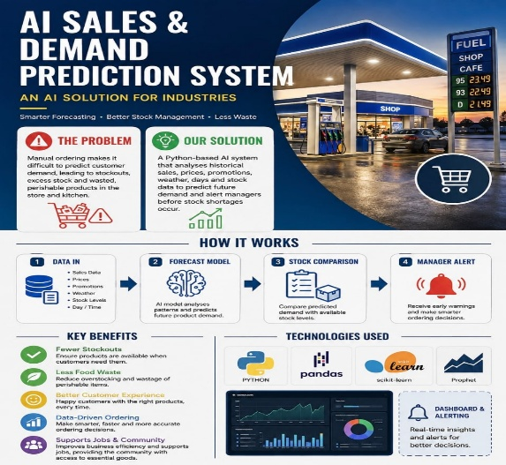
AI-Retail-Predictor
$
Background
Petrol stations in South Africa operate convenience stores and, in some cases, kitchens. However, many still rely on manual stock counting and managers' experience when making ordering decisions. This often leads to product shortages, overstocking and food waste. Our project introduces an AI-powered system that uses historical data to predict future demand and improve inventory management.

Slide 2
Project Overview
Key Focus Areas:
The AI-Retail-Predictor project aims to improve stock management at petrol station shops and kitchens. It uses AI to analyse past sales and predict future demand, helping managers make better stock decisions and reduce shortages and waste
AI-powered demand forecasting.
Historical sales data analysis
$
Automated stock alerts
$
Improved inventory management.
Better business decision-making.

Slide 3
Problem Definition
Many petrol station shops and kitchens struggle with stock management because they rely on manual counting and managers' experience. This leads to product shortages, overstocking and food waste, especially during busy periods.
Key Problems:
Manual stock management.
Shortages of popular products.
Overstocking of slow-moving items.
Food waste due to poor demand forecasting.
Poor business decisions.

Slide 4
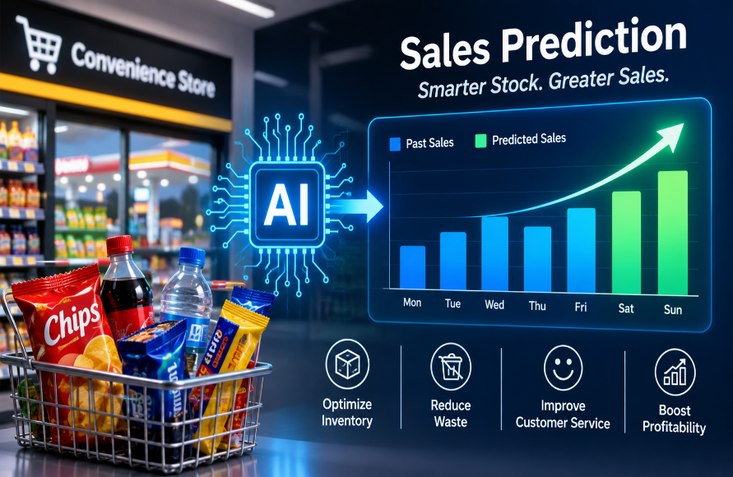
Proposed AI Solution
The project proposes an AI-powered system that analyses sales and stock data from petrol station convenience stores. It predicts future product demand and helps managers decide what products to restock and when.
Key Features:
Predicts product demand.
Analyses historical sales.
Monitors stock levels.
Provides restocking recommendations.
Reduces product shortages and overstocking

Slide 5
Business Objectives
The main objective is to improve stock management in petrol station convenience stores by using AI to predict customer demand. This will help reduce losses, improve product availability and increase business profitability.
Reduce product shortages.
Minimise overstocking.
Improve stock management.
Support better ordering decisions.
Increase customer satisfaction.
Improve overall business profitability.

Slide 6
Data Requirements
Key Data Used:
The system uses historical sales and inventory data from petrol station convenience stores to predict future product demand. This data helps the AI identify sales patterns and improve stock decisions.
Historical sales records (2022–2024).
Product quantities sold.
$
Current stock levels.
$
Weather conditions.
Promotions and seasonal trends.

Slide 7
Machine Learning Approach
Machine Learning Approach
Our system uses supervised machine learning to learn from historical sales data and predict future product demand.
1. Algorithms tested
$
A. Ridge Regression
B. Random Forest
$
Linear prediction model
Combines multiple decision trees
C. Random Forest
D. Random Forest
Sequentially improves predictions
Uses the previous day's demand as a baseline
2. Model performance
3. How predictions are used
Model | MAE
Naive Lag-1 | 40.12
Ridge Regression | 23.83
Random Forest | 20.26
HistGradientBoosting | 16.73
A. 7, 14 and 30-day forecasts
Predicts future demand for individual products and branches.
B. Inventory recommendations
Helps managers decide what and how much to reorder.

Slide 8
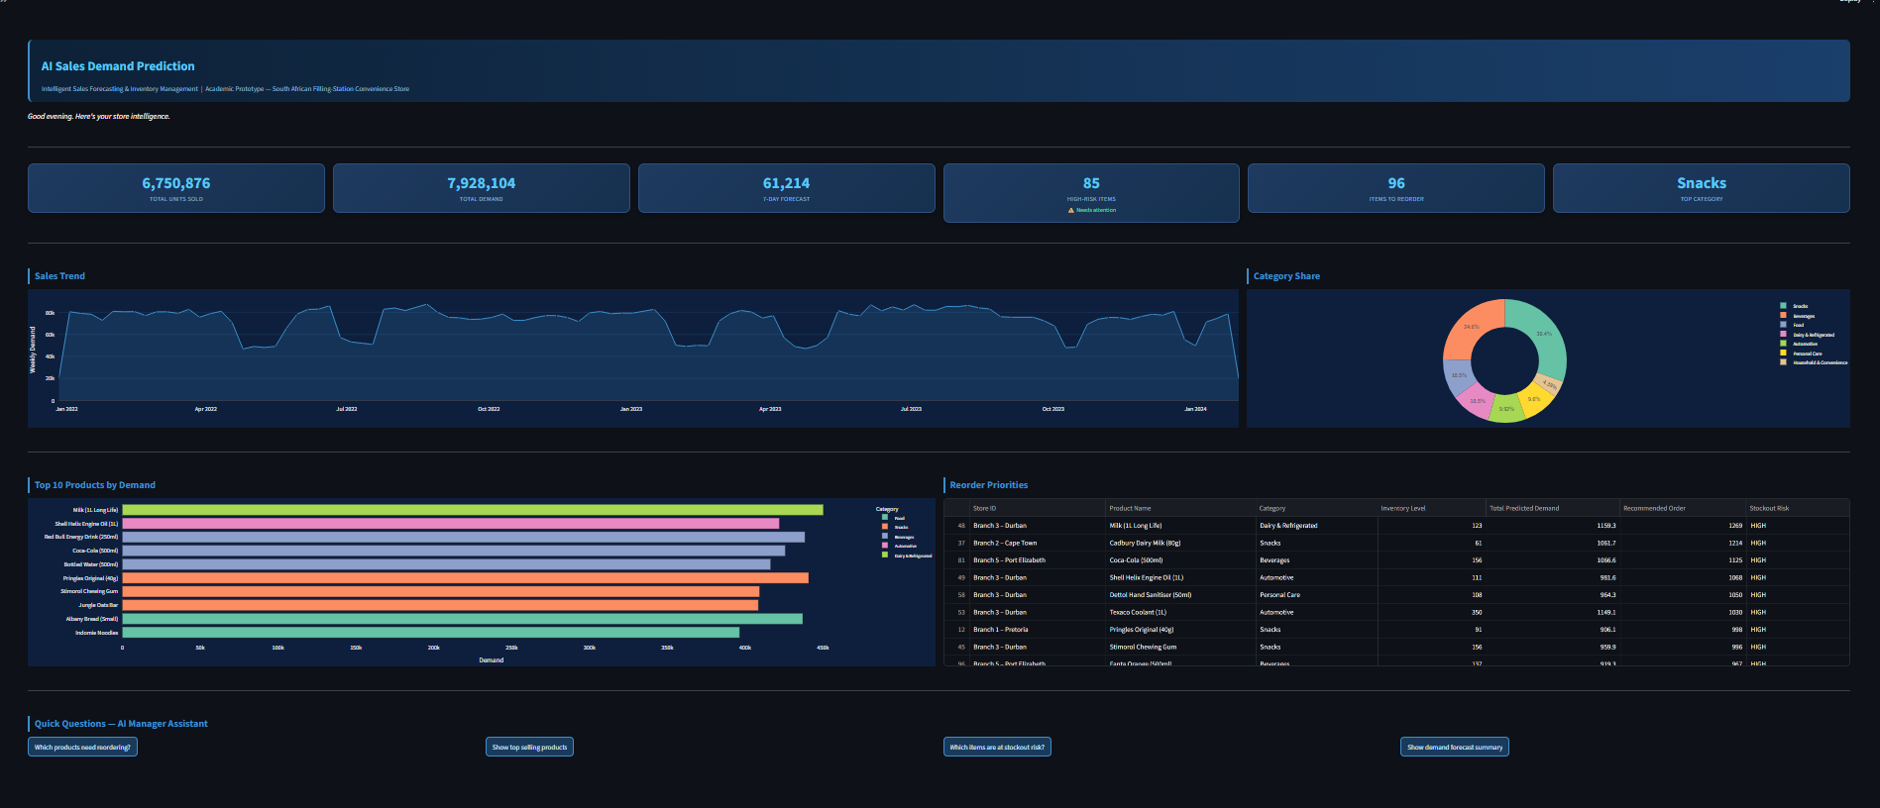
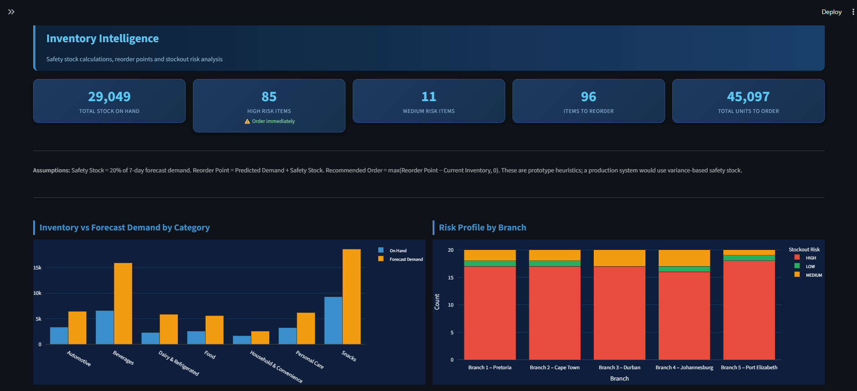
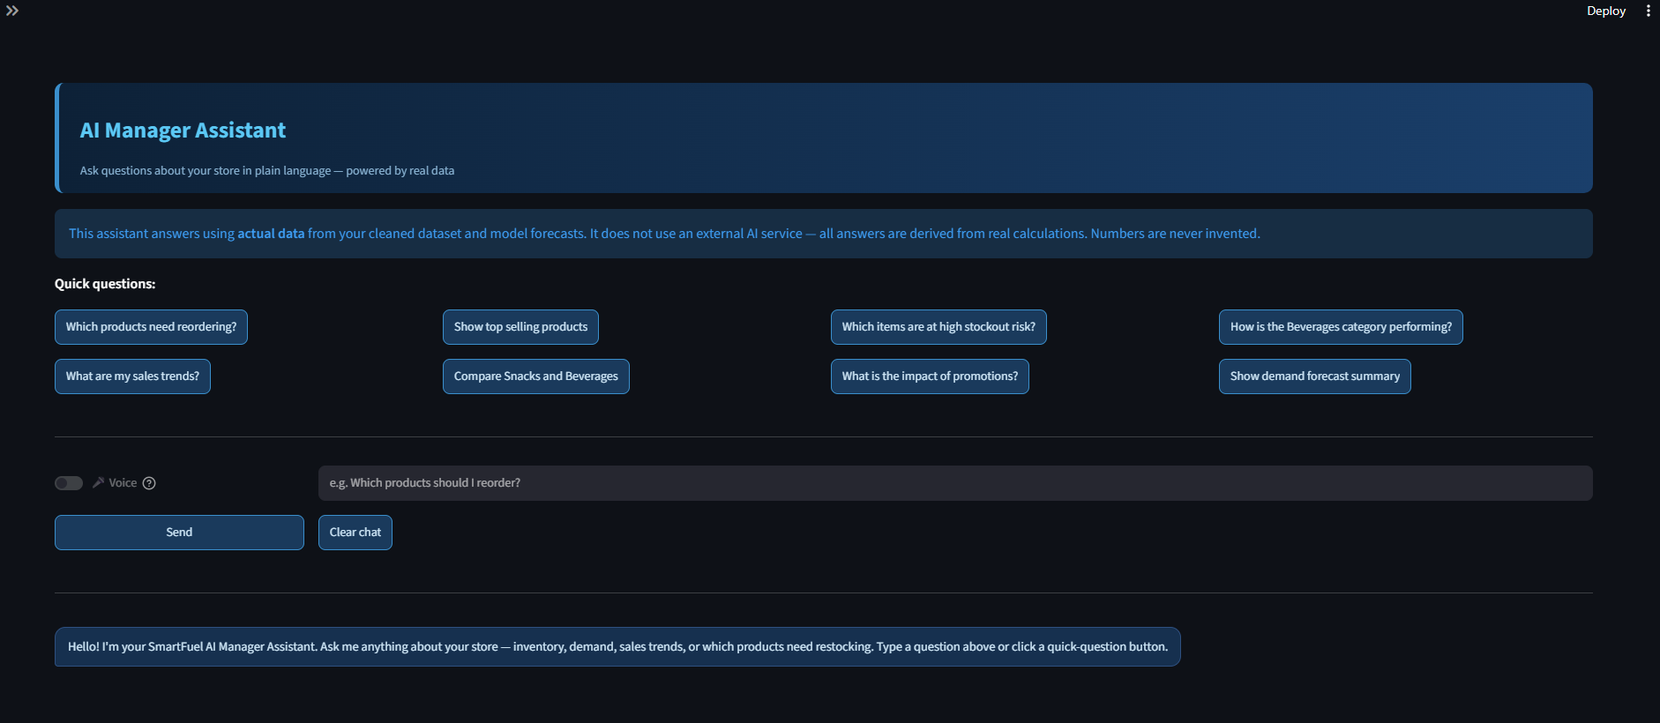
Project Outcomes
The system running on our real data: forecasts, stock alerts and an AI assistant.
1. Dashboard
2. Inventory alerts
3. AI assistant
Sales trend, category share and a 7-day forecast summary
85 high-risk items; 96 items to reorder (45,097 units)
Ask in plain English or by voice; answers come from real data
R² = 0.75
explains 75% of demand changes
±17 units
average error per product per day
Best model
HistGradientBoosting

Slide 9

Thank You
This concludes our presentation on AI-Retail-Predictor

