Slide 1










Health Hive: UKZN's Clinical Document Repository System

Slide 2
INTRODUCTION
In today's digital age, efficient and secure data management systems are crucial in healthcare.
The current system in the College of Health Science relies heavily on manual processes, posing challenges for data security and organization.
This project aims to develop a digital solution to streamline the management of clinical records.

Slide 3
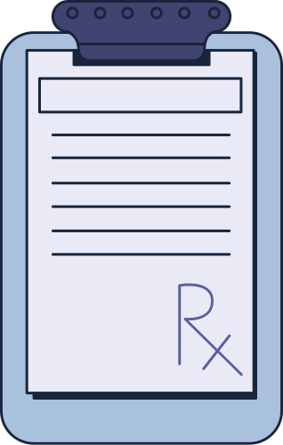
Needs Analysis
Dr. Urisha Naidoo emphasized the need for a secure and organized digital platform for student use.
Manual processes in the College of Speech and Language Therapy lead to inefficiencies and potential data breaches.
The goal is to reduce manual workload and enhance data management

Slide 4
SYSTEM OBJECTIVES
Objective 1
Objective 3
Efficiency: Automate data entry and management to reduce time and effort.
Organization: Provide a structured approach to data management
Objective 2
Objective 4
Security: Implement advanced security protocols to safeguard patient data
Accessibility: Allow authorized personnel to access records from any location.

Slide 5
Disorder Analysis: Identify prevalent conditions and track treatment effectiveness.
Innovations in Reporting
Trend Identification: Detect trends in patient demographics and disorders.
Data Visualization: Integrate with tools to present data in engaging formats like charts and dashboards.

Slide 6
Software Development Methodology
Agile Methodology
Scrum Framework
- Chosen for iterative development, adaptability, and collaboration.
- Involves stakeholders in requirements process ensuring software meets user needs.
- Emphasizes early and frequent testing to manage risks
- Roles: Scrum Master, Product Owner, Developers, Testers, Business Analysts.
- Principles: Iterative sprints, regular feedback loops, continuous improvement.
-Ensures delivery of a secure, organized, and user-friendly system

Slide 7
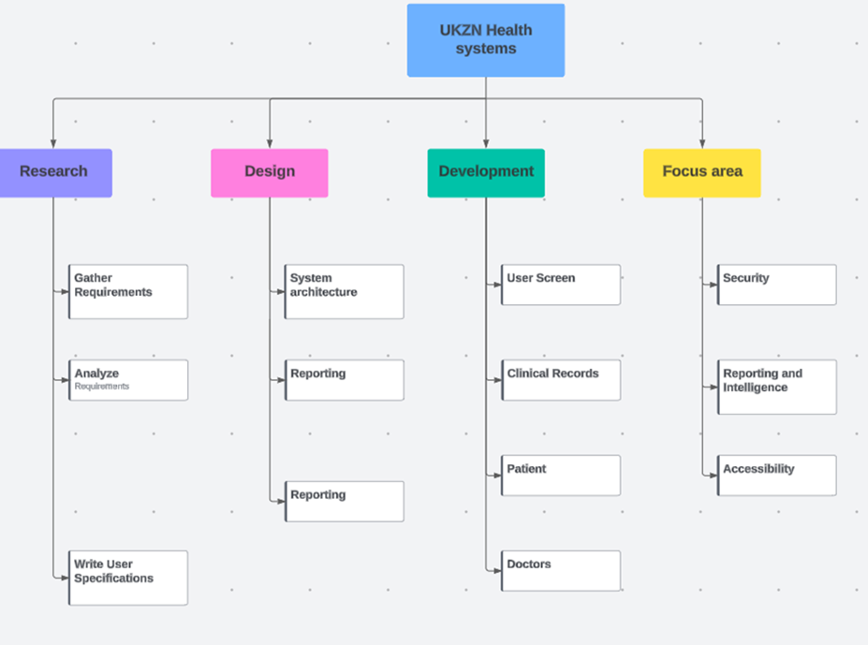
PROJECT MANAGEMENT PlAN

Slide 8
1. Scrum Master: Facilitates Scrum process and removes impediments.
2. Product Owner: Manages Product Backlog and communicates with stakeholders.
3. Developers: Design, code, and implement system features.
4.Testers: Ensure system quality and reliability.
5. Business Analysts: Gather and document requirements
Team Structure
l

Slide 9
Usability Strategy
Objectives
Design Principles
Consistency
Simplicity
Accessibility
User-Centered Design Process
Iterative Design
Usability Testing
Summative Testing
Documenting and Reporting
Qualitative analysis
Quantitative Analysis
Improve the user interface and user experience of the Health Hive.
Identify and prioritize areas for functionality enhancements.
Ensure the system meets the diverse needs of healthcare professionals.
Enhance the efficiency and accuracy of clinical documentation.
l

Slide 10
Security Strategy
Testing Strategy
Role Based Access Control
User Consent and Transparency
Advanced Security Protocols
Data Protection Measures
Unit Tests
System Tests
Integration Testing
Regression Testing
End To End Testing

Slide 11
Maintenance Strategy
Modular Design
Version Control and
Branching Strategies
Refactoring and
technical debt
management
Documentation
and knowledge
sharing
Performance
monitoring and
optimization
l

Slide 12

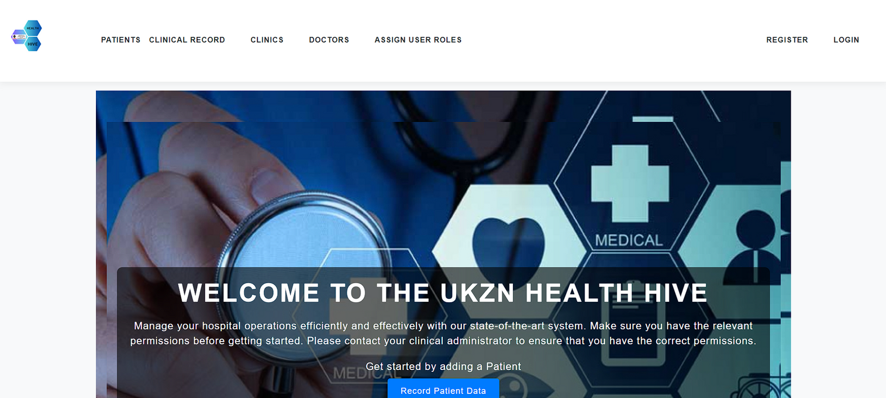

System Demonstration
System Authentication
Creating Clinical Records
Editing Clinical Records
Business Intelligence
The Future of the Health Hive

Slide 13
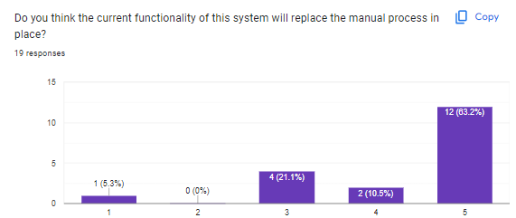
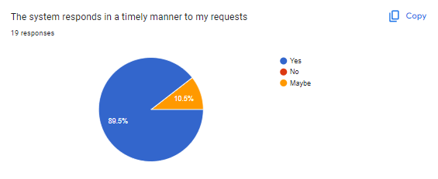
User Feedback
After Conducting Demonstrations of our system to audiences and explained the need for the system as well as the system objectives.
The audience has been given a series of questions based on the system and their experience.
Their feedback was taken into account in enhancing the user experience and functionality further
l

Slide 14
Artificial Intelligence in Healthcare
The future of AI and HealthCare
Using this Application we aspire to identify trends as well as educate people with a general understanding of disorders they may be exposed to
With the Various reporting clients and the evolution of Open AI’s API’s this functionality becomes achievable.
Presently, we’re able to analyze trends based on users age and disorders.

Slide 15
Conclusion
In conclusion, the Health Hive system successfully transforms clinical document management within the College of Health Science. By utilizing Agile and Scrum methodologies, the project has delivered a secure, efficient, and user-friendly platform. This system not only improves data security, organization, and accessibility but also enhances reporting capabilities, thereby supporting better patient care and academic activities​

Slide 16
Thank you for your attention

