Slide 1
The Impact of Bias in AI Technology
AI Ethical Challenges and Analysis in Healthcare
Student: Nikhil Kumar Reddy Chalamalla

Slide 2
Problem Statement
AI models for hospital readmission often inherit biases from historical data.
This project investigates racial bias and proposes a fairness-aware and privacy-preserving solution.

Slide 3
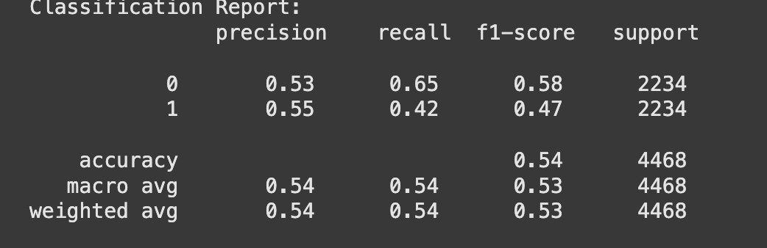
Model Evaluation: Classification Report

Slide 4
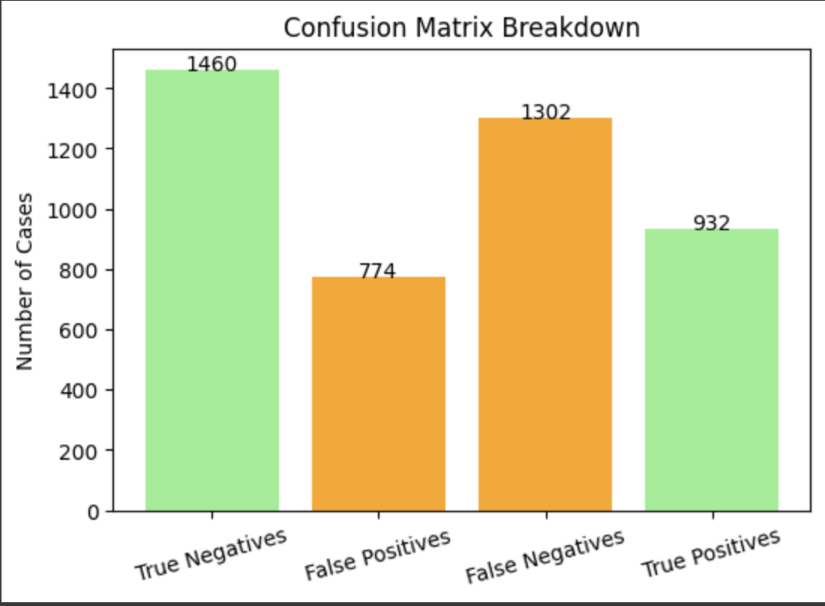
Confusion Matrix Breakdown

Slide 5
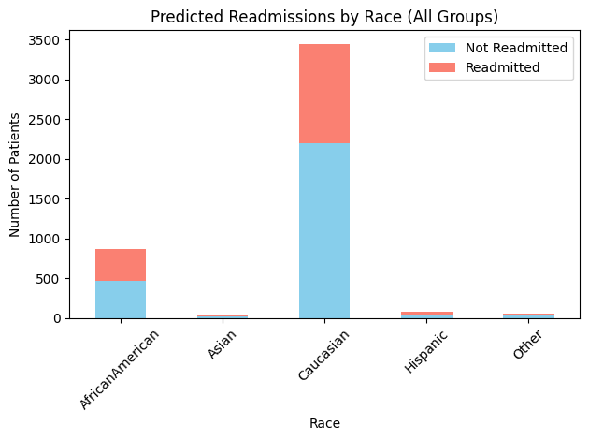
Predicted Readmissions by Race

Slide 6
Key Metrics
- Accuracy: 54%
- Precision (Readmitted): 55%
- Recall (Readmitted): 42%
- Disparate Impact: 0.73
- Equal Opportunity Difference: -0.11

Slide 7
Proposed Ethical Solutions
- Differential privacy to secure patient data
- Balanced dataset to reduce bias
- AIF360 fairness evaluation
- Consider future additions: reweighing, XAI, adversarial debiasing

Slide 8
Broader Implications
- Compliance with HIPAA and GDPR
- Design ethical AI with fairness, inclusivity, and explainability
- Continuous monitoring and accountability mechanisms

Slide 9
Conclusion
Even accurate models can exhibit bias.
Ethical AI in healthcare must protect privacy and ensure fairness.
Cross-disciplinary governance is key to responsible deployment.

