Slide 1
Innovative Projects- Raspberry-pi Using Python Line Following Robot Using Raspberry-pi
By
Naveen k s
November , 2022

Slide 2
Project Brief Summery
Overview:
Robot follows the straight path.
Robot is able to track the path with the help of an IR sensor.
We will use two IR sensors to check the robot is in track with the path and two motors to correct the robot if its moves out of the track.
Objectives:
The robot must be capable of following a path.
OUTCOME:
Industrial Applications: These robots can be used as automated equipment carriers in industries.
Automobile applications: These robots can also be used as automatic cars running on roads with embedded magnets.
Domestic applications: These can also be used at homes for domestic purposes like floor cleaning etc.
In shopping malls, University and hotels these robot are used for the transfer of things from one place to another following a straight path.
It is used to carry children in shopping malls and entertainment places.

Slide 3
Challenges Faced in Project
The interaction was limited to online ,the communication was not efficient leading to delay in the selection of the project . Even the selected project at first was selected by another group causing further delay.
Before the selection of the project title we have to know everything about the project title . It leads to delay in the selection of project.
Too many titles are there in the projects title list so it is hard to select the suitable title early.

Slide 4
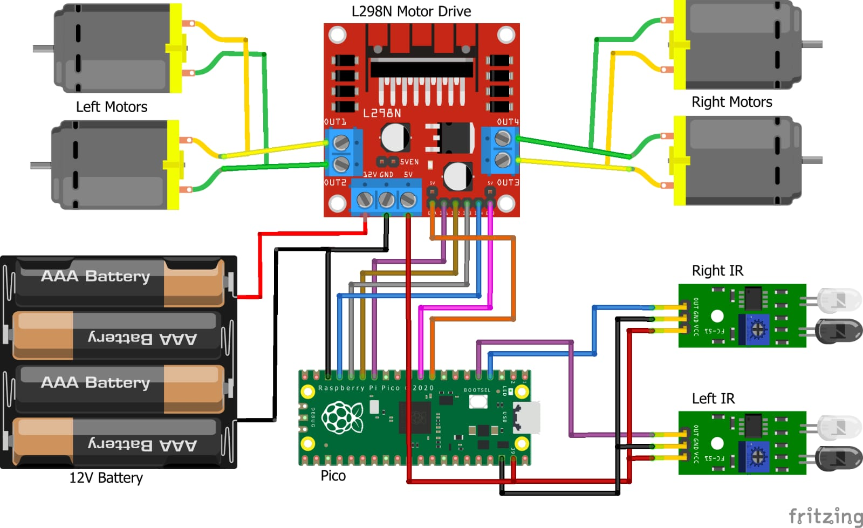
Circuit/Block Diagram

Slide 5
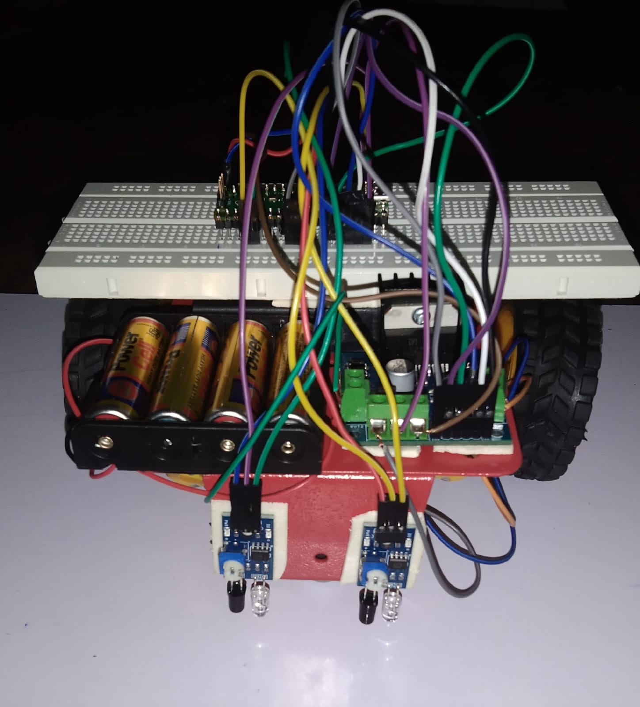
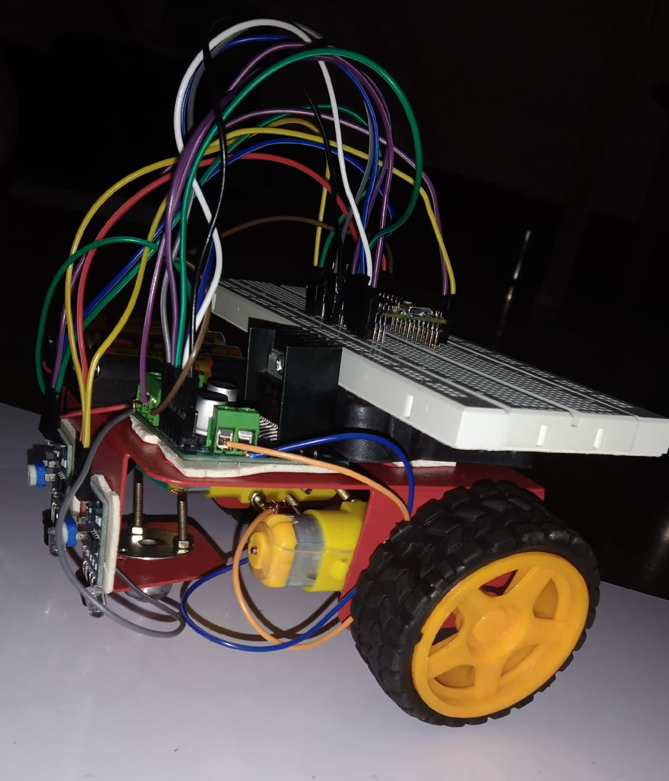
Obtained Results so far.

Slide 6
Project Timeline
Phase 1
Planned and organized the Planned and organized
the
process of project development
Taking actions and implementing plans to create working model
Phase 3
Fixing bugs or improving the project to its optimal state
Phase 2

Slide 7
Q&A

Slide 8


