Slide 1
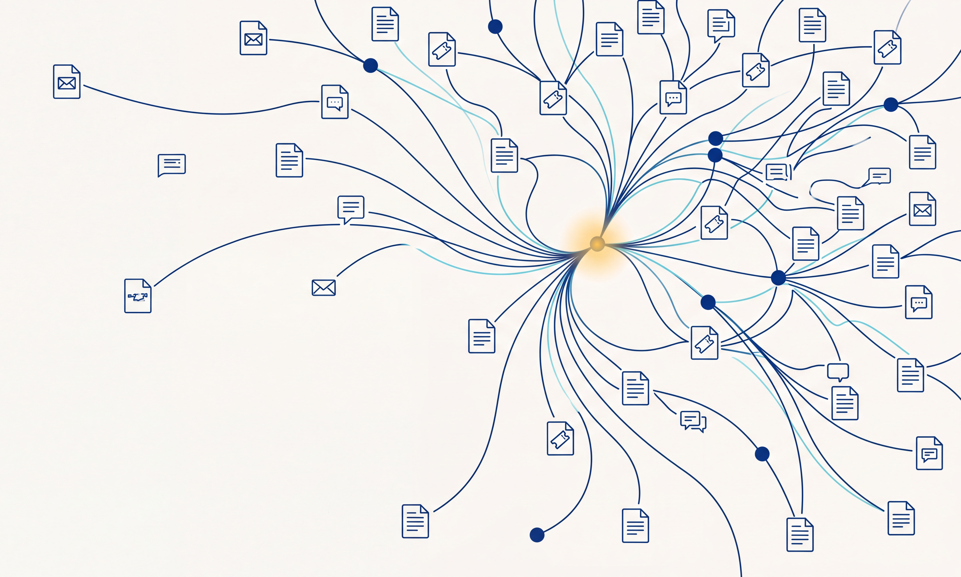
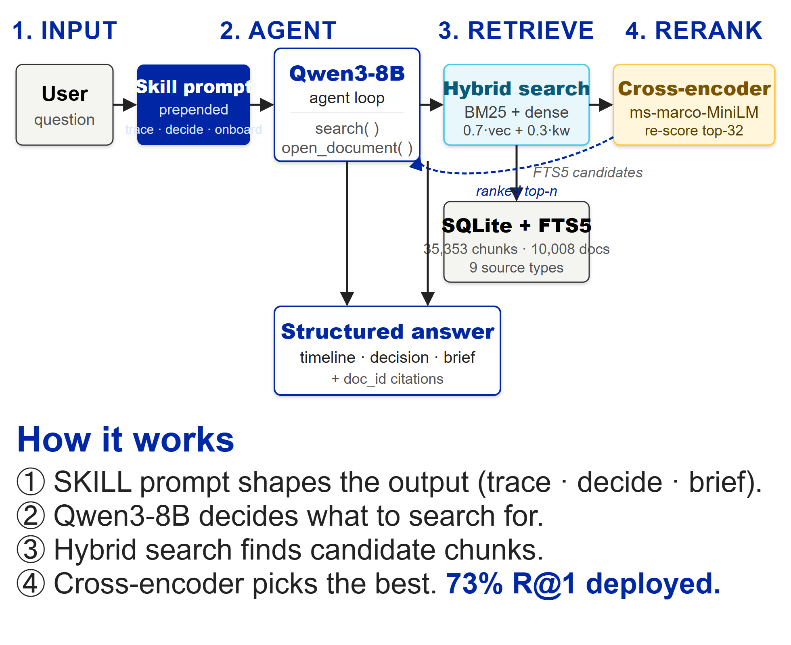
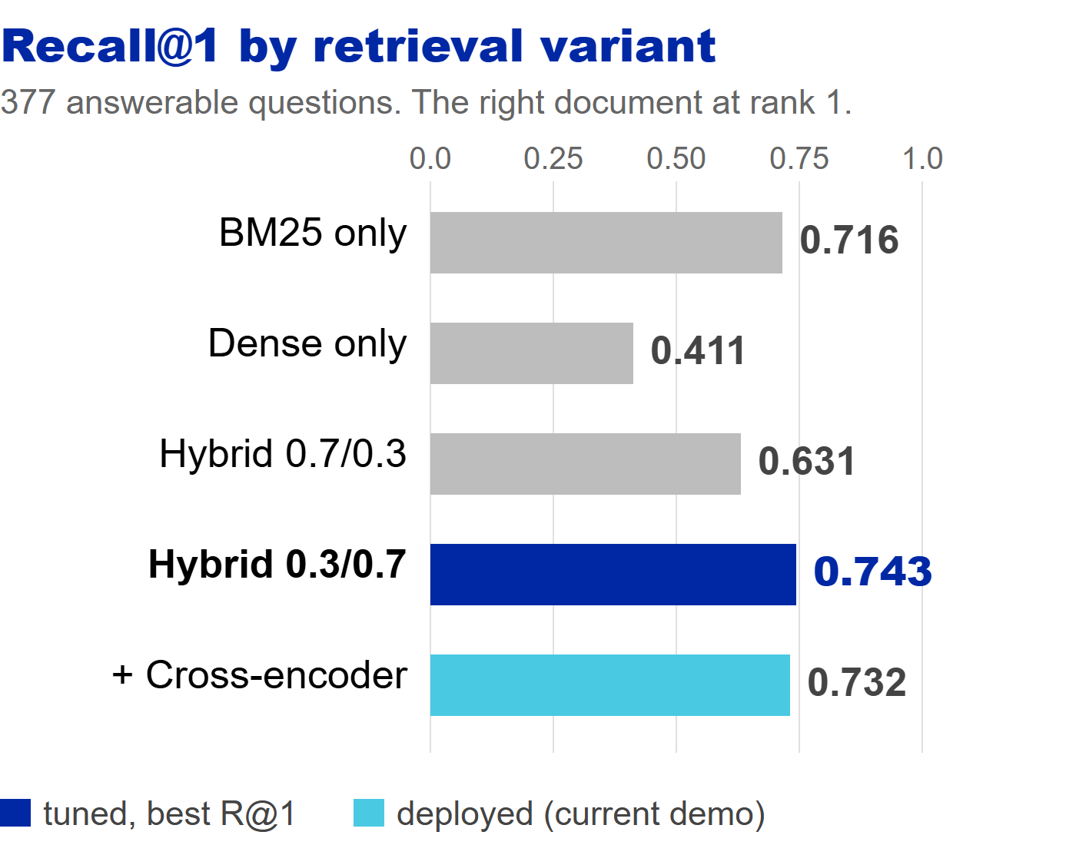





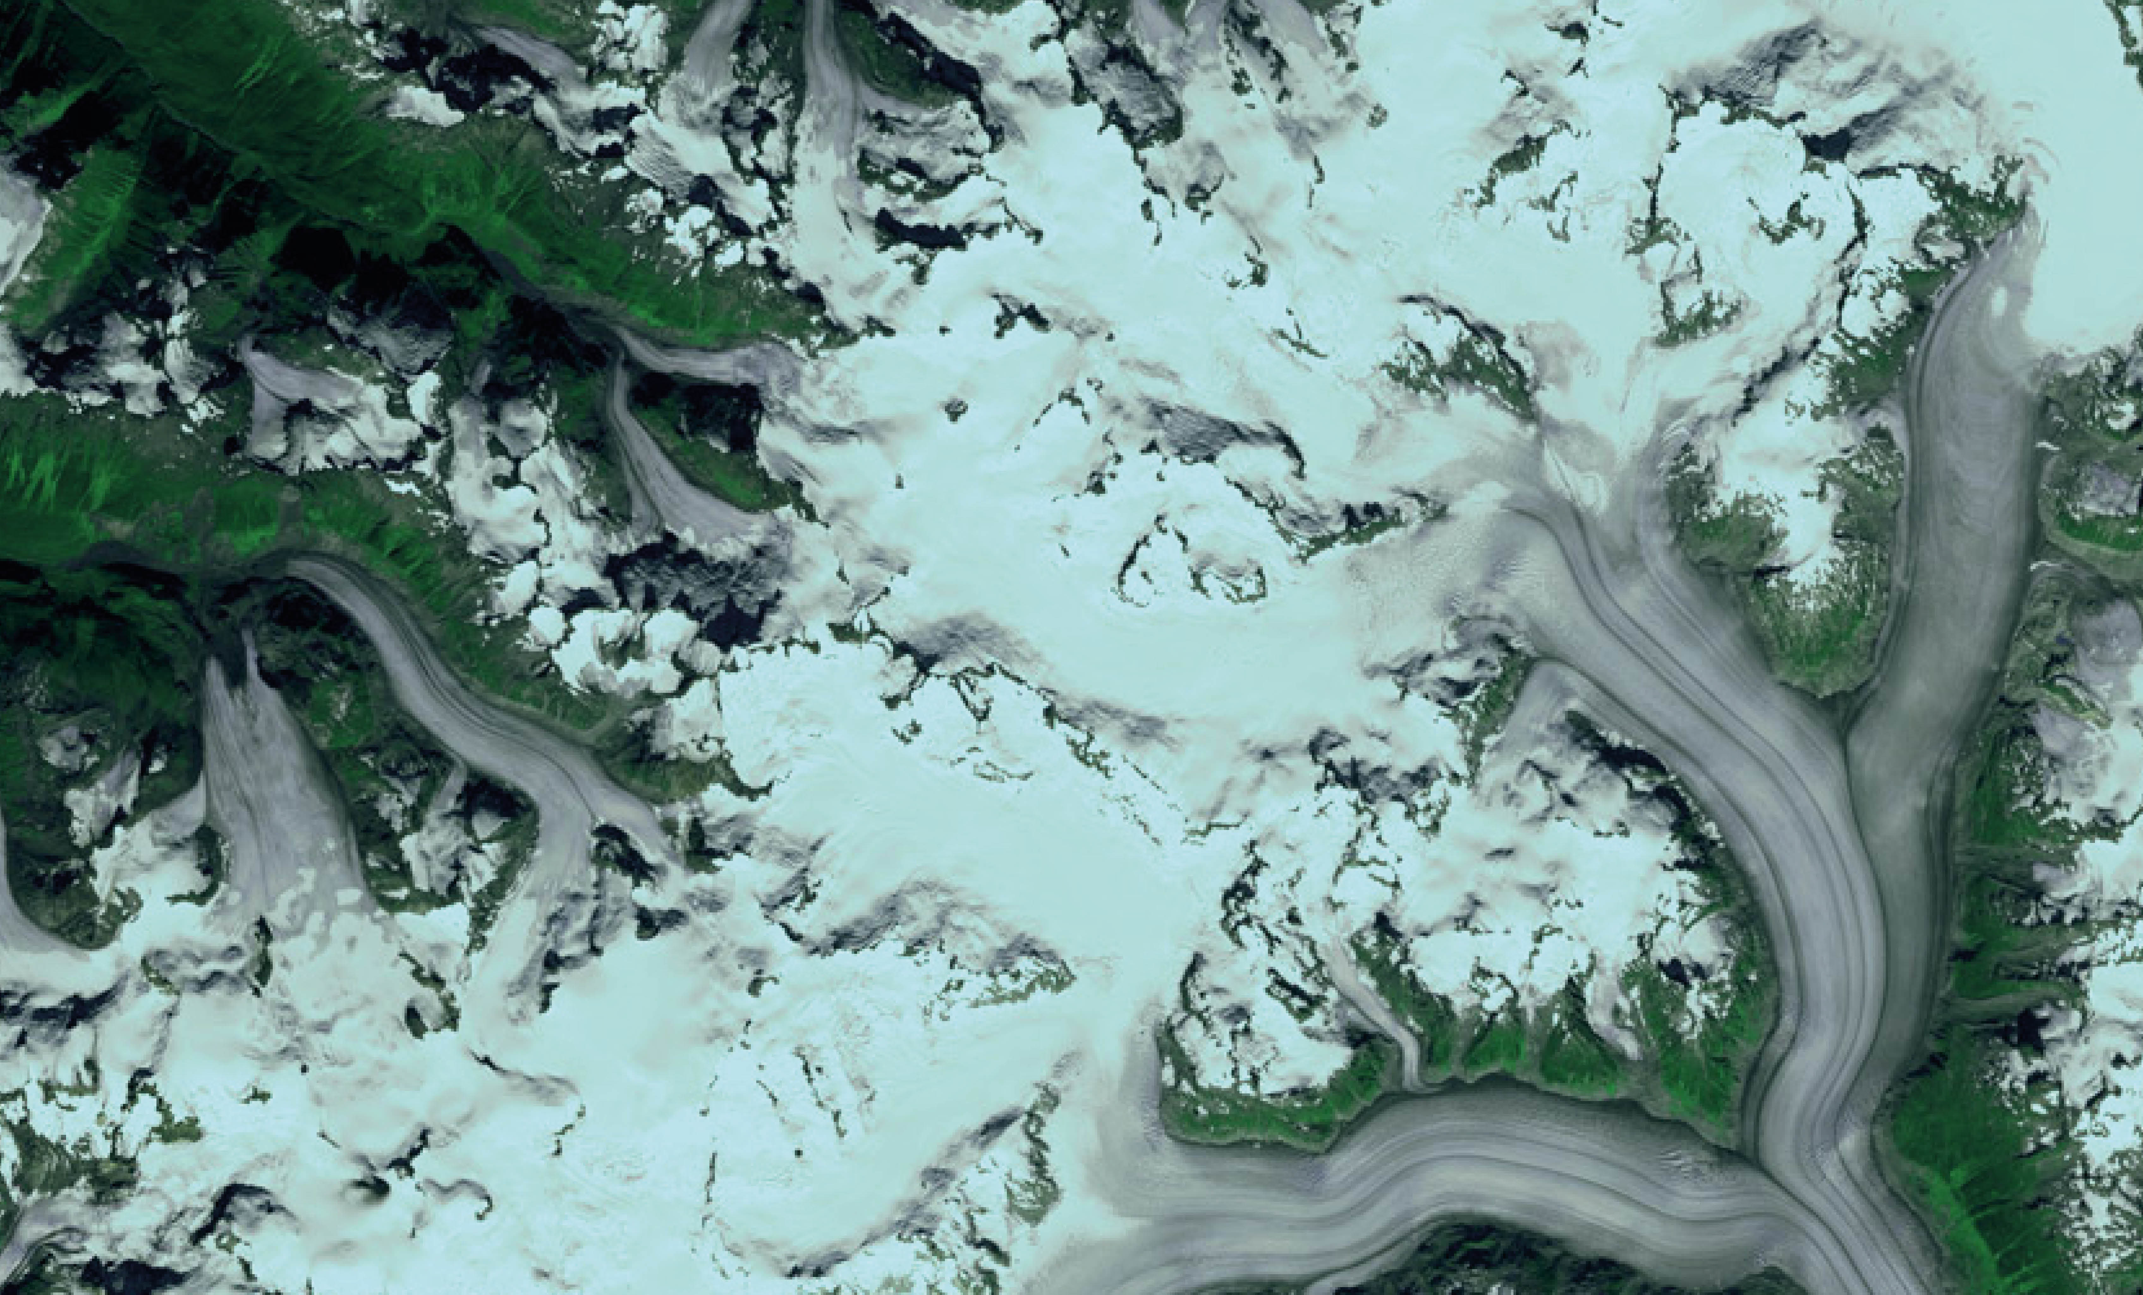
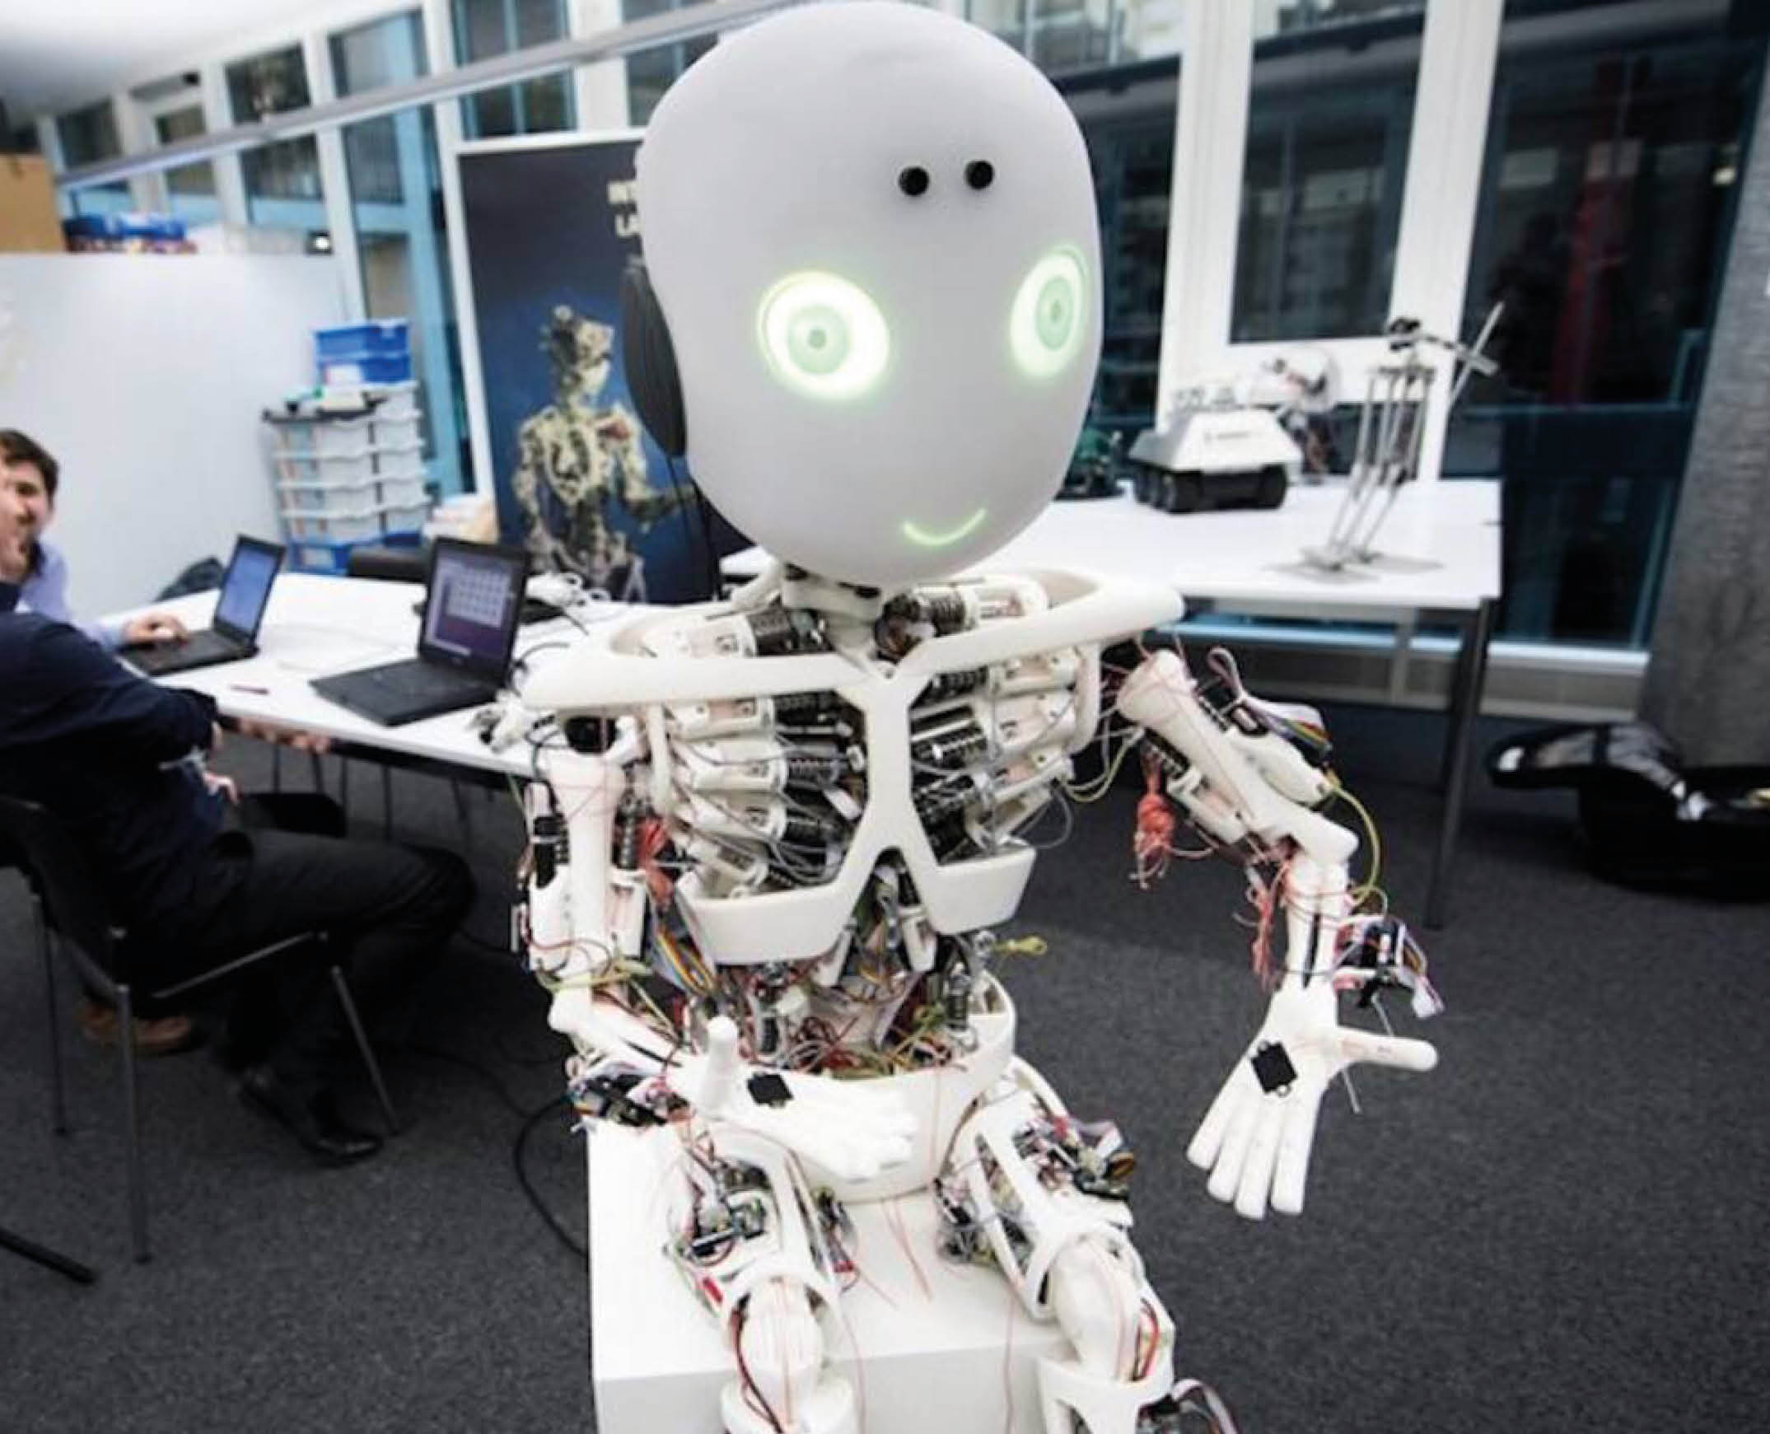
Skills turn a generic RAG into a workflow agent
UZH FS2026 — Retrieval-Augmented Generation course
Cross-encoder reranking and three workflow skills, over a 10,000-document corporate corpus. Hand-rolled, no frameworks.
With multi-query retrieval, tuned weights and cross-encoder reranking, the correct document is the top result in 73% of 377 answerable test questions, up from 63% for the published baseline. Fact recall jumped from 42% to 52% after fixing Qwen3's thinking-token suppression.
The problem
Search returns documents. Users still have to read, summarise, and trace.
The fix
Three skill buttons prepend a prompt that shapes the output: a timeline, a decision, or an onboarding brief. Same retriever, structured answer.
Sources: Slack, Gmail, Confluence, Jira, Linear, HubSpot, Google Drive, GitHub, Fireflies.
TRACE
Dated timeline of an event in chronological order. Every line cites the document it came from.
DECIDE
Final call quoted word-for-word. Who decided it, when, and which document the decision lives in.
ONBOARD
Five-section brief: what it is, goal, status, key people, open issues.
Results — retrieval ablation
377 answerable questions. Multi-query retrieval enabled. Same pool, varied retrieval stage.
Variant | R@1 | R@5 | R@10
BM25 only | 0.716 | 0.883 | 0.915
Dense only | 0.411 | 0.549 | 0.629
Hybrid 0.7/0.3 | 0.631 | 0.687 | 0.698
Hybrid 0.3/0.7 (tuned) | 0.743 | 0.854 | 0.859
+ Cross-encoder | 0.732 | 0.865 | 0.899
Re-tuned 0.3 / 0.7 weights win at R@1. BM25 alone still wins R@10. Cross-encoder is the deployed safety net.
End-to-end answer quality (n=50, seed=42)
Metric | Fusion | +Rerank
Hit@1 | 0.640 | 0.680
Hit@6 | 0.740 | 0.880
Fact recall | 0.400 | 0.520
After fixing Qwen3 thinking suppression (think:false), the reranker now lifts fact recall by 12 pp instead of hurting it.
Demo reliability across 30 runs
BM25 + dense embeddings fused 30 / 70. Cross-encoder re-scores the top-32 candidates.
Methodology highlights
• Tuned fusion weights 0.7 / 0.3 → 0.3 / 0.7. R@1 jumped from 0.63 to 0.74.
• Added multi-query retrieval: long questions are also embedded as key-terms-only to recover dilution-affected docs.
• Fixed Qwen3 thinking-token suppression (think:false). Fact recall: 0.42 → 0.52.
• Filtered eval to the 377 questions whose answer docs live in the index.
Why hand-rolled?
No LangChain or LlamaIndex by design. Writing every piece — fusion, reranker, skills — is how we found 0.3 / 0.7 weights beat the published 0.7 / 0.3, and how we caught the Qwen3 think-suppression bug.
Stack: Qwen3-8B · nomic-embed-text · SQLite FTS5 · ms-marco-MiniLM-L-6-v2 · TypeScript agent.
30 of 30 demo runs found every expected document.
Try these at the laptop
• TRACE — "the office aquarium leak" • DECIDE — "the gocritic linter rule" • ONBOARD — "Verbier Q4 ski retreat"
Scan to try the live demo →

