Slide 1

Yumekaoku - Online Rental House
Presenter – Dream Home (Group 3)

Slide 2




Agenda
Introduction
Project Overview
Project functions
API and Screen Lists
ER diagram
Project Demonstration

Slide 3


Introduction
Project Name:
Yumekaoku – Online Rental House Service
Project Members:
Aye Myat Thin Aung
Thanthar Hnin Ei
Wai Hlyan Aung

Slide 4

Overview
YUMEKAOKU is a web-based management system including both backend and frontend for an online rental house website. In this system, users can search available rental houses in Japan depending on different rent options, property category and location. If they find a property that meets their needs, they can make an online appointment after user account is registered and signed in.

Slide 5
Functions
In this system, there are two user roles -admin and customer/user.
For Customers or users
they can search available rental houses in Japan depending on different rent options, property category or monthly costs range.
if they find a property that meets their needs, they can make an online appointment after the user account is registered and signed in.
they can view their appointment list.
For admins
admins can create, edit, remove rental houses, property categories and users

Slide 6
API and Screen Lists
API
Admin
Website
Authentication and profile
User CRUD
Category CRUD
Estate CRUD
File Upload
Appointment Get and Create
User List Screen
Category List Screen
Estate List Screen
Estate Create Screen
Estate Update Screen
Appointment List Screen
Profile Screen
Password Update Screen
Login Page
Register Page
Profile Page
Password Update Page
Home Page
Search Result Page
Estate Detail Page

Slide 7
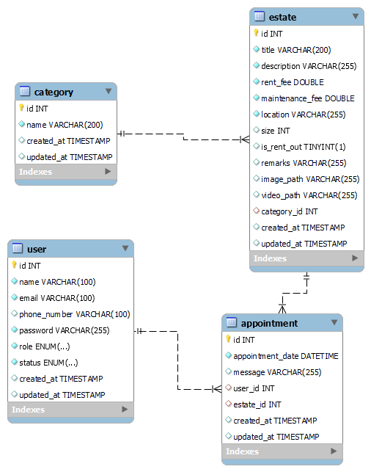
ER diagram

Slide 8


Project Demo Git Repo: https://github.com/Nlhmmh/yumekaoku

Slide 9

Thank You

