Slide 1
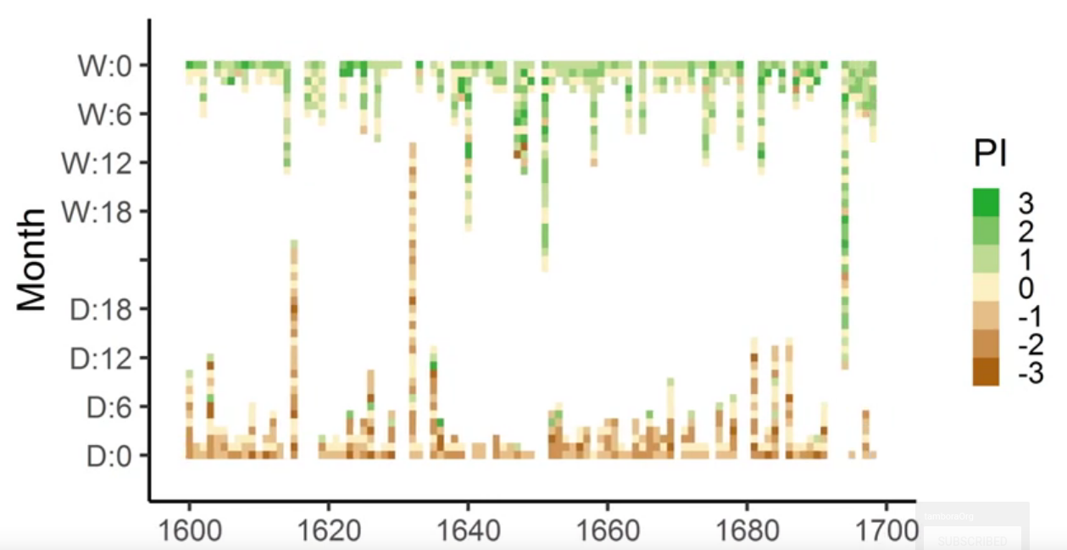
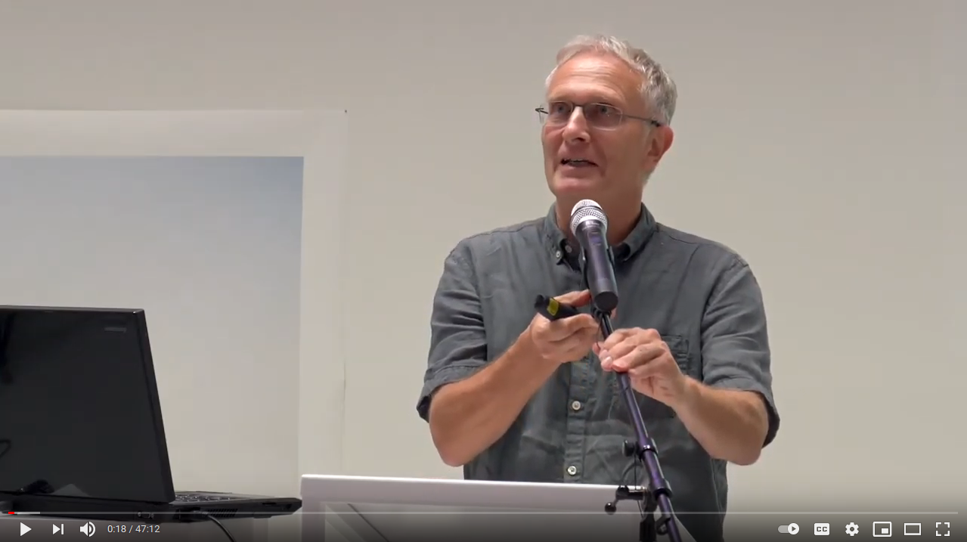
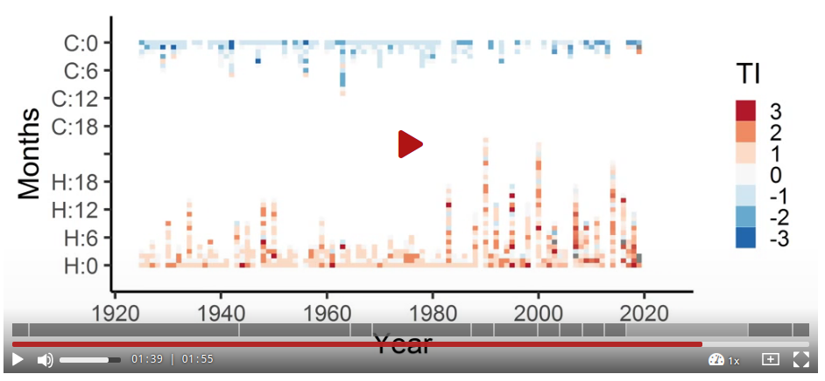
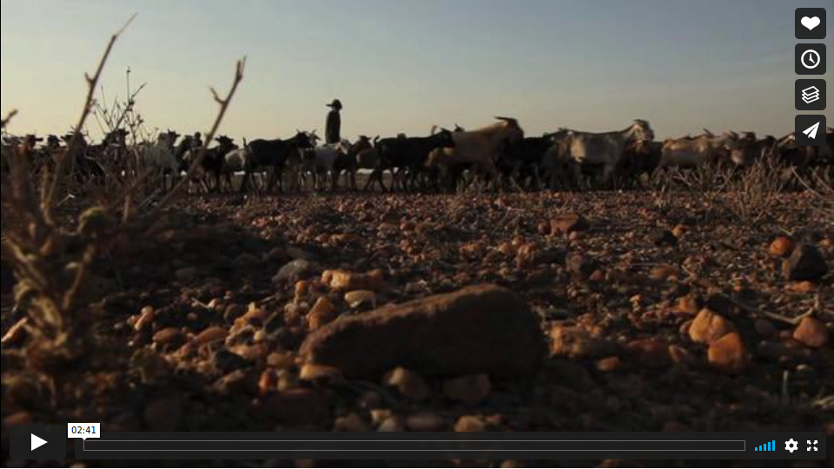


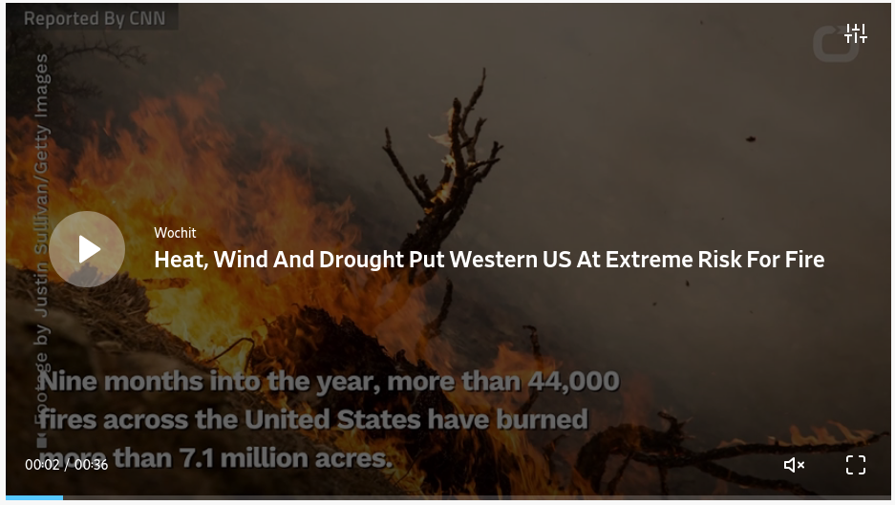
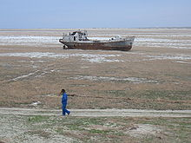

Glaser, R.; Kahle, M. 2020:
Reconstructions of droughts in Germany since 1500 – combining hermeneutic information and instrumental records in historical and modern perspectives
Climate of the Past
DOI: 10.5194/cp-16-1207-2020
Https://globalchanges.github.io/PosterExplorer/external?youtube=RaylM9RBUZA&size=60&autoplay=1&loop=1
https://globalchanges.github.io/PosterExplorer/external?youtube=Ya_6KsrTeqw&size=40
https://globalchanges.github.io/PosterExplorer/external?url=https://orcid.org/0000-0001-8571-2821
https://globalchanges.github.io/PosterExplorer/external?url=https://doi.org/10.5194/cp-16-1207-2020
https://globalchanges.github.io/PosterExplorer/external?tib=45206&size=40
https://globalchanges.github.io/PosterExplorer/external?vimeo=27583238&size=40
https://globalchanges.github.io/PosterExplorer/external?size=40&url=https://taz.de/Hydrologe-ueber-Duerreperiode-2020/!5693923/
https://globalchanges.github.io/PosterExplorer/external?size=60&url=https://web.archive.org/web/20200818173311/https://taz.de/Hydrologe-ueber-Duerreperiode-2020/!5693923/
https://globalchanges.github.io/PosterExplorer/external?dailymotion=x6xlkpu&size=80
Https://globalchanges.github.io/PosterExplorer/external?url=https://de.wikipedia.org/wiki/Desertifikation
https://globalchanges.github.io/PosterExplorer/external?size=50&url=https://de.wikipedia.org/wiki/D%C3%BCrre

