Slide 1
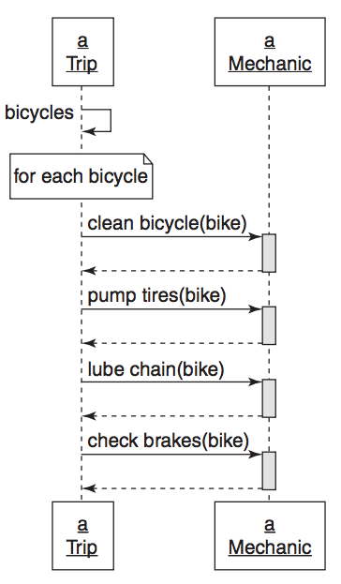
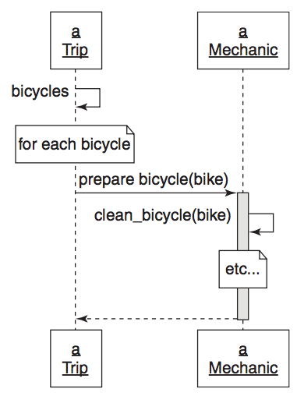
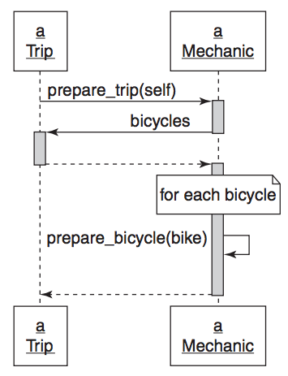
NOVICE DESIGNER
INTERMEDIATE DESIGNER
EXPERIENCED DESIGNER
Rights:
Trip tells mechanic what to do (not how)
Wrongs:
Trip still knows what mechanic does (dependency)
Trip’s context still needs someone to prepare bicycles always.
If there was trip that didn’t need bicycle preparation it would be wrong.
Need to modify trip if other things need to get prepared
Rights:
Dependency injection in prepare_trip
Trip and mechanic have small public interfaces
Trip could have an array of preparers and could call prepare_trip on each.
It is easy to extend Trip.
Extending Trip requires no modification of Trip.
Trip trusts each preparer to do its part.
Wrongs:
Trip tells mechanic how to prepare each bicycle
Trip has a large context
Mechanic has a big public interface

