Slide 1
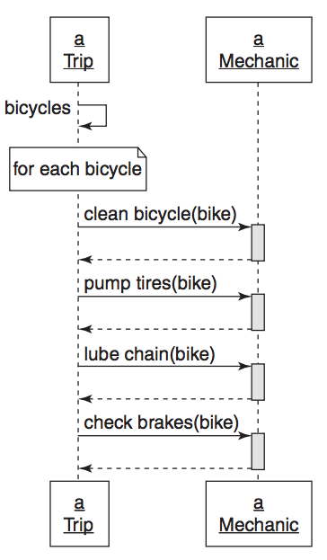
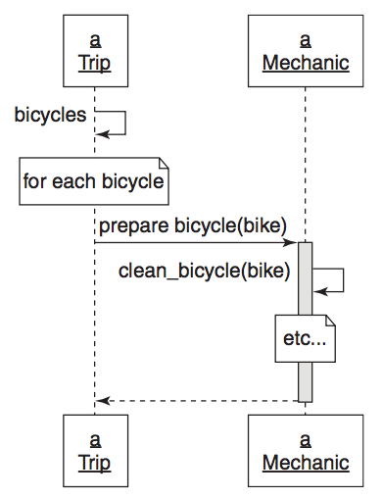
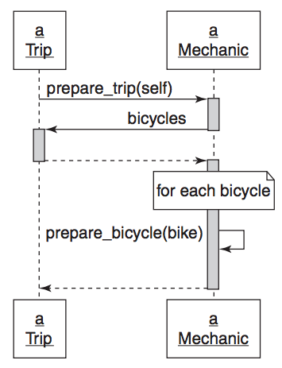
NOVICE DESIGNER
INTERMEDIATE DESIGNER
EXPERIENCED DESIGNER
Rights:
Trip tells Mechanic what to do, not how (sort of).
Trip and Mechanic have small public interfaces
Wrongs:
Trip still knows what Mechanic does (dependency)
Telling prepare_bicycles is still telling how to prepare a trip (Mechanic could do more than only prepare_bicycles for a trip).
Trip’s context still needs someone to prepare bicycles always.
If there was trip that didn’t need bicycle preparation it would be wrong.
Need to modify Trip if other things need to get prepared
Rights:
Trip is not telling Mechanic how. Trip trusts Mechanic to do its part.
Dependency injection in prepare_trip
Trip could have an array of preparers and could call prepare_trip on each.
It is easy to extend Trip
Extending Trip requires no modification of Trip
Trip trusts each preparer to do its part
Wrongs:
Trip tells Mechanic how to prepare each bicycle
Trip has a large context
Mechanic has a big public interface
Ch4

Slide 2
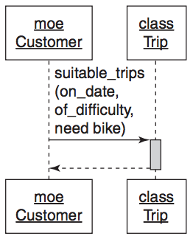
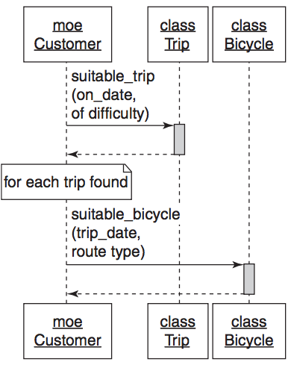
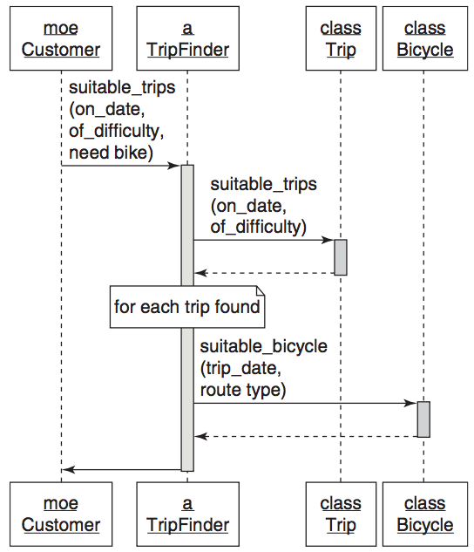
NOVICE APPROACH 1
NOVICE APPROACH 2
EXPERIENCED DESIGNER
Wrongs:
Trip has too much responsibility
Rights:
Trip and Bicycle have a single responsibility.
Wrongs:
Customer has too much responsibility
Customer knows too much about what makes a trip suitable
Customer has too much context (needs both Trip and Bicycle to work).
Rights:
Discovered hidden class TripFinder
All classes have single responsibility
Only TripFinder requires context
Ch4

Slide 3
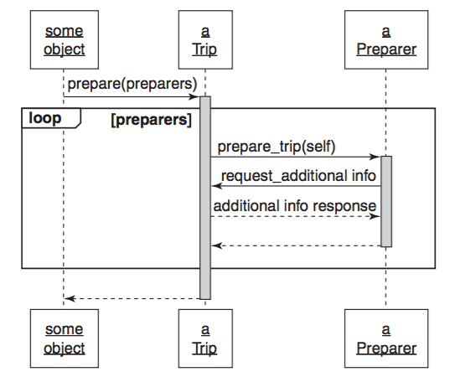
Preparer
Duck
Ch5

Slide 4
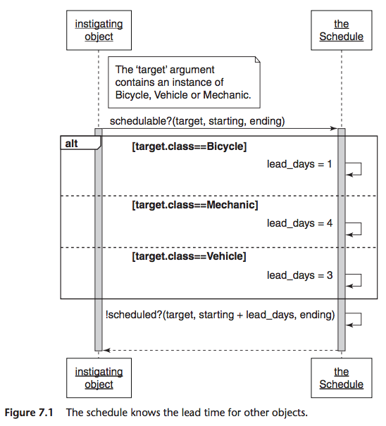
Wrongs:
Class checking anti-pattern
Creates a highly dependent structure
The knowledge of the lead days does not belong to Schedule.
The knowledge of lead days belong the classes that Schedule is checking.
Ch7

Slide 5
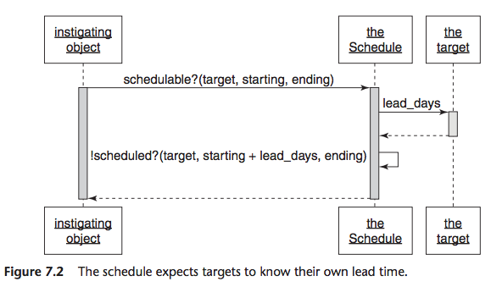
Rights:
Class checking anti-pattern has been removed.
“schedulable” duck type (role) has been discovered.
Wrongs:
“schedulables” do not speak for themselves.
The Schedule is required as a middle man to find out something about the ”schedulable”.
This creates a dependency.
The discovered “schedulable” duck type (role)
Ch7

Slide 6
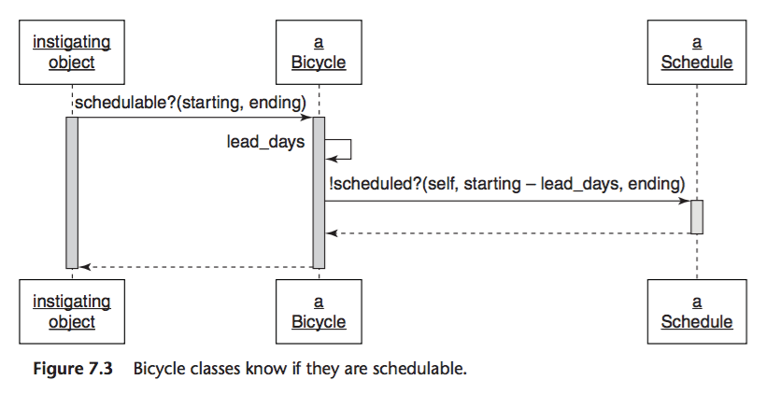
Rights:
Bicycle speaks for itself.
Instigating objects have no dependency on Schedule
Wrongs:
Bicycle is not the only thing that is schedulable in the app. The final design needs to take this into account.
Bicycle depends on Schedule.
Ch7

Slide 7
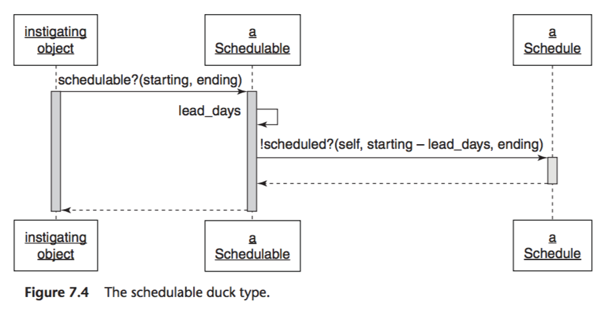
Rights:
Schedulable becomes an abstraction that many can implement.
The abstraction uses the template method pattern to invite others to provide specializations.
The dependency on Schedule is isolated.
Ch7

Slide 8
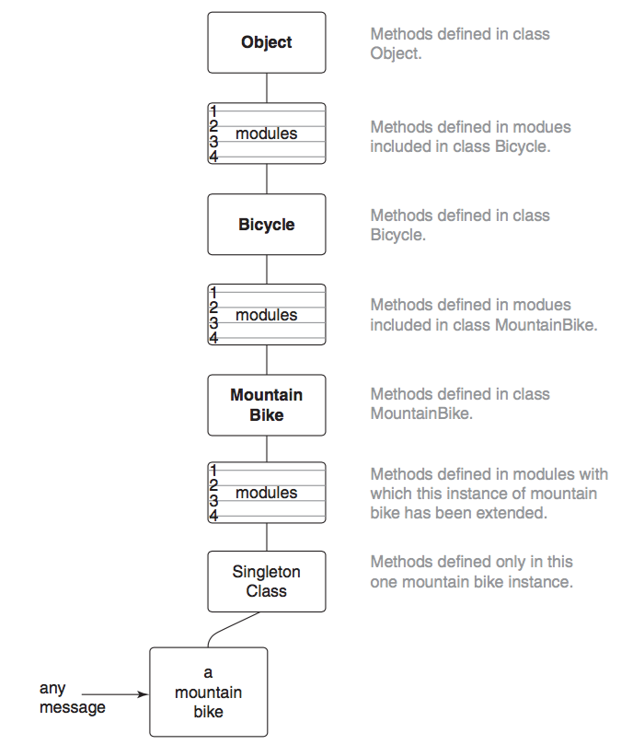
*
(for all instances)
*
(for all instances)
*
* Reverse order of inclusion. Last included takes precedence
Ch7

Slide 9
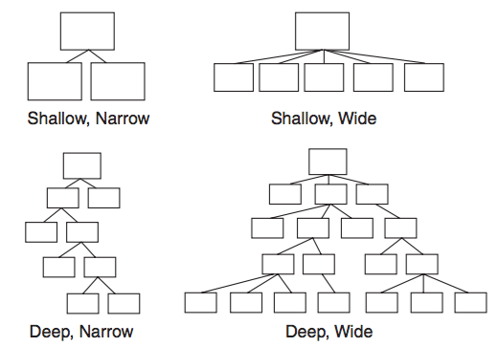
Best
Good
Bad
(Try to avoid)
Worse
(Avoid this)
Ch7

Slide 10
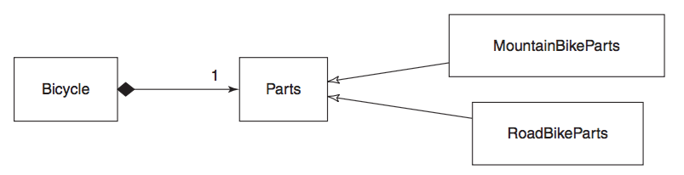
Has ONE
Inheritance
The Parts Object
Composition
Ch8

Slide 11
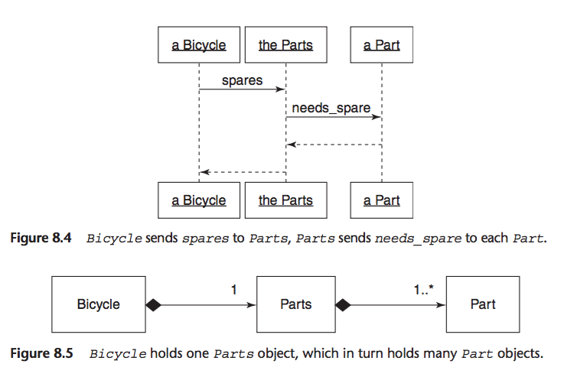
One or more
Ch8

