Slide 1
DataCamp Data Analyst Certification - Case Study
Boat Sales

Slide 2
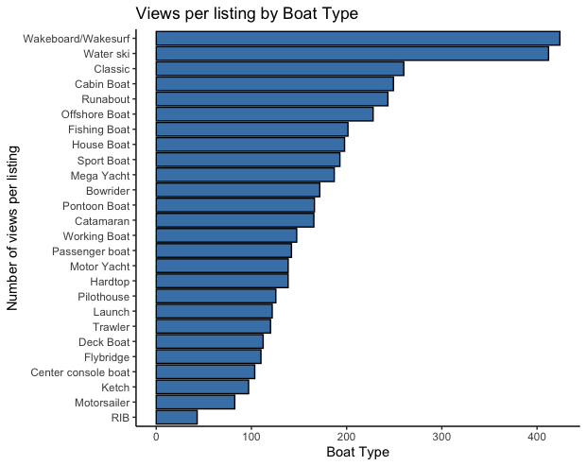
Type of boat
Wakeboard/Wakesurf and Water ski listings get the most views per listing.
Motor Yachts, Sport boat have high number of listings.
Listings with multiple boat types get more views.

Slide 3
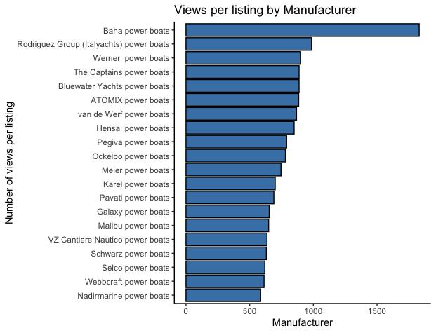
Boat manufacturer
“Baha power boats” listing got the most views per listing (1831), they had just 1 listing.
“Malibu power boats” had 10 listings, and averaged at about 650 views for each.
BÃ©nÃ©teau power boats and Jeanneau power boats had high number of listings, but averaged less views per listing

Slide 4
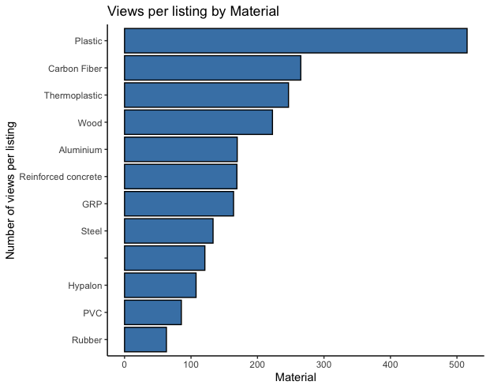
Material
Plastic boats get the most views per listing.
Carbon fiber, Thermoplastic, Wood come in as the second group.

Slide 5
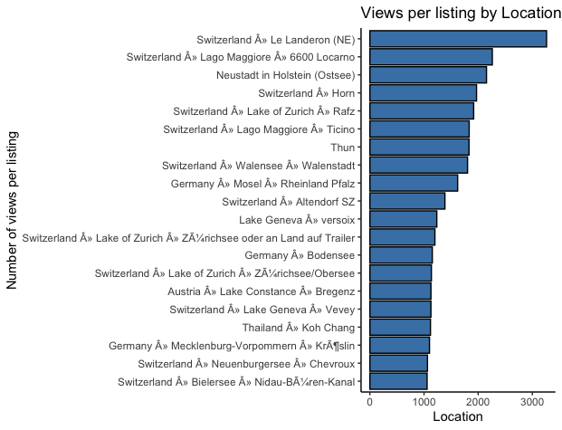
Location
Boats made in Switzerland Â» Le Landeron (NE), got the most views for its listing in the last 7 days.
Netherlands, Croatia and Italy have high number of listings, but get lower views for each

Slide 6
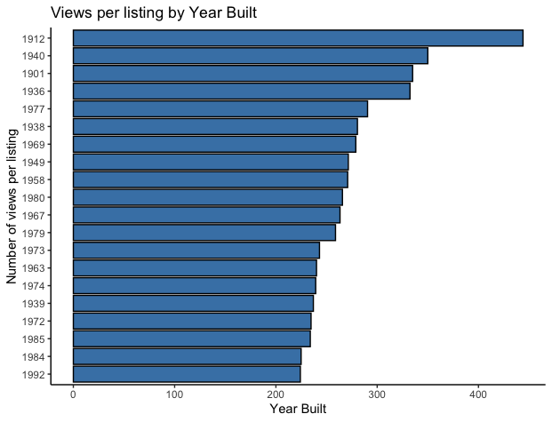
Year Built
1 Listing for a boat made in 1912 got highest views per listing.
On average, each years listings get ~160 views
Boats from 1990’s have high number of listings and also fair above the average views per listing.

Slide 7
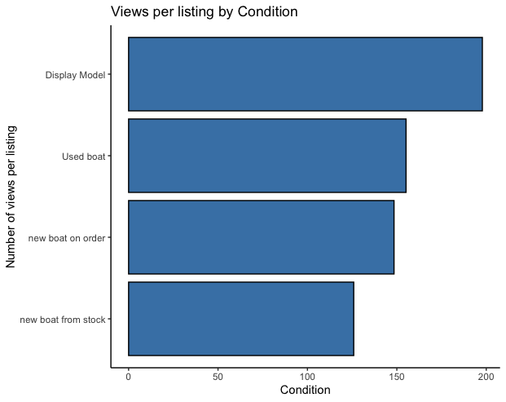
Condition
Display models get more view per listing
Used boats have the most number of listings and thus most absolute views.

Slide 8
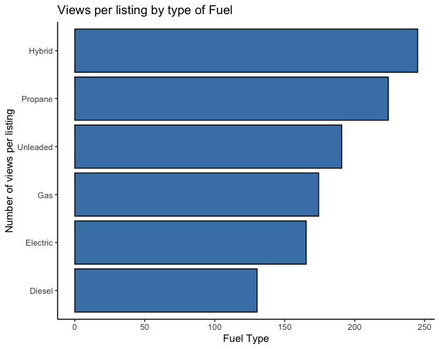
Fuel type
Hybrid and propane models get most views per listing, although there are only 2 listings for it.
Unleaded comes in third with a healthy number of listings as well.

Slide 9
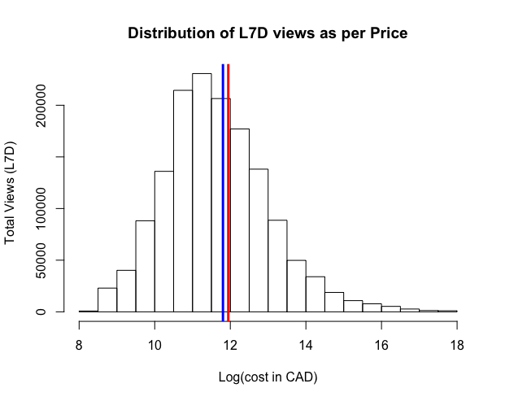
Price
Most views are ones where the price is close to the mean of the distribution i.e CAD 154218
Listings that are in the mid price range are viewed more than cheaper or more expensive boats.

