Slide 1

GROUP MEMBERS
Mohan Raj Nandagopal
Dipen shah

Slide 2




What is the MEAN Stack?

Slide 3
SURVEY TIMe
Database : Mongo DB
Server : Express, Node
Client : Angular JS

Slide 4
Node JS

Slide 5

Benefits of Node JS
Server-side javascript platform built on V8 engine
What javascript has done for the web browser, Node.js is doing for the backend server
Node’s goal is to provide an easy way to build scalable network programs

Slide 6

NodeJS module package manager
There is a module for everything, probably more than one.
Key commands - install, remove, update, search, -g flag for global

Slide 7
Node.js And MEAN Stack
High performance server-side JavaScript
Module loading
Asynchronous IO
Application platform foundation

Slide 8
Express

Slide 9
Benefits of express
A simple and robust web application framework for Node.js
Gives you everything you would expect to build a modern web server
Middleware, routing, templating, static-files, cookies, mime-types, view rendering and much much more

Slide 10
Mongo DB

Slide 11
Benefits of MongoDb
A simple and scalable document based NoSQL DB
JSON based model persistence
Flexible Schemas, Query Selectors, DOCUMENT STORAGE, Auto-Sharing, binary object store and much more

Slide 12
Angular JS

Slide 13
Benefits of Angular JS
An extensible client-side application framework
100% Javascript and 100% client side
Data-binding, syncing, templating, components and much, much more

Slide 14
Yeoman

Slide 15
Benefits of Yeoman
THE WEB'S SCAFFOLDING TOOL FOR MODERN WEBAPPS
Yeoman helps you to kickstart new projects, prescribing best practices and tools to help you stay productive.

Slide 16
Grunt

Slide 17
Benefits of Grunt
Grunt is used to build, preview and test your project, thanks to help from tasks curated by the Yeoman team and grunt-contrib.
The less work you have to do when performing repetitive tasks like minification, compilation, unit testing, linting etc, the easier your job becomes.

Slide 18
Bower

Slide 19
Benefits of Bower
Bower is used for dependency management, so that you no longer have to manually download and manage your scripts.
Bower works by fetching and installing packages from all over, taking care of hunting, finding, downloading, and saving the stuff you’re looking for.
Bower is optimized for the front-end. Bower uses a flat dependency tree, requiring only one version for each package, reducing page load to a minimum.

Slide 20
GETTING STARTED WITH

Slide 21
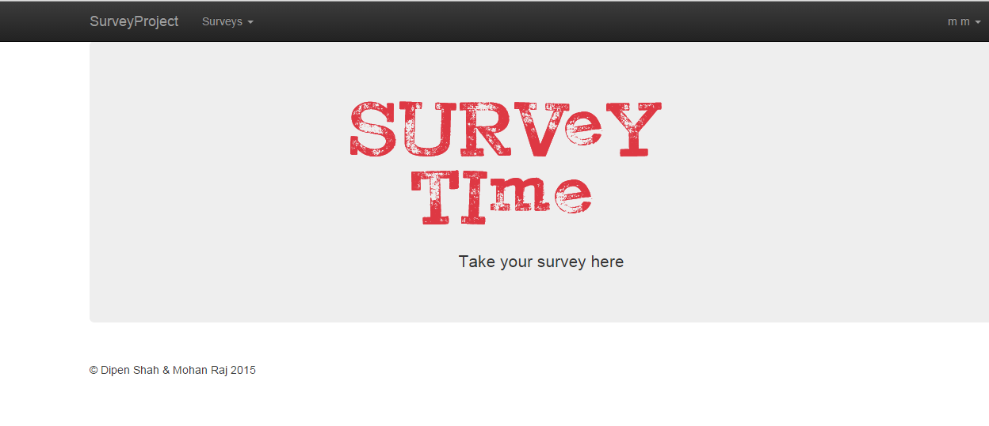
HOMEPAGE

Slide 22
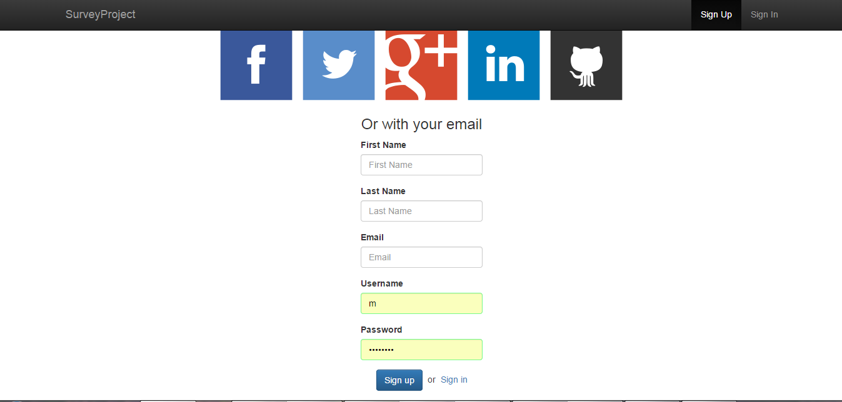
USER REGISTRATION

Slide 23
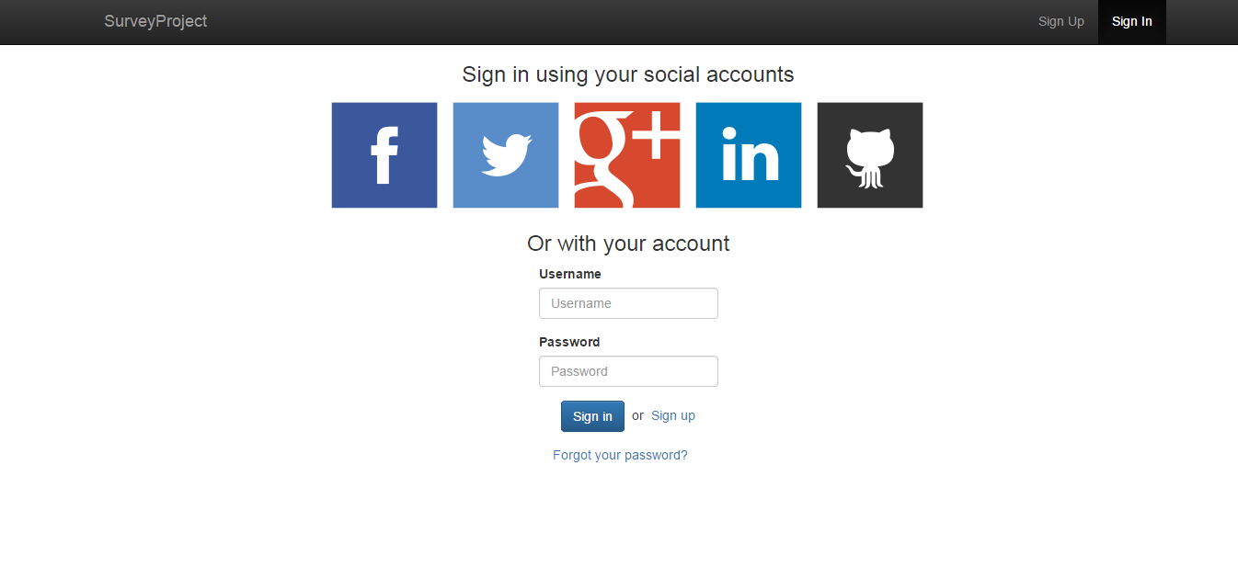
LOGIN UP

Slide 24
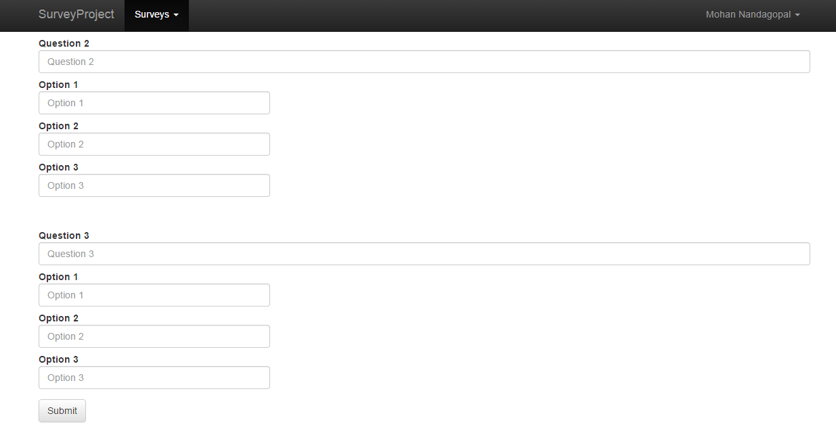
CREATING NEW SURVEY

Slide 25
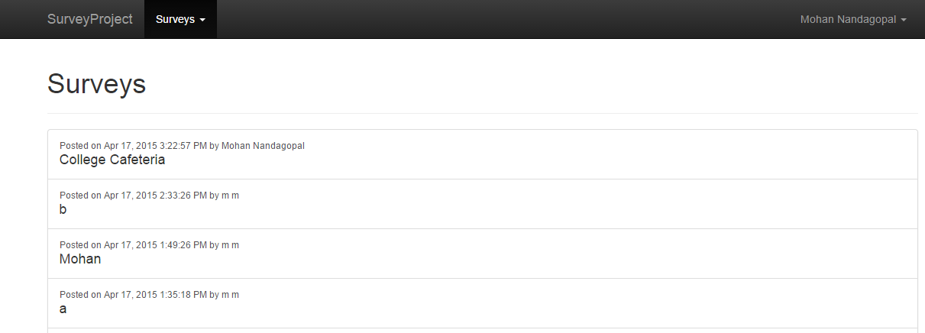
SURVEY LIST

Slide 26
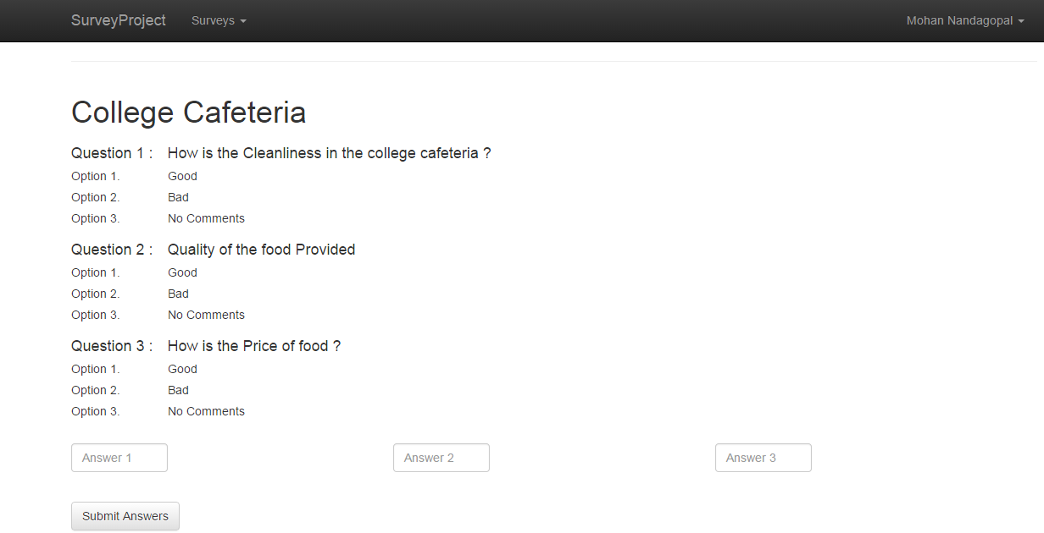
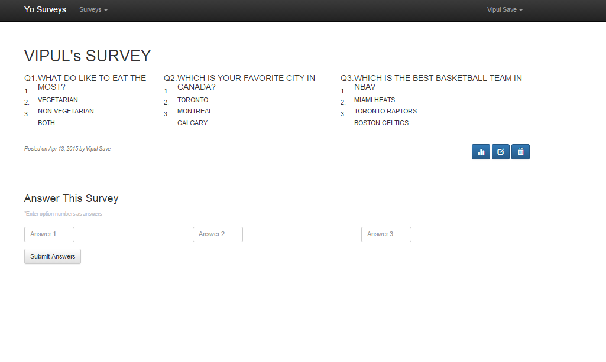
EXISTING SURVEY

Slide 27
THANK YOU !!!

