Slide 1

Retailio ETL Pipeline by: Nadia Mudassar
Data engineer consultant at AMDARI https://github.com/Nmudassar/ETL_Projects/tree/main/retailio-elt
AWS S3 → Airbyte Cloud → MotherDuck

Slide 2
Agenda
Business Overview
Aim of the Project
Architecture Diagram
AWS S3 Data Storage
Airbyte Integration
MotherDuck Warehouse
Automation
Cloud-Native Architecture
Conclusion

Slide 3
Business Overview / Problem
Manual CSV uploads cause delays and errors
Inconsistencies across branches
No centralised repository
Need for scalable cloud-based ETL

Slide 4
Aim of the Project
Centralize data in AWS S3
Automate ETL pipeline using Airbyte
Build warehouse in MotherDuck
Enable fast insights and decisions

Slide 5
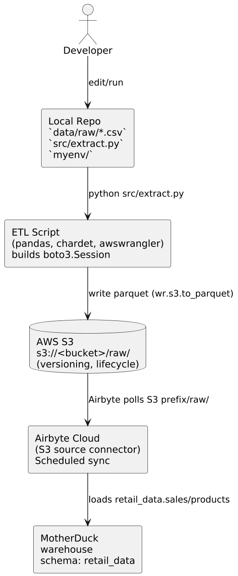
Architecture Diagram

Slide 6

Data Storage – AWS S3
Central repository for raw datasets
Versioning & lifecycle rules
Scalable and durable
Organised folder hierarchy

Slide 7

Airbyte Cloud Integration
Automated ingestion from S3
Daily scheduled syncs
Schema enforcement
Automatic table creation

Slide 8

MotherDuck Warehouse
High-performance SQL engine
Fast analytical queries
Centralised analytics environment
Scalable compute and storage

Slide 9
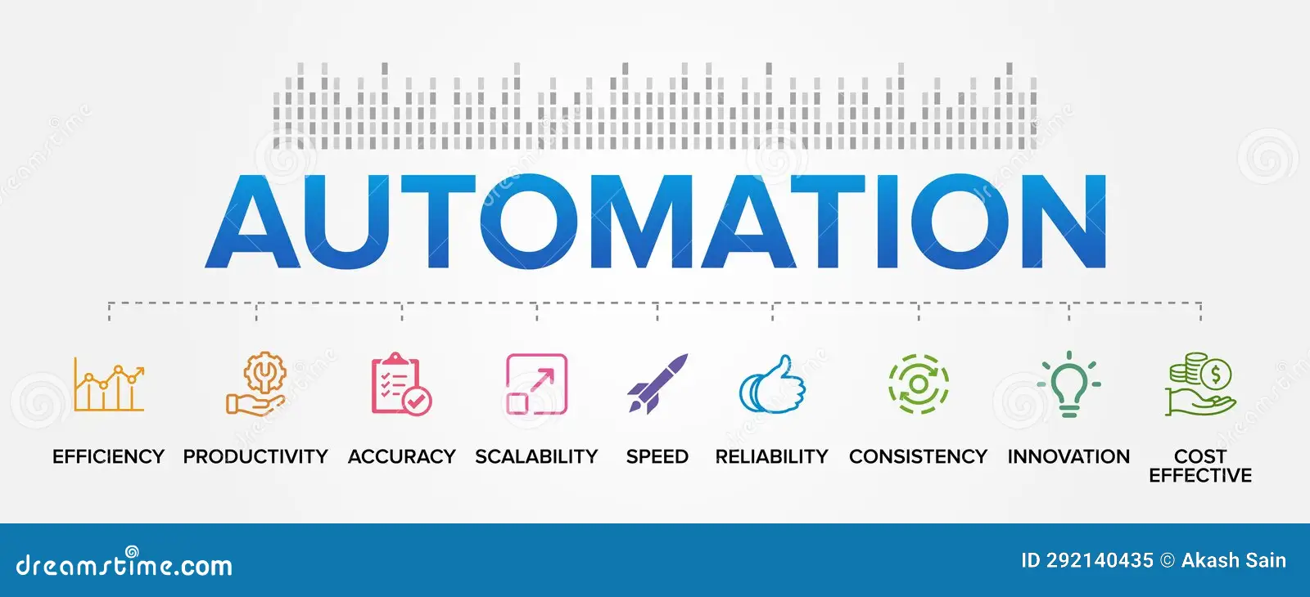
Automation Benefits
Near real-time freshness
Removes manual uploads
Reduces delays in reporting
Reliable, repeatable pipeline

Slide 10

Conclusion
Modern automated ETL pipeline implemented
Data centralised and analytics-ready
Supports scalable, future-proof architecture
Enables accurate and timely decision-making

