Slide 1
Java workshop

Slide 2
Objective: By the end of this class, students will
Identify parts of a Java program
Create a Main class that does work
Spiral Java data structures
Implement basic polymorphic methods in Java
Use Swing to get user input and instantiate class methods based on that input.
Standards : Create Java classes, Identify Java data structures, Write and explain polymorphic methods.

Slide 3
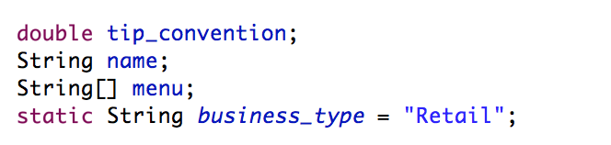
JAVA VARIABLE DECLARATION
menu = {“salad”, “steak”, “sorrell”, “okra”, “grits” }

Slide 4
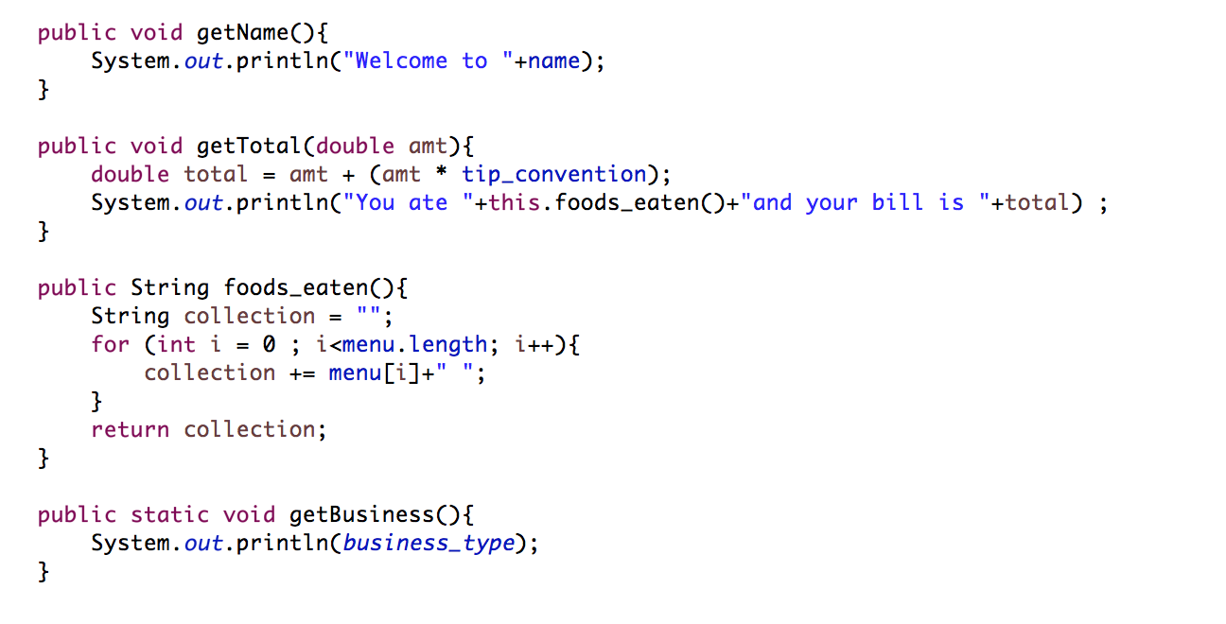
Java method declaration

Slide 5
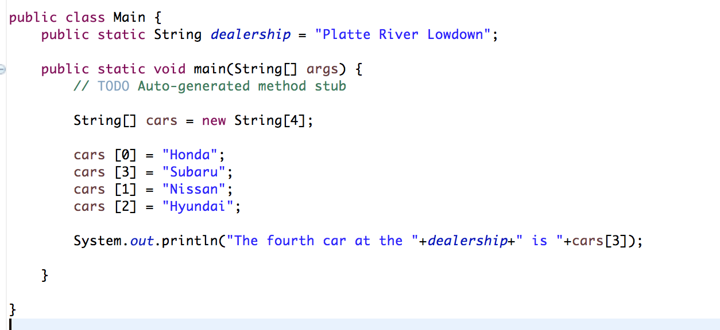
Where it all begins… the Main class

Slide 6
Project
Create a program that takes in a name of a Mammal. If the mammal is a pre-defined static array of Human names, instantiate a human instance , and make the human speak in English. If the mammal is in a Sasquatch class, instantiate a Sasquatch and make the sasquatch speak in Sasquatch language. In each class, invoke the “speak” method.

