Slide 1

Improving Hypertension treatment with machine learning: Using decision trees for personalized drug recommendations
Nancy Maina

Slide 2



Introduction
Healthcare providers face challenges in prescribing the correct medication and dosage for patients with hypertension.
Incorrect prescriptions can lead to ineffective treatment, adverse reactions, and increased healthcare costs

Slide 3

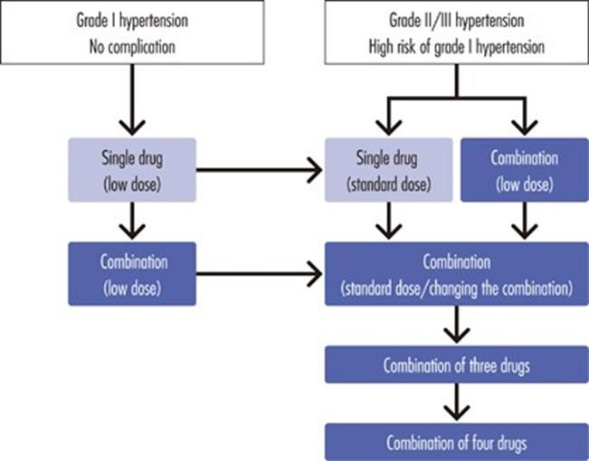
Business Problem
With a vast array of antihypertensive medications available, selecting the right drug for each patient is complex and error-prone.
Our goal is to enhance the accuracy of drug prescriptions using machine learning

Slide 4
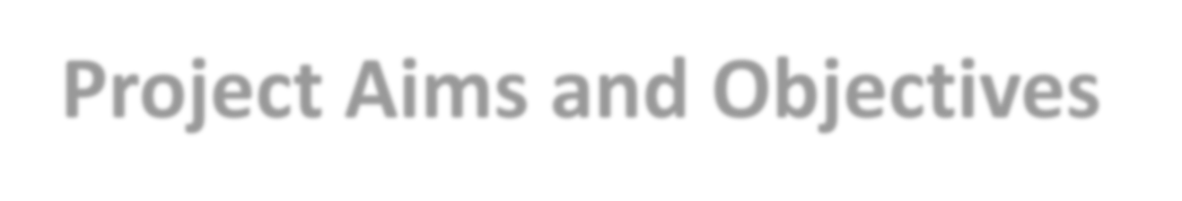
Project Aims and Objectives
Objective:
To enhance the accuracy and effectiveness of hypertension drug prescriptions by leveraging machine learning for personalized recommendations.
Aims:
Use patient data to predict the appropriate drug.
Develop a decision tree model for prescription recommendations.

Slide 5

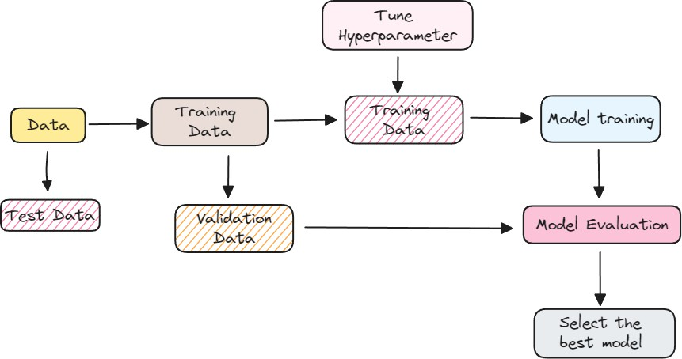
Machine Learning Process/ Methodology
Data cleaning and preparation
Feature encoding
Data splitting into training and testing sets
Training the decision tree

Slide 6
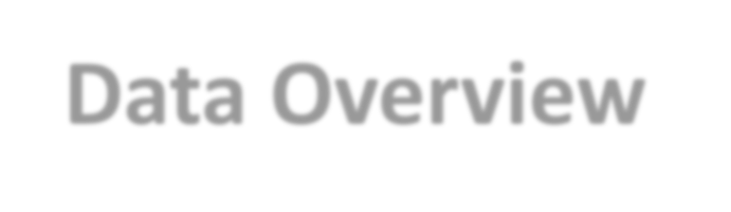
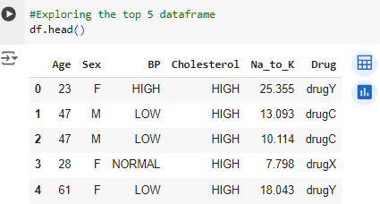
Data Overview
We utilized a dataset of patients suffering from hypertension, with features including Age, Sex, Blood Pressure, and Cholesterol levels.
The target variable is the drug each patient responded to.

Slide 7
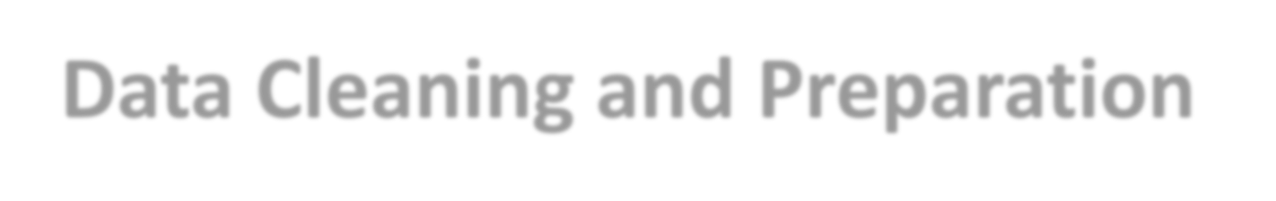
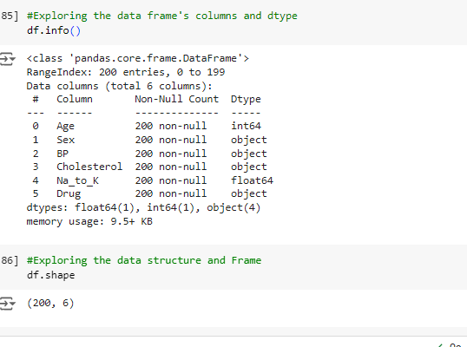
Data Cleaning and Preparation
No missing Values
No Duplicates
3 Columns with
Categorical Data
2 Columns with Numerical data

Slide 8
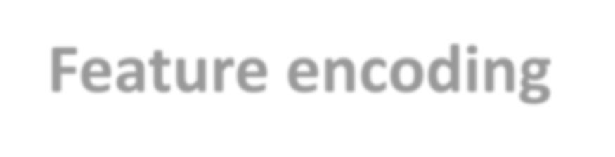
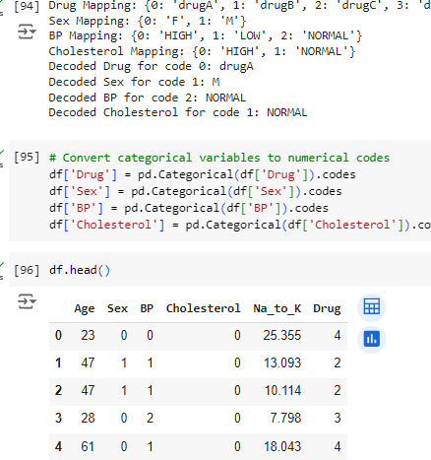
Feature encoding
To prepare the data for machine learning, convert categorical columns (e.g., Sex, BP, Cholesterol, Drug) to numerical values.
Numerical columns (e.g., Age, Na_to_K) can be used directly.

Slide 9
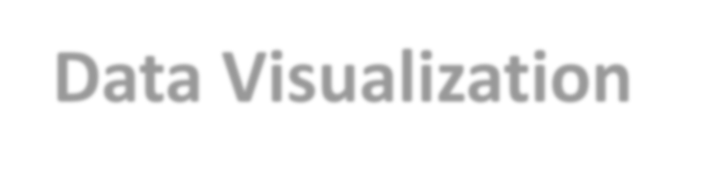
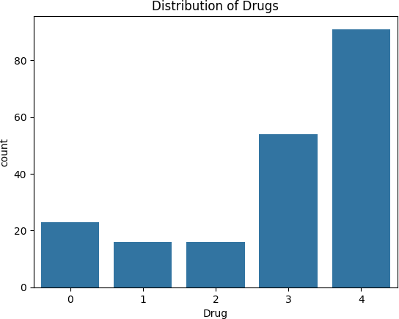
Data Visualization
Commonly prescribed are drugs Y and X
Drugs A,B & C less
frequently prescribed

Slide 10
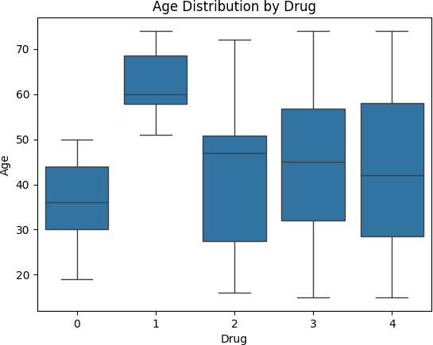
Data Visualization
Patients prescribed Drug B tend to be older.
There's a wider age range for patients on Drug Y.

Slide 11
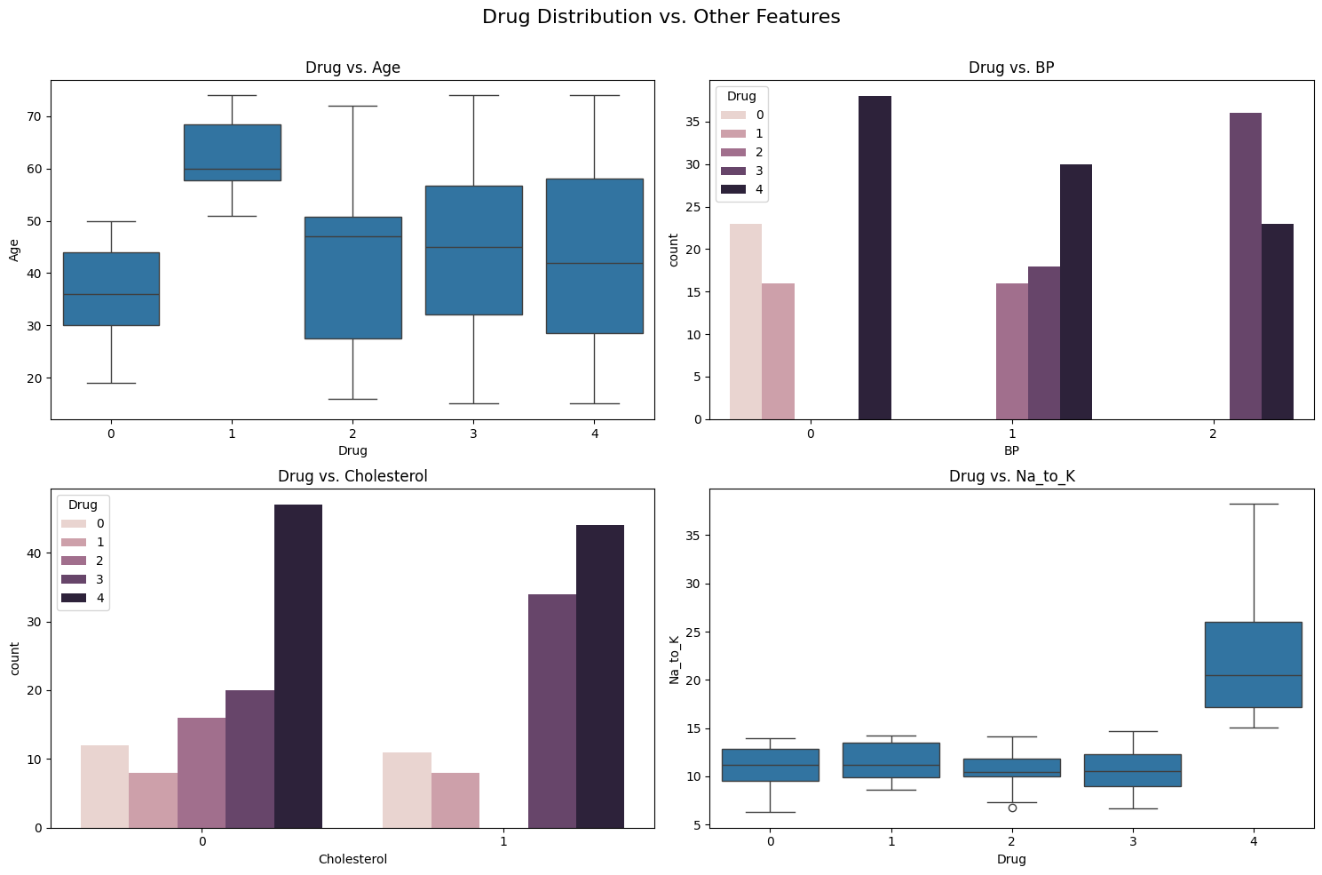
Data Visualization
Patients with high blood pressure (BP = 2) are more likely to receive Drug C=2.
Drugs A=0 and B=1 are commonly prescribed for low blood pressure (BP = 0).

Slide 12
Data Visualization
High cholesterol (Cholesterol = 1) is a common factor for patients receiving Drugs A=0, B=1, and C=2.

Slide 13
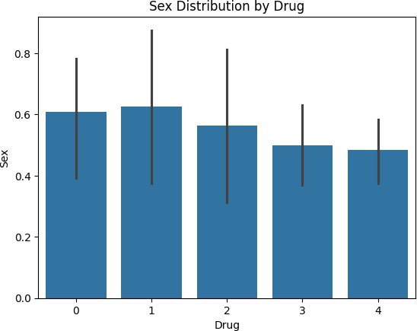
Data Visualization
There's no significant difference in drug prescription based on sex.

Slide 14
Data Visualization
Patients on Drug Y=4 generally have higher sodium to potassium ratios.

Slide 15
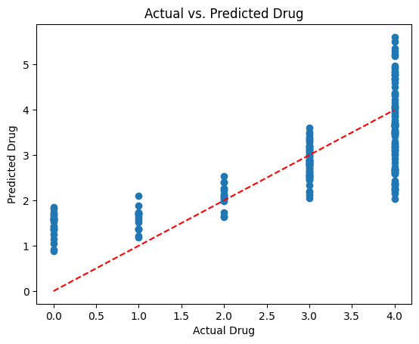
Data Visualization
There's a positive correlation between Actual vs Predicted Drug

Slide 16
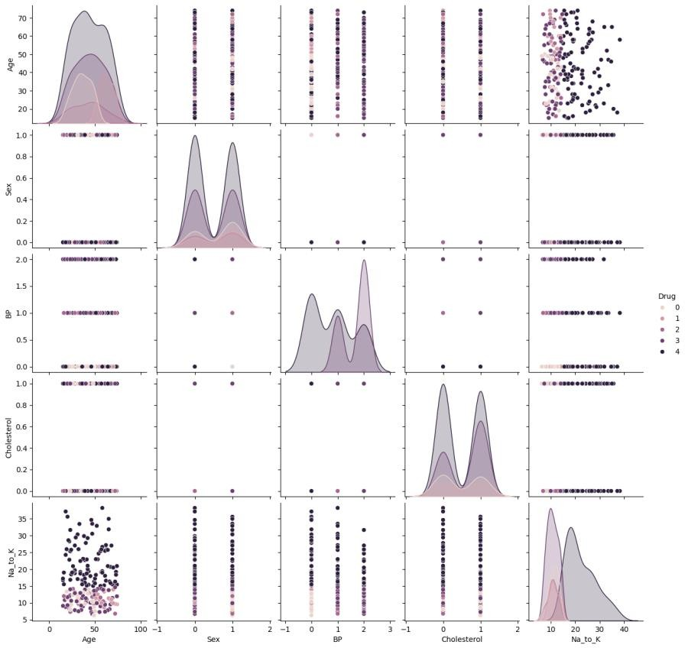
Data Visualization
a visual overview of the relationships between all feature pairs, colored by the prescribed drug.

Slide 17
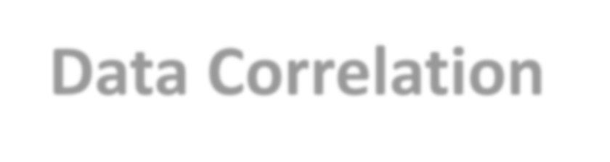
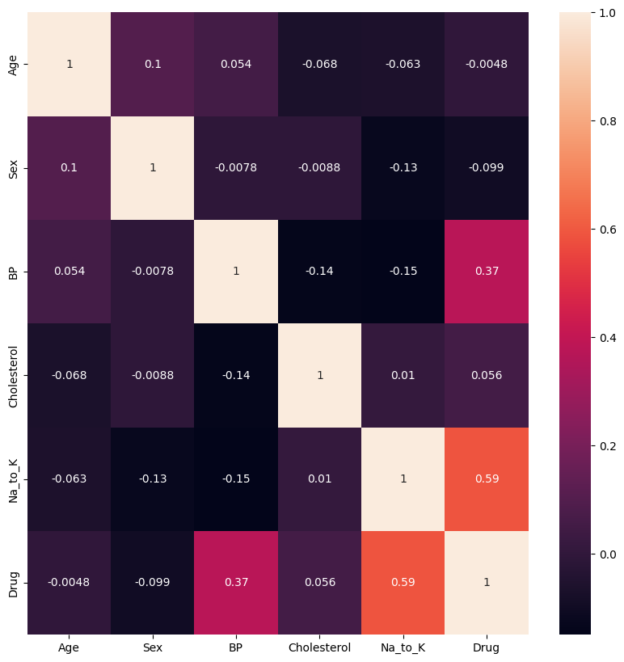
Data Correlation
Strongest positive
correlations:
Age and Blood Pressure (0.65)
Sodium to Potassium
and Drug (0.59)
Strongest negative correlation: a)Cholesterol and Drug (- 0.43)

Slide 18
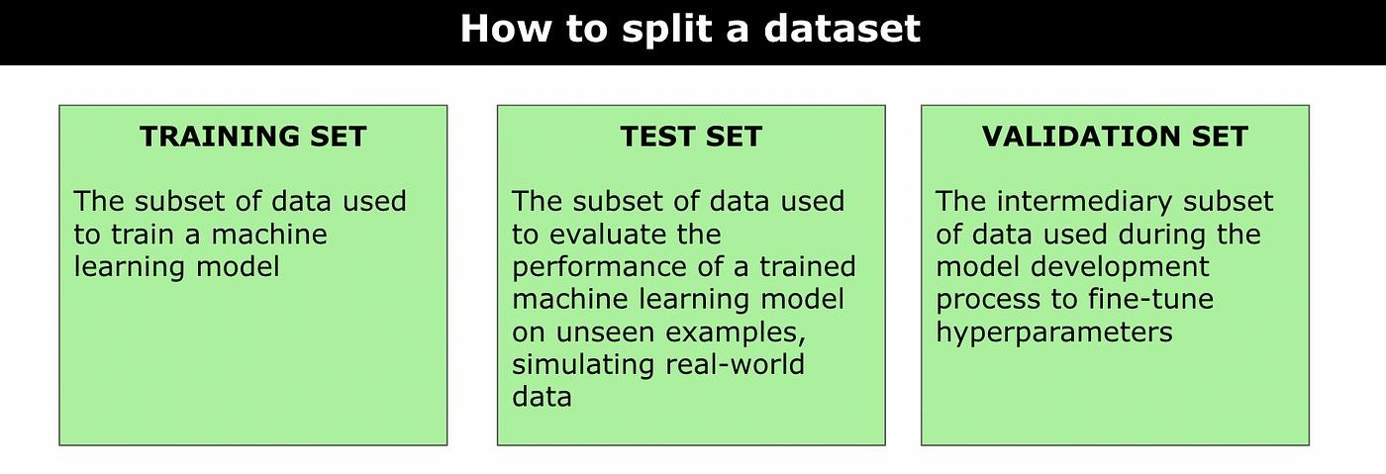
Data Splitting, training and Testing

Slide 19
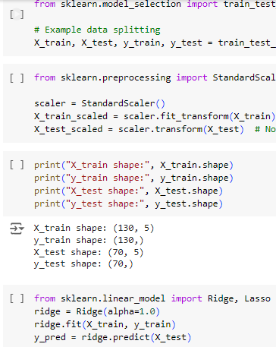
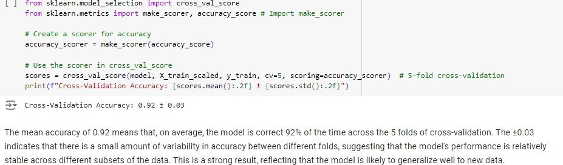
Data Splitting, training and Testing

Slide 20
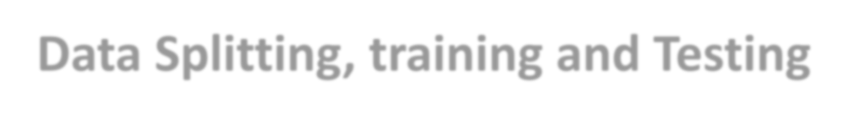
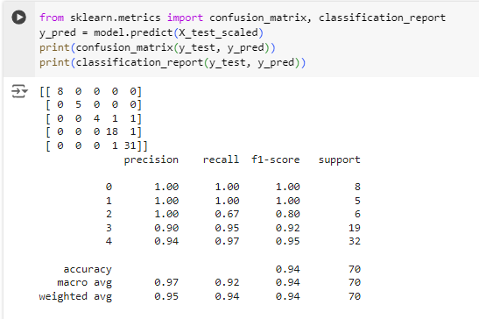
Data Splitting, training and Testing
Confusion Matrix Analysis
The model is consistently good at predicting the correct class with an accuracy of 94% and weighted average of 95%.
It doesn’t miss many true positives and doesn’t make many mistakes in its predictions.

Slide 21

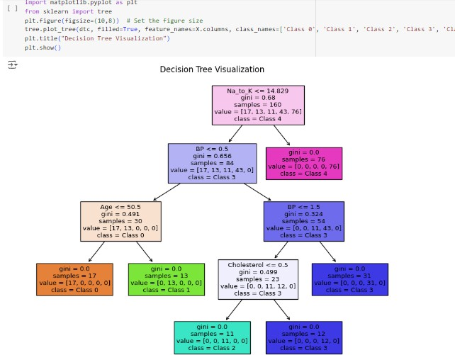
Training the Decision Tree
Decision Tree Analysis
Na_to_K <= 14.83, BP <= 0.50, Age <= 50.50: This path results in class: 0.
Na_to_K <= 14.83, BP <= 0.50, Age > 50.50: This path results in class: 1.
Na_to_K <= 14.83, BP > 0.50, BP <= 1.50, Cholesterol <= 0.50: This path results in class: 2.
Na_to_K <= 14.83, BP > 0.50, BP <= 1.50, Cholesterol > 0.50: This path results in class: 3.
Na_to_K > 14.83: This path results in class: 4

Slide 22
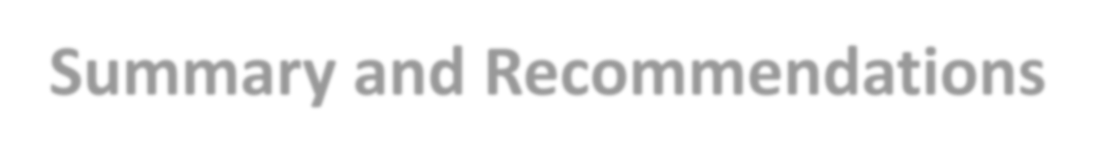
Summary and Recommendations
The precision being all at 95% , recall 94% and F1 score 94% suggests that the model is both highly accurate and reliable in predicting the classes.
Recommendation
Improvement Needed for Class 2: It struggles with Class2, missing items.
Look into why the model misses many Class 2 items and make
adjustments to improve it.
Continue to check and refine the model to ensure it works well for all
the classes.

Slide 23
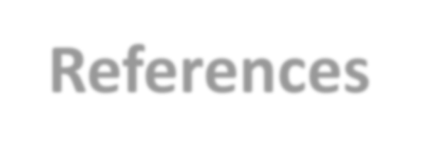
References
Gomez, P. (2021). Drugs A, B, C, X, Y for Decision Trees. https://www.kaggle.com/datasets/pablomgomez21/drugs-a-b-c-x-y- for-decision-trees
Maina, N. (2024). Tableau Dashboard.
https://public.tableau.com/views/DrugABCXYMachineLearningproject
/Dashboard2?:language=en- US&publish=yes&:sid=&:redirect=auth&:display_count=n&:origin=viz_ share_link
Maina, N. (2024). Github Repo. https://github.com/Nmwangu2/Phase3_project.git

Slide 24



