Slide 1
DATA ANALYST – CANDIDATE PRESENTATION
Environmental Waste
& Pollution Analysis
Across UK Regions
Chioma Nnadi | Data Analyst | February 2026
Presented to Southern Water – Wastewater Solutions Data Analyst Interview

Slide 2
CONTENTS – FROM DATA TO ACTION
The “Why”: Project Context and Business Goals
The “How”: My Approach & Data Sources
The “What”: Keys Findings and Insights
The “Tool”: Dashboard Walkthrough
The “Next”: Recommendations, Predictions, & Conclusion

Slide 3
SECTION 1 | PROJECT CONTEXT
The Goal, The People & Why It Mattered
🎯 The Goal
👥 Key Stakeholders
💡 Why It Mattered
Analyse environmental incident data
Understand trends over time
Assess severity of incidents
Identify risk concentration by region
🏛 Environment Agency
Supports regulatory compliance
Reduces environmental risk
Prioritises resources effectively
💧 Water Companies
🏭 Industrial Operators
🌾 Agricultural Sector
🌍 Local Authorities

Slide 4
SECTION 2 | MY APPROACH
How I Analysed the Data
1
2
3
4
5
Data
Cleaning
Structuring
Data
Pivot
Tables
Pattern
Analysis
Charts &
Findings
Standardised date formats, flagged unknown locations, checked for duplicates and inconsistencies
Organised records by region, sub-region, date, impact category, and pollutant type
Used Excel pivot tables to count incidents by region, severity, and pollution medium
Compared land, water, and air impact counts to identify which medium was most affected
Visualised regional breakdowns and pollutant types to tell a clear story from the data
📂 Source: UK Environment Agency — National Incident Reporting System (NIRS) | Over 36,000 incident records across two datasets | 🛠 Tool: Microsoft Excel

Slide 5
SECTION 2 | MY APPROACH
What the Analysis Produced
Key measures from the full 36,000+ record dataset
17,053
94,969
5.6
Total Incidents
Total Impact Score
Average Impact
Pollution incidents recorded across all UK regions
Combined severity score across land, water and air impacts
Typical severity score per incident — our baseline measure
Southwest
18,994
Highest Risk Region
Projected Reduction
The region with the greatest concentration of high-severity incidents
Estimated impact score saved by preventing 20% of high-risk incidents

Slide 6
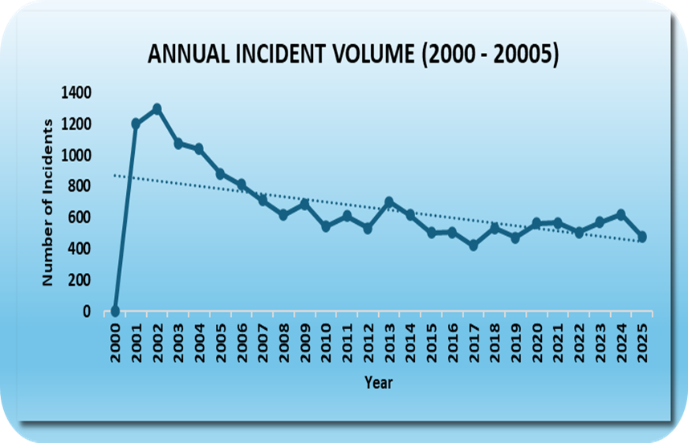
SECTION 3 | KEY FINDINGS
Incident Volumes Are Falling Over Time
Key Findings
📉
Sharp drop after 2001
Incidents peaked at over 1,200 in 2001 then fell dramatically — suggesting early intervention and regulation had a real impact.
📊
Steady long-term decline
The overall trend line shows a consistent downward trajectory over 25 years, indicating improving environmental management across the UK.
⚠️
Recent uptick worth watching
Incident volumes show a slight rise from 2022 to 2025 — flagging this as an area that warrants closer monitoring going forward.

Slide 7
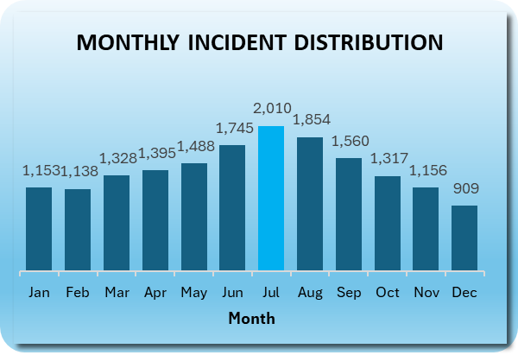
SECTION 3 | KEY FINDINGS
Summer Months Drive the Most Incidents
Key Findings
☀️
July is the peak month
July recorded the highest number of incidents at 2,010 — nearly double the quietest month. Summer activity and heat likely increase exposure and reporting.
❄️
December is the calmest
December had the fewest incidents at 909 — suggesting winter conditions reduce certain types of pollution activity.
📆
Seasonal planning opportunity
The clear June–August peak gives environmental teams advance warning to increase monitoring capacity and field presence during high-risk months.

Slide 8
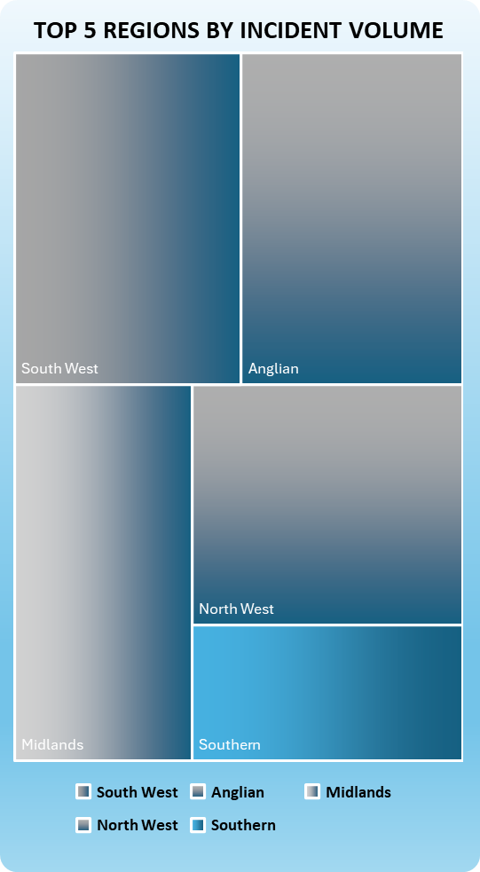
SECTION 3 | KEY FINDINGS
Southwest Is the Highest Risk Region
Key Findings
🔴
Southwest leads in volume
The Southwest accounts for the largest share of incidents — confirming it as the highest risk region and the priority area for intervention.
🌊
Anglian region is second
Anglian recorded the second highest volume — both coastal regions, suggesting proximity to water bodies may increase incident risk.
🎯
Resources should follow risk
With Southwest and Anglian dominating, targeted deployment of monitoring teams and response resources to these regions would have the greatest impact.

Slide 9
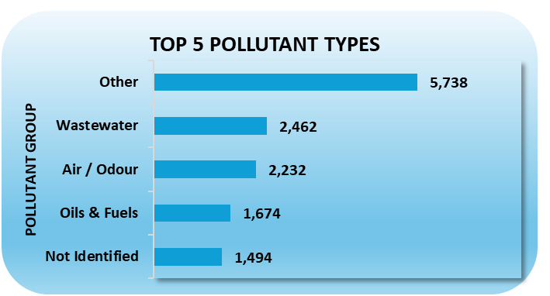
SECTION 3 | KEY FINDINGS
Wastewater & Air Pollution Are the Biggest Threats
Key Findings
🚰
Wastewater is a major concern
With 2,462 incidents, wastewater is the second largest pollutant group — directly relevant to Southern Water's core responsibility of managing sewage and effluent.
💨
Air and odour incidents significant
2,232 air and odour incidents highlight that pollution impacts go beyond water — affecting the quality of life for nearby communities.
🔍
5,738 unclassified incidents
The largest group is 'Other' — suggesting a gap in reporting standards that makes it harder to target the true root causes of pollution.

Slide 10
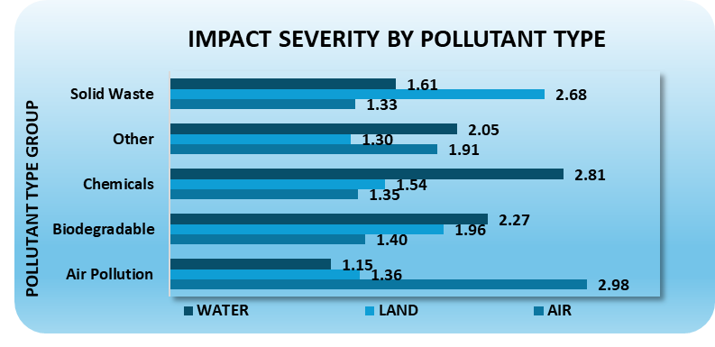
SECTION 3 | KEY FINDINGS
Water Bears the Highest Impact Across All Pollutant Types
Key Findings
💧
Water is the most impacted medium overall
Across all pollutant types, water has the highest average impact score of 2.35 — compared to land at 1.64 and air at 1.57. Water consistently bears the greatest environmental burden.
🚜
Agricultural pollution hits water hardest
Agricultural sources score 3.08 for water impact — the single highest score in the entire dataset. Farm run-off is the most critical threat to water quality.
🚰
Wastewater and unknown sources also critical
Wastewater scores 3.01 and unknown sources 3.03 for water impact — highlighting both a treatment gap and a reporting gap that need urgent attention.

Slide 11
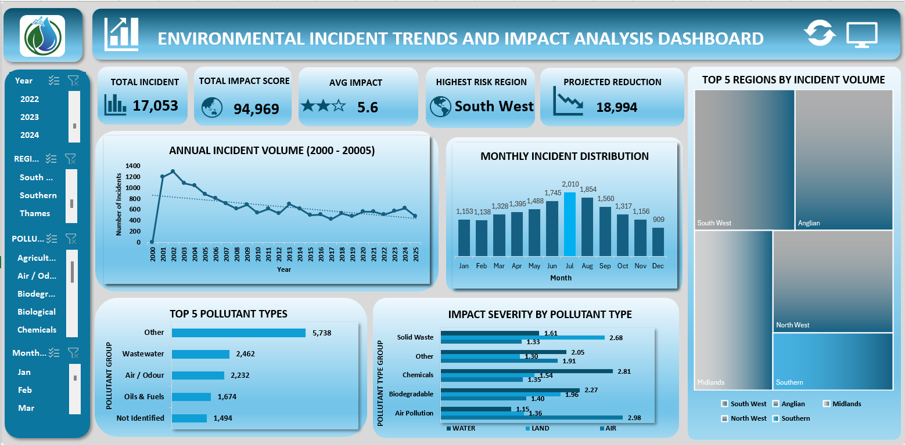
SECTION 3 | KEY FINDINGS
DASHBOARD OVERVIEW

Slide 12
SECTION 3 | KEY FINDINGS
Key Patterns & Insights
💧
Water Quality Deterioration Near Waste Sites
🏭
Industrial Activity as a Key Driver
Regions with a high concentration of landfill and industrial waste sites consistently showed lower water quality index scores, suggesting a direct link between waste proximity and contamination risk.
Areas with higher industrial activity recorded significantly elevated pollutant concentrations. This pattern held across multiple pollutant types, pointing to industrial operations as a primary risk factor.
📍
Regional Disparities Are Significant
✅
How I Validated the Findings
The gap between the highest and lowest-risk regions was considerable — suggesting that targeted, region-specific interventions would be far more effective than blanket national policies.
Cross-referenced results across multiple data sources, checked for data entry errors, and tested whether patterns remained consistent across different time periods to ensure reliability.

Slide 13
SECTION 4 | RECOMMENDATIONS & IMPACT
What I Recommended & Why It Mattered
My Recommendations
Impact of This Work
🎯 Prioritise monitoring and intervention in Southwest and Anglian— the highest-risk regions identified in the analysis
The analysis provided stakeholders with a clear regional risk picture for the first time, enabling evidence-based prioritisation of resources and monitoring efforts.
🚰 Track sewage and wastewater incidents closely. With over 2,400 incidents, they directly affect downstream water quality, which is core to Southern Water operations
🚜 Engage with agricultural operators. Farm run-off scored the highest water impact of 3.08 in the entire dataset, making it the most critical threat to water quality
Future Improvements
→ Extend to multi-year dataset for trend analysis → Add geospatial maps using coordinates already in the data → Build automated dashboard for live incident tracking
📊 Build on this analysis over time. The 25-year trend shows improvement but the recent uptick from 2022 warrants continuous monitoring, not a one-off snapshot

Slide 14
CONNECTING TO THE ROLE
Why This Experience Is Relevant to Southern Water
My Experience
Southern Water Need
Analysing pollution levels across UK regions
→
Southern Water monitors wastewater quality and environmental impact across its network
Working with complex, multi-source environmental data
→
Southern Water combines data from treatment plants, sensors, and compliance reports
Translating data into clear insights for non-technical stakeholders
→
Southern Water teams need clear reporting to support operational and regulatory decisions
Identifying high-risk areas and recommending targeted action
→
Southern Water prioritises interventions based on risk, compliance, and environmental impact

Slide 15
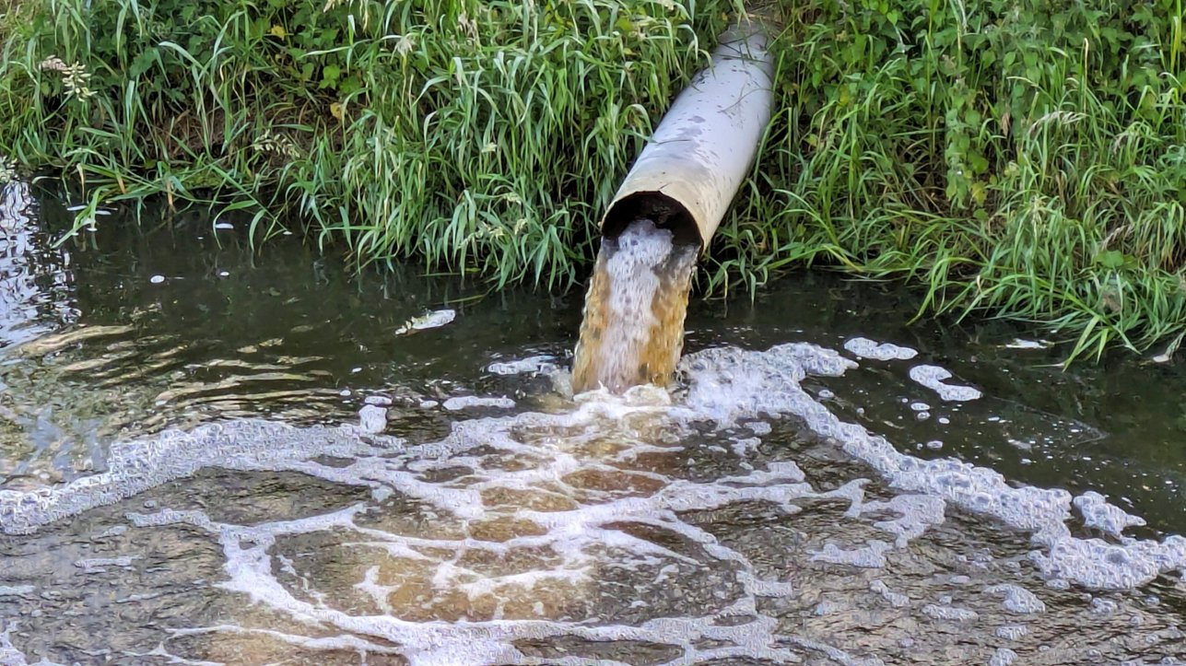
Thank You
I'm excited to bring my environmental data experience
to the Wastewater Solutions team at Southern Water.
17,053
9
2
Excel
Incidents
Analysed
UK Regions
Covered
Datasets
Combined
Primary
Tool Used
Chioma Nnadi | Data Analyst Candidate | Southern Water Interview | 23 February 2026

