Slide 1
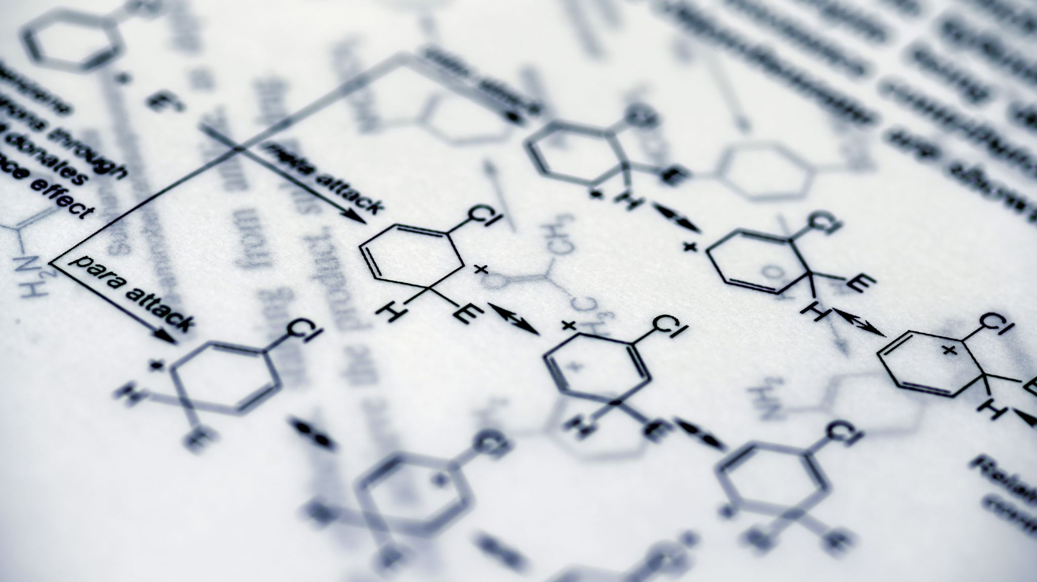
Dissecting Microbial Communities with Single-Cell Transcriptome Analysis
(Adapted from Pountain & Yanai, 2025)

Slide 2
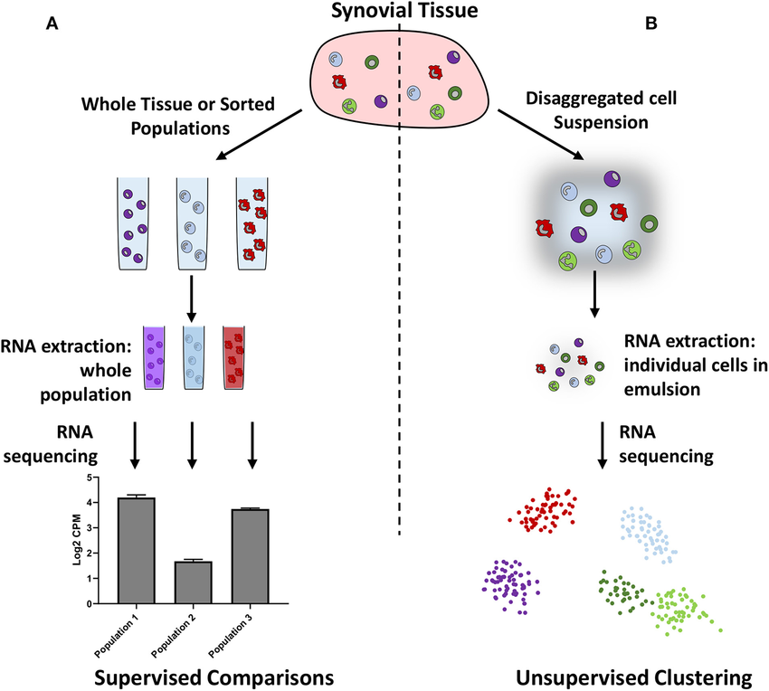
Introduction
Microbes are important for health and metabolism.
Traditional methods of studying microbial communities, like metagenomics and metatranscriptomics, study groups of cells together.
These show only average gene activity and hide differences between individual cells.
Single-cell RNA sequencing (scRNA-seq) shows what each cell is doing, revealing hidden diversity.
Source: (Pountain and Yanai, 2025)
Fig 1: Comparing bulk and scRNA-seq (Carr et al., 2020).

Slide 3
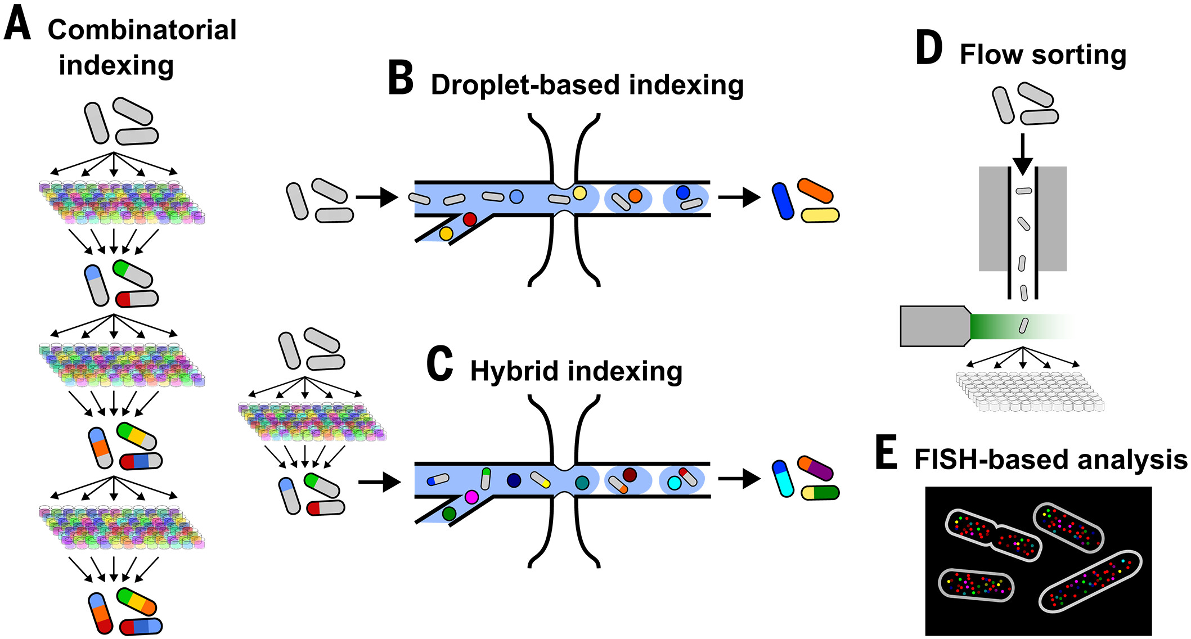
Methods of scRNA-seq
Fig 2: Methods of scRNA-seq (Pountain and Yanai, 2025).
PETRI-seq, microSPLiT, BaSSSH-seq use barcodes to tag cells.
ProBac-seq, smRandom-seq put single cells in tiny droplets.
BacDrop, M3-seq mix plate and droplet methods.
Analysis finds which genes are active in each cell.
Source: (Pountain and Yanai, 2025)

Slide 4
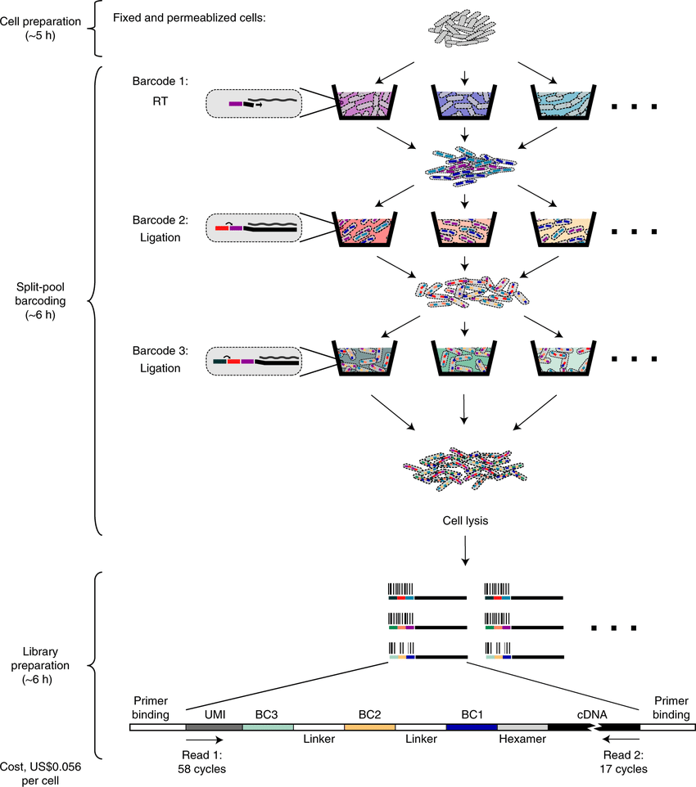
Applications of scRNA-seq
Shows differences between cells in a community.
Finds rare or special types of cells.
Tracks antibiotic resistance and stress responses.
Reveals how microbes work together or divide tasks.
Source: (Pountain and Yanai, 2025)
Fig 3: Overview of PETRI-seq workflow for bacterial single-cell RNA sequencing (Blattman et al., 2020).

Slide 5
Gaps, Challenges & Limitations
Incomplete genome references limit transcript mapping.
Sparse data and dropout events complicate analysis.
Limited integration with spatial, genetic, or metabolic data.
Lack of standardized sample preparation across microbial communities.
Current methods face scalability and reproducibility issues.

Slide 6
Conclusion
References
Blattman, S.B., Jiang, W., Oikonomou, P. and Tavazoie, S. (2020). Prokaryotic single-cell RNA sequencing by in situ combinatorial indexing. Nature Microbiology, [online] 5(10), pp.1192–1201. doi:https://doi.org/10.1038/s41564-020-0729-6.
Carr, H.L., Turner, J.D., Major, T., Scheel-Toellner, D. and Filer, A. (2020). New Developments in Transcriptomic Analysis of Synovial Tissue. Frontiers in Medicine, [online] 7. doi:https://doi.org/10.3389/fmed.2020.00021.
Pountain, A.W. and Yanai, I. (2025). Dissecting microbial communities with single-cell transcriptome analysis. Science, 389(6764). doi:https://doi.org/10.1126/science.adp6252.
Single-cell RNA sequencing reveals differences in microbial activity using various methods, though low RNA content and data noise still challenge full understanding of microbial behavior.

