Slide 1
LLM EXPERIMENTS LAB · NEBIUS SERVERLESS AI BUILDERS CHALLENGE
What if you could pause a language model mid-thought and just... ask it what it is thinking?
Textbook mode
Notebook mode
Diagrams, equations, attention math. You can describe what a loss curve should do. You've never actually watched one move.
A blank Colab cell, a CUDA driver argument, and a GPU bill you didn't plan for — before a single epoch runs.
"For a beginner, the freedom of a notebook can become noise."
There's a big gap between the two. Almost nothing lives in the middle.

Slide 2




THE SOLUTION
LLM Experiments Lab
The guided step between theory and unrestricted code.
No code, just presets
Tiny Transformer, MoE, RNN, High-LR — pick one, tweak sliders, hit Start.
Pause it and ask what it knows
Prompt the partially-trained model mid-run. Resume. Ask again later.
Actually look inside
Attention maps, Q/K/V, top-k logits — a real Inspector, not a black box.
A chatbot that's read your run
Grounded in your config, metrics and logs — not a generic explainer.

Slide 3
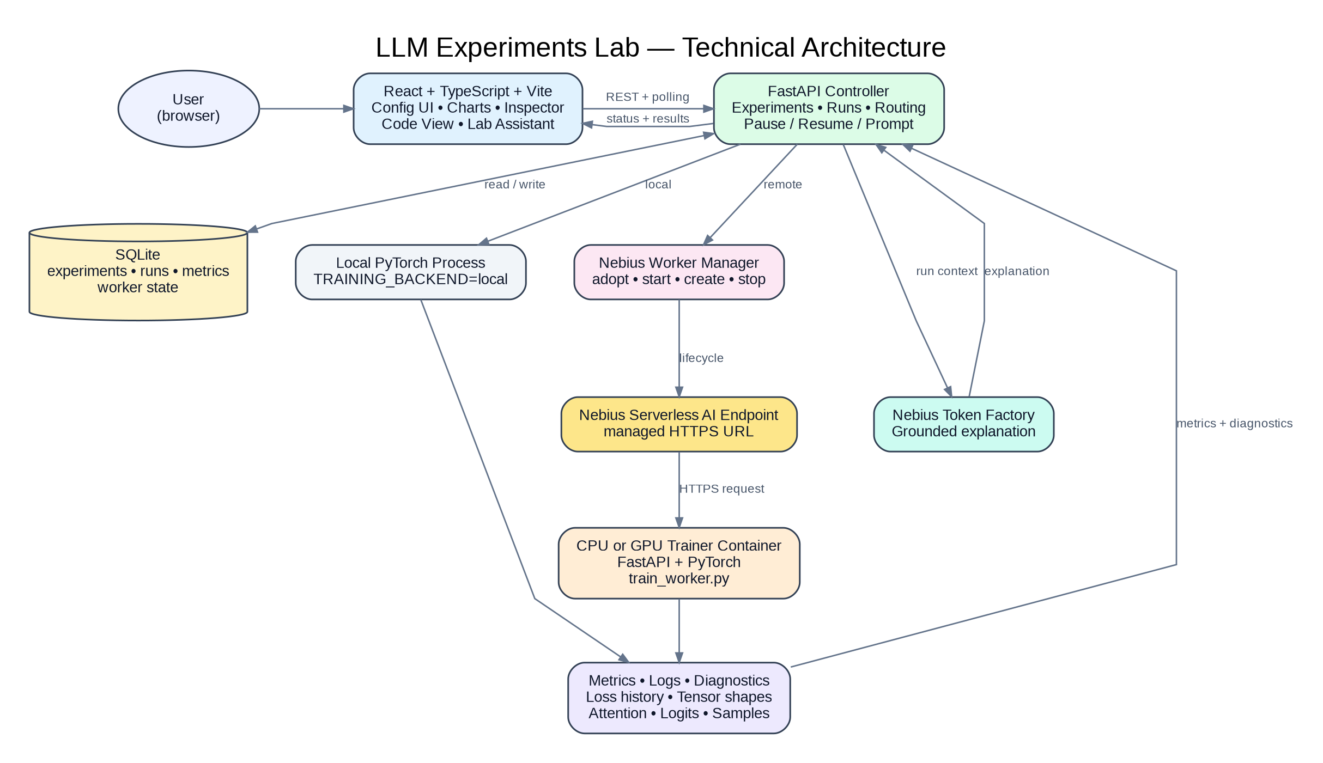
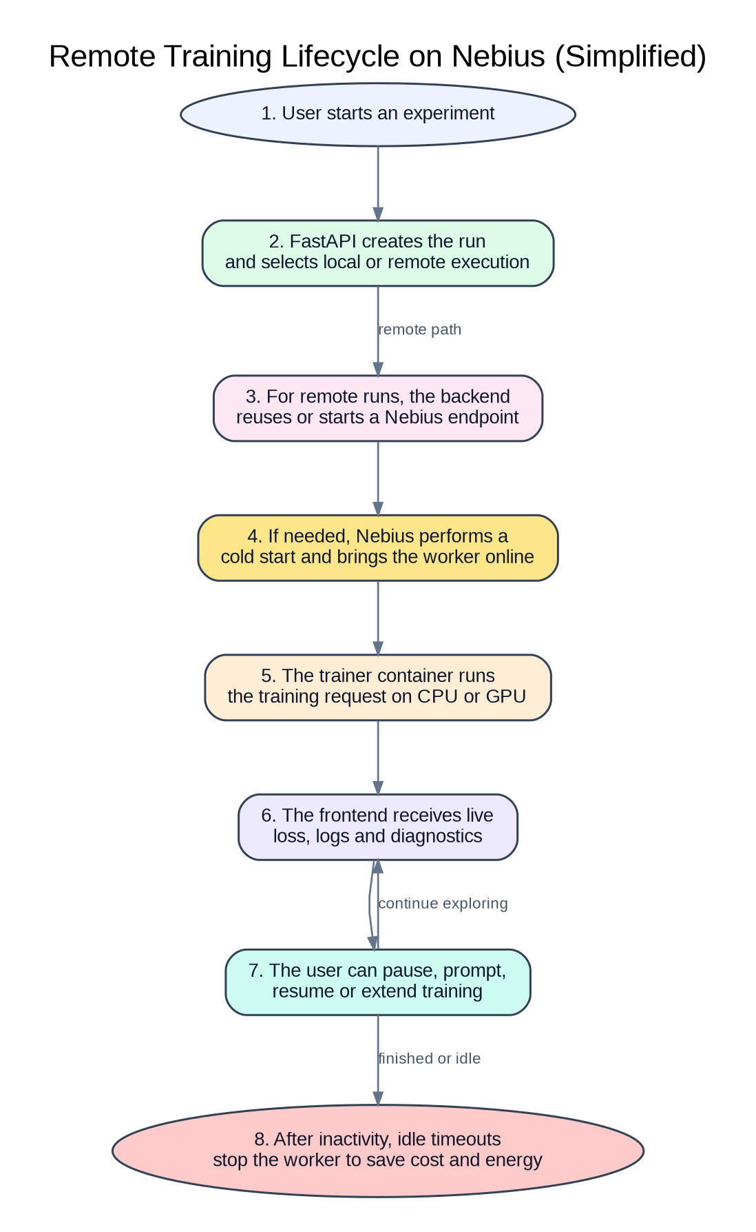
ARCHITECTURE
Three layers. Zero mystery.
FRONTEND
React + Vite, your browser
BACKEND
FastAPI + SQLite, your machine
TRAINER
Local subprocess or Nebius endpoint
Full technical architecture — every component, every connection.
The remote training lifecycle, simplified.

Slide 4





IMPLEMENTATION
The engineering bits nobody sees on the loss chart
What it actually took to make "pause and prompt" feel instant
Subprocess per run
Forward hooks power the Inspector
Idle auto-stop
Real OS-level parallelism — two runs on one box genuinely use two cores, no fighting Python's GIL.
GPU naps after ~10 min idle, CPU after ~30. Nobody's left holding a bill for a machine no one's using.
Shapes, attention, Q/K/V, top-k logits — captured in one clean pass, zero changes to the training code itself.
Split CPU / GPU images
255 tests, one hard rule
Clean, public-ready history
The CPU trainer doesn't have to drag CUDA along for a ride it'll never take.
Every real bug fix: revert it, watch the test fail, put it back, watch it pass. No exceptions.
Full git-history rewrite before open-sourcing — no stray account IDs left for anyone to find.

Slide 5


LEARNINGS & DISCOVERIES
Things that bit us (so they won't bite you)
"It's provisioning" needs a status bar. A 5-minute cold start looks exactly like broken if the UI doesn't say otherwise.
CPU containers don't want CUDA along for the ride. Splitting the trainer image in two fixed it — obvious in hindsight, not obvious at 2am.
One shared endpoint is cheap and simple. It's also a ceiling. Fine for a demo, needs queuing or hardware tiers before real concurrent users.
You can absolutely commit your own cloud account IDs to a public repo. History can be rewritten after the fact — better to just not.
Frontend work eats time if it's not your thing. Let the coding agent drive it — browser tools, Playwright, the works — and start from a working skeleton before bolting on complexity. We only added the trainer/tensor Inspector once the basic dashboard was solid.
"The best way to understand a model is not only to read about it or call its API. It is to change something, predict what will happen, run the experiment, and look inside."

