Slide 1



Stock Price Trend Forecasting App
This application forecasts stock price trends using historical data and various machine learning algorithms.

Slide 2
Problem Statement
The problem statement for this application is to accurately predict the future trend of stock prices based on historical data and patterns. By utilizing machine learning algorithms, the app aims to provide investors with valuable insights and assist them in making informed decisions in the stock market.
Expected Outcomes:
A functional application that fetches, processes, and visualizes stock data.
Accurate stock price forecasts using ARIMA, Linear Regression, and LSTM models.
Clear visualizations that help users understand historical trends and future predictions.
Actionable recommendations to assist users in making informed investment decisions.
Comparative analysis of different forecasting models based on their prediction accuracy.

Slide 3
Historical Data Fetching
User Input
Data Fetching
Data Preprocessing
The user provides stock symbol, start date, and end date for the analysis.
The yfinance library fetches the historical stock data from online sources, such as Yahoo Finance.
The fetched data is cleansed, cleaned, and formatted for subsequent modeling.

Slide 4





Approach
Preprocess Historical Data
The fetched data is cleansed, cleaned, and formatted for subsequent modeling.
Train ML Models
Machine learning algorithms, including ARIMA, Linear Regression, and LSTM models, are trained on the preprocessed historical stock data.
Generate Forecasts
The trained models are utilized to make accurate stock price forecasts.
Visualize Insights
The forecasts are visualized in clear and understandable graphs, allowing users to comprehend historical trends and future predictions.
Provide Recommendations
The application provides actionable recommendations to assist users in making informed investment decisions and conducts comparative analysis of different forecasting models based on their prediction accuracy.

Slide 5

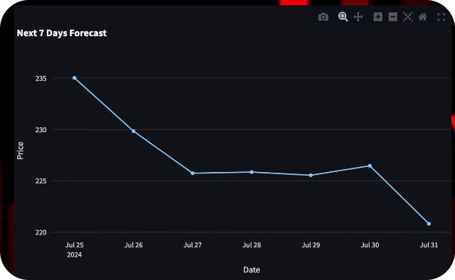
Predictive Modeling
1
ARIMA
2
Linear Regression
An autoregressive integrated moving average model analyzes historical data to predict future price trends.
This model uses a straight line to predict future stock prices based on historical data.
3
LSTM
Long short-term memory networks are a type of recurrent neural network that can capture complex patterns in time series data.

Slide 6

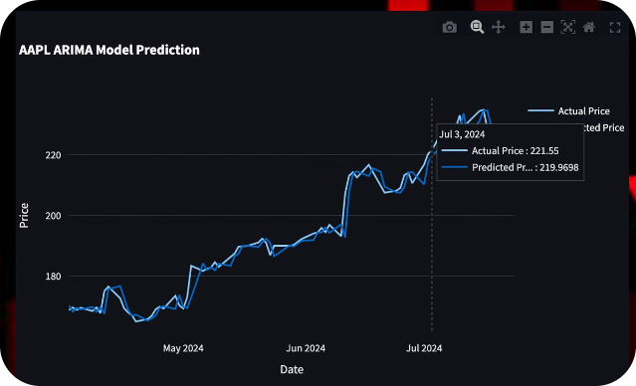
ARIMA Model
1
Stationarity
2
Parameter Estimation
The ARIMA model requires the data to be stationary, meaning the statistical properties of the data are constant over time.
The model learns the best parameters to predict future stock prices based on the historical data.
3
Forecasting
The ARIMA model uses the estimated parameters to forecast stock prices for a given time horizon.

Slide 7

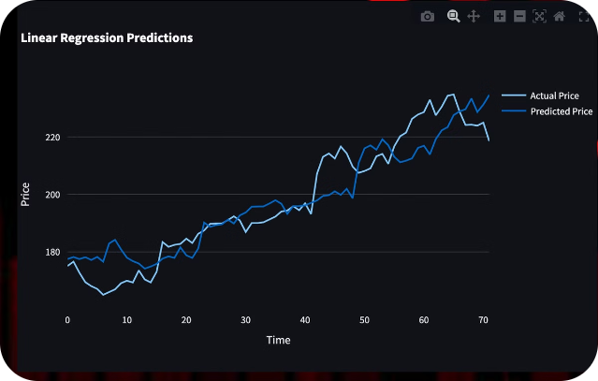
Linear Regression Model
1
Historical Data
The historical data is used to train the model.
2
Linear Relationship
The model seeks a linear relationship between the historical data and the stock price.
3
Price Prediction
The trained model predicts future stock prices using the established linear relationship.

Slide 8


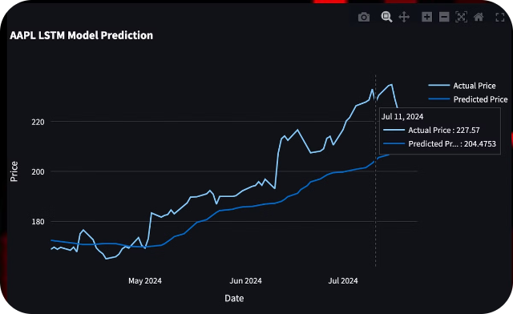


LSTM Model
Input Layer
The model receives the historical stock data as input.
Hidden Layers
LSTM layers learn patterns and dependencies in the historical data.
Output Layer
The output layer produces the predicted stock prices based on the learned patterns.

Slide 9

Unlock the future with our stock price forecasting app
Leverage advanced machine learning to gain accurate insights on future stock prices. With just a few clicks, you'll have the edge in the market.

Slide 10

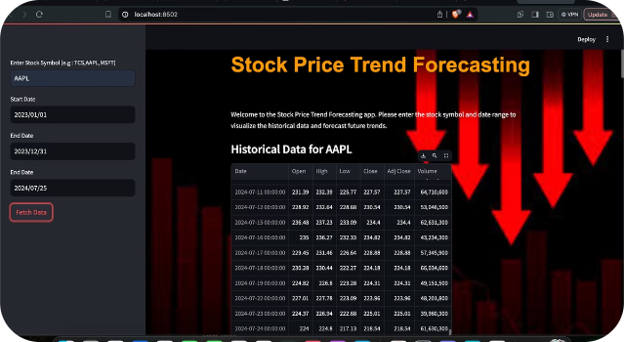
Streamlit App Interface
The Streamlit framework provides an intuitive and easy-to-use interface for users.
Plotly charts provide interactive visualizations of the stock price data.
Users can customize the time horizon, stock symbol, and other parameters for their analysis.

Slide 11
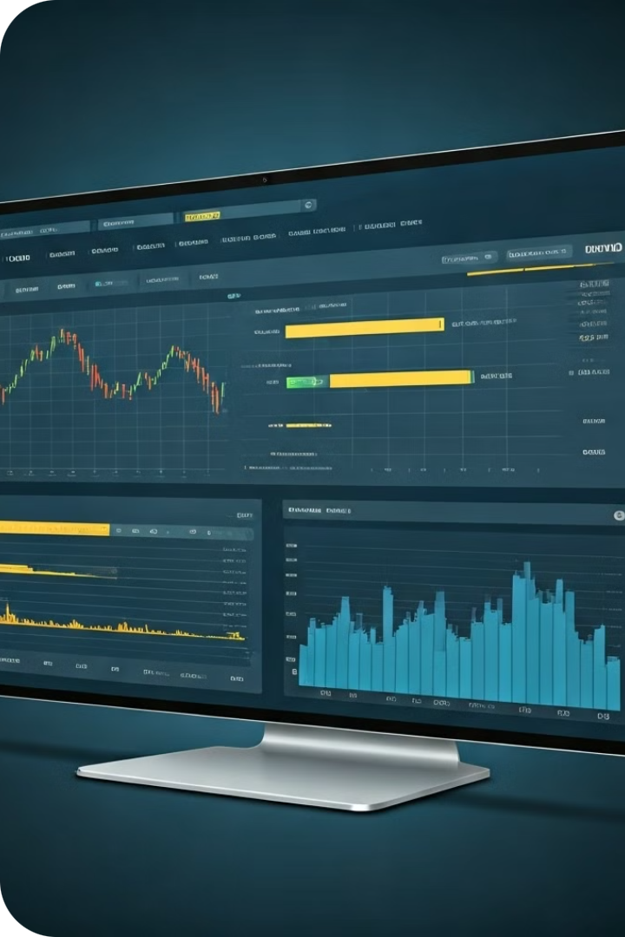
Future Enhancements
One potential enhancement is to analyze news and social media sentiment related to the stock. This could provide insights into market psychology and improve prediction accuracy.
Allowing users to compare different forecasting models side-by-side would help them choose the best approach for their needs.
Integrating real-time data feeds could keep the predictions continuously updated, enabling timely investment decisions.

Slide 12
Conclusion: A Powerful Tool
This stock forecasting app provides investors with a powerful tool for analyzing market trends. By combining advanced machine learning models, the app generates accurate predictions from historical data.
The user-friendly interface allows investors to customize their analysis and quickly visualize insights. With potential enhancements, this tool can revolutionize how investors approach the stock market.
This app empowers everyday investors to make more informed and profitable decisions by harnessing the power of advanced analytics.

