Slide 1
HR Workforce Attrition Dashboard
Overview of employee attrition insights, salary structures and workforce trends.
By Pod Orion

Slide 2
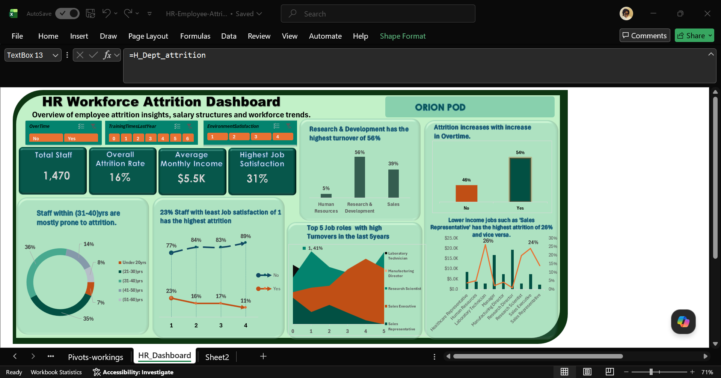

Slide 3
Overall Attrition
16% of employees left the workforce. Retention remains high at 84%.

Slide 4
Attrition by Age Group
Key Insight:
Employees aged 21–40 account for over 70% of attrition.

Slide 5
Attrition by Department
Research & Development contributes the largest share of employee exits.

Slide 6
Attrition by Job Role
Key Insight:
Laboratory Technicians, Research Scientist and Sales Executives show the highest attrition rates due to lower incomes, etc.

Slide 7
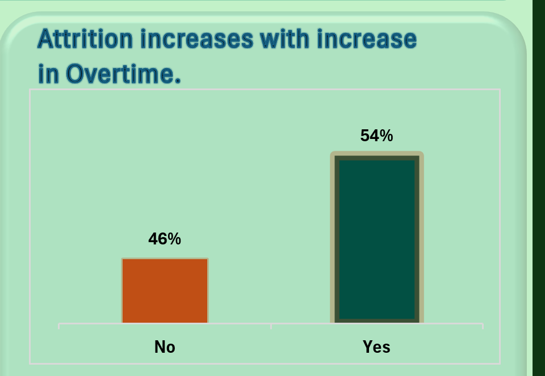
Overtime Impact
Key Insight:
Employees working overtime are more likely to leave, indicating workload pressure.

Slide 8
Key Recommendations
Reduce excessive overtime, improve working environment and work-life balance to minimise employee burnout and turnover.
Focus retention efforts on employees aged 21–40 and high-attrition departments such as Research & Development and Sales through targeted engagements .
Invest in career development/trainings, and competitive monthly income to improve employee satisfaction and long-term retention.

