Slide 1
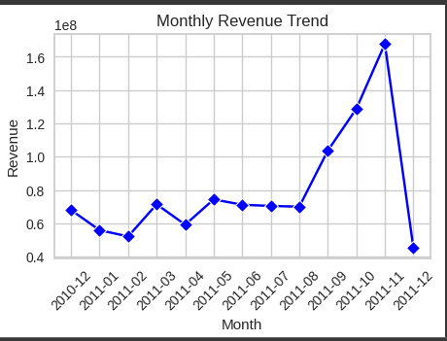
Cohort Analysis
Deliverables
By Nneoma Joyce Ikechukwu

Slide 2
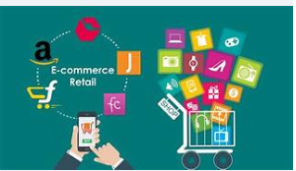
The Business
E-shop Pro is a global online retailer offering a diverse portfolio of products. Over the past five years, the company has achieved consistent annual growth of 30% in its user base. Since introducing its loyalty program, E-shop Pro has retained 80% of its VIP customers within the first two years of implementation.

Slide 3
Business Problem
Despite this growth, the company is currently facing several challenges:
Decline in overall sales
Decreasing repeat purchase rate
Increasing customer churn
Low customer engagement
Addressing these issues is critical to sustaining the company’s growth trajectory and maintaining competitiveness in the online retail sector.

Slide 4
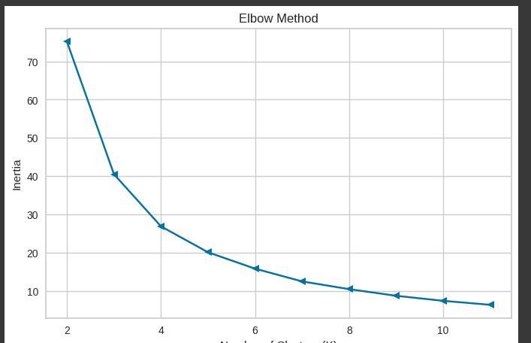
Aim of the Project
The primary aim of this project is to improve E-shop Pro’s customer retention rate.

Slide 5
Cohort Analysis
Cohort analysis provides a powerful framework for tackling these challenges by segmenting customers into groups with shared characteristics and tracking their behavior over time. This approach enables the business to:
Identify trends in customer retention and disengagement
Pinpoint when customers are most likely to churn
Implement timely interventions to improve loyalty and repeat purchases

Slide 6
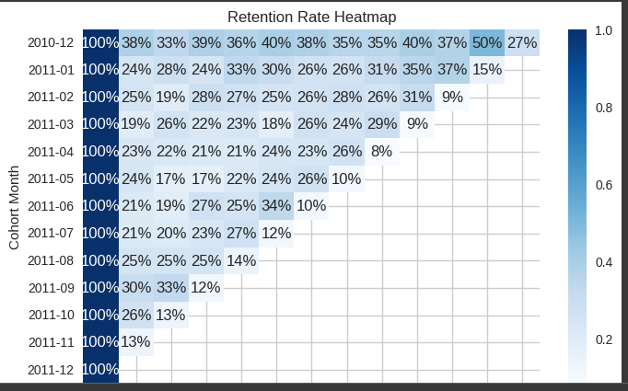
Cohort
Customers were grouped by their first month of purchase.
A cohort index was created to track the number of months since each customer’s initial transaction.
Cohort pivot tables were used to measure the percentage decline in customer activity following their first purchase.
Heatmaps were developed to visualize the retention decline over time.

Slide 7
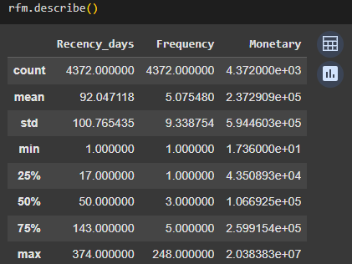
RFM Analysis
Customers were analyzed based on Recency, Frequency, and Monetary value.
RFM grouping provided insights into average, minimum, maximum, and distributional statistics for each cohort.
These insights were further used to classify customers into meaningful retention segments.
Clustering
K-means clustering was applied to segment customers into distinct groups based on their RFM profiles.
This segmentation highlighted patterns of high-value, loyal, at-risk, and disengaged customers.

Slide 8
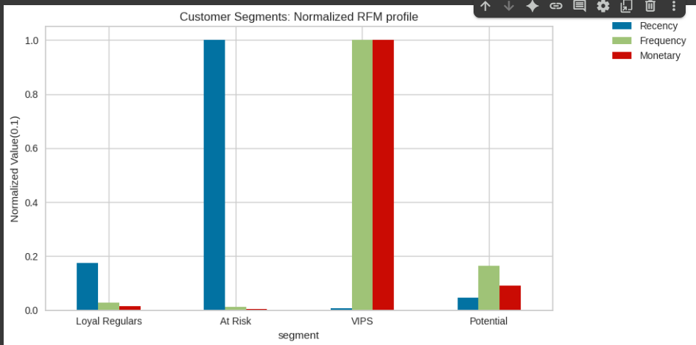
Clusters
Loyal Regulars: Customers who visit consistently but tend to make smaller purchases.
At Risk: Customers with infrequent visits and low-value purchases.
VIPS: High-value customers who visit frequently and make substantial purchases.
Potential: Customers who demonstrate regular activity but have untapped potential to increase their purchase value.

Slide 9
Steps for Improving Customer Retention
LOYAL REGULARS
Upselling & Cross-Selling → Suggest complementary or higher-value products.
Personalized Offers → Provide bundle deals or discounts on premium items to encourage higher spend.
Loyalty Program Enhancement → Reward frequent visits with tiered benefits that incentivize bigger purchases.
Customer Feedback → Collect insights on why spending is low (e.g., product fit, pricing).

Slide 10
At risk
Targeted reactivation → campaigns to regain their engagement.
Win-Back Campaigns → Send personalized reactivation emails or SMS with limited-time offers.
Targeted Discounts → Provide attractive deals on their preferred products.
Engagement Triggers → Use reminders (e.g., “We miss you” campaigns, product restock alerts).
Remove Friction → Analyze barriers (delivery cost, website usability, service experience) that might discourage return.

Slide 11
Vip’s
Exclusive Rewards → Give early access to new products, VIP-only discounts, or premium services.
Personalized Experiences → Offer tailored recommendations, concierge-level support, or birthday/anniversary perks.
Recognition Programs → Highlight them as valued customers (e.g., “Gold” or “Platinum” tier).
Retention First → Focus on keeping them engaged rather than discounting too heavily (profitability focus).
Prioritized and personalized rewards → exclusive offers, and recognition programs.

Slide 12
potential
Targeted Upsell Campaigns → Recommend higher-value items based on browsing/purchase history.
Incentivized Upgrades → Provide rewards when they cross spending thresholds
Education & Awareness → Showcase product benefits they may not know about (tutorials, newsletters).
Behavior Nudges → Use personalized reminders (“Only 1 left in stock,” “Customers like you also bought…”).
Tailored incentives and engagement strategies → They can be developed into loyal or VIP customers.

Slide 13
THANK YOU!!!

