Slide 1
QMPI Interface Design
Tommy

Slide 2
Structure
Point Communication
Collective Communication
User Code (tests)
User Code (tests)
Convert.py
MPI_collective.py
MPI.py
MPI.py

Slide 3
Convert.py
Objective: Transform quantum circuit into one that uses quantum teleportation between nodes
Assumptions:
User has to define the quantum nodes via quantum registers
Each node must have extra space for 2 EPR qubits and one classical bit (buffer)
Procedure
Decompose circuit into single qubit gates + cx gates
Add EPR qubits and classical bits to each node (buffer)
For every cx gate on different nodes, replace cx with quantum teleportation defined in MPI.py

Slide 4
MPI.py
Objective: A class EPRsetup that handles quantum teleportation with EPR pairs
Parameters: (q, srcBit, destBit)
q is the quantum circuit
srcBit is the source bit to teleport from
destBit is the destination bit to teleport to
Assumptions:
EPR pairs + classical bits already allocated as different registers
Function:
Implements tp_comm version of send, cnot, receive, and unsend between different nodes
Makes EPR pairs between different nodes when needed (can be specified later depending on hardware)

Slide 5
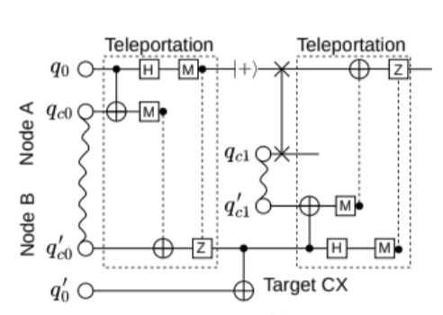
Send and Receive
Receive – once I measure the classical bits and send it to the other node is how I define receive
Send
Unsend
cnot

Slide 6
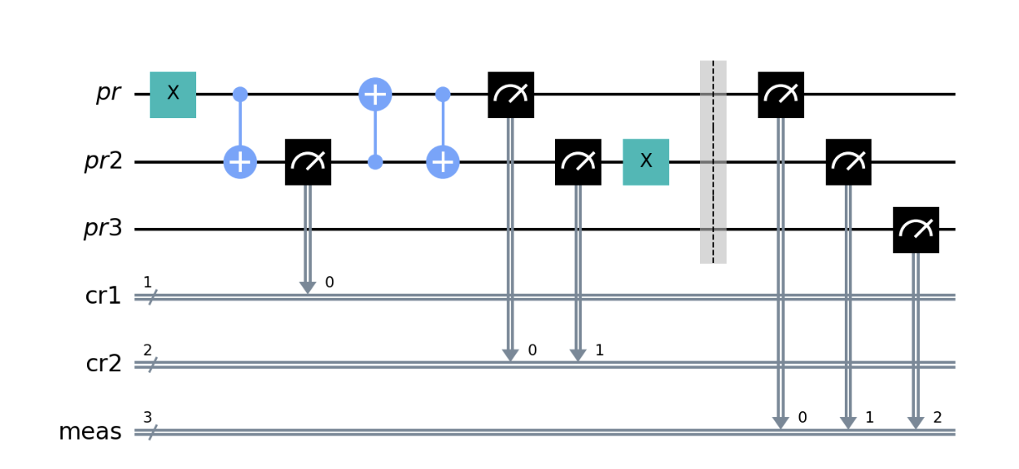
Tests – OPENQASM benchmark
Adder
Basis Change
Deutsch
Error Correction
Grover
My own personal tests:
All passed!

Slide 7
MPI_collective.py
Objective: CollectiveMPI class that implement the collective operations defined in classical MPI
Assumptions:
User has to define the quantum nodes via quantum registers
Each node must have extra space for 2 EPR qubits and one classical bit (buffer)
Initialize: Takes in a quantum circuit and adds a 2-qubit EPR register to each quantum node
Methods: broadcast , scatter, gather, allGather, reduce, allReduce, alltoall

Slide 8
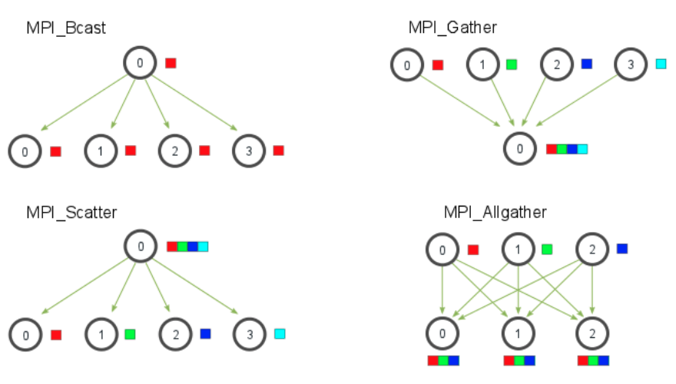
Collective Operations
Broadcast (arr) – first index in arr is qubit to broadcast
Gather(arr, qubits) - inverse of scatter
2
1
2
Scatter(qubits, arr) – send qubits to arr element wise
Allgather(qubits, arrs) - uses broadcast)

Slide 9
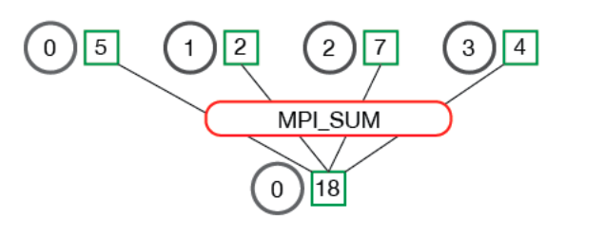
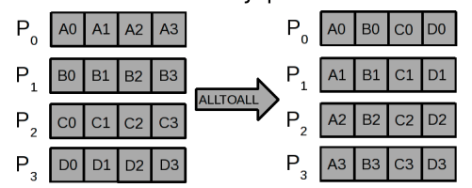
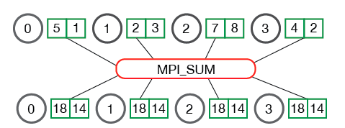
Collective Operations con.
Reduce(arr, qubits, gates) – qubits must be size 2 where first qubit is qubit to apply gates on sequentially and second one is destination for teleportation. Gates is a quantum circuit between two qubits
Alltoall(qubits, arrs) – uses scatter to scatter qubits into arrs
Gates
Allreduce(arr, qubits, gates) – reduce then broadcast and qubits is a list to broadcast too
Gates

Slide 10
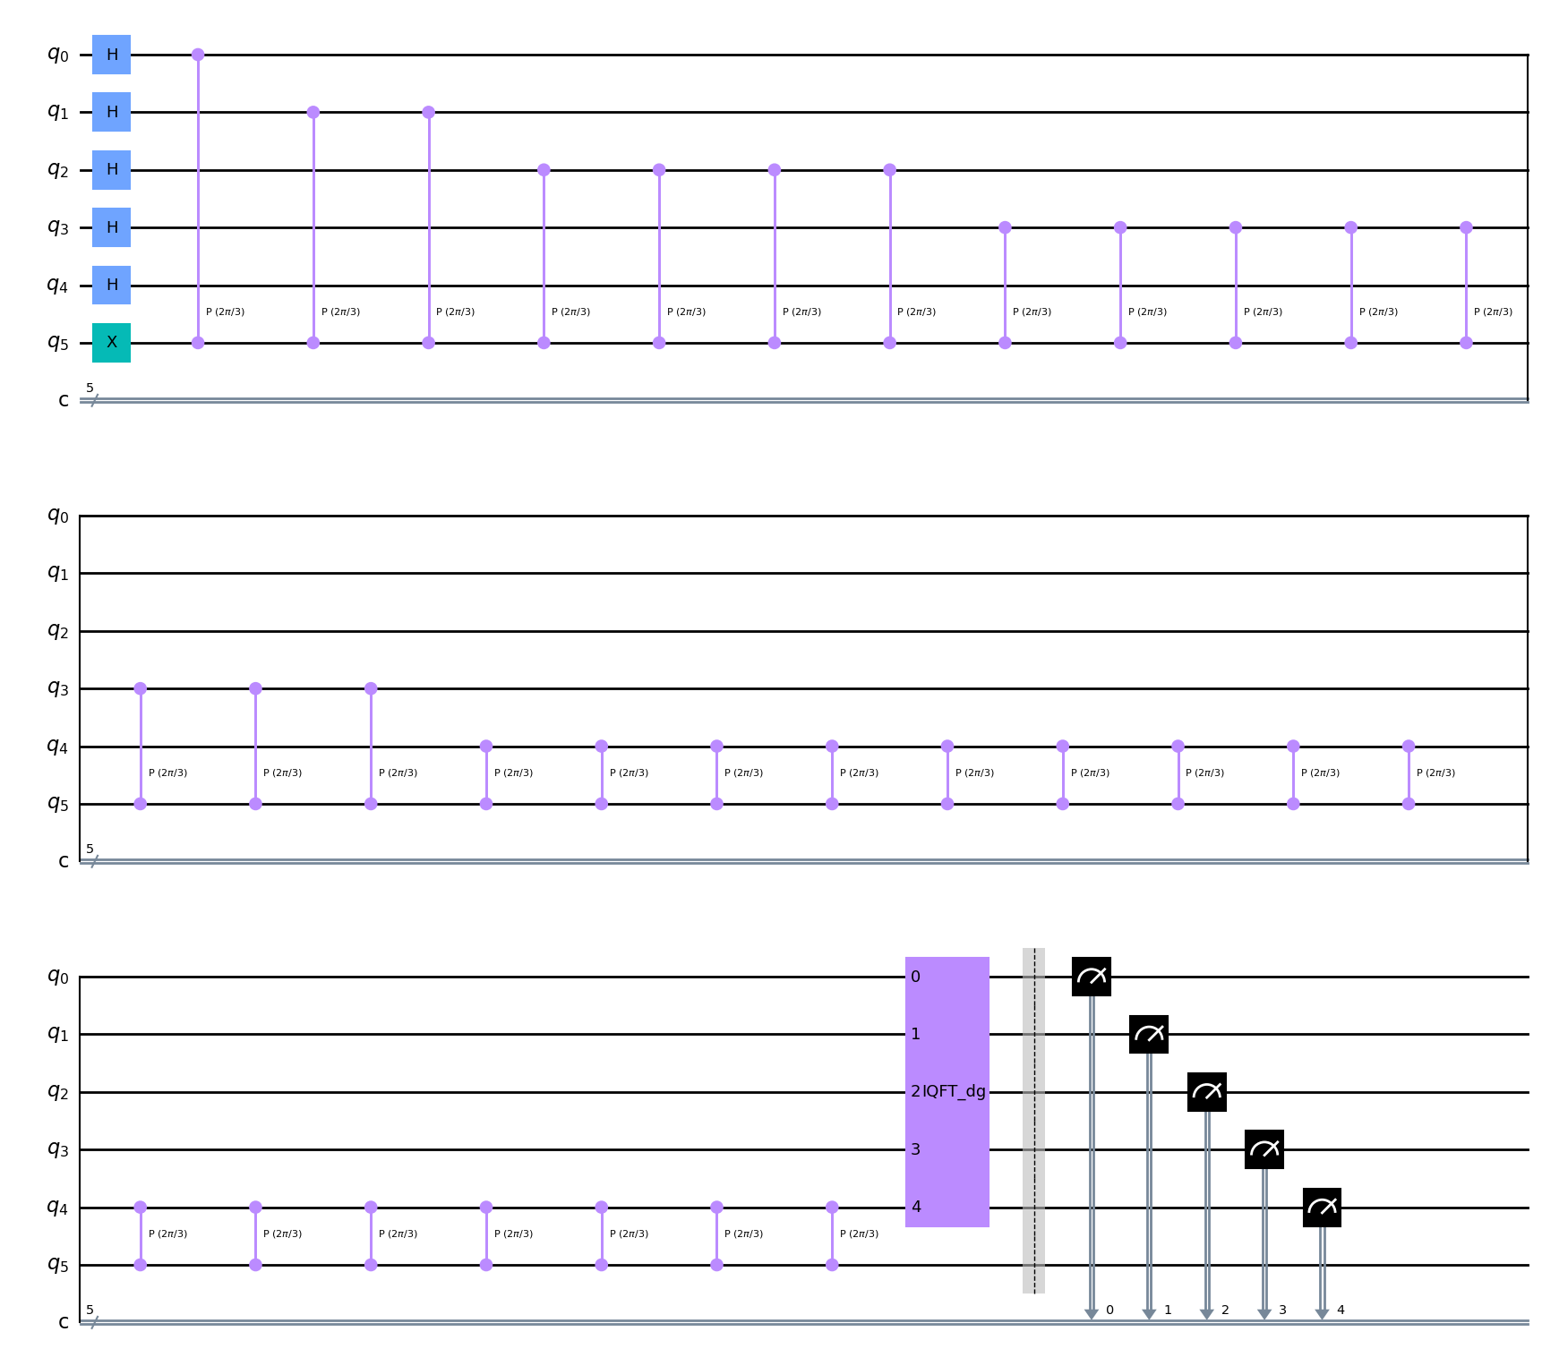
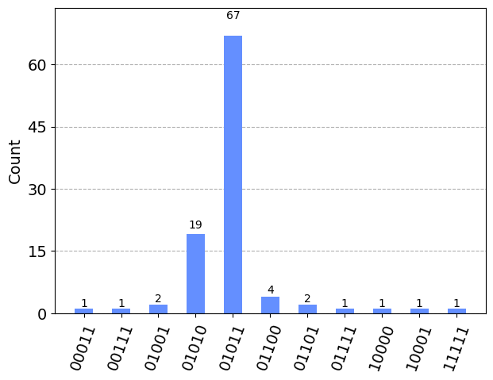
Test of Gather- Quantum Phase Estimation
Works!
Gather into last qubit

Slide 11

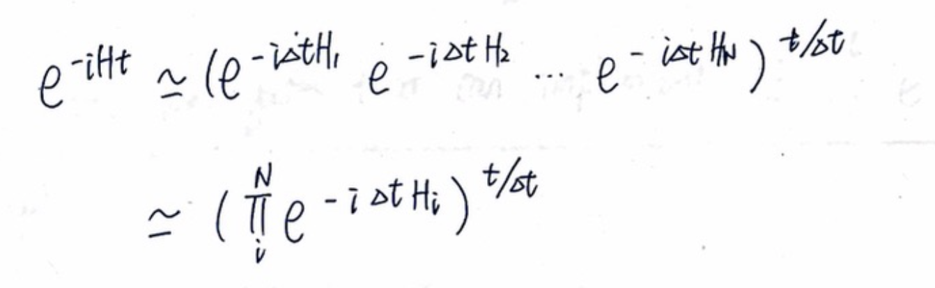
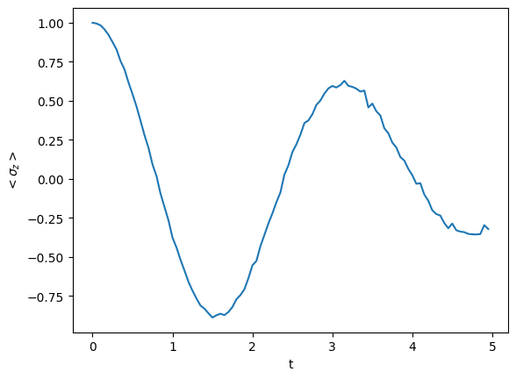
Test of Broadcast – Trotterization of Transverse Ising Model
Idea
Broadcast into different nodes and split the trotterization between nodes
Reduction in time by number of nodes

Slide 12
Test of Reduce – compute Parity

