Slide 1

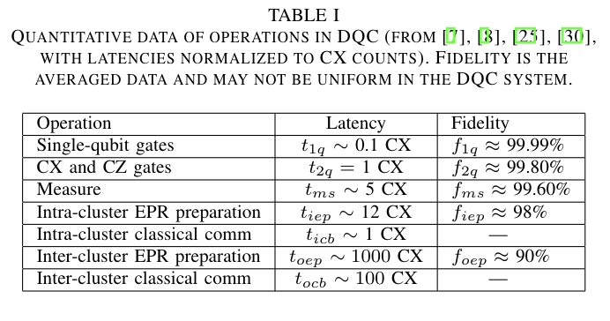
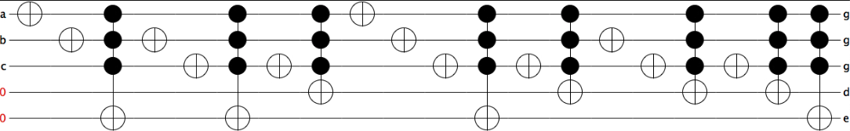
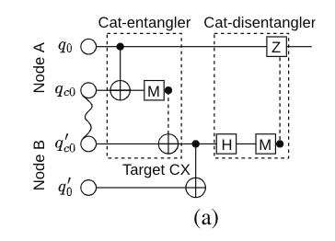
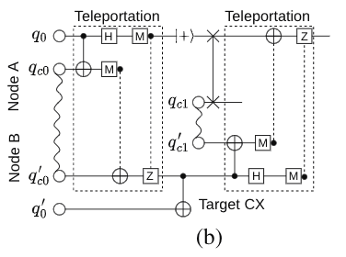
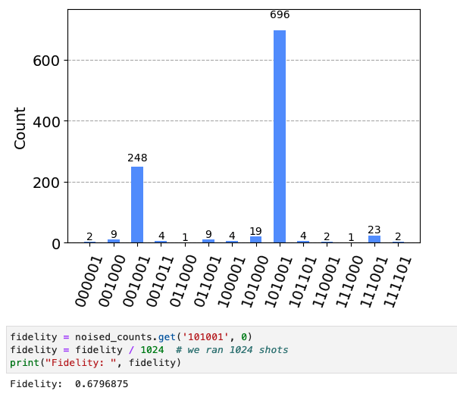
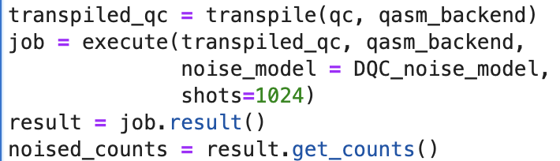
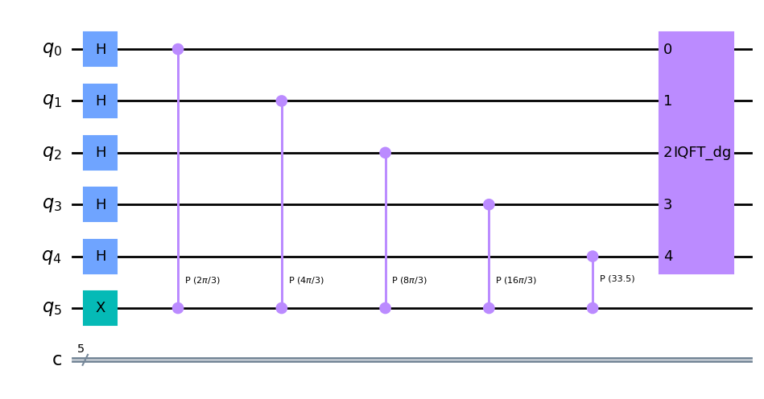
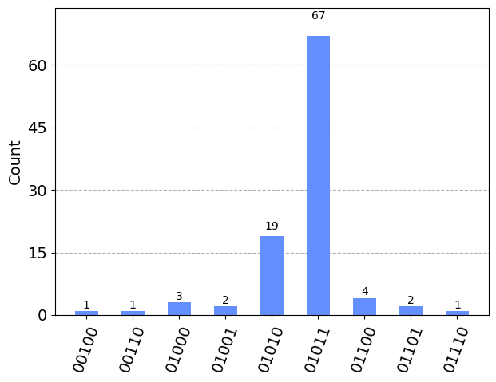
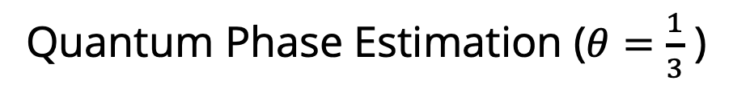
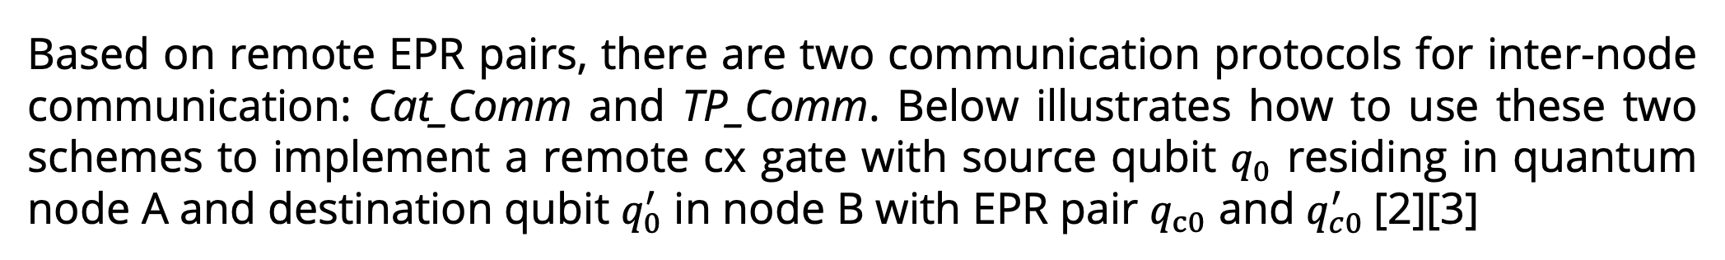
EE 522 Capstone: A Reference Implementation for a Quantum Message Passing Interface (QMPI)
STUDENTS: Yue Shi, Tommy Nguyen
Distributed Quantum Computing & Quantum MPI
A Strategy for improving Collective Communication Efficiency
Scalability: Distributed Quantum Computing and QMPI can be used to connect multiple quantum processors to overcome the difficulty of finite qubit resources, especially in the NISQ era where noise is correlated with qubit number
Interoperability: QMPI is an important step for creating a standard communication protocol between different quantum computers. This ensures interoperability between quantum devices from different hardware, just as MPI does for classical computers. This is vital in developing a global quantum internet, where quantum computers can communicate and collaborate effectively
Quantum Advantage: Distributed Quantum Computing and QMPI are crucial for harnessing the full potential of quantum computers. By distributing quantum resources, latency can be increased for complex computations, thereby enhancing the quantum advantage
On top of the Auto_Comm and Coll_Comm frameworks [2][3], we develop a new strategy for quantum circuits with MCT (multi-controlled Toffoli) gates. This can reduce resource consumption and improve the fidelity of collective communication in distributed quantum systems.
Circuits with MCT gates
Decompose MCT gates with qubits distributed
Check the internode communication distribution
Allocate the buffer qubits to each nodes
Execute computation on DQC with help of buffers
Iteratively search the single qubit gates between
Move it backward using gates commutation rule
Avoid internode communication back forth
Multi-Controlled Toffoli (MCT) Experimental Setup
Quantum Message Passing Interface (QMPI)
Platform: simulations implemented on QASM simulator
Benchmark circuit: Function rd32 circuit imported from RevLib (as shown below) [4]
Noise model: Built according to the parameters in the Coll_Comm paper [3]
Baseline: Coll_Comm DQC compiler
[2]
The QMPI is a communication framework for distributed quantum computation inspired by the classical MPI used in high-performance classical computing. We have developed the QMPI framework in Qiskit and built an API for users
Point to Point Communication
Metrics: total number of consumed EPR pairs and fidelity of computation
[4]
Based on remote EPR pairs, there are two communication protocols for inter-node communication: Cat_Comm and TP_Comm. Below illustrates how to use these two schemes to implement a remote cx gate with source qubit $q_{0}$ residing in quantum node A and destination qubit $q_{0}^{′}$ in node B with EPR pair $q_{c0}$ and $q_{c0}^{′}$[2][3]
[2]
[2]
Simulation Results
Our MCT technique produces the correct result with 68% fidelity when simulating the benchmark circuit and uses 5 EPR pairs. The fidelity greatly improved over the baseline (44%), and the usage of remote EPR pairs significantly decreased.
The MCT strategy works for other quantum circuits with MCT gates with improvements on the distributed quantum system.
We implemented Quantum Phase Estimation with Gather and the trotterization of the Transverse Ising Model with Scatter to test our QMPI framework
a)
Cat_Comm
TP_Comm
Send and unsend are implemented with TP_Comm using 2 buffered EPR pairs for each node
Receive is implemented using feedback from the classical measurements in TP_Comm for blocking functionality
We designed an interface to replace any quantum circuit with remote multi-qubit gates into one that uses QMPI’s point to point communication
b)
 | Remote EPR pair cost | Fidelity
Using buffers | 14 | 0.442
Optimized | 5 | 0.680
metrics
methods
Collective Communication
Quantum Phase Estimation ($θ=\frac{1}{3}$ )
Broadcast
Gather
Scatter
Allgather
Gather into last Quantum Node
(0.313)
(0.344)
Future Work, References, and Acknowledgments
Reduce
Allreduce
Develop a compiler combining our MCT strategy with the QMPI framework
Implement more applications within the QMPI framework and MCT and compare fidelities, latencies, and # of EPR pairs
Further optimizations using strategies within Auto_Comm and Coll_Comm that would be automatic within QMPI
Generalize QMPI for quantum architectures that doesn’t assume all-to-all connectivity
We acknowledge
Advisor: Ang Li, Samuel Stein, Tim Stavenger, Marvin Warner (PNNL), Martin Roetteler (Microsoft)
Faculty: Sara Mouradian, Peter Pauzaiskie (UW)
for their kind help in this project.
References:
[1] Thomas Haner et. al., Distributed quantum computing with QMPI. Proceedings of international conference for high performance computing, network, storage and analysis. November 2021, No.16.
[2] Anbang Wu et. al., AutoComm: A Framework for enabling efficient communication in distributed quantum program. 55th IEEE/ACM International Symposium on Microarchitecture (MICRO), Chicago, IL, USA, 2022, pp. 1027-1041.
[3] Anbang Wu et. al., CollComm: Enabling efficient collective quantum communication based on EPR buffering. arXiv: 2208.06724v2
[4] https://www.revlib.org
Gates
Gates
Potential Applications:
Transverse Ising Model – Broadcast, Scatter
Quantum Phase Estimation – Reduce/Gather
Quantum Key Distribution – Allgather
VQE/QAOA – Scatter, Reduce
Quantum Arithmetic – Allreduce
ADVISERS: Ang Li, Samuel Stein, Tim Stavenger, Marvin Warner (PNNL); Martin Roetteler (Microsoft)
SPONSOR: ELECTRICAL & COMPUTER ENGINEERING DEPARTMENT, UNIVERSITY OF WASHINGTON
Notes:
Vertical Example

