Slide 1
EIE4113 Wireless and Mobile Systems
Routing Algorithm
Week 6
Prof. Liu Liang

Slide 2



Routing is Necessary for Wireless Network
When the transmitter and receiver are not in the same cell, base stations should talk with each other
Base stations are connected by fiber cables (backhaul network)

Slide 3
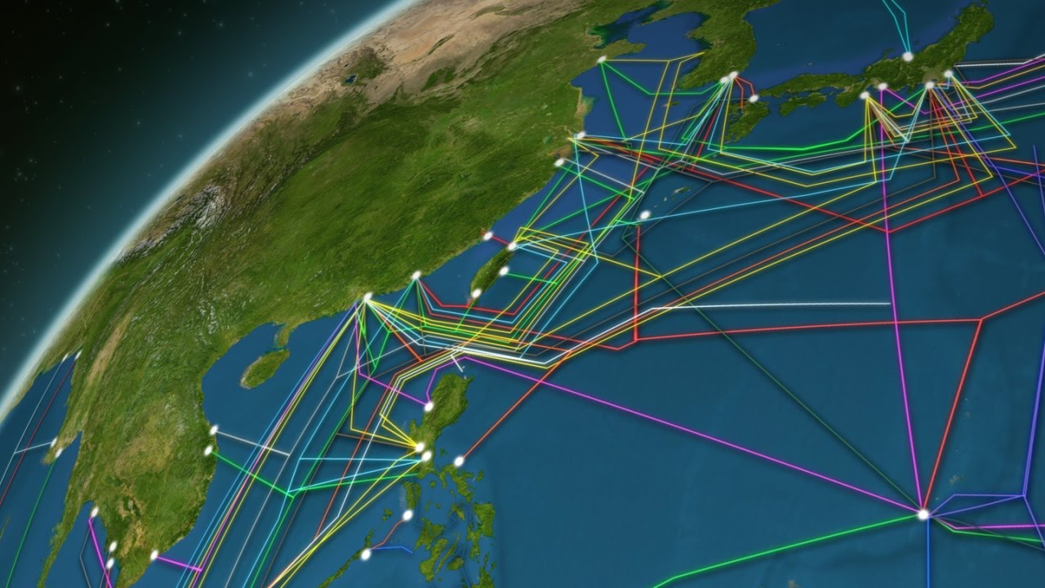
Routing is Necessary for Wireless Network
When you are at Hong Kong, and your friend is at London
Your signal is sent to a base station
Signal is then routed to London, and then a base station there serves your friend

Slide 4
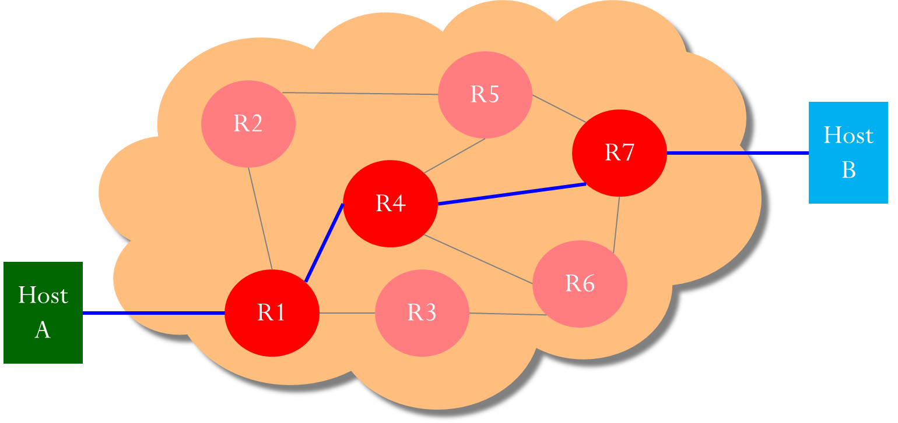
Routing in Fiber Network
When transmitter and receiver is connected via a lot of routers, it is hard to find a good routing strategy

Slide 5
Routing in Fiber Network
When transmitter and receiver is connected via a lot of routers, it is hard to find a good routing strategy

Slide 6
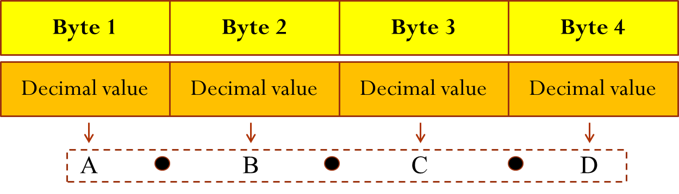
IP Address
IP addresses are 32-bit long, usually expressed in the dotted-decimal notation A.B.C.D
Example: 152.123.1.2
10011000 10000100 00000001 00000010

Slide 7
















Routing protocols
mobile network
Routing protocol goal: determine “good” paths (equivalently, routes), from sending hosts to receiving host, through network of routers
path: sequence of routers packets traverse from given initial source host to final destination host
“good”: least “cost”, “fastest”, “least congested”
routing: a “top-10” networking challenge!
national or global ISP
application
transport
network
link
physical
network
link
physical
network
link
physical
network
link
physical
network
link
physical
network
link
physical
datacenter
network
application
transport
network
link
physical
enterprise
network

Slide 8

Routing tables
Within each router, there is a routing table specifying how to route packets to the destination.
The rules that used to build a routing table is called a routing algorithm.
Example:
Destination: IP address of final destination
Outgoing interface: index
Gateway: IP address of next hop
Destination (IP) | Gateway (IP) | Interface (Index)
IP of Network B
IP of B’s Interface 4
1
IP of Network C
IP of C’s Interface 1
2
Each interface: 1 IP address
A
1 2 3 4
B
1 2 3 4
1 2 3 4
C

Slide 9


Routing example
Two networks are connected through three routers
154.207.0.1
154.207.0.5
Interface 1
Interface 3
154.207.0.2
Interface 2
Interface 7
154.207.0.3
158.132.0.1
158.147.0.1
Interface 1
Interface 4
158.132.148.111
158.147.103.222
A
B

Slide 10
Routing example
Network Destination | Gateway | Interface
158.147.0.0 | 154.207.0.3 | 3
158.132.0.0 | 154.207.0.2 | 1
Routing table at each router
Network Destination | Gateway | Interface
158.147.0.0 | 154.207.0.1 | 2
158.132.0.0 | Directly | 1
154.207.0.1
154.207.0.5
Network Destination | Gateway | Interface
158.147.0.0 | Directly | 4
158.132.0.0 | 154.207.0.5 | 7
Interface 1
Interface 3
154.207.0.2
Interface 2
Interface 7
154.207.0.3
158.132.0.1
158.147.0.1
Interface 1
Interface 4
158.132.148.111
158.147.103.222
A
B

Slide 11
Routing example
Host A to Host B - IP and Ethernet Addresses
Network Destination | Gateway | Interface
158.147.0.0 | 154.207.0.1 | 2
158.132.0.0 | Directly | 1
154.207.0.1
154.207.0.5
Interface 1
Interface 3
154.207.0.2
Interface 2
Interface 7
154.207.0.3
158.132.0.1
158.147.0.1
Interface 1
Interface 4
158.132.148.111
158.147.103.222
Destination IP: 158.147.103.222
A
Ethernet Frame
B

Slide 12
Routing example
Network Destination | Gateway | Interface
158.147.0.0 | 154.207.0.3 | 3
158.132.0.0 | 154.207.0.2 | 1
Host A to Host B (cont’d) - IP and Ethernet Addresses
154.207.0.1
154.207.0.5
Interface 1
Interface 3
154.207.0.2
Interface 2
Interface 7
154.207.0.3
158.132.0.1
158.147.0.1
Interface 1
Interface 4
158.132.148.111
158.147.103.222
Destination IP: 158.147.103.222
A
Ethernet Frame
B

Slide 13
Routing example
Host A to Host B (cont’d) - IP and Ethernet Addresses
Network Destination | Gateway | Interface
158.147.0.0 | Directly | 4
158.132.0.0 | 154.207.0.5 | 7
154.207.0.1
154.207.0.5
Interface 1
Interface 3
154.207.0.2
Interface 2
Interface 7
154.207.0.3
158.132.0.1
158.147.0.1
Interface 1
Interface 4
158.132.148.111
158.147.103.222
Destination IP: 158.147.103.222
A
Ethernet Frame
B

Slide 14
Routing example
Host A to Host B (cont’d) - IP and Ethernet Addresses
154.207.0.1
154.207.0.5
Interface 1
Interface 3
154.207.0.2
Interface 2
Interface 7
154.207.0.3
158.132.0.1
158.147.0.1
Interface 1
Interface 4
158.132.148.111
158.147.103.222
Destination IP: 158.147.103.222
A
Ethernet Frame
B

Slide 15
Graph abstraction: link costs
5
c_{a,b}: cost of direct link connecting a and b
e.g., c_{w,z} = 5, c_{u,z} = ∞
cost defined by network operator: could always be 1, or inversely related to bandwidth, or related to congestion
v
3
w
2
5
u
2
1
z
3
1
2
x
y
1
graph: G = (N,E)
N (node): set of routers = { u, v, w, x, y, z }
E (edge): set of links ={ (u,v), (u,x), (u,w), (v,x), (v,w), (x,w), (x,y), (w,y), (w,z), (y,z) }

Slide 16
Dijkstra’s link-state routing algorithm
centralized: network topology, link costs known to all nodes
accomplished via “link state broadcast”
all nodes have same info
computes least cost paths from one node (“source”) to all other nodes
gives forwarding table for that node
iterative: after k iterations, know least cost path to k destinations
notation
c_{a,b}: direct link cost from node a to b; = ∞ if not direct neighbors
D(b): current estimate of cost of least-cost-path from source to destination b
p(b): predecessor node along path from source to b
N': set of nodes whose least-cost-path definitively known

Slide 17
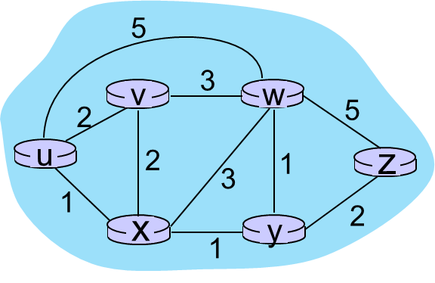
Dijkstra’s link-state routing algorithm
1 Initialization:
2 N' = {u} /* compute least cost path from u to all other nodes */
3 for all nodes b
4 if b adjacent to u /* u initially knows direct-path-cost only to direct neighbors */
5 then D(b) = c_{u,b} /* but may not be minimum cost! */
6 else D(b) = ∞
7
8 Loop
9
10
11
12
13
14
15 until all nodes in N'
find a not in N' such that D(a) is a minimum
add a to N'
update D(b) for all b adjacent to a and not in N' :
D(b) = min ( D(b), D(a) + c_{a,b} )
/* new least-path-cost to b is either old least-cost-path to b or known
least-cost-path to a plus direct-cost from a to b */

Slide 18
Dijkstra’s algorithm: an example
v
w
x
y
z
Step
0
1
2
3
4
5
N'
D(v),p(v)
D(w),p(w)
D(x),p(x)
D(y),p(y)
D(z),p(z)
u
2,u
5,u
1,u
∞
∞
one-hop cost
why?
ux
2,u
4,x
2,x
∞
one-hop and two-hop cost
uxy
2,u
3,y
4,y
uxyv
3,y
4,y
D(w),p(w)
5,u
4,x
3,y
3,y
uxyvw
4,y
uxyvwz
Initialization (step 0): For all a: if a adjacent to then D(a) = c_{u,a}
5
find a not in N' such that D(a) is a minimum
add a to N'
update D(b) for all b adjacent to a and not in N' :
D(b) = min ( D(b), D(a) + c_{a,b} )
v
3
w
2
5
u
2
1
z
3
1
2
x
y
1
Other than u and x, the one-hop and two-hop costs to other routers are always equal to or larger than 2 (the minimum one-hop and two-hop cost). Hence, it is not possible to find better path to y via the other routers.
Is it possible to visit v, w, y, or z with lower cost in two hops via x?

Slide 19
Dijkstra’s algorithm: an example
5
v
3
w
2
5
u
2
1
z
3
1
2
D(w),p(w)
5,u
4,x
3,y
3,y
x
y
1
resulting least-cost-path tree from u:
resulting forwarding table in u:
v
w
destination
outgoing link
v
x
y
w
x
(u,v)
(u,x)
(u,x)
(u,x)
(u,x)
route from u to v directly
u
z
x
route from u to all other destinations via x
y

Slide 20
Dijkstra’s algorithm: another example
v
w
x
y
z
x
D(v),
p(v)
D(w),
p(w)
D(x),
p(x)
D(y),
p(y)
D(z),
p(z)
9
Step
N'
0
u
7,u
3,u
5,u
∞
∞
5
7
4
1
uw
6,w
5,u
11,w
∞
8
2
uwx
6,w
11,w
14,x
u
3
w
y
z
2
3
uwxv
10,v
14,x
3
4
uwxvy
12,y
7
4
5
uwxvyz
v
notes:
construct least-cost-path tree by tracing predecessor nodes
ties can exist (can be broken arbitrarily)

Slide 21
Dijkstra’s algorithm: discussion
algorithm complexity: n nodes
each of n iteration: need to check all nodes, b, not in N’
n(n+1)/2 comparisons: O(n²) complexity
more efficient implementations possible: O(nlogn)
message complexity:
each router must broadcast its link state information to other n routers
efficient (and interesting!) broadcast algorithms: O(n) link crossings to disseminate a broadcast message from one source
each router’s message crosses O(n) links: overall message complexity: O(n²)

Slide 22
Mid-Term Test
Mid-Term Test: 10%
Time: Wednesday of Week 7, 9:50 – 11:20
Location: HJ202
Closed-book exam
Week 1 – Week 6

