Slide 1

Hypothesis
Our hypothesis predicts that there is a correlation between crime and time of year. Crime rates will fluctuate between day of the week, season, and lunar cycle.

Slide 2
Questions & Data
In order to prove our hypothesis we needed to find information on what crimes had been committed in St. Louis and what lunar phase happened on each day.

Slide 3


Research Questions
What season has the highest crime rate?
Are more crimes committed on the weekends?
Does the Lunar Phase correlate to crimes?
Are different types of crimes more prevalent during specific times of the year?

Slide 4
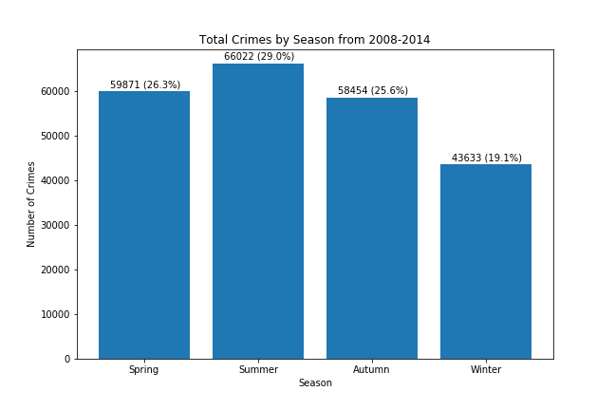
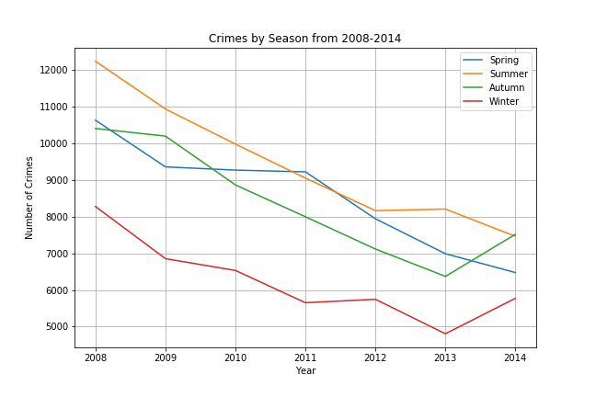
Seasonal Crime

Slide 5
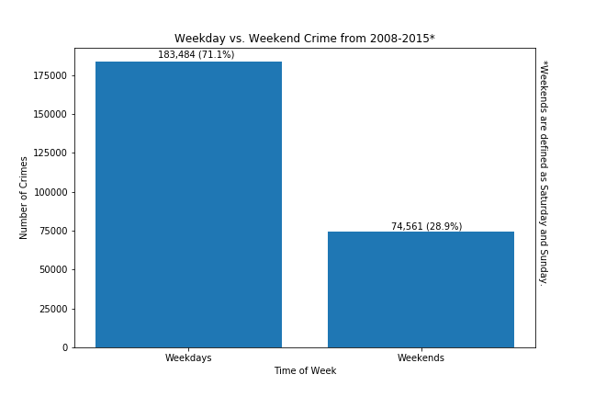
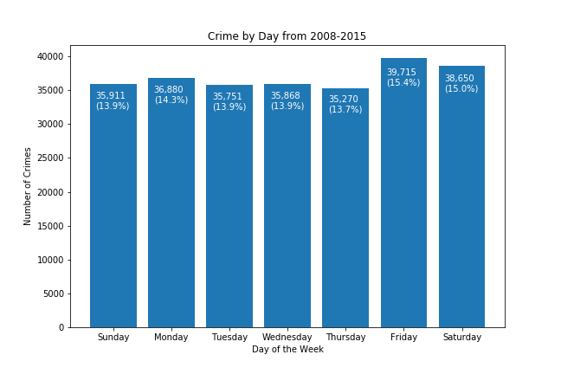
Weekend Crime

Slide 6
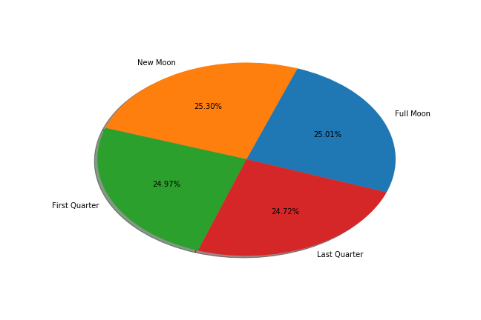
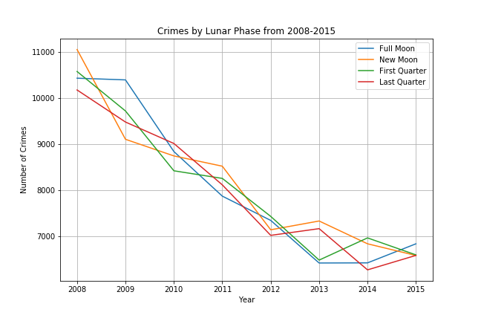
Lunar Crime

Slide 7
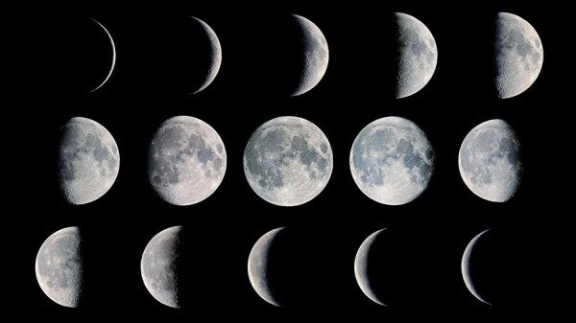

Slide 8
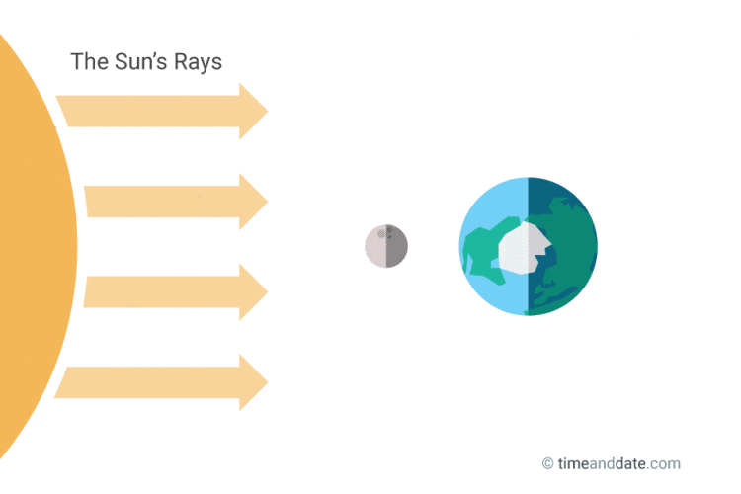
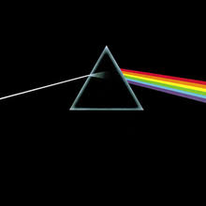
New Moon is the 1st primary phase of the moon and it occurs when the Sun and Moon are aligned, with the Sun and Earth on opposite sides of the Moon. A New Moon cannot normally be seen from Earth since only the dark side of the Moon faces our planet at this time.

Slide 9
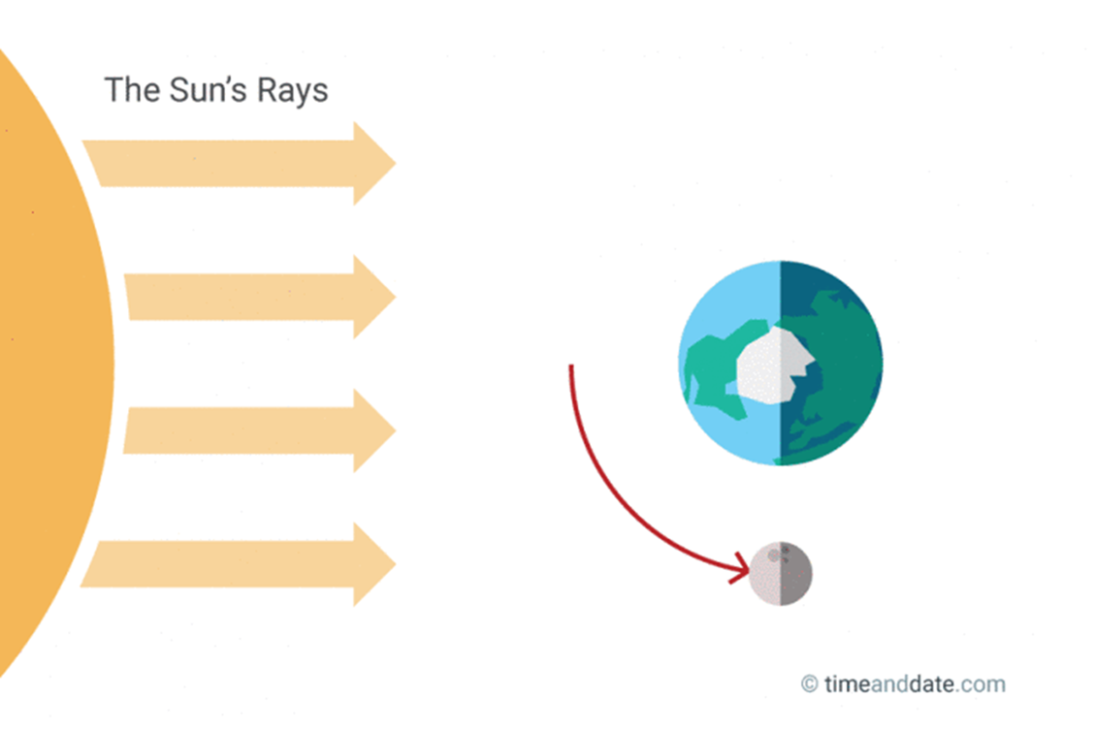
First Quarter Moon is the 2nd primary Moon phase and it is defined as the moment the Moon as reached the 1st quarter of its orbit around the Earth, hence the name. It is also called the Half Moon as we can see exactly 50% of the Moon’s surface illuminated.

Slide 10
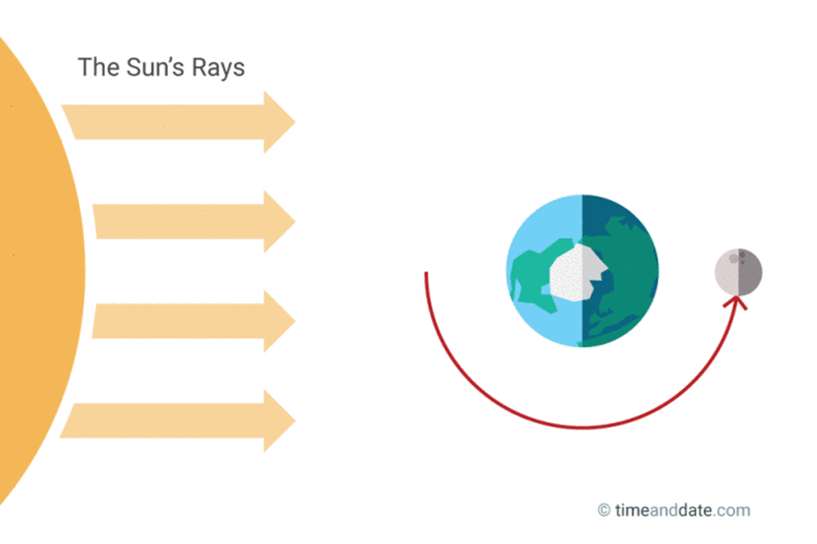

Full Moon appears in the night sky when the Sun and the Moon are aligned on opposite sides of Earth. Full Moon is the brightest phase.

Slide 11
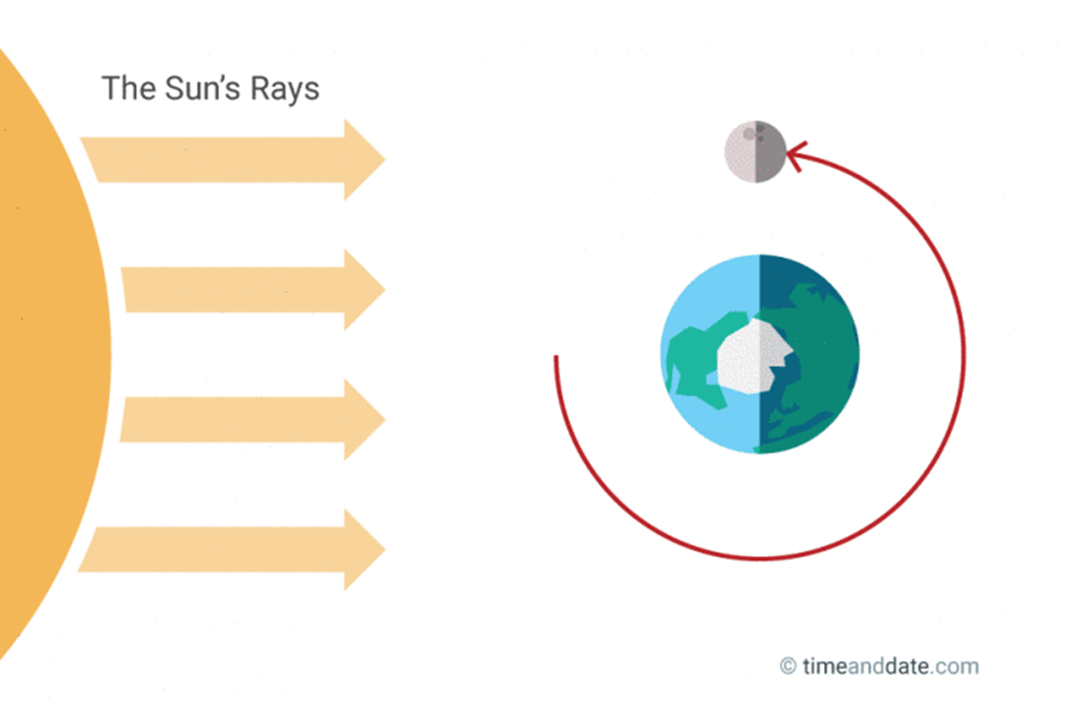
The Last Quarter (aka Third Quarter0occurs the moment the opposite half of the Moon is illuminated compared to the First Quarter Moon.

Slide 13
Statistics Fun
Pearson correlation coefficient measures the linear relationship between two datasets.
It requires that each dataset be normally distributed. AWESOME!
Pearson correlation varies between -1 and +0 with 0 implying no correlation.
Correlations of -1 or +1 imply an exact linear relationship.
Positive correlations imply that as x increases, so does y.
Negative correlations imply that as x increases, y decreases.
How do I know if my data is normally distributed?

