Slide 1
Project : DrugX
Team members:
Dhyey
Wenqi
Srivastav
Sushant

Slide 2





Background/ Problem Statement - Approach
Initial Data Exploration
Data Preprocessing
Data Insights (EDA)
Machine Learning (ML) Modelling
Insights and Key Takeaways
Drug Adverse Effects

Slide 3





Initial Data Exploration
About the data
Each object indicates an adverse event
Lots of missing values
Nested JSON format
Workflow
Normalize JSON files
Convert JSON files to data frames
Analyze

Slide 4




Data Preprocessing – APIs
Retrieve some(<26000) sample data
Filter by field
We can’t:
Select the field we need
Count non-numeric fields
Download all data
Using the APIs, we can:
Therefore, we decide to download the data for preprocessing.

Slide 5


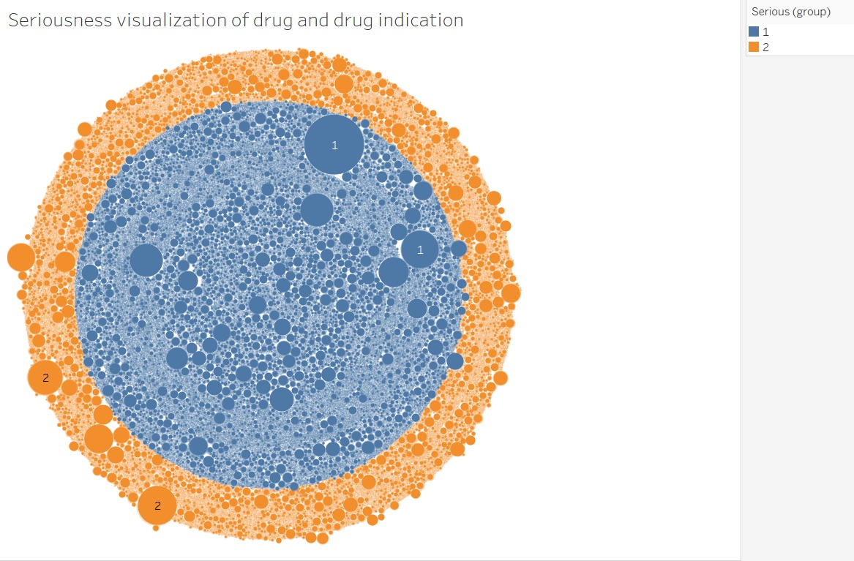
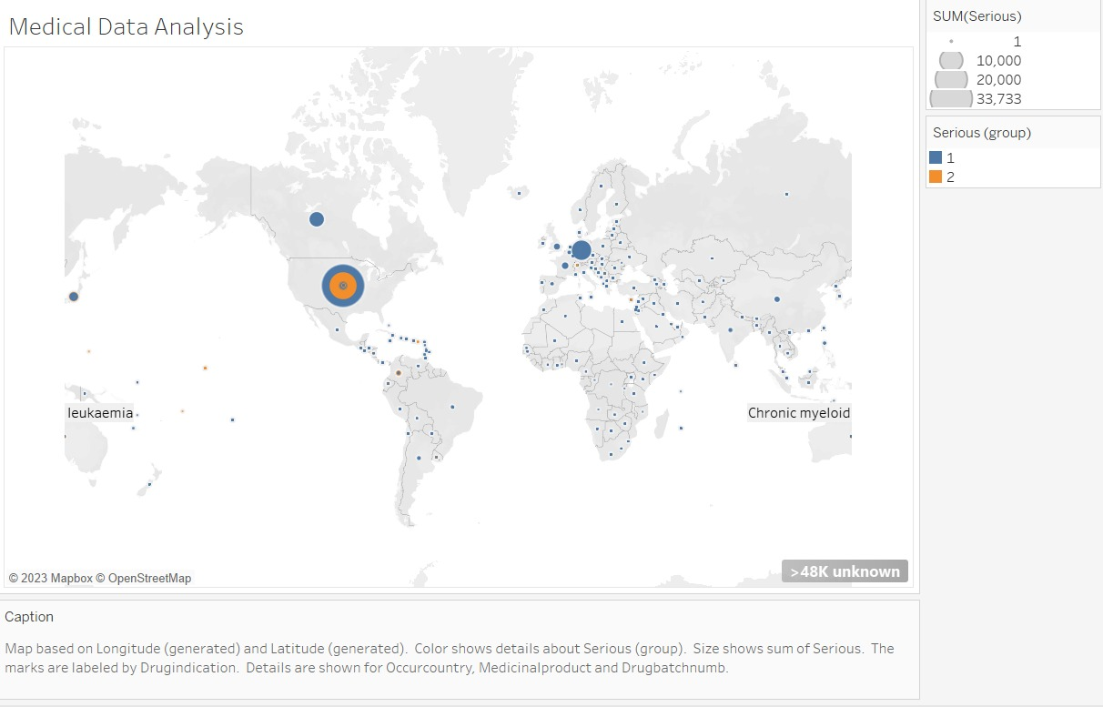
Data Insights (EDA)
Takeaways -

Slide 6
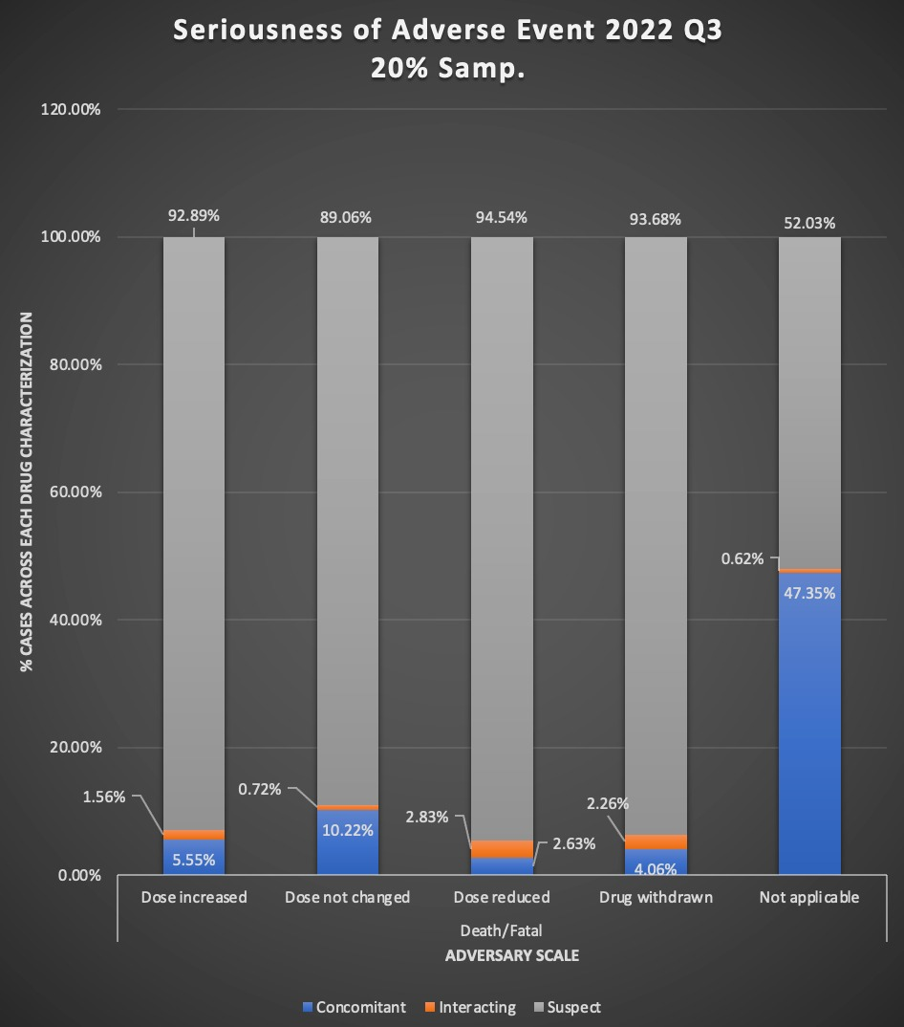
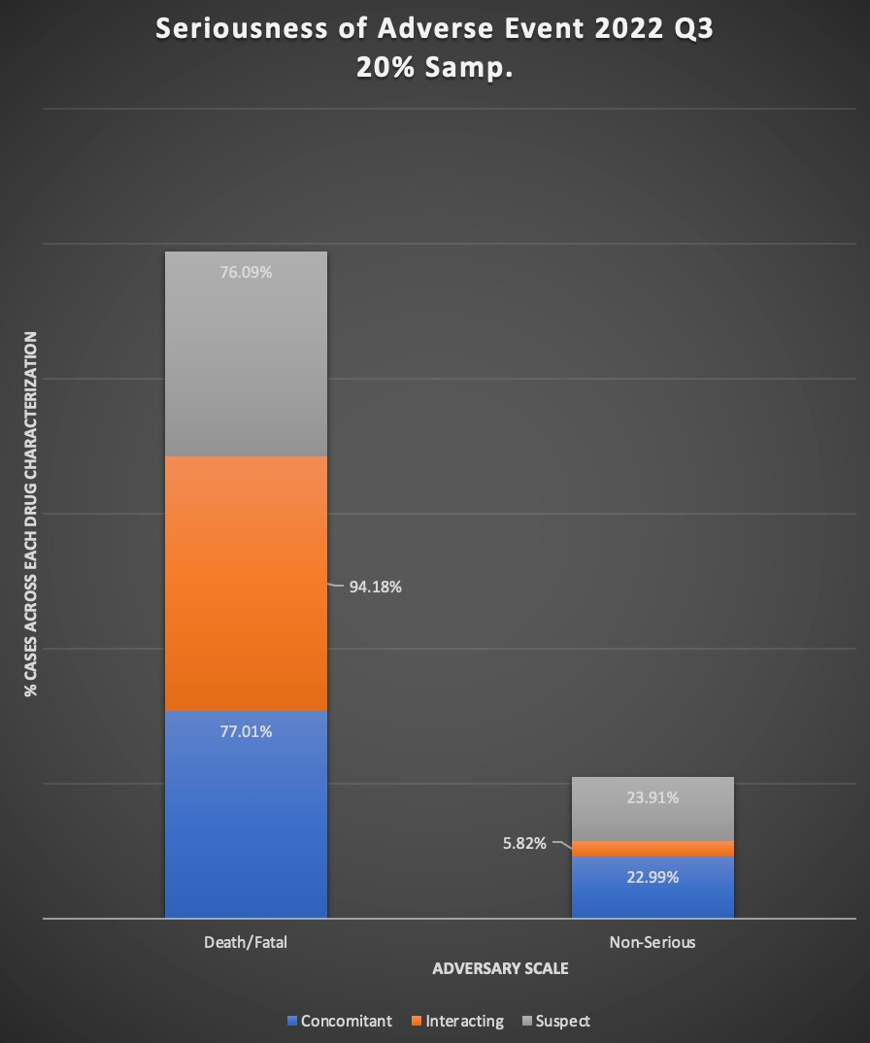
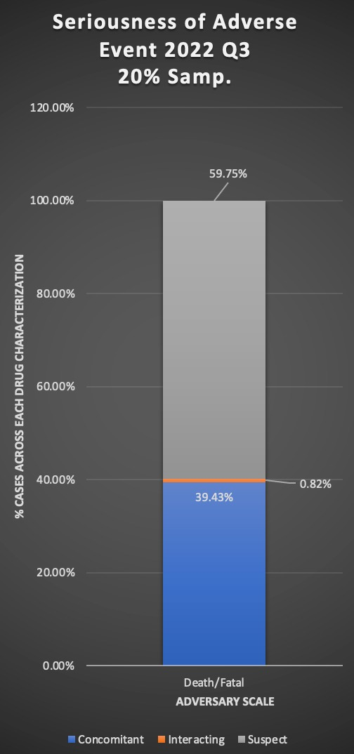
Data Insights (EDA)
Action of the drug
Drug Characterization
Drug Category

Slide 7
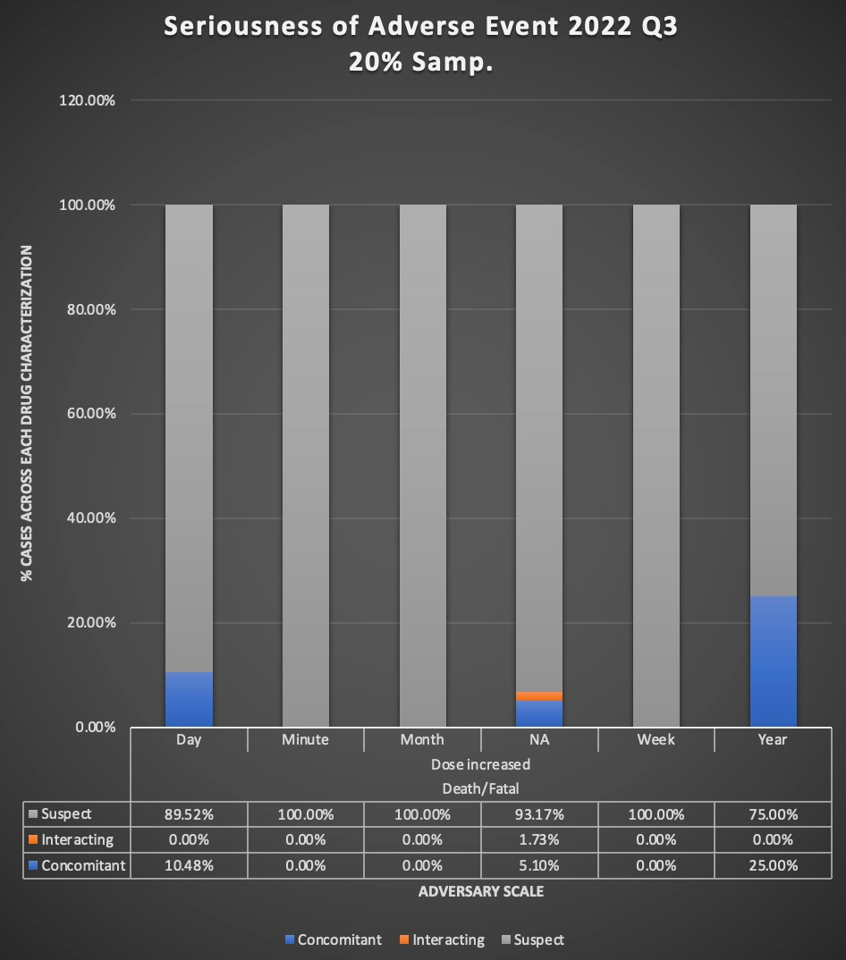
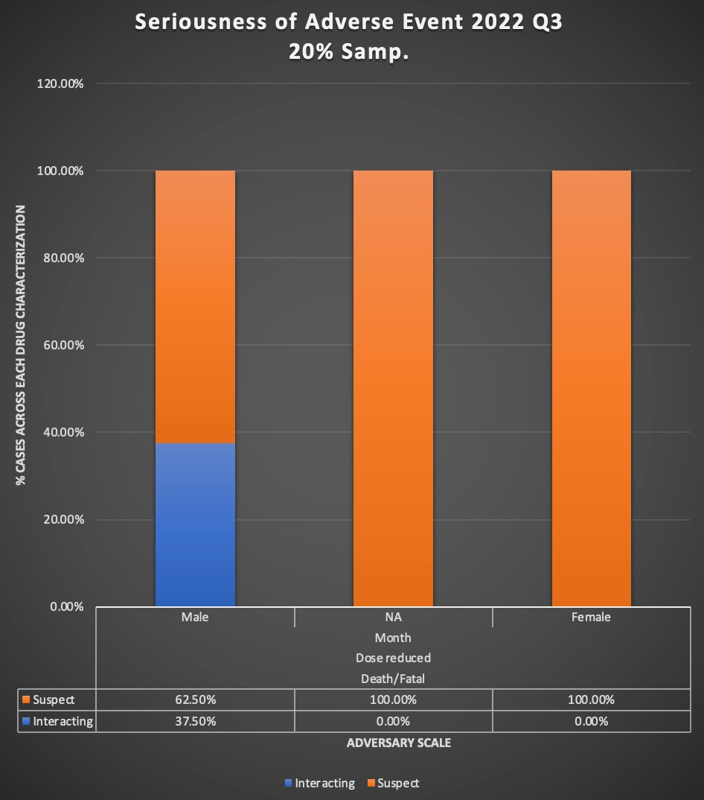
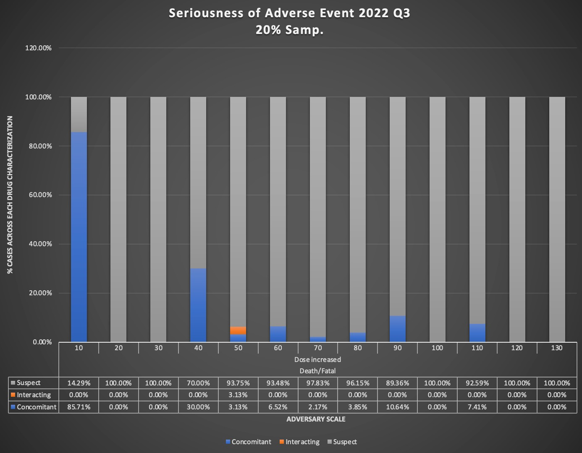
Data Insights (EDA)
Drug treatment duration
Gender of the patient
Weight category of the patient

Slide 8

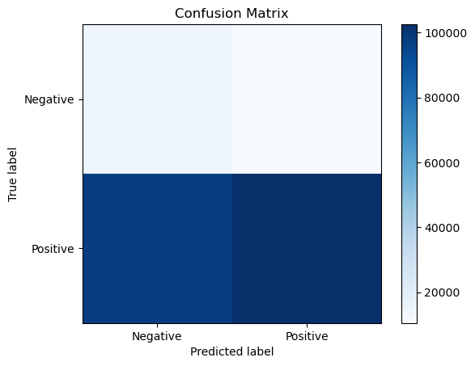
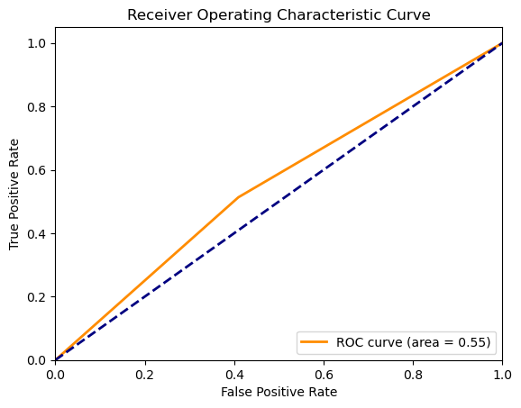
Machine Learning (ML) Modelling

Slide 9


Insights and Key Takeaways
JSON normalize
Usage of FDA APIs
Spatial distribution
Grid search optimization
Drug X

Slide 10
THANK YOU
Open for Q&A

