Slide 1
Criteria |  | Guiding Questions | Score
Technical Knowledge | Data Exploration | Did the team attempt to visualize the data? Was there any insight from this data visualization step that guided their approach to the problem? | / 10
 | Problem Statement / Approach | What problem was the team trying to solve? Was their methodology clear? Did the team explain their reasons for choosing one model/method over another? How well was their solution implemented? | / 10
 | Performance | What metrics did the team use to evaluate their models’ performance? Was this metric appropriate? | / 10
 | Evaluation of Results | Does the team understand why they got their result? | / 10
Creativity | Novelty | How unique is the solution to the problem identified? | / 20
 | Impact | What value did this project bring? How excited are you about this project? | / 20
Presentation | Clarity/Delivery | Was the presentation clear/easy to follow? Slide quality | / 15
 | Q&A |  | / 5
Total |  |  | / 100
Judging Rubrics
Team Name:
Any other comments:

Slide 2
Project : DrugX
Team members:
Dhyey
Wenqi
Srivastav
Sushant

Slide 3





Background/ Problem Statement - Approach
Drug Adverse Effects

Slide 4





Initial Data Exploration
About the data
Each object indicates an adverse event
Lots of missing values
Nested JSON format
Workflow
Normalize JSON files
Convert JSON files to data frames
Analyze
Takeaways -

Slide 5




Data Preprocessing – APIs
Retrieve some(<26000) sample data
Filter by field
We can’t:
Select the field we need
Count non-numeric fields
Download all data
Using the APIs, we can:
Therefore, we decide to download the data for preprocessing.
Takeaways -

Slide 6


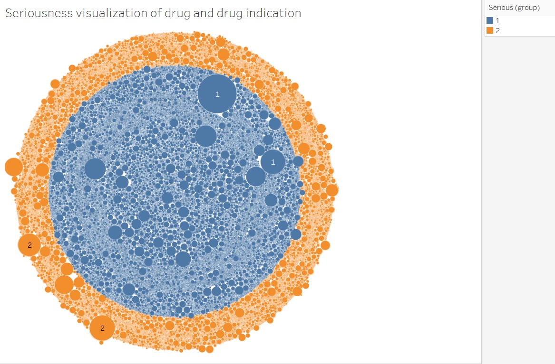
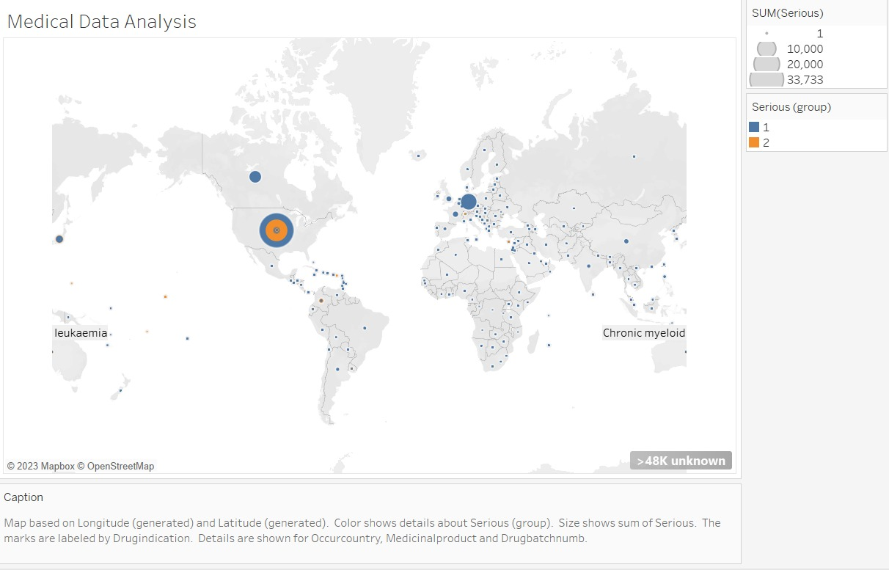
Data Insights (EDA)
Takeaways -

Slide 7

Machine Learning (ML) Modelling
Takeaways -

Slide 8


Insights and Key Takeaways
Insight 3
Insight 5
Insight 7
Insight 1
Insight 6
Insight 2
Insight 4
Drug X

Slide 9
THANK YOU
Open for Q&A

