Slide 1
Accountable Internet
Protocol
CS5321 (Network Security): Week 5 Paper Summary Presentation
Hemant Joshi (e1104450)
Accountable Internet Protocol (AIP) (cmu.edu)
David G. Andersen , Hari Balakrishnan , Nick Feamster ,
Teemu Koponen , Daekyeong Moon , and Scott Shenker

Slide 2
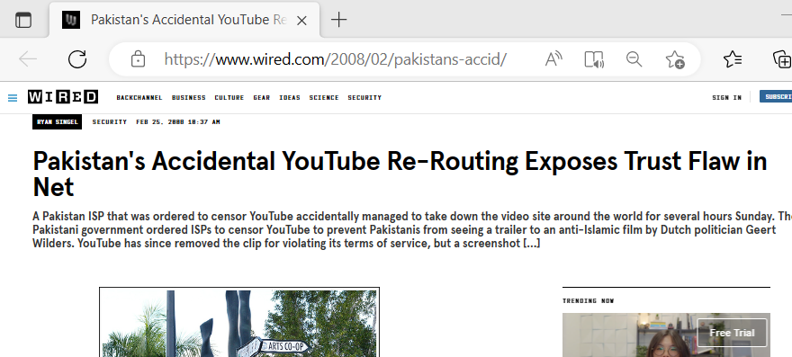
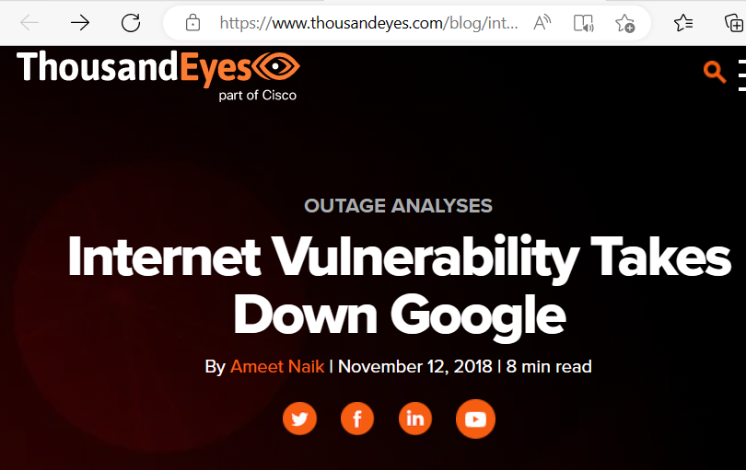
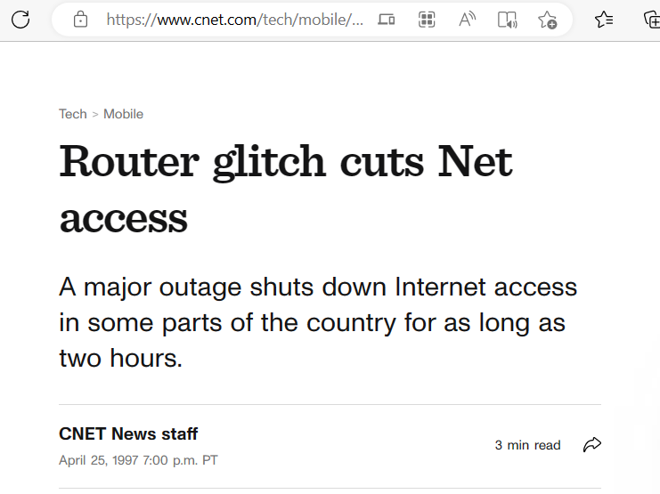
Internet Vulnerability
Pakistan's Accidental YouTube Re-Routing Exposes Trust Flaw in Net | WIRED
Internet Vulnerability Takes Down Google | ThousandEyes
Feb 2008
November 12, 2018
Router glitch cuts Net access - CNET
April 1997

Slide 3
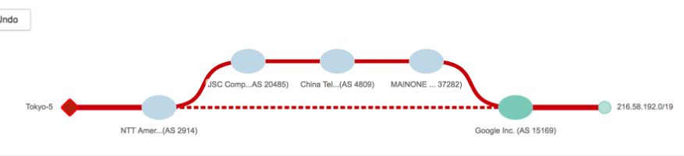
Problems?
Current IP architecture provides very little accountability
IP addresses do not always map one-to-one to Internet endpoints because of NATs, firewalls, and proxies
IP addresses are trivial to forge
Misconfigured routers can wreak widespread havoc on packet delivery.
Malicious or compromised hosts spoof their source addresses as there is little chance of them being detected or having any consequences.
Denial-of-service attacks like SYN Flood
Fundamental Problem: Lack of Accountability in the
current Internet Architecture
e.g. Internet Vulnerability Takes Down Google
The bigger problem is how routing runs currently (BGP)
The outage was reportedly caused by an improper rerouting of IP addresses and the moving of traffic away from the usual ports toward China and Russia instead.
The origin of this leak was the BGP peering relationship between MainOne, the Nigerian provider, and China Telecom. MainOne has a peering relationship with Google via IXPN in Lagos and has direct routes to Google

Slide 4
Accountable Internet Protocol
AIP’s cornerstone is self-certifying addressing.
AIP addresses are of the form AD: EID which is a simple two-level hierarchical address.
Each administrative unit decomposes its network into one or more accountability domains (ADs)
Each host is assigned a globally unique endpoint identifier (EID)
Both address components are derived from public keys held by the domain and host, respectively. Which acts as the identifier.
EID 2.a
EID 2.b
host
host
AD2
AD1
EID 1.a
host
EID 3.a
EID 3.b
host
host
AD3
Accountability Domains (ADs)

Slide 5



Self Certifying Address
The domain name system would include an AIP-record, which would contain the AIP address(es) for a hostname.
In AIP, the AD is the hash of the public key of the domain, while the EID is the hash of the public key of the corresponding host.
Existing schemes (e.g., S-BGP ) implement this binding using registries that map identifiers to their public keys (a PKI). Unfortunately, these registries must be both up-to-date (via manual configuration5) and globally trusted.
Until the packet reaches the destination AD, routers use only the destination AD to forward the packet. Upon reaching the destination AD, routers forward the packet using only its EID.
R1
R2
EID 1.a
EID 1.b
EID 3.a
EID 3.b
host
host
host
host
AD1
AD3
a1
a2
a3
AD | EID
Accountability Domains (ADs)
Accountability Domains (ADs)

Slide 6
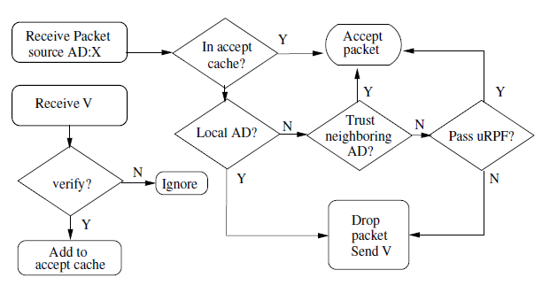

Source Accountability: Detecting & Preventing Source Spoofing
Source address spoofing refers to the problem of a host using a source address that has been assigned to another host.
AD and EID public keys validate the source address of a packet in two places. First, each first-hop router verifies that its directly-connected hosts are not spoofing. Next, each AD through which a packet passes verifies that the previous hop is a “valid” previous-hop for the specified source address.
AIP’s source accountability mechanism essentially adds to the Unicast Reverse Path Forwarding (URPF)
If (first-hop router R) != verified (source host) then && (Host == Local AD) Drop the Packet, AND send V(verification packet) to the source.
The sender must prove that it has identity EID by signing V with the private key associated with EID
The sender must prove that it has an identity EID by signing V with the private key associated with EID. If the host produces the correct signature, then R caches this information and forwards subsequent packets as well.
Now for a packet entering AD A from AD B, AD A performs the following checks
If A trusts B to have performed the appropriate checks on the packet’s source address then A forwards the packet.
If A does not trust B, then A performs uRPF checks to determine if the packet coming from the same interface. If no then it drops the packet and generate the same verification.

Slide 7
Address Minting
Address minting is the process of creating new IP addresses from existing ones.
In AIP the already trusted hosts or domains may become malicious which can lead to
malicious host from creating an arbitrary set of EIDs
Or, a malicious domain from making up routing announcements for an arbitrary number of fake Ads
The solution is similar in both cases which do not completely solve the problem but limits it to an extent
EID limiting
AD limiting

Slide 8
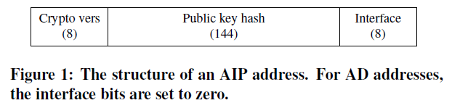
Scalability with AIP
Routing table entries size
AIP Routing information base size (RIB) and Forwarding Information Base(FIB ) will increase the size.
The size of prefixes and ASes(Autonomous System) will increase from their current 32 and 16 bits to 160 bits.
AIP addresses will be larger
Diameter changes:
Large domains will be split into multiple ADs., (for instance, a large ISP might split itself into a transit AD and a number of ADs from which it allocates direct customers. )
As a consequence, the move to AIP might increase the diameter of the network, perhaps by two or three AD-hops.

Slide 9
Key Management
AIP faces three general problems in key management:
Key discovery: Sources must be able to discover the destination address (key).
Individual key compromise: Domains and hosts must cope with the possibility that their key might be compromised.
A very real danger of crypto-based systems such as AIP is one of false confidence: with a compromised key, an attacker could silently impersonate his victim for quite a while before a victim noticed.
Cryptographic algorithm compromise: In the long term, AIP must be able to migrate to newer digital signature and hash algorithms as earlier algorithms are weakened.
For example, crypto version 0 represents RSA signatures with SHA-1 hashes. The hash function must be truncated or zero-filled, as appropriate, to fill the 144-bit hash space in the AIP address. Paper envisions that at most two or three crypto versions will be present on the network at any given time:

Slide 10
AIP (Final thoughts)
Prospects for future
  AIP brings accountability to the network DNA
  With a simple hierarchical addressing scheme and self-certifying components, AIP enables simple solutions to
    source spoofing,
    Shutting off certain kinds of DoS traffic, and
    securing BGP.
Major Challenge
Deployability
  AIP requires an overhaul of the Internet Protocol (IP).
  All hosts and networks must be re-numbered. Applications must be revised to use AIP addresses.
  Every routing protocol, both intra-domain, and inter-domain, must be revised to propagate AIP addresses
  DNS must be extended to include AIP records, and so on.
  Detecting key compromise

