Slide 1
A Stealthier Partitioning Attack against Bitcoin Peer-to-Peer Network
Presenter: Jin Pei Ng

Slide 2
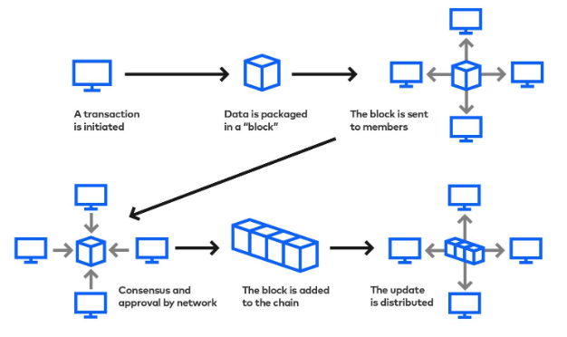
The Bitcoin blockchain refers to the data stored in “blocks” of information that are then linked together in a permanent “chain”. Bitcoin relies on an underlying peer-to-peer network.

Slide 3
Partitioning Attack on Bitcoin Network
Attacking bitcoin consensus
Partitioning a fraction of miners (e.g., 30%) from the rest of the network can make an adversary, who even does not control much of the mining power (e.g., 40%), launch the 51% attack.
Attacking Bitcoin’s off-chain protocols.
The adversary prevents the partitioned victim node from settling the payment channels
on the blockchain and steals the victim’s funds from her off-chain transactions.
Taking down cryptocurrencies.
A powerful adversary, such as a nation-state attacker, may even aim to disrupt a large
portion of the underlying peer-to-peer network of a cryptocurrency. At a small scale, the adversary can arbitrarily censor the transactions from the victim.

Slide 4
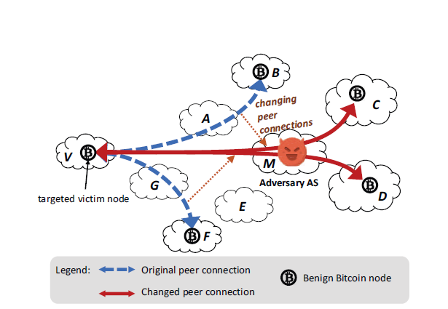
Can a Partitioning attack be stealthier?
Erebus attack

Slide 5
Technical challenges:
Is there enough shadow IPs (AS C or AS D) that the adversary can use?
How to influence the victim node’s peer selection so the route includes the adversary?

Slide 6
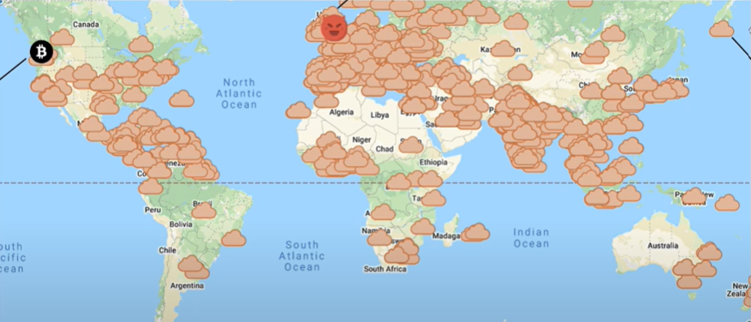
How many shadow IPs are available?
Adversary AS in Europe
Shadow AS
Victim Node (Amazon)

Slide 7
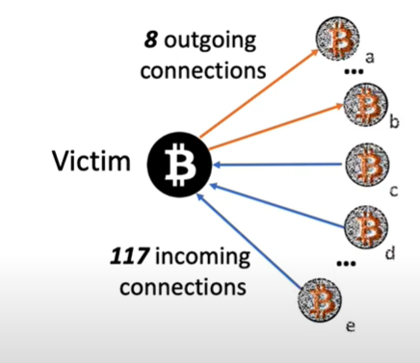
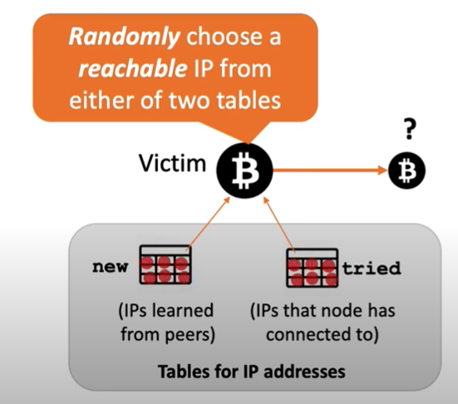
How does the adversary influence the victim node’s peer selection?

Slide 8
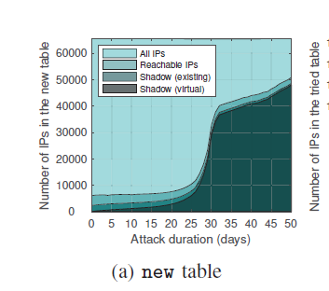
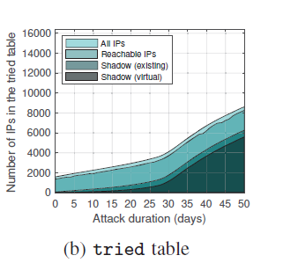

Slide 9
Countermeasures
Ineffective Countermeasure:
Active route measurements
Inter-domain route estimation
Whitelisting IP addresses
Rate limiting addr messages
Rate limiting incoming connections
Network-level data-plane detection
Countermeasure without Bitcoin Protocol Changes:
1. Rely on third-party proxies (VPNs, Tor, relays)
Countermeasure with Bitcoin Protocol Changes:
Table size reduction.
More outgoing connections.
Incorporating AS topology in the peer selection.
Eviction policy that protects peers by providing fresher
block data.

Slide 10

A Stealthier Partitioning Attack against Bitcoin Peer-to-Peer Network

Slide 11
Summary
Erebus attack is stealthy because no route manipulation is needed, which makes the attack undetectable to control-plane and even to data-plane detectors.
Also, the Erebus attack makes the adversary a natural man-in-the-middle network of all the peer connections of one or more targeted Bitcoin nodes by patiently influencing the targeted nodes’ peering decision by sending low-rate of traffic.

Slide 12
Thank You!

