Slide 1
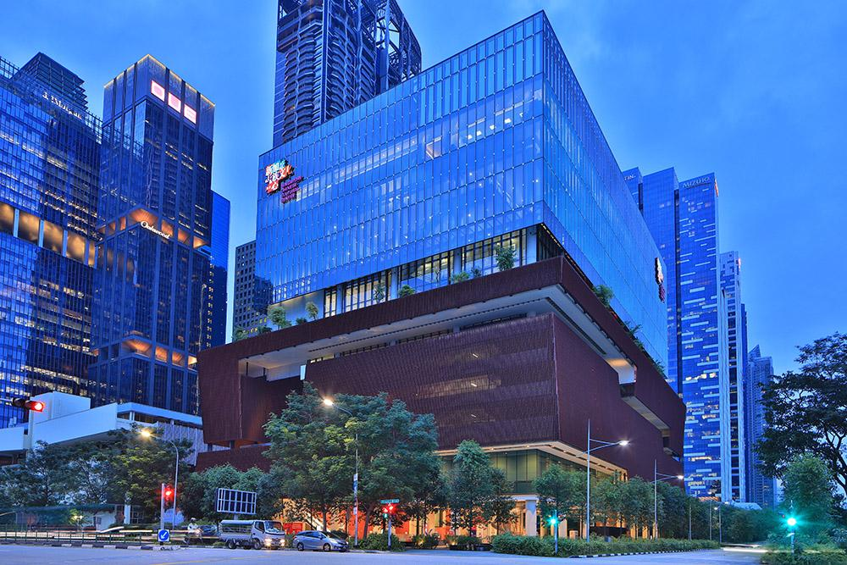
The Singapore Chinese Cultural Centre
Vision: A vibrant Singapore Chinese culture, rooted in a cohesive, multi-racial society
Mission: Nurture Singapore Chinese culture and enhance social harmony
2012: The centre was an idea proposed by Mr Chua Thian Poh and supported by PM Mr Lee Hsien Loong
2013: Incorporation of SCCC by SG federation of Chinese clan association. Mr Chua Thian Poh appointed chairman of SCCC.
2014: Mr Choo Thiam Siew, president of Nanyang Academy of Fine Arts, was designated as the CEO.
2016: Premiered their inaugural cultural exhibition, displaying various elements of local Chinese culture across literature, arts, festivals, foods.
2017: Centre officially opened by PM Lee.
What they do:
-Collaborate with arts and cultural groups to promote and develop local Chinese culture
-Embrace multi-cultural identity; Be an inclusive platform that welcomes all Singaporeans
-Organise many cultural activities throughout the year e.g. exhibitions, fairs, performances, seminars, talks, workshops

