Slide 1
CS1231S Tutorial #1
Propositional Logic and Proofs

Slide 2

About me:
Andrew Tan
Year 4 CS major
Took CS1231 during AY17/18 Sem 1, taught it in AY18/19
Email: andrew.tan@u.nus.edu
Consultation hours: email me to schedule

Slide 3

Telegram chat
https://t.me/joinchat/GFlCahl__8m6EYeTenuBNw

Slide 4
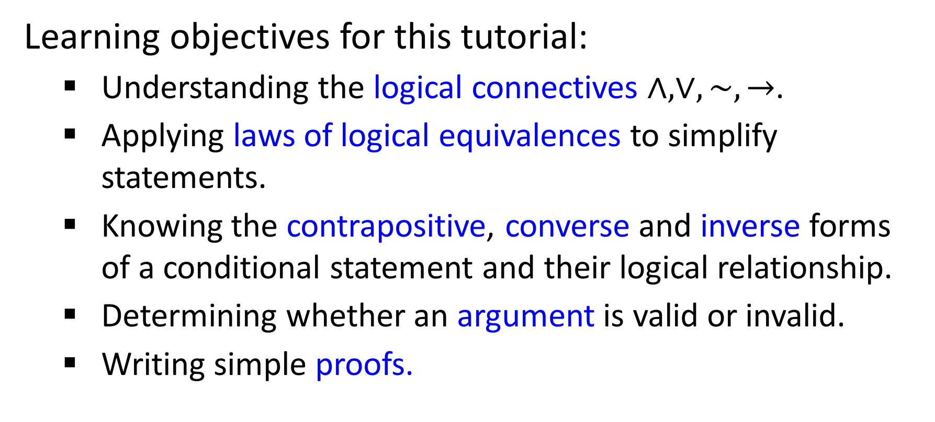
Learning objectives for this tutorial:
Understanding the logical connectives $∧,∨,\sim ,→$.
Applying laws of logical equivalences to simplify statements.
Knowing the contrapositive, converse and inverse forms of a conditional statement and their logical relationship.
Determining whether an argument is valid or invalid.
Writing simple proofs.

Slide 5






Q1
(a) Negating “$1 < a < 5$” becomes “$1≥a≥5$”
$$1<a<5$$
$$≡\left(1<a\right)∧(a<5)$$
Implicit AND
$$\sim \left(\left(1<a\right)∧\left(a<5\right)\right)$$
$≡\sim \left(1<a\right)∨\sim (a<5)$ (De Morgan’s)
$$≡\left(1≥a\right)∨(a≥5)$$
Are they logically equivalent?

Slide 6

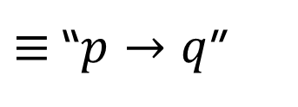
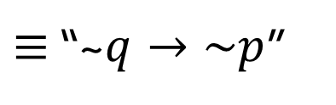
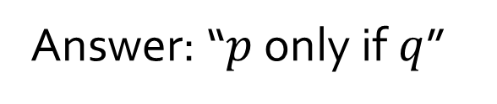

Q1
(b) “He’s welcome to come along only if he behaves himself” means “if he behaves himself then he’s welcome to come along”.
Let $p$ be “He’s welcome to come along”
and $q$ be “He behaves himself”.
Question: is “$p$ only if $q$” $≡$ “$q→p$”?
Answer: “$p$ only if $q$”
$≡$ “~$q→\sim p$”
$≡$ “$p→q$”
(Lecture #2 slide 45)

Slide 7
Q2
Theorem 2.1.1 Logical Equivalences
1 | Commutative laws | p ∧ q ≡ q ∧ p | p ∨ q ≡ q ∨ p
2 | Associative laws | (p ∧ q) ∧ r ≡ p ∧ (q ∧ r) | (p ∨ q) ∨ r ≡ p ∨ (q ∨ r)
3 | Distributive laws | p ∧ (q ∨ r) ≡ (p ∧ q) ∨ (p ∧ r) | p ∨ (q ∧ r) ≡ (p ∨ q) ∧ (p ∨ r)
4 | Identity laws | p ∧ true ≡ p | p ∨ false ≡ p
5 | Negation laws | p ∨ ~p ≡ true | p ∧ ~p ≡ false
6 | Double negative law | ~(~p) ≡ p
7 | Idempotent laws | p ∧ p ≡ p | p ∨ p ≡ p
8 | Universal bound laws | p ∨ true ≡ true | p ∧ false ≡ false
9 | De Morgan’s laws | ~(p ∧ q) ≡ ~p ∨ ~q | ~(p ∨ q) ≡ ~p ∧ ~q
10 | Absorption laws | p ∨ (p ∧ q) ≡ p | p ∧ (p ∨ q) ≡ p
11 | Negation of true and false | ~true ≡ false | ~false ≡ true

Slide 8
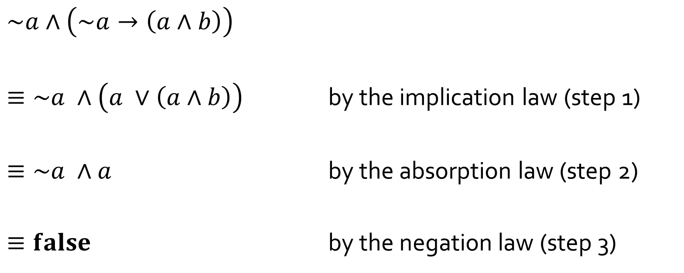
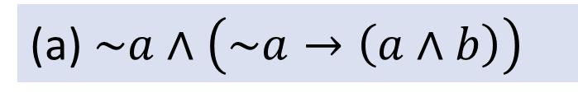
Q2
(a) $\sim a∧\left(\sim a→\left(a∧b\right)\right)$
$$\sim a∧\left(\sim a→\left(a∧b\right)\right)$$
$≡\sim a ∧\left(a ∨\left(a∧b\right)\right)$ by the implication law (step 1)
$≡\sim a ∧a$ by the absorption law (step 2)
$≡false$ by the negation law (step 3)
$≡\sim a ∧\left(\sim (\sim a) ∨\left(a∧b\right)\right)$ by the implication law
double negative law
$≡a∧\sim a$ by the commutative law

Slide 9
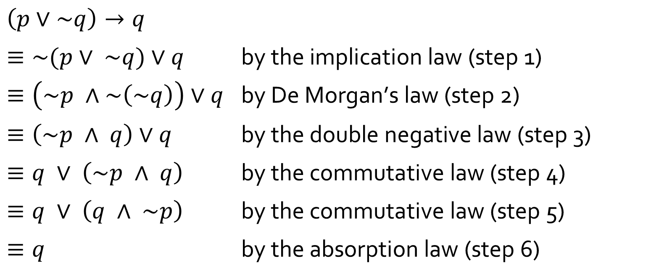
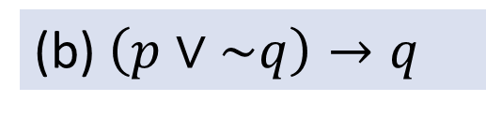
Q2
(b) $\left(p∨\sim q\right)→q$
$$\left(p∨\sim q\right)→q$$
$≡\sim (p∨ \sim q)∨q$ $\text{by} \text{the} \text{implication} \text{law}\text{ (}\text{step}\text{ 1)}$
$≡\left(\sim p ∧\sim \left(\sim q\right)\right)∨q$ $\text{by} \text{De} \text{Morgan}\text{’}\text{s} \text{law}\text{ (}\text{step}\text{ 2)}$
$≡\left(\sim p ∧ q\right)∨q$ $\text{by} \text{the} \text{double} \text{negative} \text{law}\text{ (}\text{step}\text{ 3)}$
$≡q ∨ \left(\sim p ∧ q\right)$ $\text{by} \text{the} \text{commutative} \text{law}\text{ (}\text{step}\text{ 4)}$
$≡q ∨ \left(q ∧ \sim p\right)$ $\text{by} \text{the} \text{commutative} \text{law}\text{ (}\text{step}\text{ 5)}$
$≡q$ $\text{by} \text{the} \text{absorption} \text{law}\text{ (}\text{step}\text{ 6)}$

Slide 10
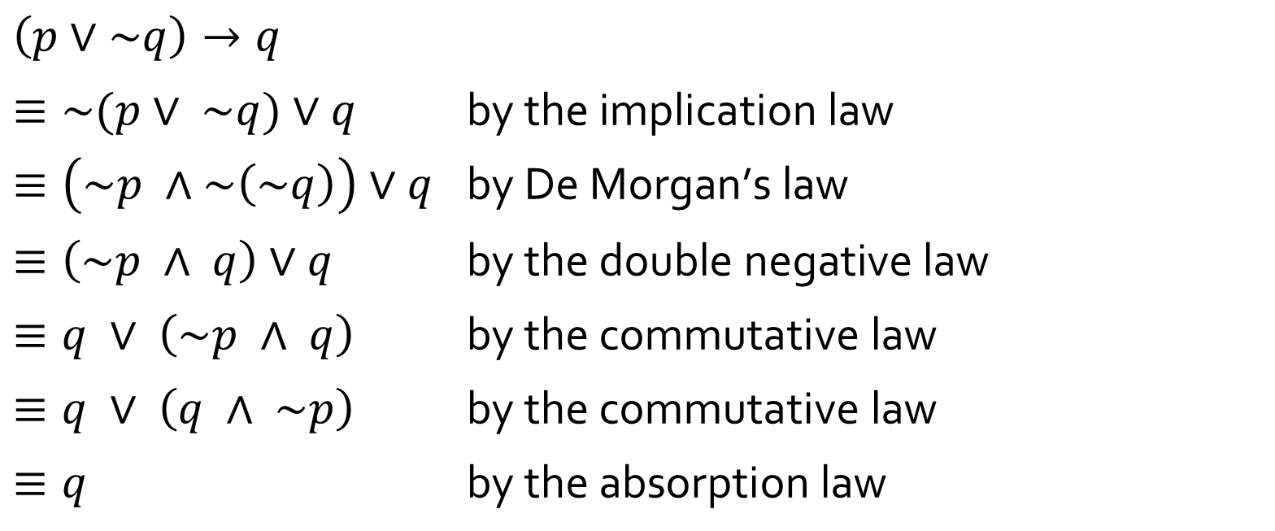
Q2
(b) $\left(p∨\sim q\right)→q$
You may combine two simple steps into one line, by citing the laws applied. Try not to combine more than 2 steps into one line or it may confuse your readers
$$\left(p∨\sim q\right)→q$$
$≡\sim (p∨ \sim q)∨q$ $\text{by} \text{the} \text{implication} \text{law}$
$≡\left(\sim p ∧\sim \left(\sim q\right)\right)∨q$ $\text{by} \text{De} \text{Morgan}\text{’}\text{s} \text{law}$
$≡\left(\sim p ∧ q\right)∨q$ $\text{by} \text{the} \text{double} \text{negative} \text{law}$
$≡q ∨ \left(\sim p ∧ q\right)$ $\text{by} \text{the} \text{commutative} \text{law}$
$≡q ∨ \left(q ∧ \sim p\right)$ $\text{by} \text{the} \text{commutative} \text{law}$
$≡q$ $\text{by} \text{the} \text{absorption} \text{law}$
twice

Slide 11
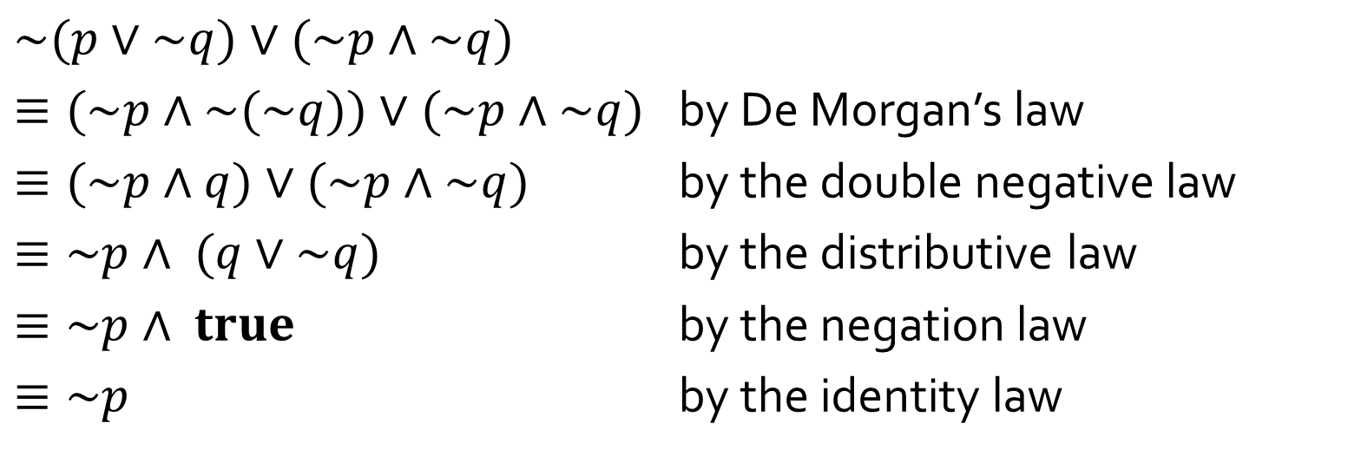
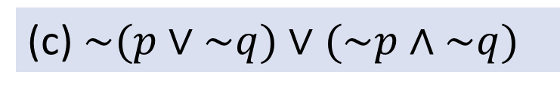
Q2
(c)$\sim (p∨\sim q)∨(\sim p∧\sim q)$
$$\sim (p∨\sim q)∨(\sim p∧\sim q)$$
$≡(\sim p∧\sim (\sim q))∨(\sim p∧\sim q)$ by De Morgan’s law
$≡(\sim p∧q)∨(\sim p∧\sim q)$ by the double negative law
$≡\sim p∧ (q∨\sim q)$ by the distributive law
$≡\sim p∧ true$ by the negation law
$≡\sim p$ by the identity law

Slide 12
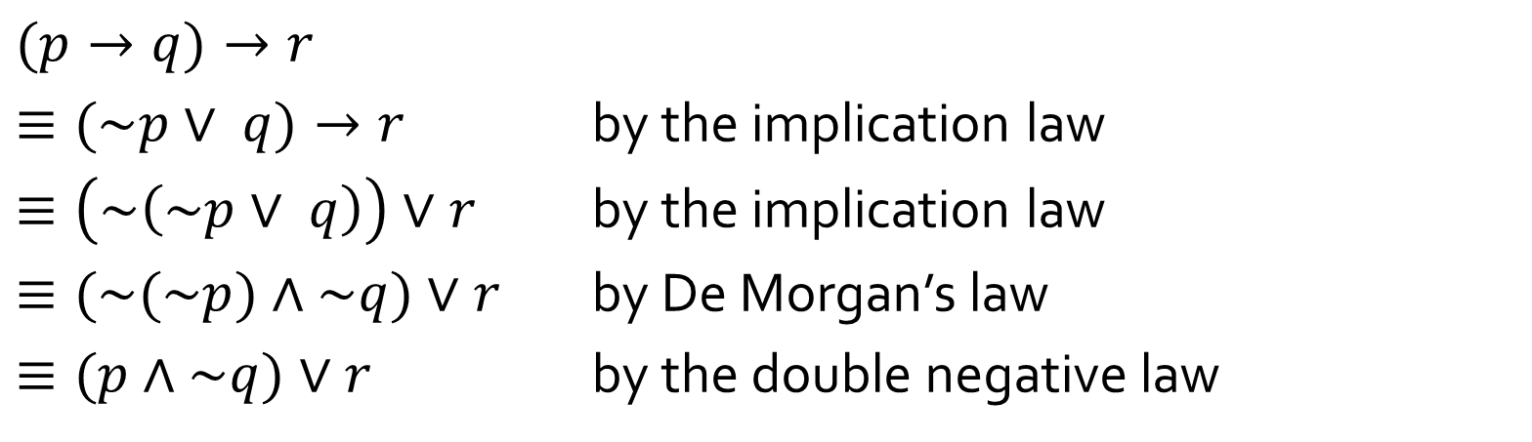
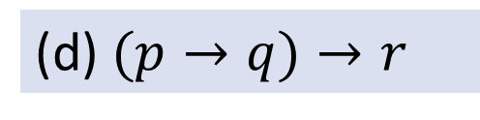
Q2
(d)$(p→q)→r$
$$(p→q)→r$$
$≡(\sim p∨ q)→r$ by the implication law
$≡\left(\sim \left(\sim p∨ q\right)\right)∨r$ by the implication law
$≡(\sim (\sim p)∧\sim q)∨r$ by De Morgan’s law
$≡(p∧\sim q)∨r$ by the double negative law

Slide 13
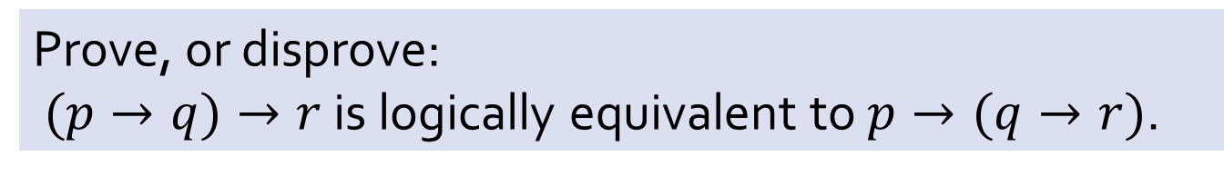
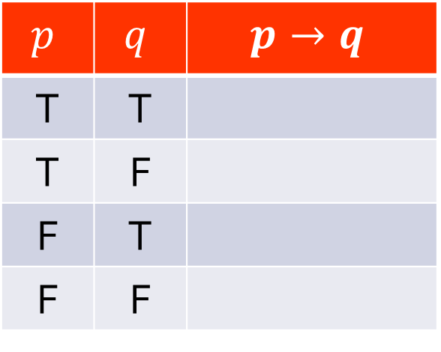

Q3
Prove, or disprove:
$(p→q)→r$ is logically equivalent to $p→(q→r)$.
Definition of conditional statement $p→q$:
$$p$$ | $$q$$ | $$p→q$$
T | T
T | F
F | T
F | F
T
F
T
T

Slide 14

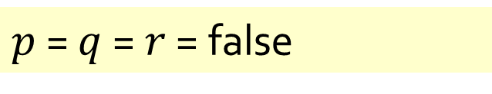





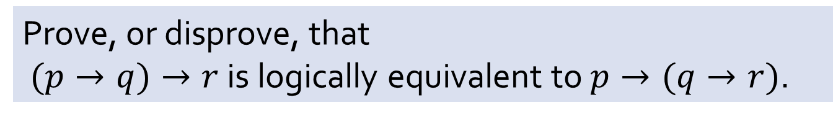








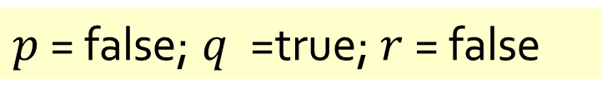


Q3
Prove, or disprove, that
$(p→q)→r$ is logically equivalent to $p→(q→r)$.
True or false?
If false, what do you need?
What counterexample can you give?
$p$ = false; $q$ =true; $r$ = false
$p$ = $q$ = $r$ = false
$$(p→q)→r$$
$$(p→q)→r$$
$$≡(F→T)→F$$
$$≡(F→F)→F$$
$$≡T→F$$
$$≡F$$
Any of these two counterexamples suffices.
$$≡T→F$$
$$≡F$$
$$p→(q→r)$$
$$p→(q→r)$$
$$≡F→(T→F)$$
$$≡F→(F→F)$$
$$≡F→F$$
$$≡T$$
$$≡F→T$$
$$≡T$$

Slide 15
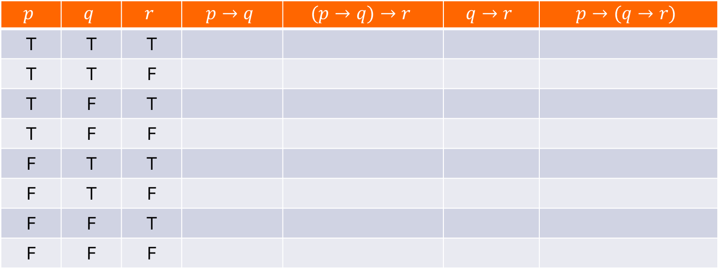
Q3
Prove, or disprove, that
$(p→q)→r$ is logically equivalent to $p→(q→r)$.
If you do not know if it is true or false, you may have to draw the truth table to find out:
$$p$$ | $$q$$ | $$r$$ | $$p→q$$ | $$(p→q)→r$$ | $$q→r$$ | $$p→(q→r)$$
T | T | T
T | T | F
T | F | T
T | F | F
F | T | T
F | T | F
F | F | T
F | F | F
T
T
F
F
T
T
T
T
T
F
T
T
T
F
T
F
T
F
T
T
T
F
T
T
T
F
T
T
T
T
T
T

Slide 16


Q4
To qualify for the draw to win 100,000 AirAsia Miles, credit card holders must “charge a minimum of S$50 nett to their card during the Qualifying Period”.
C = “charge a minimum of S$50 net”,
P = “charge during the Qualifying Period”,
W = “win 100,000 AirAsia Miles”.
(a) Write a conditional statement that describes the rule above.
$$W→(C∧P)$$
We say $(C∧P)$ is the necessary condition for W.

Slide 17

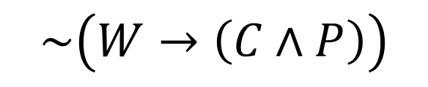

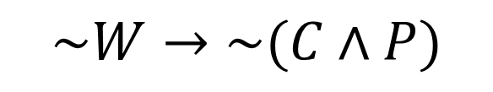
Q4
(b) Write the converse, inverse, contrapositive and negation forms of the statement in part (a).
$$W→(C∧P)$$
Converse:
$(C∧P)$ $→W$
Inverse:
$$\sim W→\sim (C∧P)$$
Contrapositive:
$\sim (C∧P)$ $→\sim W$
Negation:
$$\sim \left(W→\left(C∧P\right)\right)$$

Slide 18
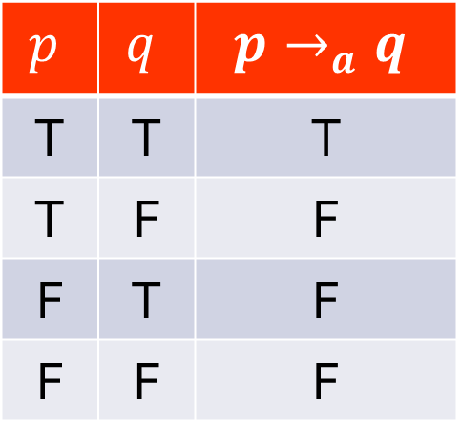


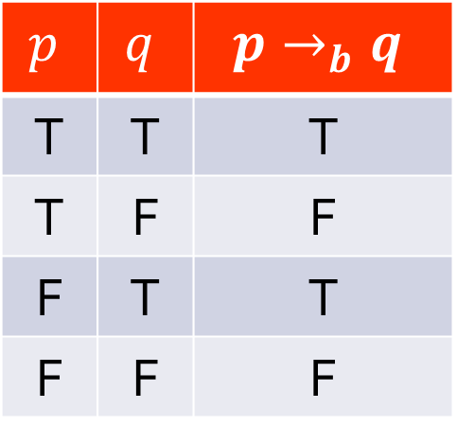
Q5
$$\left(\left(p→q\right)∧\left(q→r\right)\right)→\left(p→r\right)$$
$$p$$ | $$q$$ | $$p→_{a}q$$
T | T | T
T | F | F
F | T | F
F | F | F
$$p$$ | $$q$$ | $$p→_{b}q$$
T | T | T
T | F | F
F | T | T
F | F | F
$$p$$ | $$q$$ | $$p→_{c}q$$
T | T | T
T | F | F
F | T | F
F | F | T

Slide 19
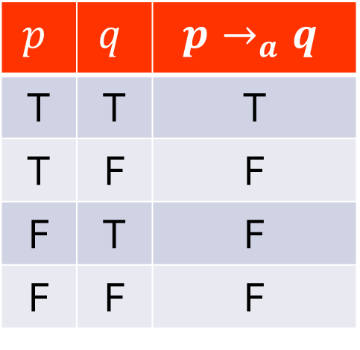
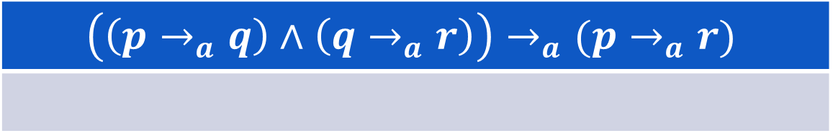
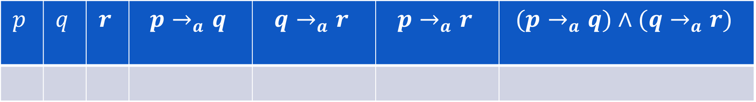
Q5
$$\left(\left(p→q\right)∧\left(q→r\right)\right)→\left(p→r\right)$$
$$p$$ | $$q$$ | $$p→_{a}q$$
T | T | T
T | F | F
F | T | F
F | F | F
$$p$$ | $$q$$ | $$r$$ | $$p→_{a}q$$ | $$q→_{a}r$$ | $$p→_{a}r$$ | $$(p→_{a}q)∧(q→_{a}r)$$
T
T
F
T
F
F
F
$$\left(\left(p→_{a}q\right)∧\left(q→_{a}r\right)\right)→_{a}(p→_{a}r)$$
F

Slide 20
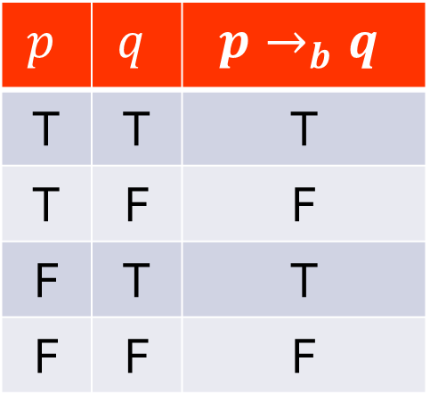

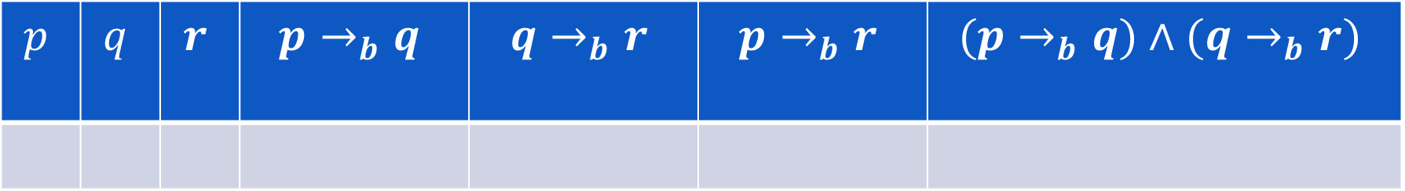
Q5
$$\left(\left(p→q\right)∧\left(q→r\right)\right)→\left(p→r\right)$$
$$p$$ | $$q$$ | $$p→_{b}q$$
T | T | T
T | F | F
F | T | T
F | F | F
$$p$$ | $$q$$ | $$r$$ | $$p→_{b}q$$ | $$q→_{b}r$$ | $$p→_{b}r$$ | $$(p→_{b}q)∧(q→_{b}r)$$
T
T
F
T
F
F
F
$$\left(\left(p→_{b}q\right)∧\left(q→_{b}r\right)\right)→_{b}(p→_{b}r)$$
F

Slide 21
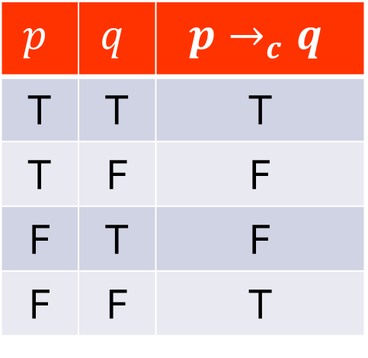
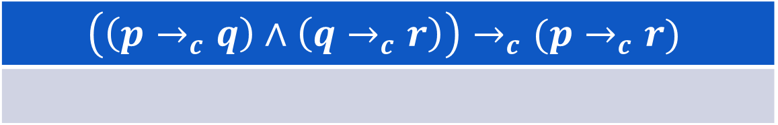
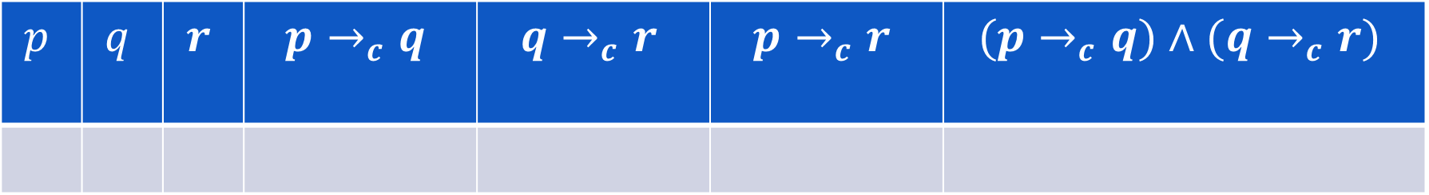
Q5
$$\left(\left(p→q\right)∧\left(q→r\right)\right)→\left(p→r\right)$$
$$p$$ | $$q$$ | $$p→_{c}q$$
T | T | T
T | F | F
F | T | F
F | F | T
$$p$$ | $$q$$ | $$r$$ | $$p→_{c}q$$ | $$q→_{c}r$$ | $$p→_{c}r$$ | $$(p→_{c}q)∧(q→_{c}r)$$
F
T
F
F
F
T
F
$$\left(\left(p→_{c}q\right)∧\left(q→_{c}r\right)\right)→_{c}(p→_{c}r)$$
F

Slide 22
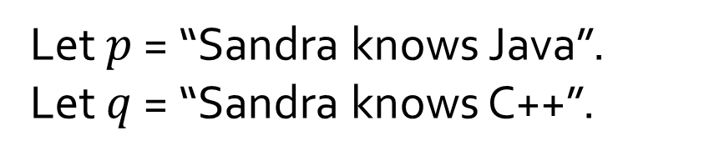
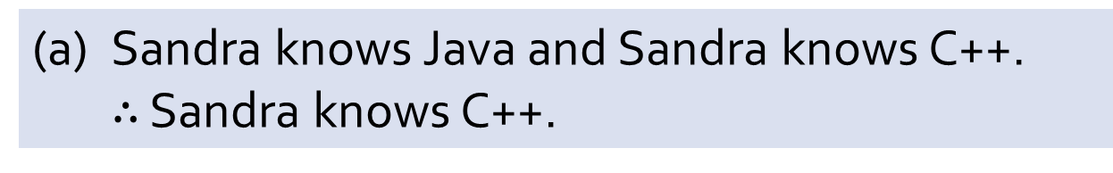
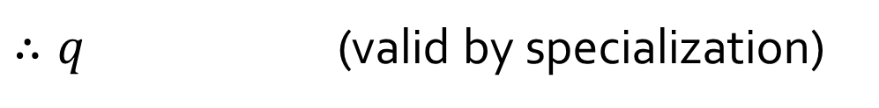
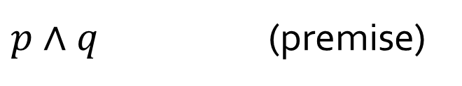
Q6
(a) Sandra knows Java and Sandra knows C++.
$∴$ Sandra knows C++.
Let $p$ = “Sandra knows Java”.
Let $q$ = “Sandra knows C++”.
$p∧q$ (premise)
$∴q$ (valid by specialization)

Slide 23
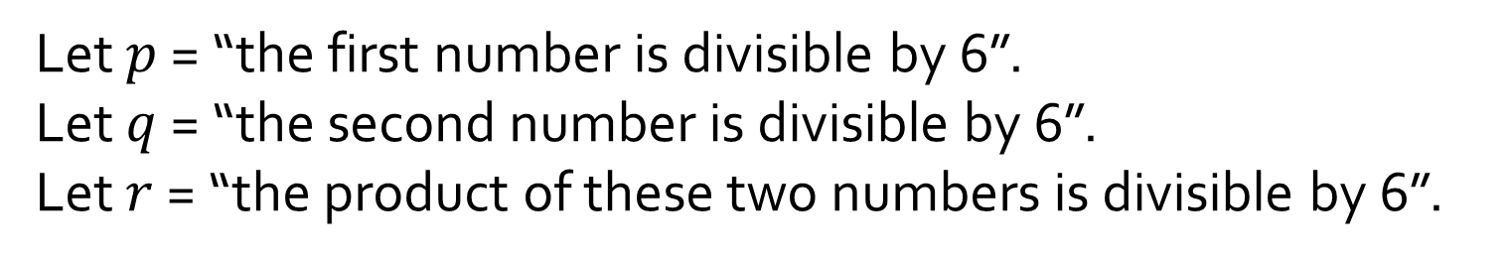
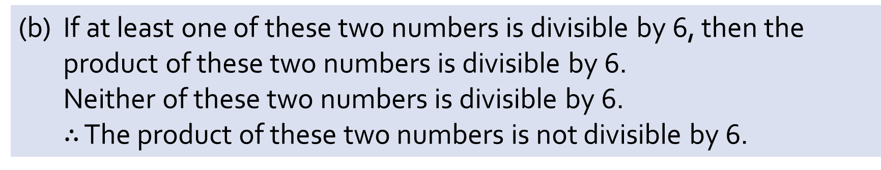
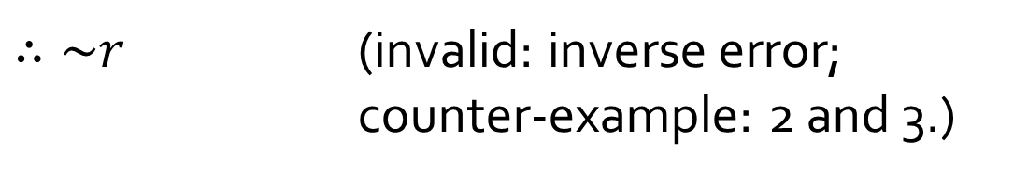
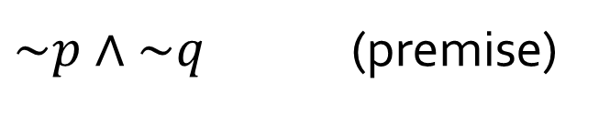
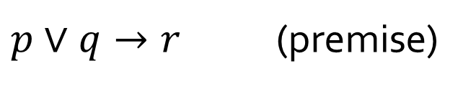
Q6
(b) If at least one of these two numbers is divisible by 6, then the product of these two numbers is divisible by 6.
Neither of these two numbers is divisible by 6.
$∴$ The product of these two numbers is not divisible by 6.
Let $p$ = “the first number is divisible by 6”.
Let $q$ = “the second number is divisible by 6”.
Let $r$ = “the product of these two numbers is divisible by 6”.
$p∨q→r$ (premise)
$\sim p∧\sim q$ (premise)
$∴\sim r$ (invalid: inverse error;
counter-example: 2 and 3.)

Slide 24
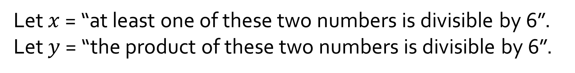
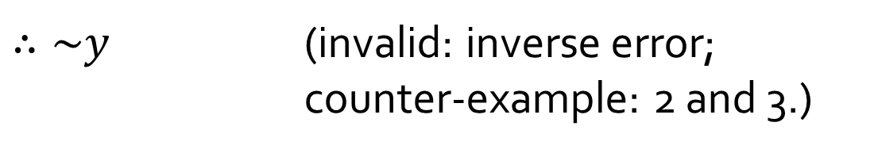
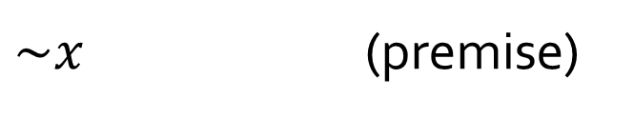
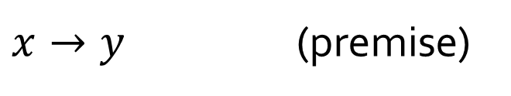
Q6
(b) If at least one of these two numbers is divisible by 6, then the product of these two numbers is divisible by 6.
Neither of these two numbers is divisible by 6.
$∴$ The product of these two numbers is not divisible by 6.
Let’s discuss this version:
Let $x$ = “at least one of these two numbers is divisible by 6”.
Let $y$ = “the product of these two numbers is divisible by 6”.
$x→y$ (premise)
$\sim x$ (premise)
$∴\sim y$ (invalid: inverse error;
counter-example: 2 and 3.)

Slide 25
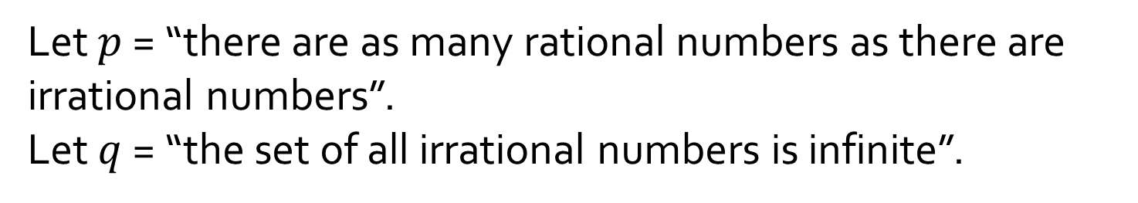
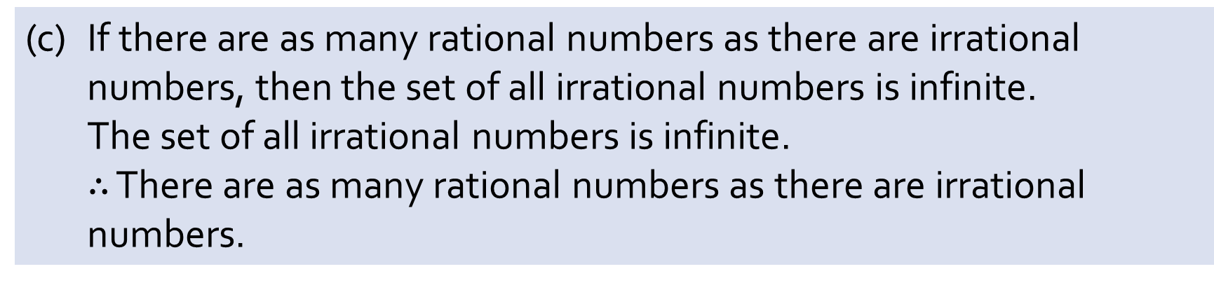
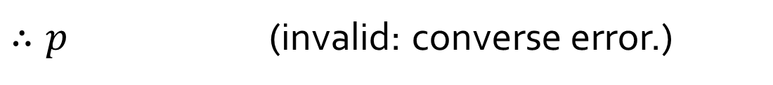
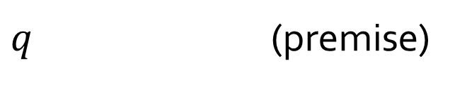
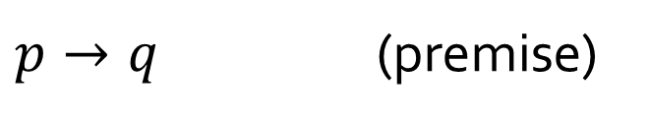
Q6
(c) If there are as many rational numbers as there are irrational numbers, then the set of all irrational numbers is infinite.
The set of all irrational numbers is infinite.
$∴$ There are as many rational numbers as there are irrational numbers.
Let $p$ = “there are as many rational numbers as there are irrational numbers”.
Let $q$ = “the set of all irrational numbers is infinite”.
$p→q$ (premise)
$q$ (premise)
$∴p$ (invalid: converse error.)

Slide 26
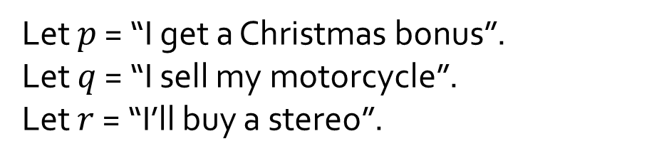



Q6
(d) If I get a Christmas bonus, I’ll buy a stereo.
If I sell my motorcycle, I’ll buy a stereo.
$∴$ If I get a Christmas bonus or I sell my motorcycle, I’ll buy a stereo.
Let $p$ = “I get a Christmas bonus”.
Let $q$ = “I sell my motorcycle”.
Let $r$ = “I’ll buy a stereo”.
$p→r$ (premise)
$q→r$ (premise)
$(p→r)∧(q→r)$ (conjunction of rule of inference)
$(\sim p∨r)∧(\sim q∨r)$ (implication law)
$(\sim p∧\sim q)∨r$ (distributive law)
$\sim (p∨q)∨r$ (De Morgan’s law)
$∴(p∨q)→r$ (implication law)

Slide 27
Q6
(d) If I get a Christmas bonus, I’ll buy a stereo.
If I sell my motorcycle, I’ll buy a stereo.
$∴$ If I get a Christmas bonus or I sell my motorcycle, I’ll buy a stereo.
Let $p$ = “I get a Christmas bonus”.
Let $q$ = “I sell my motorcycle”.
Let $r$ = “I’ll buy a stereo”.
premises
conclusion
p | q | r | p → r | q → r | p ∨ q→ r
T | T | T | T | T | T
T | T | F | F | F | F
T | F | T | T | T | T
T | F | F | F | T | F
F | T | T | T | T | T
F | T | F | T | F | F
F | F | T | T | T | T
F | F | F | T | T | T
27

Slide 28


Q7
Prove that there exist $x,y,z∈ℤ_{>10}$ such that $x^{2}+y^{2}=z^{2}$.
1. Let $x=11,y=60, z=61.$
2. Then $x,y,z∈ℤ_{>10},$ so $x^{2}+y^{2}={11}^{2}+{60}^{2}=121+3600=3721={61}^{2}$.
3. Thus $∃x,y,z∈ℤ_{>10},$ such that $x^{2}+y^{2}=z^{2}$.
Proof by construction.
The values are called Pythagorean triples.

Slide 29


Q8
(a) Two natives A and B:
A says: Both of us are knights.
B says: A is a knave.
Tempting to say “Contradiction” right after 1.4. However, this is not valid because contradiction requires $p∧\sim p$, but ‘knave’ is not the negation of ‘knight’.
Hence 1.5 is required before we arrive at the contradiction in 1.6.
Proof (by contradiction):
1. If A is a knight, then:
1.1 What A says is true. (by definition of knight)
1.2 ∴ B is a knight too. (that’s what A says)
1.3 ∴ What B says is true. (by definition of knight)
1.4 ∴ A is a knave. (that’s what B says)
1.5 ∴ A is not a knight. (since A is either a knight or a knave, but not both)
1.6 ∴ Contradiction to 1.
2. ∴ A is not a knight.
3. ∴ A is a knave. (since A is either a knight or a knave, but not both)
4. ∴ What B says is true.
5. ∴ B cannot be a knave. (as B has said something true)
6. ∴ B is a knight. (as there are only knights and knaves)
7. Conclusion: A is a knave and B is a knight.

Slide 30
Q8
(b) Two natives C and D:
C says: D is a knave.
D says: C is a knave.
How many knights and knaves are there?
Proof (by division in cases):
1. If C is a knight, then:
1.1 What C says is true. (by definition of knight)
1.2 ∴ D is a knave. (that’s what C says)
2. If C is not a knight, then:
2.1 Then C is a knave. (one is either a knight or a knave)
2.2 ∴ what C says is false. (by definition of knave)
2.3 ∴ D is not a knave. (C says D is a knave, but what C says is false)
2.4 ∴ D is a knight. (one is either a knight or a knave)
3. Conclusion: in both cases, there is one knight and one knave.

Slide 31

Q9
Prove Tutorial #1 Lemma #1:
The product of any two odd integers is an odd integer.
To tutors: Definitions of even and odd numbers are given in lecture (lect #1 slide 27)
Direct proof:
1. Take any two odd integers $n,m$.
2. Then $n=2k+1$ and $m=2p+1$, for $k,p∈ℤ$ (by definition of odd numbers)
Hence $nm=\left(2k+1\right)\left(2p+1\right)$
$=\left(2k\left(2p+1\right)\right)+\left(2p+1\right)$
$=\left(4kp+2k\right)+(2p+1)$
$=2\left(2kp+k+p\right)+1$ (by basic algebra)
4. Let $q=2kp+k+p$ which is an integer (by closure under $+$ and $×$).
5. Then $nm=2q+1$ which is odd (by definition of odd numbers)
6. Therefore, the product of any two odd integers is an odd integer.
Give justification

Slide 32


Q10
If $a,b,c$ are integers such that $a^{2}+b^{2}=c^{2}$, then $a,b$ cannot both be odd.
(a) Smart’s attempt:
1. Suppose $a, b$ are both odd.
2. Then $∃k,m∈ℤ$ s.t. $a=2k+1$ and $b=2m+1$.
Then $a^{2}+b^{2}={\left(2k+1\right)}^{2}+{\left(2m+1\right)}^{2}$
$=4k^{2}+4k+4m^{2}+4m+2=c^{2}$
4. Then $c=\sqrt{4k^{2}+4k+4m^{2}+4m+2}$
5. But the right-hand side is not an integer.
6. This contradicts the fact that c is an integer.
7. Hence, $a,b$ cannot both be odd.

Slide 33


Q10
If $a,b,c$ are integers such that $a^{2}+b^{2}=c^{2}$, then $a,b$ cannot both be odd.
(b) Write a proof using contraposition.
Proof by contraposition: if $a,b$ are both odd, then $a^{2}+b^{2}≠c^{2}$.
1. Suppose $a, b$ are both odd.
2. Then $∃k,m∈ℤ$ s.t. $a=2k+1$ and $b=2m+1$ (by def of odd numbers)
Thus $a^{2}+b^{2}={\left(2k+1\right)}^{2}+{\left(2m+1\right)}^{2}$
$=4k^{2}+4k+4m^{2}+4m+2$ (by basic algebra)
4. or, $a^{2}+b^{2}=2(2z+1)$, where $z=k^{2}+k+m^{2}+m$.
5. Now, $z$ is an integer (by closure of integers under $×$ and $+$). Likewise, $2z+1$ is also an integer by the closure property.
6. Hence, $a^{2}+b^{2}$ is even (by definition of even numbers)
7. Moreover, since $2\left(2z+1\right)=4z+2$, it follows that $a^{2}+b^{2}$ has remainder 2 when divided by 4.

Slide 34


Q10
If $a,b,c$ are integers such that $a^{2}+b^{2}=c^{2}$, then $a,b$ cannot both be odd.
(b) Write a proof using contraposition.
Proof by contraposition: if $a,b$ are both odd, then $a^{2}+b^{2}≠c^{2}$.
7. … it follows that $a^{2}+b^{2}$ has remainder 2 when divided by 4.
8. Now, $c$ is either odd or even. (We use division by cases here)
8.1 Case 1: $c$ is odd
8.1.1 Then $c^{2}$ is odd (by Lemma 1 in question 9)
8.1.2 Then $c^{2}≠a^{2}+b^{2}$ since the RHS is even (line 6)
8.2 Case 2: $c$ is even
8.2.1 Then $∃p∈ℤ$ s.t. $c=2p$(by definition of even numbers)
8.2.2 Then $c^{2}={4p}^{2}$ which means $c^{2}$ has remainder zero when divided by 4.
8.2.3 Hence, $c^{2}≠a^{2}+b^{2}$ since RHS has remainder 2 when divided by 4.
9. In all case, $c^{2}≠a^{2}+b^{2}$.
10. Therefore, by contraposition, the original statement is true.

Slide 35

Tutorial answers will be uploaded on LumiNUS at the end of the week.
If you still have any doubts, please contact me or post on the LumiNUS forum.

