Slide 1
Cs1231S tutorial #10
Counting 2

Slide 2
Learning objectives of this tutorial
Counting
Counting combinations (where order does not matter).
Solving multiset problems.
Applying combinatorial argument in proof.
Applying Binomial Theorem.
Calculating expected value.
Using conditional probability and Bayes’ Theorem.

Slide 3



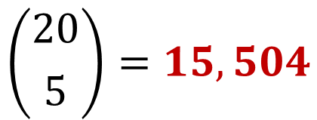
Q1.
6
12
20
How many teams of 5 members can you have if:
Designer
Consultant
Programmer
(a) The team is made up completely of programmers.
$$\left({20 \atop 5}\right)=15,504$$

Slide 4
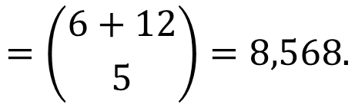
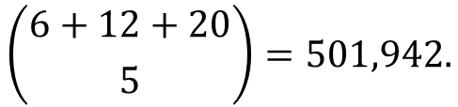
Q1.
6
12
20
How many teams of 5 members can you have if:
(b) The team must have at least 1 programmer.
Designer
Consultant
Programmer
1. Total number of possible teams:
$$\left({6+12+20 \atop 5}\right)=501,942.$$
2. Teams with no programmers
$=$ number of teams consisting entirely of designers or consultants
$$=\left({6+12 \atop 5}\right)=8,568.$$
3. $∴$ #teams with at least 1 programmer$: 501,942−8,568=493,374$.

Slide 5
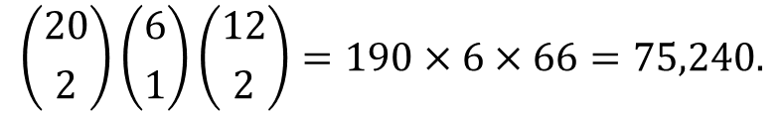
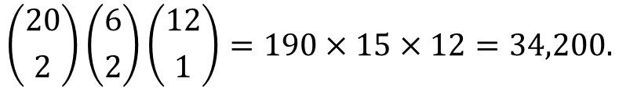
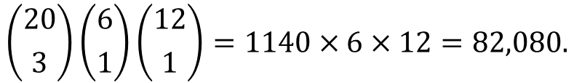
Q1.
6
12
20
How many teams of 5 members can you have if:
(c) The team must have at least 2 programmers, at least 1 designer and at least 1 business consultant.
Designer
Consultant
Programmer
There are 3 possibilities:
1. #teams with 3 programmers, 1 designer and 1 consultant:
$$\left({20 \atop 3}\right)\left({6 \atop 1}\right)\left({12 \atop 1}\right)=1140×6×12=82,080.$$
2. #teams with 2 programmers, 2 designers and 1 consultant:
$$\left({20 \atop 2}\right)\left({6 \atop 2}\right)\left({12 \atop 1}\right)=190×15×12=34,200.$$
2. #teams with 2 programmers, 1 designer and 2 consultants:
$$\left({20 \atop 2}\right)\left({6 \atop 1}\right)\left({12 \atop 2}\right)=190×6×66=75,240.$$
Therefore, total number of teams$:82,080+34,200+75,240=191,520$.

Slide 6
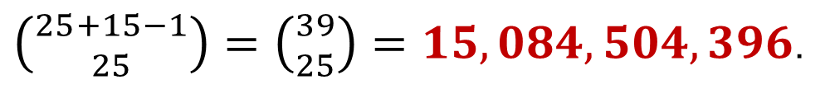
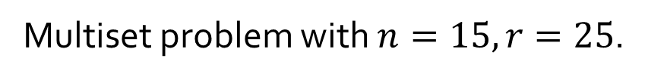
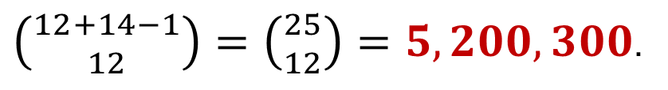
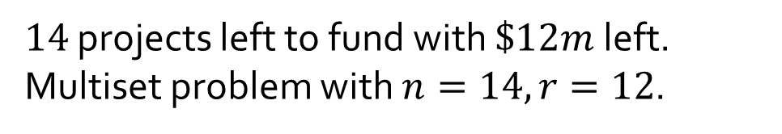
Q2.
$25m of funds for 15 projects. Funding amounts in units of $1m.
(a) How many ways can you fund the 15 projects?
Multiset problem with $n=15, r=25$.
$\left({25+15−1 \atop 25}\right)=\left({39 \atop 25}\right)=15,084,504,396$.
(b) Must provide exactly $3m for one project, at at least $2m for each of 5 other projects. How many ways can you fund the 15 projects?
$14$ projects left to fund with $\$12m$left.
Multiset problem with $n=14, r=12$.
$\left({12+14−1 \atop 12}\right)=\left({25 \atop 12}\right)=5,200,300$.

Slide 7

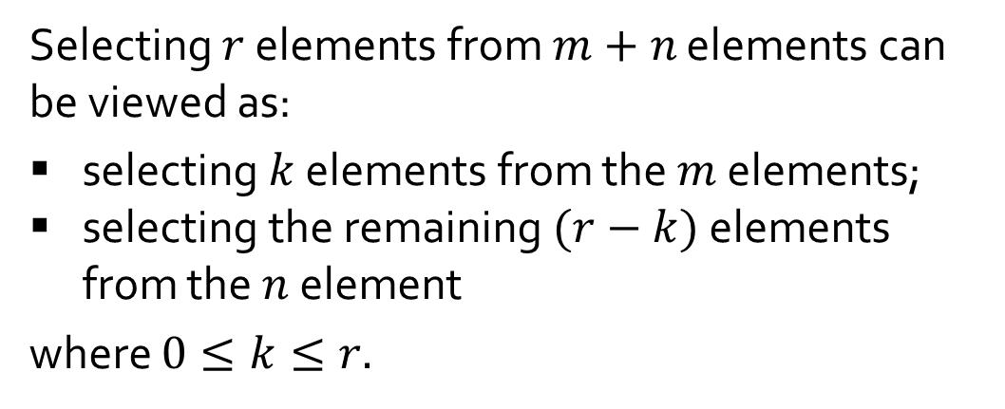






Q3.
Think of a set with $m+n$ elements as composed of 2 parts, one with $m$ elements and the other with $n$ elements. Give a combinatorial argument to show that:
$$\left({m+n \atop r}\right)=\left({m \atop 0}\right)\left({n \atop r}\right)+\left({m \atop 1}\right)\left({n \atop r−1}\right)+⋯+\left({m \atop r}\right)\left({n \atop 0}\right)$$
… (A)
where $m,n∈ℤ^{+},r≤m$ and $r≤n$.
Pick: $0$ element; $r$ elements.
Selecting $r$ elements from $m+n$ elements can be viewed as:
selecting $k$ elements from the $m$ elements;
selecting the remaining $(r−k)$ elements from the $n$ element
where $0≤k≤r.$
$m$ elements
$n$ elements
Pick: $1$ element; $r−1$ elements.
Pick: $r$ elements; $0$element.

Slide 8

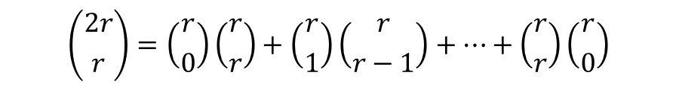
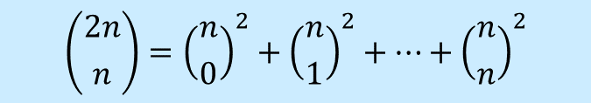


Q3.
$$\left({m+n \atop r}\right)=\left({m \atop 0}\right)\left({n \atop r}\right)+\left({m \atop 1}\right)\left({n \atop r−1}\right)+⋯+\left({m \atop r}\right)\left({n \atop 0}\right)$$
… (A)
where $m,n∈ℤ^{+},r≤m$ and $r≤n$.
Using equation (A), prove that for all integers $n≥0,$
$$\left({2n \atop n}\right)={\left({n \atop 0}\right)}^{2}+{\left({n \atop 1}\right)}^{2}+⋯+{\left({n \atop n}\right)}^{2}$$
Let $m=n=r$, then equation (A) becomes
$$\left({2r \atop r}\right)=\left({r \atop 0}\right)\left({r \atop r}\right)+\left({r \atop 1}\right)\left({r \atop r−1}\right)+⋯+\left({r \atop r}\right)\left({r \atop 0}\right)$$
From Lecture #11 example 8, $\left({n \atop r}\right)=\left({n \atop n−r}\right)$, therefore the above is equivalent to
$$\left({2r \atop r}\right)=\left({r \atop 0}\right)\left({r \atop 0}\right)+\left({r \atop 1}\right)\left({r \atop 1}\right)+⋯+\left({r \atop r}\right)\left({r \atop r}\right)={\left({r \atop 0}\right)}^{2}+{\left({r \atop 1}\right)}^{2}+⋯+{\left({r \atop r}\right)}^{2}$$

Slide 9
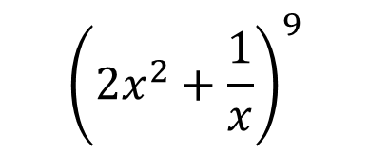

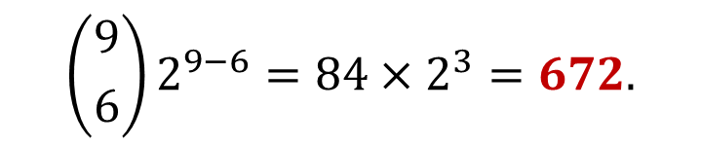
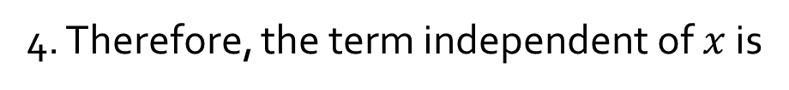
Q4.
Find the term independent of $x$ in the expansion of
$${\left(2x^{2}+\frac{1}{x}\right)}^{9}$$
Recall the Binomial Theorem:
$${\left(a+b\right)}^{n}=a^{n}+\left({n \atop 1}\right)a^{n−1}b^{1}+\left({n \atop 2}\right)a^{n−2}b^{2}+⋯+\left({n \atop n−1}\right)a^{1}b^{n−1}+b^{n}$$
1. We have $a=2x^{2},b=\frac{1}{x},n=9.$
2. The general term in the expansion of ${(a+b)}^{n}$ is given by:
$$\left({n \atop r}\right)a^{n−r}b^{r}=\left({9 \atop r}\right){(2x^{2})}^{9−r}{\left(\frac{1}{x}\right)}^{r}=\left({9 \atop r}\right)2^{9−r}x^{18−2r}x^{−r}=\left({9 \atop r}\right)2^{9−r}x^{18−3r}$$
3. For this term to be independent of $x$, we must have $18−3r=0,$ or $r=6$.
4. Therefore, the term independent of $x$ is
$$\left({9 \atop 6}\right)2^{9−6}=84×2^{3}=672.$$

Slide 10


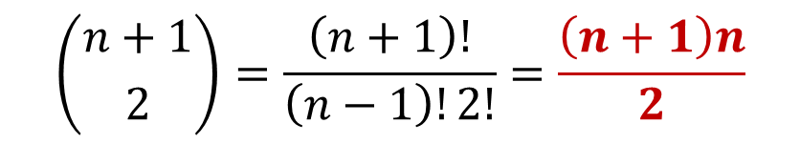

Q5.
Given n boxes numbered 1 to n, each box to be filled with a white ball or a blue ball. At least one box contains a white ball and boxes containing white balls must be consecutively numbered.
What is the total number of ways this can be done?
$$\sum_{k=1}^{n}{k}=\frac{n\left(n+1\right)}{2}$$
X
X
X
X
…
X
X
1 2 3 … n
The task is similar to choose $2$ out of the $n+1$ crosses to mark the start and end of the consecutively numbered boxes that contain the white balls.
$$\left({n+1 \atop 2}\right)=\frac{\left(n+1\right)!}{\left(n−1\right)!2!}=\frac{\left(n+1\right)n}{2}$$

Slide 11
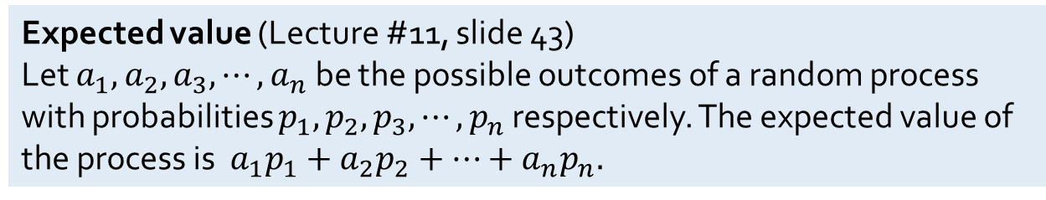
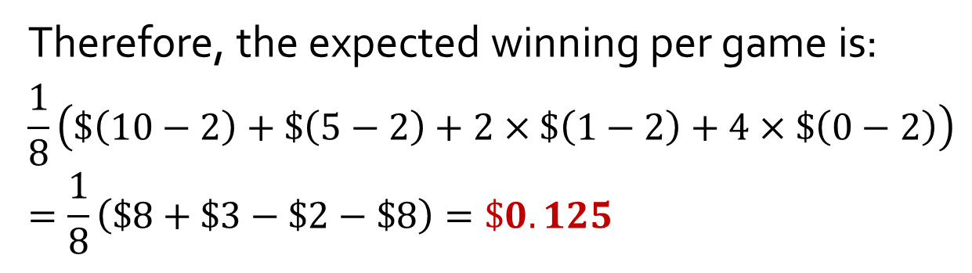

Q6.
Toss 3 coins once each for $2.
3 heads → win $10; 2 heads (not in a row) → win $5; 2 heads (in a row) → win $1.
If you play this game many times, how much would you win overall per game?
Each outcome has equal probability of $\frac{1}{8}.$
Outcome | Winning
HHH | $10
HHT | $1
HTH | $5
HTT | $0
THH | $1
THT | $0
TTH | $0
TTT | $0
Therefore, the expected winning per game is:
$$\frac{1}{8}\left(\$\left(10−2\right)+\$\left(5−2\right)+2×\$\left(1−2\right)+4×\$\left(0−2\right)\right)=\frac{1}{8}\left(\$8+\$3−\$2−\$8\right)=\$0.125$$
Expected value (Lecture #11, slide 43)
Let $a_{1},a_{2},a_{3},⋯,a_{n}$ be the possible outcomes of a random process with probabilities $p_{1},p_{2},p_{3},⋯,p_{n}$ respectively. The expected value of the process is $a_{1}p_{1}+a_{2}p_{2}+⋯+a_{n}p_{n}.$

Slide 12
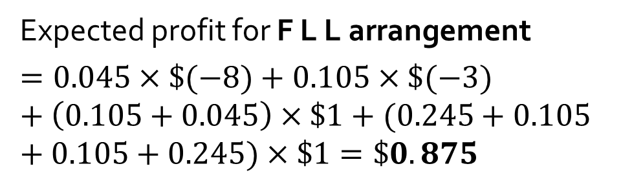
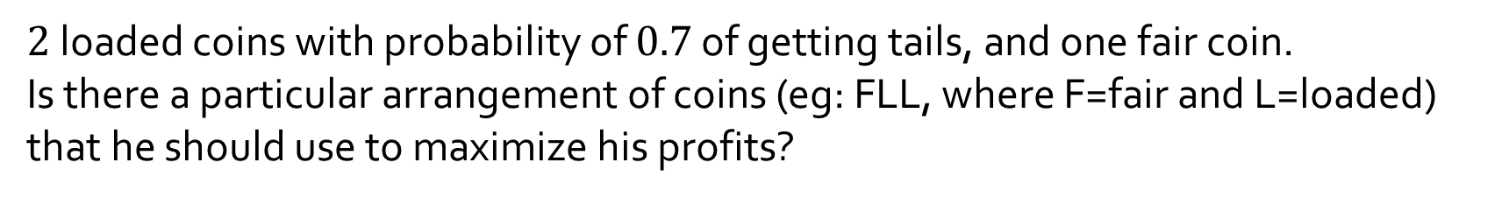
Q7.
$2$ loaded coins with probability of $0.7$ of getting tails, and one fair coin.
Is there a particular arrangement of coins (eg: FLL, where F=fair and L=loaded) that he should use to maximize his profits?
 | Arrangement: F L L
HHH (1) Profit: -8 | 0.5 × 0.3 × 0.3 = 0.045
HTH (2) Profit: -3 | 0.5 × 0.7 × 0.3 = 0.105
HHT (3) Profit: 1 | 0.5 × 0.3 × 0.7 = 0.105
THH (4) Profit: 1 | 0.5 × 0.3 × 0.3 = 0.045
TTT (5) Profit: 2 | 0.5 x 0.7 x 0.7 = 0.245
TTH (6) Profit: 2 | 0.5 x 0.7 x 0.3 = 0.105
THT (7) Profit: 2 | 0.5 x 0.3 x 0.7 = 0.105
HTT (8) Profit: 2 | 0.5 x 0.7 x 0.7 = 0.245
3 possible arrangement of coins:
F L L, L F L, L L F
We will build a table of possible probabilities for each winning outcomes.
Expected profit for F L L arrangement
$$=0.045×\$(−8)+0.105×\$(−3)+\left(0.105+0.045\right)×\$1+(0.245+0.105+0.105+0.245)×\$1=\$0.875$$

Slide 13
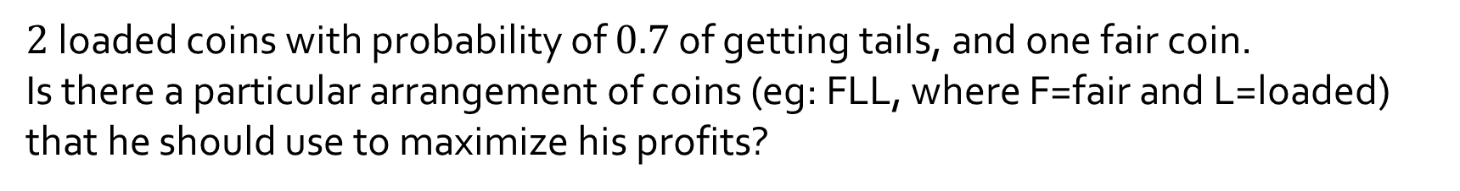
Q7.
$2$ loaded coins with probability of $0.7$ of getting tails, and one fair coin.
Is there a particular arrangement of coins (eg: FLL, where F=fair and L=loaded) that he should use to maximize his profits?
 | F L L | L F L | L L F
HHH (1) Profit: -8 | 0.5 × 0.3 × 0.3 = 0.045 | 0.3 × 0.5 × 0.3 = 0.045 | 0.3 × 0.3 × 0.5 = 0.045
HTH (2) Profit: -3 | 0.5 × 0.7 × 0.3 = 0.105 | 0.3 × 0.5 × 0.3 = 0.045 | 0.3 × 0.7 × 0.5 = 0.105
HHT (3) Profit: 1 | 0.5 × 0.3 × 0.7 = 0.105 | 0.3 × 0.5 × 0.7 = 0.105 | 0.3 × 0.3 × 0.5 = 0.045
THH (4) Profit: 1 | 0.5 × 0.3 × 0.3 = 0.045 | 0.7 × 0.5 × 0.3 = 0.105 | 0.7 × 0.3 × 0.5 = 0.105
TTT (5) Profit: 2 | 0.5 x 0.7 x 0.7 = 0.245 | 0.7 x 0.5 x 0.7 = 0.245 | 0.7 x 0.7 x 0.5 = 0.245
TTH (6) Profit: 2 | 0.5 x 0.7 x 0.3 = 0.105 | 0.7 x 0.5 x 0.3 = 0.105 | 0.7 x 0.7 x 0.5 = 0.245
THT (7) Profit: 2 | 0.5 x 0.3 x 0.7 = 0.105 | 0.7 x 0.5 x 0.7 = 0.245 | 0.7 x 0.3 x 0.5 = 0.105
HTT (8) Profit: 2 | 0.5 x 0.7 x 0.7 = 0.245 | 0.3 x 0.5 x 0.7 = 0.105 | 0.3 x 0.7 x 0.5 = 0.105
Expected profit (1) × -8 + (2) × -3 + [(3) + (4)] × 1 + ((5) + (6) + (7) + (8)) x 2 | $0.875 | $1.115 | $0.875
He should use L F L. , which has the highest profit.

Slide 14

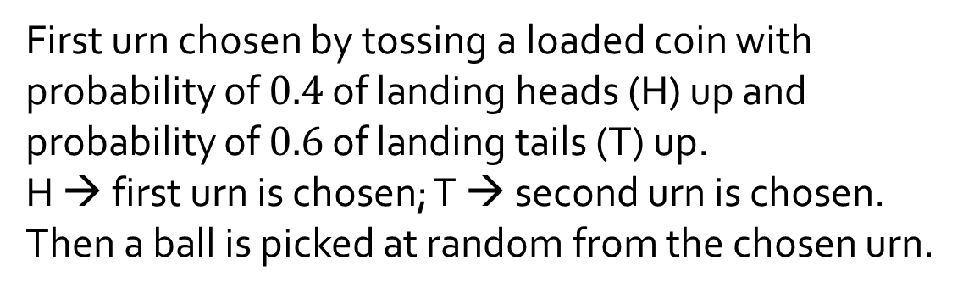
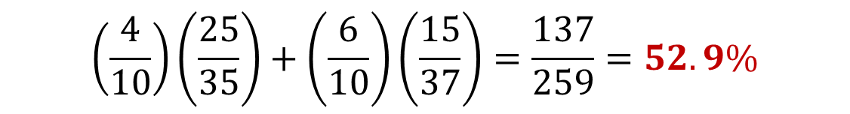
Q8.
Urn 1
Urn 2
First urn chosen by tossing a loaded coin with probability of $0.4$ of landing heads (H) up and probability of $0.6$ of landing tails (T) up.
H → first urn is chosen; T → second urn is chosen.
Then a ball is picked at random from the chosen urn.
10 red
25 green
22 red
15 green
(a) What is the probability that the chosen ball is green?
$$\left(\frac{4}{10}\right)\left(\frac{25}{35}\right)+\left(\frac{6}{10}\right)\left(\frac{15}{37}\right)=\frac{137}{259}=52.9\%$$
To tutors: Students are to know what “3 significant figures” means. (Required for the exam!)

Slide 15
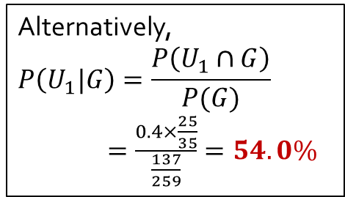
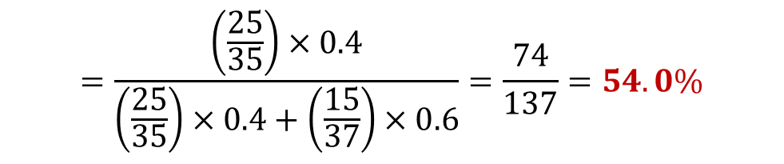
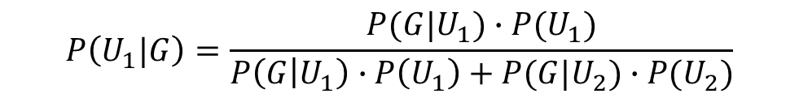
Q8.
Urn 1
Urn 2
First urn chosen by tossing a loaded coin with probability of $0.4$ of landing heads (H) up and probability of $0.6$ of landing tails (T) up.
H → first urn is chosen; T → second urn is chosen.
Then a ball is picked at random from the chosen urn.
10 red
25 green
22 red
15 green
(b) If the chosen ball is green, what is the probability that it was picked from the first urn?
Let $G$ be the event that the chosen ball is green, $U_{1}$ the event that the ball came from the first urn, and $U_{2}$ the event that the ball came from the second urn.
$$P\left(U_{1}\right)=0.4, P\left(U_{2}\right)=0.6, P\left(G | U_{1}\right)=\frac{25}{35}, P\left(G | U_{2}\right)=\frac{15}{37}.$$
By Bayes’ Theorem,
$$P\left(U_{1}|G\right)=\frac{P(G|U_{1})∙P(U_{1})}{P\left(G | U_{1}\right)∙P\left(U_{1}\right)+P(G|U_{2})∙P(U_{2})}$$
Alternatively,
$$P\left(U_{1}|G\right)=\frac{P\left(U_{1}∩G\right)}{P(G)}$$
$=\frac{0.4×\frac{25}{35}}{\frac{137}{259}}=54.0\%$
$$=\frac{\left(\frac{25}{35}\right)×0.4}{\left(\frac{25}{35}\right)×0.4+\left(\frac{15}{37}\right)×0.6}=\frac{74}{137}=54.0\%$$

Slide 16
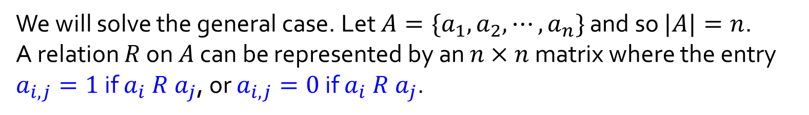
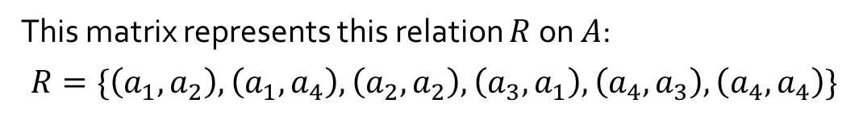
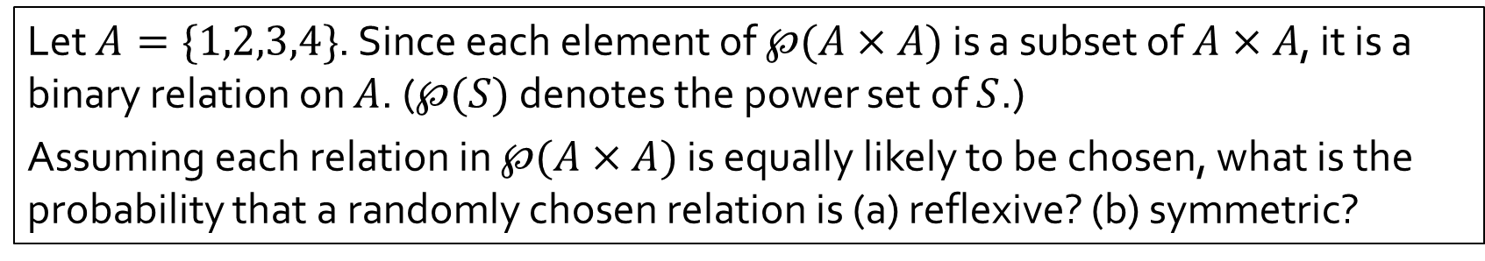


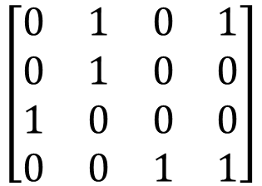
Q9.
Let $A=\{1,2,3,4\}$. Since each element of $℘(A×A)$ is a subset of $A×A$, it is a binary relation on $A$. ($℘(S)$ denotes the power set of $S$.)
Assuming each relation in $℘(A×A)$ is equally likely to be chosen, what is the probability that a randomly chosen relation is (a) reflexive? (b) symmetric?
We will solve the general case. Let $A=\{a_{1},a_{2},⋯,a_{n}\}$ and so $|A|=n$.
A relation $R$ on $A$ can be represented by an $n×n$ matrix where the entry $a_{i,j}=1$ if $a_{i} R a_{j}$, or $a_{i,j}=0$ if $a_{i} R a_{j}$.
Example:
$$a_{1}{ a}_{2} a_{3} a_{4}$$
$$a_{1}$$
$$a_{2}$$
$$a_{3}$$
$$a_{4}$$
$$\left[\begin{matrix}0 & 1 & 0 & 1 \\ 0 & 1 & 0 & 0 \\ 1 & 0 & 0 & 0 \\ 0 & 0 & 1 & 1\end{matrix}\right]$$
This matrix represents this relation $R$ on $A$:
$$R=\{\left(a_{1},a_{2}\right),\left(a_{1},a_{4}\right),\left(a_{2},a_{2}\right),\left(a_{3},a_{1}\right),\left(a_{4},a_{3}\right),\left(a_{4},a_{4}\right)\}$$

Slide 17
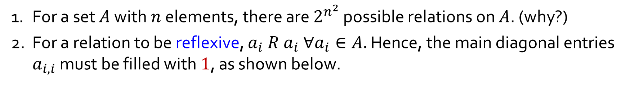
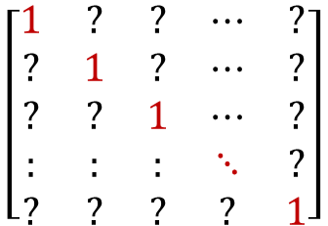
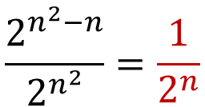
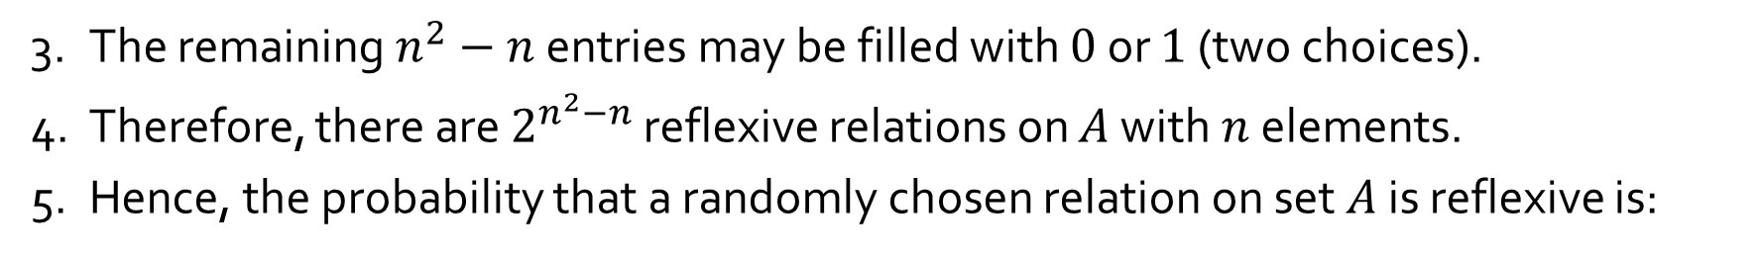
Q9.
(a) Reflexive relations
1. For a set $A$ with $n$ elements, there are $2^{n^{2}}$ possible relations on $A$. (why?)
2. For a relation to be reflexive, $a_{i} R a_{i} ∀a_{i}∈A.$ Hence, the main diagonal entries $a_{i,i}$ must be filled with $1$, as shown below.
$$\left[\begin{matrix}1 & ? & ? & ⋯ & ? \\ ? & 1 & ? & ⋯ & ? \\ ? & ? & 1 & ⋯ & ? \\ : & : & : & ⋱ & ? \\ ? & ? & ? & ? & 1\end{matrix}\right]$$
3. The remaining $n^{2}−n$ entries may be filled with $0$ or $1$ (two choices).
4. Therefore, there are $2^{n^{2}−n}$ reflexive relations on $A$ with $n$ elements.
5. Hence, the probability that a randomly chosen relation on set $A$ is reflexive is:
$$\frac{2^{n^{2}−n}}{2^{n^{2}}}=\frac{1}{2^{n}}$$
In particular, when $n=4$, the probability is $\frac{1}{2^{4}}$ or $\frac{1}{16}.$

Slide 18
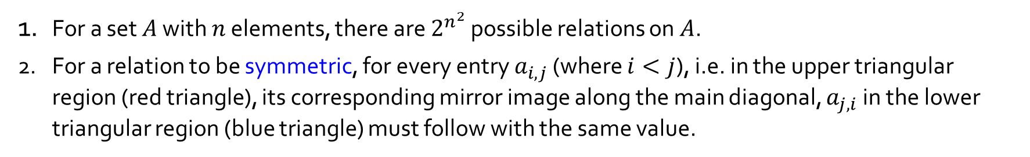


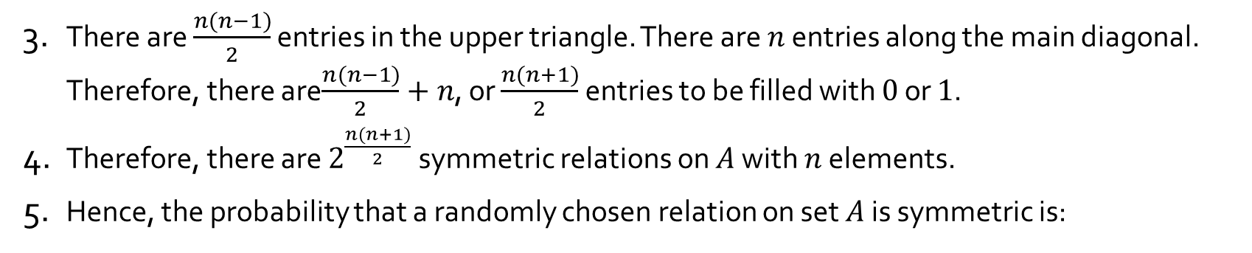
Q9.
(b) Symmetric relations
1. For a set $A$ with $n$ elements, there are $2^{n^{2}}$ possible relations on $A$.
2. For a relation to be symmetric, for every entry $a_{i,j}$ (where $i<j$), i.e. in the upper triangular region (red triangle), its corresponding mirror image along the main diagonal, $a_{j,i}$ in the lower triangular region (blue triangle) must follow with the same value.
$$\left[\begin{matrix}? & ? & ? & ⋯ & ? \\ ? & ? & ? & ⋯ & ? \\ ? & ? & ? & ⋯ & ? \\ : & : & : & ⋱ & ? \\ ? & ? & ? & ? & ?\end{matrix}\right]$$
3. There are $\frac{n(n−1)}{2}$ entries in the upper triangle. There are $n$ entries along the main diagonal. Therefore, there are$\frac{n(n−1)}{2}+n$, or $\frac{n(n+1)}{2}$ entries to be filled with $0$ or $1$.
4. Therefore, there are $2^{\frac{n(n+1)}{2}}$ symmetric relations on $A$ with $n$ elements.
5. Hence, the probability that a randomly chosen relation on set $A$ is symmetric is:
$$\frac{2^{\frac{n(n+1)}{2}}}{2^{n^{2}}}=\frac{1}{2^{\frac{n^{2}−n}{2}}}$$
In particular, when $n=4$, the probability is $\frac{1}{2^{6}}$ or $\frac{1}{64}.$

Slide 19
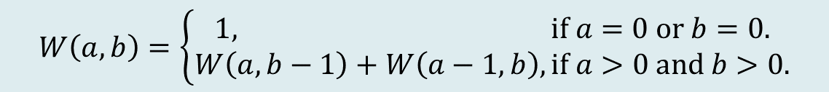
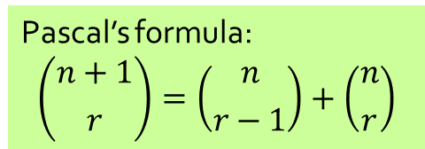
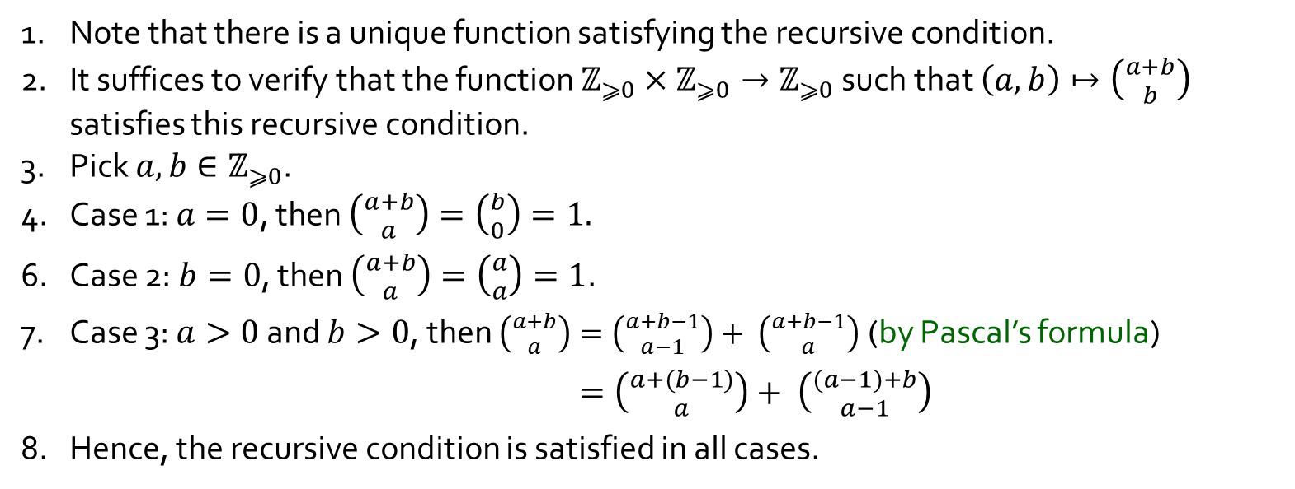
Q10.
Let us define a function $W(a,b)$ to be the number of ways the tournament can be completed if team $A$ has to win $a$ more games to win, while team $B$ has to win $b$ more games to win.
$$W\left(a,b\right)=\left\{\begin{aligned}1, if a=0 or b=0. \\ W\left(a,b−1\right)+W\left(a−1,b\right), if a>0 and b>0.\end{aligned}\right.$$
Verify that $W\left(a,b\right)=\left({a+b \atop a}\right)$ using the above recursive condition.
1. Note that there is a unique function satisfying the recursive condition.
2. It suffices to verify that the function $ℤ_{⩾0}×ℤ_{⩾0}→ℤ_{⩾0}$ such that $\left(a,b\right)↦\left({a+b \atop b}\right)$ satisfies this recursive condition.
3. Pick $a,b∈ℤ_{⩾0}$.
4. Case 1: $a=0$, then $\left({a+b \atop a}\right)=\left({b \atop 0}\right)=1.$
6. Case 2: $b=0$, then $\left({a+b \atop a}\right)=\left({a \atop a}\right)=1$.
7. Case 3: $a>0$ and $b>0$, then $\left({a+b \atop a}\right)=\left({a+b−1 \atop a−1}\right)+ \left({a+b−1 \atop a}\right)$ (by Pascal’s formula)
$=\left({a+(b−1) \atop a}\right)+ \left({(a−1)+b \atop a−1}\right)$
8. Hence, the recursive condition is satisfied in all cases.
Pascal’s formula:
$$\left({n+1 \atop r}\right)=\left({n \atop r−1}\right)+\left({n \atop r}\right)$$

Slide 20
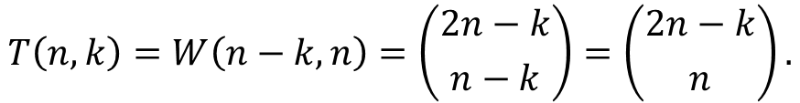
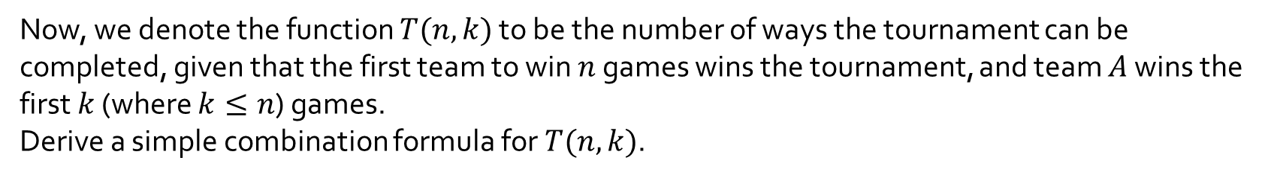


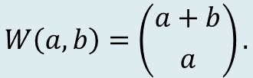
Q10.
$$W\left(a,b\right)=\left({a+b \atop a}\right).$$
Now, we denote the function $T(n,k)$ to be the number of ways the tournament can be completed, given that the first team to win $n$ games wins the tournament, and team $A$ wins the first $k$ (where $k≤n$) games.
Derive a simple combination formula for $T(n,k)$.
$$T\left(n,k\right)=W\left(n−k,n\right)=\left({2n−k \atop n−k}\right)=\left({2n−k \atop n}\right).$$
(by lecture 11 example 8: $\left({n \atop r}\right)=\left({n \atop n−r}\right)$.)
Therefore, $T\left(4,2\right)=\left({6 \atop 4}\right)=15.$

Slide 21
THE END

