Slide 1
Cs1231S tutorial #11
Graphs and Trees

Slide 2
Learning objectives of this tutorial
Graphs and Trees
Introducing complement graphs and self-complementary graphs.
Calculating the number of walks of a certain length in a graph.
Modeling a problem as a graph problem.
Understanding pre-order, in-order and post-order traversals.
Calculating the number of spanning trees in a graph.
Applying Kruskal’s Algorithm and Prim’s Algorithm.

Slide 3

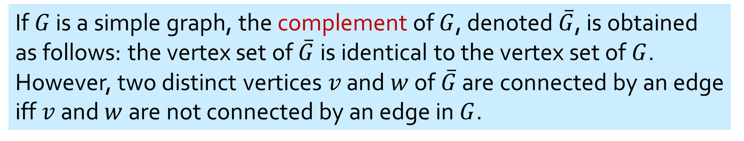


Definitions
If $G$ is a simple graph, the complement of $G$, denoted $\overline{G}$, is obtained as follows: the vertex set of $\overline{G}$is identical to the vertex set of $G$. However, two distinct vertices $v$ and $w$ of $\overline{G}$ are connected by an edge iff $v$ and $w$ are not connected by an edge in $G$.
$G$:
$\overline{G}$:
A self-complementary graph is isomorphic with its complement.
A graph $G$ and its complement $\overline{G}$.
A simple circuit (cycle) of length 3 is called a triangle.

Slide 4




Q1.
Draw all self-complementary graphs with
Complement graph
(a) 4 vertices
How about this?
$$≅$$
$$≇$$
(b) 5 vertices
$$≅$$
$$≅$$

Slide 5
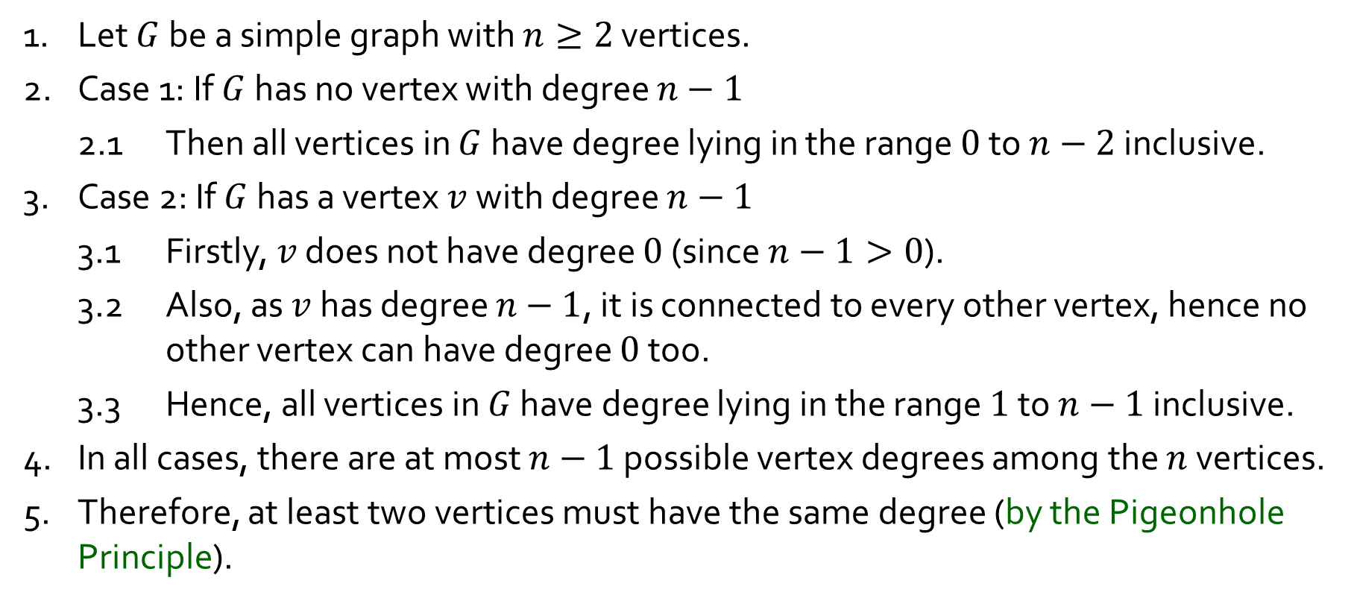
Q2.
Show that every simple graph with at least 2 vertices has two vertices of the same degree.
1. Let $G$ be a simple graph with $n≥2$ vertices.
2. Case 1: If $G$ has no vertex with degree $n−1$
2.1 Then all vertices in $G$ have degree lying in the range $0$ to $n−2$ inclusive.
3. Case 2: If $G$ has a vertex $v$ with degree $n−1$
3.1 Firstly, $v$ does not have degree $0$ (since $n−1>0$).
3.2 Also, as $v$ has degree $n−1$, it is connected to every other vertex, hence no other vertex can have degree $0$ too.
3.3 Hence, all vertices in $G$ have degree lying in the range $1$ to $n−1$ inclusive.
4. In all cases, there are at most $n−1$ possible vertex degrees among the $n$ vertices.
5. Therefore, at least two vertices must have the same degree (by the Pigeonhole Principle).

Slide 6
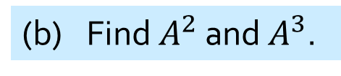
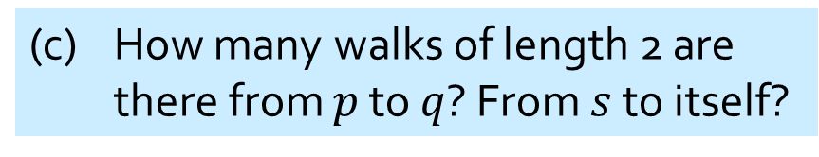
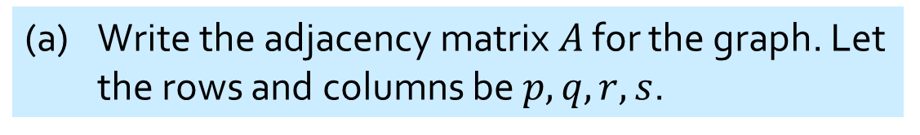
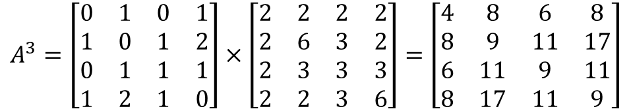

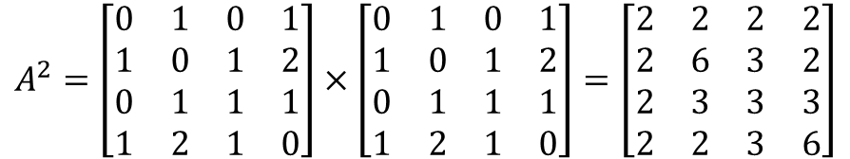
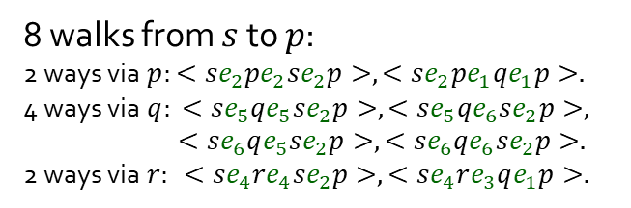

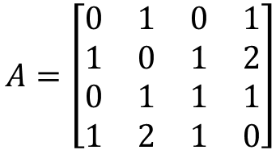
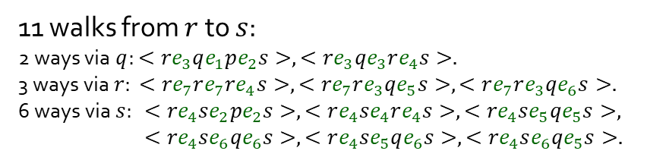
Q3.
(a) Write the adjacency matrix $A$ for the graph. Let the rows and columns be $p,q,r,s$.
Given this graph
p
e₁
q
$$p q r s$$
e₃
$$A=\left[\begin{matrix}0 & 1 & 0 & 1 \\ 1 & 0 & 1 & 2 \\ 0 & 1 & 1 & 1 \\ 1 & 2 & 1 & 0\end{matrix}\right]$$
$$p$$
$$q$$
$$r$$
$$s$$
(b) Find $A^{2}$ and $A^{3}$.
e₂
e₅
e₆
e₇
$$A^{2}=\left[\begin{matrix}0 & 1 & 0 & 1 \\ 1 & 0 & 1 & 2 \\ 0 & 1 & 1 & 1 \\ 1 & 2 & 1 & 0\end{matrix}\right]×\left[\begin{matrix}0 & 1 & 0 & 1 \\ 1 & 0 & 1 & 2 \\ 0 & 1 & 1 & 1 \\ 1 & 2 & 1 & 0\end{matrix}\right]=\left[\begin{matrix}2 & 2 & 2 & 2 \\ 2 & 6 & 3 & 2 \\ 2 & 3 & 3 & 3 \\ 2 & 2 & 3 & 6\end{matrix}\right]$$
r
e₄
s
(c) How many walks of length 2 are there from $p$ to $q$? From $s$ to itself?
$$A^{3}=\left[\begin{matrix}0 & 1 & 0 & 1 \\ 1 & 0 & 1 & 2 \\ 0 & 1 & 1 & 1 \\ 1 & 2 & 1 & 0\end{matrix}\right]×\left[\begin{matrix}2 & 2 & 2 & 2 \\ 2 & 6 & 3 & 2 \\ 2 & 3 & 3 & 3 \\ 2 & 2 & 3 & 6\end{matrix}\right]=\left[\begin{matrix}4 & 8 & 6 & 8 \\ 8 & 9 & 11 & 17 \\ 6 & 11 & 9 & 11 \\ 8 & 17 & 11 & 9\end{matrix}\right]$$
2 walks from $p$ to $q$: $<pe_{2}se_{5}q>,<pe_{2}se_{6}q>.$
6 walks from $s$ to $s$: $<se_{2}pe_{2}s>,<se_{4}re_{4}s>$ $,<se_{5}qe_{5}s>,,<se_{6}qe_{6}s>,$ $<se_{5}qe_{6}s>,,<se_{6}qe_{5}s>.$
(d) How many walks of length 3 are there from $r$ to $s$? From $s$ to $p$?
11 walks from $r$ to $s$:
2 ways via $q$: $<re_{3}qe_{1}pe_{2}s>,<re_{3}qe_{3}re_{4}s>.$
3 ways via $r$: $<re_{7}re_{7}re_{4}s>,<re_{7}re_{3}qe_{5}s>,<re_{7}re_{3}qe_{6}s>.$
6 ways via $s$: $<re_{4}se_{2}pe_{2}s>,<re_{4}se_{4}re_{4}s>,<re_{4}se_{5}qe_{5}s>,$
$<re_{4}se_{6}qe_{6}s>,<re_{4}se_{5}qe_{6}s>,<re_{4}se_{6}qe_{5}s>.$
8 walks from $s$ to $p$:
2 ways via $p$: $<se_{2}pe_{2}se_{2}p>,<se_{2}pe_{1}qe_{1}p>.$
4 ways via $q$: $<se_{5}qe_{5}se_{2}p>,<se_{5}qe_{6}se_{2}p>,$
$<se_{6}qe_{5}se_{2}p>,<se_{6}qe_{6}se_{2}p>.$
2 ways via $r$: $<se_{4}re_{4}se_{2}p>,<se_{4}re_{3}qe_{1}p>.$

Slide 7
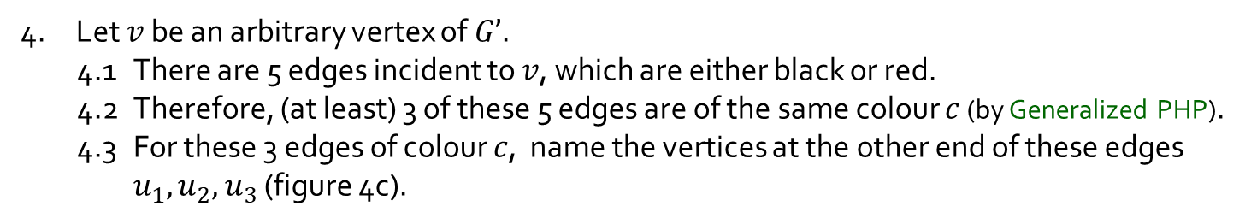
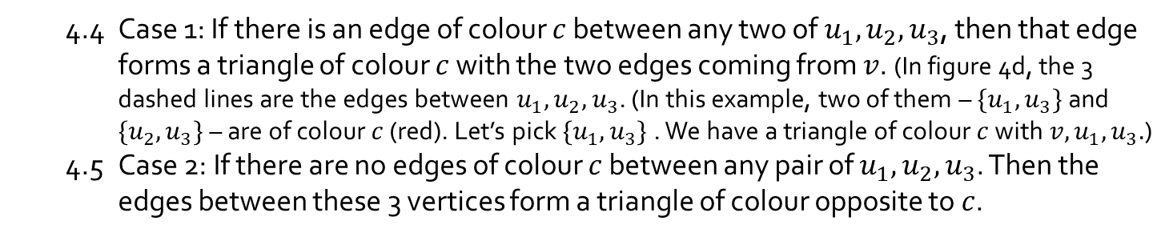

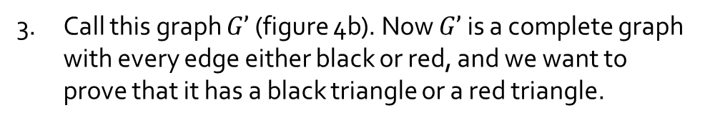



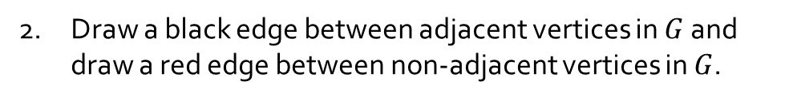






Q4.
Prove that for any simple graph $G$ with 6 vertices, $G$ or its complementary graph $\overline{G}$ contains a triangle.
1. Take any simple graph $G$ with 6 vertices (figure 4a).
2. Draw a black edge between adjacent vertices in $G$ and draw a red edge between non-adjacent vertices in $G$.
3. Call this graph $G’$ (figure 4b). Now $G’$ is a complete graph with every edge either black or red, and we want to prove that it has a black triangle or a red triangle.
Figure 4a: Graph $G$
Figure 4b: Graph $G’$
$$u_{1}$$
4. Let $v$ be an arbitrary vertex of $G’$.
4.1 There are 5 edges incident to $v$, which are either black or red.
4.2 Therefore, (at least) 3 of these 5 edges are of the same colour $c$ (by Generalized PHP).
4.3 For these 3 edges of colour $c$, name the vertices at the other end of these edges $u_{1},u_{2},$ $u_{3}$ (figure 4c).
$$u_{2}$$
$$v$$
$u_{3}$u
4.4 Case 1: If there is an edge of colour $c$ between any two of $u_{1},u_{2},$ $u_{3}$, then that edge forms a triangle of colour $c$ with the two edges coming from $v$. (In figure 4d, the 3 dashed lines are the edges between $u_{1},u_{2},$ $u_{3}$. (In this example, two of them – $\{u_{1},u_{3}\}$ and $\{u_{2},u_{3}\}$ – are of colour $c$ (red). Let’s pick $\{u_{1},u_{3}\}$ . We have a triangle of colour $c$ with ${v,u}_{1},u_{3}.$)
4.5 Case 2: If there are no edges of colour $c$ between any pair of $u_{1},u_{2},$ $u_{3}$. Then the edges between these 3 vertices form a triangle of colour opposite to $c$.
Figure 4c
$$u_{1}$$
$$u_{2}$$
$$v$$
$u_{3}$u
5. In all cases, there is a triangle of the same colour.
Figure 4d

Slide 8


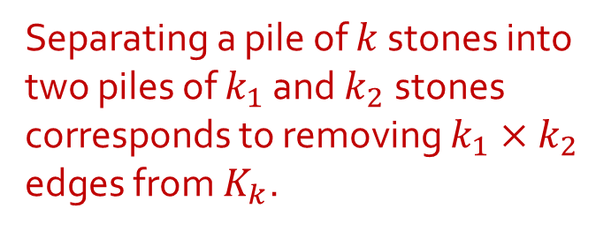

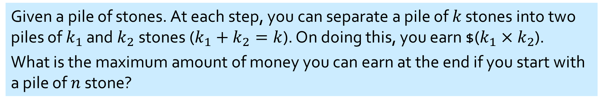


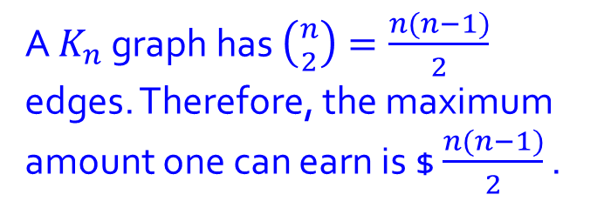
Q5.
Given a pile of stones. At each step, you can separate a pile of $k$ stones into two piles of $k_{1}$ and $k_{2}$stones ($k_{1}+k_{2}=k$). On doing this, you earn $($k_{1}×k_{2}$).
What is the maximum amount of money you can earn at the end if you start with a pile of $n$stone?
Earn $6
Earn $15
Model this as a graph problem. Let vertices represent the stones. Draw an edge between two vertices if the stones they represent are in the same pile.
…
Separating a pile of $k$ stones into two piles of $k_{1}$ and $k_{2}$stones corresponds to removing $k_{1}×k_{2}$ edges from $K_{k}$.
In the beginning, we have a $K_{n}$ graph.
In the end, we have a graph of $n$ isolated vertices.
Eg: $K_{5}$
A $K_{n}$ graph has $\left({n \atop 2}\right)=\frac{n(n−1)}{2}$ edges. Therefore, the maximum amount one can earn is $ $\frac{n(n−1)}{2}$ .

Slide 9
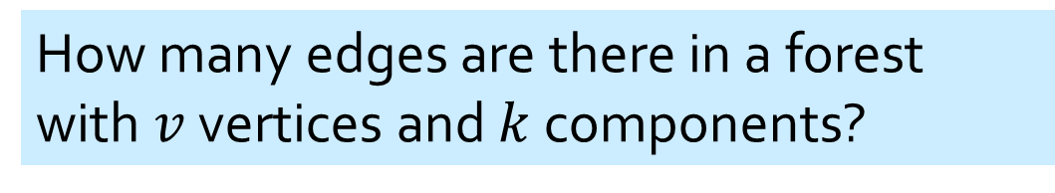
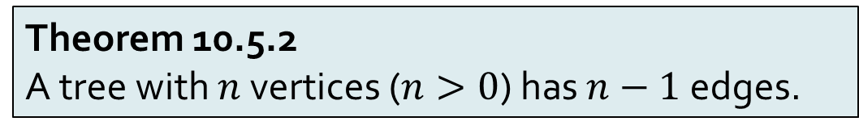
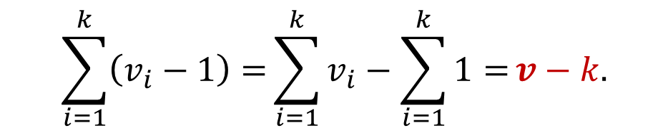
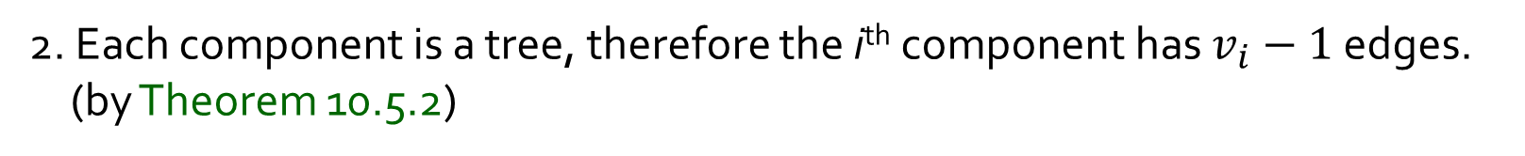
Q6.
How many edges are there in a forest with $v$ vertices and $k$ components?
1. Let the i^{th} component of the forest contains $v_{i}$ vertices.
2. Each component is a tree, therefore the i^{th} component has $v_{i}−1$ edges. (by Theorem 10.5.2)
3. Hence, the total number of edges in the forest is
$$\sum_{i=1}^{k}{\left(v_{i}−1\right)=}\sum_{i=1}^{k}{v_{i}−\sum_{i=1}^{k}{1}=}v−k.$$
Theorem 10.5.2
A tree with $n$ vertices ($n>0$) has $n−1$edges.

Slide 10
Q7.
How many possible binary trees with 4 vertices A, B, C and D have this in-order traversal: A B C D? Draw them.
Total: 14
Rooted at A: 5
Rooted at B: 2
A
A
A
A
A
B
B
B
B
C
D
D
A
D
A
C
C
D
B
D
C
B
C
D
D
C
B
C
Rooted at D: 5
Rooted at C: 2
A
D
D
D
D
C
C
B
C
B
A
A
D
A
D
B
C
A
C
A
B
C
B
A
D
B
C
B

Slide 11
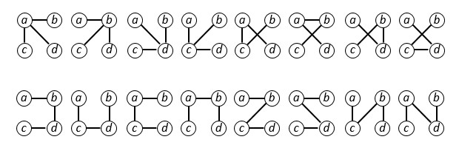

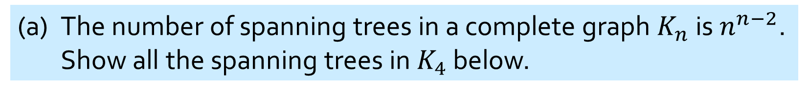
Q8.
(a) The number of spanning trees in a complete graph $K_{n}$ is $n^{n−2}$. Show all the spanning trees in $K_{4}$ below.
$$4^{4−2}=16$$

Slide 12
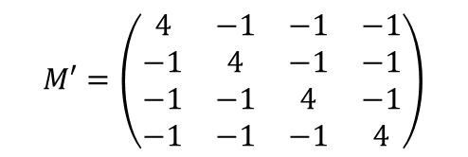

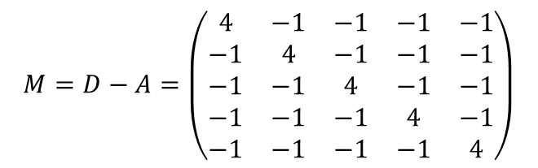
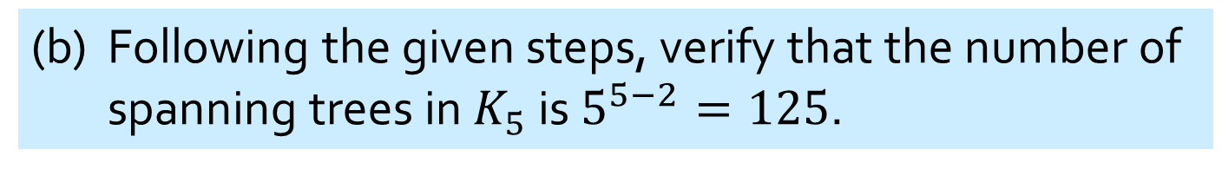
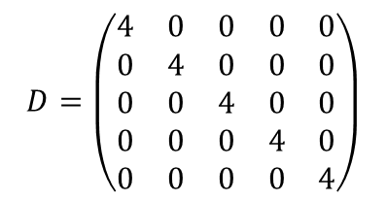

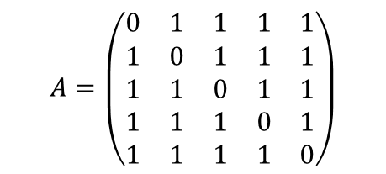
Q8.
(b) Following the given steps, verify that the number of spanning trees in $K_{5}$ is $5^{5−2}=125$.
Adjacency matrix $A$ for $K_{5}$:
$$A=\left(\begin{matrix}0 & 1 & 1 & 1 & 1 \\ 1 & 0 & 1 & 1 & 1 \\ 1 & 1 & 0 & 1 & 1 \\ 1 & 1 & 1 & 0 & 1 \\ 1 & 1 & 1 & 1 & 0\end{matrix}\right)$$
Diagonal matrix $D$:
$$D=\left(\begin{matrix}4 & 0 & 0 & 0 & 0 \\ 0 & 4 & 0 & 0 & 0 \\ 0 & 0 & 4 & 0 & 0 \\ 0 & 0 & 0 & 4 & 0 \\ 0 & 0 & 0 & 0 & 4\end{matrix}\right)$$
$$M=D−A=\left(\begin{matrix}4 & −1 & −1 & −1 & −1 \\ −1 & 4 & −1 & −1 & −1 \\ −1 & −1 & 4 & −1 & −1 \\ −1 & −1 & −1 & 4 & −1 \\ −1 & −1 & −1 & −1 & 4\end{matrix}\right)$$
$$M′=\left(\begin{matrix}4 & −1 & −1 & −1 \\ −1 & 4 & −1 & −1 \\ −1 & −1 & 4 & −1 \\ −1 & −1 & −1 & 4\end{matrix}\right)$$
det($M′$)$=4\left|\begin{matrix}4 & −1 & −1 \\ −1 & 4 & −1 \\ −1 & −1 & 4\end{matrix}\right|+\left|\begin{matrix}−1 & −1 & −1 \\ −1 & 4 & −1 \\ −1 & −1 & 4\end{matrix}\right|−\left|\begin{matrix}−1 & 4 & −1 \\ −1 & −1 & −1 \\ −1 & −1 & 4\end{matrix}\right|$+$\left|\begin{matrix}−1 & 4 & −1 \\ −1 & −1 & 4 \\ −1 & −1 & −1\end{matrix}\right|$
$$=4\left(50\right)+\left(−25\right)−\left(25\right)+\left(−25\right)=125.$$

Slide 13
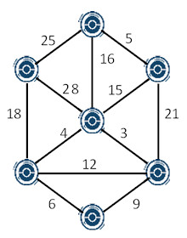
Q9.
Find the MST of the graph below.
Kruskal’s algorithm
Edges in non-decreasing order:
3
4
5
6
9
12
15
16
18
21
25
28



Weight of MST = $3+4+5+6+15+18=51.$

Slide 14
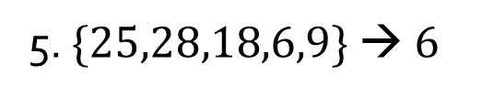
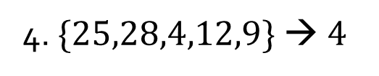
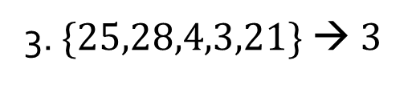
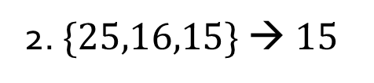
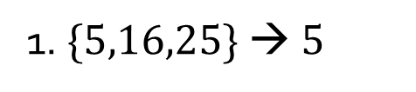
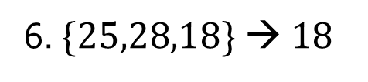
Q9.
Find the MST of the graph below.
Prim’s algorithm
Start from top vertex.
1. $\{5,16,25\} → 5$
2. $\{25,16,15\} → 15$
3. $\{25,28,4,3,21\} → 3$
4. $\{25,28,4,12,9\} → 4$
5. $\{25,28,18,6,9\} → 6$
6. $\{25,28,18\} → 18$
Weight of MST = $5+15+3+4+6+18=51.$

Slide 15
Q10.
Construct the binary tree give the following in-order and pre-order traversal of the tree:
In-order: I A D J N H B E K O F L G C M
Pre-order: H N A I J D O B K E C L F G M
H
I A D J N
B E K O F L G C M

Slide 16
Q10.
Construct the binary tree give the following in-order and pre-order traversal of the tree:
In-order: I A D J N H B E K O F L G C M
Pre-order: H N A I J D O B K E C L F G M
H
N
I A D J N
I A D J
B E K O F L G C M

Slide 17
Q10.
Construct the binary tree give the following in-order and pre-order traversal of the tree:
In-order: I A D J N H B E K O F L G C M
Pre-order: H N A I J D O B K E C L F G M
H
N
A
I
I A D J
D J
B E K O F L G C M

Slide 18
Q10.
Construct the binary tree give the following in-order and pre-order traversal of the tree:
In-order: I A D J N H B E K O F L G C M
Pre-order: H N A I J D O B K E C L F G M
H
N
A
I
I
D J
B E K O F L G C M

Slide 19
Q10.
Construct the binary tree give the following in-order and pre-order traversal of the tree:
In-order: I A D J N H B E K O F L G C M
Pre-order: H N A I J D O B K E C L F G M
H
N
A
I
J
D J
B E K O F L G C M
D

Slide 20
Q10.
Construct the binary tree give the following in-order and pre-order traversal of the tree:
In-order: I A D J N H B E K O F L G C M
Pre-order: H N A I J D O B K E C L F G M
H
N
A
I
J
D
B E K O F L G C M
D

Slide 21
Q10.
Construct the binary tree give the following in-order and pre-order traversal of the tree:
In-order: I A D J N H B E K O F L G C M
Pre-order: H N A I J D O B K E C L F G M
H
N
O
A
J
B E K
I
F L G C M
D
B E K O F L G C M

Slide 22
Q10.
Construct the binary tree give the following in-order and pre-order traversal of the tree:
In-order: I A D J N H B E K O F L G C M
Pre-order: H N A I J D O B K E C L F G M
H
N
O
A
J
B E K
I
F L G C M
D
Repeat the process…

Slide 23
Q10.
Construct the binary tree give the following in-order and pre-order traversal of the tree:
In-order: I A D J N H B E K O F L G C M
Pre-order: H N A I J D O B K E C L F G M
H
N
O
A
B
C
J
K
L
M
I
D
E
F
G
Final binary tree

Slide 24
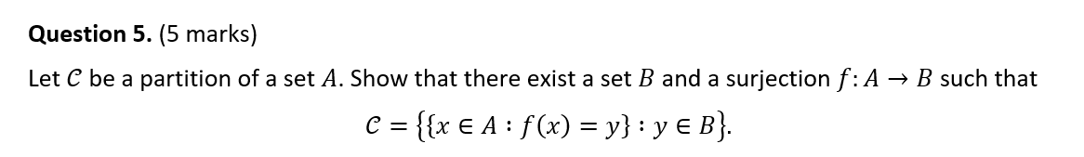

Assignment #2 notes
From tutorial #8:

Slide 25
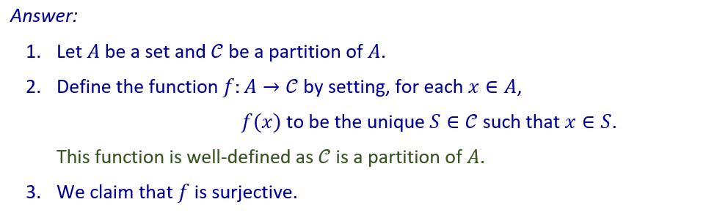
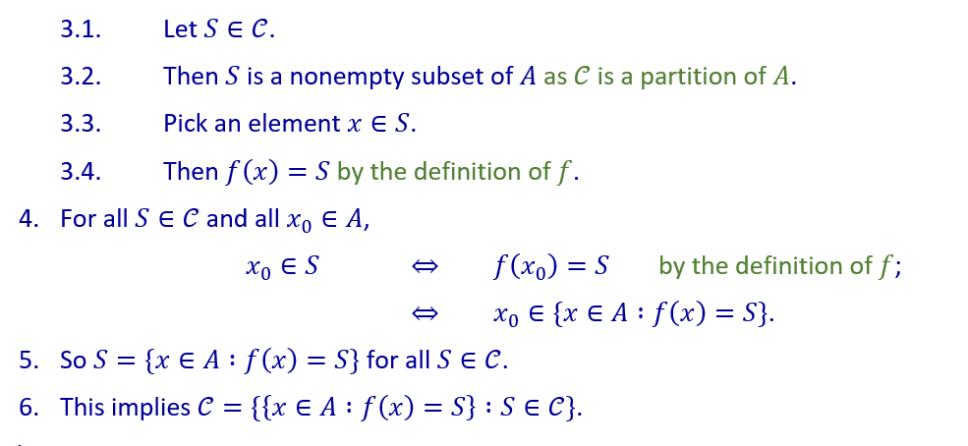
Assignment #2 notes

Slide 26


Slide 27
THE END

