Slide 1
CS1231S Tutorial #2
Predicate Logic and Proofs

Slide 2
Recap: Logic of Quantified Statements
Predicates and Quantified Statements
Statement with Multiple Quantifiers
Arguments with Quantified Statements

Slide 3
Predicates and quantified statements
Predicate - sentence that contains a finite number of values and becomes a statement when specific values are substituted for the variables.
Domain - set of all values that may be substituted in place of the variable.
Truth set – set of all elements that make a predicate P(x) true when substituted for x

Slide 4
Universal quantifier
Denoted with $"∀“$
Universal statement has the form: $∀x∈D, Q(x)$

Slide 5
Existential quantifier
Denoted with “$∃“$
Existential statement has the form: $∃x∈D \text{such} \text{that} Q( x)$

Slide 6
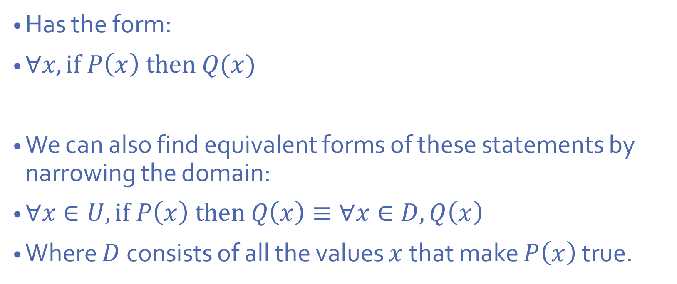
Universal conditional statement
Has the form:
$∀x, if P\left(x\right) then Q(x)$
We can also find equivalent forms of these statements by narrowing the domain:
$∀x∈U, if P\left(x\right) then Q\left(x\right)≡∀x∈D, Q\left(x\right)$
Where $D$consists of all the values $x$that make $P\left(x\right)$ true.

Slide 7
Implicit quantification
$P\left(x\right) ⇒Q(x)$ is equivalent to $∀x, P\left(x\right)→Q\left(x\right)$
$P\left(x\right) ⇔Q(x)$ is equivalent to $∀x, P\left(x\right)↔Q\left(x\right)$

Slide 8
Variants of universal conditional statements
Consider the statement form: $∀x∈D, if P\left(x\right) then Q(x)$
Contrapositive: $∀x∈D, if∼Q\left(x\right) then∼P(x)$
Converse:$∀x∈D, if Q\left(x\right) then P(x)$
Inverse: $∀x∈D, if∼P\left(x\right) then∼Q(x)$

Slide 9
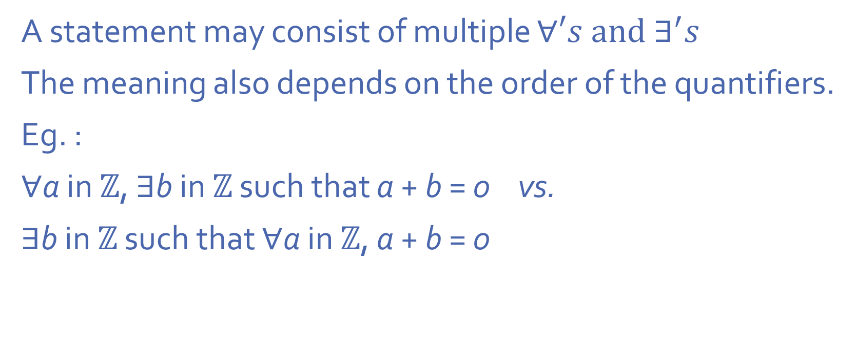
Statements with multiple quantifiers
A statement may consist of multiple $∀′s and ∃^{′}s$
The meaning also depends on the order of the quantifiers.
Eg. :
∀a in ℤ, ∃b in ℤ such that a + b = 0 vs.
∃b in ℤ such that ∀a in ℤ, a + b = 0

Slide 10
Negation of quantified statements
Eg.
∼(∀x in D, ∃y in E such that P(x, y)) ≡ ∃x in D such that ∀y in E, ∼P(x, y)
Generally, to negate a quantified statement,
1. Negate all predicate variables
2. switch the $∀^{′}s and ∃^{′}s$

Slide 11
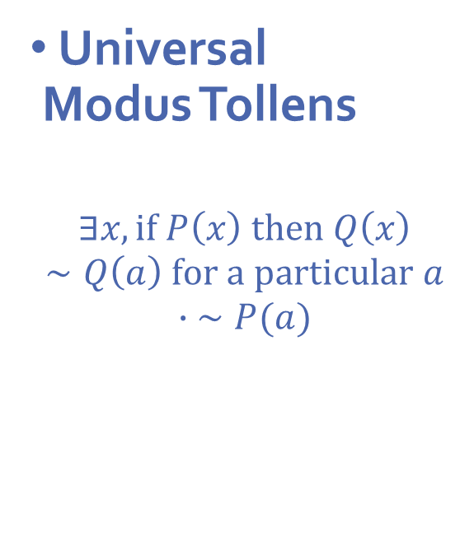
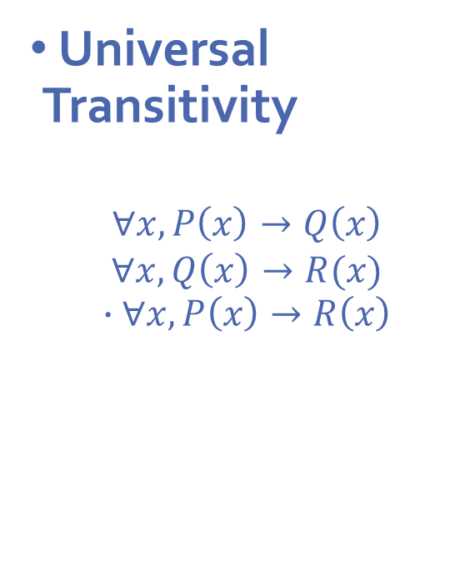
Arguments with quantified statements
Universal Modus Ponens
$$∃x, if P\left(x\right) then Q\left(x\right)$$
$$P\left(a\right) for a particular a$$
$$∙Q(a)$$
Universal Modus Tollens
$$∃x, if P\left(x\right) then Q\left(x\right)$$
$$∼Q\left(a\right) for a particular a$$
$$∙ ∼P(a)$$
Universal Transitivity
$$∀x, P\left(x\right)→Q\left(x\right)$$
$$∀x, Q\left(x\right)→R(x)$$
$$∙∀x, P\left(x\right)→R\left(x\right)$$

Slide 12




Q1
Converse, inverse and contrapositive.
Quick recap:
Conditional statement:
$$p →q$$
Converse:
$$q →p$$
Inverse:
$$\sim p →\sim q$$
Contrapositive:
$$\sim q →\sim p$$

Slide 13
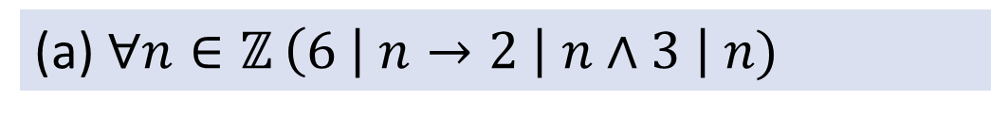
Q1
Converse, inverse and contrapositive.
(a) $∀n∈ℤ$ $\left(6 \right| n→2 \left| n∧3 \right| n)$
True
True
Converse:
$$∀n∈ℤ \left(2 \right| n ∧3 | n→6 | n)$$
$$∀n∈ℤ (6∤n→2∤n∨3∤n)$$
Inverse:
True
Contrapositive:
$$∀n∈ℤ (2∤n∨3∤n→6∤n)$$
True

Slide 14
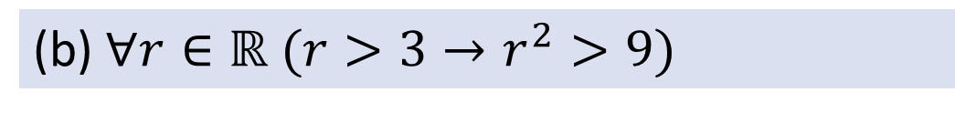
Q1
Converse, inverse and contrapositive.
(b) $∀r∈ℝ (r>3→r^{2}>9)$
True
False
Converse:
$$∀r∈ℝ {(r}^{2}>9→r>3)$$
$$∀r∈ℝ (r≤3→r^{2}≤9)$$
Inverse:
False
$$∀r∈ℝ {(r}^{2}≤9→r≤3)$$
Contrapositive:
True
Counterexample for converse and inverse?

Slide 15
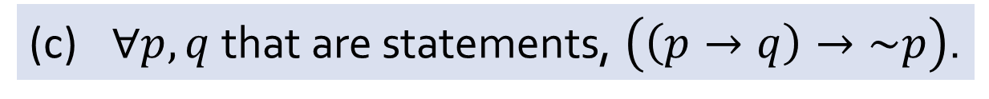
Q1
Converse, inverse and contrapositive.
(c) $∀p,q$ that are statements, $\left(\left(p→q\right)→\sim p\right)$.
False
Converse:
$$∀p,q \text{that} \text{are} \text{statements}\text{,} (\sim p→(p→q)\text{) }\text{.}$$
True
Inverse:
$$∀p,q \text{that} \text{are} \text{statements}\text{,} \left(\sim \left(p→q\right)→p\right)\text{.}$$
True
Contrapositive:
$$∀p,q \text{that} \text{are} \text{statements}\text{,} \left(p→\sim \left(p→q\right)\right)\text{.}$$
False
Counterexample for original statement and contrapositive statement?

Slide 16
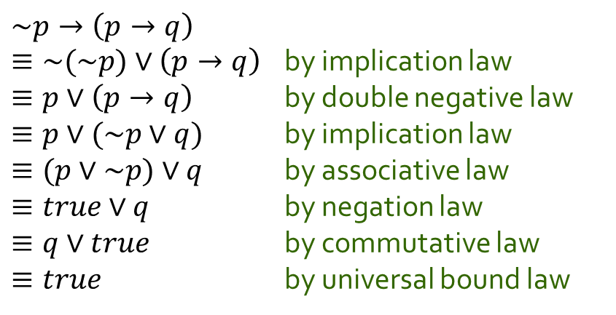

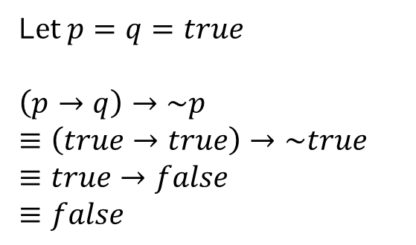
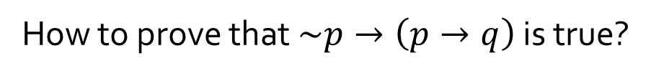
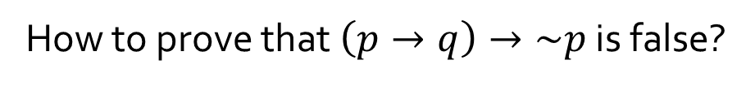
Q1
(c) $∀p,q$ that are statements, $\left(\left(p→q\right)→\sim p\right)$.
False
Converse:
$$∀p,q \text{that} \text{are} \text{statements}\text{,} (\sim p→(p→q)\text{) }\text{.}$$
True
How to prove that $\left(p→q\right)→\sim p$ is false?
How to prove that $\sim p→\left(p→q\right)$ is true?
$$\sim p→\left(p→q\right)$$
$≡\sim (\sim p)∨\left(p→q\right)$ by implication law
$≡p∨\left(p→q\right)$ by double negative law
$≡p∨(\sim p∨q)$ by implication law
$≡(p∨\sim p)∨q$ by associative law
$≡true∨q$ by negation law
$≡q∨true$ by commutative law
$≡true$ by universal bound law
L$et p=q=true$
$\left(p→q\right)→\sim p$
$$≡\left(true→true\right)→\sim true$$
$$≡true→false$$
$$≡false$$

Slide 17
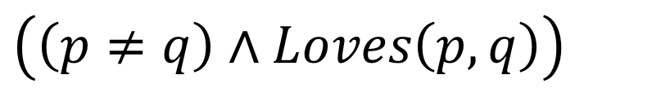
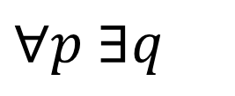
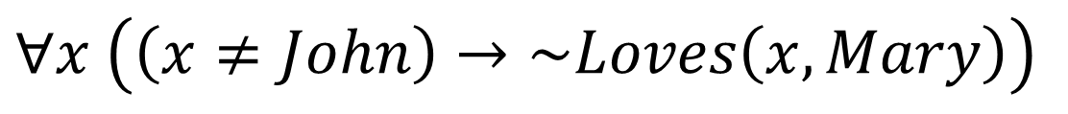

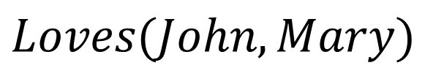
Q2
(a) Everybody loves someone else.
$$∀p ∃q$$
$$\left(\left(p≠q\right)∧Loves\left(p,q\right)\right)$$
(b) Nobody except John loves Mary.
$$Loves(John,Mary)$$
$$∧$$
$$∀x \left(\left(x≠John\right)→\sim Loves\left(x,Mary\right)\right)$$

Slide 18
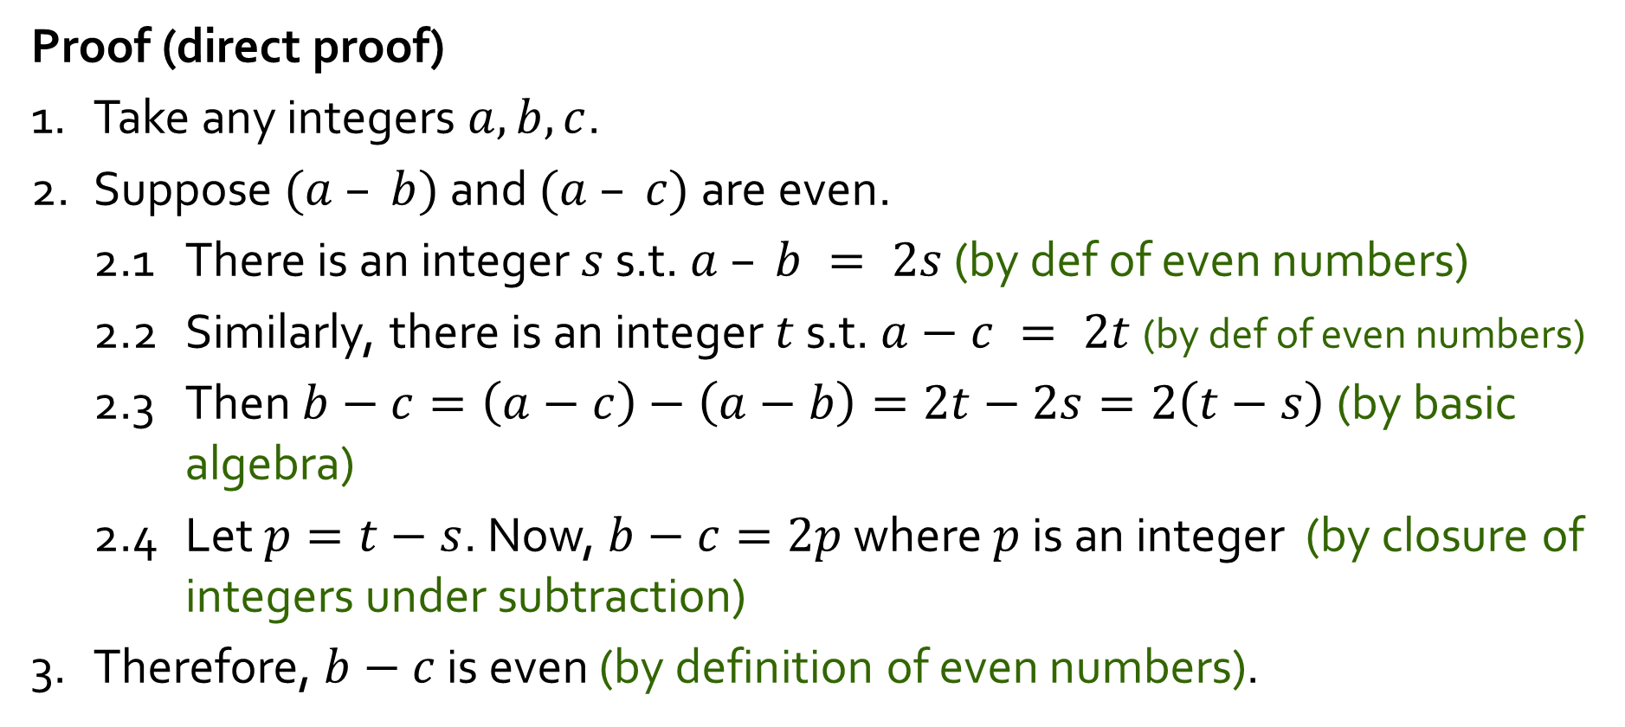
Q3
Prove or disprove:
$∀a,b,c∈ℤ\text{, }\text{if} a−b \text{is} \text{even} \text{and} a−c \text{is} \text{even}\text{, }\text{then} b−c \text{is} \text{even}\text{.}$
Proof (direct proof)
1. Take any integers $a, b, c$.
2. Suppose $(a – b)$and $(a – c)$ are even.
2.1 There is an integer $s$ s.t. $a – b = 2s$ (by def of even numbers)
2.2 Similarly, there is an integer $t$ s.t. $a−c = 2t$(by def of even numbers)
2.3 Then $b−c=\left(a−c\right)−\left(a−b\right)=2t−2s=2\left(t−s\right)$(by basic algebra)
2.4 Let $p=t−s$. Now, $b−c=2p$ where $p$ is an integer (by closure of integers under subtraction)
3. Therefore, $b−c$ is even (by definition of even numbers).

Slide 19
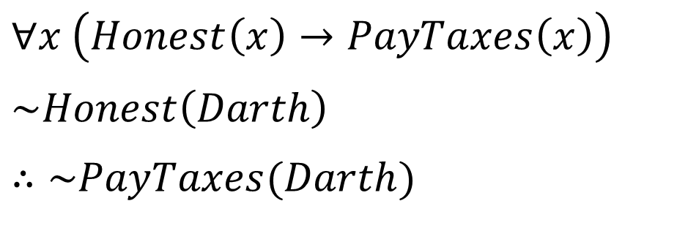
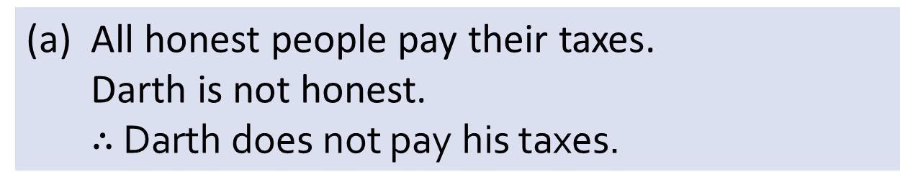
Q4
(a) All honest people pay their taxes.
Darth is not honest.
$∴$ Darth does not pay his taxes.
$$∀x \left(Honest\left(x\right)→PayTaxes\left(x\right)\right)$$
$$\sim Honest\left(Darth\right)$$
$$∴\sim PayTaxes(Darth)$$
Invalid;
Inverse error.

Slide 20
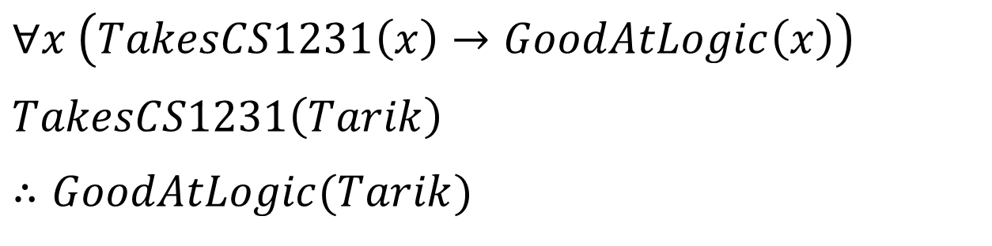
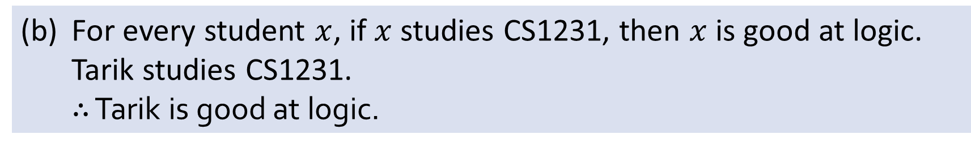
Q4
(b) For every student $x$, if $x$ studies CS1231, then $x$ is good at logic.
Tarik studies CS1231.
$∴$ Tarik is good at logic.
$$∀x \left(TakesCS1231\left(x\right)→GoodAtLogic\left(x\right)\right)$$
$$TakesCS1231\left(Tarik\right)$$
$$∴GoodAtLogic(Tarik)$$
Valid;
Universal modus ponens.

Slide 21
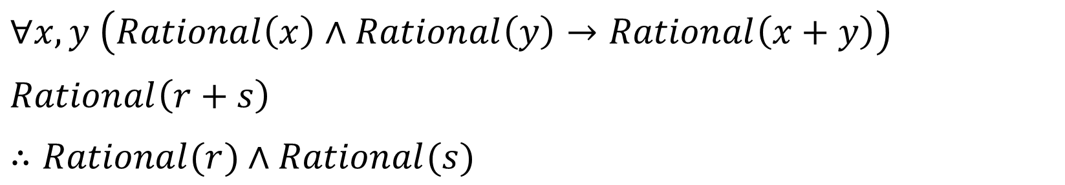
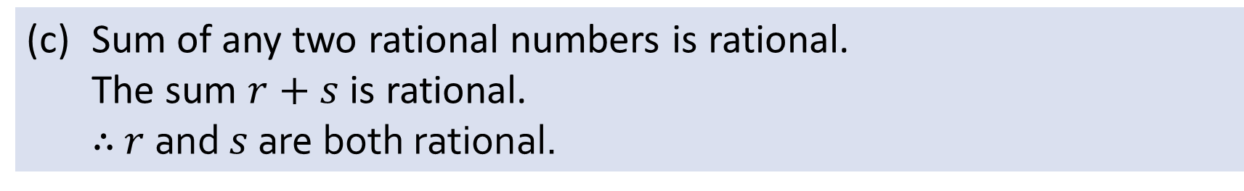
Q4
(c) Sum of any two rational numbers is rational.
The sum $r+s$ is rational.
$∴$ $r$and $s$ are both rational.
$$∀x,y \left(Rational\left(x\right)∧Rational\left(y\right)→Rational\left(x+y\right)\right)$$
$$Rational\left(r+s\right)$$
$∴Rational(r)$ $∧Rational(s)$
Invalid;
Converse error.

Slide 22
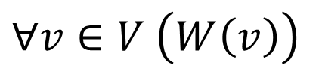
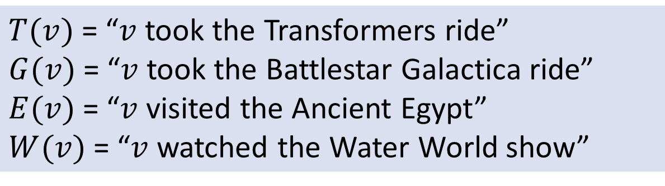
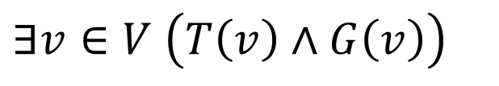
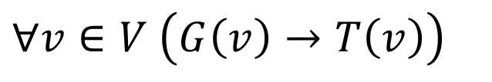
Q5
$T(v)$= “$v$ took the Transformers ride”
$G(v)$= “$v$ took the Battlestar Galactica ride”
$E(v)$= “$v$ visited the Ancient Egypt”
$W(v)$= “$v$ watched the Water World show”
(a) Every visitor watched the Water World show.
$$∀v∈V \left(W\left(v\right)\right)$$
(b) Every visitor who took the Battlestar Galactica ride also took the Transformers ride.
$$∀v∈V \left(G\left(v\right)→T\left(v\right)\right)$$
(c) There is a visitor who took both the Transformers ride and the Battlestar Galactica ride.
$$∃v∈V \left(T\left(v\right)∧G\left(v\right)\right)$$

Slide 23
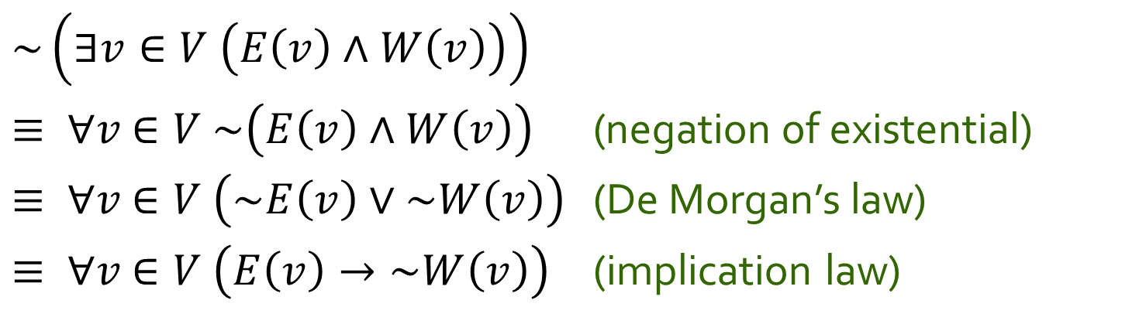
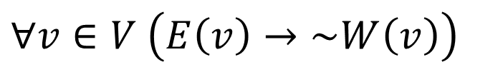
Q5
(d) No visitor who visited the Ancient Egypt watched the Water World show.
$$∀v∈V \left(E\left(v\right)→\sim W\left(v\right)\right)$$
Equivalently,
~(there is a visitor who visited the Ancient Egypt and watched the Water World show).
$$\sim \left(∃v∈V \left(E\left(v\right)∧W\left(v\right)\right)\right)$$
$≡ ∀v$ $∈V \sim \left(E\left(v\right)∧W\left(v\right)\right)$ (negation of existential)
$≡ ∀v$ $∈V \left(\sim E\left(v\right)∨\sim W\left(v\right)\right)$ (De Morgan’s law)
$≡ ∀v$ $∈V \left(E\left(v\right)→\sim W\left(v\right)\right)$ (implication law)

Slide 24
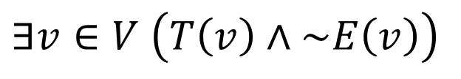
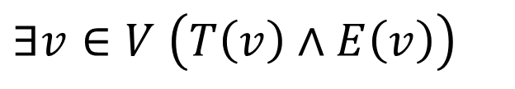

Q5
(e) Some visitors who took the Transformers ride also visited the Ancient Egypt but some (who took the Transformers ride) did not (visit the Ancient Egypt).
$$∃v∈V \left(T\left(v\right)∧E\left(v\right)\right)$$
$$∧$$
$$∃v∈V \left(T\left(v\right)∧\sim E\left(v\right)\right)$$

Slide 25
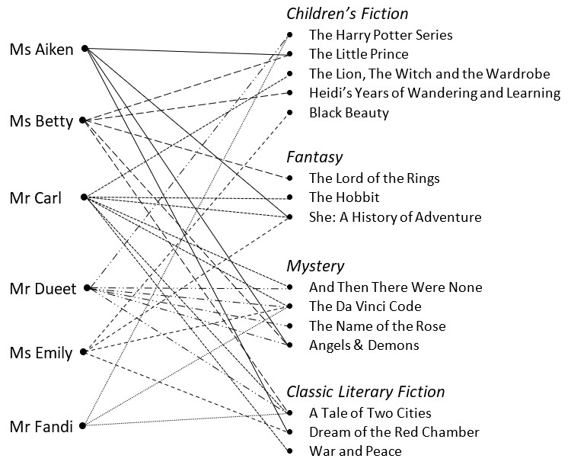

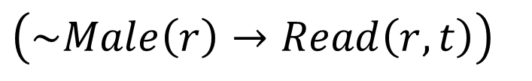
Q6
(a) Some title is read by all the female readers.
False;
None of the titles is read by all 3 female readers.
$$∃t∈V,∀r∈R$$
$$\left(\sim Male\left(r\right)→Read\left(r,t\right)\right)$$

Slide 26

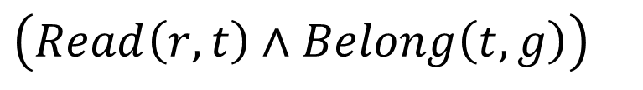
Q6
(b) Every reader reads some title in every genre.
False;
Mr Dueet doesn’t read any Fantasy title.
$$∀r∈R,∀g∈G,∃t∈T$$
$$\left(Read\left(r,t\right)∧Belong\left(t,g\right)\right)$$

Slide 27

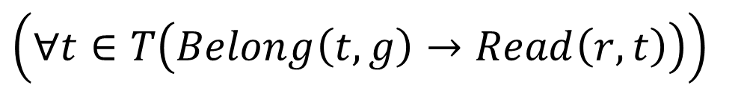
Q6
(c) Some reader reads all titles of some genre.
True;
Mr Dueet reads all Mystery titles.
$$∃r∈R,∃g∈G$$
$$\left(∀t∈T\left(Belong\left(t,g\right)→Read\left(r,t\right)\right)\right)$$

Slide 28

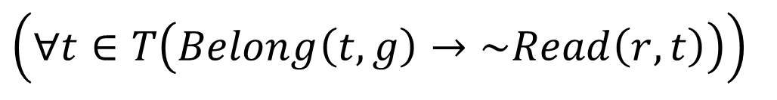
Q6
(d) There is some genre for which some reader does not read any of its titles.
True;
None of the Fantasy titles is read by Dueet (and Fandi).
$$∃g∈G,∃r∈R$$
$$\left(∀t∈T\left(Belong\left(t,g\right)→\sim Read\left(r,t\right)\right)\right)$$

Slide 29
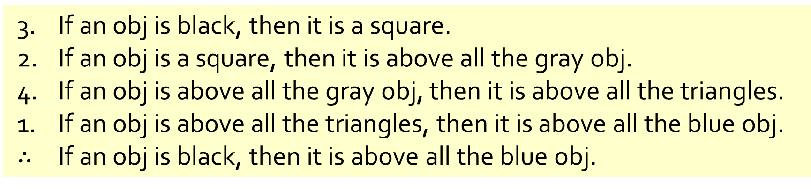
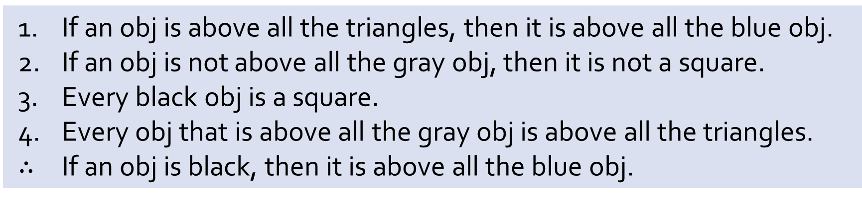
Q7
If an obj is above all the triangles, then it is above all the blue obj.
If an obj is not above all the gray obj, then it is not a square.
Every black obj is a square.
Every obj that is above all the gray obj is above all the triangles.
$∴$ If an obj is black, then it is above all the blue obj.
(a) Reorder the premises to show that the conclusion follows as a valid consequence from the premises by applying universal transitivity.
3. If an obj is black, then it is a square.
2. If an obj is a square, then it is above all the gray obj.
4. If an obj is above all the gray obj, then it is above all the triangles.
1. If an obj is above all the triangles, then it is above all the blue obj.
$∴$ If an obj is black, then it is above all the blue obj.

Slide 30
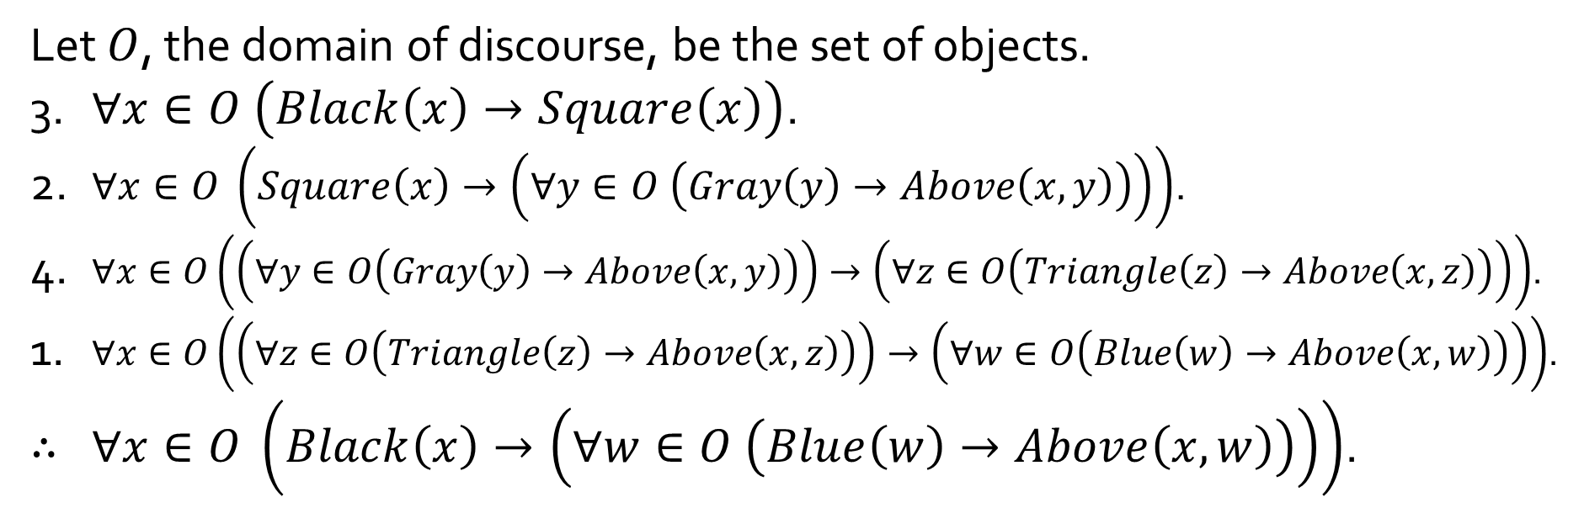
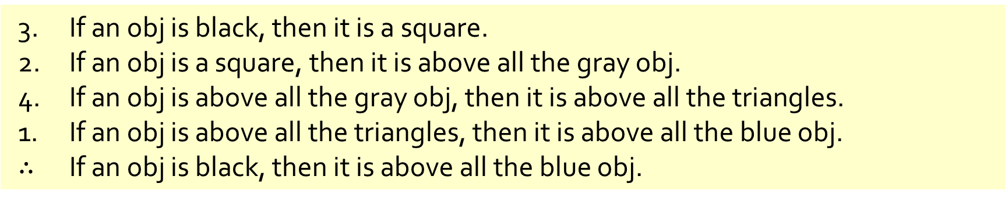
Q7
3. If an obj is black, then it is a square.
2. If an obj is a square, then it is above all the gray obj.
4. If an obj is above all the gray obj, then it is above all the triangles.
1. If an obj is above all the triangles, then it is above all the blue obj.
$∴$ If an obj is black, then it is above all the blue obj.
(b) Rewrite your answer in (a) using predicates and quantified statements.
Let $O$, the domain of discourse, be the set of objects.
3. $∀x∈O \left(Black\left(x\right)→Square\left(x\right)\right)$.
2. $∀x∈O \left(Square\left(x\right)→\left(∀y∈O \left(Gray\left(y\right)→Above\left(x,y\right)\right)\right)\right)$.
4. $∀x∈O\left(\left(∀y∈O\left(Gray\left(y\right)→Above\left(x,y\right)\right)\right)→\left(∀z∈O\left(Triangle\left(z\right)→Above\left(x,z\right)\right)\right)\right)$.
1. $∀x∈O\left(\left(∀z∈O\left(Triangle\left(z\right)→Above\left(x,z\right)\right)\right)→\left(∀w∈O\left(Blue\left(w\right)→Above\left(x,w\right)\right)\right)\right)$.
$∴$ $∀x∈O \left(Black\left(x\right)→\left(∀w∈O \left(Blue\left(w\right)→Above\left(x,w\right)\right)\right)\right)$.

Slide 31
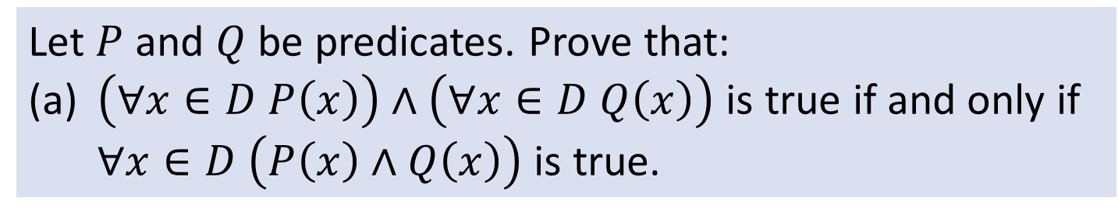
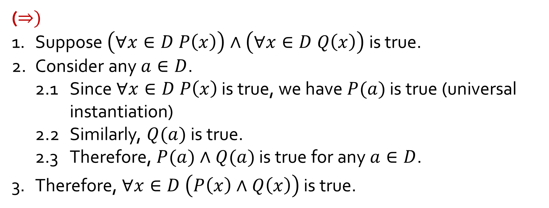
Q8
Let $P$ and $Q$ be predicates. Prove that:
(a) $\left(∀x∈D P\left(x\right)\right)∧\left(∀x∈D Q\left(x\right)\right)$ is true if and only if $∀x∈D \left(P\left(x\right)∧Q\left(x\right)\right)$ is true.
$$\left(∀x∈D P\left(x\right)\right)∧\left(∀x∈D Q\left(x\right)\right)⇔∀x∈D \left(P\left(x\right)∧Q\left(x\right)\right)$$
($⇒)$
1. Suppose $\left(∀x∈D P\left(x\right)\right)∧\left(∀x∈D Q\left(x\right)\right)$ is true.
2. Consider any $a∈D$.
2.1 Since $∀x∈D P\left(x\right)$ is true, we have $P(a)$ is true (universal instantiation)
2.2 Similarly, $Q(a)$ is true.
2.3 Therefore, $P(a)∧Q(a)$ is true for any $a∈D$.
3. Therefore, $∀x∈D \left(P\left(x\right)∧Q\left(x\right)\right)$ is true.

Slide 32
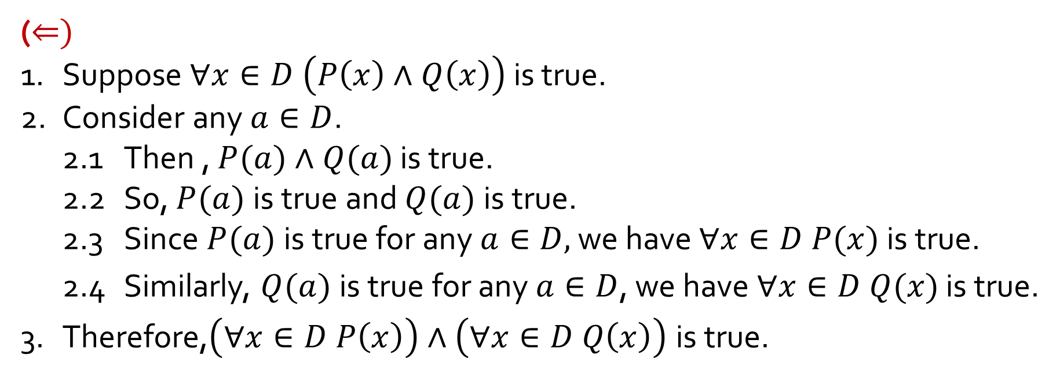
Q8
Let $P$ and $Q$ be predicates. Prove that:
(a) $\left(∀x∈D P\left(x\right)\right)∧\left(∀x∈D Q\left(x\right)\right)$ is true if and only if $∀x∈D \left(P\left(x\right)∧Q\left(x\right)\right)$ is true.
$$\left(∀x∈D P\left(x\right)\right)∧\left(∀x∈D Q\left(x\right)\right)⇔∀x∈D \left(P\left(x\right)∧Q\left(x\right)\right)$$
($⇐)$
1. Suppose $∀x∈D \left(P\left(x\right)∧Q\left(x\right)\right)$ is true.
2. Consider any $a∈D$.
2.1 Then , $P(a)∧Q(a)$ is true.
2.2 So, $P(a)$is true and $Q(a)$is true.
2.3 Since $P(a)$is true for any $a∈D,$ we have $∀x∈D P(x)$ is true.
2.4 Similarly, $Q(a)$is true for any $a∈D$, we have $∀x∈D Q(x)$ is true.
3. Therefore,$\left(∀x∈D P\left(x\right)\right)∧\left(∀x∈D Q\left(x\right)\right)$ is true.

Slide 33
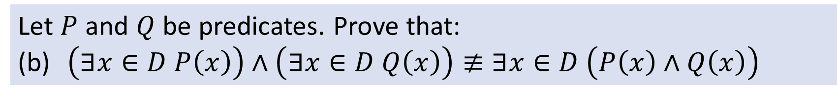
Q8
Let $P$ and $Q$ be predicates. Prove that:
(b) $\left(∃x∈D P\left(x\right)\right)∧\left(∃x∈D Q\left(x\right)\right)≢∃x∈D \left(P\left(x\right)∧Q\left(x\right)\right)$
Counterexample:
Let $D=ℕ$, $P(x)$ be “$x^{2}=0$” and $Q(x)$ be “$x^{2}=1$”.
$$\left(∃x∈ℕ x^{2}=0\right)∧\left(∃x∈ℕ x^{2}=1\right)$$
True
$$∃x∈ℕ \left(x^{2}=0∧x^{2}=1\right)$$
False

Slide 34
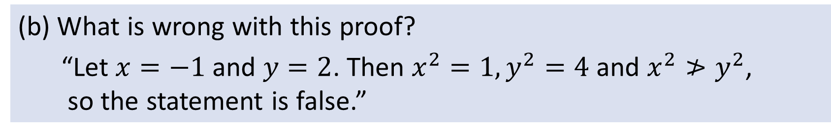
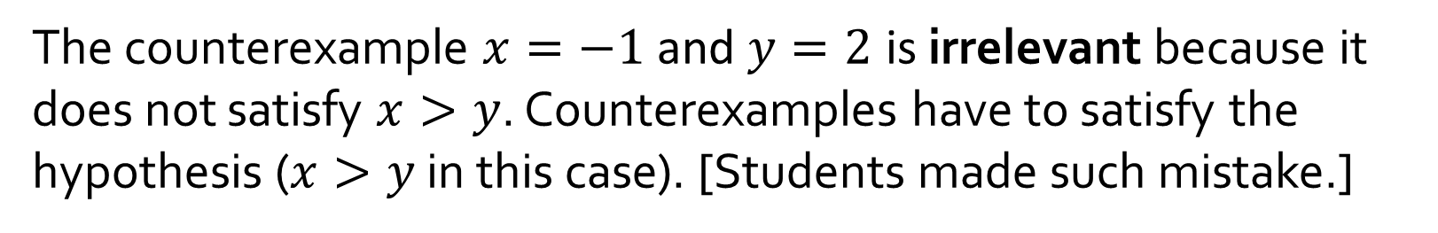
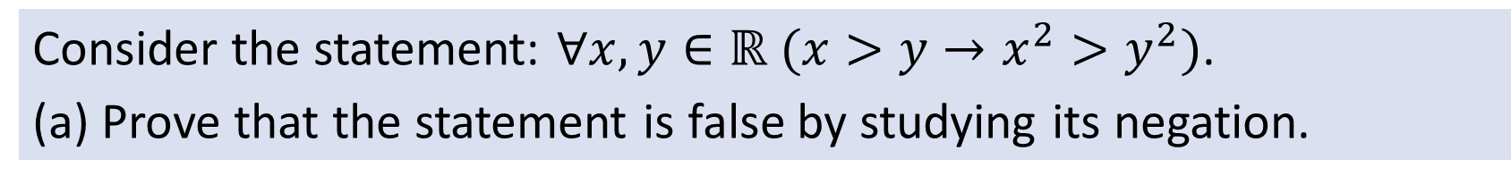
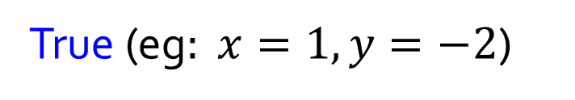


Q9
Consider the statement: $∀x,y∈ℝ (x>y→x^{2}>y^{2})$.
(a) Prove that the statement is false by studying its negation.
Negate the statement:
$\sim \left(∀x,y∈ℝ (x>y→x^{2}>y^{2}\right)$
$≡∃x,y∈ℝ (x>y∧x^{2}≤y^{2})$
True (eg$: x=1,y=−2$)
(b) What is wrong with this proof?
“Let $x=−1$and $y=2$. Then $x^{2}=1,y^{2}=4$ and $x^{2}≯y^{2}$,
so the statement is false.”
The counterexample $x=−1$and $y=2$ is irrelevant because it does not satisfy $x>y$. Counterexamples have to satisfy the hypothesis ($x>y$ in this case). [Students made such mistake.]

Slide 35
THE END

