Slide 1
Cs1231S tutorial #3
Sets

Slide 2
Recap: Sets
Membership, inclusion, equality of sets
Power sets and Cartesian products
Union, intersections, complements
Set identities
Venn diagrams
Cardinalities of finite sets

Slide 3

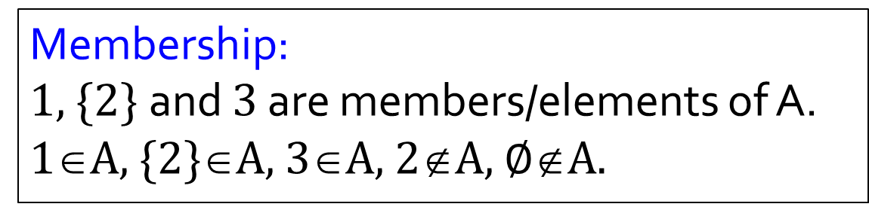
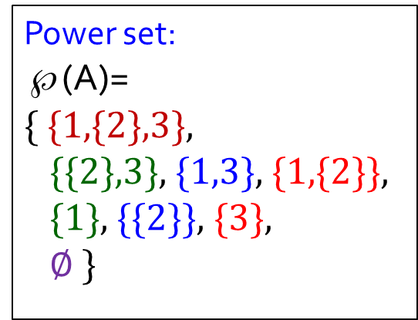
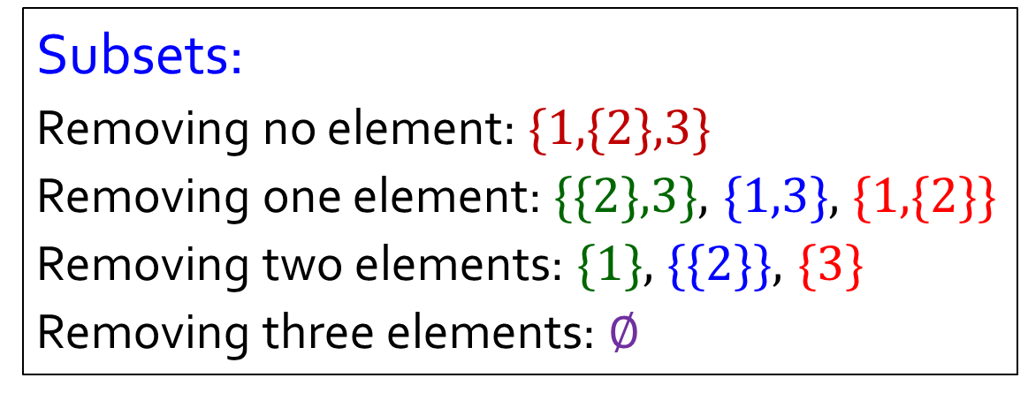
Prof Aaron’s post on Forum
A
A = {1, {2}, 3}
Membership:
1, {2} and 3 are members/elements of A.
1∈A, {2}∈A, 3∈A, 2∉A, $∅$∉A.
1
2
3
Subsets:
Removing no element: {1,{2},3}
Removing one element: {{2},3}, {1,3}, {1,{2}}
Removing two elements: {1}, {{2}}, {3}
Removing three elements: $∅$
Power set:
℘(A)=
{ {1,{2},3},
{{2},3}, {1,3}, {1,{2}},
{1}, {{2}}, {3},
$∅$ }

Slide 4

Prof Aaron’s post on Forum
Empty set $∅$
Do not call it “null set”.
In measure theory, a null set is set of measure zero (not necessarily empty)
Do not call it “null”!
An empty set is NOT equivalent to nothing. It is a set that has no members/elements.

Slide 5
Q1
TRUE
FALSE
(a) ∅ ∈ ∅
(b) ∅ ⊆ ∅
(c) ∅ ∈ {∅}
(d) ∅ ⊆ {∅}
(e) {∅, 1} = {1}
(f) 1 ∈ {{1,2}, {2,3}, 4}
(g) {1,2} ⊆ {3,2,1}
(h) {3,3,2} ⊊ {3,2,1}

Slide 6
Q2. Let A = {1, {1, 2}, 2, {1, 2}}. Find |A|.
A = {1, {1,2}, 2}
A
|A| = 3
1
1,2
2

Slide 7
3. A = {0,1,4,5,6,9}, B = {0,2,4,6,8}
Find |A|, |B|, |A ⋂ B| , |A ⋃ B|
|S|: cardinality of set S (#elements in S)
|A| = 6
A ⋂ B= {0,4,6}
|A ⋂ B| = 3
|B| = 5
A ⋃ B= {0,1,2,4,5,6,8,9}
|A ⋃ B| = 8

Slide 8
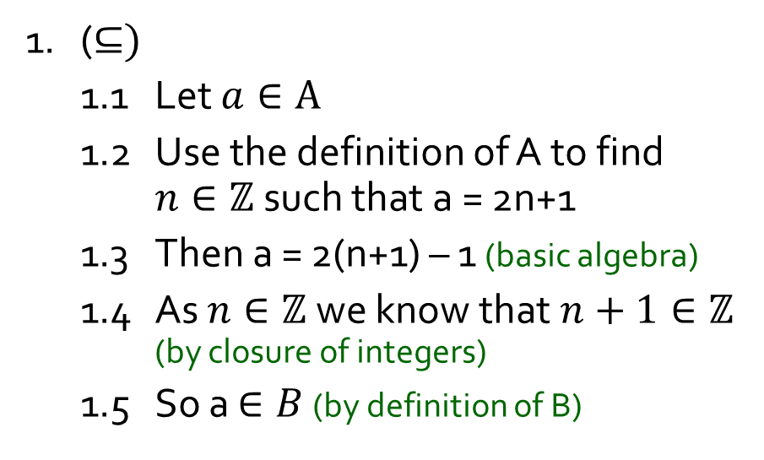
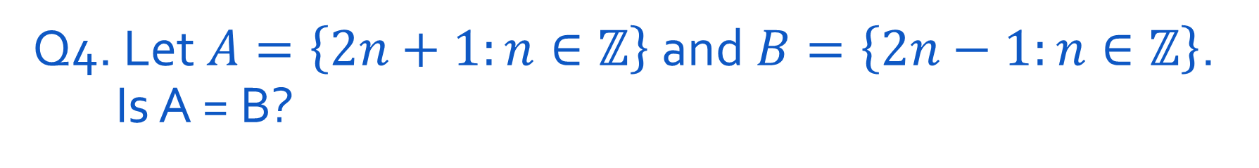

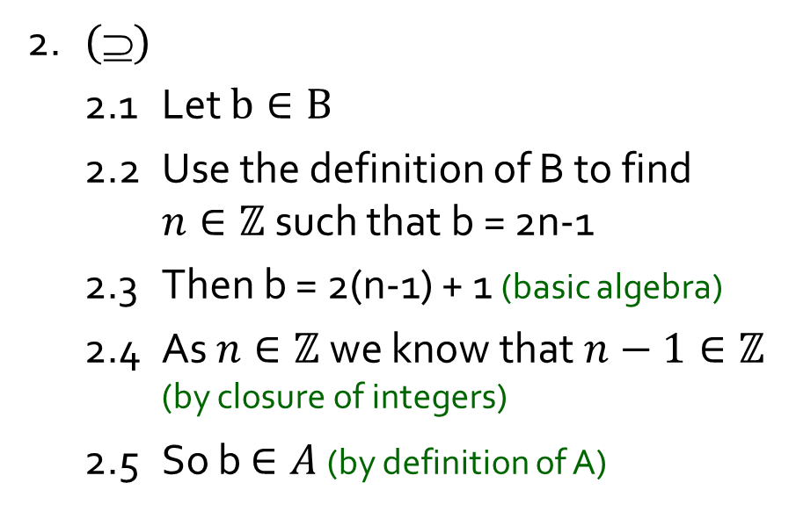
Q4. Let$A=\left\{2n+1:n∈ℤ\right\}$ and$B=\left\{2n−1:n∈ℤ\right\}$. Is A = B?
Yes or No?
To show A=B, we show A⊆B and B ⊆A.
From context, this means A⊆B
From context, this means A $$B
1. ($⊆)$
1.1 Let $a∈A$
1.2 Use the definition of A to find $n∈ℤ$ such that a = 2n+1
1.3 Then a = 2(n+1) – 1 (basic algebra)
1.4 As $n∈ℤ$ we know that $n+1∈ℤ$ (by closure of integers)
1.5 So a $∈B$ (by definition of B)
2. $()$
2.1 Let $b∈B$
2.2 Use the definition of B to find $n∈ℤ$ such that b = 2n-1
2.3 Then b = 2(n-1) + 1 (basic algebra)
2.4 As $n∈ℤ$ we know that $n−1∈ℤ$ (by closure of integers)
2.5 So b $∈A$ (by definition of A)
3. Hence A = B by definition of set equality

Slide 9
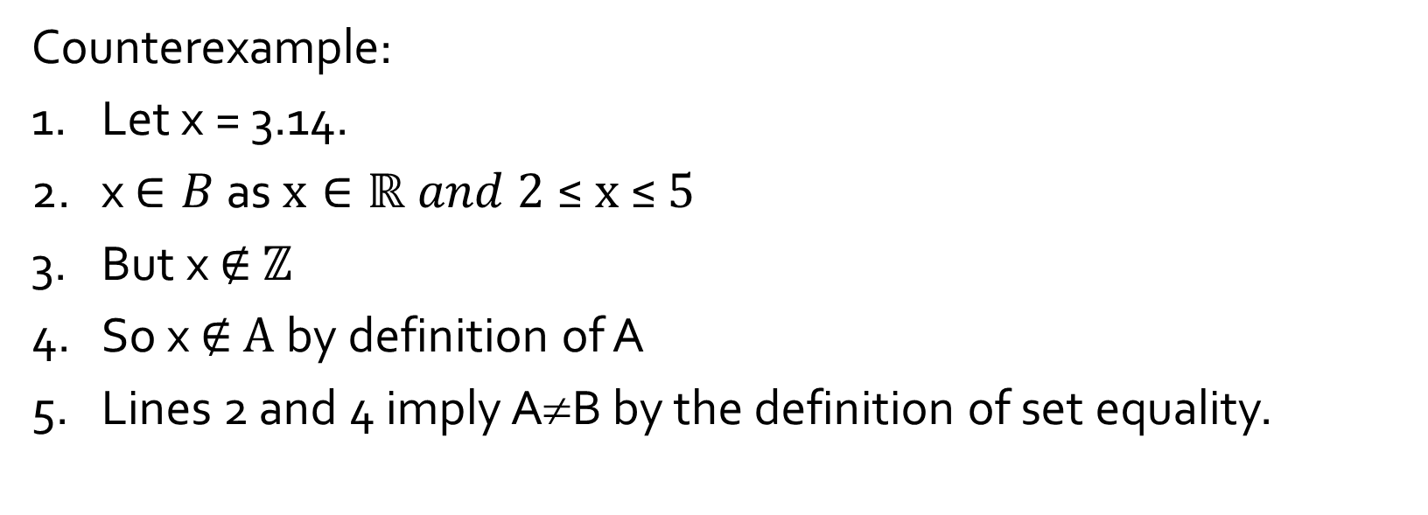
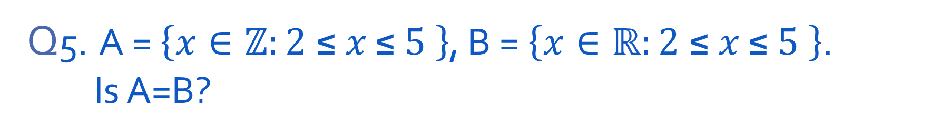
Q5. A = $\left\{x∈ℤ:2 \text{≤} x \text{≤} 5 \right\}$, B = $\left\{x∈ℝ:2 \text{≤} x \text{≤} 5 \right\}$. Is A=B?
Yes or No?
Counterexample:
1. Let x = 3.14.
2. x $∈B$ as $x∈ℝ and 2 \text{≤} \text{x} \text{≤} 5$
3. But x ∉ $ℤ$
4. So x ∉ $A$by definition of A
5. Lines 2 and 4 imply A≠B by the definition of set equality.

Slide 10
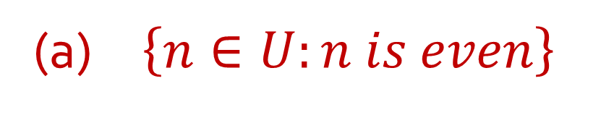
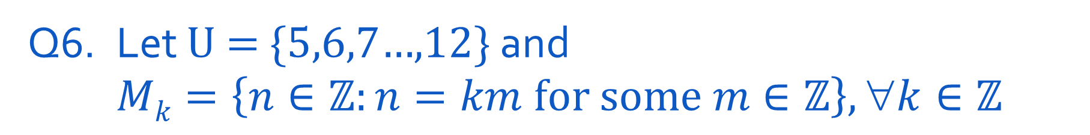

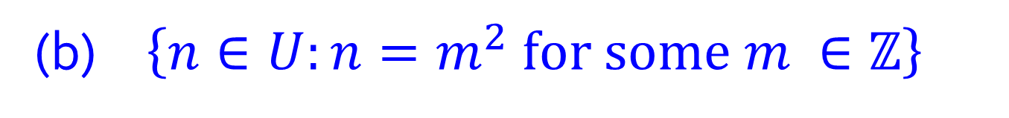
Q6. Let U = {5,6,7…,12} and $Mk=\left\{n∈ℤ:n=km for some m∈ℤ\right\}, ∀k∈ℤ$
(a) $\left\{n∈U:n is even\right\}$
(b) $\left\{n∈U:n=m^{2} for some m ∈ℤ\right\}$
(c) $\text{\{−5, −4, −3,…,5\}} \text{\backslash } \text{\{1,2,3,…,10\}}$

Slide 11

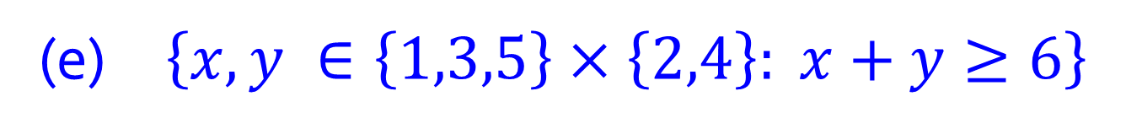
Q6. Let U = {5,6,7…,12} and $Mk=\left\{n∈ℤ:n=km for some m∈ℤ\right\}, ∀k∈ℤ$
(d) $\overline{\left\{5,7,9\right\}∪\{9,11\} } \text{(}\text{U} \text{is} \text{the} \text{universal} \text{set}\text{)}$
What is this called?
{1,3,5}×{2,4} =
{ (1,2),
(1,4),
(3,2),
(3,4),
(5,2),
(5,4) }
(e) $\left\{x, y ∈\left\{1,3,5\right\}×\left\{2,4\right\}: x+y≥6\right\}$
Ordered pairs
(f) $℘\text{(\{2,4\})}$
Is (3,2) =(2,3)?

Slide 12
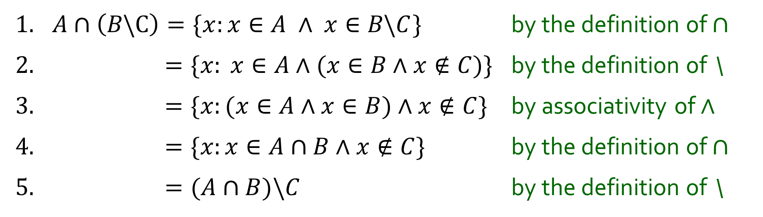
Q7. Show that for all sets A,B, C A ⋂ (B \ C) = (A ⋂ B) \ C
1. $A∩\left(B\backslash C\right)=\{x:x∈A ∧ x∈B\backslash C\}$ by the definition of $∩$
2. $=\{x: x∈A∧(x∈B∧x∉C$)} by the definition of \
3. $=\{x:(x∈A∧x∈B)∧x∉C$} by associativity of $∧$
4. $=\{x:x∈A∩B∧x∉C$} by the definition of $∩$
5. $=(A∩B)\backslash C$ by the definition of \

Slide 13
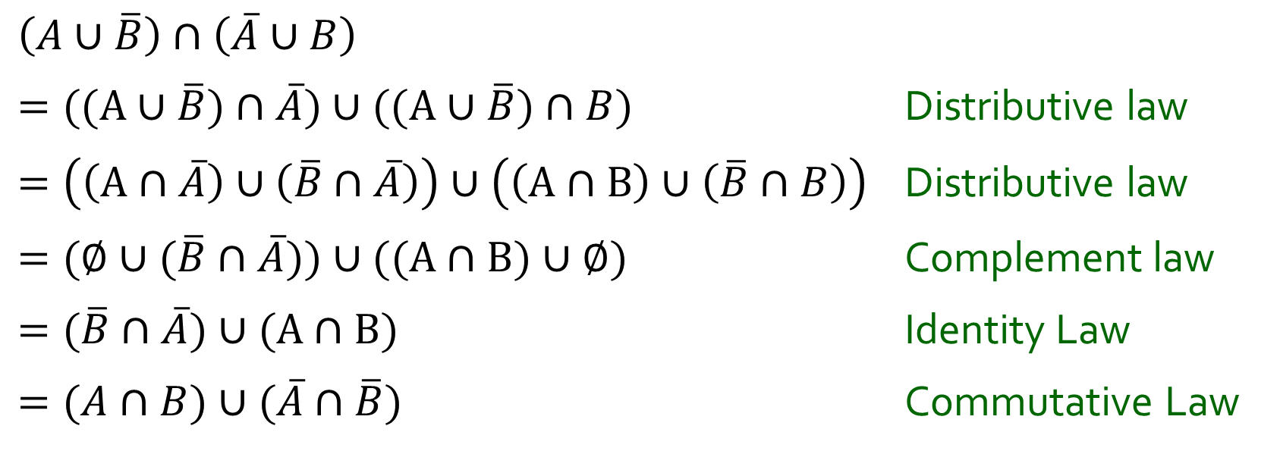
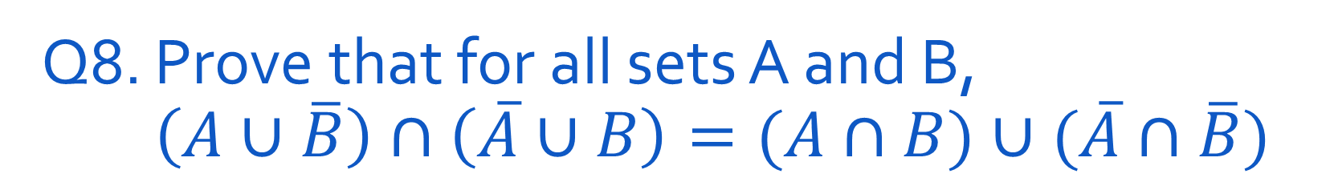
Q8. Prove that for all sets A and B, $\left(A∪\overline{B}\right)∩\left(\overline{A}∪B\right)=(A∩B)∪(\overline{A}∩\overline{B})$
$$\left(A∪\overline{B}\right)∩\left(\overline{A}∪B\right)$$
$=((A∪\overline{B})∩\overline{A})∪((A∪\overline{B})∩B)$ Distributive law
$=\left(\left(A∩\overline{A}\right)∪\left(\overline{B}∩\overline{A}\right)\right)∪\left(\left(A∩B\right)∪\left(\overline{B}∩B\right)\right)$ Distributive law
$=(∅∪(\overline{B}∩\overline{A}))∪((A∩B)∪∅)$ Complement law
$=(\overline{B}∩\overline{A})∪(A∩B)$ Identity Law
$=(A∩B)∪(\overline{A}∩\overline{B})$ Commutative Law

Slide 14
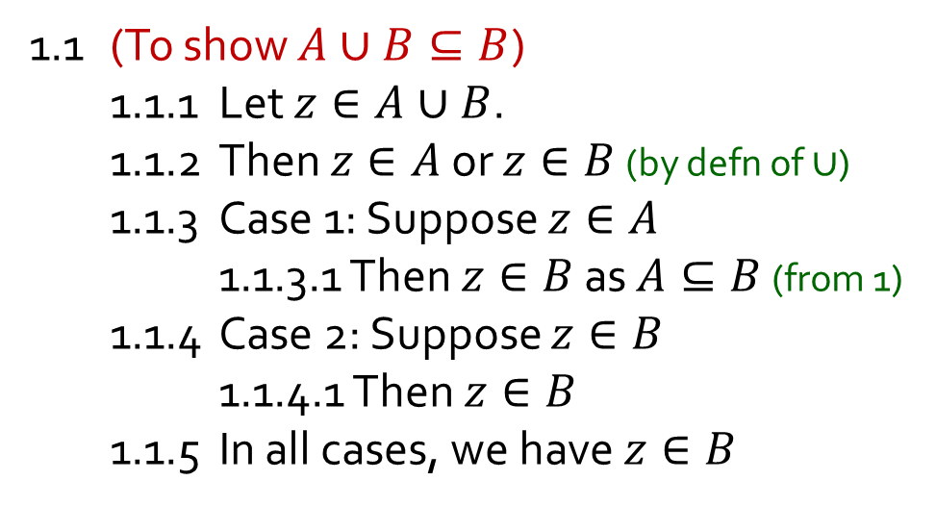
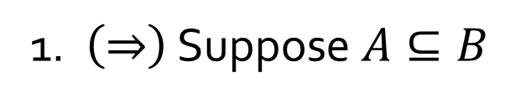
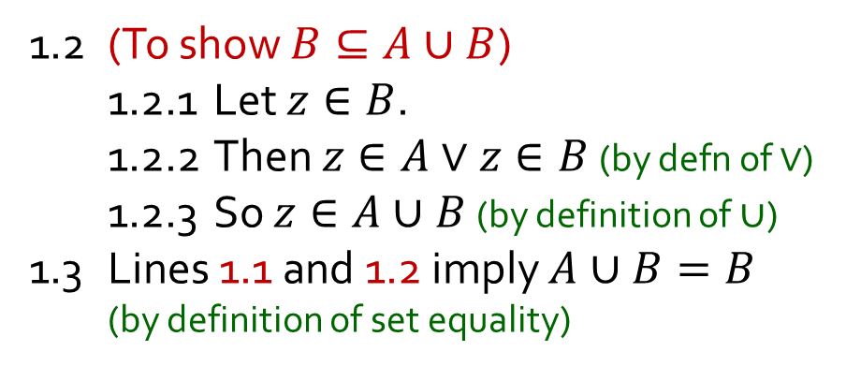
Q9. Let A, B be sets. Show that A ⊆ B iff A ⋃ B = B
This is the “only if” part
1. $\left(⇒\right)$ Suppose $A⊆B$
1.1 (To show $A∪B⊆B$)
1.1.1 Let $z∈A∪B$.
1.1.2 Then $z∈A$ or $z∈B$ (by defn of $∪$)
1.1.3 Case 1: Suppose $z∈A$
1.1.3.1 Then $z∈B$ as $A⊆B$ (from 1)
1.1.4 Case 2: Suppose $z∈B$
1.1.4.1 Then $z∈B$
1.1.5 In all cases, we have $z∈B$
1.2 (To show $B⊆A∪B$)
1.2.1 Let $z∈B$.
1.2.2 Then $z∈A∨z∈B$ (by defn of $∨$)
1.2.3 So $z∈A∪B$ (by definition of$∪$)
1.3 Lines 1.1 and 1.2 imply $A∪B=B$ (by definition of set equality)

Slide 15
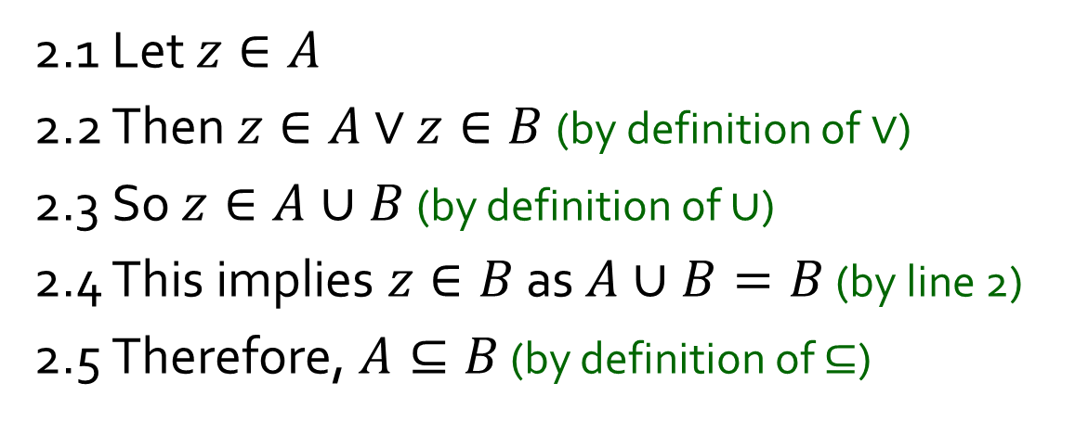
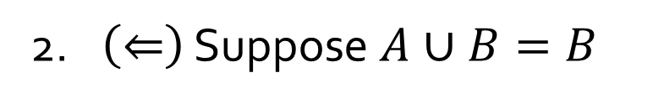
Q9. Let A, B be sets. Show that A ⊆ B iff A ⋃ B = B
This is the “if” part
2. $\left(⇐\right)$ Suppose $A∪B=B$
2.1 Let $z∈A$
2.2 Then $z∈A$ $∨$ $z∈B$ (by definition of$∨$)
2.3 So $z∈A∪B$ (by definition of $∪$)
2.4 This implies $z∈B$ as $A∪B=B$ (by line 2)
2.5 Therefore, $A⊆B$ (by definition of $⊆$)

Slide 16


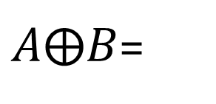
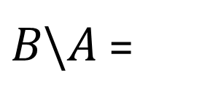
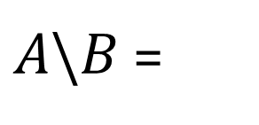
Q10. For sets A and B, define $A⨁B=(A\backslash B)∪(B\backslash A)$
(a) $\text{Let} \text{A}\text{ = \{1, 4, 9, 16\} }\text{and} \text{B}\text{ = \{2, 4, 6, 8, 10, 12, 14, 16\}. }$
Find $A⨁B$.
$A\backslash B$=
$B\backslash A$=
$A⨁B$=

Slide 17
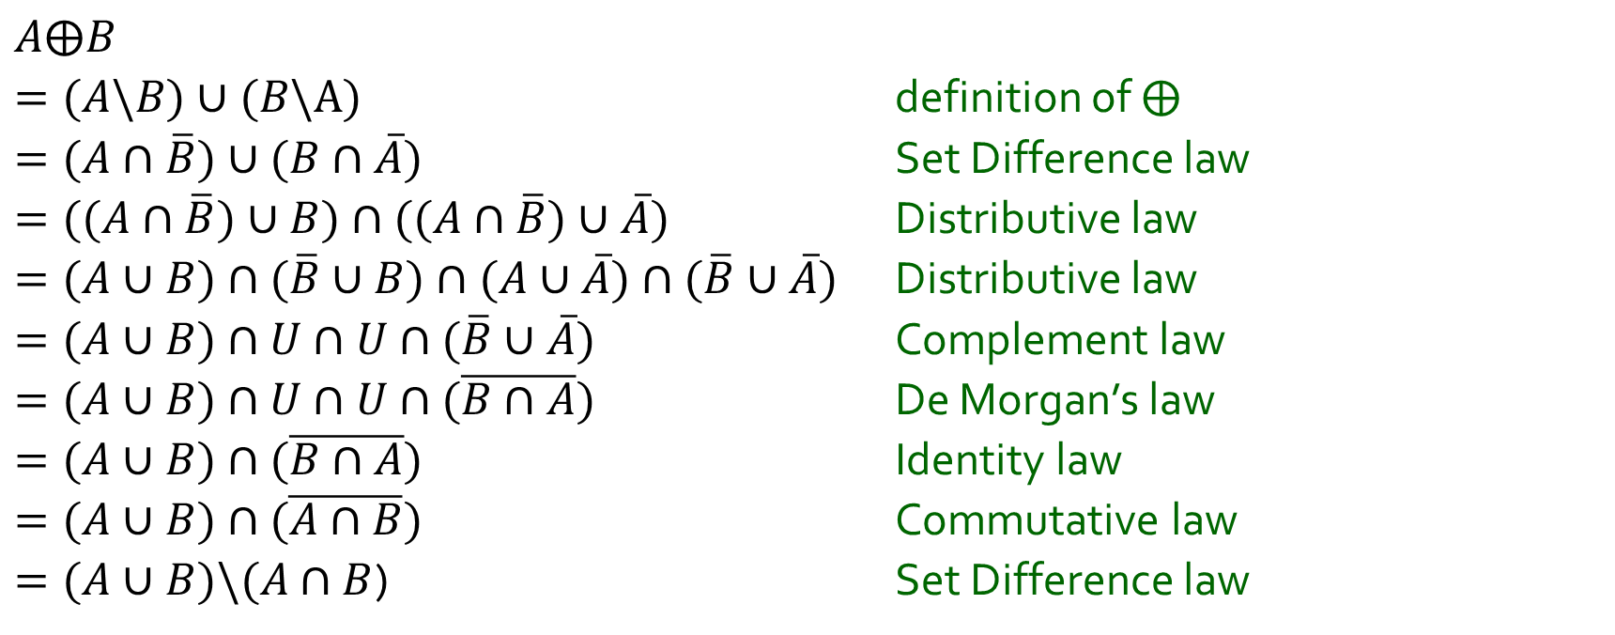
Q10. For sets A and B, define $A⨁B=(A\backslash B)∪(B\backslash A)$
(b) Show that for all sets A, B: $A⨁B=(A∪B)\backslash (A∩B)$.
$$A⨁B$$
$=(A\backslash B)∪(B\backslash A)$ definition of $⨁$
$=(A∩\overline{B})∪(B∩\overline{A})$ Set Difference law
$=((A∩\overline{B})∪B)∩((A∩\overline{B})∪\overline{A})$ Distributive law
$=(A∪B)∩(\overline{B}∪B)∩(A∪\overline{A})∩(\overline{B}∪\overline{A})$ Distributive law
$=(A∪B)∩U∩U∩(\overline{B}∪\overline{A})$ Complement law
$=(A∪B)∩U∩U∩(\overline{B∩A})$ De Morgan’s law
$=(A∪B)∩(\overline{B∩A})$ Identity law
$=(A∪B)∩(\overline{A∩B})$ Commutative law
$=(A∪B)\backslash (A∩B$) Set Difference law

Slide 18
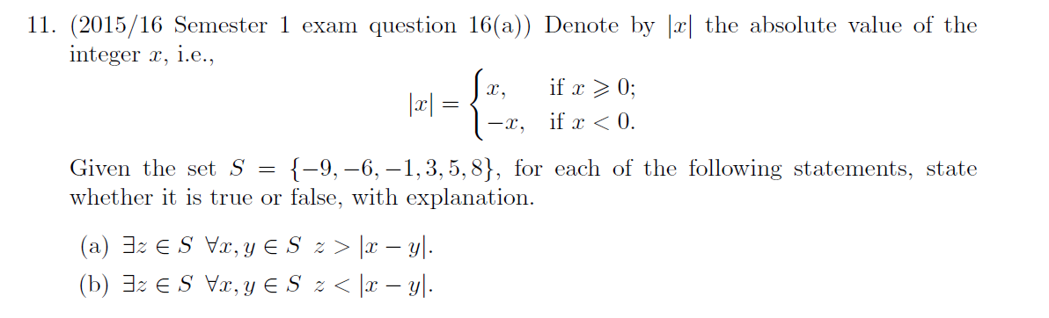
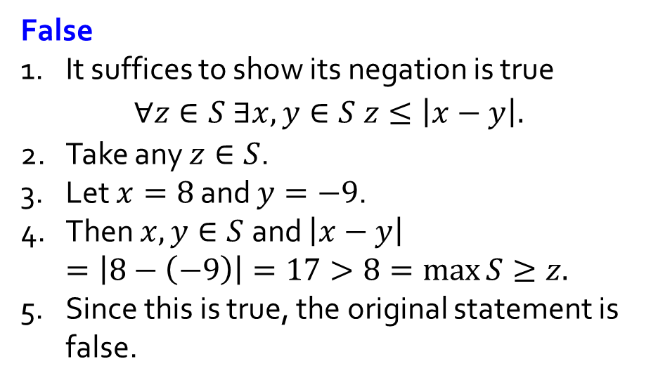
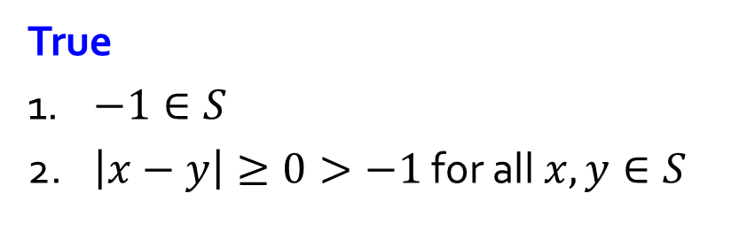
False
1. It suffices to show its negation is true
$$∀z∈S ∃x,y∈S z≤\left|x−y\right|.$$
2. Take any $z∈S$.
3. Let $x=8$ and $y=−9$.
4. Then $x,y∈S$and $\left|x−y\right|$
$=\left|8−\left(−9\right)\right|=17>8=\max{S≥z.}$
5. Since this is true, the original statement is false.
True
1. $−1∈S$
2. $\left|x−y\right|≥0>−1$ for all $x,y∈S$

Slide 19
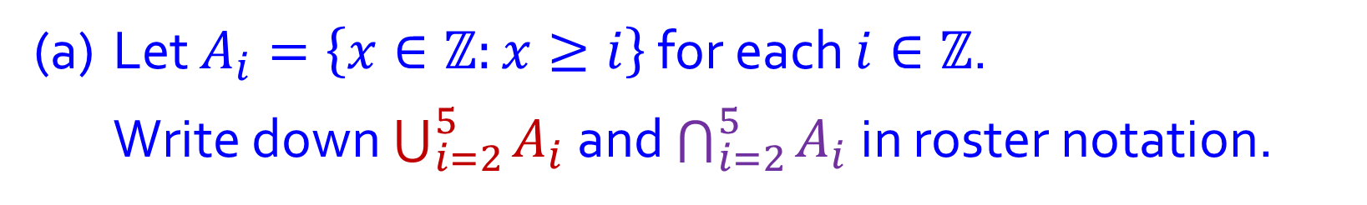
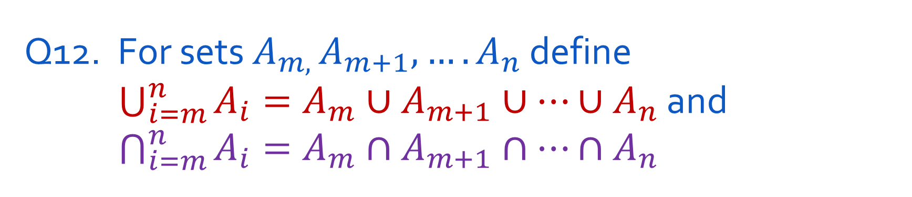
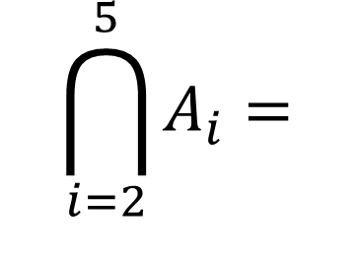
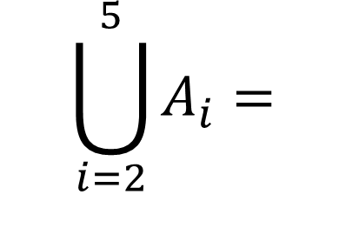
Q12. For sets $A_{m, }A_{m+1},….A_{n}$ define $\bigcup_{i=m}^{n}{A_{i}}=A_{m}∪A_{m+1}∪…{∪A}_{n}$ and $\bigcap_{i=m}^{n}{A_{i}}=A_{m}∩A_{m+1}∩…∩A_{n}$
(a) Let $A_{i}=\left\{x∈ℤ:x≥i\right\}$ for each $i∈ℤ$.
Write down $\bigcup_{i=2}^{5}{A_{i}}$ and $\bigcap_{i=2}^{5}{A_{i}}$ in roster notation.
$$\bigcup_{i=2}^{5}{A_{i}}=$$
$$\bigcap_{i=2}^{5}{A_{i}}=$$

Slide 20
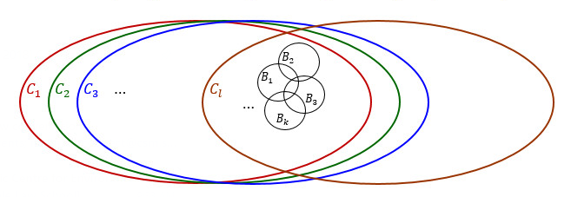
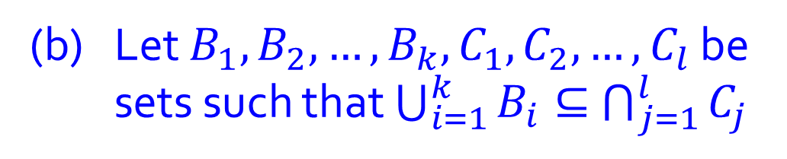
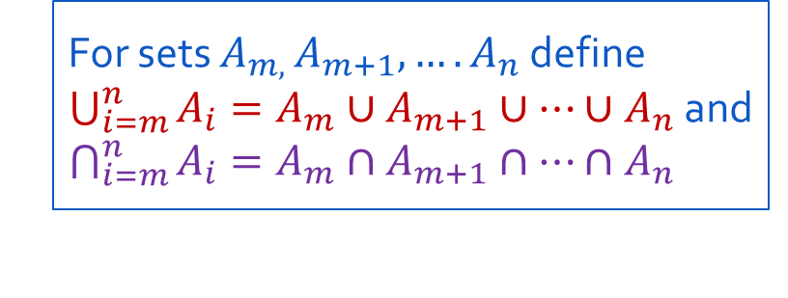
For sets $A_{m, }A_{m+1},….A_{n}$ define $\bigcup_{i=m}^{n}{A_{i}}=A_{m}∪A_{m+1}∪…{∪A}_{n}$ and $\bigcap_{i=m}^{n}{A_{i}}=A_{m}∩A_{m+1}∩…∩A_{n}$
(b) Let $B_{1},B_{2},…,B_{k},C_{1},C_{2},…,C_{l}$ be sets such that $\bigcup_{i=1}^{k}{B_{i}}⊆$ $\bigcap_{j=1}^{l}{C_{j}}$
Show that $B_{i}⊆C_{j}$ for all $i∈\left\{1,2,…,k\right\} and all j∈\{1,2,…,l\}$

Slide 21
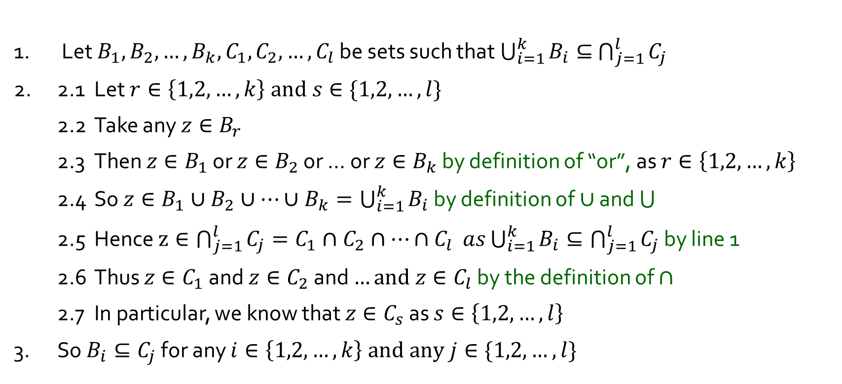
For sets $A_{m, }A_{m+1},….A_{n}$ define $\bigcup_{i=m}^{n}{A_{i}}=A_{m}∪A_{m+1}∪…{∪A}_{n}$ and $\bigcap_{i=m}^{n}{A_{i}}=A_{m}∩A_{m+1}∩…∩A_{n}$
(b) Let $B_{1},B_{2},…,B_{k},C_{1},C_{2},…,C_{l}$ be sets such that $\bigcup_{i=1}^{k}{B_{i}}⊆$ $\bigcap_{j=1}^{l}{C_{j}}$
Show that $B_{i}⊆C_{j}$ for all $i∈\left\{1,2,…,k\right\} and all j∈\{1,2,…,l\}$
1. Let $B_{1},B_{2},…,B_{k},C_{1},C_{2},…,C_{l}$ be sets such that $\bigcup_{i=1}^{k}{B_{i}}⊆$ $\bigcap_{j=1}^{l}{C_{j}}$
2. 2.1 Let $r∈\left\{1,2,…,k\right\} and s∈\{1,2,…,l\}$
2.2 Take any $z∈B_{r}$
2.3 Then $z∈B_{1}$ or $z∈B_{2}$ or … or $z∈B_{k}$ by definition of “or”, as $r∈\left\{1,2,…,k\right\}$
2.4 So $z∈B_{1}∪B_{2}∪…∪B_{k}=\bigcup_{i=1}^{k}{B_{i}}$ by definition of $∪$ and
2.5 Hence $z∈\bigcap_{j=1}^{l}{C_{j}=C_{1}∩C_{2}∩…∩C_{l}} as\bigcup_{i=1}^{k}{B_{i}}⊆\bigcap_{j=1}^{l}{C_{j}}$ by line 1
2.6 Thus $z∈C_{1}$ and $z∈C_{2}$ and $…and z∈C_{l}$ by the definition of $∩$
2.7 In particular, we know that $z∈C_{s}$ as $s∈\left\{1,2,…,l\right\}$
3. So $B_{i}⊆C_{j}$ for any $i∈\left\{1,2,…,k\right\} and any j∈\{1,2,…,l\}$

Slide 22
THE END

