Slide 1
Cs1231S tutorial #4
Functions

Slide 2
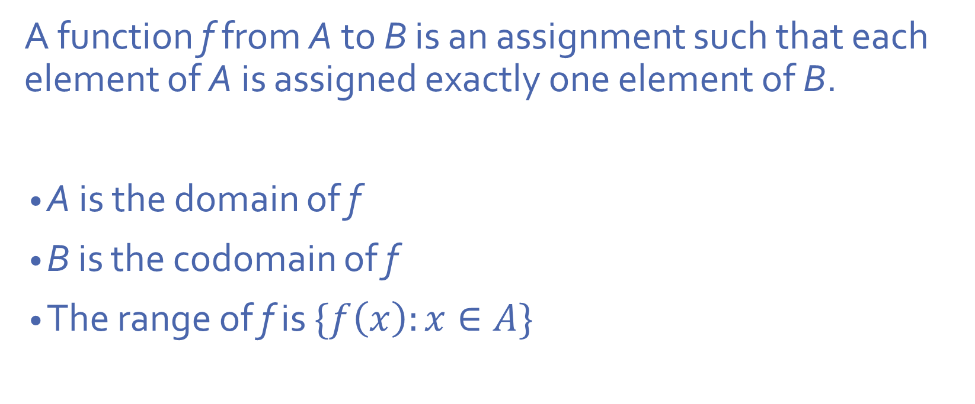
Functions
A function f from A to B is an assignment such that each element of A is assigned exactly one element of B.
A is the domain of f
B is the codomain of f
The range of f is $\{f\left(x\right):x∈A\}$

Slide 3

Equality
Two functions $f :A→B$ and $g:C→D$ are equal if
A = C and B = D
$f\left(x\right)=g\left(x\right)$ for all $x∈A$

Slide 4
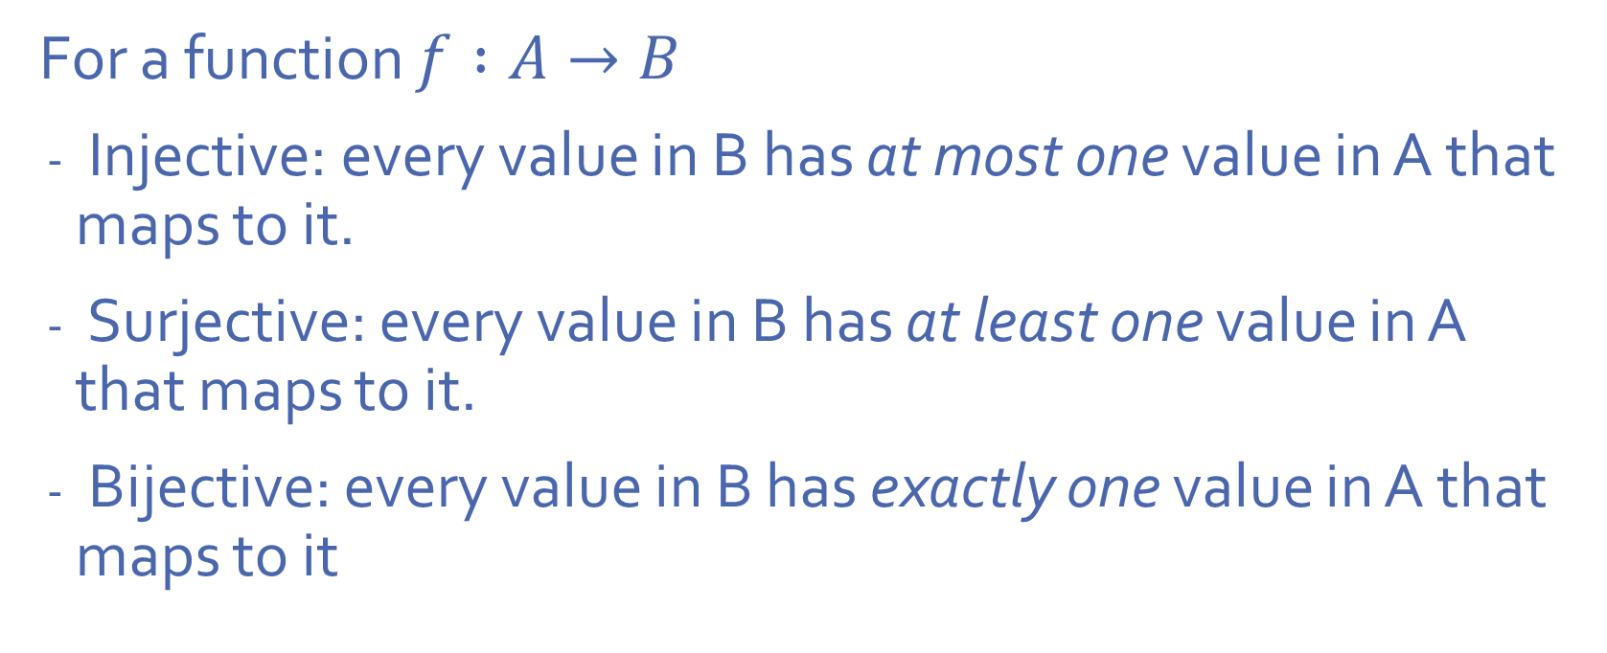
Function properties
For a function $f :A→B$
Injective: every value in B has at most one value in A that maps to it.
Surjective: every value in B has at least one value in A that maps to it.
Bijective: every value in B has exactly one value in A that maps to it

Slide 5
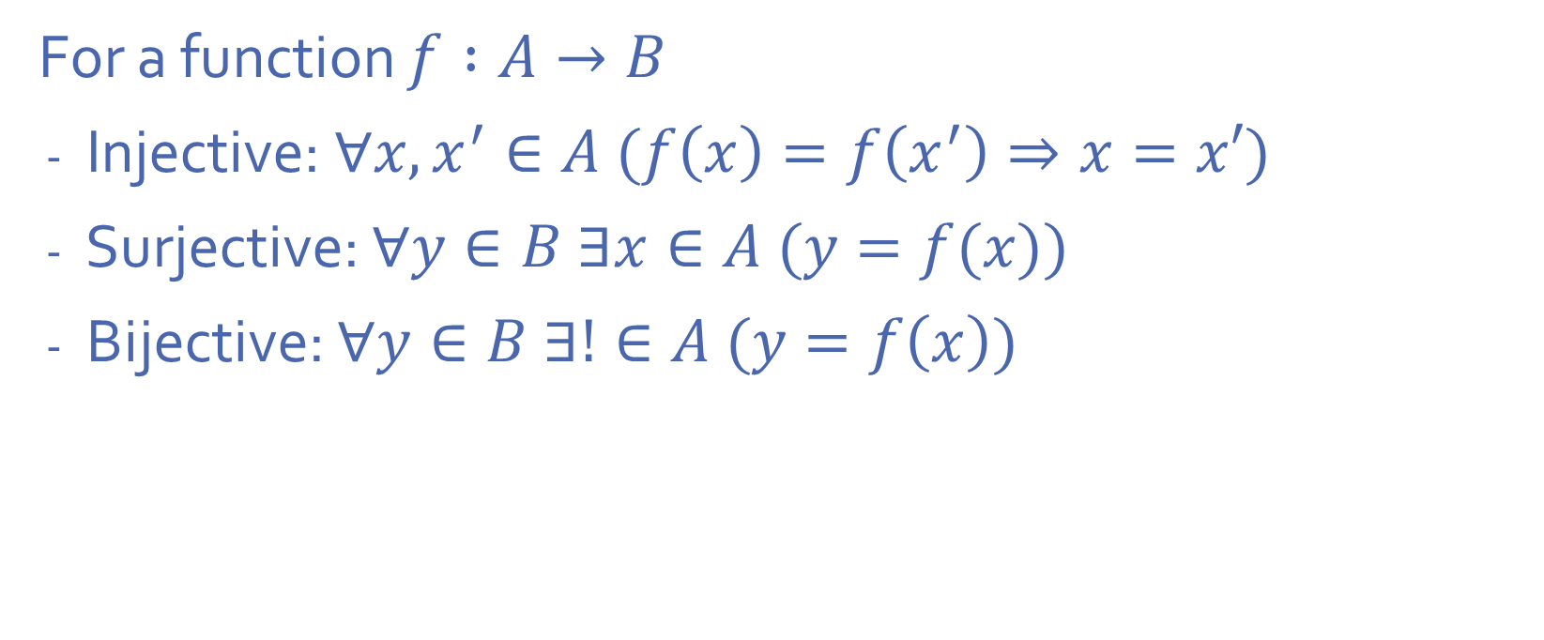
Function properties
For a function $f :A→B$
Injective: $∀x, x^{′}∈A (f\left(x\right)=f\left(x^{′}\right)⇒x=x′)$
Surjective: $∀y∈B ∃x∈A (y=f(x))$
Bijective: $∀y∈B ∃!∈A (y=f\left(x\right))$

Slide 6
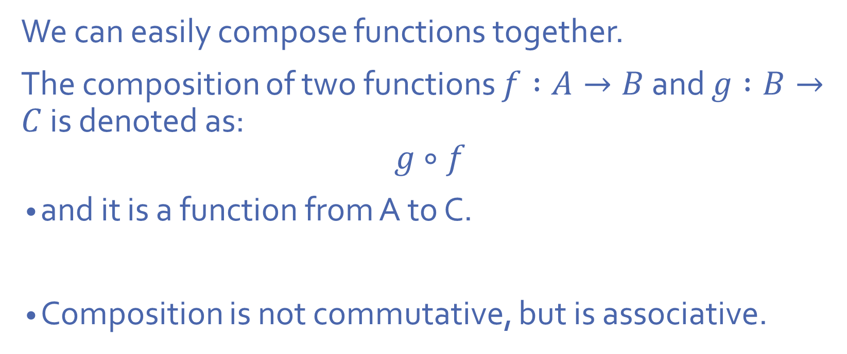
Composition
We can easily compose functions together.
The composition of two functions $f :A→B$ and $g :B→C$ is denoted as:
$$g∘f$$
and it is a function from A to C.
Composition is not commutative, but is associative.

Slide 7
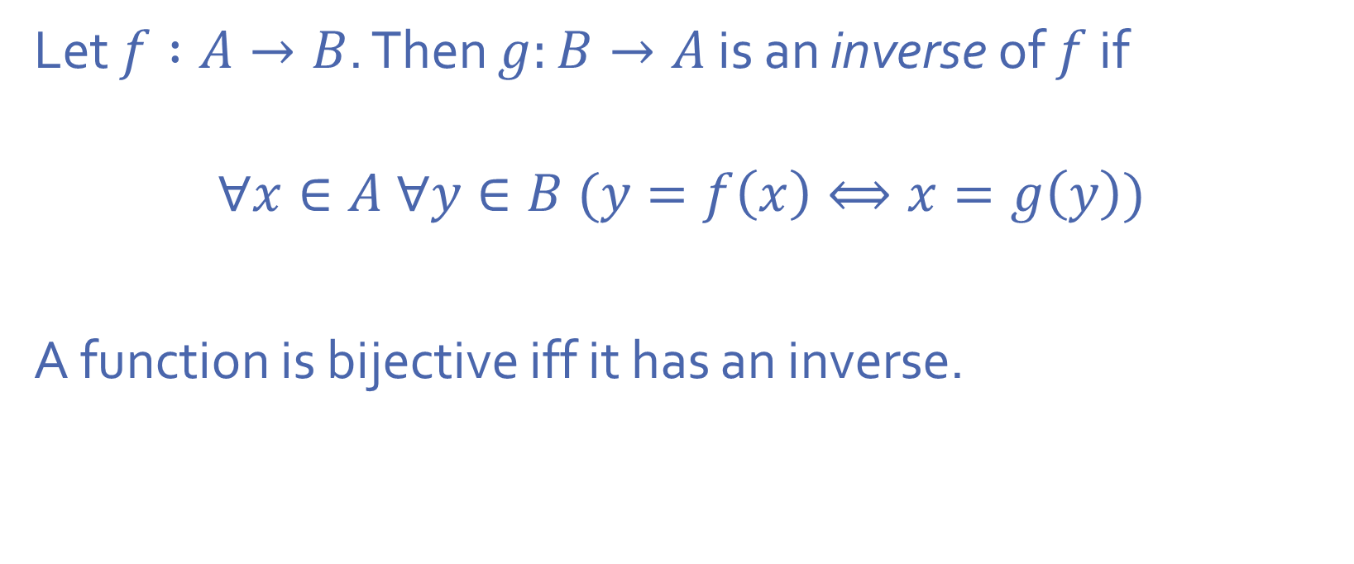
Inverses
Let $f :A→B$. Then $g:B→A$ is an inverse of $f$ if
$$∀x∈A ∀y∈B (y=f\left(x\right)⟺x=g\left(y\right))$$
A function is bijective iff it has an inverse.

Slide 8
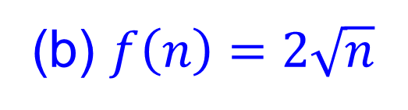

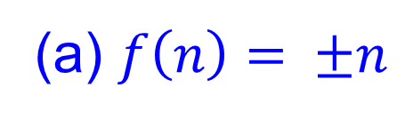
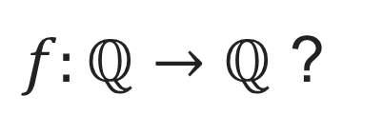
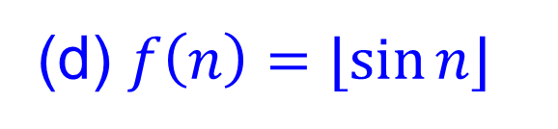
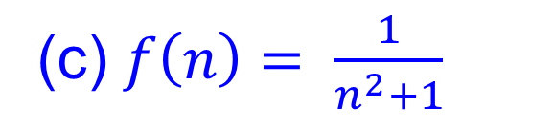
Q1.
$f:ℚ→ℚ$ ?
YES
NO
Why?
(a) $f\left(n\right)= ±n$
Why?
(b) $f\left(n\right)=2\sqrt{n}$
(c) $f\left(n\right)= \frac{1}{n^{2}+1}$
(d) $f\left(n\right)=⌊sin{n⌋}$
What is the range of sine $n$?

Slide 9





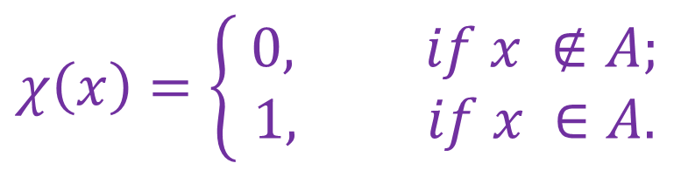
Q2.
Let $U$ be a set and $A⊆U$ such that $∅≠A≠U$.
Define $χ:U→ℤ$ by setting, for all $x∈U,$
$$χ\left(x\right)=\left\{\begin{aligned} 0, if x ∉A; \\ 1, if x ∈A.\end{aligned}\right.$$
Domain:
Codomain:
Image:
$$U$$
Find the domain, the codomain, and the image of $χ$.
$$ℤ$$
$\{0, 1\}$

Slide 10
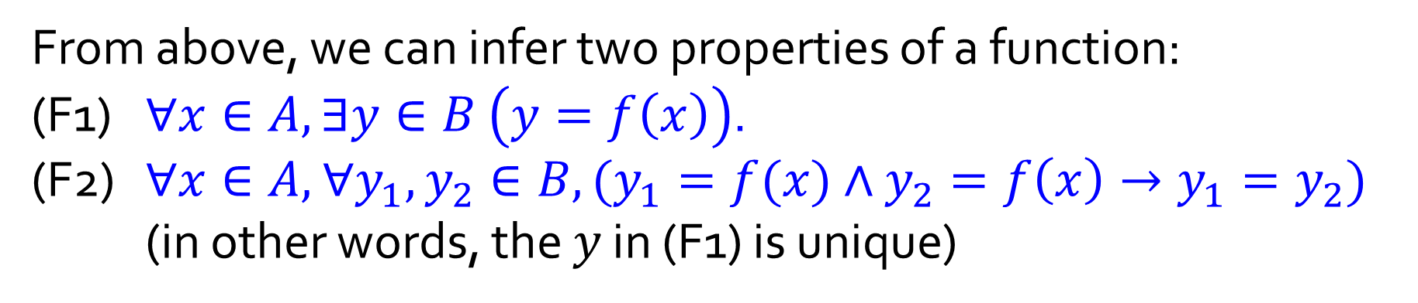
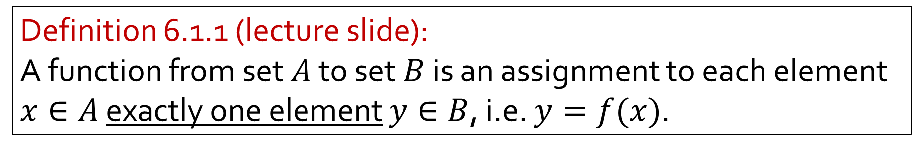

Definition of a function (recap)
Definition 6.1.1 (lecture slide):
A function from set $A$ to set $B$ is an assignment to each element $x∈A$ exactly one element $y∈B$, i.e. $y=f(x)$.
From above, we can infer two properties of a function:
(F1) $∀x∈A,∃y∈B$ $\left(y=f\left(x\right)\right)$.
(F2) $∀x∈A,$ $∀y_{1},y_{2}∈B, (y_{1}=f(x)∧$ $y_{2}=f\left(x\right)→y_{1}=y_{2})$ (in other words, the $y$ in (F1) is unique)
Or, combining (F1) and (F2):
$∀x∈A,$ $∃!y∈B \left(y=f\left(x\right)\right)$.

Slide 11














Quick check: Which of the following are functions and which are not?
$$A$$
$$f_{1}$$
$$B$$
$$A$$
$$f_{2}$$
$$B$$
Informally, for a function, every element in the domain must have exactly one arrow coming out of it.
Note that nothing is said about elements in the codomain.
$$A$$
$$f_{3}$$
$$B$$
$$A$$
$$f_{4}$$
$$B$$

Slide 12
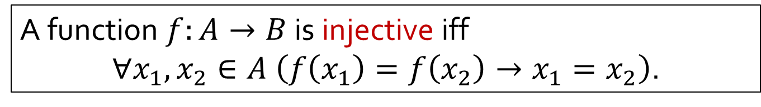



Recap: Definition 6.2.5 (lecture slide)
A function $f:A→B$ is surjective iff
$∀y∈B,∃x∈A \left(y=f\left(x\right)\right)$.
A function $f:A→B$ is injective iff
$∀x_{1},x_{2}∈A \left(f\left(x_{1}\right)=f\left(x_{2}\right)→x_{1}=x_{2}\right)$.
A function is bijective iff it is surjective and injective.
(Surjective) Informally, every element in the codomain must have at least one arrow going into it.
(Injective) Informally, every element in the codomain must have at most one arrow going into it.
(Bijective) Informally, every element in the codomain must have exactly one arrow going into it.
$$∧$$
$$≡$$

Slide 13
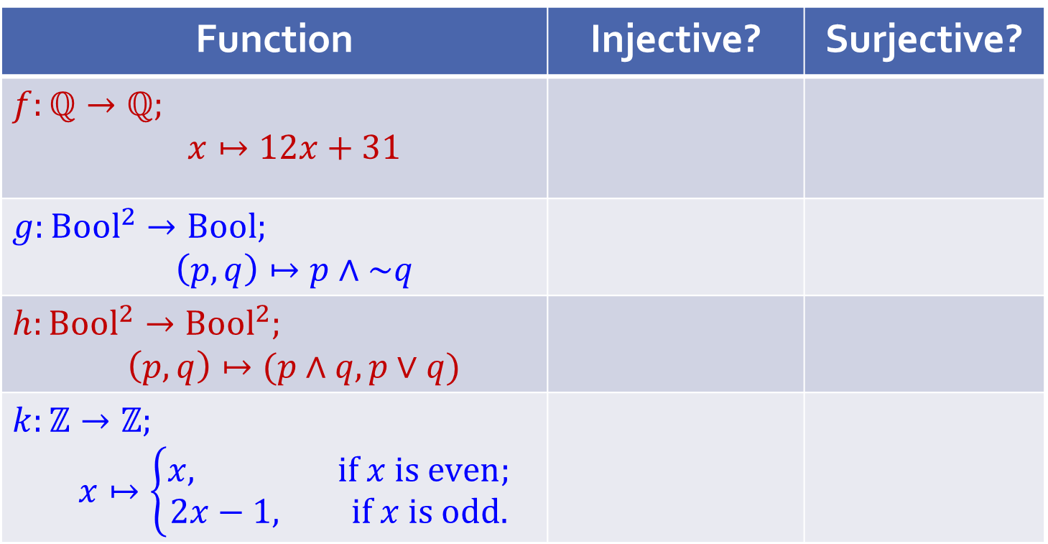
Q3.
Is the function injective? Surjective? Prove. If it is bijective, find the inverse function. Here denote by Bool the set {true; false}.
Quick check before we go into the details:
Function | Injective? | Surjective?
$$f:ℚ→ℚ;$$ $$x↦12x+31$$
$$g:Bool^{2}→Bool;$$ $$\left(p,q\right)↦p∧\sim q$$
$$h:Bool^{2}→Bool^{2};$$ $$\left(p,q\right)↦(p∧q,p∨q)$$
$$k:ℤ→ℤ;$$ $$x↦\left\{\begin{aligned}x, if x is even; \\ 2x−1, if x is odd.\end{aligned}\right.$$

Slide 14
Q3.
What does the previous table show?
A function can be
injective but not surjective;
surjective but not injective;
injective and surjective (i.e. bijective); or
neither injective nor surjective.
All four cases are possible!

Slide 15
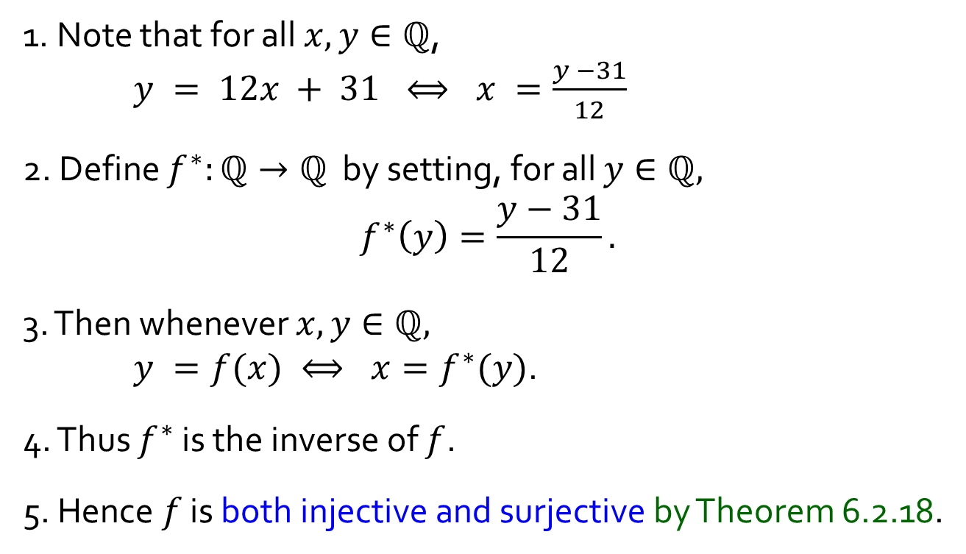
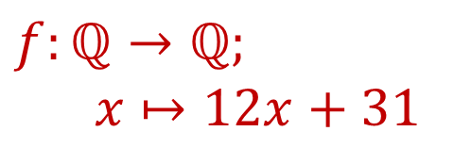

Q3.
$$f:ℚ→ℚ;$$
$$x↦12x+31$$
Both Injective and Surjective
Part 1
1. Note that for all $x,y∈ℚ$,
$y = 12x + 31 ⟺ x =\frac{y −31}{12}$
2. Define $f^{∗}:ℚ→ℚ$ by setting, for all $y∈ℚ,$ $$f^{∗}\left(y\right)=\frac{y−31}{12}.$$
3. Then whenever $x,y∈ℚ,$
$y =f(x) ⟺ x=f^{∗}(y)$.
4. Thus $f^{∗}$ is the inverse of $f$.
5. Hence $f$ is both injective and surjective by Theorem 6.2.18.
Students to note:
You see that for this solution, we didn’t show that $f$ is injective and surjective separately, and then conclude that $f$ is bijective (we could have done so).
Instead, we find the inverse of $f$, and since its inverse exists, it must be bijective (by Theorem 6.2.18.)

Slide 16
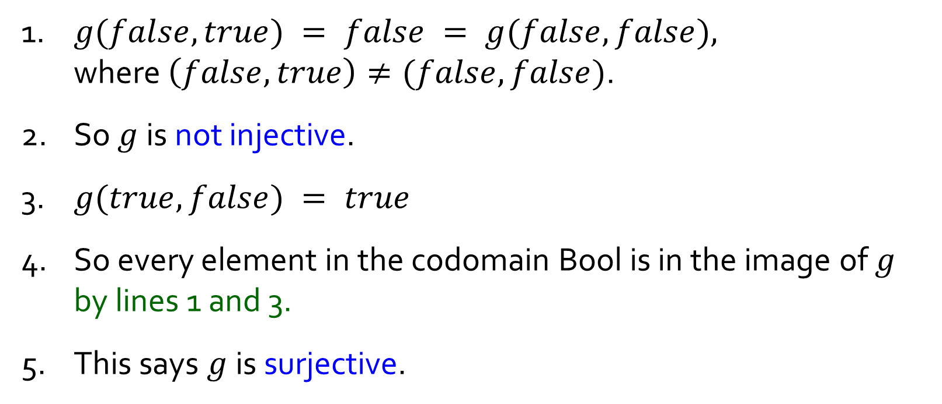
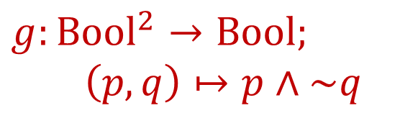
Q3.
$$g:Bool^{2}→Bool;$$
$$\left(p,q\right)↦p∧\sim q$$
Not Injective But Surjective
Part 2
1. $g(false,true) = false = g(false,false),$
where $\left(false,true\right)≠(false,false)$.
2. So $g$ is not injective.
3. $g(true, false) = true$
4. So every element in the codomain Bool is in the image of $g$ by lines 1 and 3.
5. This says $g$is surjective.

Slide 17
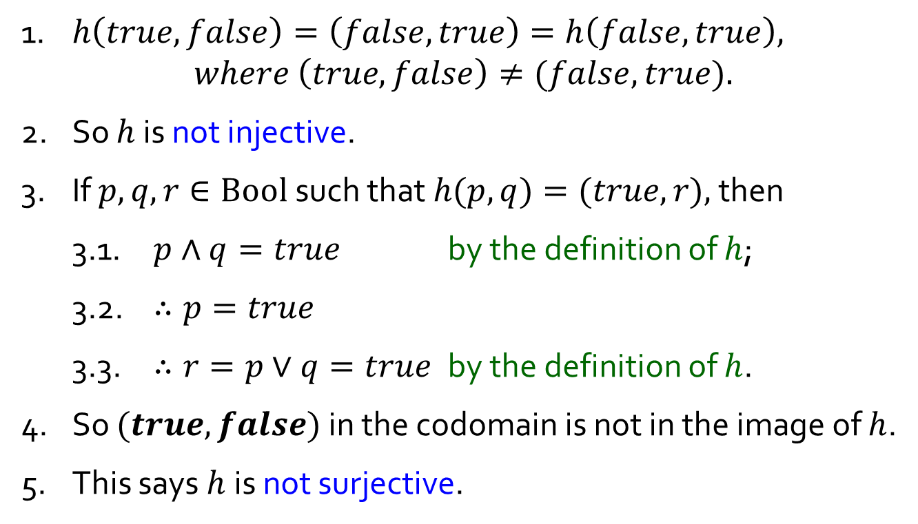
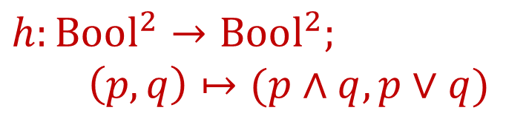
Q3.
$$h:Bool^{2}→Bool^{2};$$
$$\left(p,q\right)↦(p∧q,p∨q)$$
Not Injective, Not Surjective
Part 3
1. $h\left(true,false\right)=\left(false,true\right)=h\left(false, true\right),$
$$where \left(true, false\right)≠(false, true).$$
2. So $h$ is not injective.
3. If $p,q,r∈Bool$such that $h(p,q)=(true,r),$ then
3.1. $p∧q=true$ by the definition of $h$;
3.2. $∴p=true$
3.3. $∴r=p∨q=true$ by the definition of $h$.
4. So $(true,false)$ in the codomain is not in the image of $h$.
5. This says $h$is not surjective.

Slide 18
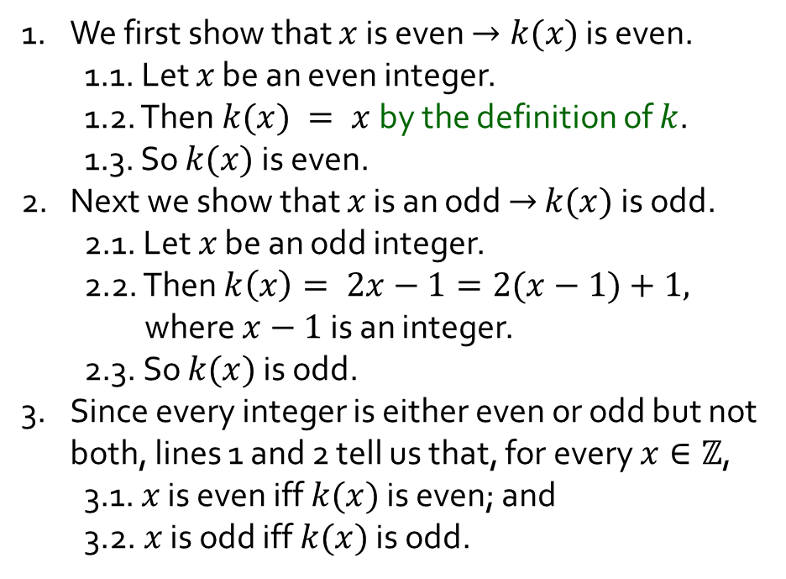
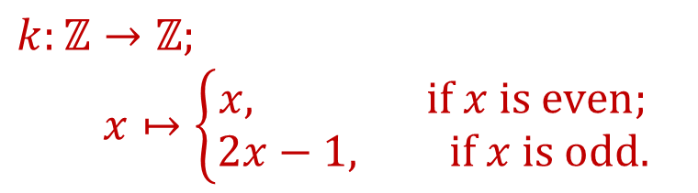
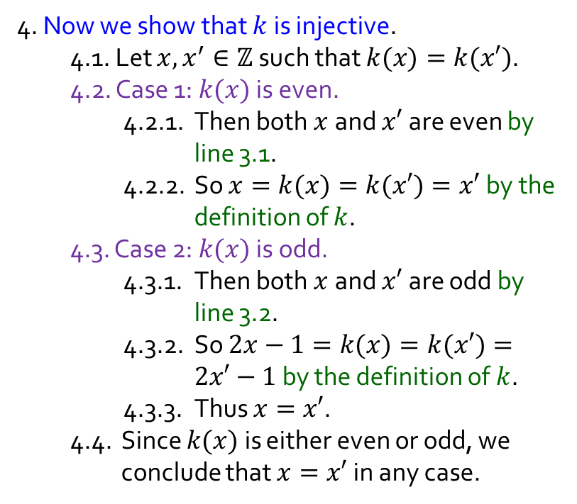
Q3.
$$k:ℤ→ℤ;$$
$$x↦\left\{\begin{aligned}x, if x is even; \\ 2x−1, if x is odd.\end{aligned}\right.$$
Injective, Not Surjective
Part 4
4. Now we show that $k$ is injective.
4.1. Let $x,x^{′}∈ℤ$such that $k(x)=k(x′)$.
4.2. Case 1: $k(x)$ is even.
4.2.1. Then both $x$and $x′$are even by line 3.1.
4.2.2. So $x=k(x)=k(x′)=x′$by the definition of $k$.
4.3. Case 2: $k(x)$ is odd.
4.3.1. Then both $x$and $x′$are odd by line 3.2.
4.3.2. So $2x−1=k(x)=k(x′)=2x′−1$ by the definition of $k$.
4.3.3. Thus $x=x′$.
4.4. Since $k(x)$ is either even or odd, we conclude that $x=x′$ in any case.
1. We first show that $x$ is even $→k(x)$ is even.
1.1. Let $x$ be an even integer.
1.2. Then $k(x) = x$by the definition of $k$.
1.3. So $k(x)$ is even.
2. Next we show that $x$ is an odd $→$ $k(x)$is odd.
2.1. Let $x$ be an odd integer.
2.2. Then $k\left(x\right)= 2x−1=2(x−1)+1,$ where $x−1$is an integer.
2.3. So $k(x)$ is odd.
3. Since every integer is either even or odd but not both, lines 1 and 2 tell us that, for every $x∈ℤ$,
3.1. $x$ is even iff $k(x)$ is even; and
3.2. $x$ is odd iff $k(x)$ is odd.
Continued …

Slide 19


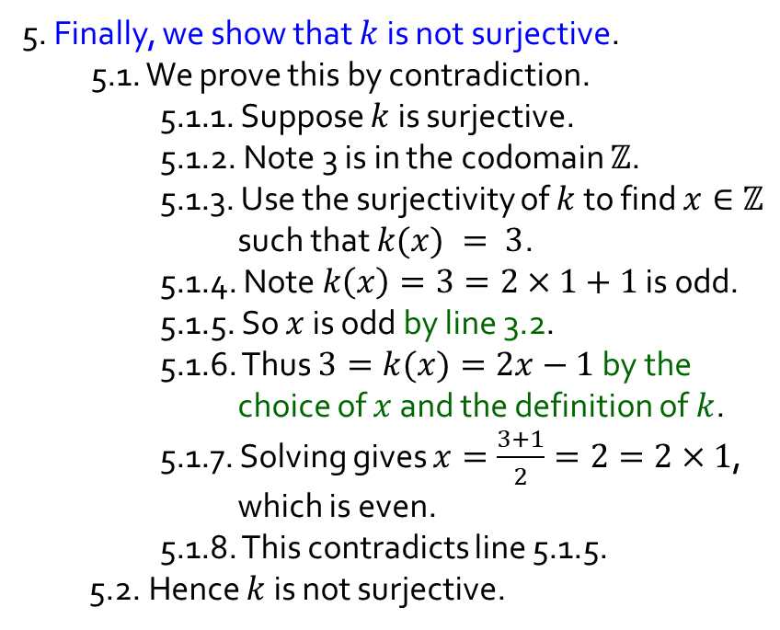
Q3.
$$k:ℤ→ℤ;$$
$$x↦\left\{\begin{aligned}x, if x is even; \\ 2x−1, if x is odd.\end{aligned}\right.$$
Injective, Not Surjective
Part 4
5. Finally, we show that $k$ is not surjective.
5.1. We prove this by contradiction.
5.1.1. Suppose $k$ is surjective.
5.1.2. Note 3 is in the codomain $ℤ$.
5.1.3. Use the surjectivity of $k$ to find $x∈ℤ$ such that $k(x) = 3$.
5.1.4. Note $k\left(x\right)=3=2×1+1$ is odd.
5.1.5. So $x$ is odd by line 3.2.
5.1.6. Thus $3=k(x)=2x−1$ by the choice of $x$ and the definition of $k$.
5.1.7. Solving gives $x=\frac{3+1}{2}=2=2×1$, which is even.
5.1.8. This contradicts line 5.1.5.
5.2. Hence $k$ is not surjective.
4. Now we show that $k$ is injective.
4.1. Let $x,x^{′}∈ℤ$such that $k(x)=k(x′)$.
4.2. Case 1: $k(x)$ is even.
4.2.1. Then both $x$and $x′$are even by line 3.1.
4.2.2. So $x=k(x)=k(x′)=x′$by the definition of $k$.
4.3. Case 2: $k(x)$ is odd.
4.3.1. Then both $x$and $x′$are odd by line 3.2.
4.3.2. So $2x−1=k(x)=k(x′)=2x’−1$ by the definition of $k$.
4.3.3. Thus $x=x′$.
4.4. Since $k(x)$ is either even or odd, we conclude that $x=x′$ in any case.

Slide 20

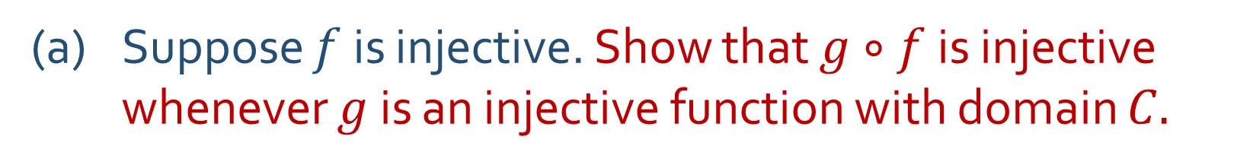

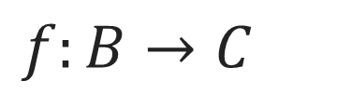



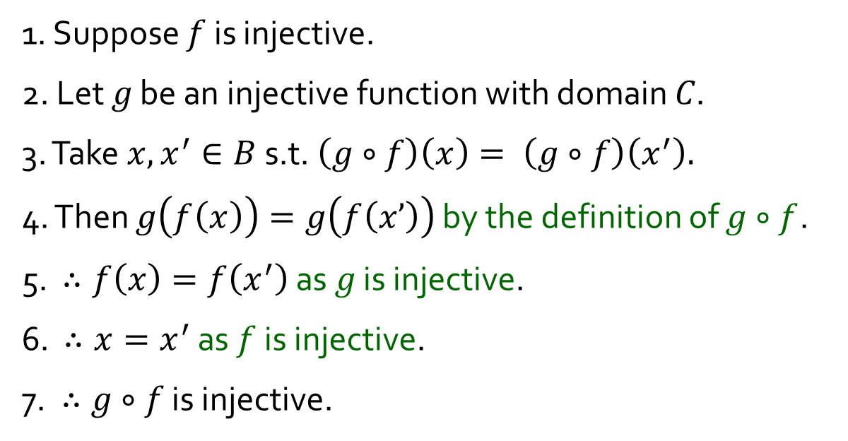

Q4.
$f:B→C$
(a) Suppose $f$ is injective. Show that $g∘f$is injective whenever $g$ is an injective function with domain $C.$
1. Suppose $f$ is injective.
2. Let 𝑔 be an injective function with domain 𝐶.
3. Take $x, x^{′}∈B$s.t. $\left(g∘f\right)\left(x\right)= \left(g∘f\right)\left(x^{′}\right).$
4. Then $g\left(f\left(x\right)\right)=g\left(f\left(x’\right)\right)$ by the definition of $g∘f$.
5. $∴f\left(x\right)=f\left(x^{′}\right)$ as 𝑔 is injective.
6. $∴x=x^{′}$ as $f$ is injective.
7. $∴g∘f$ is injective.
$$B$$
$$C$$
$$D$$
$$f$$
$$g$$
$$g∘f$$

Slide 21
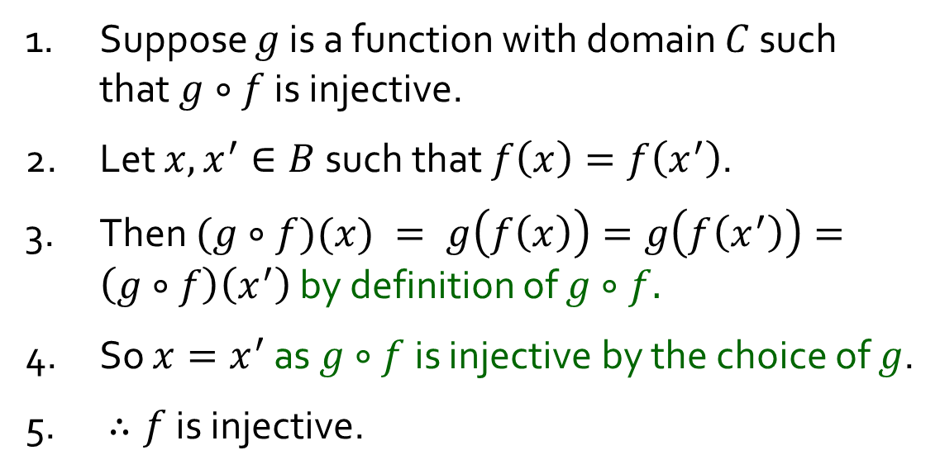

Q4.
$f:B→C$
(b) Suppose we have a function $g$ with domain $C$ such that $g∘f$ is injective. Show that $f$is injective$.$
1. Suppose $g$ is a function with domain $C$ such that $g∘f$ is injective.
2. Let $x,x^{′}∈B$such that $f\left(x\right)=f\left(x^{′}\right)$.
3. Then $(g∘f)(x) = g\left(f\left(x\right)\right)=g\left(f\left(x^{′}\right)\right)=\left(g∘f\right)\left(x^{′}\right)$ by definition of $g∘f.$
4. So $x=x^{′}$ as $g∘f$ is injective by the choice of $g$.
5. $∴f$ is injective.
$$B$$
$$C$$
$$D$$
$$f$$
$$g$$
$$g∘f$$

Slide 22

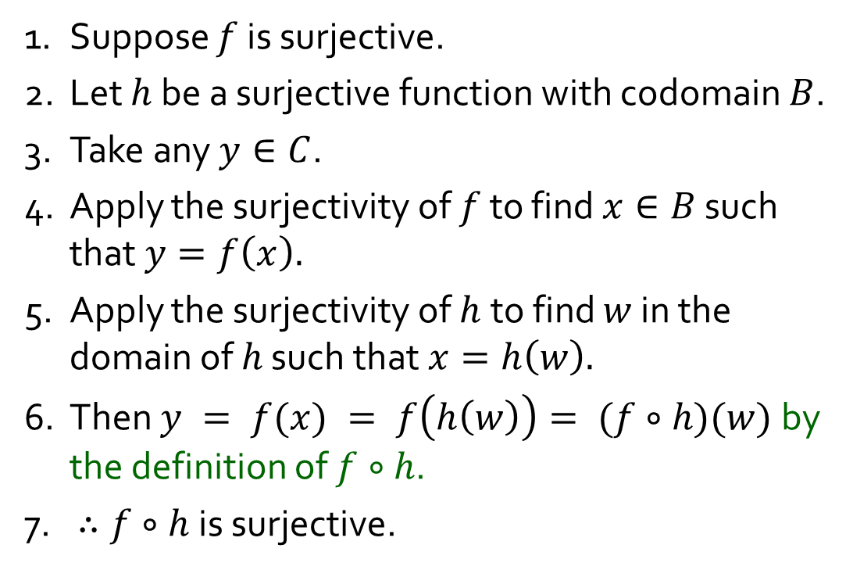

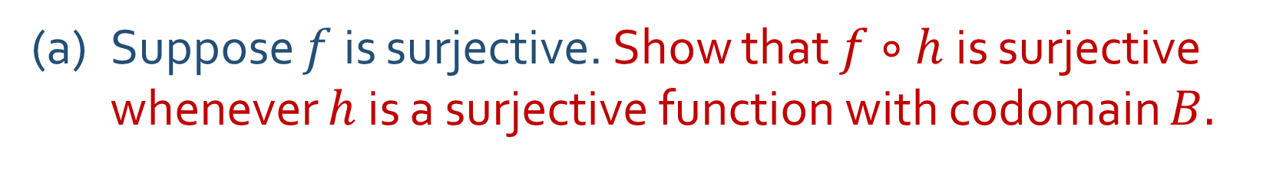




Q5.
$f:B→C$
(a) Suppose $f$ is surjective. Show that $f∘h$is surjective whenever $h$ is a surjective function with codomain $B.$
1. Suppose $f$ is surjective.
2. Let $h$ be a surjective function with codomain $B$.
3. Take any $y∈C$.
4. Apply the surjectivity of $f$ to find $x∈B$ such that $y=f\left(x\right).$
5. Apply the surjectivity of $h$to find $w$ in the domain of $h$ such that $x=h\left(w\right).$
6. Then $y = f(x) = f\left(h\left(w\right)\right)= (f∘h)(w)$by the definition of $f∘h$.
7. $∴f∘h$ is surjective.
$$A$$
$$B$$
$$C$$
$$h$$
$$f$$
$$f∘h$$

Slide 23
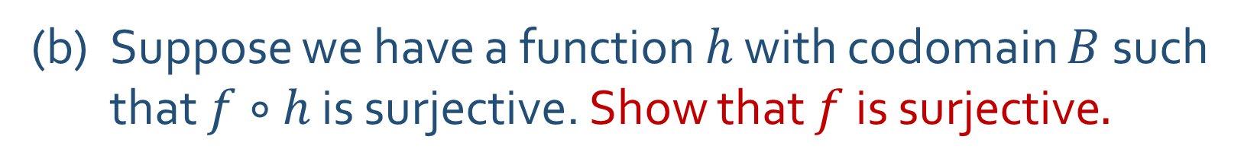
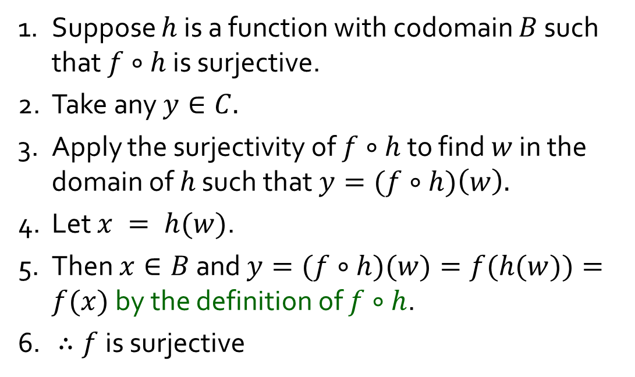
Q5.
$f:B→C$
(b) Suppose we have a function $h$ with codomain $B$ such that $f∘h$ is surjective. Show that $f$is surjective$.$
1. Suppose $h$ is a function with codomain $B$ such that $f∘h$ is surjective.
2. Take any $y∈C.$
3. Apply the surjectivity of $f∘h$ to find $w$ in the domain of $h$ such that $y=(f∘h)\left(w\right).$
4. Let $x = h(w)$.
5. Then $x∈B$and $y=(f∘h)(w)=f(h(w))=f(x)$ by the definition of $f∘h$.
6. $∴f$ is surjective
$$A$$
$$B$$
$$C$$
$$h$$
$$f$$
$$f∘h$$

Slide 24
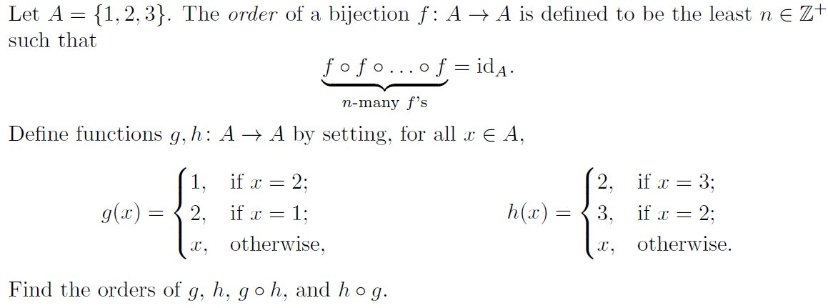


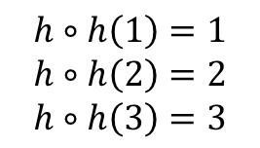







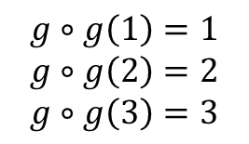



Q6.
$$A$$
$$g$$
$$A$$
$$g$$
$$A$$
$$A$$
$$h$$
$$A$$
$$h$$
$$A$$
1
2
3
1
2
3
1
2
3
$$g∘g\left(1\right)=1$$
$$g∘g\left(2\right)=2$$
$$g∘g\left(3\right)=3$$
1
2
3
1
2
3
1
2
3
$$h∘h\left(1\right)=1$$
$$h∘h\left(2\right)=2$$
$$h∘h\left(3\right)=3$$
$∴$ order of $g$ = 2
$∴$ order of $h$ = 2

Slide 25
















Q6.
Is $\left(g∘h\right)∘\left(g∘h\right)={id}_{A}$?
Is $\left(g∘h\right)∘\left(g∘h\right)∘\left(g∘h\right)={id}_{A}$?
$$A$$
$$h$$
$$A$$
$$g$$
$$A$$
$$A$$
$$A$$
$$A$$
$$A$$
1
2
3
1
2
3
1
2
3
1
2
3
1
2
3
1
2
3
1
2
3
$$≡$$
$$g∘h$$
$$g∘h$$
$$g∘h$$
$$g∘h$$

Slide 26










Q6.
Is $\left(h∘g\right)∘\left(h∘g\right)={id}_{A}$?
Is $\left(h∘g\right)∘\left(h∘g\right)∘\left(h∘g\right)={id}_{A}$?
$$A$$
$$g$$
$$A$$
$$h$$
$$A$$
$$A$$
$$A$$
$$A$$
$$A$$
1
2
3
1
2
3
1
2
3
1
2
3
1
2
3
1
2
3
1
2
3
$$≡$$
$$h∘g$$
$$h∘g$$
$$h∘g$$
$$h∘g$$

Slide 27

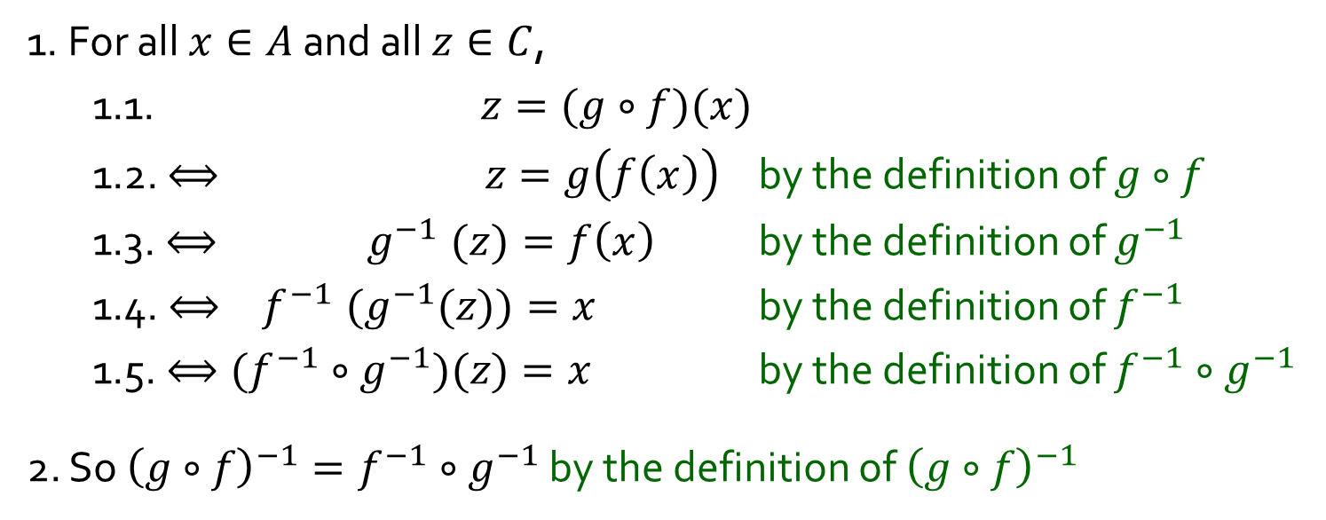

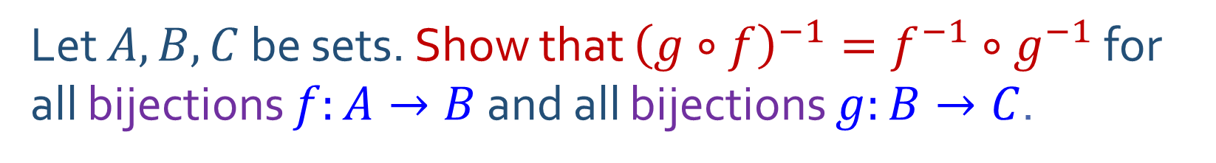



Q7.
Let $A, B, C$ be sets. Show that ${\left(g∘f\right)}^{−1}=f^{−1}∘g^{−1}$ for all bijections $f:A→B$ and all bijections $g:B→C$.
$$A$$
$$f$$
$$B$$
$$g$$
$$C$$
:
:
:
1. For all $x∈A$ and all $z∈C$,
1.1. $z=(g∘f)(x)$
1.2. $⟺ z=g\left(f\left(x\right)\right)$ by the definition of $g∘f$
1.3. ${⟺ g}^{−1}(z)=f\left(x\right)$ by the definition of $g^{−1}$
1.4. ${{⟺ f}^{−1}(g}^{−1}(z))=x$ by the definition of $f^{−1}$
1.5. $⟺({f^{−1}∘g}^{−1})(z)=x$ by the definition of $f^{−1}∘g^{−1}$
2. So ${\left(g∘f\right)}^{−1}=f^{−1}∘g^{−1}$ by the definition of ${\left(g∘f\right)}^{−1}$
:
:
:
$$g∘f$$

Slide 28
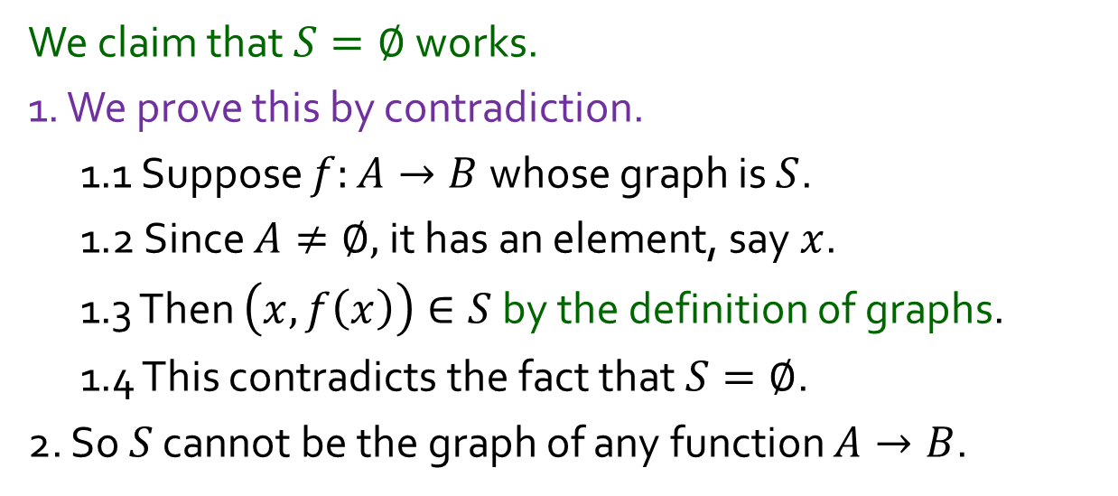
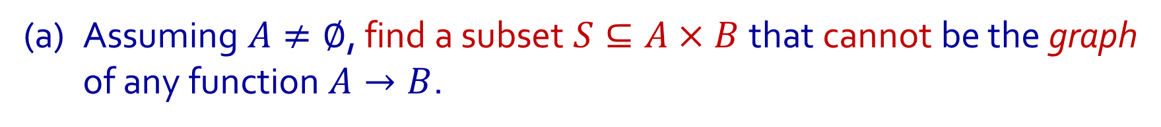
Q8.
$A, B$are sets. The graph of a function $f:A→B$ is
$$\{\left(x,y\right)∈A×B : y = f\left(x\right)\}$$
(a) Assuming $A≠∅$, find a subset $S⊆A×B$that cannot be the graph of any function $A→B$.
We claim that $S=∅$works.
1. We prove this by contradiction.
1.1 Suppose $f:A→B$whose graph is $S$.
1.2 Since $A≠∅,$it has an element, say $x$.
1.3 Then $\left(x, f\left(x\right)\right)∈S$ by the definition of graphs.
1.4 This contradicts the fact that $S=∅$.
2. So $S$ cannot be the graph of any function $A→B$.

Slide 29
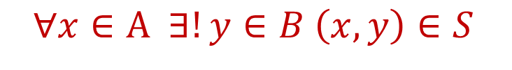
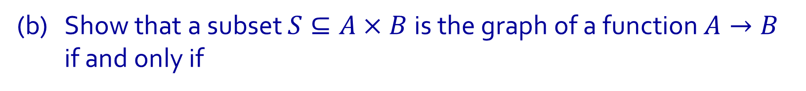
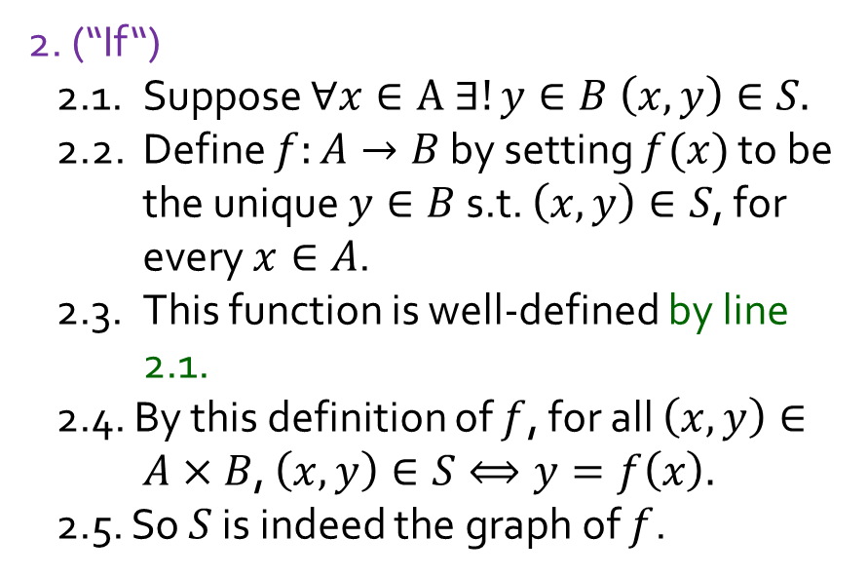
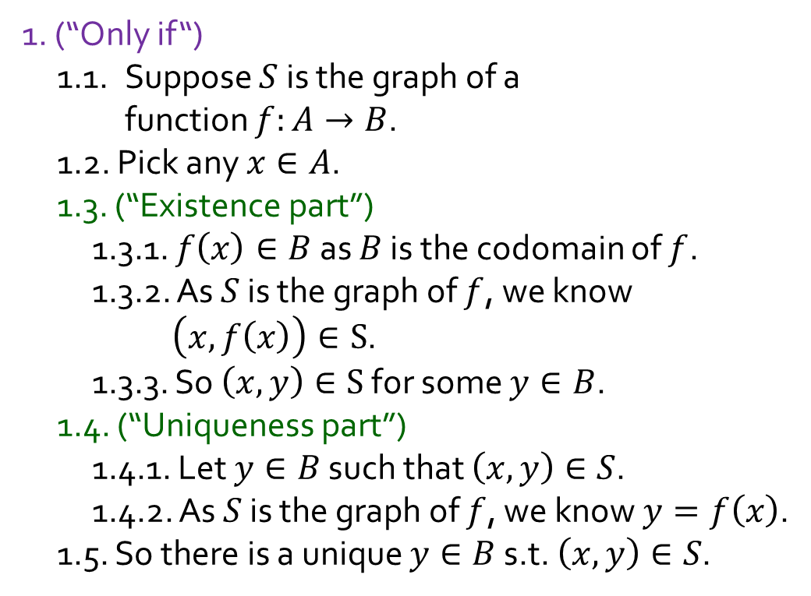
Q8.
(b) Show that a subset $S⊆A×B$is the graph of a function $A→B$ if and only if
$$∀x∈A ∃!y∈B \left(x,y\right)∈S$$
1. (“Only if“)
1.1. Suppose $S$ is the graph of a function $f:A→B$.
1.2. Pick any $x∈A$.
1.3. (“Existence part”)
1.3.1. $f\left(x\right)∈B$ as $B$ is the codomain of $f$.
1.3.2. As $S$ is the graph of $f$, we know $\left(x,f\left(x\right)\right)∈S$.
1.3.3. So $\left(x,y\right)∈S$ for some $y∈B$.
1.4. (“Uniqueness part”)
1.4.1. Let $y∈B$ such that $\left(x,y\right)∈S$.
1.4.2. As $S$ is the graph of $f$, we know $y=f\left(x\right)$.
1.5. So there is a unique $y∈B$ s.t. $\left(x,y\right)∈S$.
2. (“If“)
2.1. Suppose $∀x∈A ∃!y∈B \left(x,y\right)∈S.$
2.2. Define $f:A→B$ by setting $f(x)$ to be the unique $y∈B$ s.t. $\left(x,y\right)∈S$, for every $x∈A$.
2.3. This function is well-defined by line 2.1.
2.4. By this definition of $f$, for all $\left(x,y\right)∈A×B$, $\left(x,y\right)∈S⟺y=f\left(x\right).$
2.5. So $S$ is indeed the graph of $f$.

Slide 30

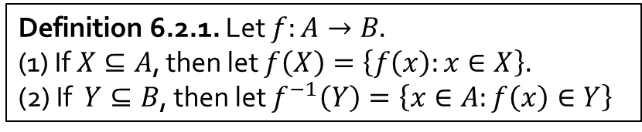
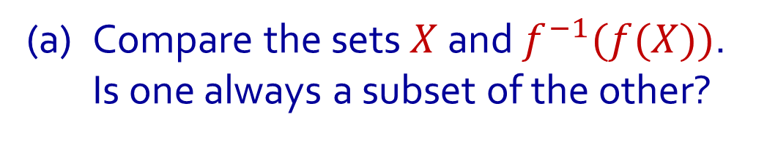
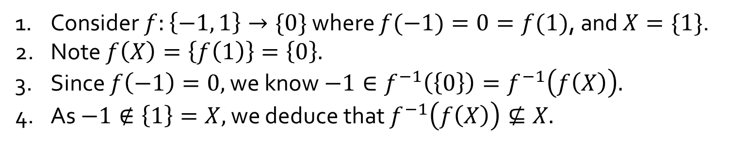




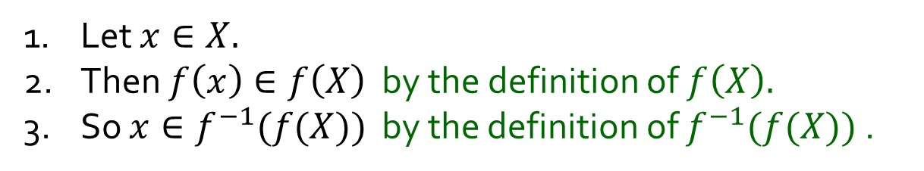



Q9.
Let $f:A→B$ be a function. Let $X⊆A$ and $Y⊆B$.
(a) Compare the sets $X$ and $f^{−1}(f(X))$.
Is one always a subset of the other?
$$A$$
$$f$$
$$B$$
$$f^{−1}\left(f\left(X\right)\right)$$
Is $X⊆f^{−1}(f(X))$ always true?
Yes
$$f(X)$$
1. Let $x∈X.$
2. Then $f\left(x\right)∈f\left(X\right)$ by the definition of $f\left(X\right).$
3. So $x∈f^{−1}(f(X))$ by the definition of $f^{−1}(f(X))$ .
$$X$$
Is$f^{−1}(f(X))⊆X$ always true?
No
1. Consider $f:\left\{−1, 1\right\}→\{0\}$ where $f(−1)=0=f(1)$, and $X=\{1\}$.
2. Note $f\left(X\right)=\left\{f\left(1\right)\right\}=\left\{0\right\}.$
3. Since $f\left(−1\right)=0,$ we know $−1∈f^{−1}\left(\left\{0\right\}\right)=f^{−1}\left(f\left(X\right)\right).$
4. As $−1∉\left\{1\right\}=X,$ we deduce that $f^{−1}\left(f\left(X\right)\right)⊈X.$
Definition 6.2.1. Let $f:A→B.$
(1) If $X⊆A$, then let $f\left(X\right)=\left\{f\left(x\right):x∈X\right\}.$
(2) If $Y⊆B$, then let $f^{−1}\left(Y\right)=\left\{x∈A:f\left(x\right)∈Y\right\}$

Slide 31









Q9.
Let $f:A→B$ be a function. Let $X⊆A$ and $Y⊆B$.
(b) Compare the sets $Y$ and $f(f^{−1}(Y))$.
Is one always a subset of the other?
$$A$$
$$f$$
$$B$$
Is $f(f^{−1}(Y))⊆Y$ always true?
Yes
$f^{−1}(Y$)
$$f\left(f^{−1}\left(Y\right)\right)$$
Take any $y∈f(f^{−1}\left(Y\right)).$
2. There is some $x∈f^{−1}\left(Y\right)$ s.t. $y=f\left(x\right)$ by the def^{n} of $f\left(f^{−1}\left(Y\right)\right)$.
3. As $x∈f^{−1}\left(Y\right),$ we get $y′∈Y$ which makes $y′=f(x)$.
4. Since $f$ is a function, $y=f\left(x\right)=y^{′}∈Y$.
$$Y$$
Is $Y⊆f(f^{−1}(Y))$ always true?
No
1. Consider $f:\{0\}→\left\{−1, 1\right\}$ where $f\left(0\right)=1$, and $Y=\{−1\}$.
2. Note that no $x∈\left\{0\right\}$ makes $f\left(X\right)=−1.$
3. So $f^{−1}\left(Y\right)=∅$ by the definition of $f^{−1}\left(Y\right).$
4. This entails $f\left(f^{−1}\left(Y\right)\right)=∅⊉\left\{−1\right\}=Y.$
Definition 6.2.1. Let $f:A→B.$
(1) If $X⊆A$, then let $f\left(X\right)=\left\{f\left(x\right):x∈X\right\}.$
(2) If $Y⊆B$, then let $f^{−1}\left(Y\right)=\left\{x∈A:f\left(x\right)∈Y\right\}$

Slide 32
THE END

