Slide 1
Cs1231S tutorial #5
Mathematical Induction

Slide 2
Learning objectives of this tutorial
Understanding mathematical induction (MI)
Using MI and Strong MI in proofs
Recursive definition of a set
Using structural induction over recursively defined sets

Slide 3
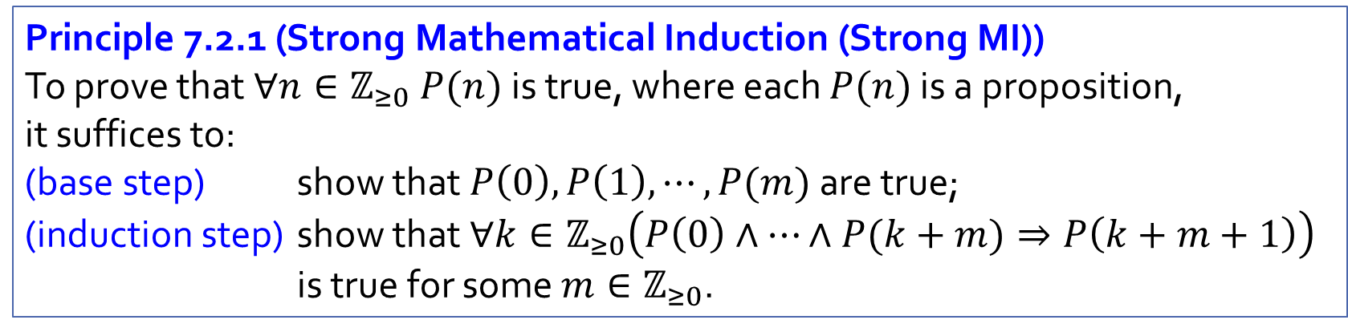
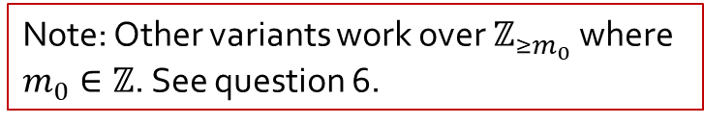
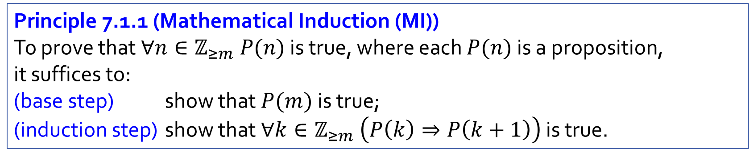
Recap
Note: Other variants work over $ℤ_{≥m_{0}}$ where $m_{0}∈ℤ$. See question 6.
Principle 7.1.1 (Mathematical Induction (MI))
To prove that $∀n∈ℤ_{≥m} P(n)$ is true, where each $P(n)$ is a proposition, it suffices to:
(base step) show that $P(m)$ is true;
(induction step) show that $∀k∈ℤ_{≥m} \left(P\left(k\right)⇒P\left(k+1\right)\right)$ is true.
Principle 7.2.1 (Strong Mathematical Induction (Strong MI))
To prove that $∀n∈ℤ_{≥0} P(n)$ is true, where each $P(n)$ is a proposition, it suffices to:
(base step) show that $P\left(0\right),P\left(1\right),⋯,P(m)$ are true;
(induction step) show that $∀k∈ℤ_{≥0}\left(P\left(0\right)∧⋯∧P(k+m)⇒P\left(k+m+1\right)\right)$ is true for some $m∈ℤ_{≥0}$.

Slide 4

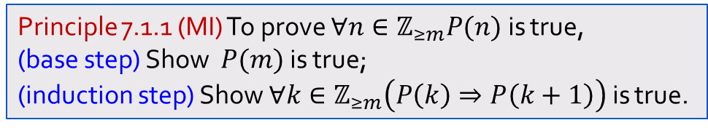
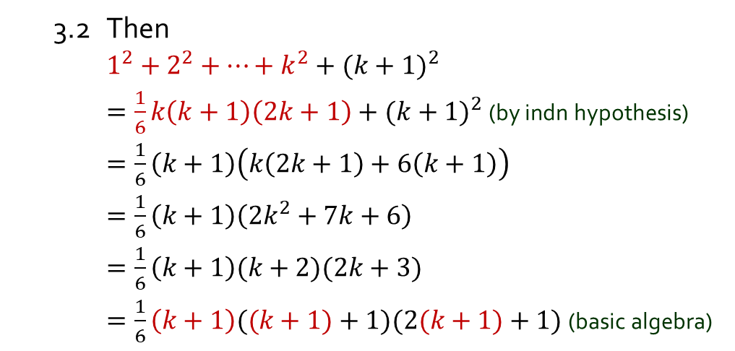
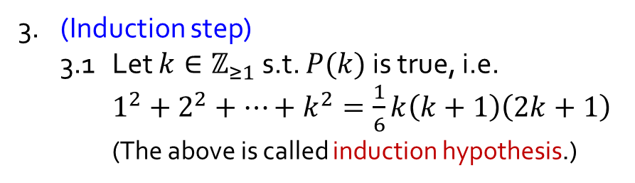
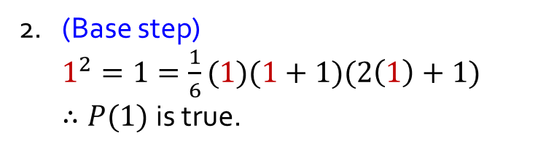

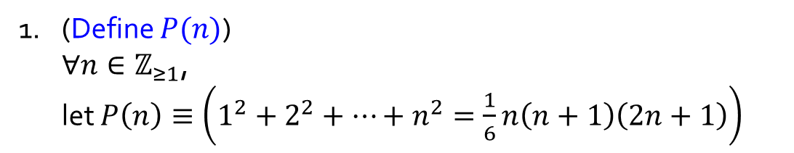

Q1.
Prove: $∀n∈ℤ_{≥1}, 1^{2}+2^{2}+⋯+n^{2}=\frac{1}{6}n(n+1)(2n+1)$
Principle 7.1.1 (MI) To prove $∀n∈ℤ_{≥m}P(n)$ is true,
(base step) Show $P(m)$ is true;
(induction step) Show $∀k∈ℤ_{≥m}\left(P\left(k\right)⇒P\left(k+1\right)\right)$ is true.
1. (Define $P(n)$)
$∀n∈ℤ_{≥1}$,
let $P\left(n\right)≡\left(1^{2}+2^{2}+⋯+n^{2}=\frac{1}{6}n\left(n+1\right)\left(2n+1\right)\right)$
(We want to show that $P(k+1)$ is true.)
3.2 Then
$1^{2}+2^{2}+⋯+k^{2}+{(k+1)}^{2}$
$=\frac{1}{6}k\left(k+1\right)\left(2k+1\right)+{(k+1)}^{2}$ (by indn hypothesis)
$=\frac{1}{6}\left(k+1\right)\left(k\left(2k+1\right)+6\left(k+1\right)\right)$
$=\frac{1}{6}\left(k+1\right)\left(2k^{2}+7k+6\right)$
$=\frac{1}{6}\left(k+1\right)(k+2)(2k+3)$
$=\frac{1}{6}\left(k+1\right)((k+1)+1)(2(k+1)+1)$ (basic algebra)
2. (Base step)
$1^{2}=1=\frac{1}{6}(1)(1+1)(2\left(1\right)+1)$
$∴P(1)$is true.
3. (Induction step)
3.1 Let $k∈ℤ_{≥1}$ s.t. $P(k)$is true, i.e.
$1^{2}+2^{2}+⋯+k^{2}=\frac{1}{6}k\left(k+1\right)\left(2k+1\right)$
(The above is called induction hypothesis.)
3.3 Therefore $P(k+1)$ is true.
4. Hence, $∀n∈ℤ_{≥1} P(n)$ is true by MI.

Slide 5

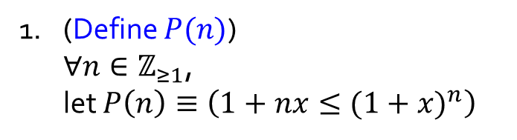

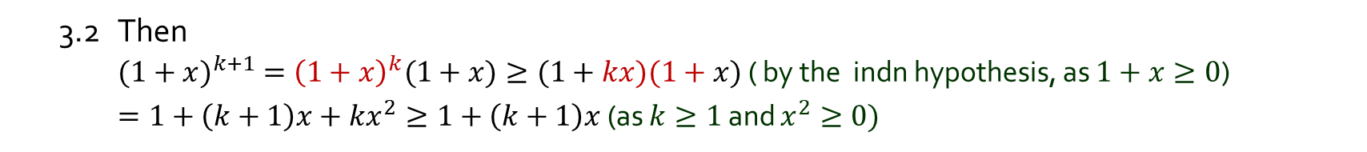
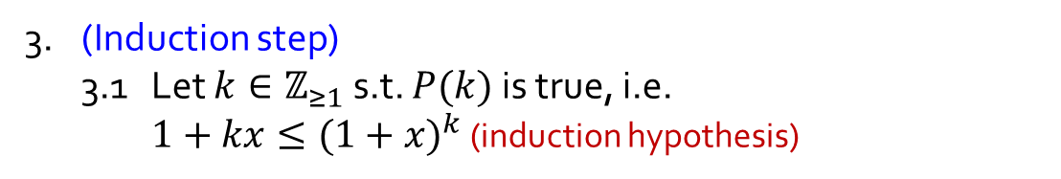
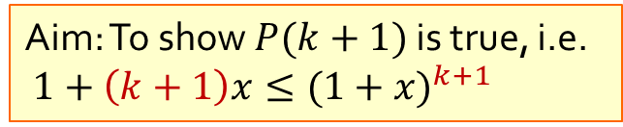
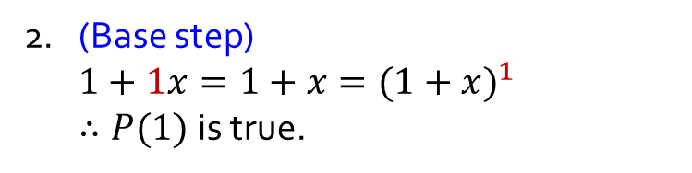
Q2.
Let $x∈ℝ_{≥−1}$. Prove: $∀n∈ℤ_{≥1}, 1+nx≤{(1+x)}^{n}.$
1. (Define $P(n)$)
$∀n∈ℤ_{≥1}$,
let $P\left(n\right)≡\left(1+nx≤{(1+x)}^{n}\right)$
Principle 7.1.1 (MI) To prove $∀n∈ℤ_{≥m}P(n)$ is true,
(base step) Show $P(m)$ is true;
(induction step) Show $∀k∈ℤ_{≥m}\left(P\left(k\right)⇒P\left(k+1\right)\right)$ is true.
2. (Base step)
$1+1x=1+x={(1+x)}^{1}$
$∴P(1)$is true.
3. (Induction step)
3.1 Let $k∈ℤ_{≥1}$ s.t. $P(k)$is true, i.e.
$1+kx≤{(1+x)}^{k}$ (induction hypothesis)
Aim: To show $P(k+1)$ is true, i.e.
$1+\left(k+1\right)x≤{(1+x)}^{k+1}$
3.2 Then
${(1+x)}^{k+1} ={\left(1+x\right)}^{k}(1+x)≥(1+kx)(1+x)$ ( by the indn hypothesis, as $1+x≥0$)
$=1+\left(k+1\right)x+kx^{2}≥1+\left(k+1\right)x$ (as $k≥1$ and $x^{2}≥0)$
3.3 Therefore $P(k+1)$ is true.
4. Hence, $∀n∈ℤ_{≥1} P(n)$ is true by MI.

Slide 6

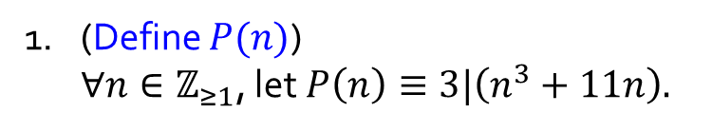

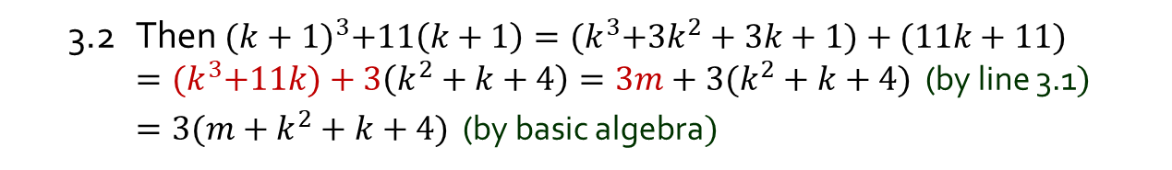
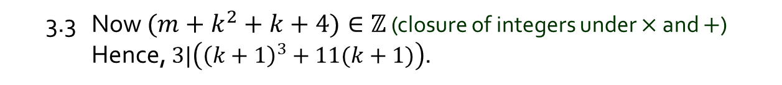
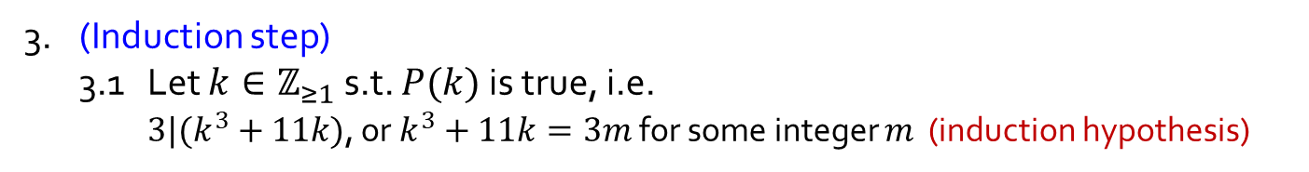
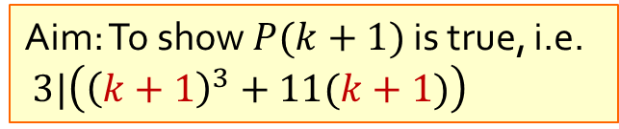
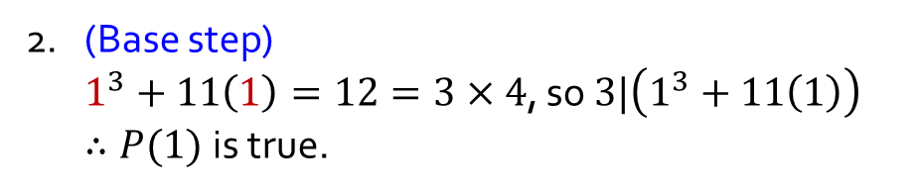
Q3.
Prove: $∀n∈ℤ_{≥1}, 3 | (n^{3}+11n).$
1. (Define $P(n)$)
$∀n∈ℤ_{≥1}$, let $P\left(n\right)≡3|\left(n^{3}+11n\right).$
Principle 7.1.1 (MI) To prove $∀n∈ℤ_{≥m}P(n)$ is true,
(base step) Show $P(m)$ is true;
(induction step) Show $∀k∈ℤ_{≥m}\left(P\left(k\right)⇒P\left(k+1\right)\right)$ is true.
2. (Base step)
$1^{3}+11\left(1\right)=12=3×4$, so $3|\left(1^{3}+11\left(1\right)\right)$
$∴P(1)$is true.
Aim: To show $P(k+1)$ is true, i.e.
$3|\left({\left(k+1\right)}^{3}+11(k+1)\right)$
3. (Induction step)
3.1 Let $k∈ℤ_{≥1}$ s.t. $P(k)$is true, i.e.
$3|(k^{3}+11k)$, or $k^{3}+11k=3m$ for some integer $m$ (induction hypothesis)
3.2 Then ${(k+1)}^{3}+11\left(k+1\right)={(k}^{3}+3k^{2}+3k+1)+(11k+11)$
$={(k}^{3}+11k)+3\left(k^{2}+k+4\right)=3m+3(k^{2}+k+4)$ (by line 3.1$)$
$=3(m+k^{2}+k+4)$ (by basic algebra$)$
3.3 Now $(m+k^{2}+k+4)∈ℤ$ (closure of integers under $×$ and $+$) Hence, $3|\left({\left(k+1\right)}^{3}+11(k+1)\right)$.
3.4 Therefore $P(k+1)$ is true.
4. Hence, $∀n∈ℤ_{≥1} P(n)$ is true by MI.

Slide 7
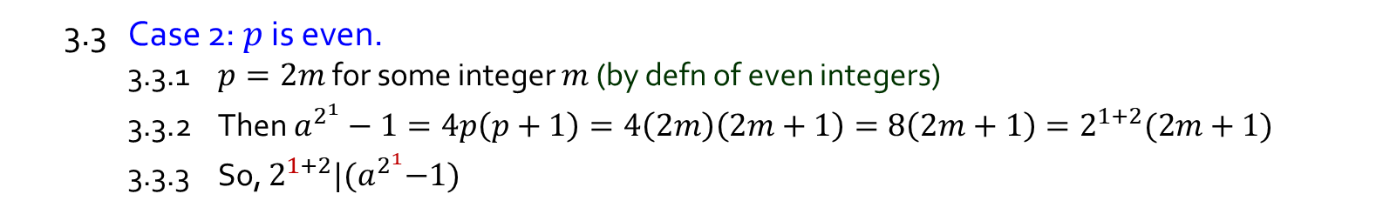
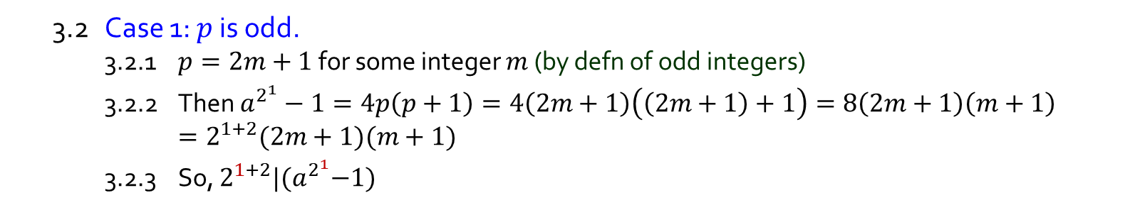
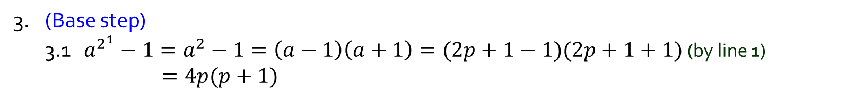
Q4.
Let $a$ be an odd integer. Prove: $∀n∈ℤ_{≥1}, 2^{n+2} | (a^{2^{n}}−1).$
1. $a = 2p+1$for some integer $p$ (by defn of odd integers)
2. (Define $P(n)$) $∀n∈ℤ_{≥1}$, let $P\left(n\right)≡2^{n+2} | (a^{2^{n}}−1).$
3. (Base step)
3.1 $a^{2^{1}}−1=a^{2}−1=\left(a−1\right)\left(a+1\right)=(2p+1−1)(2p+1+1)$ (by line 1) $=4p(p+1)$
3.2 Case 1: $p$ is odd.
3.2.1 $p=2m+1$ for some integer $m$ (by defn of odd integers)
3.2.2 Then $a^{2^{1}}−1=4p\left(p+1\right)=4\left(2m+1\right)\left(\left(2m+1\right)+1\right)=8\left(2m+1\right)\left(m+1\right)$ $$=2^{1+2}(2m+1)(m+1)$$
3.2.3 So, $2^{1+2}|{(a}^{2^{1}}−1)$
3.3 Case 2: $p$ is even.
3.3.1 $p=2m$ for some integer $m$ (by defn of even integers)
3.3.2 Then $a^{2^{1}}−1=4p\left(p+1\right)=4\left(2m\right)\left(2m+1\right)=8\left(2m+1\right)=2^{1+2}(2m+1)$
3.3.3 So, $2^{1+2}|{(a}^{2^{1}}−1)$
3.4 Since p is either odd or even, $2^{1+2}|{(a}^{2^{1}}−1)$ in all cases.
3.5 Therefore, $P(1)$ is true.

Slide 8
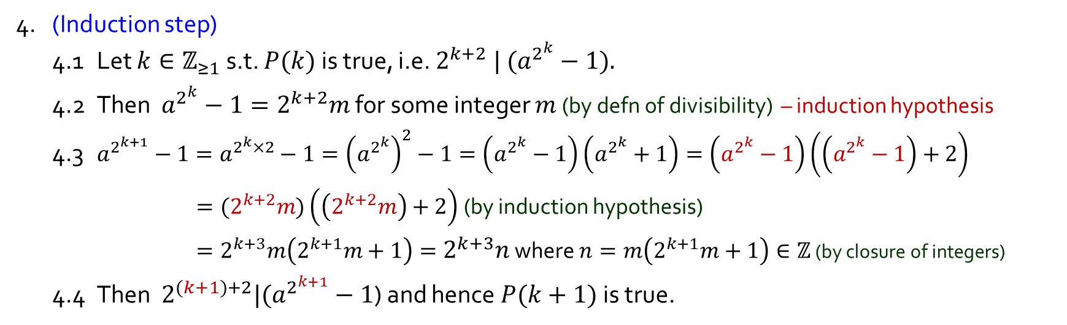
Q4.
Let $a$ be an odd integer. Prove: $∀n∈ℤ_{≥1}, 2^{n+2} | (a^{2^{n}}−1).$
1. $a = 2p+1$for some integer $p$ (by defn of odd integers)
2. (Define $P(n)$) $∀n∈ℤ_{≥1}$, let $P\left(n\right)≡2^{n+2} | (a^{2^{n}}−1).$
3. (Base step) … $P(1)$ is true.
4. (Induction step)
4.1 Let $k∈ℤ_{≥1}$ s.t. $P(k)$ is true, i.e. $2^{k+2} | (a^{2^{k}}−1).$
4.2 Then $a^{2^{k}}−1=2^{k+2}m$ for some integer $m$ (by defn of divisibility) – induction hypothesis
4.3 $a^{2^{k+1}}−1=a^{2^{k}×2}−1={\left(a^{2^{k}}\right)}^{2}−1=\left(a^{2^{k}}−1\right)\left(a^{2^{k}}+1\right)=\left(a^{2^{k}}−1\right)\left(\left(a^{2^{k}}−1\right)+2\right)$
$={(2}^{k+2}m)\left(\left(2^{k+2}m\right)+2\right)$ (by induction hypothesis)
$=2^{k+3}m\left(2^{k+1}m+1\right)=2^{k+3}n$ where $n=m\left(2^{k+1}m+1\right)∈ℤ$ (by closure of integers)
4.4 Then $2^{(k+1)+2}|(a^{2^{k+1}}−1$) and hence $P(k+1)$is true.
5. Hence, , $∀n∈ℤ_{≥1} P(n)$ is true by MI.

Slide 9

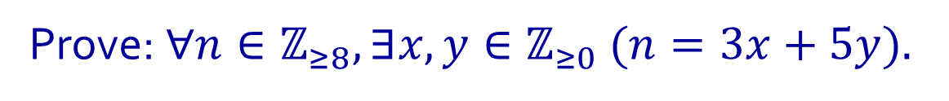
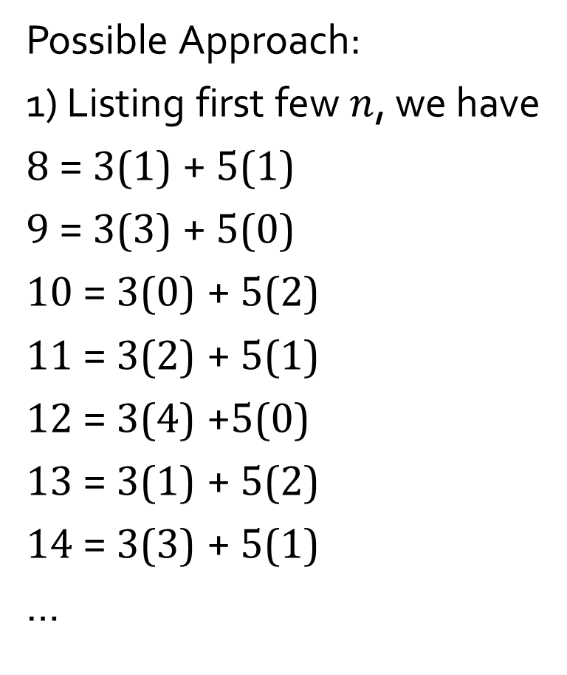
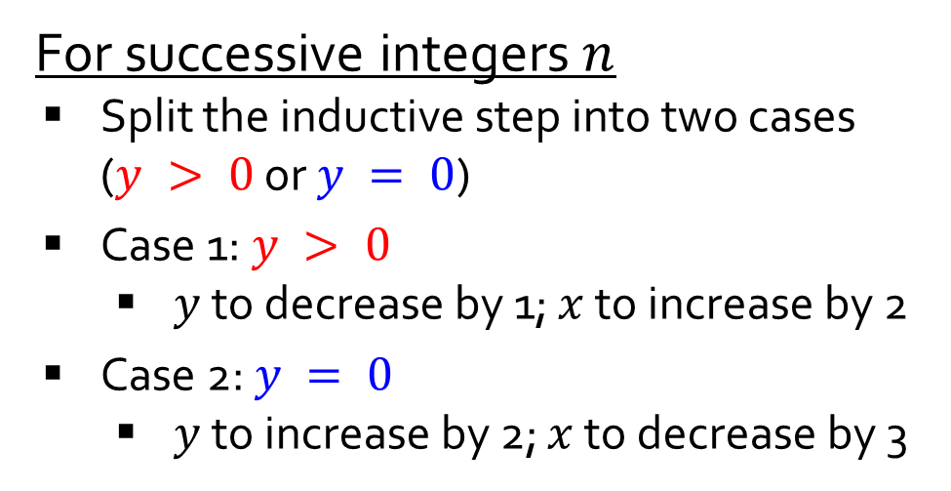
Q5.
Prove: $∀n∈ℤ_{≥8}, ∃x,y∈ℤ_{≥0} (n=3x+5y).$
Possible Approach:
1) Listing first few $n$, we have
8 = 3(1) + 5(1)
9 = 3(3) + 5(0)
10 = 3(0) + 5(2)
11 = 3(2) + 5(1)
12 = 3(4) +5(0)
13 = 3(1) + 5(2)
14 = 3(3) + 5(1)
…
2) Finding a pattern
For successive integers $n$
Split the inductive step into two cases ($y > 0$ or $y = 0$)
Case 1: $y > 0$
$y$ to decrease by 1; $x$ to increase by 2
Case 2: $y = 0$
$y$ to increase by 2; $x$ to decrease by 3
+2
-1
-3
+2
+2
-1
+2
-1
-3
+2
+2
-1

Slide 10



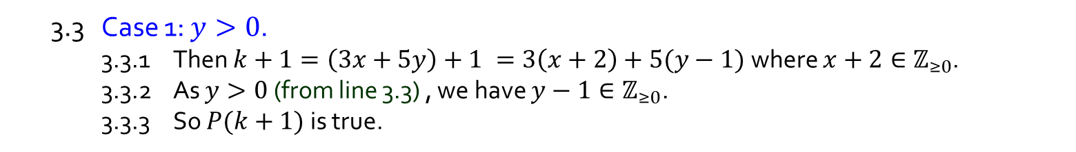
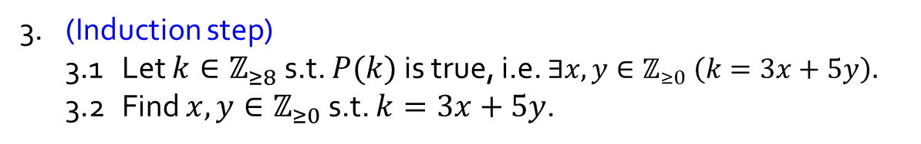
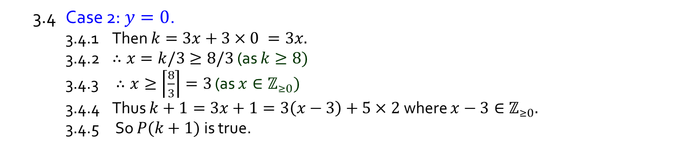
Q5.
Prove: $∀n∈ℤ_{≥8}, ∃x,y∈ℤ_{≥0} (n=3x+5y).$
1. $∀n∈ℤ_{≥8}$, let $P\left(n\right)≡∃x,y∈ℤ_{≥0} (n=3x+5y).$
2. (Base step) $P(8)$is true as $8=3×1+5×1.$
3. (Induction step)
3.1 Let $k∈ℤ_{≥8}$ s.t. $P(k)$is true, i.e. $∃x,y∈ℤ_{≥0} \left(k=3x+5y\right).$
3.2 Find $x,y∈ℤ_{≥0}$ s.t. $k=3x+5y$.
3.3 Case 1: $y>0$.
3.3.1 Then $k+1=\left(3x+5y\right)+1 =3\left(x+2\right)+5(y−1)$ where $x+2∈ℤ_{≥0}$.
3.3.2 As $y>0$ (from line 3.3) , we have $y−1∈ℤ_{≥0}\text{.}$
3.3.3 So $P(k+1)$ is true.
3.4 Case 2: $y=0$.
3.4.1 Then $k=3x+3×0 =3x.$
3.4.2 $∴x=k/3≥8/3$ (as $k≥8)$
3.4.3 $∴x≥\left\lceil \frac{8}{3}\right\rceil =3$ (as $x∈ℤ_{≥0})$
3.4.4 Thus $k+1=3x+1=3\left(x−3\right)+5×2$ where $x−3∈ℤ_{≥0}.$
3.4.5 So $P(k+1)$ is true.
3.5 Thus $P(k+1)$ is true for all case.
4. Hence, $∀n∈ℤ_{≥8} P(n)$ is true by MI.

Slide 11

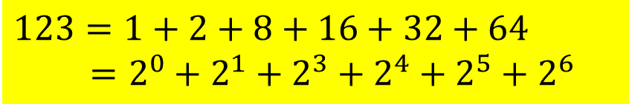
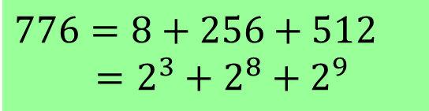
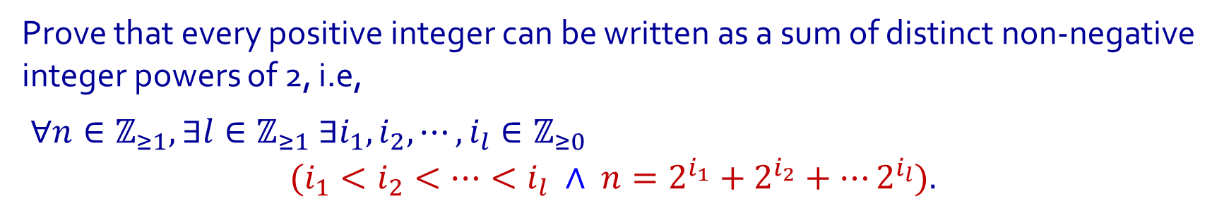

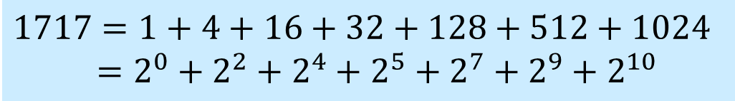

Q6.
Prove that every positive integer can be written as a sum of distinct non-negative integer powers of 2, i.e,
$∀n∈ℤ_{≥1}, ∃l∈ℤ_{≥1} ∃i_{1},i_{2}, ⋯,i_{l}∈ℤ_{≥0}$
$$(i_{1}<i_{2}<⋯<i_{l} ∧ {n=2}^{i_{1}}+2^{i_{2}}+⋯2^{i_{l}}).$$
Examples:
Binary representation
$$123=1+2+8+16+32+64$$
$=2^{0}+2^{1}+2^{3}+2^{4}+2^{5}+2^{6}$
$$123={1111011}_{2}$$
$$1717=1+4+16+32+128+512+1024$$
$=2^{0}+{2^{2}+2}^{4}+2^{5}+2^{7}+2^{9}+2^{10}$
$$1717={11010110101}_{2}$$
$$776=8+256+512$$
$=2^{3}+2^{8}+2^{9}$
$$776={1100001000}_{2}$$

Slide 12
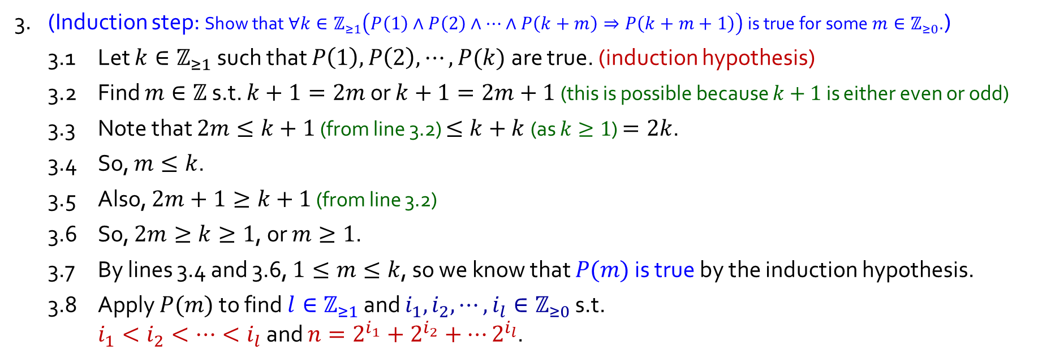
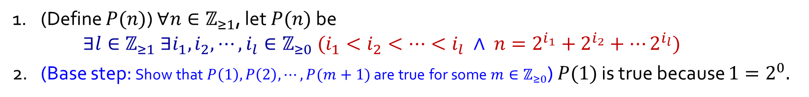
Q6.
Using Strong MI
1. (Define $P(n)$) $∀n∈ℤ_{≥1}$, let $P(n)$ be $∃l∈ℤ_{≥1} ∃i_{1},i_{2}, ⋯,i_{l}∈ℤ_{≥0} (i_{1}<i_{2}<⋯<i_{l} ∧ {n=2}^{i_{1}}+2^{i_{2}}+⋯2^{i_{l}})$
2. (Base step: Show that $P\left(1\right),P\left(2\right),⋯,P(m+1)$ are true for some $m∈ℤ_{≥0}$) $P(1)$ is true because $1=2^{0}.$
3. (Induction step: Show that $∀k∈ℤ_{≥1}\left(P\left(1\right)∧P\left(2\right)∧⋯∧P\left(k+m\right)⇒P\left(k+m+1\right)\right)$ is true for some $m∈ℤ_{≥0}$.)
3.1 Let $k∈ℤ_{≥1}$ such that $P\left(1\right),P\left(2\right),⋯,P(k)$are true. (induction hypothesis)
3.2 Find $m∈ℤ$ s.t. $k+1=2m$ or $k+1=2m+1$ (this is possible because $k+1$ is either even or odd)
3.3 Note that $2m≤k+1$ (from line 3.2) $≤k+k$ (as $k≥1$) $=2k$.
3.4 So, $m≤k$.
3.5 Also, $2m+1≥k+1$ (from line 3.2)
3.6 So, $2m≥k≥1$, or $m≥1$.
3.7 By lines 3.4 and 3.6, $1≤m≤k$, so we know that $P(m)$ is true by the induction hypothesis.
3.8 Apply $P(m)$ to find $l∈ℤ_{≥1}$ and $i_{1},i_{2}, ⋯,i_{l}∈ℤ_{≥0}$ s.t. $i_{1}<i_{2}<⋯<i_{l}$ and ${n=2}^{i_{1}}+2^{i_{2}}+⋯2^{i_{l}}$.

Slide 13


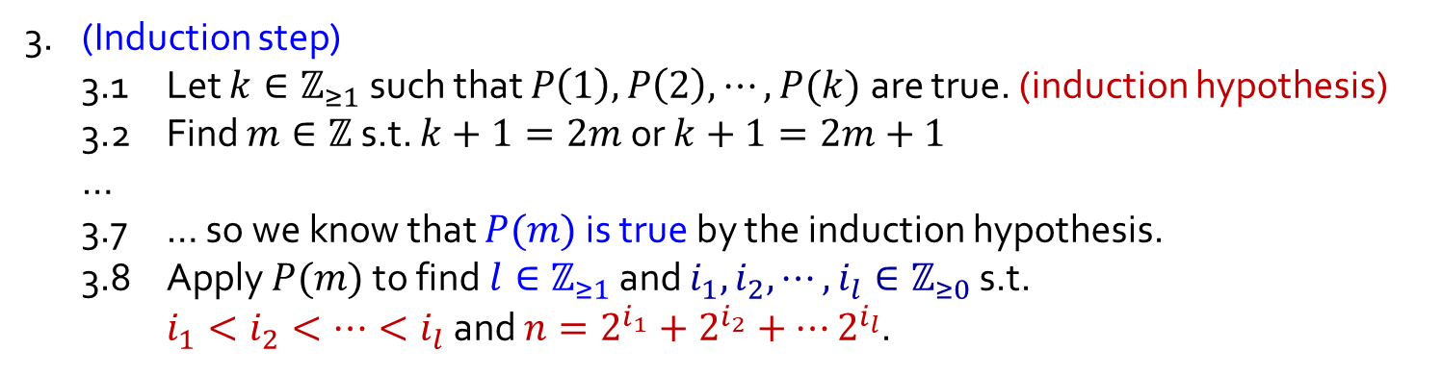
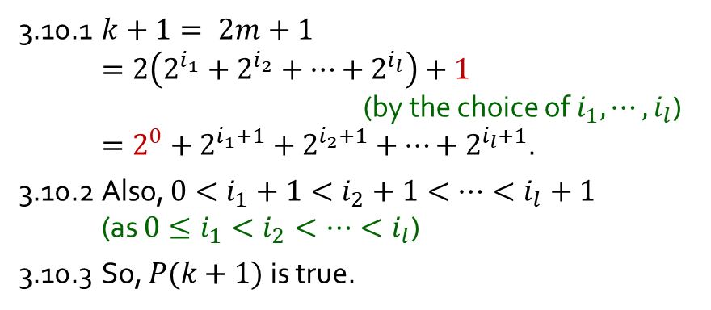

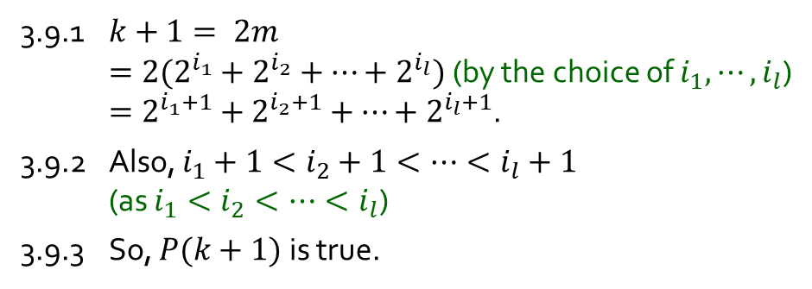
Q6.
3. (Induction step)
3.1 Let $k∈ℤ_{≥1}$ such that $P\left(1\right),P\left(2\right),⋯,P(k)$are true. (induction hypothesis)
3.2 Find $m∈ℤ$ s.t. $k+1=2m$ or $k+1=2m+1$
…
3.7 … so we know that $P(m)$ is true by the induction hypothesis.
3.8 Apply $P(m)$ to find $l∈ℤ_{≥1}$ and $i_{1},i_{2}, ⋯,i_{l}∈ℤ_{≥0}$ s.t. $i_{1}<i_{2}<⋯<i_{l}$ and ${n=2}^{i_{1}}+2^{i_{2}}+⋯2^{i_{l}}$.
Using Strong MI
3.9 Case 1$: k+1 = 2m$.
3.10 Case 2$: k+1 = 2m+1$.
3.9.1 $k+1= 2m$ $=2(2^{i_{1}}+2^{i_{2}}+⋯+2^{i_{l}})$ (by the choice of $i_{1},⋯,i_{l}$) $=2^{i_{1}+1}+2^{i_{2}+1}+⋯+2^{i_{l}+1}$.
3.9.2 Also, $i_{1}+1<i_{2}+1<⋯<i_{l}+1$ (as $i_{1}<i_{2}<⋯<i_{l}$)
3.9.3 So, $P(k+1)$ is true.
3.10.1 $k+1= 2m+1$ $=2\left(2^{i_{1}}+2^{i_{2}}+⋯+2^{i_{l}}\right)+1$ (by the choice of $i_{1},⋯,i_{l}$) $=2^{0}+2^{i_{1}+1}+2^{i_{2}+1}+⋯+2^{i_{l}+1}$.
3.10.2 Also, ${0<i}_{1}+1<i_{2}+1<⋯<i_{l}+1$ (as $0≤i_{1}<i_{2}<⋯<i_{l}$)
3.10.3 So, $P(k+1)$ is true.
3.11 Thus $P(k+1)$ is true in all cases.
4. Hence, $∀n∈ℤ_{≥1} P(n)$ is true by Strong MI.

Slide 14
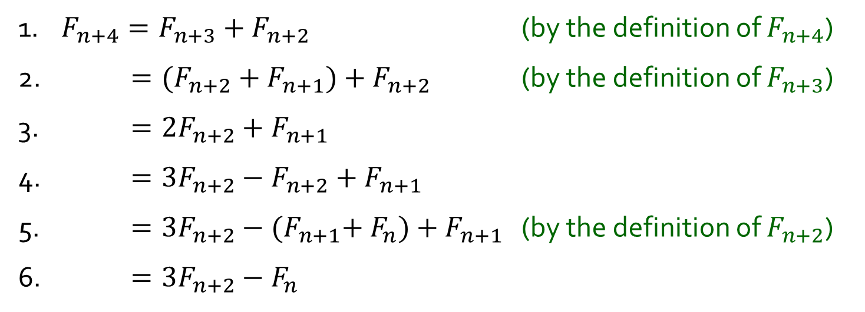
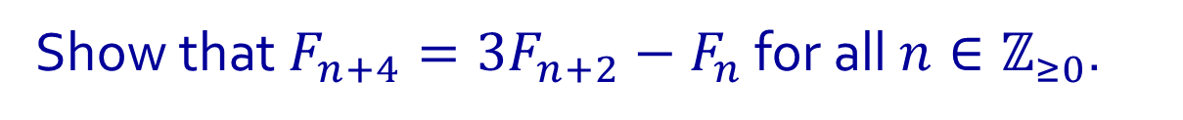
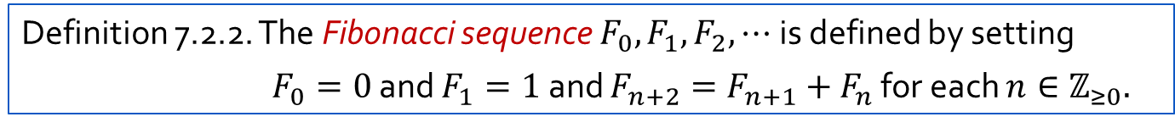
Q7.
Definition 7.2.2. The Fibonacci sequence $F_{0},F_{1},F_{2},⋯$ is defined by setting
$F_{0}=0$ and $F_{1}=1$ and $F_{n+2}=F_{n+1}{+ F}_{n}$ for each $n∈ℤ_{≥0}.$
Show that $F_{n+4}=3F_{n+2}−F_{n}$ for all $n∈ℤ_{≥0}$.
1. $F_{n+4}=F_{n+3}+F_{n+2}$ (by the definition of $F_{n+4}$)
2. $=(F_{n+2}+F_{n+1})+F_{n+2}$ (by the definition of $F_{n+3}$)
3. $=2F_{n+2}+F_{n+1}$
4. $=3F_{n+2}−F_{n+2}+F_{n+1}$
5. $=3F_{n+2}−{(F}_{n+1}+ F_{n})+F_{n+1}$ (by the definition of $F_{n+2}$)
6. $=3F_{n+2}−F_{n}$

Slide 15
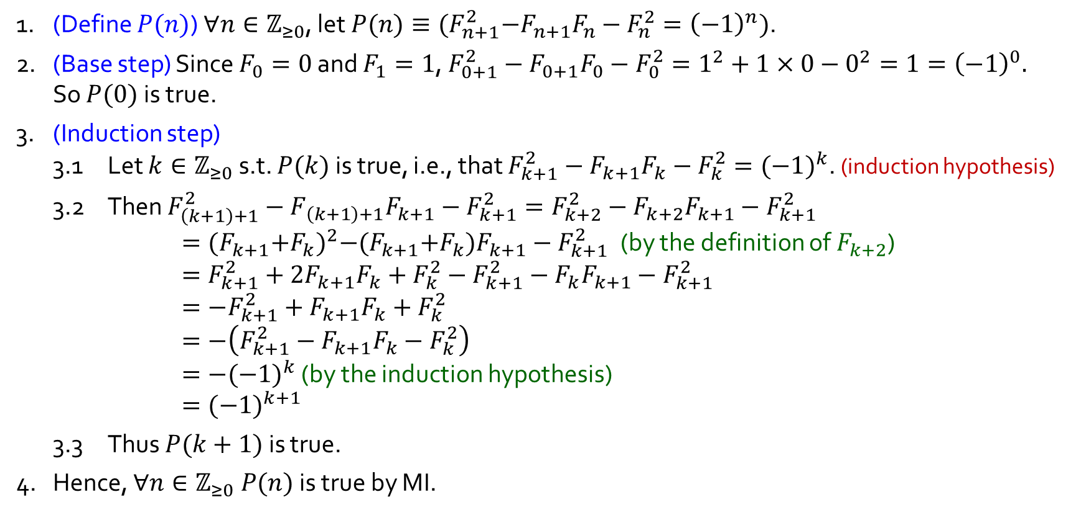
Q8.
Show that $F_{n+1}^{2}−F_{n+1}F_{n}−F_{n}^{2}={(−1)}^{n}$ for all $n∈ℤ_{≥0}$.
1. (Define $P(n)$) $∀n∈ℤ_{≥0}$, let $P(n)≡{(F}_{n+1}^{2}−F_{n+1}F_{n}−F_{n}^{2}={\left(−1\right)}^{n})$.
2. (Base step) Since $F_{0}=0$ and $F_{1}=1$, $F_{0+1}^{2}−F_{0+1}F_{0}−F_{0}^{2}=1^{2}+1×0−0^{2}=1={\left(−1\right)}^{0}.$ So $P(0)$ is true.
3. (Induction step)
3.1 Let $k∈ℤ_{≥0}$ s.t. $P(k)$ is true, i.e., that $F_{k+1}^{2}−F_{k+1}F_{k}−F_{k}^{2}={(−1)}^{k}$. (induction hypothesis)
3.2 Then $F_{\left(k+1\right)+1}^{2}−F_{\left(k+1\right)+1}F_{k+1}−F_{k+1}^{2}=F_{k+2}^{2}−F_{k+2}F_{k+1}−F_{k+1}^{2}$ $={(F_{k+1}{+F}_{k})}^{2}−{(F}_{k+1}{+F}_{k})F_{k+1}−F_{k+1}^{2}$ (by the definition of $F_{k+2}$) $=F_{k+1}^{2}+2F_{k+1}F_{k}+F_{k}^{2}−F_{k+1}^{2}−F_{k}F_{k+1}−F_{k+1}^{2}$ $={−F}_{k+1}^{2}+F_{k+1}F_{k}+F_{k}^{2}$ $=−\left(F_{k+1}^{2}−F_{k+1}F_{k}−F_{k}^{2}\right)$ $=−{(−1)}^{k}$ (by the induction hypothesis) $={(−1)}^{k+1}$
3.3 Thus $P(k+1)$ is true.
4. Hence, $∀n∈ℤ_{≥0} P(n)$ is true by MI.

Slide 16
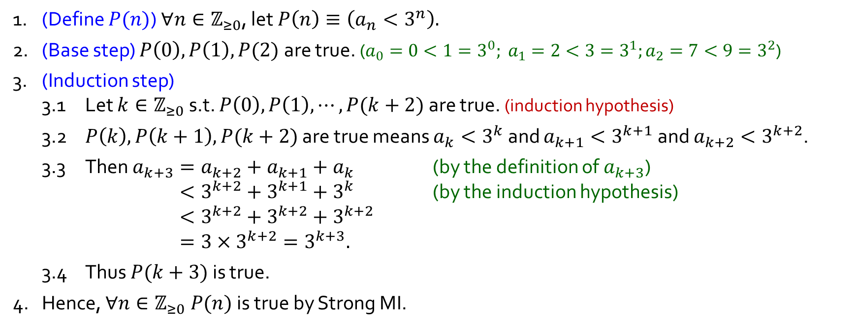
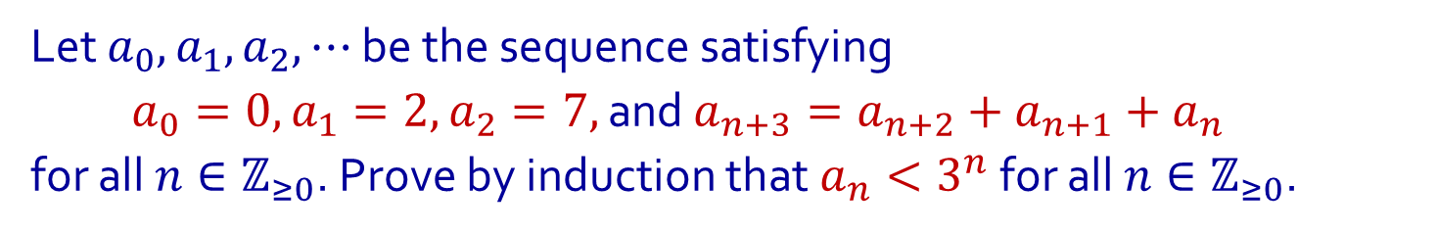
Q9.
Using Strong MI
Let $a_{0},a_{1},a_{2},⋯$ be the sequence satisfying
$a_{0}=0, a_{1}=2, a_{2}=7,$ and $a_{n+3}=a_{n+2}+a_{n+1}+a_{n}$
for all $n∈ℤ_{≥0}$. Prove by induction that $a_{n}<3^{n}$ for all $n∈ℤ_{≥0}$.
1. (Define $P(n)$) $∀n∈ℤ_{≥0}$, let $P\left(n\right)≡\left(a_{n}<3^{n}\right).$
2. (Base step) $P\left(0\right),P\left(1\right),P(2)$ are true. ($a_{0}=0<1=3^{0}; a_{1}=2<3=3^{1};a_{2}=7<9=3^{2}$)
3. (Induction step)
3.1 Let $k∈ℤ_{≥0}$ s.t. $P\left(0\right),P\left(1\right),⋯,P(k+2)$ are true. (induction hypothesis)
3.2 $P\left(k\right),P\left(k+1\right),P(k+2)$ are true means $a_{k}<3^{k}$ and $a_{k+1}<3^{k+1}$ and $a_{k+2}<3^{k+2}$.
3.3 Then $a_{k+3}=a_{k+2}+a_{k+1}+a_{k}$ (by the definition of $a_{k+3}$) $<3^{k+2}+3^{k+1}+3^{k}$ (by the induction hypothesis) $<3^{k+2}+3^{k+2}+3^{k+2}$ $=3×3^{k+2}=3^{k+3}.$
3.4 Thus $P(k+3)$ is true.
4. Hence, $∀n∈ℤ_{≥0} P(n)$ is true by Strong MI.

Slide 17



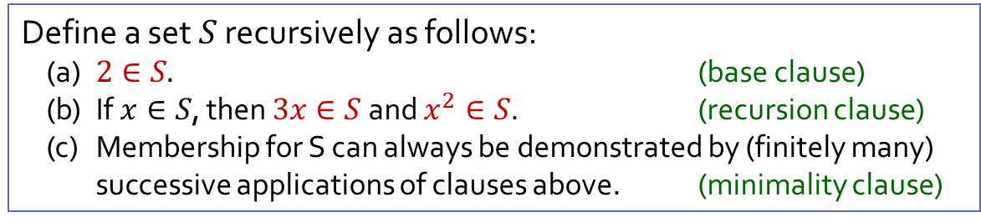









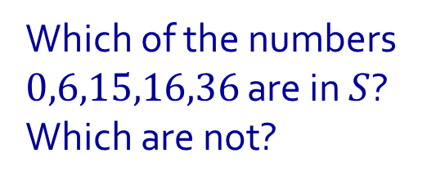


Q10.
Define a set $S$ recursively as follows:
(a) $2∈S.$ (base clause)
(b) If $x∈S$, then $3x∈S$ and $x^{2}∈S$. (recursion clause)
(c) Membership for S can always be demonstrated by (finitely many) successive applications of clauses above. (minimality clause)
Which of the numbers $0,6,15,16,36$ are in $S$? Which are not?
18
$$3x$$
$$3x$$
$$x^{2}$$
6
$$x^{2}$$
36
$$3x$$
$$3x$$
$$x^{2}$$
2
$$x^{2}$$
12
$$3x$$
4
$$3x$$
$$x^{2}$$
$$x^{2}$$
16
$$3x$$
$$x^{2}$$

Slide 18




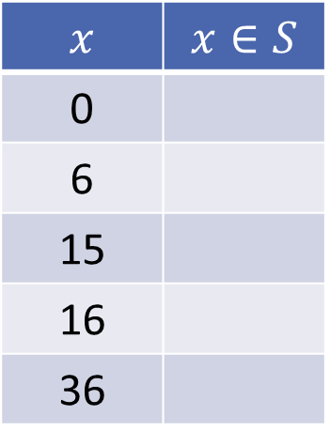
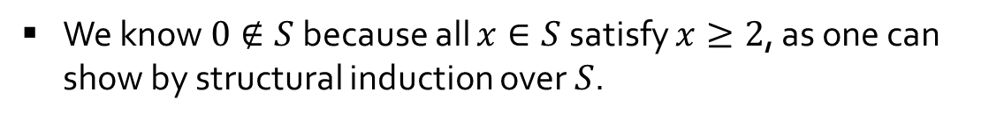
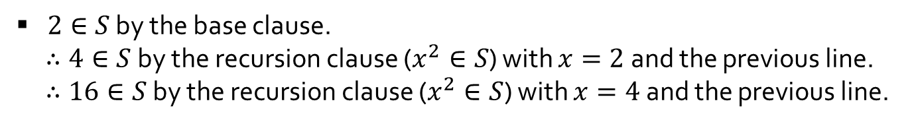
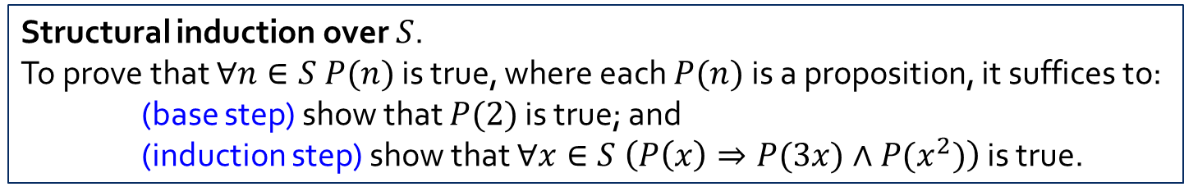

Q10.
Define a set $S$ recursively as follows:
(a) $2∈S.$ (base clause)
(b) If $x∈S$, then $3x∈S$ and $x^{2}∈S$. (recursion clause)
(c) Membership for S can always be demonstrated by (finitely many) successive applications of clauses above. (minimality clause)
Which of the numbers $0,6,15,16,36$ are in $S$? Which are not?
Structural induction over $S$.
To prove that $∀n∈S P(n)$ is true, where each $P(n)$is a proposition, it suffices to:
(base step) show that $P(2)$ is true; and
(induction step) show that $∀x∈S \left(P\left(x\right)⇒P(3x)∧P(x^{2})\right)$ is true.
$$x$$ | $$x∈S$$
0
6
15
16
36
We know $0∉S$ because all $x∈S$ satisfy $x≥2$, as one can show by structural induction over $S$.
$2∈S$ by the base clause.
$∴6∈S$ by the recursion clause ($3x∈S$) with $x=2$ and the previous line.
$∴36∈S$ by the recursion clause ($x^{2}∈S$) with $x=6$ and the previous line.
$2∈S$ by the base clause.
$∴4∈S$ by the recursion clause ($x^{2}∈S$) with $x=2$ and the previous line.
$∴16∈S$ by the recursion clause ($x^{2}∈S$) with $x=4$ and the previous line.
We know $15∉S$ because no $x∈S$ is odd, as one can show by structural induction over $S$.

Slide 19
THE END

