Slide 1
CS1231S Tutorial 6
Number Theory 1

Slide 2
Learning objectives of this tutorial
reason about divisibility (including divisors and multiples) and primes
manipulate quotients and remainders
convert between different bases
reason about representations of numbers with respect to a certain base

Slide 3
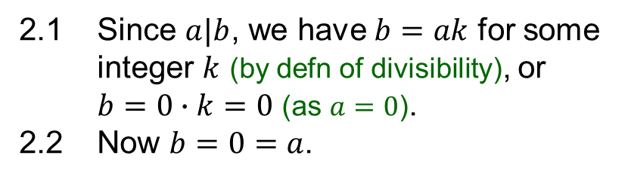
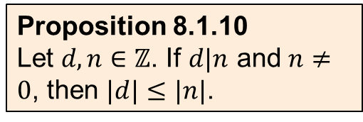
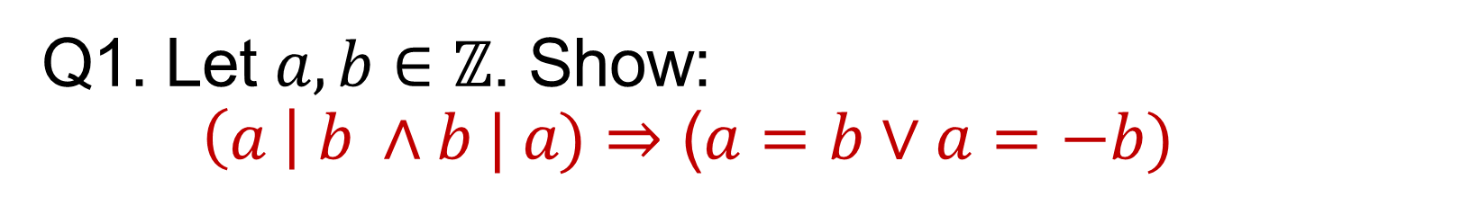
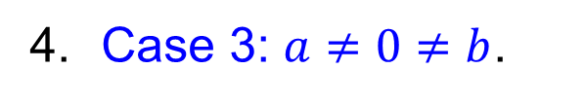
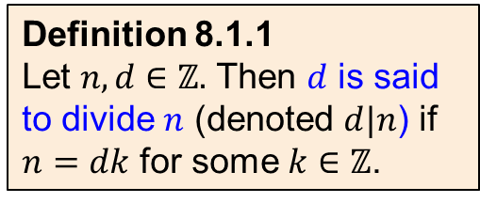
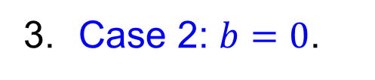
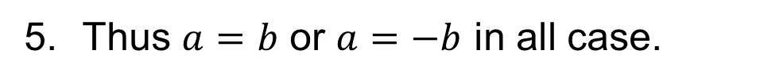
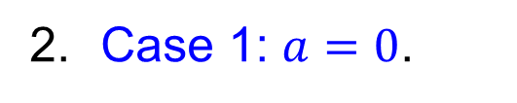
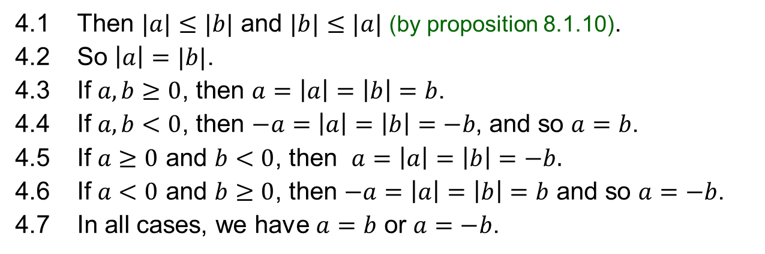
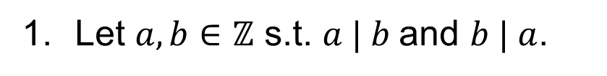

Q1. Let $a,b∈ℤ$. Show: $\left(a \right| b ∧b | a)⇒$ ($a=b∨a=−b)$
Definition 8.1.1
Let $n,d∈ℤ.$ Then $d$ is said to divide $n$ (denoted $d|n$) if $n=dk$ for some $k∈ℤ$.
1. Let $a,b∈ℤ$ s.t. $a | b$and $b | a$.
2. Case 1: $a=0$.
3. Case 2: $b=0$.
2.1 Since $a|b$, we have $b=ak$ for some integer $k$ (by defn of divisibility), or $b=0∙k=0$ (as $a=0$).
2.2 Now $b=0=a$.
3.1 Since $b|a$, we have $a=bk$ for some integer $k$ (by defn of divisibility), or $a=0∙k=0$ (as $b=0$).
3.2 Now $a=0=b$.
4. Case 3: $a≠0≠b$.
Proposition 8.1.10
Let $d,n∈ℤ$. If $d|n$ and $n≠0$, then $|d|≤|n|$.
4.1 Then $|a|≤|b|$ and $|b|≤|a|$ (by proposition 8.1.10).
4.2 So $\left|a\right|=|b|$.
4.3 If $a,b≥0$, then $a=\left|a\right|=\left|b\right|=b$.
4.4 If $a,b<0$, then $−a=\left|a\right|=\left|b\right|=−b$, and so $a=b$.
4.5 If $a≥0$ and $b<0$, then $a=\left|a\right|=\left|b\right|=−b.$
4.6 If $a<0$ and $b≥0$, then $−a=\left|a\right|=\left|b\right|=b$ and so $a=−b$.
4.7 In all cases, we have $a=b$ or $a=−b$.
5. Thus $a=b$ or $a=−b$ in all case.

Slide 4


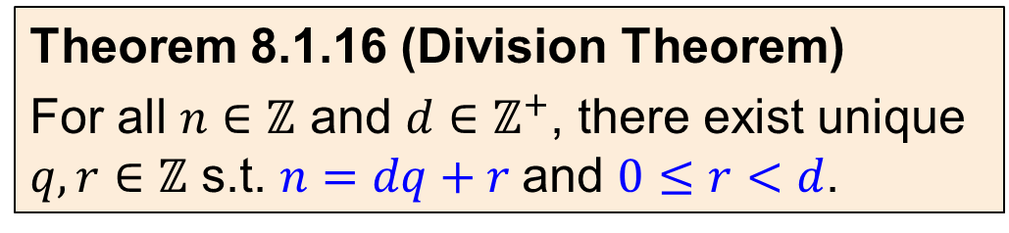



Q2. Find the quotient and the remainder when
 |  |  | Quotient | Remainder
(a) | 44 is divided by 8
(b) | 777 is divided by 21
(c) | -123 is divided by 19
(d) | 0 is divided by 17
(e) | -100 is divided by 101
$$44 = 8∙5+4$$
5
4
$$777 =21∙37+0$$
37
0
$$−123 =19∙(−7)+10$$
-7
10
$$0 =17∙0+0$$
0
0
$$−100 =101∙(−1)+1$$
-1
1
Theorem 8.1.16 (Division Theorem)
For all $n∈ℤ$ and $d∈ℤ^{+}$, there exist unique $q,r∈ℤ$ s.t. $n=dq+r$and $0≤r<d$.

Slide 5
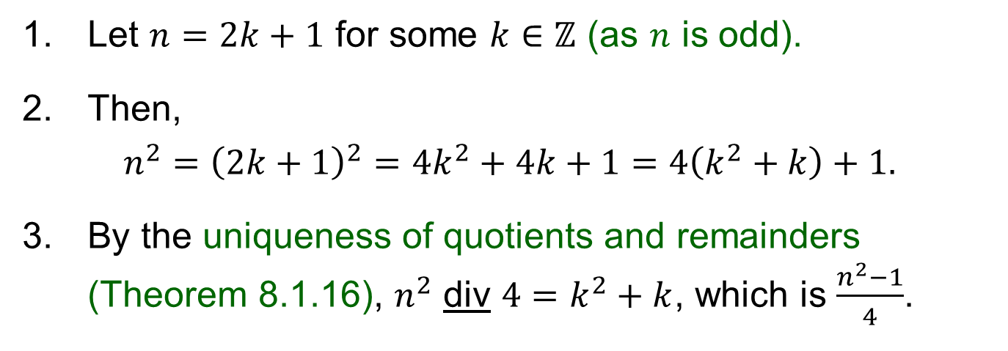
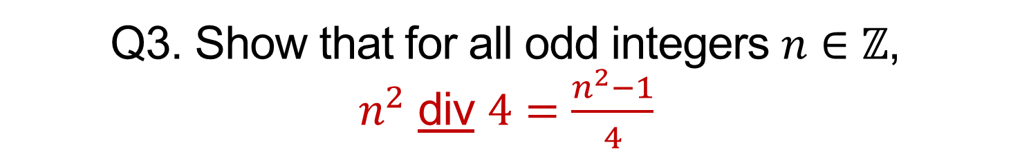
Q3. Show that for all odd integers $n∈ℤ$, $n^{2}$ div $4=\frac{n^{2}−1}{4}$
1. Let $n=2k+1$ for some $k∈ℤ$ (as $n$ is odd).
2. Then,
$$n^{2}={\left(2k+1\right)}^{2}=4k^{2}+4k+1=4\left(k^{2}+k\right)+1.$$
3. By the uniqueness of quotients and remainders (Theorem 8.1.16), $n^{2}$ div $4=k^{2}+k$, which is $\frac{n^{2}−1}{4}$.
Theorem 8.1.16 (Division Theorem)
For all $n∈ℤ$ and $d∈ℤ^{+}$, there exist unique $q,r∈ℤ$ s.t. $n=dq+r$and $0≤r<d$.

Slide 6
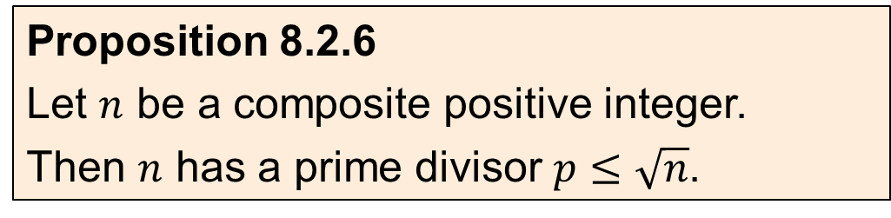
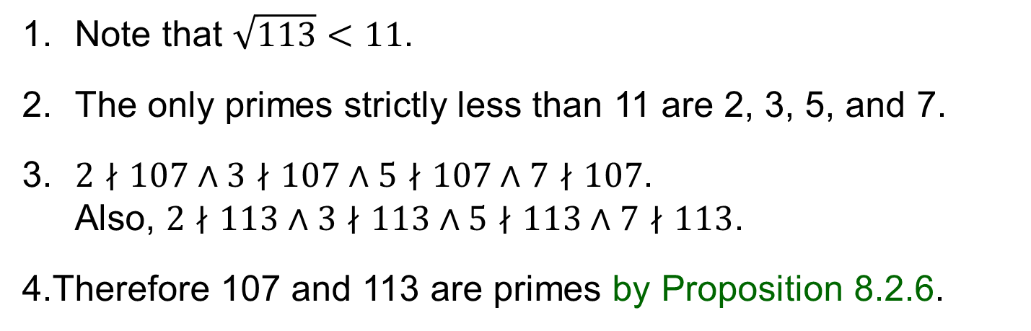
Q4. Is 107 prime? Is 113 prime?
1. Note that $\sqrt{113}<11$.
2. The only primes strictly less than 11 are 2, 3, 5, and 7.
3. $2∤107∧3∤107∧5∤107∧7∤107$. Also, $2∤113∧3∤113∧5∤113∧7∤113$.
4.Therefore 107 and 113 are primes by Proposition 8.2.6.
Proposition 8.2.6
Let $n$ be a composite positive integer.
Then $n$ has a prime divisor $p≤\sqrt{n}$.

Slide 7
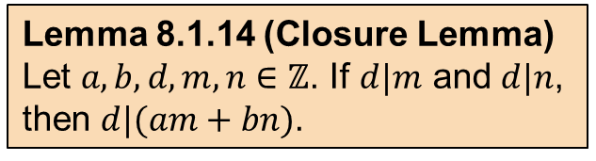
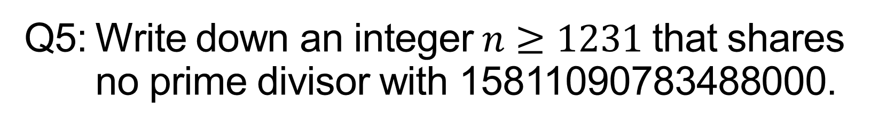
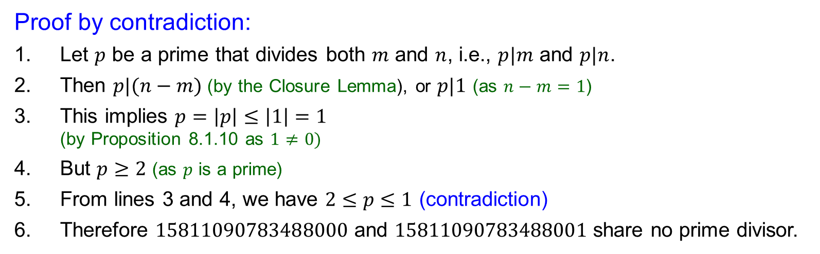
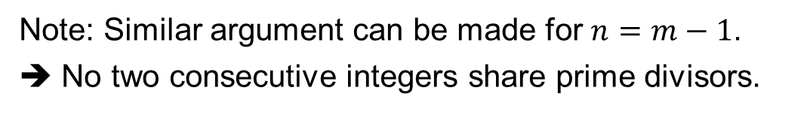
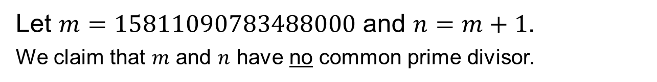
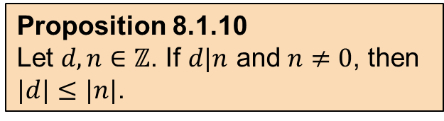
Q5: Write down an integer$n≥1231$ that shares no prime divisor with 15811090783488000.
Answer: 15811090783488001 or 15811090783487999.
Let $m=15811090783488000$ and $n=m+1$.
We claim that $m$ and $n$ have no common prime divisor.
Lemma 8.1.14 (Closure Lemma)
Let $a,b,d,m,n∈ℤ$. If $d|m$ and $d|n$, then $d|(am+bn)$.
Proof by contradiction:
1. Let $p$ be a prime that divides both $m$ and $n$, i.e., $p|m$ and $p|n$.
2. Then $p|(n−m)$(by the Closure Lemma), or $p|1$ (as $n−m=1$)
3. This implies $p=\left|p\right|≤\left|1\right|=1$ (by Proposition 8.1.10 as $1≠0)$
4. But $p≥2$ (as $p$ is a prime)
5. From lines 3 and 4, we have $2≤p≤1$ (contradiction)
6. Therefore $15811090783488000$ and $15811090783488001$ share no prime divisor.
Proposition 8.1.10
Let $d,n∈ℤ$. If $d|n$ and $n≠0$, then $|d|≤|n|$.
Note: Similar argument can be made for $n=m−1$.
➔ No two consecutive integers share prime divisors.

Slide 8
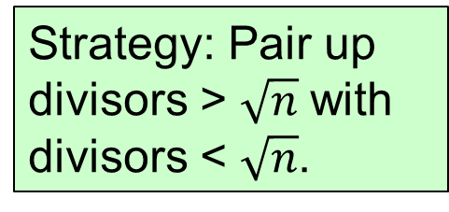
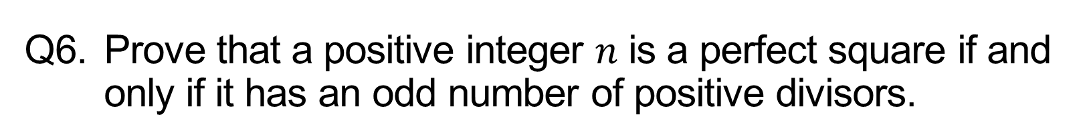
Q6. Prove that a positive integer $n$ is a perfect square if and only if it has an odd number of positive divisors.
Perfect squares
Not perfect squares
16
20
Strategy: Pair up divisors > $\sqrt{n}$ with divisors < $\sqrt{n}$.
1
16
1
20
2
8
2
10
4²
4
5
144
96
1
144
1
96
2
72
2
48
3
48
3
32
4
36
4
24
6
24
6
16
8
18
8
12
12²

Slide 9
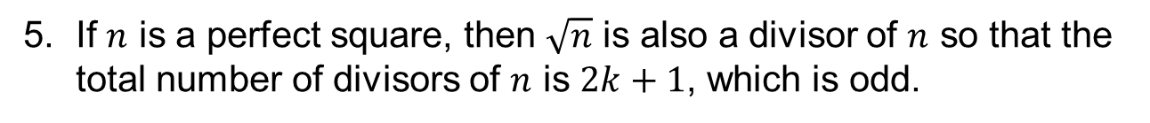
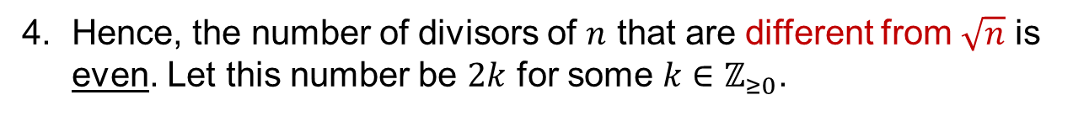
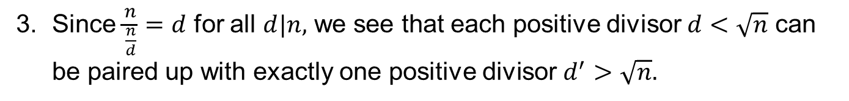
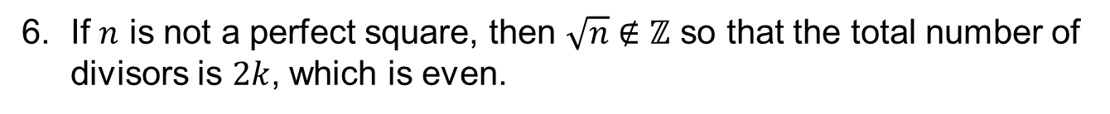
Q6. Prove that a positive integer $n$ is a perfect square if and only if it has an odd number of positive divisors.
16
1. If $d|n$ with $1≤d<\sqrt{n},$then $\sqrt{n}<\frac{n}{d}≤n$ and $\frac{n}{d}|n$.
1
16
2
8
2. Similarly, if $d|n$ with $\sqrt{n}<d≤n,$then $1≤\frac{n}{d}<\sqrt{n}$ and $\frac{n}{d}|n$.
4²
3. Since $\frac{n}{\frac{n}{d}}=d$ for all $d|n,$ we see that each positive divisor $d<\sqrt{n}$ can be paired up with exactly one positive divisor $d^{′}>\sqrt{n}.$
20
1
20
4. Hence, the number of divisors of $n$ that are different from $\sqrt{n}$ is even. Let this number be $2k$ for some $k∈ℤ_{≥0}$.
2
10
4
5
5. If $n$ is a perfect square, then $\sqrt{n}$ is also a divisor of $n$ so that the total number of divisors of $n$ is $2k+1$, which is odd.
6. If $n$ is not a perfect square, then $\sqrt{n}∉ℤ$ so that the total number of divisors is $2k$, which is even.

Slide 10



Q7. Find the binary, octal and hexadecimal expansions of 1231.
$${\left(1231\right)}_{10}={( )}_{2}$$
$$10011001111$$
1231 / 8 = 153 r 7
153 / 8 = 19 r 1
19 / 8 = 2 r 3
2 / 8 = 0 r 2
$$2317$$
$${\left(1231\right)}_{10}={( )}_{8}$$
$${\left(1231\right)}_{10}={( )}_{16}$$
$$4CF$$
1231 / 16 = 76 r 15 (F)
76 / 16 = 4 r 12 (C)
4 / 16 = 0 r 4

Slide 11
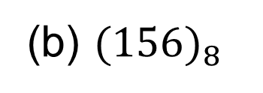
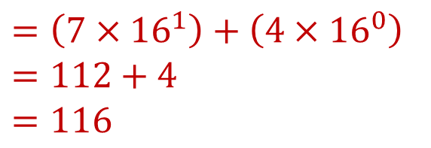
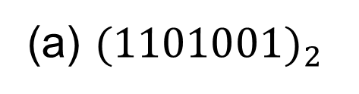
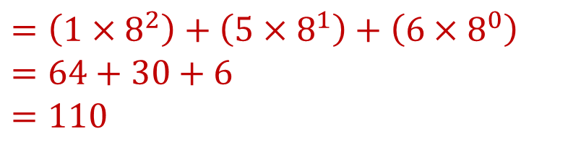
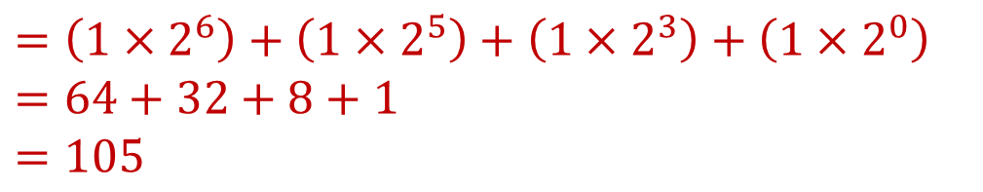
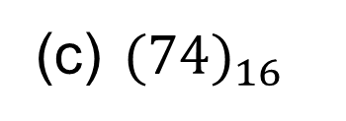
Q8. Find the decimal expansions of
(a) ${(1101001)}_{2}$
$$=\left(1×2^{6}\right)+\left(1×2^{5}\right)+\left(1×2^{3}\right)+\left(1×2^{0}\right)$$
$$=64+32+8+1$$
$$=105$$
(b) ${(156)}_{8}$
$$=\left(1×8^{2}\right)+\left(5×8^{1}\right)+\left(6×8^{0}\right)$$
$$=64+30+6$$
$$=110$$
(c) ${(74)}_{16}$
$$=\left(7×{16}^{1}\right)+\left(4×{16}^{0}\right)$$
$$=112+4$$
$$=116$$

Slide 12
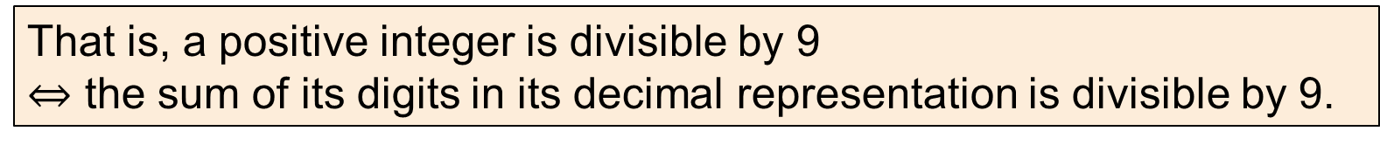
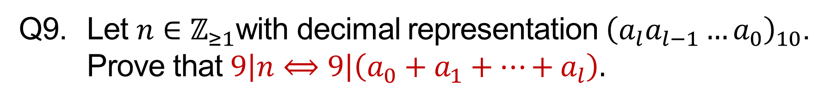
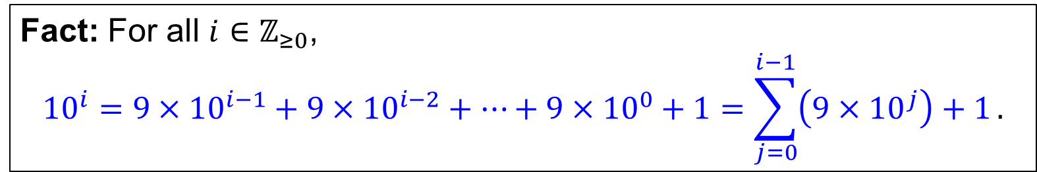
Q9. Let $n∈ℤ_{≥1}$with decimal representation ${\left(a_{l}a_{l−1}…a_{0}\right)}_{10}$. Prove that $9\left|n⟺9\right|\left(a_{0}+a_{1}+⋯+a_{l}\right).$
That is, a positive integer is divisible by 9
$⇔$ the sum of its digits in its decimal representation is divisible by 9.
Example:
Is 7524 divisible by 9?
7 + 5 + 2 + 4 = 18 is divisible by 9.
Therefore, 7524 is divisible by 9.
Fact: For all $i∈ℤ_{≥0}$,
$${10}^{i}=9×{10}^{i−1}+9×{10}^{i−2}+⋯+9×{10}^{0}+1=\sum_{j=0}^{i−1}{\left(9×{10}^{j}\right)+1}.$$

Slide 13
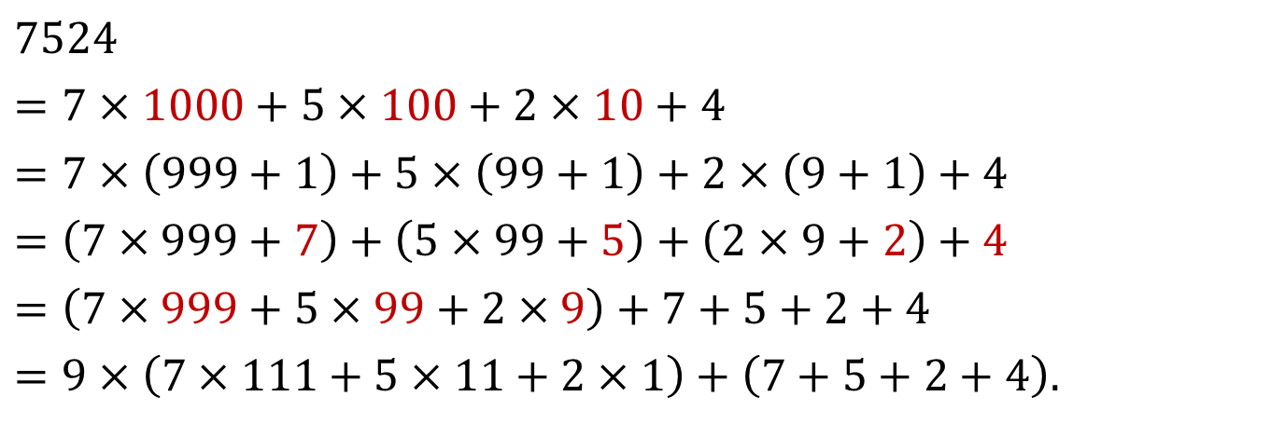
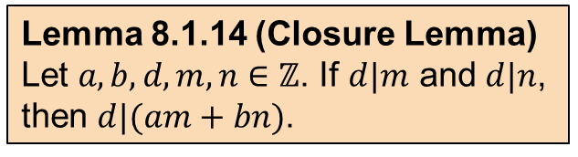
Q9. Let $n∈ℤ_{≥1}$with decimal representation ${\left(a_{l}a_{l−1}…a_{0}\right)}_{10}$. Prove that $9\left|n⟺9\right|\left(a_{0}+a_{1}+⋯+a_{l}\right).$
That is, a positive integer is divisible by 9
$⇔$ the sum of its digits in its decimal representation is divisible by 9.
$$7524$$
$$=7×1000+5×100+2×10+4$$
$$=7×\left(999+1\right)+5×\left(99+1\right)+2×\left(9+1\right)+4$$
$$=\left(7×999+7\right)+\left(5×99+5\right)+\left(2×9+2\right)+4$$
$$=\left(7×999+5×99+2×9\right)+7+5+2+4$$
$$=9×\left(7×111+5×11+2×1\right)+\left(7+5+2+4\right).$$
Lemma 8.1.14 (Closure Lemma)
Let $a,b,d,m,n∈ℤ$. If $d|m$ and $d|n$, then $d|(am+bn)$.
Fact: For all $i∈ℤ_{≥0}$,
$${10}^{i}=9×{10}^{i−1}+9×{10}^{i−2}+⋯+9×{10}^{0}+1=\sum_{j=0}^{i−1}{\left(9×{10}^{j}\right)+1}.$$

Slide 14
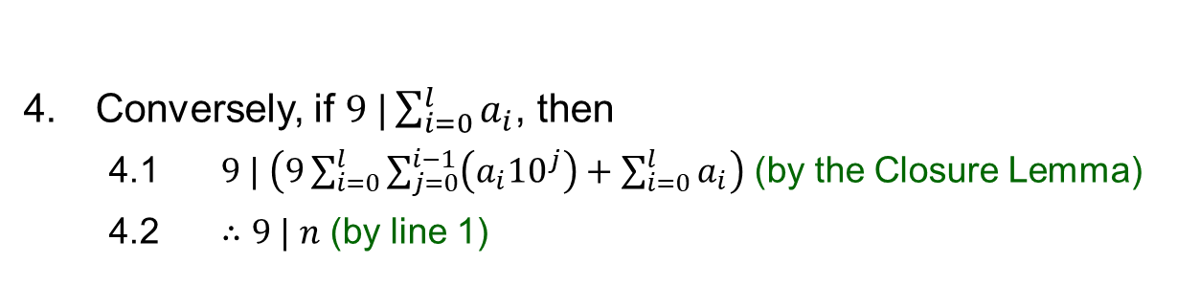
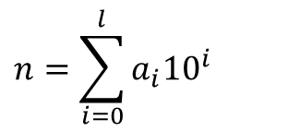
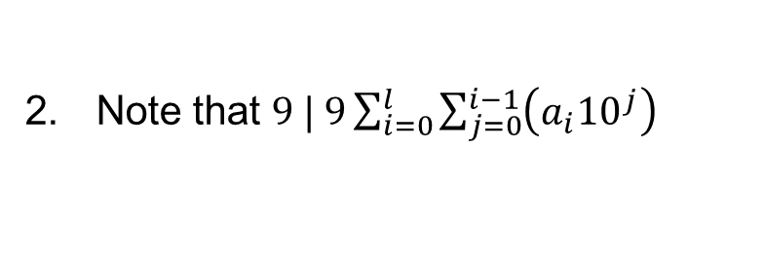
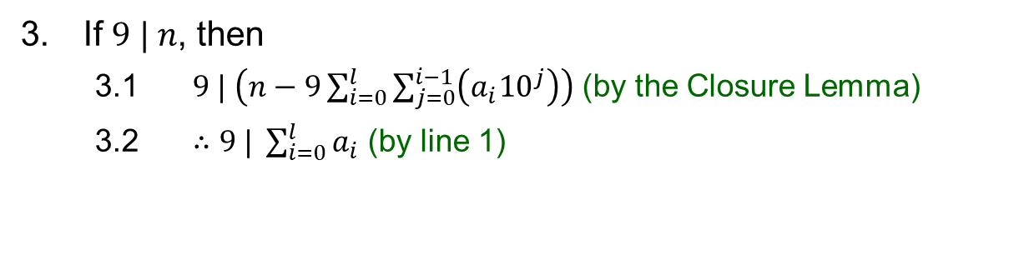
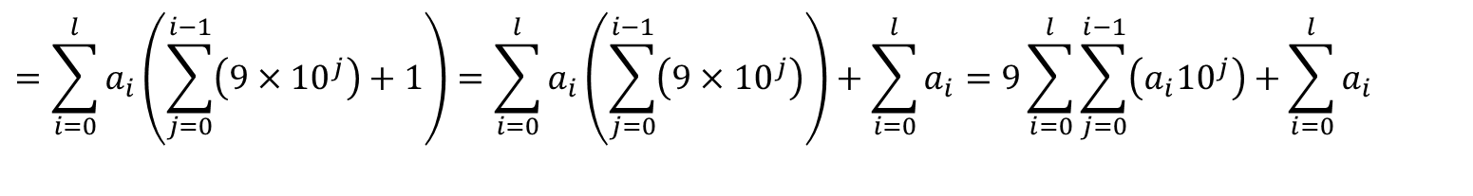
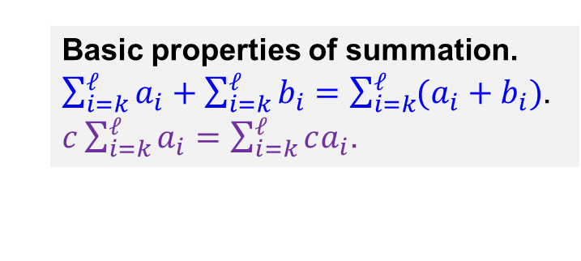

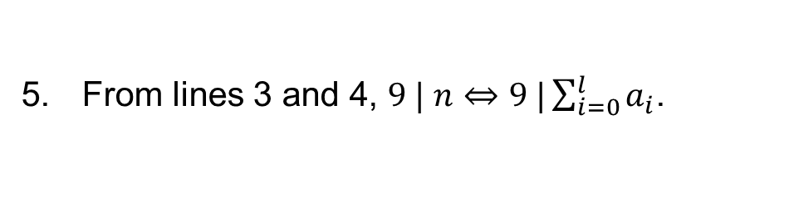
Q9. Let $n∈ℤ_{≥1}$with decimal representation ${\left(a_{l}a_{l−1}…a_{0}\right)}_{10}$. Prove that $9\left|n⟺9\right|\left(a_{0}+a_{1}+⋯+a_{l}\right).$
Basic properties of summation.
$\sum_{i=k}^{ℓ}{a_{i}}+\sum_{i=k}^{ℓ}{b_{i}}=\sum_{i=k}^{ℓ}{(a_{i}+b_{i})}$.
$c\sum_{i=k}^{ℓ}{a_{i}}=\sum_{i=k}^{ℓ}{ca_{i}}$.
$$n=\sum_{i=0}^{l}{a_{i}{10}^{i}}$$
1.
as $n={(a_{l}a_{l−1}⋯a_{0})}_{10}$
$$=\sum_{i=0}^{l}{a_{i}\left(\sum_{j=0}^{i−1}{\left(9×{10}^{j}\right)}+1\right)}=\sum_{i=0}^{l}{a_{i}\left(\sum_{j=0}^{i−1}{\left(9×{10}^{j}\right)}\right)}+\sum_{i=0}^{l}{a_{i}}=9\sum_{i=0}^{l}{\sum_{j=0}^{i−1}{\left({a_{i}10}^{j}\right)}}+\sum_{i=0}^{l}{a_{i}}$$
2. Note that $9 | 9\sum_{i=0}^{l}{\sum_{j=0}^{i−1}{\left({a_{i}10}^{j}\right)}}$
If $9 | n$, then
3.1 $9 | \left(n−9\sum_{i=0}^{l}{\sum_{j=0}^{i−1}{\left({a_{i}10}^{j}\right)}}\right)$ (by the Closure Lemma)
3.2 $∴9 | \sum_{i=0}^{l}{a_{i}}$ (by line 1)
Lemma 8.1.14 (Closure Lemma)
Let $a,b,d,m,n∈ℤ$. If $d|m$ and $d|n$, then $d|(am+bn)$.
Conversely, if $9 |\sum_{i=0}^{l}{a_{i}}$, then
4.1 $9 | \left(9\sum_{i=0}^{l}{\sum_{j=0}^{i−1}{\left({a_{i}10}^{j}\right)}}+\sum_{i=0}^{l}{a_{i}}\right)$ (by the Closure Lemma)
4.2 $∴9 | n$ (by line 1)
5. From lines 3 and 4, $9 | n⇔9 |\sum_{i=0}^{l}{a_{i}}$.

Slide 15
THE END

