Slide 1
Tutorial 7: NUMBER THEORY II
Slides by Lin Geyu & Zhu Xiaochen
with additions by Aaron Tan and Lawrence

Slide 2
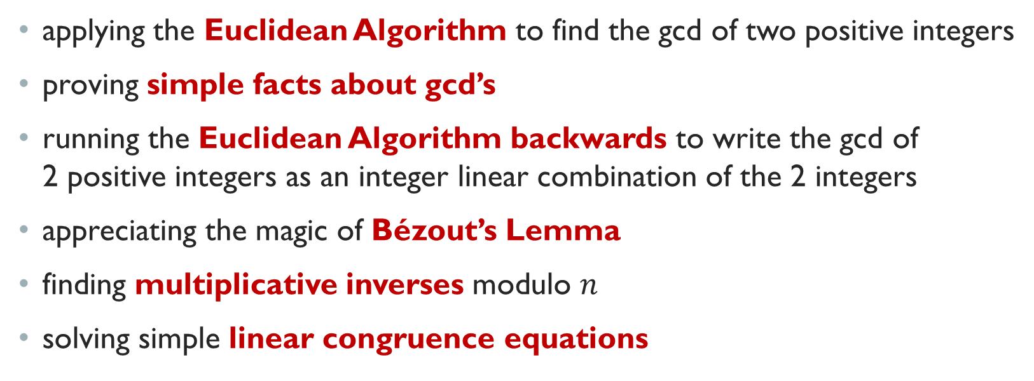
Learning objectives of this tutorial
applying the Euclidean Algorithm to find the gcd of two positive integers
proving simple facts about gcd’s
running the Euclidean Algorithm backwards to write the gcd of 2 positive integers as an integer linear combination of the 2 integers
appreciating the magic of Bézout’s Lemma
finding multiplicative inverses modulo $n$
solving simple linear congruence equations

Slide 3
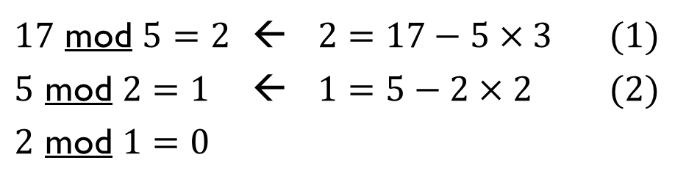
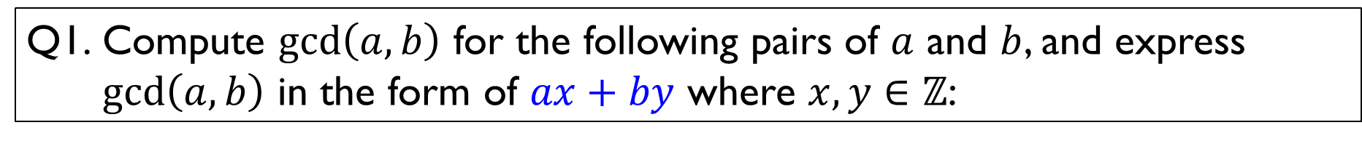
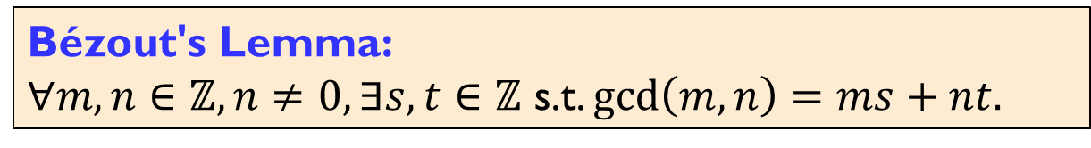
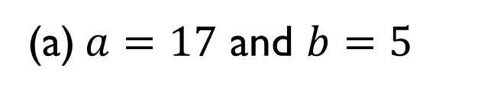
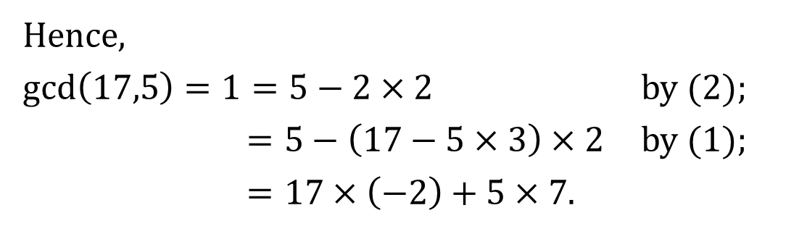
Q1. Compute $\gcd\left(a,b\right)$ for the following pairs of $a$ and $b$, and express $\gcd\left(a,b\right)$ in the form of $ax+by$ where $x,y∈ℤ$:
(a) $a=17$ and $b=5$
$17$ mod $5=2$ ← $2=17−5×3$ (1)
$5$ mod $2=1$ ← $1=5−2×2$ (2)
$2$ mod $1=0$
Hence,
$\gcd\left(17,5\right)=1=5−2×2$ by (2);
$=5−\left(17−5×3\right)×2$ by (1);
$=17×\left(−2\right)+5×7$.
Bézout's Lemma:
$∀m,n∈ℤ,n≠0,∃s,t∈ℤ$ s.t. $\gcd\left(m,n\right)=ms+nt.$

Slide 4
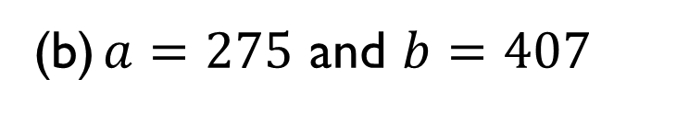
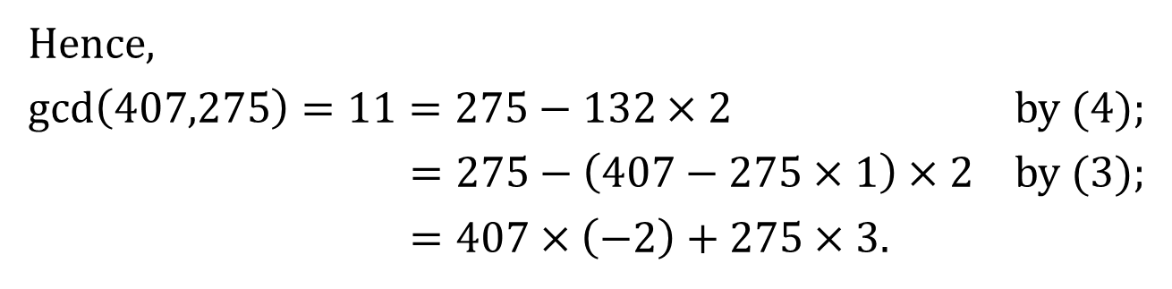
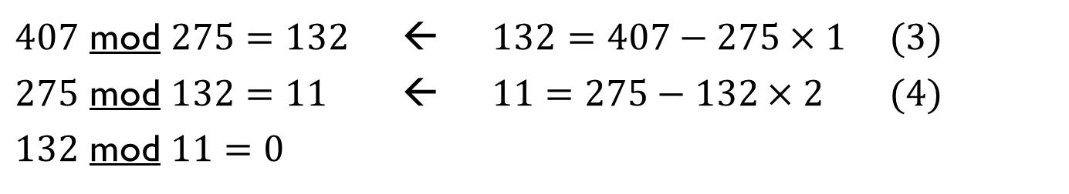
Q1. Compute $\gcd\left(a,b\right)$ for the following pairs of $a$ and $b$, and express $\gcd\left(a,b\right)$ in the form of $ax+by$ where $x,y∈ℤ$:
(b) $a=275$ and $b=407$
$407$ mod $275=132$ ← 13$2=407−275×1$ (3)
$275$ mod $132=11$ ← 1$1=275−132×2$ (4)
$132$ mod $11=0$
Hence,
$\gcd\left(407,275\right)=11=275−132×2$ by (4);
$=275−\left(407−275×1\right)×2$ by (3);
$=407×\left(−2\right)+275×3$.
Bézout's Lemma:
$∀m,n∈ℤ,n≠0,∃s,t∈ℤ$ s.t. $\gcd\left(m,n\right)=ms+nt.$

Slide 5




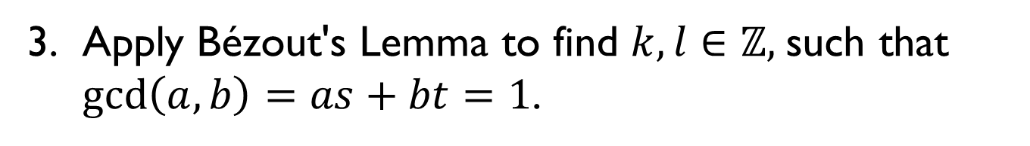
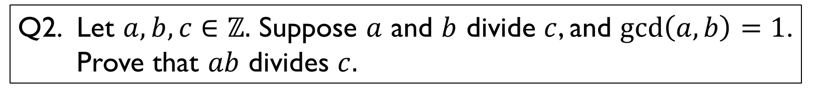

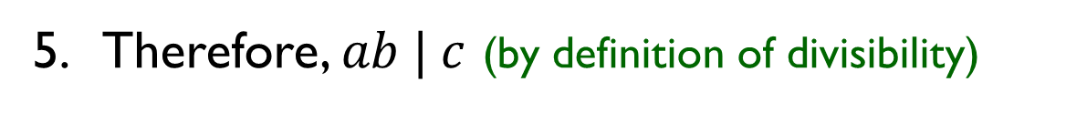

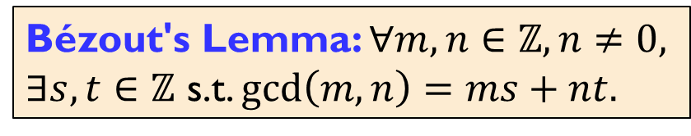
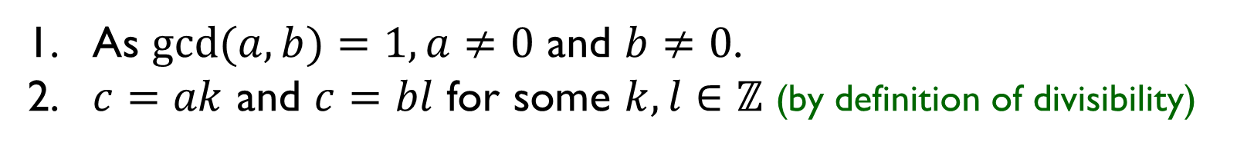


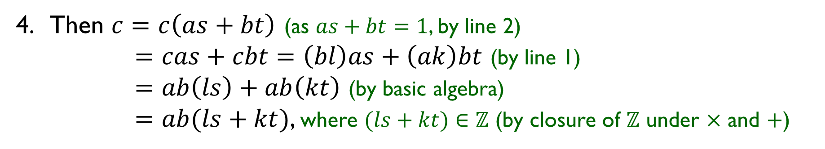
Q2. Let $a,b,c∈ℤ.$ Suppose $a$ and $b$ divide $c$, and $\gcd\left(a,b\right)=1$. Prove that $ab$ divides $c.$
Thought process…
Given info:
$$a | c$$
$$⇒c=ak$$
Goal:
$$ab | c$$
Going forward:
$$b | c$$
$$⇒c=bl$$
Going backward:
$$c=abm$$
1. As $gcd⁡(a,b)=1, a≠0$ and $b≠0$.
2. $c=ak$ and $c=bl$ for some $k,l∈ℤ$ (by definition of divisibility)
Idea:
Bézout's Lemma!
3. Apply Bézout's Lemma to find $k,l∈ℤ,$such that $\gcd\left(a,b\right)=as+bt=1$.
4. Then $c=c\left(as+bt\right)$ (as $as+bt=1$, by line 2)
$=cas+cbt=\left(bl\right)as+\left(ak\right)bt$ (by line 1)
$=ab\left(ls\right)+ab\left(kt\right)$ (by basic algebra)
$=ab(ls+kt)$, where $(ls+kt)∈ℤ$ (by closure of $ℤ$ under $×$ and $+$)
5. Therefore, $ab | c$ (by definition of divisibility)
Bézout's Lemma: $∀m,n∈ℤ,n≠0,$
$∃s,t∈ℤ$ s.t. $\gcd\left(m,n\right)=ms+nt.$

Slide 6
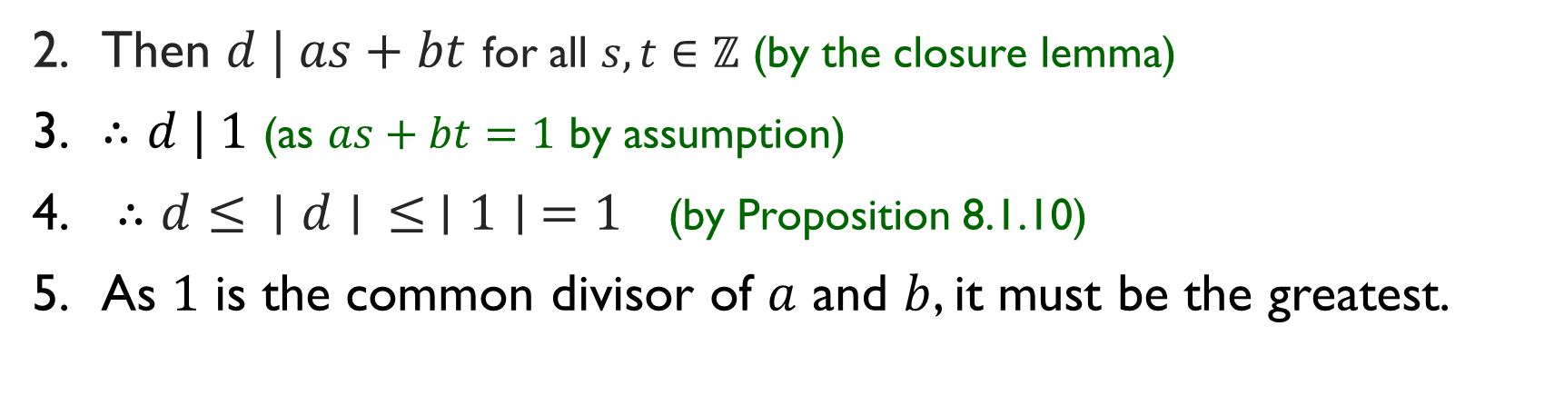
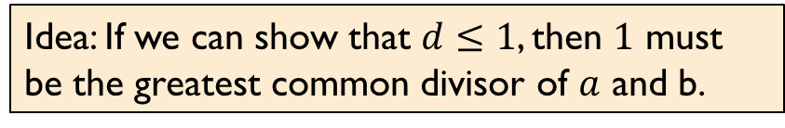
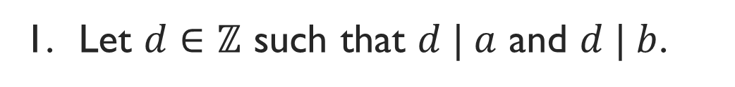
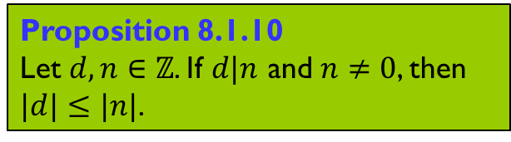
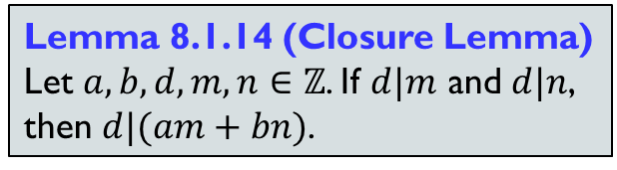
Q3. Let $a,b,s,t∈ℤ$ such that $as+bt=1.$ Show that $\gcd\left(a,b\right)=1.$
Lemma 8.1.14 (Closure Lemma)
Let $a,b,d,m,n∈ℤ$. If $d|m$ and $d|n$, then $d|(am+bn)$.
1. Let $d∈ℤ$ such that $d | a$ and $d | b$.
Idea: If we can show that $d≤1$, then $1$ must be the greatest common divisor of $a$ and b.
Proposition 8.1.10
Let $d,n∈ℤ$. If $d|n$ and $n≠0$, then $|d|≤|n|$.
2. Then $d | as+bt$ for all $s,t∈ℤ$ (by the closure lemma)
3. $∴d | 1$ (as $as+bt=1$ by assumption)
4. $∴d≤ ∣d∣ ≤ ∣1∣ =1$ (by Proposition 8.1.10)
5. As $1$ is the common divisor of $a$ and $b$, it must be the greatest.
We will use this result in Q3 to help solve Q4 and Q5.

Slide 7
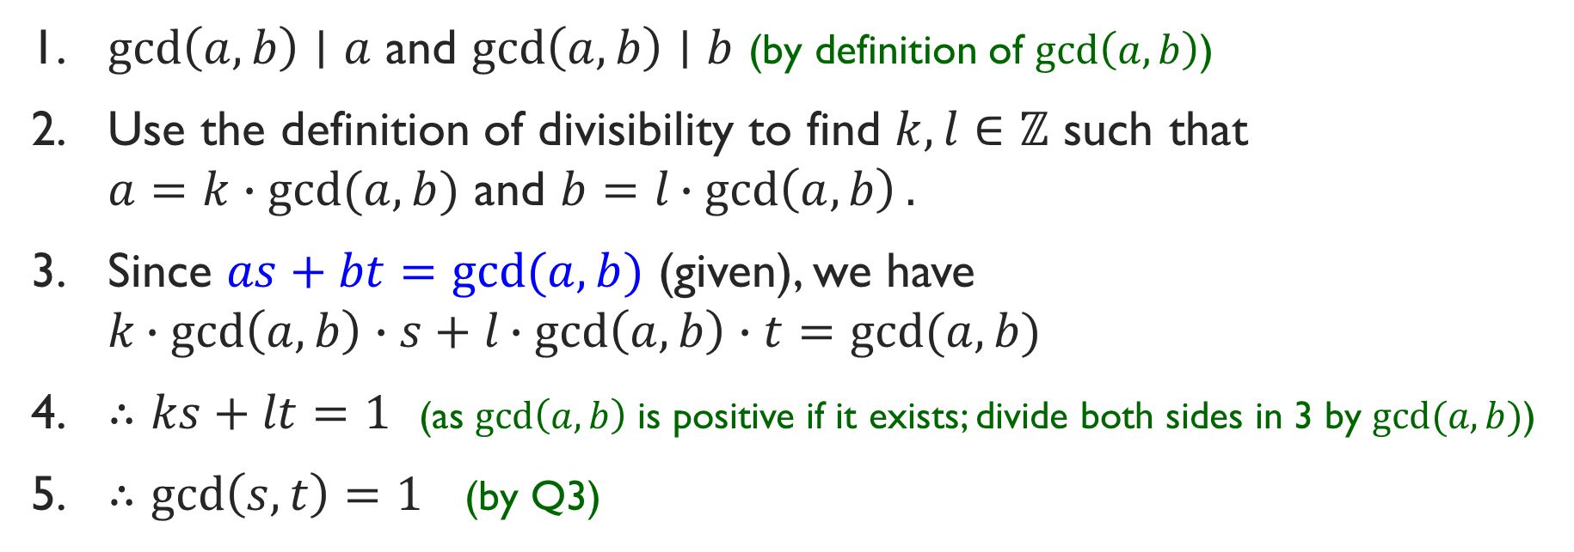
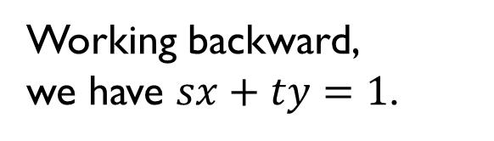
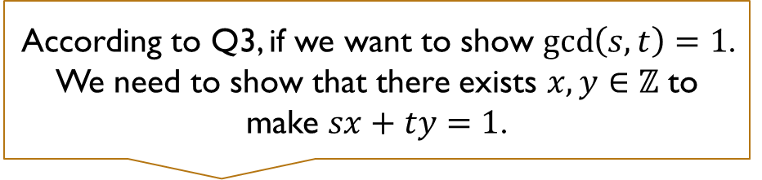
Q4. Let $a,b,s,t∈ℤ$ s.t. $as+bt=gcd(a, b).$ Show that $\gcd\left(s,t\right)=1$.
According to Q3, if we want to show $\gcd\left(s,t\right)=1$. We need to show that there exists $x,y∈ℤ$ to make $sx+ty=1$.
Working backward,
we have $sx+ty=1$.
1. $\gcd\left(a,b\right)∣a$ and $\gcd\left(a,b\right)∣b$ (by definition of $\gcd\left(a,b\right)$)
2. Use the definition of divisibility to find $k,l∈ℤ$ such that $a=k∙gcd⁡(a,b)$ and $b=l∙gcd\left(a,b\right).$
3. Since $as+bt=gcd⁡(a,b)$ (given), we have $k∙gcd\left(a,b\right)∙s+l∙gcd\left(a,b\right)∙t=gcd⁡(a,b)$
4. $∴ks+lt=1$ (as $\gcd\left(a,b\right)$ is positive if it exists; divide both sides in 3 by $gcd⁡(a,b)$)
5. $∴gcd\left(s,t\right)=1$ (by Q3)

Slide 8
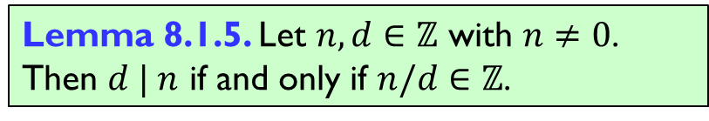
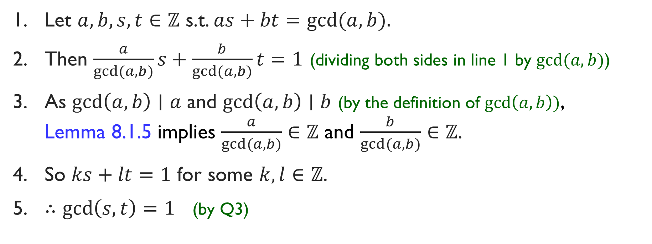
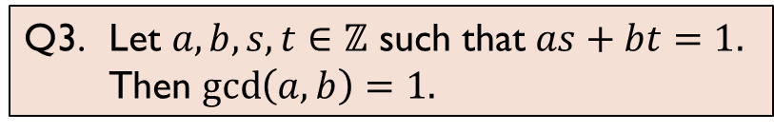
Q4. Let $a,b,s,t∈ℤ$ s.t. $as+bt=gcd(a, b).$ Show that $\gcd\left(s,t\right)=1$.
Alternative solution:
Working backward,
we have $sx+ty=1$.
1. Let $a,b,s,t∈ℤ$ s.t. $as+bt=gcd(a, b).$
2. Then $\frac{a}{gcd(a,b)}s+\frac{b}{gcd(a,b)}t=1$ (dividing both sides in line 1 by $gcd⁡(a,b)$)
3. As $\gcd\left(a,b\right)∣a$ and $\gcd\left(a,b\right)∣b$ (by the definition of $\gcd\left(a,b\right))$, Lemma 8.1.5 implies $\frac{a}{gcd(a,b)}∈ℤ$ and $\frac{b}{gcd(a,b)}∈ℤ$.
4. So $ks+lt=1$ for some $k,l∈ℤ$.
5. $∴gcd\left(s,t\right)=1$ (by Q3)
Lemma 8.1.5. Let $n,d∈ℤ$ with $n≠0$.
Then $d | n$ if and only if $n/d∈ℤ$.
Q3. Let $a,b,s,t∈ℤ$ such that $as+bt=1.$ Then $\gcd\left(a,b\right)=1.$

Slide 9
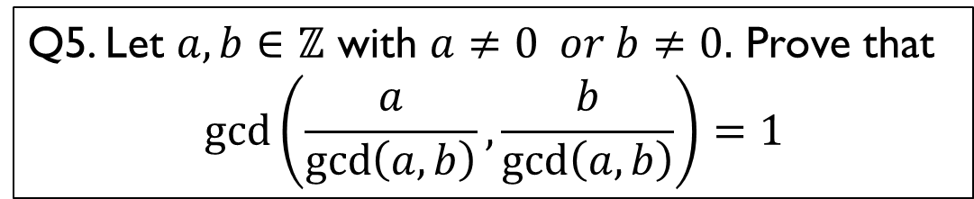
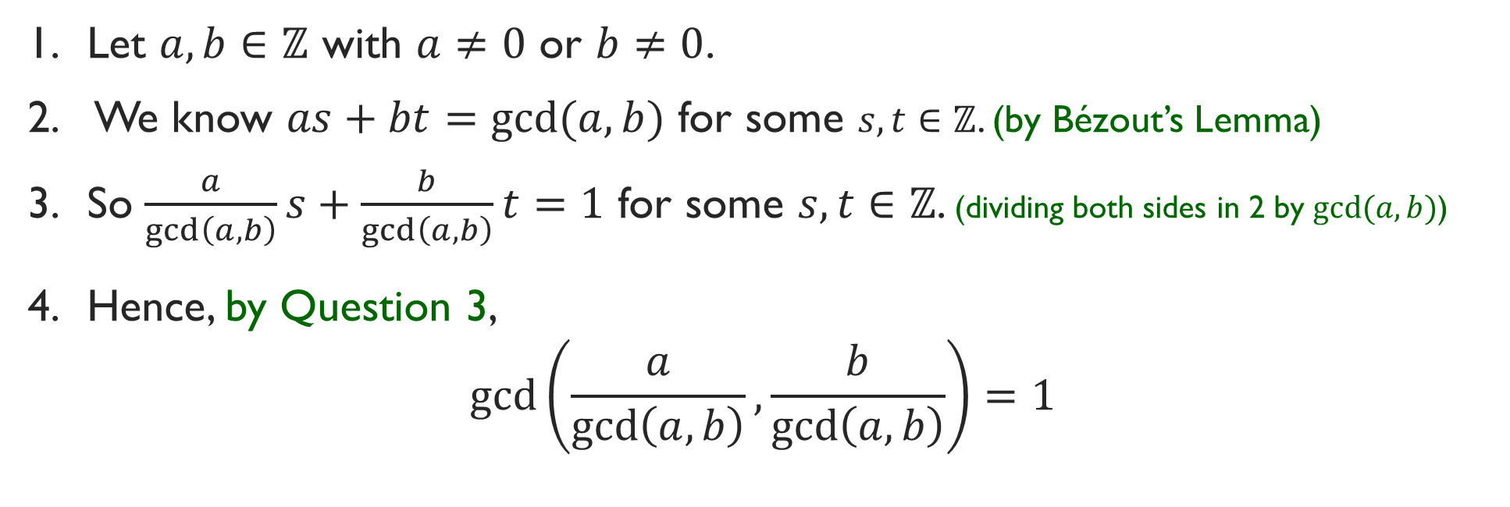
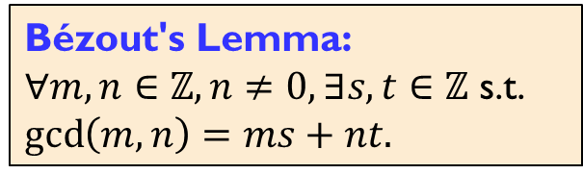
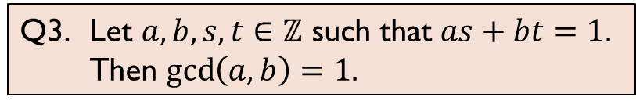
Q5. Let $a,b∈ℤ$ with $a≠0 or b≠0.$ Prove that
$$\gcd\left(\frac{a}{\gcd\left(a,b\right)}, \frac{b}{\gcd\left(a,b\right)}\right)=1$$
Bézout's Lemma:
$∀m,n∈ℤ,n≠0,∃s,t∈ℤ$ s.t. $\gcd\left(m,n\right)=ms+nt.$
Q3. Let $a,b,s,t∈ℤ$ such that $as+bt=1.$ Then $\gcd\left(a,b\right)=1.$
1. Let $a,b∈ℤ$ with $a≠0$ or $b≠0$.
2. We know $as+bt=gcd(a,b)$ for some $s,t∈ℤ$. (by Bézout’s Lemma)
3. So $\frac{a}{\gcd\left(a,b\right)}s+\frac{b}{\gcd\left(a,b\right)}t=1$ for some $s,t∈ℤ$. (dividing both sides in 2 by $gcd⁡(a,b)$)
4. Hence, by Question 3,
$$\gcd\left(\frac{a}{\gcd\left(a,b\right)}, \frac{b}{\gcd\left(a,b\right)}\right)=1$$

Slide 10

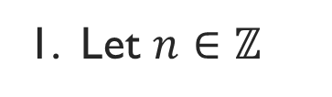
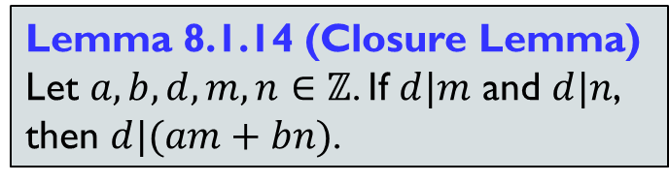
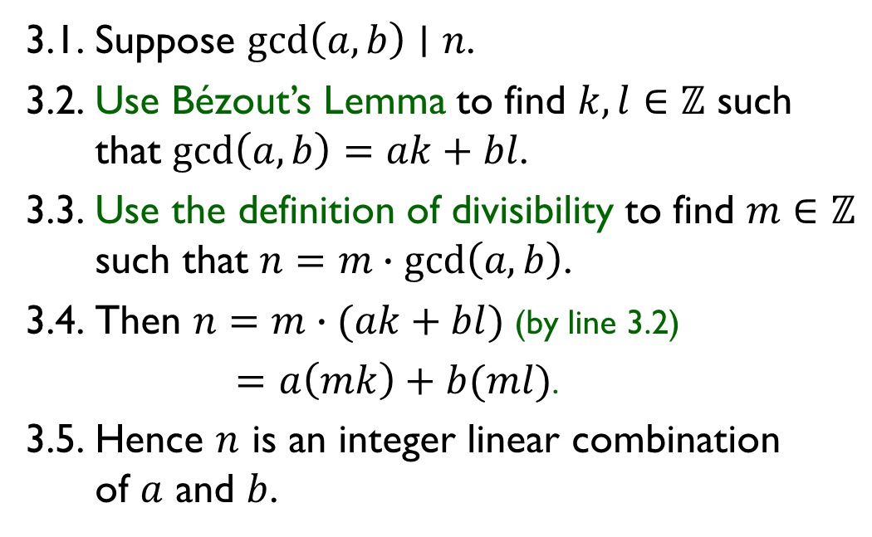
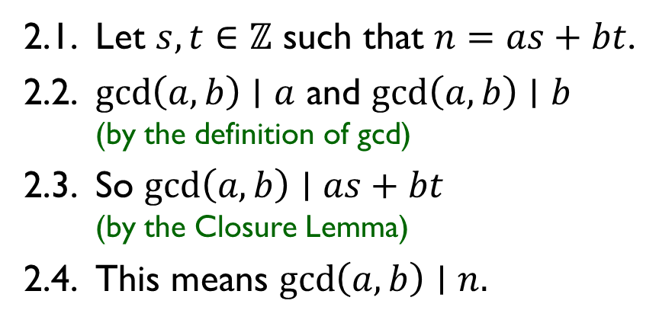
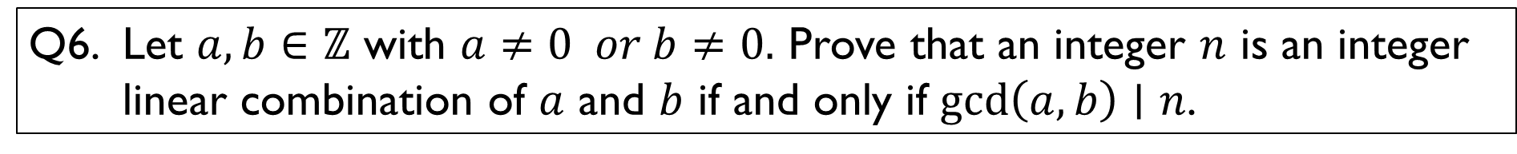
Q6. Let $a,b∈ℤ$ with $a≠0 or b≠0.$ Prove that an integer $n$ is an integer linear combination of $a$ and $b$ if and only if $\gcd\left(a,b\right)∣n$.
1. Let $n∈ℤ$
Bézout's Lemma:
$∀m,n∈ℤ,n≠0,∃s,t∈ℤ$ s.t. $\gcd\left(m,n\right)=ms+nt.$
2. “Only if”:
3. “If”:
2.1. Let $s,t∈ℤ$ such that $n=as+bt$.
2.2. $\gcd\left(a,b\right)∣a$ and $\gcd\left(a,b\right)∣b$ (by the definition of gcd)
2.3. So $\gcd\left(a,b\right)∣as+bt$ (by the Closure Lemma)
2.4. This means $\gcd\left(a,b\right)∣n.$
3.1. Suppose $\gcd\left(a,b\right)∣n$.
3.2. Use Bézout’s Lemma to find $k,l∈ℤ$ such that $\gcd\left(a,b\right)=ak+bl$.
3.3. Use the definition of divisibility to find $m∈ℤ$ such that $n=m∙gcd\left(a,b\right)$.
3.4. Then $n=m∙(ak+bl)$ (by line 3.2)
$=a\left(mk\right)+b(ml)$.
3.5. Hence $n$ is an integer linear combination of $a$ and $b$.
Lemma 8.1.14 (Closure Lemma)
Let $a,b,d,m,n∈ℤ$. If $d|m$ and $d|n$, then $d|(am+bn)$.

Slide 11
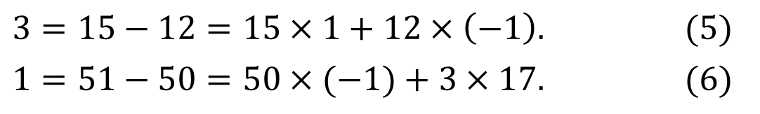



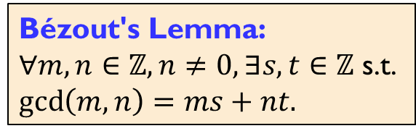

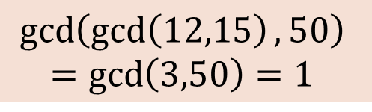
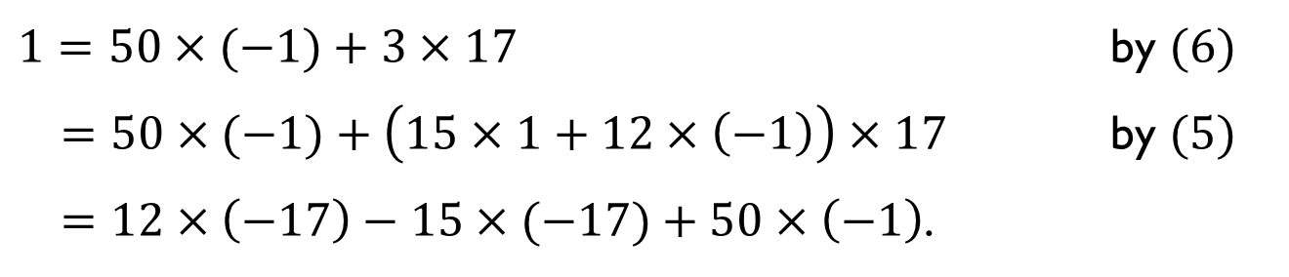
Bézout's Lemma:
$∀m,n∈ℤ,n≠0,∃s,t∈ℤ$ s.t. $\gcd\left(m,n\right)=ms+nt.$
Q7. Find $x,y,z∈ℤ$ such that $12x−15y+50z=1.$
$$gcd⁡(12,15)=3$$
$⇒$ $3$ is an integer linear combination of $12$ and $15$.
$$\gcd\left(\gcd\left(12,15\right),50\right)$$
$$=\gcd\left(3,50\right)=1$$
$⇒$ $1$ is an integer linear combination of $3$ and $50$.
$3=15−12=15×1+12×\left(−1\right).$ $(5)$
$1=51−50=50×(−1)+3×17.$ $(6)$
Using Euclidean Algorithm:
$1=50×(−1)+3×17$ by $(6)$
$=50×(−1)+\left(15×1+12×\left(−1\right)\right)×17$ by $(5)$
$=12×\left(−17\right)−15×(−17)+50×\left(−1\right)$.
$$x$$
$$y$$
$$z$$

Slide 12
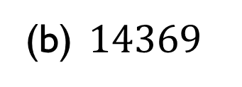
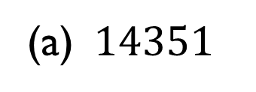

Q8. Determine the prime factorization of each of the following integers:
(a) $14351$
$$=113×127$$
(b) $14369$
It’s a prime!
It is not easy to factorize large numbers!

Slide 13


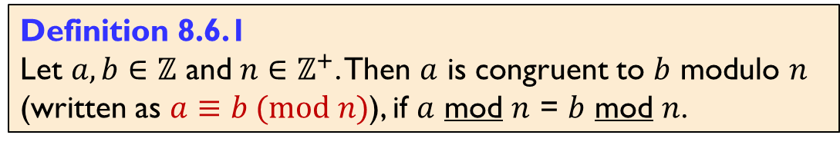


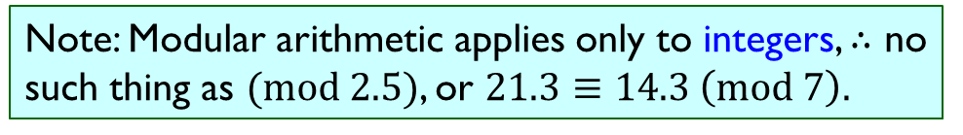


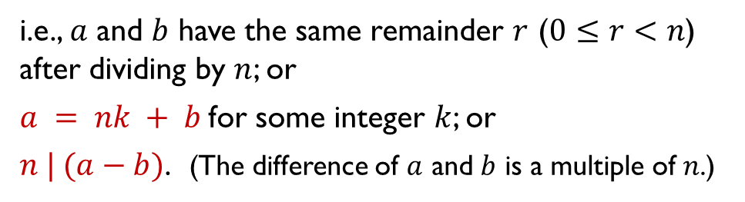
Modular Arithmetic (aka Clock Arithmetic)
Definition 8.6.1
Let $a,b∈ℤ$ and $n∈ℤ^{+}$. Then $a$ is congruent to $b$ modulo $n$ (written as $a≡b (mod n)$), if $a$ mod $n$ = $b$ mod $n$.
i.e., $a$ and $b$ have the same remainder $r$ ($0≤r<n$) after dividing by $n$; or
$a = nk + b$for some integer $k$; or
$n | (a−b)$. (The difference of $a$ and $b$ is a multiple of $n$.)
Eg: A mod-12 clock.
0
11
1
Take the value $3$:
$$3≡15 (mod 12)$$
(Turn one round clockwise)
10
2
-45
$$3≡39 (mod 12)$$
(Turn three rounds clockwise)
-9
9
3
$$3≡−9 (mod 12)$$
(Turn one round anti-clockwise)
15
$$3≡−45 (mod 12)$$
(Turn four rounds anti-clockwise)
39
8
4
So $3, 15, 39, −9$ and $−45$ are in the same “clock position”.
7
5
6
Note: Modular arithmetic applies only to integers, $∴$ no such thing as $(mod 2.5)$, or $21.3≡14.3 \left(mod 7\right).$

Slide 14
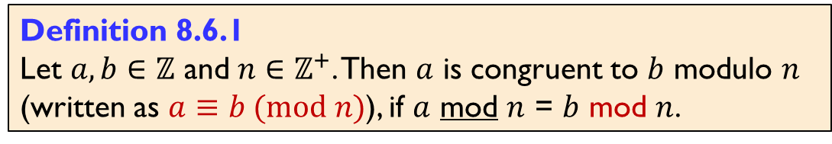
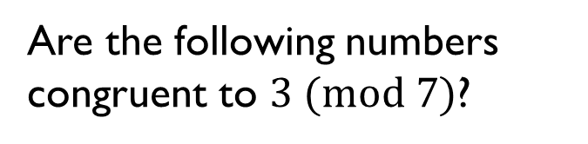
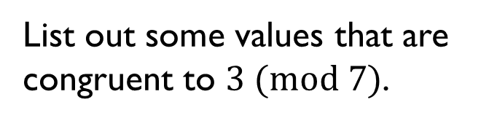
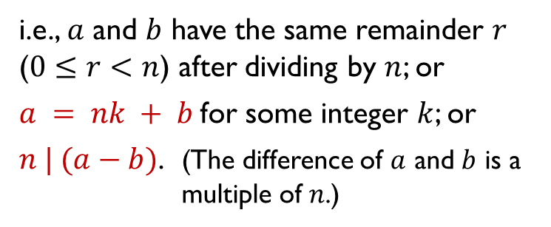
Modular Arithmetic (aka Clock Arithmetic)
Definition 8.6.1
Let $a,b∈ℤ$ and $n∈ℤ^{+}$. Then $a$ is congruent to $b$ modulo $n$ (written as $a≡b (mod n)$), if $a$ mod $n$ = $b$ mod $n$.
i.e., $a$ and $b$ have the same remainder $r$ ($0≤r<n$) after dividing by $n$; or
$a = nk + b$for some integer $k$; or
$n | (a−b)$. (The difference of $a$ and $b$ is a multiple of $n$.)
Eg: A mod-7 clock.
0
6
1
List out some values that are congruent to $3 (mod 7)$.
5
2
Are the following numbers congruent to $3 (mod 7)$?
$$0, 3, −3, −4, 80, −137, 700,7^{100}+3$$
4
3

Slide 15
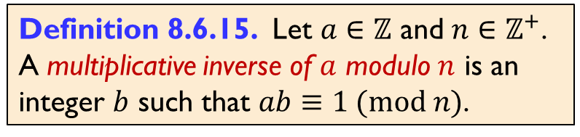
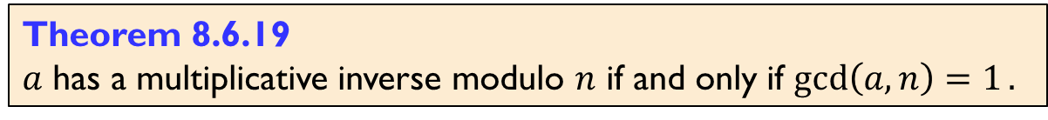





Q9. For each of the following pairs of $a$ and $n$, determine whether $a$ has a multiplicative inverse modulo $n$, and find one if it has any:
(a) $a=3$ and $n=8$
(b) $a=6$ and $n=14$
Note that $\gcd\left(3,8\right)=1$. So $3$ has a multiplicative inverse modulo $8$ (by Theorem 8.6.19).
Observe that
$$1=9−8=3×3−8$$
Therefore,
$$1≡3×3 \left(mod 8\right).$$
Thus $3$ is a multiplicative inverse of $3$ modulo $8$.
Note that $\gcd\left(6, 14\right)=2≠1$.
So $6$ does not have a multiplicative inverse modulo $14$ (by Theorem 8.6.19).
Definition 8.6.15. Let $a∈ℤ$ and $n∈ℤ^{+}$.
A multiplicative inverse of $a$ modulo $n$ is an integer $b$ such that $ab≡1 (mod n)$.
Theorem 8.6.19
$a$ has a multiplicative inverse modulo $n$ if and only if $\gcd\left(a,n\right)=1.$

Slide 16



Q9. For each of the following pairs of $a$ and $n$, determine whether $a$ has a multiplicative inverse modulo $n$, and find one if it has any:
(c) $a=31$ and $n=24$
Hence
$\gcd\left(31,24\right)=1=7−3×2$ by (9);
$=7−\left(24−7×3\right)×2$ by (8);
$=24×\left(−2\right)+7×7$
$=24×\left(−2\right)+\left(31−24×1\right)×7$ by (7);
$=31×7+24×(−9)$
$≡31×7 (mod 24)$.
Thus $7$ is the multiplicative inverse of $31$ modulo $24$.
Note that $\gcd\left(31,24\right)=1$. So $31$ has a multiplicative inverse modulo $24$ (by Theorem 8.6.19).
By the Euclidean Algorithm,
$31$ mod$24=7←7=31−24×1$ (7)
$24$ mod $7=3←3=24−7×3$ (8)
$7$ mod $3=1←1=7−3×2$ (9)
$3$ mod $1=0$
Theorem 8.6.19
$a$ has a multiplicative inverse modulo $n$ if and only if $\gcd\left(a,n\right)=1.$

Slide 17



Q10. For each of the congruence equations below, ﬁnd all integers $x$, if any, that satisfy it:
Theorem 8.6.19
$a$ has a multiplicative inverse modulo $n$ iff $\gcd\left(a,n\right)=1.$
(a) $5x≡2 \left(mod 32\right)$
Does $5$ have a multiplicative inverse modulo $32$? Need to check. Which theorem?
$\gcd\left(5, 32\right)=1$. So $5$ has a multiplicative inverse modulo $32.$
We observe that: $1=65−64=5×13+32×\left(−2\right)≡5×13 \left(mod 32\right)$.
$∴13$ is a multiplicative inverse of $5$ modulo $32$.
$∴∀x∈ℤ$, $5x≡2 \left(mod 32\right)⟺x≡13×2=26 \left(mod 32\right)$ (by Corollary 8.6.23)
Corollary 8.6.23
Let $n{∈ℤ}^{+}$. Suppose $a,b,c∈ℤ$ where $b$ is a multiplicative inverse of $a$ modulo $n$.
Then $ax≡c (mod n)⇔x≡bc (mod n)$.
From notes8-numthy.pdf

Slide 18







Q10. For each of the congruence equations below, ﬁnd all integers $x$, if any, that satisfy it:
Theorem 8.6.19
$a$ has a multiplicative inverse modulo $n$ if and only if $\gcd\left(a,n\right)=1.$
(b) $4x≡6 \left(mod 48\right)$
Does $4$ have a multiplicative inverse modulo $48$?
$\gcd\left(4, 48\right)=4≠1$. So $4$ does not have a multiplicative inverse modulo $48.$
We will prove that $4x≡6 \left(mod 48\right)$ has no solution by contradiction.
Lemma 8.6.2. Let $a,b∈ℤ$ and $n∈ℤ^{+}$. Then $a≡b (mod n)$ if and only if $a=nk+b$ for some $k∈ℤ$.
1. Let $x∈ℤ$ such that $4x≡6 \left(mod 48\right)$.
2. Use Lemma 8.6.2 to get $k∈ℤ$ such that $4x=48k+6.$
3. Note that $6$ is an integer linear combination of $4$ and $48$ (as $6=4x+48(−k)$).
Therefore, $\gcd\left(4,48\right)| 6$. (by Q6)
5. However, we know $\gcd\left(4,48\right)=4$ and $4∤6$ (by lemma 8.1.5 as $6/4=1.5∉ℤ$) which is the required contradiction.
Q6. Let $a,b∈ℤ$ with $a≠0 or b≠0.$ Prove that an integer $n$ is an integer linear combination of $a$ and $b$ if and only if $\gcd\left(a,b\right)∣n$.
Lemma 8.1.5 Let $n,d∈ℤ$, $d≠0.$
Then $d | n$ if and only if $n/d∈ℤ$.

Slide 19



Q11. Let $a,b∈ℤ$ and $m,n∈ℤ^{+}$ with $\gcd\left(m,n\right)=1$. Consider the following system of simultaneous congruence equations:
$$\left\{\begin{aligned} x≡a \left(mod m\right); \\ x≡b \left(mod n\right).\end{aligned}\right.$$
Apply Bézout’s Lemma to ﬁnd $s,t∈ℤ$ such that $ms+nt=1$. Let $c_{0}=ant+bms.$
Verify that $x=c_{0}$ is a solution to the system of simultaneous congruence equations above.
Goal: To show $c_{0}≡a (mod m)$ and $c_{0}≡b \left(mod n\right).$
$c_{0}=ant+bms$ by the definition of $c_{0}$
$=a\left(1−ms\right)+bms$ by the choice of $s$ and $t$
$=a+m(−as+bs)$ by basic algebra
$≡a (mod m)$ as $−as+bs∈ℤ$ by closure
$c_{0}=ant+bms$ by the definition of $c_{0}$
$=ant+b(1−nt)$ by the choice of $s$ and $t$
$=b+n(at−bt)$ by basic algebra
$≡b (mod n)$ as $at−bt∈ℤ$ by closure

Slide 20










Q11. Let $a,b∈ℤ$ and $m,n∈ℤ^{+}$ with $\gcd\left(m,n\right)=1$.
Consider the following system of simultaneous congruence equations:
Apply Bézout’s Lemma to ﬁnd $s,t∈ℤ$ such that $ms+nt=1$. Let $c_{0}=ant+bms.$
$$\left\{\begin{aligned} x≡a \left(mod m\right); \\ x≡b \left(mod n\right).\end{aligned}\right.$$
(b) Let $c∈ℤ$. Prove that $x=c$ is a solution to the system of simultaneous congruence equations above if and only if $c≡c_{0} \left(mod mn\right).$
Congruence is symmetric: $x≡y \left(mod m\right)⇒y≡x \left(mod m\right).$
Proof:
$x≡y \left(mod m\right)⇒x−y=km$ for some integer $k$
$⇒y−x=−km$ for some integer $−k$ $⇒y≡x \left(mod m\right)$
1. (“Only if”)
1.1. Suppose $x=c$ is a solution to the system of simultaneous congruence equations.
1.2. This means $c≡a (mod m)$ and $c≡b (mod n)$.
1.3. As congruence is symmetric and transitive, we deduce that $c≡c_{0} (mod m)$ and $c≡c_{0} (mod n)$ by part (a).
1.4. So $m∣(c−c_{0})$ and $n∣\left(c−c_{0}\right)$ by the alternative definitions of congruence.
1.5. Thus $mn∣(c−c_{0})$ by Question 2 as $\gcd{(m,n)}=1$ .
1.6 Hence $c≡c_{0} \left(mod mn\right).$
Congruence is transitive:
$x≡y \left(mod m\right)∧y≡z \left(mod m\right)⇒x≡z \left(mod m\right)$
Proof:
$$x≡y \left(mod m\right)∧y≡z \left(mod m\right)$$
$⇒(x−y=km)∧(y−z=lm)$ for some integers $k, l$
$$⇒x−z=\left(x−y\right)+\left(y−z\right)=km+lm=\left(k+l\right)m$$
$$⇒x≡z \left(mod m\right)$$
$c≡a (mod m)$ (from 1.2)
$c_{0}≡a (mod m)$ (from part a)
$c≡c_{0}(mod m)$ (transitivity)
$a≡c_{0} (mod m)$ (symmetry)
Q2. Let $a,b,c∈ℤ.$
$$a|c∧b|c∧\gcd\left(a,b\right)=1⇒ab|c.$$
We will cover symmetry and transitivity in Relations.

Slide 21

Q11. Let $a,b∈ℤ$ and $m,n∈ℤ^{+}$ with $\gcd\left(m,n\right)=1$.
Consider the following system of simultaneous congruence equations:
Apply Bézout’s Lemma to ﬁnd $s,t∈ℤ$ such that $ms+nt=1$. Let $c_{0}=ant+bms.$
$$\left\{\begin{aligned} x≡a \left(mod m\right); \\ x≡b \left(mod n\right).\end{aligned}\right.$$
(b) Let $c∈ℤ$. Prove that $x=c$ is a solution to the system of simultaneous congruence equations above if and only if $c≡c_{0} \left(mod mn\right).$
1. (“Only if”)
1.1. Suppose $x=c$ is a solution to the system of simultaneous congruence equations.
1.2. This means $c≡a (mod m)$ and $c≡b (mod n)$.
1.3. As congruence is symmetric and transitive, we deduce that $c≡c_{0} (mod m)$ and $c≡c_{0} (mod n)$ by part (a).
1.4. So $m∣(c−c_{0})$ and $n∣\left(c−c_{0}\right)$ by the alternative definitions of congruence.
1.5. Thus $mn∣(c−c_{0})$ by Question 2 as $\gcd{(m,n)}=1$ .
1.6 Hence $c≡c_{0} \left(mod mn\right).$
2. (“If”)
2.1. Suppose $c≡c_{0} (mod mn)$.
2.2. Use the alternative definitions of congruence to find $k∈ℤ$ such that $c=k\left(mn\right)+c_{0}$.
2.3. Then $c=c_{0}+m\left(kn\right)$
$≡c_{0} \left(mod m\right)$
$≡a (mod m)$ by part (a).
2.4 Similarly, $c=c_{0}+n\left(km\right)$
$≡c_{0} \left(mod n\right)$
$≡b (mod n)$ by part (a).
2.5 So $x=c$ is a solution to the system of simultaneous congruence equations.

Slide 22
The end

