Slide 1
Tutorial 8: Relations
Slides by
Goh siau chiak
With Additions from Aaron

Slide 2
Learning objectives
- Relations: reflexivity, symmetry, transitivity
- Equivalence relations and equivalence classes
- Partitions
- Partial/total oder
- smallest/largest vs minimal/maximal
- linearization

Slide 3

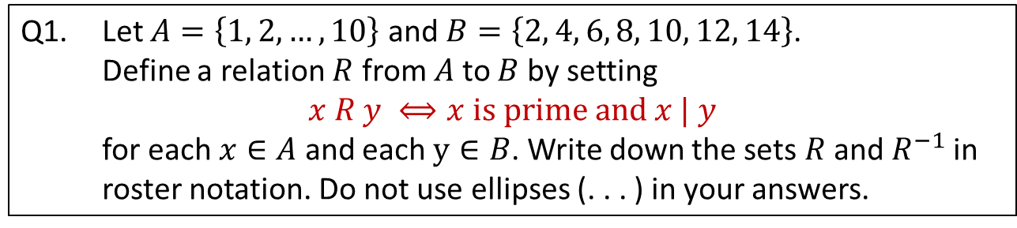

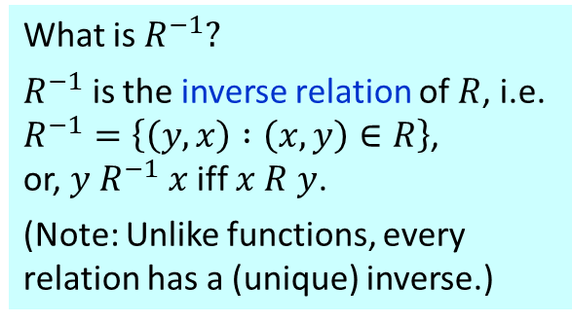




Q1. Let $A=\left\{1, 2, …, 10\right\}$ and $B=\left\{2, 4, 6, 8, 10, 12, 14\right\}$.
Define a relation $R$ from $A$to $B$by setting
$$x R y ⟺x is prime and x | y$$
for each $x∈A$ and each $y∈B$. Write down the sets $R$and $R^{−1}$in roster notation. Do not use ellipses (. . . ) in your answers.
What is $R^{−1}?$
$R^{−1}$ is the inverse relation of $R$, i.e.
$R^{−1}=\left\{\left(y,x\right) :\left(x,y\right)∈R\right\}$,
or, $y R^{−1} x$ iff $x R y$.
(Note: Unlike functions, every relation has a (unique) inverse.)
$$A$$
$$R$$
2
4
6
8
10
12
14
$$B$$
$$A$$
$$R^{−1}$$
$$B$$
1
2
3
4
5
6
7
8
9
10
•
•
•
•
•
•
•
•
•
•
1
2
3
4
5
6
7
8
9
10
•
•
•
•
•
•
•
•
•
•
2
4
6
8
10
12
14
(Arrow diagrams shown for illustration purpose only.)
$$R=\{\text{(2,2), (2,4), (2,6), (2,8), (2,10), (2,12), }\text{(2,14),}\text{(3,6), (3,12), (5,10), (7,14)}\text{\}}$$
$$R^{−1}=\{\text{(2,2), (4,2), (6,2), (8,2), (10,2), (12,2),}\text{(14,2),}\text{ (6,3), (12,3), (10,5), (14,7)}\text{\}}$$

Slide 4
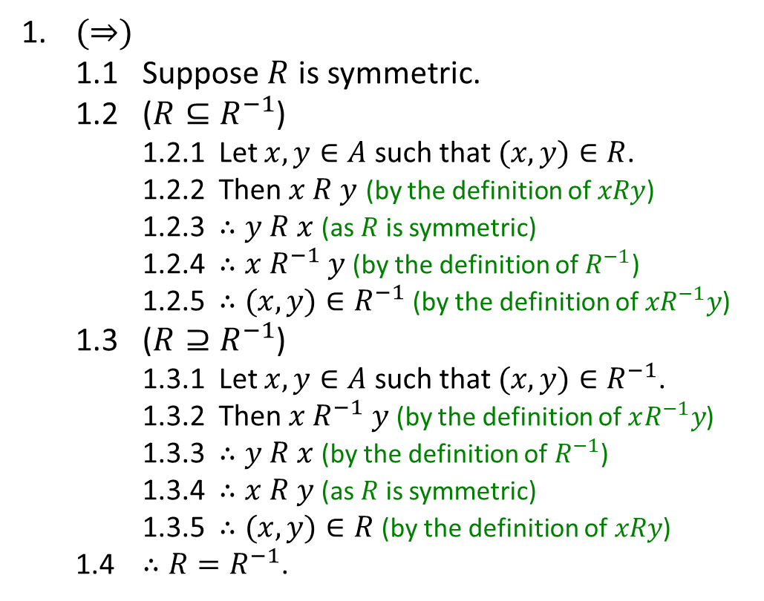
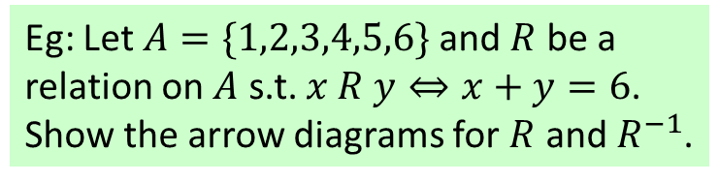
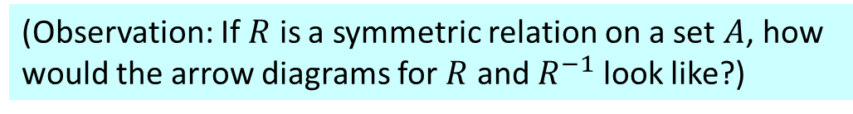
Q2. Let $R$be a relation on set $A$. Show that $R$is symmetric$⇔R=R^{−1}.$
(Observation: If $R$ is a symmetric relation on a set $A$, how would the arrow diagrams for $R$ and $R^{−1}$ look like?)
Eg: Let $A=\{1,2,3,4,5,6\}$and $R$ be a relation on $A$ s.t. $x R y⇔x+y=6$.
Show the arrow diagrams for $R$ and $R^{−1}$.
1. $(⇒)$
1.1 Suppose $R$ is symmetric.
1.2 ($R{⊆R}^{−1}$)
1.2.1 Let $x, y∈A$ such that $(x, y)∈R$.
1.2.2 Then $x R y$ (by the definition of $xRy$)
1.2.3 $∴y R x$ (as $R$ is symmetric)
1.2.4 $∴x{ R}^{−1} y$ (by the definition of$R^{−1}$)
1.2.5 $∴(x,y)∈R^{−1}$ (by the definition of${xR}^{−1}y$)
1.3 ($R⊇R^{−1}$)
1.3.1 Let $x, y∈A$ such that $(x, y)∈R^{−1}$.
1.3.2 Then $x{ R}^{−1} y$ (by the definition of $xR^{−1}y$)
1.3.3 $∴y R x$ (by the definition of$R^{−1}$)
1.3.4 $∴x R y$ (as $R$ is symmetric)
1.3.5 $∴(x,y)∈R$ (by the definition of$xRy$)
1.4 $∴R=R^{−1}$.
• 1
• 6
• 5
• 2
• 4
• 3

Slide 5
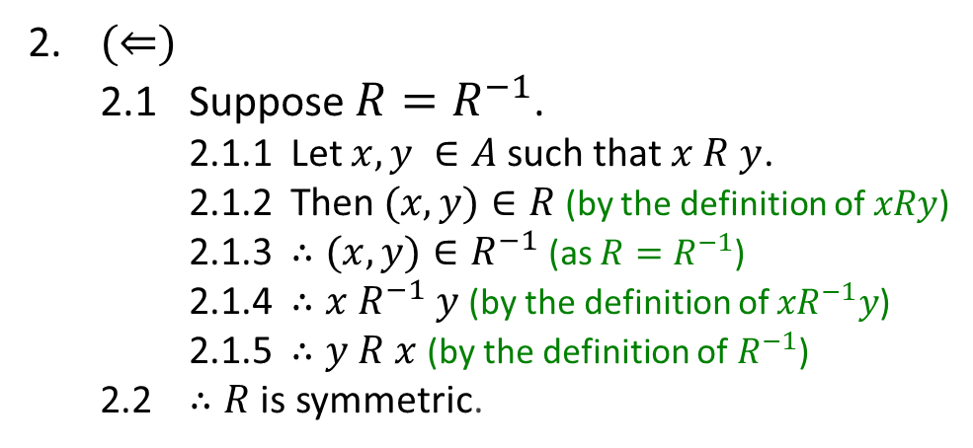
Q2. Let $R$be a relation on set $A$. Show that $R$is symmetric$⇔R=R^{−1}.$
1. $(⇒)$
1.1 Suppose $R$ is symmetric.
1.2 ($R{⊆R}^{−1}$)
1.2.1 Let $x, y∈A$ such that $(x, y)∈R$.
1.2.2 Then $x R y$ (by the definition of $xRy$)
1.2.3 $∴y R x$ (as $R$ is symmetric)
1.2.4 $∴x{ R}^{−1} y$ (by the definition of$R^{−1}$)
1.2.5 $∴(x,y)∈R^{−1}$ (by the definition of${xR}^{−1}y$)
1.3 ($R⊇R^{−1}$)
1.3.1 Let $x, y∈A$ such that $(x, y)∈R^{−1}$.
1.3.2 Then $x{ R}^{−1} y$ (by the definition of $xR^{−1}y$)
1.3.3 $∴y R x$ (by the definition of$R^{−1}$)
1.3.4 $∴x R y$ (as $R$ is symmetric)
1.3.5 $∴(x,y)∈R$ (by the definition of$xRy$)
1.4 $∴R=R^{−1}$.
2. $(⇐)$
2.1 Suppose $R=R^{−1}$.
2.1.1 Let $x,y ∈A$ such that $x R y$.
2.1.2 Then $(x, y)∈R$ (by the definition of $xRy$)
2.1.3 $∴(x, y)∈R^{−1}$ (as $R=R^{−1}$)
2.1.4 $∴x{ R}^{−1} y$ (by the definition of ${xR}^{−1}y$)
2.1.5 $∴y R x$ (by the definition of$R^{−1}$)
2.2 $∴R$ is symmetric.

Slide 6




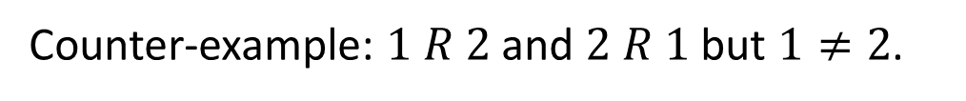
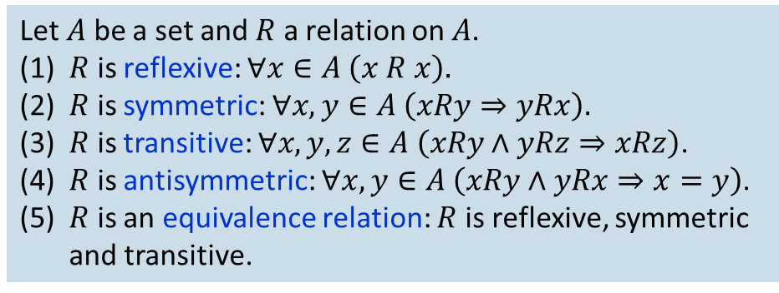
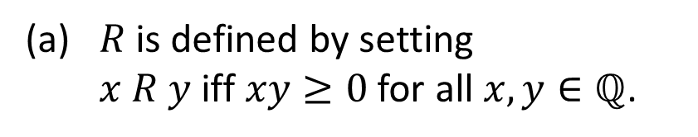
Q3. For each of the following relations on $ℚ$, determine if it is (i) reflexive, (ii) symmetric, (iii) transitive, (iv) antisymmetric, (v) an equivalence relation.
Let $A$ be a set and $R$ a relation on $A$.
(1) $R$ is reflexive: $∀x∈A \left(x R x\right).$
(2) $R$ is symmetric: $∀x,y∈A \left(xRy⇒yRx\right).$
(3) $R$ is transitive: $∀x,y,z∈A \left(xRy∧yRz⇒xRz\right)$.
(4) $R$ is antisymmetric: $∀x,y∈A \left(xRy∧yRx⇒x=y\right)$.
(5) $R$ is an equivalence relation: $R$ is reflexive, symmetric and transitive.
(a) $R$ is defined by setting $x R y$ iff $xy≥0$ for all $x, y∈ℚ$.
Reflexive?
$$∀x∈ℚ, x∙x=x^{2}≥0$$
Symmetric?
$∀x, y∈ℚ, xy≥0 ⇒yx=xy≥0$ (by commutativity of $×$)
Transitive?
Counter-example: $1 R 0$ and $0 R (−1)$ but $1 R (−1)$.
Antisymmetric?
Counter-example: $1 R 2$ and $2 R 1$ but $1≠2$.
Equivalence relation?
$R$ is not transitive.

Slide 7
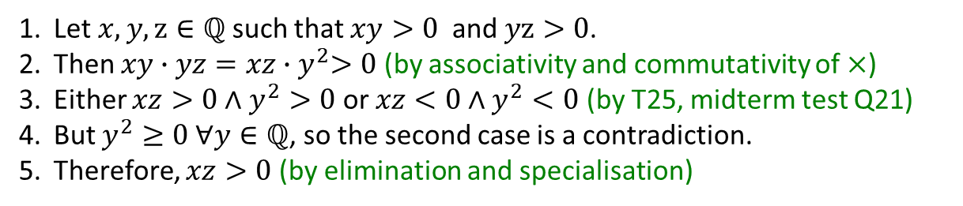


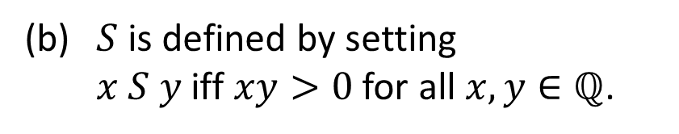
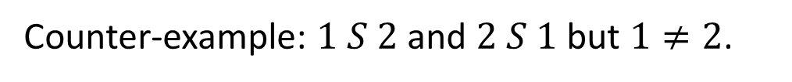
Q3. For each of the following relations on $ℚ$, determine if it is (i) reflexive, (ii) symmetric, (iii) transitive, (iv) antisymmetric, (v) an equivalence relation.
Let $A$ be a set and $R$ a relation on $A$.
(1) $R$ is reflexive: $∀x∈A \left(x R x\right).$
(2) $R$ is symmetric: $∀x,y∈A \left(xRy⇒yRx\right).$
(3) $R$ is transitive: $∀x,y,z∈A \left(xRy∧yRz⇒xRz\right)$.
(4) $R$ is antisymmetric: $∀x,y∈A \left(xRy∧yRx⇒x=y\right)$.
(5) $R$ is an equivalence relation: $R$ is reflexive, symmetric and transitive.
(b) $S$ is defined by setting $x S y$ iff $xy>0$ for all $x, y∈ℚ$.
Reflexive?
$\text{Counter}\text{−}\text{example}\text{:}0 S$ 0
Symmetric?
$∀x, y∈ℚ, xy>0 ⇒yx=xy>0$ (by commutativity of $×$)
1. Let $x, y,z∈ℚ$ such that $xy>0$ and $yz>0$.
2. Then $xy∙yz=xz{∙y}^{2}>0$ (by associativity and commutativity of $×$)
3. Either $xz>0∧y^{2}>0$ or $xz<0∧y^{2}<0$ (by T25, midterm test Q21)
4. But $y^{2}≥0 ∀y∈ℚ$, so the second case is a contradiction.
5. Therefore, $xz>0$ (by elimination and specialisation)
Transitive?
Antisymmetric?
Counter-example: $1 S 2$ and $2 S 1$ but $1≠2$.
Equivalence relation?
$S$ is not reflexive.

Slide 8
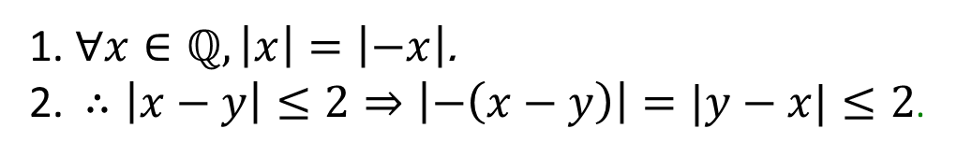
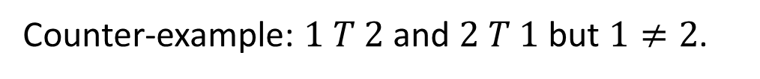

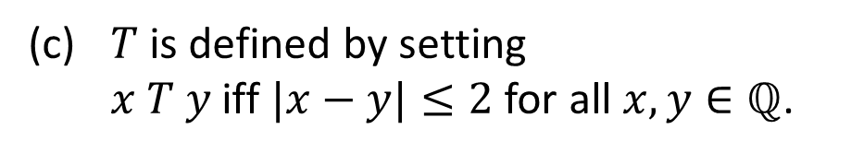

Q3. For each of the following relations on $ℚ$, determine if it is (i) reflexive, (ii) symmetric, (iii) transitive, (iv) antisymmetric, (v) an equivalence relation.
Let $A$ be a set and $R$ a relation on $A$.
(1) $R$ is reflexive: $∀x∈A \left(x R x\right).$
(2) $R$ is symmetric: $∀x,y∈A \left(xRy⇒yRx\right).$
(3) $R$ is transitive: $∀x,y,z∈A \left(xRy∧yRz⇒xRz\right)$.
(4) $R$ is antisymmetric: $∀x,y∈A \left(xRy∧yRx⇒x=y\right)$.
(5) $R$ is an equivalence relation: $R$ is reflexive, symmetric and transitive.
(c) $T$ is defined by setting $x T y$ iff $|x−y|≤2$ for all $x, y∈ℚ$.
Reflexive?
$$∀x∈ℚ, \left|x−x\right|=0≤2.$$
Symmetric?
1. $∀x∈ℚ,\left|x\right|=\left|−x\right|$.
2. $∴\left|x−y\right|≤2⇒\left|−\left(x−y\right)\right|=|y−x|≤2$.
Transitive?
Counter-example: $−2 T 0$ and $0 T 2$ but $−2 T 2$.
Antisymmetric?
Counter-example: $1 T 2$ and $2 T 1$ but $1≠2$.
Equivalence relation?
$T$ is not transitive.

Slide 9

















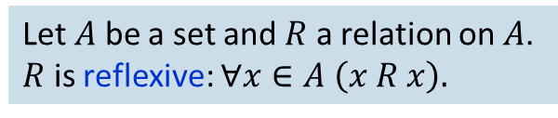










Given a set $A=\{a,b,c\}$and a relation defined on $A$ as follows.
Which of the relations below are REFLEXIVE?
Let $A$ be a set and $R$ a relation on $A$.
$R$ is reflexive: $∀x∈A \left(x R x\right).$
$$R_{1}$$
$$R_{2}$$
$$R_{3}$$
$$R_{4}$$
$$a$$
$$b$$
$$a$$
$$b$$
$$a$$
$$b$$
$$a$$
$$b$$
$$c$$
$$c$$
$$c$$
$$c$$
$$a$$
$$b$$
$$a$$
$$b$$
$$a$$
$$b$$
$$a$$
$$b$$
$$c$$
$$c$$
$$c$$
$$c$$
$$R_{5}$$
$$R_{6}$$
$$R_{7}$$
$$R_{8}$$

Slide 10
























Given a set $A=\{a,b,c\}$and a relation defined on $A$ as follows.
Which of the relations below are REFLEXIVE?
Let $A$ be a set and $R$ a relation on $A$.
$R$ is reflexive: $∀x∈A \left(x R x\right).$
$$R_{1}$$
$$R_{2}$$
$$R_{3}$$
$$R_{4}$$
$$a$$
$$b$$
$$a$$
$$b$$
$$a$$
$$b$$
$$a$$
$$b$$
$$c$$
$$c$$
$$c$$
$$c$$
$$a$$
$$b$$
$$a$$
$$b$$
$$a$$
$$b$$
$$a$$
$$b$$
$$c$$
$$c$$
$$c$$
$$c$$
$$R_{5}$$
$$R_{6}$$
$$R_{7}$$
$$R_{8}$$

Slide 11




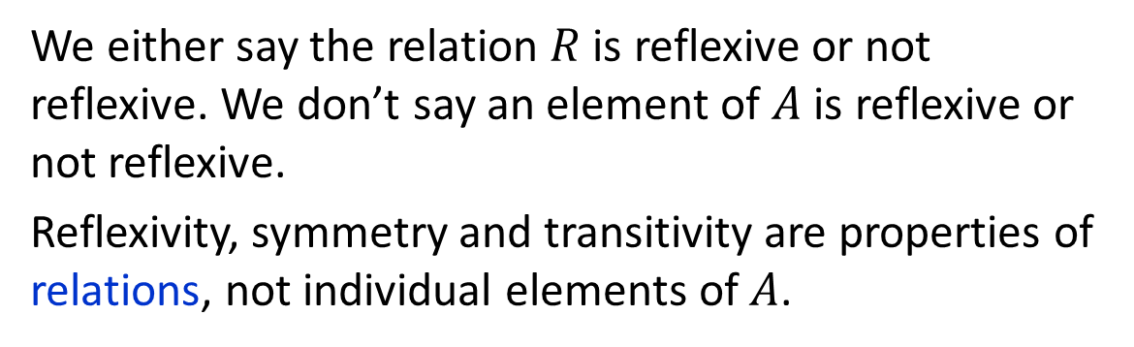
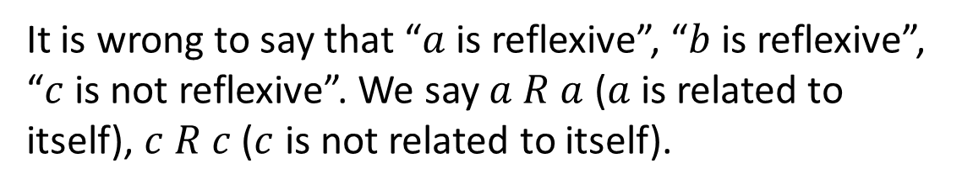
Given a set $A=\{a,b,c\}$and a relation defined on $A$ as follows.
Common mistake
It is wrong to say that “$a$ is reflexive”, “$b$ is reflexive”, “$c$ is not reflexive”. We say $a R a$ ($a$ is related to itself), $c R c$ ($c$ is not related to itself).
$$R$$
$$a$$
$$b$$
We either say the relation $R$ is reflexive or not reflexive. We don’t say an element of $A$ is reflexive or not reflexive.
Reflexivity, symmetry and transitivity are properties of relations, not individual elements of $A$.
$$c$$

Slide 12
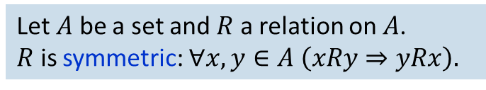
Given a set $A=\{a,b,c\}$and a relation defined on $A$ as follows.
Which of the relations below are SYMMETRIC?
Let $A$ be a set and $R$ a relation on $A$.
$R$ is symmetric: $∀x,y∈A \left(xRy⇒yRx\right).$
$$R_{1}$$
$$R_{2}$$
$$R_{3}$$
$$R_{4}$$
$$a$$
$$b$$
$$a$$
$$b$$
$$a$$
$$b$$
$$a$$
$$b$$
$$c$$
$$c$$
$$c$$
$$c$$
$$a$$
$$b$$
$$a$$
$$b$$
$$a$$
$$b$$
$$a$$
$$b$$
$$c$$
$$c$$
$$c$$
$$c$$
$$R_{5}$$
$$R_{6}$$
$$R_{7}$$
$$R_{8}$$

Slide 13
Given a set $A=\{a,b,c\}$and a relation defined on $A$ as follows.
Which of the relations below are SYMMETRIC?
Let $A$ be a set and $R$ a relation on $A$.
$R$ is symmetric: $∀x,y∈A \left(xRy⇒yRx\right).$
$$R_{1}$$
$$R_{2}$$
$$R_{3}$$
$$R_{4}$$
$$a$$
$$b$$
$$a$$
$$b$$
$$a$$
$$b$$
$$a$$
$$b$$
$$c$$
$$c$$
$$c$$
$$c$$
$$a$$
$$b$$
$$a$$
$$b$$
$$a$$
$$b$$
$$a$$
$$b$$
$$c$$
$$c$$
$$c$$
$$c$$
$$R_{5}$$
$$R_{6}$$
$$R_{7}$$
$$R_{8}$$

Slide 14
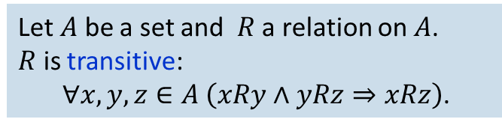
Given a set $A=\{a,b,c\}$and a relation defined on $A$ as follows.
Let $A$ be a set and $R$ a relation on $A$.
$R$ is transitive:
$∀x,y,z∈A \left(xRy∧yRz⇒xRz\right)$.
Which of the relations below are TRANSITIVE?
$$R_{1}$$
$$R_{2}$$
$$R_{3}$$
$$R_{4}$$
$$a$$
$$b$$
$$a$$
$$b$$
$$a$$
$$b$$
$$a$$
$$b$$
$$c$$
$$c$$
$$c$$
$$c$$
$$a$$
$$b$$
$$a$$
$$b$$
$$a$$
$$b$$
$$a$$
$$b$$
$$c$$
$$c$$
$$c$$
$$c$$
$$R_{5}$$
$$R_{6}$$
$$R_{7}$$
$$R_{8}$$

Slide 15
Given a set $A=\{a,b,c\}$and a relation defined on $A$ as follows.
Let $A$ be a set and $R$ a relation on $A$.
$R$ is transitive:
$∀x,y,z∈A \left(xRy∧yRz⇒xRz\right)$.
Which of the relations below are TRANSITIVE?
$$R_{1}$$
$$R_{2}$$
$$R_{3}$$
$$R_{4}$$
$$a$$
$$b$$
$$a$$
$$b$$
$$a$$
$$b$$
$$a$$
$$b$$
$$c$$
$$c$$
$$c$$
$$c$$
$$a$$
$$b$$
$$a$$
$$b$$
$$a$$
$$b$$
$$a$$
$$b$$
$$c$$
$$c$$
$$c$$
$$c$$
$$R_{5}$$
$$R_{6}$$
$$R_{7}$$
$$R_{8}$$

Slide 16

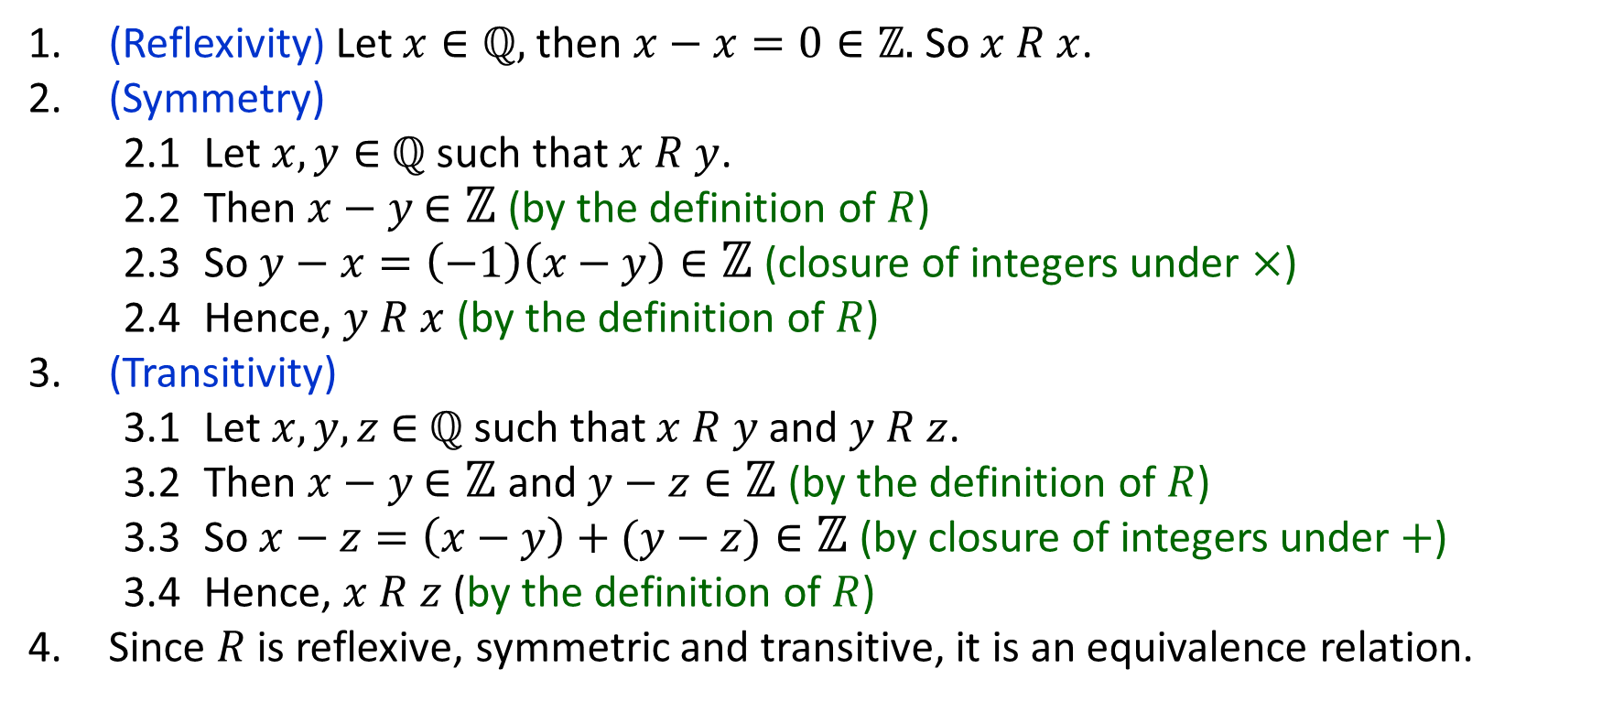
Q4. Define a relation $R$ on $ℚ$ as follows
$$x R y ⟺x−y∈ℤ$$
(a) Show that $R$ is an equivalence relation.
1. (Reflexivity) Let $x∈ℚ,$then $x−x=0∈ℤ.$So $x R x$.
2. (Symmetry)
2.1 Let $x, y∈$ $ℚ$ such that $x R y$.
2.2 Then $x−y$ $∈ℤ$ (by the definition of $R$)
2.3 So $y−x=\left(−1\right)\left(x−y\right)∈ℤ$ (closure of integers under $×$)
2.4 Hence, $y R x$ (by the definition of $R$)
3. (Transitivity)
3.1 Let $x,y,z$ $∈$ $ℚ$ such that $x R y$ and $y R z$.
3.2 Then $x−y$ $∈ℤ$ and $y−z∈ℤ$ (by the definition of $R$)
3.3 So $x−z=\left(x−y\right)+(y−z)∈ℤ$ (by closure of integers under $+$)
3.4 Hence, $x R z$ (by the definition of $R$)
4. Since $R$ is reflexive, symmetric and transitive, it is an equivalence relation.

Slide 17
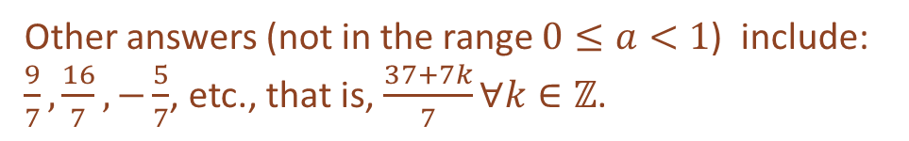
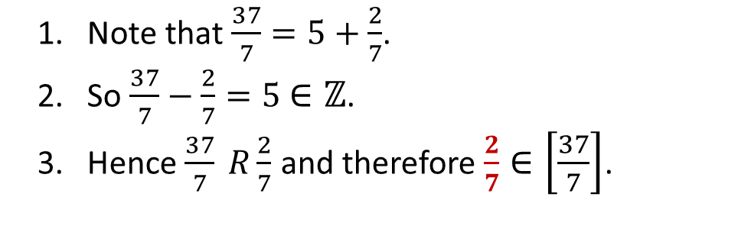
Q4. Define a relation $R$ on $ℚ$ as follows
$$x R y ⟺x−y∈ℤ$$
(b) Find an element $a$ in the equivalence class $\left[\frac{37}{7}\right]$ that satisfies $0≤a<1.$
Idea: Look for a rational number $r$ such that $\frac{37}{7}−r$ is an integer.
1. Note that $\frac{37}{7}=5+\frac{2}{7}$.
2. So $\frac{37}{7}−\frac{2}{7}=5$ $∈ℤ$.
3. Hence $\frac{37}{7} R\frac{2}{7}$ and therefore $\frac{2}{7}∈\left[\frac{37}{7}\right]$.
Other answers (not in the range $0≤a<1$) include: $\frac{9}{7},\frac{16}{7},−\frac{5}{7}$, etc., that is, $\frac{37+7k}{7}∀k∈ℤ$.

Slide 18
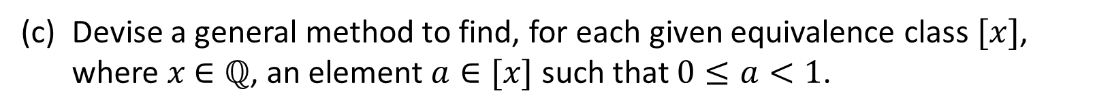
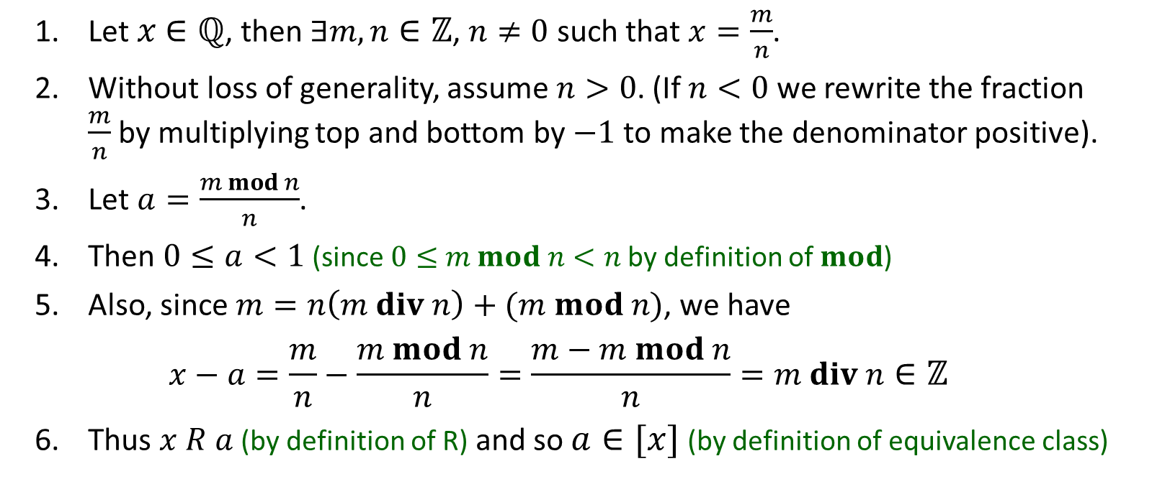
Q4. Define a relation $R$ on $ℚ$ as follows
$$x R y ⟺x−y∈ℤ$$
(c) Devise a general method to find, for each given equivalence class $[x]$, where $x$ $∈ℚ$, an element $a∈[x]$ such that $0≤a<1$.
1. Let $x$ $∈ℚ$, then $∃m,n∈ℤ$, $n≠0$ such that $x=\frac{m}{n}$.
2. Without loss of generality, assume $n>0$. (If $n<0$ we rewrite the fraction $\frac{m}{n}$by multiplying top and bottom by $−1$to make the denominator positive).
3. Let $a=\frac{m mod n}{n}$.
4. Then $0≤a<1$ (since $0≤$ $m mod n<n$ by definition of $mod$)
5. Also, since $m=n\left(m div n\right)+(m mod n)$, we have
$$x−a=\frac{m}{n}−\frac{m mod n}{n}=\frac{m−m mod n}{n}=m div n∈ℤ$$
6. Thus $x R a$ (by definition of R) and so $a∈[x]$ (by definition of equivalence class)

Slide 19

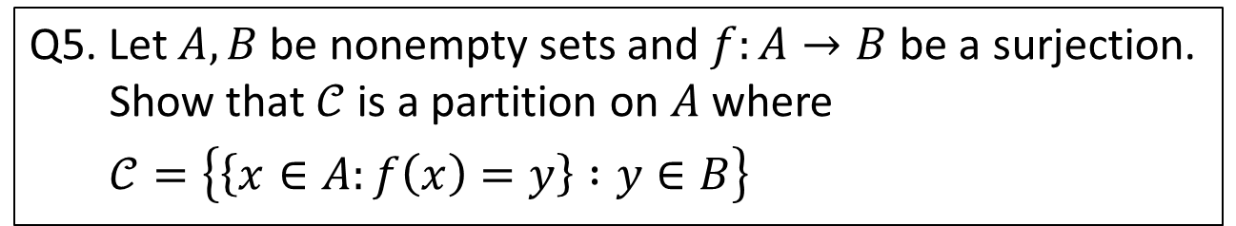
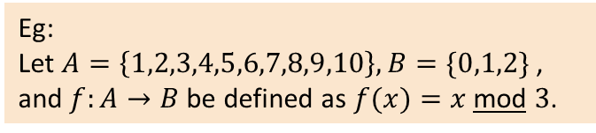
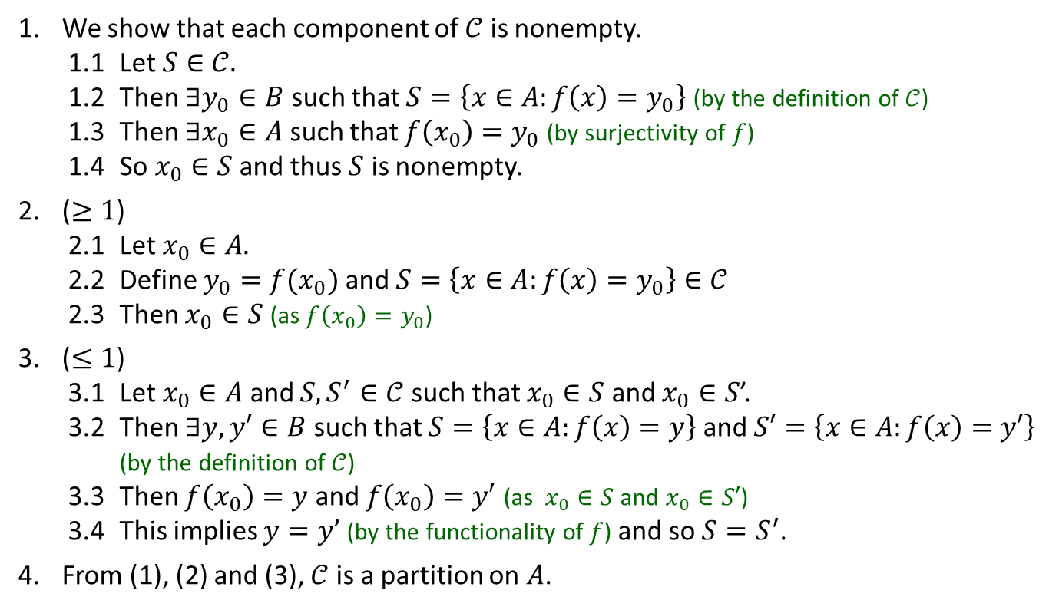
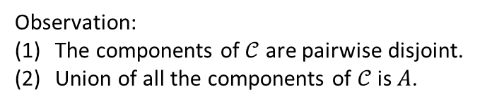
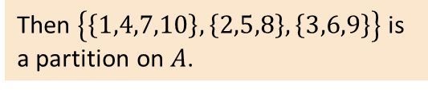
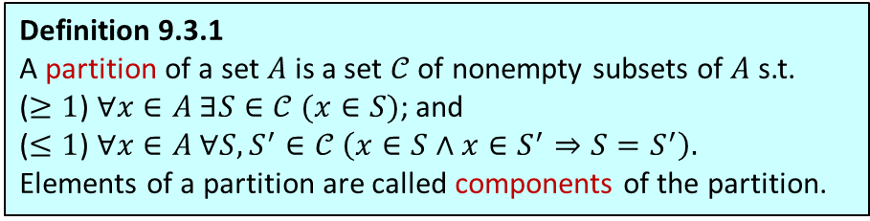

Observation:
(1) The components of $𝒞$ are pairwise disjoint.
(2) Union of all the components of $𝒞$ is $A$.
Q5. Let $A, B$ be nonempty sets and $f:A→B$ be a surjection. Show that $𝒞$ is a partition on $A$ where
$$𝒞=\left\{\left\{x∈A:f\left(x\right)=y\right\} :y∈B\right\}$$
Definition 9.3.1
A partition of a set $A$ is a set $𝒞$ of nonempty subsets of $A$ s.t.
($≥1$) $∀x∈A ∃S∈𝒞 (x∈S)$; and
($≤1$) $∀x∈A ∀S,S^{′}∈𝒞 \left(x∈S∧x∈S^{′}⇒S=S^{′}\right).$
Elements of a partition are called components of the partition.
1. We show that each component of $𝒞$ is nonempty.
1.1 Let $S∈𝒞.$
1.2 Then $∃y_{0}∈B$ such that $S=\left\{x∈A:f\left(x\right)=y_{0}\right\}$ (by the definition of $𝒞$)
1.3 Then $∃x_{0}∈A$ such that $f\left(x_{0}\right)=y_{0}$ (by surjectivity of $f$)
1.4 So $x_{0}∈S$ and thus $S$ is nonempty.
2. ($≥1$)
2.1 Let $x_{0}∈A.$
2.2 Define $y_{0}=f(x_{0})$ and $S=\left\{x∈A:f\left(x\right)=y_{0}\right\}∈𝒞$
2.3 Then $x_{0}∈S$ (as $f\left(x_{0}\right)=y_{0}$)
3. ($≤1$)
3.1 Let $x_{0}∈A$ and $S,S^{′}∈𝒞$ such that $x_{0}∈S$ and $x_{0}∈S$’.
3.2 Then $∃y,y′∈B$ such that $S=\left\{x∈A:f\left(x\right)=y\right\}$ and $S′=\left\{x∈A:f\left(x\right)=y′\right\}$ (by the definition of $𝒞$)
3.3 Then $f\left(x_{0}\right)=y$ and $f\left(x_{0}\right)=y′$ (as $x_{0}∈S$ and $x_{0}∈S′$)
3.4 This implies $y=y’$ (by the functionality of $f$) and so $S=S^{′}$.
4. From (1), (2) and (3), $𝒞$ is a partition on $A$.
Eg:
Let $A=\left\{1,2,3,4,5,6,7,8,9,10\right\},B=\{0,1,2\}$, and $f:A→B$ be defined as $f(x)=x$mod $3$.
$$A$$
$$B$$
1
2
3
4
5
6
7
8
9
10
•
•
•
•
•
•
•
•
•
•
0
1
2
These map to 1.
These map to 2.
These map to 0.
Then $\left\{\left\{1,4,7,10\right\},\left\{2,5,8\right\},\left\{3,6,9\right\}\right\}$ is a partition on $A$.
That is, the preimages of 0,1,2 form the respective components of the partition.

Slide 20
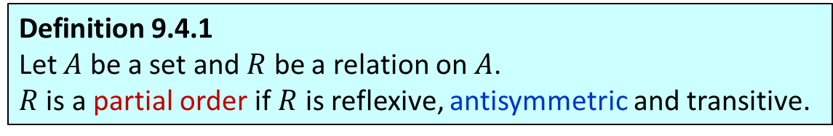
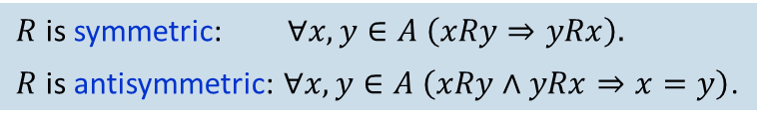
Partial orders
Definition 9.4.1
Let $A$ be a set and $R$ be a relation on $A$.
$R$ is a partial order if $R$ is reflexive, antisymmetric and transitive.
$R$ is symmetric: $∀x,y∈A \left(xRy⇒yRx\right).$
$R$ is antisymmetric: $∀x,y∈A \left(xRy∧yRx⇒x=y\right)$.
$$R_{1}$$
$$R_{2}$$
$$R_{3}$$
$$R_{4}$$
$$a$$
$$b$$
$$a$$
$$b$$
$$a$$
$$b$$
$$a$$
$$b$$
Anti-symmetric
Anti-symmetric
Anti-symmetric
Anti-symmetric
Symmetric
Symmetric
Symmetric
Symmetric
$$c$$
$$c$$
$$c$$
$$c$$
$$a$$
$$b$$
$$a$$
$$b$$
$$a$$
$$b$$
$$a$$
$$b$$
Anti-symmetric
Anti-symmetric
Anti-symmetric
Anti-symmetric
Symmetric
$$c$$
Symmetric
$$c$$
Symmetric
$$c$$
Symmetric
$$c$$
$$R_{5}$$
$$R_{6}$$
$$R_{7}$$
$$R_{8}$$

Slide 21
Partial orders
Definition 9.4.1
Let $A$ be a set and $R$ be a relation on $A$.
$R$ is a partial order if $R$ is reflexive, antisymmetric and transitive.
$R$ is symmetric: $∀x,y∈A \left(xRy⇒yRx\right).$
$R$ is antisymmetric: $∀x,y∈A \left(xRy∧yRx⇒x=y\right)$.
$$R_{1}$$
$$R_{2}$$
$$R_{3}$$
$$R_{4}$$
$$a$$
$$b$$
$$a$$
$$b$$
$$a$$
$$b$$
$$a$$
$$b$$
Anti-symmetric
Anti-symmetric
Anti-symmetric
Anti-symmetric
Symmetric
Symmetric
Symmetric
Symmetric
$$c$$
$$c$$
$$c$$
$$c$$
$$a$$
$$b$$
$$a$$
$$b$$
$$a$$
$$b$$
$$a$$
$$b$$
Anti-symmetric
Anti-symmetric
Anti-symmetric
Anti-symmetric
Symmetric
$$c$$
Symmetric
$$c$$
Symmetric
$$c$$
Symmetric
$$c$$
$$R_{5}$$
$$R_{6}$$
$$R_{7}$$
$$R_{8}$$

Slide 22
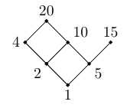
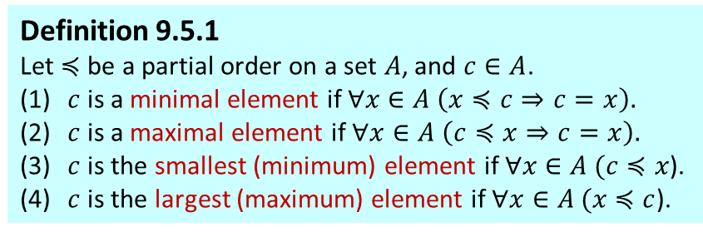

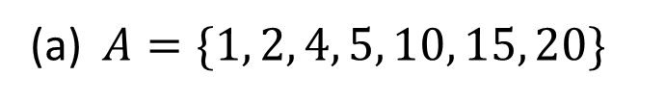
Q6. Considering the “divides” relation of each of the following sets of integers, draw a Hasse diagram and find all largest, smallest, maximal and minimal elements, and a linearization.
(a) $A=\{1, 2, 4, 5, 10, 15, 20\}$
Note that the “divides” relation on integers is a partial order.
Definition 9.5.1
Let $≼$ be a partial order on a set $A$, and $c∈A$.
(1) $c$ is a minimal element if $∀x∈A \left(x≼c⇒c=x\right).$
(2) $c$ is a maximal element if $∀x∈A \left(c≼x⇒c=x\right).$
(3) $c$ is the smallest (minimum) element if $∀x∈A (c$ $≼x$).
(4) $c$ is the largest (maximum) element if $∀x∈A (x$ $≼c$).
Largest element
No largest
Smallest element
1
Maximal elements
20 and 15
Minimal elements
1
Linearization
$≤$ on $A$ (i.e. 1, 2, 4, 5, 10, 15, 20)
Many other answers: 1,2,4,5,10,20,15; or 1,5,2,10,15,4,20; or 1,2,5,10,15,4,20; etc.

Slide 23
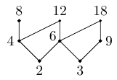
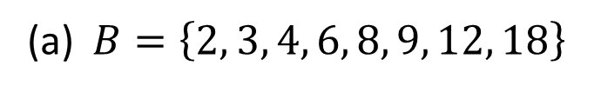
Q6. Considering the “divides” relation of each of the following sets of integers, draw a Hasse diagram and find all largest, smallest, maximal and minimal elements, and a linearization.
(a) $B=\left\{2, 3, 4, 6, 8, 9, 12, 18\right\}$
Definition 9.5.1
Let $≼$ be a partial order on a set $A$, and $c∈A$.
(1) $c$ is a minimal element if $∀x∈A \left(x≼c⇒c=x\right).$
(2) $c$ is a maximal element if $∀x∈A \left(c≼x⇒c=x\right).$
(3) $c$ is the smallest (minimum) element if $∀x∈A (c$ $≼x$).
(4) $c$ is the largest (maximum) element if $∀x∈A (x$ $≼c$).
Largest element
No largest
Smallest element
No smallest
Maximal elements
8, 12 and 18
Minimal elements
2 and 3
Linearization
$≤$ on $B$ (i.e. 2, 3, 4, 6, 8, 9, 12, 18)
Many other answers: 2,3,9,6,4,12,18,8; or 3,2,4,8,9,18,6,12; or 3,2,6,9,18,12,4,8; etc.

Slide 24
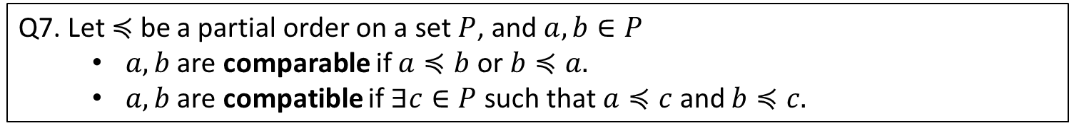
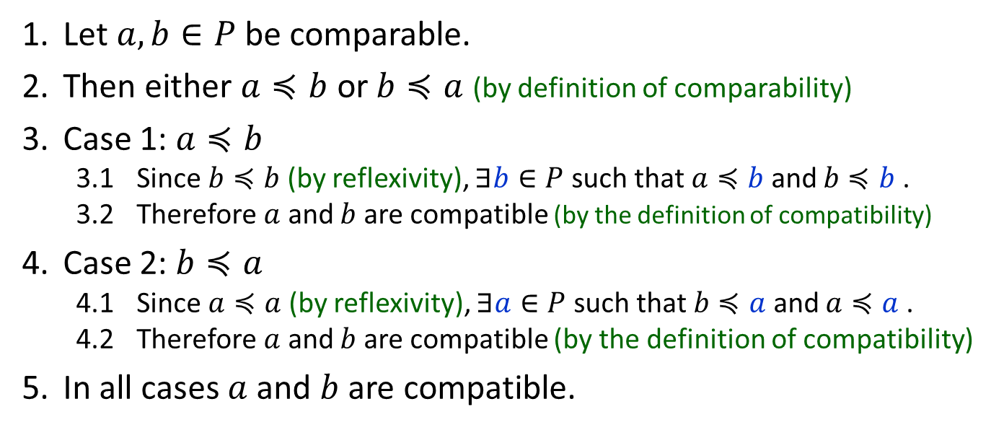
Q7. Let $≼$ be a partial order on a set $P$, and $a, b∈P$
$a, b$ are comparable if $a≼b$ or $b≼a.$
$a,b$ are compatible if $∃c∈P$ such that $a≼c$ and $b≼c.$
(a) Is it true that in all partially ordered sets, any two comparable elements are compatible?
YES
1. Let $a, b∈P$ be comparable.
2. Then either $a≼b$ or $b≼a$ (by definition of comparability)
3. Case 1: $a≼b$
3.1 Since $b≼b$ (by reflexivity), $∃b∈P$ such that $a≼b$ and $b≼b$ .
3.2 Therefore $a$ and $b$ are compatible (by the definition of compatibility)
4. Case 2: $b≼a$
4.1 Since $a≼a$ (by reflexivity), $∃a∈P$ such that $b≼a$ and $a≼a$ .
4.2 Therefore $a$ and $b$ are compatible (by the definition of compatibility)
5. In all cases $a$ and $b$ are compatible.

Slide 25
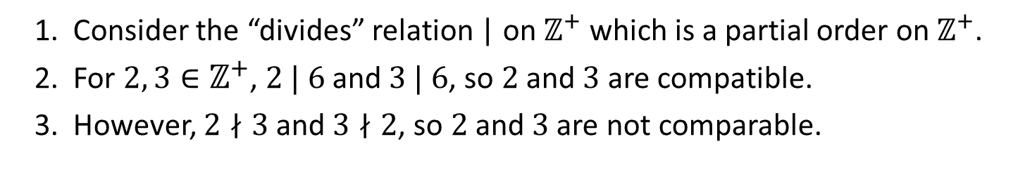
Q7. Let $≼$ be a partial order on a set $P$, and $a, b∈P$
$a, b$ are comparable if $a≼b$ or $b≼a.$
$a,b$ are compatible if $∃c∈P$ such that $a≼c$ and $b≼c.$
(b) Is it true that in all partially ordered sets, any two compatible elements are comparable?
NO
1. Consider the “divides” relation | on $ℤ^{+}$ which is a partial order on $ℤ^{+}$.
2. For $2, 3∈ℤ^{+}$, $2 | 6$ and $3 | 6$, so $2$and $3$ are compatible.
3. However, $2∤3$ and $3∤2$, so $2$and $3$ are not comparable.

Slide 26
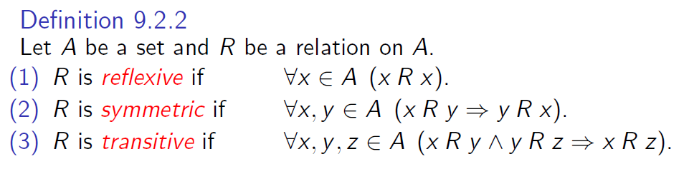
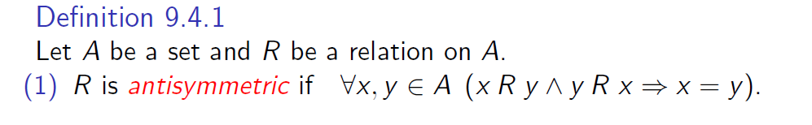
Bonus question

Slide 27
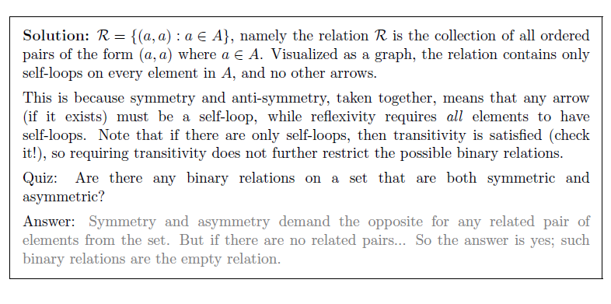

Bonus question

Slide 28
END OF FILE

