Slide 1
CS1231S
CS1231 Past Year’s Paper
AY2018/19 Sem1

Slide 2

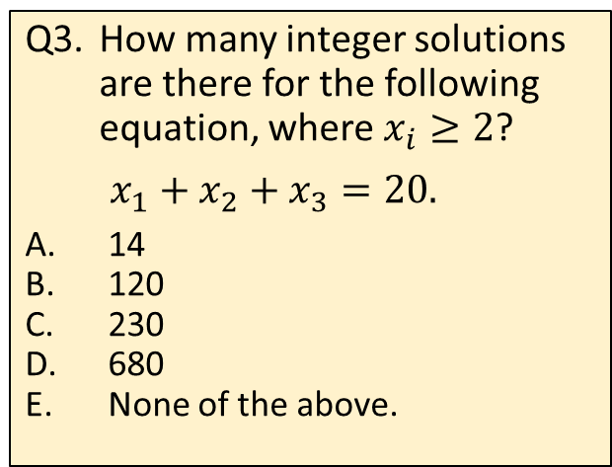
MCQs
Q2. Which of the following arguments is valid?
(I) No mammals lay eggs.
Duck-billed platypus lay eggs.
∴ duck-billed platypus is not a mammal.
(II) You get A grade iff you get > 90 marks.
If you fail your midterm, you don’t get > 90 marks.
∴ if you don’t fail your midterm, you get A grade.
(III) Water is a necessary condition for air.
Water is a sufficient condition for ice.
∴ air only if ice.
(I) only.
(I) and (II) only.
(I) and (III) only.
(II) and (III) only.
All of (I), (II) and (III).
Q1. How many permutations are there for this 8-letter word “ICanDoIt”?
7!
(8/2)!
8!
8!/2
8×7
Q3. How many integer solutions are there for the following equation, where $x_{i}≥2$?
$$x_{1}+x_{2}+x_{3}=20.$$
14
120
230
680
None of the above.
$y_{1}+y_{2}+y_{3}=14$where $y_{i}≥0$.
$$n=3, r=14$$
$$\left({r+n−1 \atop r}\right)=\left({16 \atop 14}\right)=120$$

Slide 3
MCQs
Q4. What is the total weight of the MST of the graph on the right?
39
47
50
55
60
3
21
Kruskal’s algorithm
2
4
7
12
6
15
10
8
9
18
14
Q5. Which of the following statements are TRUE about the graph above?
The graph contains an Euler circuit.
The graph contains an Euler trail but not an Euler circuit.
The graph does not contain an Euler trail nor an Euler circuit.
The graph does not contain a Hamiltonian circuit.
None of the above.

Slide 4
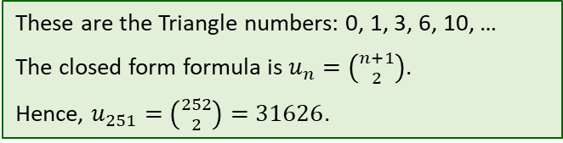
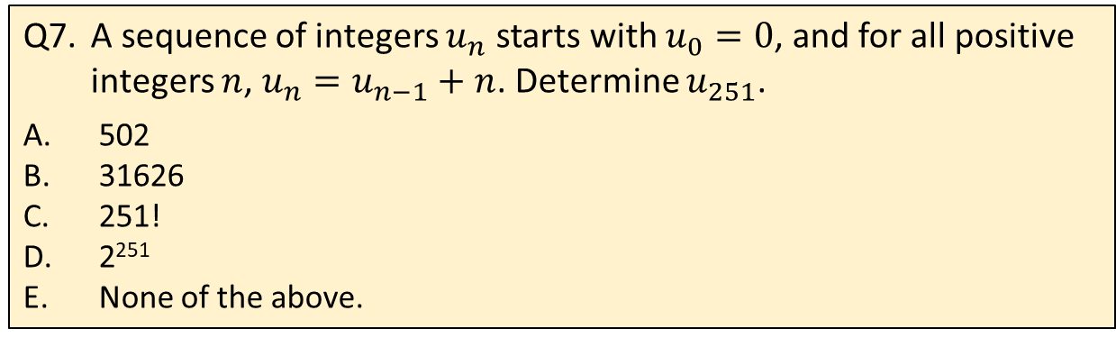
MCQs
Q6. The preorder traversal and inorder traversal of a binary tree with vertices A, B, C, D, E, F, G, H, I, J, K and L are given below:
Preorder: A B D G I J C E H J L F
Inorder: D I G J B A E K H L C F
What is the postorder traversal of this binary tree?
A B C D E F G H I J K L
L K J I H G F E D C B A
I J G D B K L H E C F A
I J G D B K L H E F C A
None of the above.
A
B
C
D
E
F
G
H
I
J
K
L
Q7. A sequence of integers $u_{n}$ starts with $u_{0}=0$, and for all positive integers $n$, $u_{n}=u_{n−1}+n$. Determine $u_{251}$.
502
31626
251!
2²⁵¹
None of the above.
These are the Triangle numbers: 0, 1, 3, 6, 10, …
The closed form formula is $u_{n}=\left({n+1 \atop 2}\right)$.
Hence, $u_{251}=\left({252 \atop 2}\right)=31626$.

Slide 5
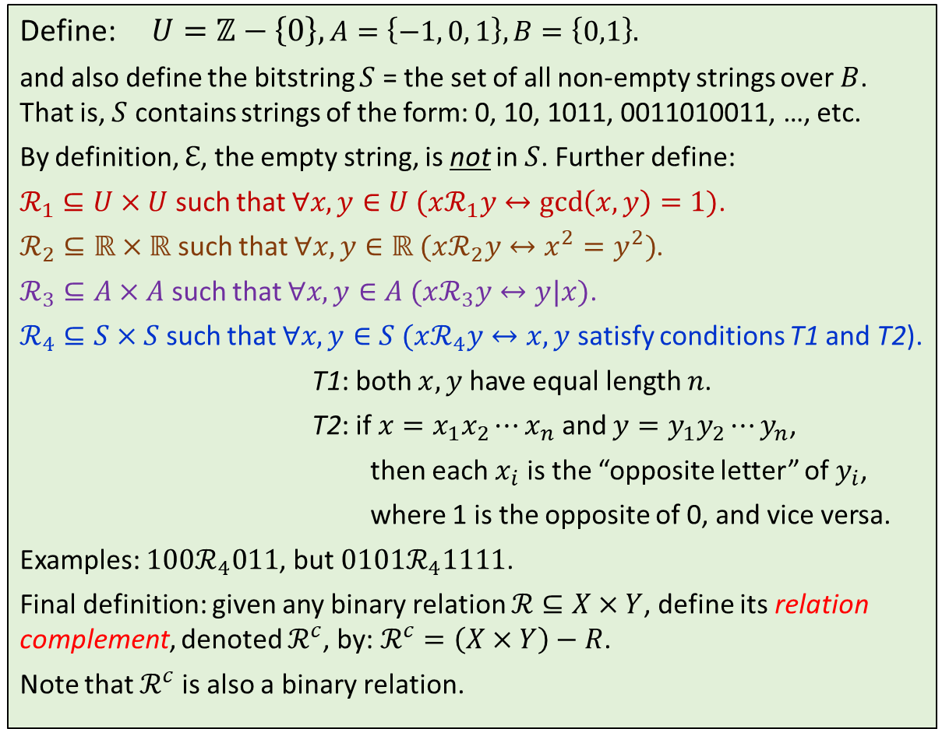
MCQs (Q8 – Q13)
Define: $U=ℤ−\left\{0\right\}, A=\left\{−1, 0, 1\right\}, B=\left\{0,1\right\}.$
and also define the bitstring $S$ = the set of all non-empty strings over $B$. That is, $S$ contains strings of the form: 0, 10, 1011, 0011010011, …, etc.
By definition, $ℇ$, the empty string, is not in $S$. Further define:
$ℛ_{1}⊆U×U$ such that $∀x,y∈U (xℛ_{1}y↔\gcd\left(x,y\right)=1)$.
$ℛ_{2}⊆ℝ×ℝ$ such that $∀x,y∈ℝ (xℛ_{2}y↔x^{2}=y^{2})$.
$ℛ_{3}⊆A×A$ such that $∀x,y∈A (xℛ_{3}y↔y|x)$.
$ℛ_{4}⊆S×S$ such that $∀x,y∈S (xℛ_{4}y↔x,y$ satisfy conditions T1 and T2).
T1: both $x,y$ have equal length $n$.
T2: if $x=x_{1}x_{2}⋯x_{n}$ and $y=y_{1}y_{2}⋯y_{n}$,
then each $x_{i}$ is the “opposite letter” of $y_{i}$,
where 1 is the opposite of 0, and vice versa.
Examples: $100ℛ_{4}011$, but $0101ℛ_{4}1111$.
Final definition: given any binary relation $ℛ⊆X×Y$, define its relation complement, denoted $ℛ^{c}$, by: $ℛ^{c}=\left(X×Y\right)−R$.
Note that $ℛ^{c}$ is also a binary relation.

Slide 6
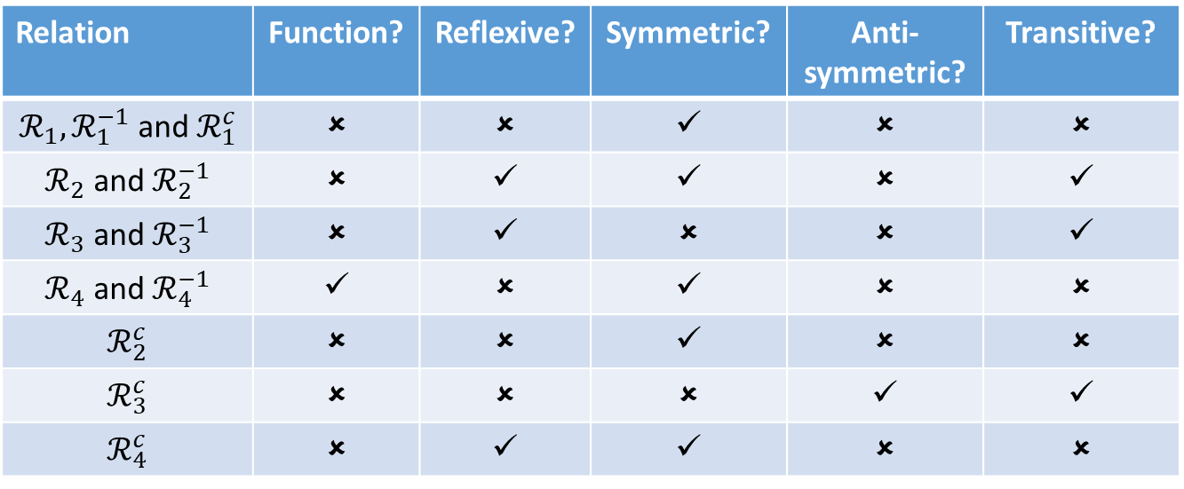
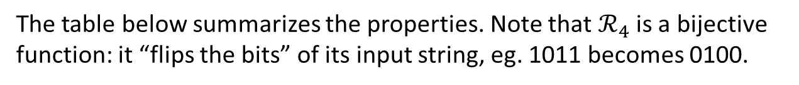



MCQs (Q8 – Q13)
The table below summarizes the properties. Note that $ℛ_{4}$ is a bijective function: it “flips the bits” of its input string, eg. 1011 becomes 0100.
Relation | Function? | Reflexive? | Symmetric? | Anti-symmetric? | Transitive?
$ℛ_{1},ℛ_{1}^{−1}$ and $ℛ_{1}^{c}$ | ✗ | ✗ | ✓ | ✗ | ✗
$ℛ_{2}$ and $ℛ_{2}^{−1}$ | ✗ | ✓ | ✓ | ✗ | ✓
$ℛ_{3}$ and $ℛ_{3}^{−1}$ | ✗ | ✓ | ✗ | ✗ | ✓
$ℛ_{4}$ and $ℛ_{4}^{−1}$ | ✓ | ✗ | ✓ | ✗ | ✗
$$ℛ_{2}^{c}$$ | ✗ | ✗ | ✓ | ✗ | ✗
$$ℛ_{3}^{c}$$ | ✗ | ✗ | ✗ | ✓ | ✓
$$ℛ_{4}^{c}$$ | ✗ | ✓ | ✓ | ✗ | ✗
-1
1
-1
1
-1
1
0
0
0
$$ℛ_{3}$$
$$ℛ_{3}^{−1}$$
$$ℛ_{3}^{C}$$

Slide 7
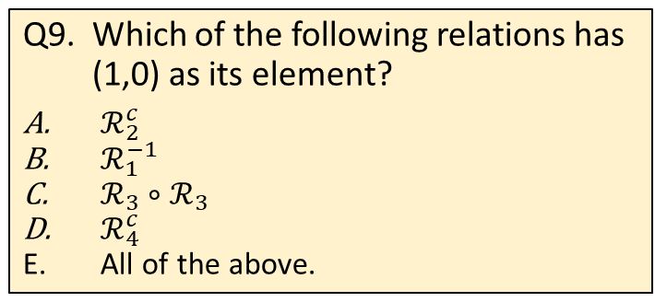
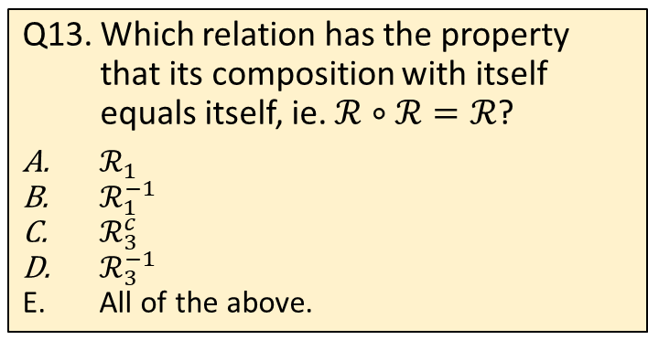
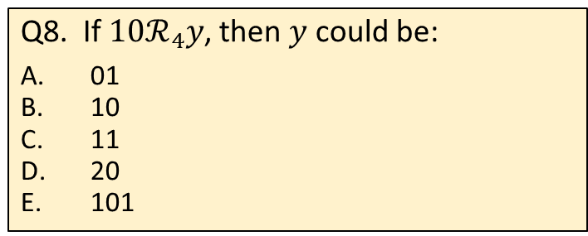
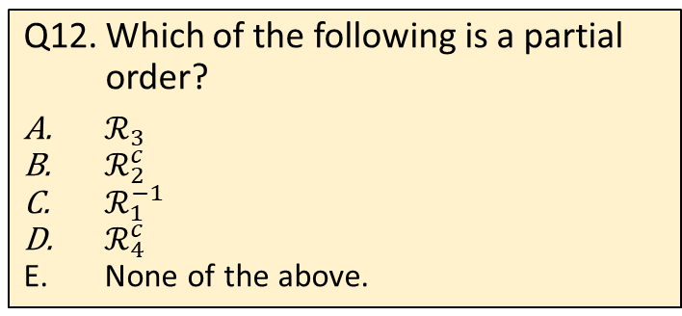
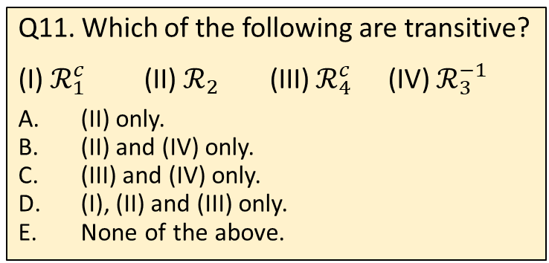
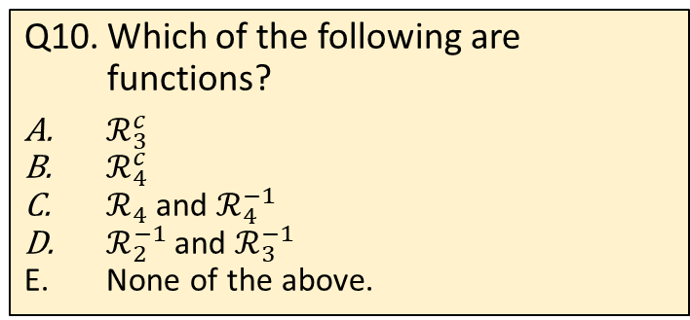
MCQs
Q11. Which of the following are transitive?
(I) $ℛ_{1}^{c}$ (II) $ℛ_{2}$ (III) $ℛ_{4}^{c}$ (IV) $ℛ_{3}^{−1}$
(II) only.
(II) and (IV) only.
(III) and (IV) only.
(I), (II) and (III) only.
None of the above.
Q8. If $10ℛ_{4}y$, then $y$ could be:
01
10
11
20
101
Q9. Which of the following relations has (1,0) as its element?
$ℛ_{2}^{c}$
$ℛ_{1}^{−1}$
$ℛ_{3}∘ℛ_{3}$
$ℛ_{4}^{c}$
All of the above.
Q12. Which of the following is a partial order?
$ℛ_{3}$
$ℛ_{2}^{c}$
$ℛ_{1}^{−1}$
$ℛ_{4}^{c}$
None of the above.
Q10. Which of the following are functions?
$ℛ_{3}^{c}$
$ℛ_{4}^{c}$
$ℛ_{4}$ and $ℛ_{4}^{−1}$
$ℛ_{2}^{−1}$ and $ℛ_{3}^{−1}$
None of the above.
Q13. Which relation has the property that its composition with itself equals itself, ie. $ℛ∘ℛ=ℛ$?
$ℛ_{1}$
$ℛ_{1}^{−1}$
$ℛ_{3}^{c}$
$ℛ_{3}^{−1}$
All of the above.

Slide 8
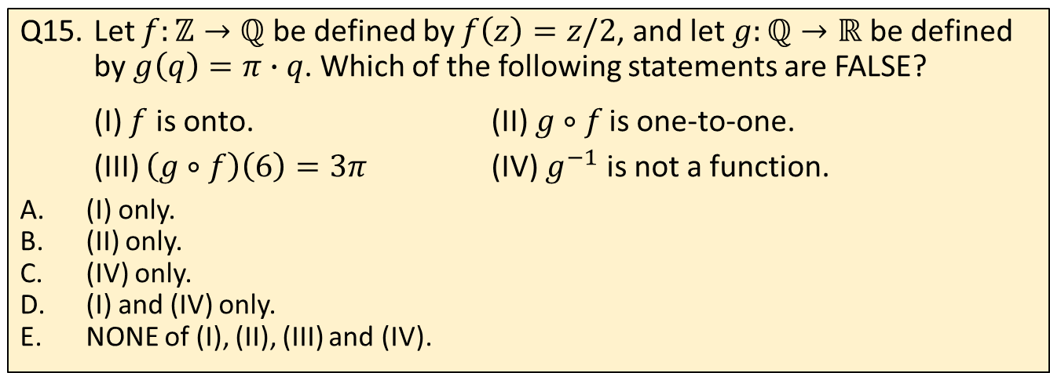
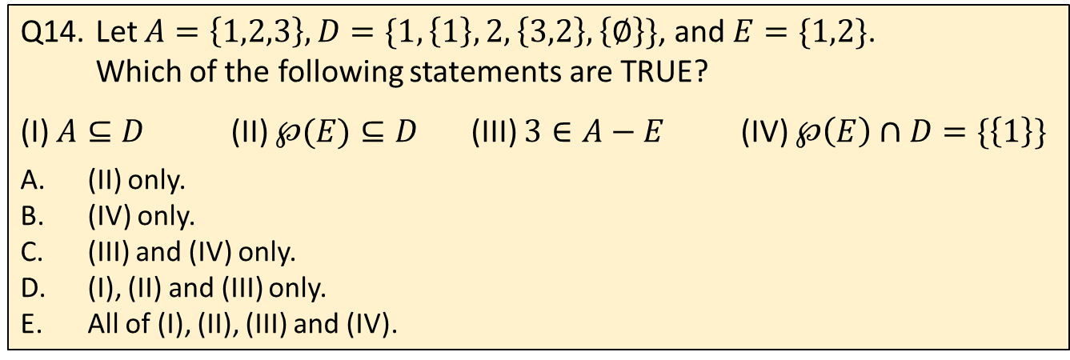
MCQs
Q14. Let $A=\left\{1,2,3\right\}, D=\{1,\left\{1\right\},2,\left\{3,2\right\},\left\{∅\right\}\}$, and $E=\{1,2\}$. Which of the following statements are TRUE?
(I) $A⊆D$ (II) $℘(E)⊆D$ (III) $3∈A−E$ (IV) $℘\left(E\right)∩D=\{\left\{1\right\}\}$
(II) only.
(IV) only.
(III) and (IV) only.
(I), (II) and (III) only.
All of (I), (II), (III) and (IV).
Q15. Let $f:ℤ→ℚ$ be defined by $f\left(z\right)=z/2$, and let $g:ℚ→ℝ$ be defined by $g\left(q\right)=π∙q$. Which of the following statements are FALSE?
(I) $f$ is onto. (II) $g∘f$ is one-to-one.
(III) $\left(g∘f\right)\left(6\right)=3π$ (IV) $g^{−1}$ is not a function.
(I) only.
(II) only.
(IV) only.
(I) and (IV) only.
NONE of (I), (II), (III) and (IV).

Slide 9

Q16
(a) What is the probability that on three rolls of a fair six-sided die, at least one 6 shows up? Leave your answer as a fraction.
Let p be the probability that 6 shows up on a roll of a die; p = 1/6.
P(6 does not show up on all 3 rolls) = 5/6 × 5/6 × 5/6 =125/216.
P(at least one 6 shows up on three rolls) = 1 – 125/216 = 91/216.
(b) The figure below shows a combination lock with 40 positions. To open the lock, you rotate to a number in the clockwise direction, then to a second number in the counterclockwise direction, and finally to a third number in the clockwise direction. If consecutive numbers in the combination cannot be the same, how many combinations of three-number codes are there?
40 × 39 × 39 = 60840.

Slide 10
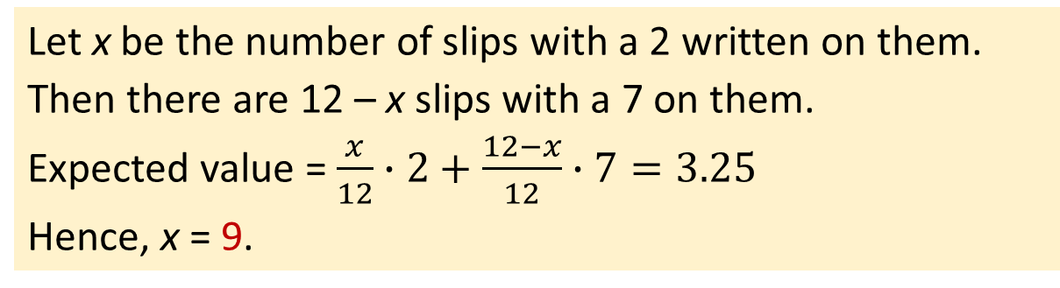
Q16
(c) There are 12 slips of paper in a bag. Some of the slips have a 2 written on them, and the rest have a 7 written on them. If the expected value of the number shown on a slip randomly drawn from the bag is 3.25, how many slips have a 2 written on them?
Let x be the number of slips with a 2 written on them.
Then there are 12 – x slips with a 7 on them.
Expected value = $\frac{x}{12}∙2+\frac{12−x}{12}∙7=3.25$
Hence, x = 9.

Slide 11
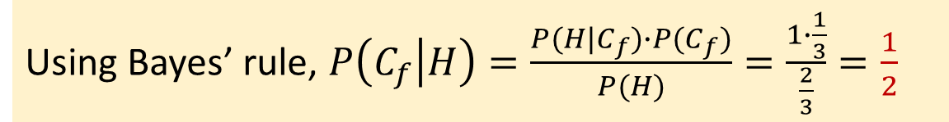
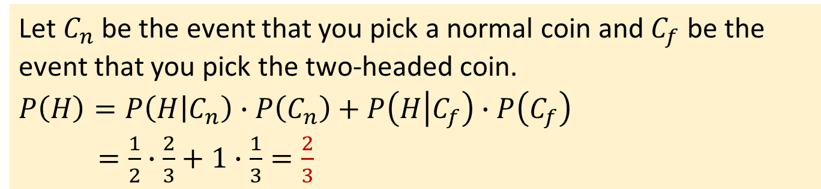
Q16
(d) A bowl contains three coins. Two of them are normal coins and one of them is a two-headed coin.
(i) You pick one coin at random and toss it. What is the probability that you get a head? Write your answer as a fraction.
Let $C_{n}$ be the event that you pick a normal coin and $C_{f}$ be the event that you pick the two-headed coin.
$$P\left(H\right)=P\left(H | C_{n}\right)∙P\left(C_{n}\right)+P\left(H | C_{f}\right)∙P\left(C_{f}\right)$$
$=\frac{1}{2}∙\frac{2}{3}+1∙\frac{1}{3}=\frac{2}{3}$
(ii) You pick one coin at random, toss it and get a head. What is the probability that the coin is a two-headed coin? Write your answer as a fraction.
Using Bayes’ rule, $P\left(C_{f} | H\right)=\frac{P(H|C_{f})∙P(C_{f})}{P(H)}=\frac{1∙\frac{1}{3}}{\frac{2}{3}}=\frac{1}{2}$

Slide 12
Q16
(e) A row of houses are randomly assigned distinct numbers between 1 and 50 inclusive. What is the minimum number of houses to ensure that there are 5 houses numbered consecutively.
Split the 50 number into ten pigeon-holes: 1-5, 6-10, 11-15, 16-20, 21-25, 26-30, 31-35, 35-40, 41-45, 46-50.
Therefore, there must be at least 10×4 + 1 = 41 houses (pigeons).

Slide 13
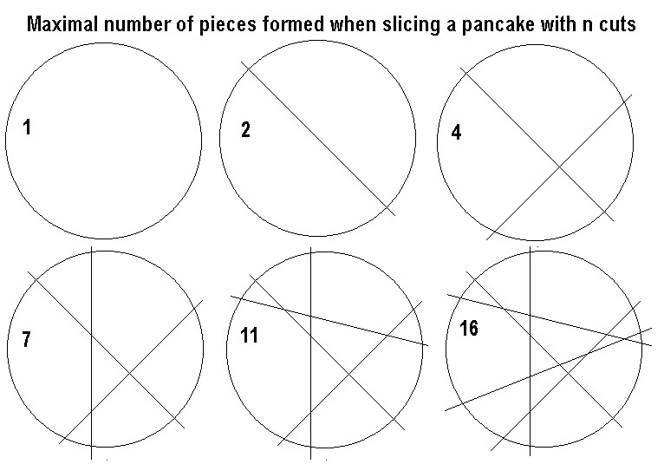
Q17
The lazy caterer’s sequence describes the number of maximum pieces of a pancake that can be made with a given number of straight cuts.

Slide 14
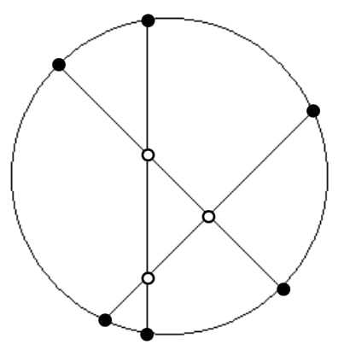
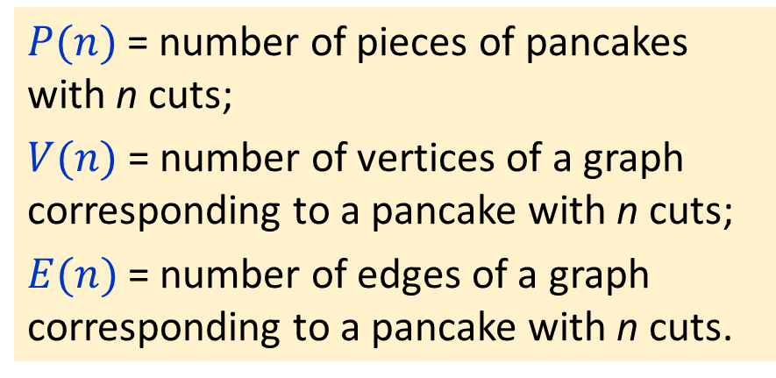
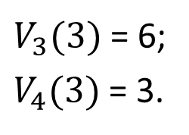
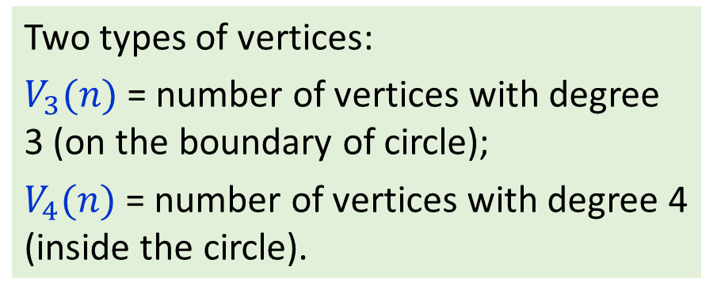
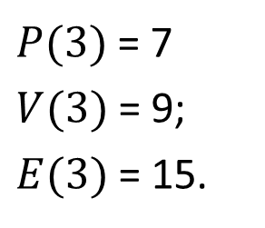
Q17
Graph corresponding to n=3, where the vertices are the intersections among the cuts and the boundary of the pancake.
$P(n)$= number of pieces of pancakes with n cuts;
$V(n)$= number of vertices of a graph corresponding to a pancake with n cuts;
$E(n)$= number of edges of a graph corresponding to a pancake with n cuts.
$P(3)$= 7
$V(3)$= 9;
$E(3)$= 15.
$V_{3}(3)$= 6;
$V_{4}(3)$= 3.
Two types of vertices:
$V_{3}(n)$= number of vertices with degree 3 (on the boundary of circle);
$V_{4}(n)$= number of vertices with degree 4 (inside the circle).

Slide 15
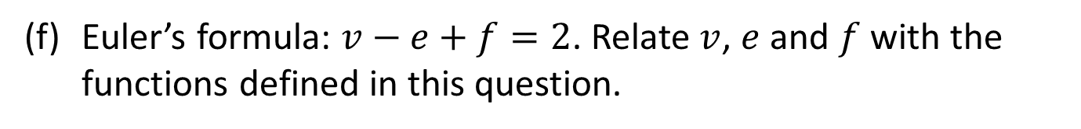
Q17
(a) Express $E(n)$ in terms of $V_{3}(n)$ and $V_{4}(n)$.
(b) Write the recurrence relation for $V(n)$. Base case $V\left(0\right)=0$.
(c) Write the closed form formula for $V(n)$.
(d) Write the recurrence relation for $E(n)$. Base case $E\left(0\right)=0$.
(e) Write the closed form formula for $E(n)$.
(f) Euler’s formula: $v−e+f=2$. Relate $v$, $e$ and $f$ with the functions defined in this question.
(g) From (f) or otherwise, derive the closed form formula for $P(n)$.

Slide 16
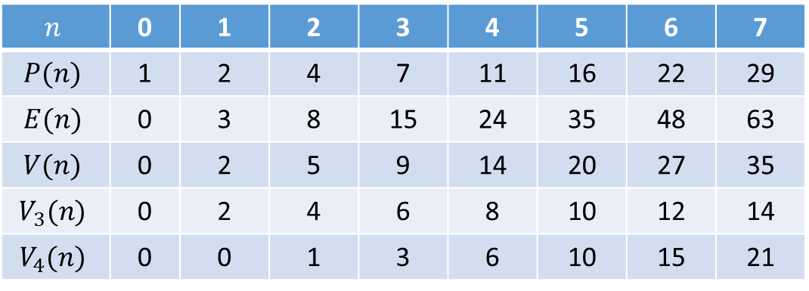
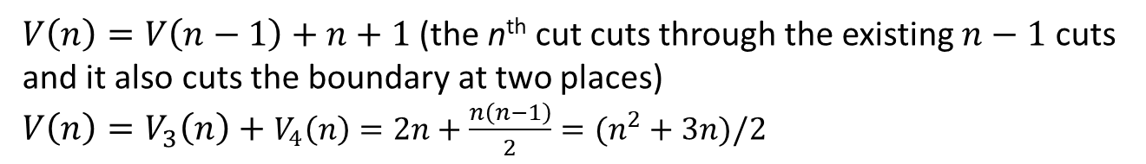
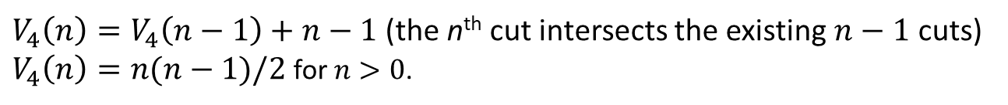
Q17
$$n$$ | 0 | 1 | 2 | 3 | 4 | 5 | 6 | 7
$$P(n)$$ | 1 | 2 | 4 | 7 | 11 | 16 | 22 | 29
$$E(n)$$ | 0 | 3 | 8 | 15 | 24 | 35 | 48 | 63
$$V(n)$$ | 0 | 2 | 5 | 9 | 14 | 20 | 27 | 35
$$V_{3}(n)$$ | 0 | 2 | 4 | 6 | 8 | 10 | 12 | 14
$$V_{4}(n)$$ | 0 | 0 | 1 | 3 | 6 | 10 | 15 | 21
$V_{3}\left(n\right)=2n$ (every cut creates two new vertices on the boundary)
$V_{4}\left(n\right)=V_{4}\left(n−1\right)+n−1$ (the n^{th} cut intersects the existing $n−1$ cuts)
$V_{4}\left(n\right)=n(n−1)/2$ for $n>0$.
$V\left(n\right)=V\left(n−1\right)+n+1$ (the n^{th} cut cuts through the existing $n−1$ cuts and it also cuts the boundary at two places)
$V\left(n\right)=V_{3}\left(n\right)+$ $V_{4}\left(n\right)=2n+\frac{n\left(n−1\right)}{2}=(n^{2}+3n)/2$

Slide 17
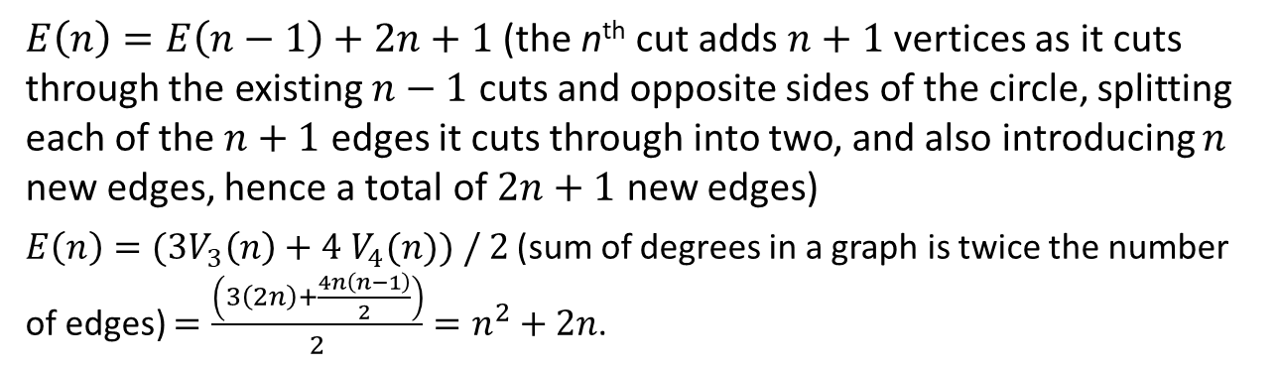
Q17
$$n$$ | 0 | 1 | 2 | 3 | 4 | 5 | 6 | 7
$$P(n)$$ | 1 | 2 | 4 | 7 | 11 | 16 | 22 | 29
$$E(n)$$ | 0 | 3 | 8 | 15 | 24 | 35 | 48 | 63
$$V(n)$$ | 0 | 2 | 5 | 9 | 14 | 20 | 27 | 35
$$V_{3}(n)$$ | 0 | 2 | 4 | 6 | 8 | 10 | 12 | 14
$$V_{4}(n)$$ | 0 | 0 | 1 | 3 | 6 | 10 | 15 | 21
$E\left(n\right)=E\left(n−1\right)+2n+1$ (the n^{th} cut adds $n+1$ vertices as it cuts through the existing $n−1$ cuts and opposite sides of the circle, splitting each of the $n+1$ edges it cuts through into two, and also introducing $n$ new edges, hence a total of $2n+1$ new edges)
$E\left(n\right)=(3V_{3}\left(n\right)+4$ $V_{4}(n)) / 2$ (sum of degrees in a graph is twice the number of edges) $=\frac{\left(3\left(2n\right)+\frac{4n\left(n−1\right)}{2}\right)}{2}=n^{2}+2n$.

Slide 18



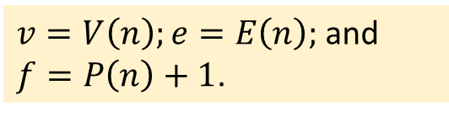
Q17
(a) Express $E(n)$ in terms of $V_{3}(n)$ and $V_{4}(n)$.
$E\left(n\right)=(3V_{3}\left(n\right)+4$ $V_{4}(n)) / 2$
(b) Write the recurrence relation for $V(n)$. Base case $V\left(0\right)=0$.
$$V\left(n\right)=V\left(n−1\right)+n+1\text{, }\text{for} n>0\text{.}$$
(c) Write the closed form formula for $V(n)$.
$V\left(n\right)=(n^{2}+3n)/2$ $\text{, }\text{for} n≥0\text{.}$
(d) Write the recurrence relation for $E(n)$. Base case $E\left(0\right)=0$.
$$E\left(n\right)=E\left(n−1\right)+2n+1\text{, }\text{for} n>0\text{.}$$
(e) Write the closed form formula for $E(n)$.
$$E\left(n\right)=n^{2}+2n\text{, }\text{for} n≥0\text{.}$$
(f) Euler’s formula: $v−e+f=2$. Relate $v$, $e$ and $f$ with the functions defined in this question.
$v=V\left(n\right);e=E\left(n\right);$ and $f=P\left(n\right)+1$.
(g) From (f) or otherwise, derive the closed form formula for $P(n)$.
$$P\left(n\right)=f−1=1−v+e=1−V\left(n\right)+E\left(n\right)=(n^{2}+n+2)/2$$

Slide 19
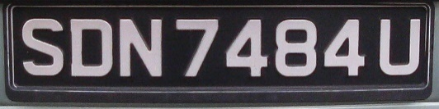
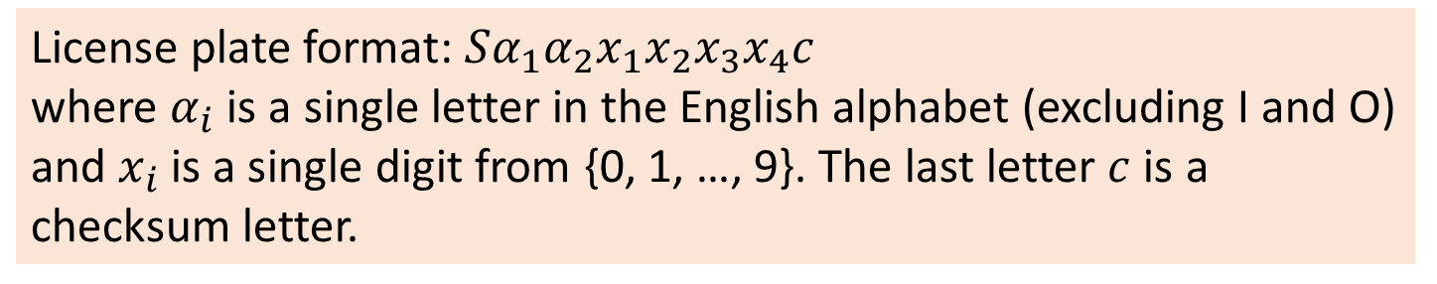
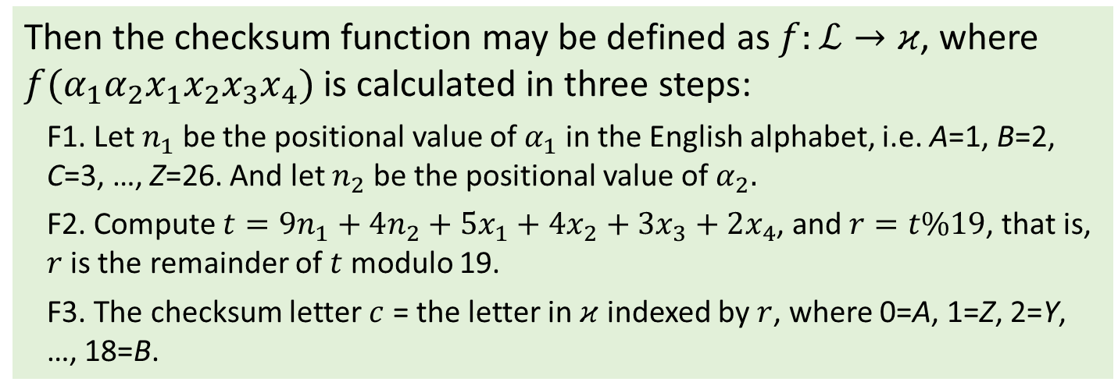
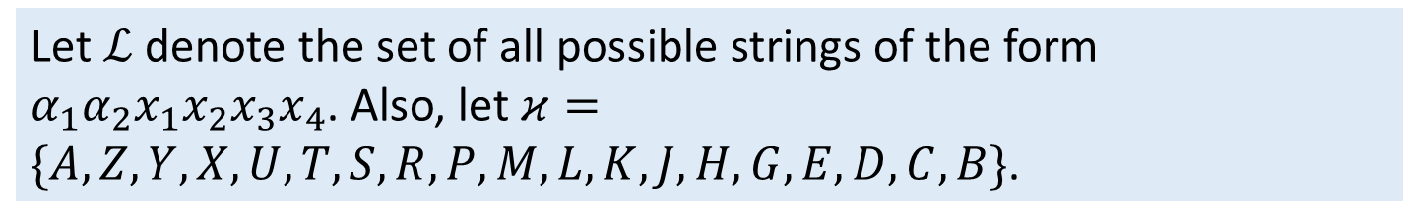
Q18
License plate format: $Sα_{1}α_{2}x_{1}x_{2}x_{3}x_{4}c$
where $α_{i}$ is a single letter in the English alphabet (excluding I and O) and $x_{i}$ is a single digit from {0, 1, …, 9}. The last letter $c$ is a checksum letter.
Let $ℒ$ denote the set of all possible strings of the form $α_{1}α_{2}x_{1}x_{2}x_{3}x_{4}$. Also, let $κ=\{A,Z,Y,X,U,T,S,R,P,M,L,K,J,H,G,E,D,C,B\}$.
Then the checksum function may be defined as $f:ℒ→κ$, where $f(α_{1}α_{2}x_{1}x_{2}x_{3}x_{4})$ is calculated in three steps:
F1. Let $n_{1}$ be the positional value of $α_{1}$ in the English alphabet, i.e. A=1, B=2, C=3, …, Z=26. And let $n_{2}$ be the positional value of $α_{2}.$
F2. Compute $t=9n_{1}+4n_{2}+5x_{1}+$ $4x_{2}+3x_{3}+$ $2x_{4}$, and $r=t\%19$, that is, $r$is the remainder of $t$ modulo 19.
F3. The checksum letter $c$ = the letter in $κ$ indexed by $r$, where 0=A, 1=Z, 2=Y, …, 18=B.

Slide 20
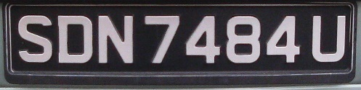
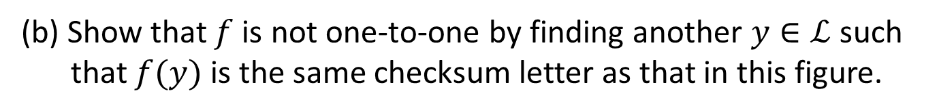
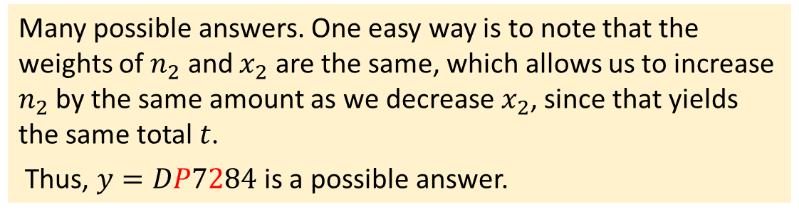
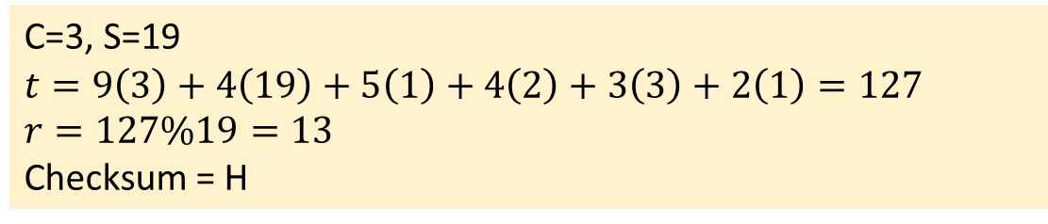
Q18
$κ=\{A,Z,Y,X,U,T,S,R,P,M,L,K,J,H,G,E,D,C,B\}$.
(a) Determine the checksum letter for “CS1231”.
C=3, S=19
$$t=9\left(3\right)+4\left(19\right)+5\left(1\right)+4\left(2\right)+3\left(3\right)+2\left(1\right)=127$$
$$r=127\%19=13$$
Checksum = H
(b) Show that $f$ is not one-to-one by finding another $y∈ℒ$ such that $f(y)$ is the same checksum letter as that in this figure.
Many possible answers. One easy way is to note that the weights of $n_{2}$ and $x_{2}$ are the same, which allows us to increase $n_{2}$ by the same amount as we decrease $x_{2}$, since that yields the same total $t$.
Thus, $y=DP7284$ is a possible answer.

Slide 21
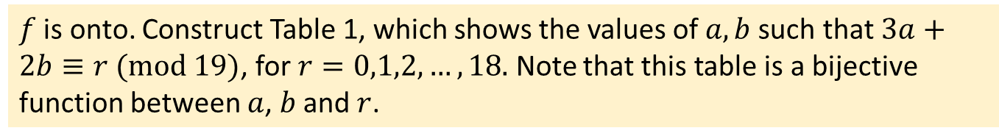
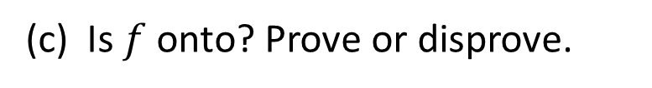
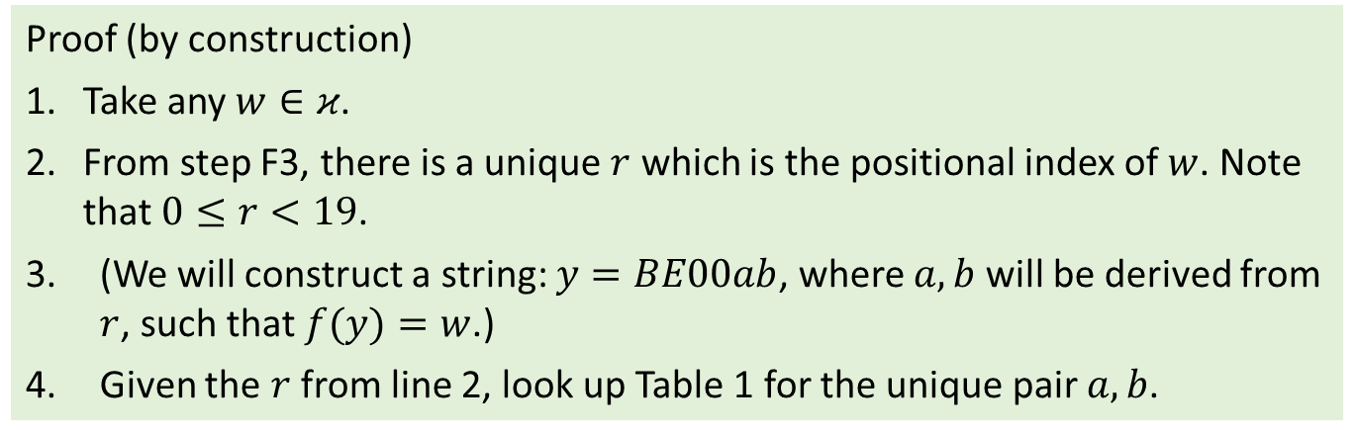
$κ=\{A,Z,Y,X,U,T,S,R,P,M,L,K,J,H,G,E,D,C,B\}$.
Q18
(c) Is $f$ onto? Prove or disprove.
$f$ is onto. Construct Table 1, which shows the values of $a, b$such that $3a+2b≡r (mod 19)$, for $r=0,1,2, …, 18.$ Note that this table is a bijective function between $a$, $b$ and $r$.
a \ b | 0 | 1 | 2 | 3 | 4
0 | 0 | 2 | 4
1 | 3 | 5 | 7
2 | 6 | 8 | 10 | 12
3 | 9 | 11 | 13 | 15 | 17
4 |  | 14 | 16 | 18 | 1
Table 1
Proof (by construction)
1. Take any $w∈κ$.
2. From step F3, there is a unique $r$ which is the positional index of $w$. Note that $0≤r<19$.
(We will construct a string: $y=BE00ab$, where $a,b$ will be derived from $r$, such that $f(y)=w$.)
4. Given the $r$ from line 2, look up Table 1 for the unique pair $a,b$.

Slide 22
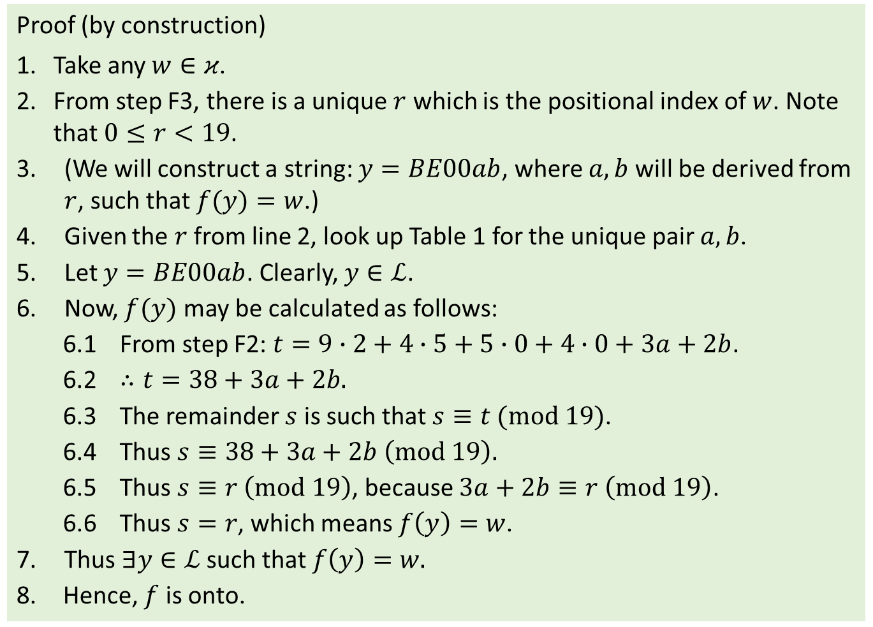
$κ=\{A,Z,Y,X,U,T,S,R,P,M,L,K,J,H,G,E,D,C,B\}$.
Q18
(c) Is $f$ onto? Prove or disprove.
Proof (by construction)
1. Take any $w∈κ$.
2. From step F3, there is a unique $r$ which is the positional index of $w$. Note that $0≤r<19$.
(We will construct a string: $y=BE00ab$, where $a,b$ will be derived from $r$, such that $f(y)=w$.)
Given the $r$ from line 2, look up Table 1 for the unique pair $a,b$.
5. Let $y=BE00ab$. Clearly, $y∈ℒ$.
Now, $f(y)$ may be calculated as follows:
6.1 From step F2: $t=9∙2+4∙5+5∙0+4∙0+3a+2b$.
6.2 $∴t=38+3a+2b.$
6.3 The remainder $s$ is such that $s≡t (mod 19)$.
6.4 Thus $s≡38+3a+2b \left(mod 19\right).$
6.5 Thus $s≡r \left(mod 19\right)$, because $3a+2b≡r \left(mod 19\right)$.
6.6 Thus $s=r$, which means $f\left(y\right)=w$.
Thus $∃y∈ℒ$ such that $f\left(y\right)=w.$
8. Hence, $f$ is onto.

Slide 23
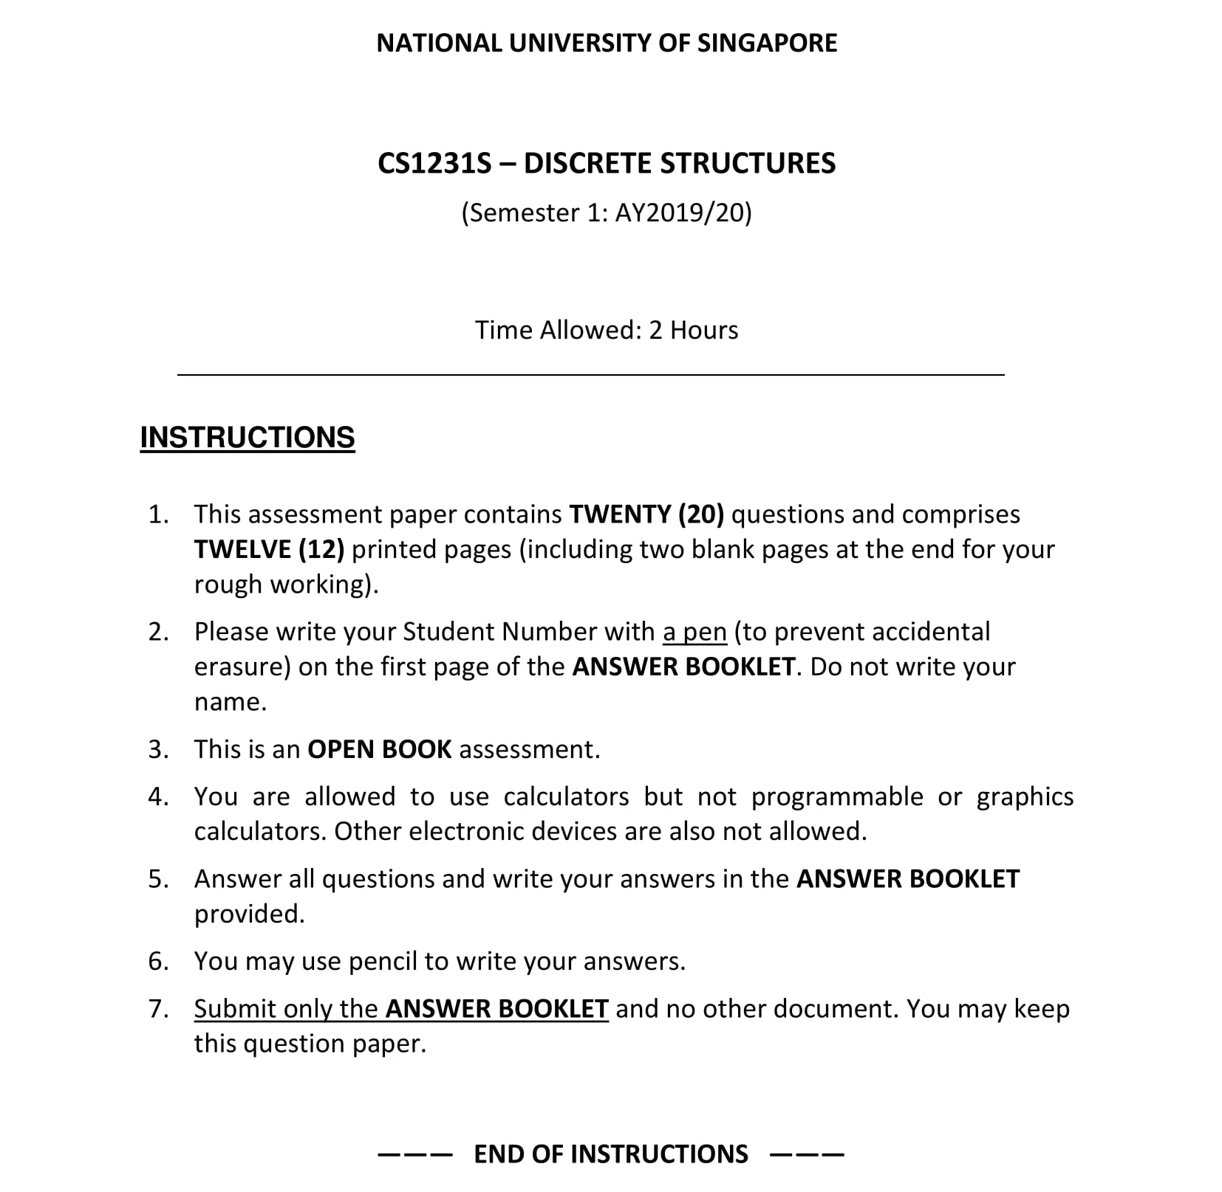

Slide 24
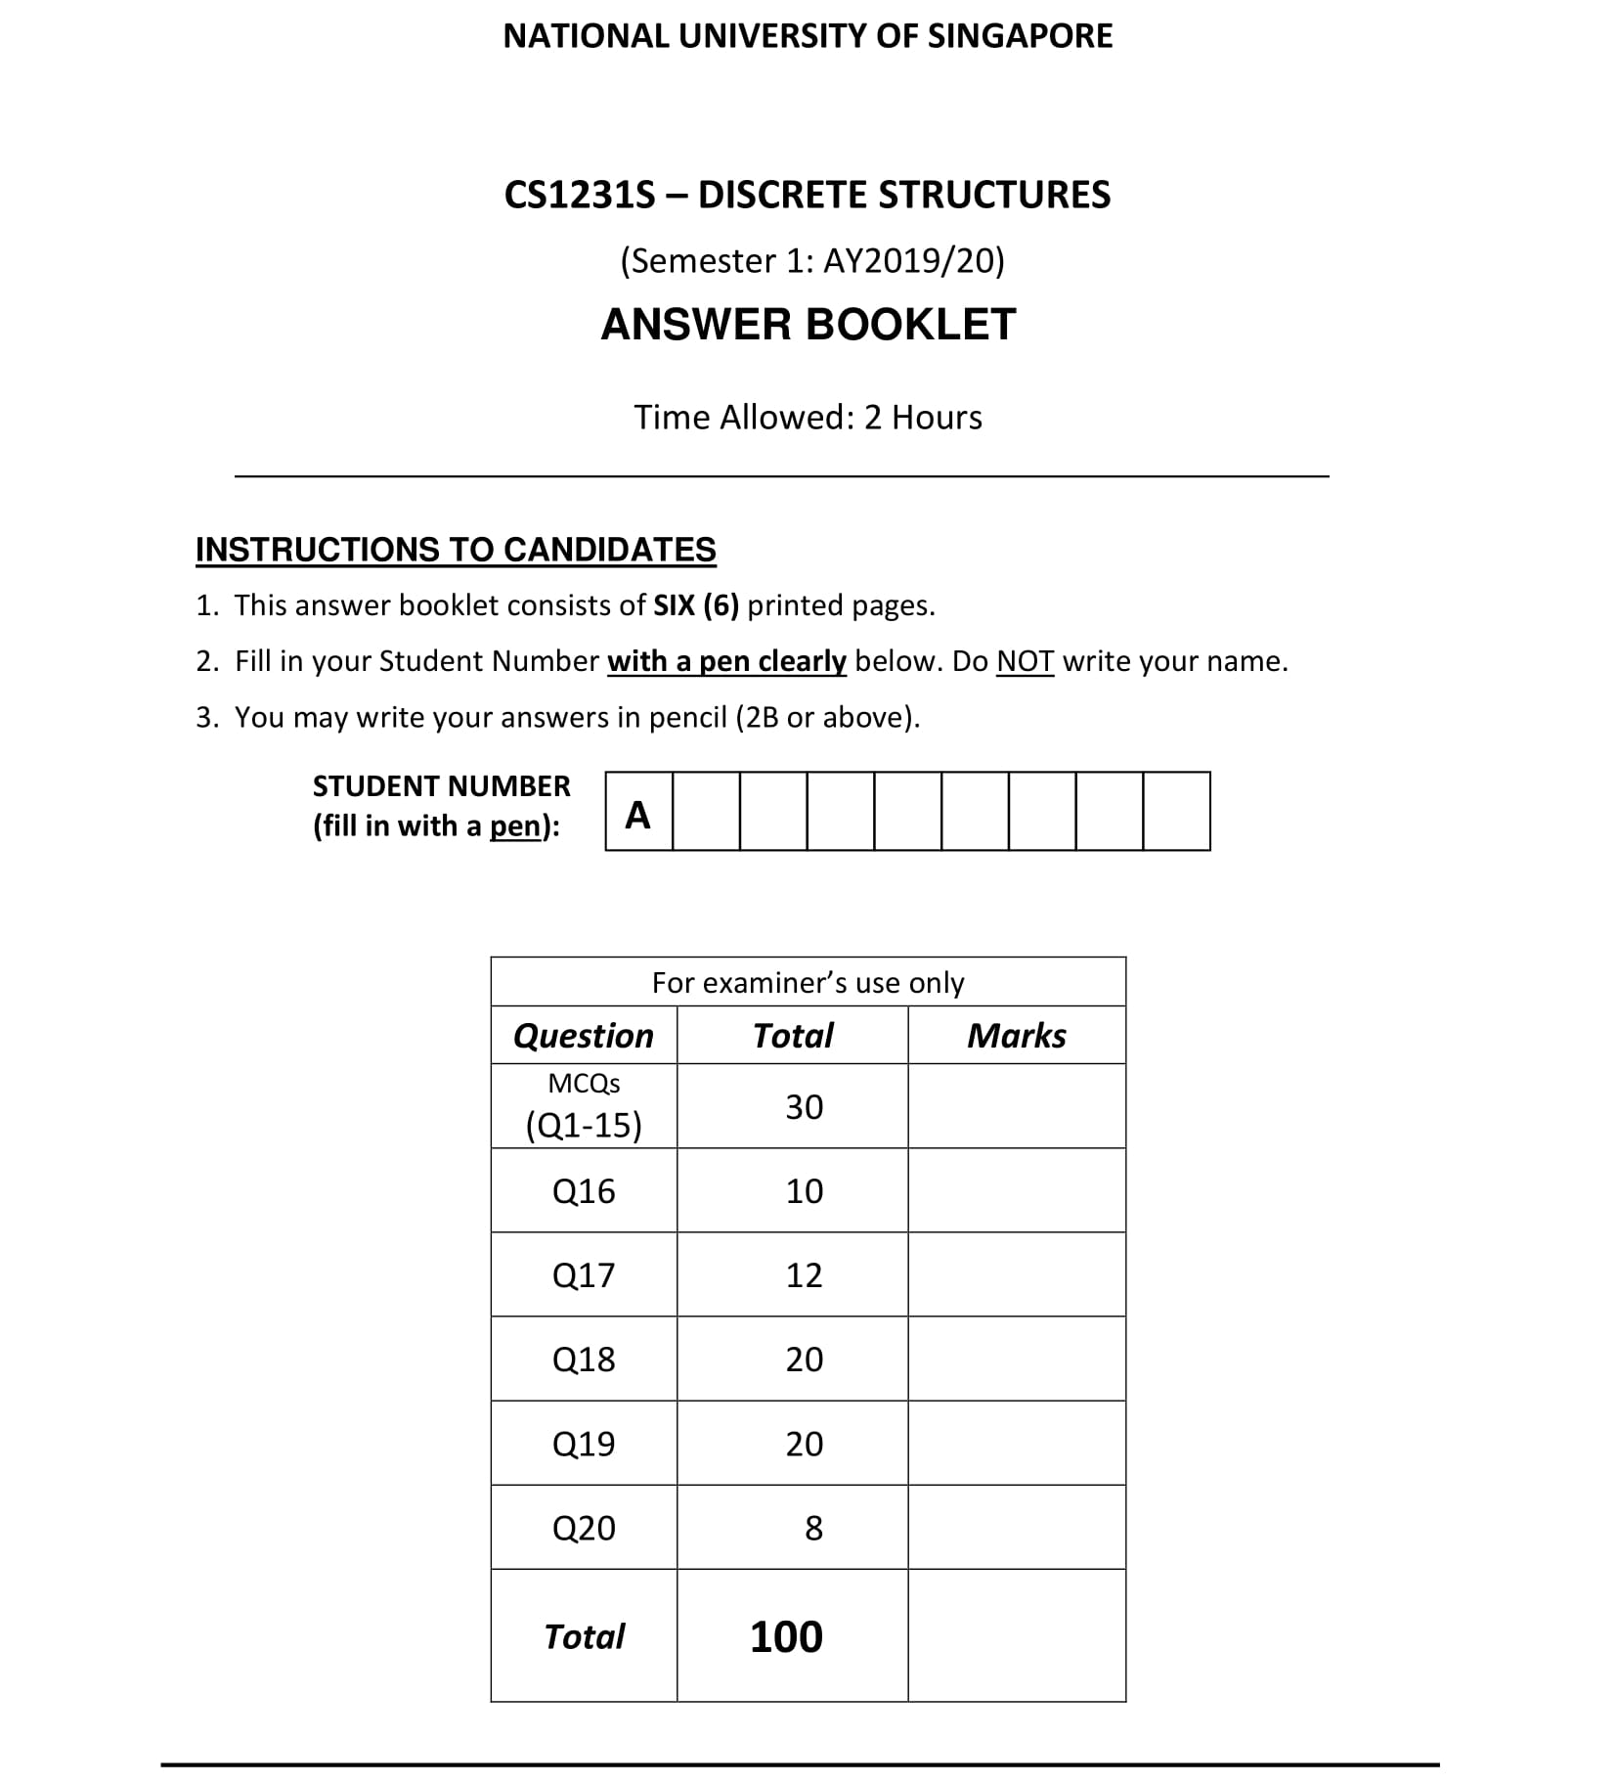

Slide 25

Exam Tips!
Focus on later topics (topics not tested in mid-term test)
Time management (leave the hard questions for last)
Review tutorial answers
Do past years’ exam papers
Don’t memorise; understand

Slide 26
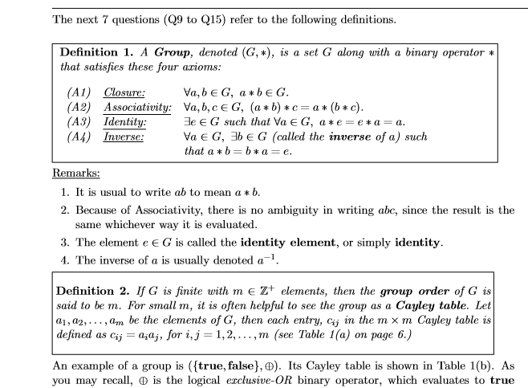
Exam Tips!
Last year’s paper

Slide 27
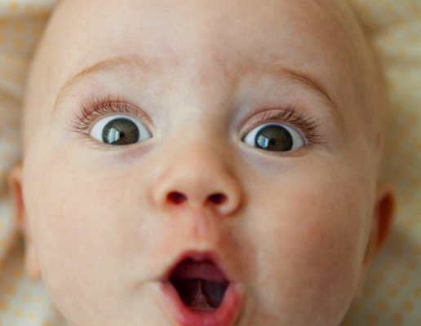
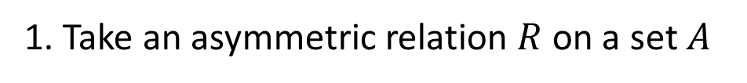
Exam Tips!
Stuck at a proof?
Tutorial #7 Q2:
Proof that an asymmetric relation is also anti-symmetric.
1. Take an asymmetric relation $R$ on a set $A$
1.1 Then $∀x,y∈A \left(x R y →y R x\right)$ by definition of asymmetric
1.2 Thus $∀x,y∈A \left(x R y∨y R x\right)$ by implication law
Oops! I’m stuck here!
Got it!
1.? $∀x,y∈A \left(x R y ∨y R x\right)∨x=y$ by generalisation
1.? $∀x,y∈A \sim \left(x R y ∧y R x\right)∨x=y$
My goal:
Work backward…
1.? $∀x,y∈A \left(x R y ∧y R x\right)→x=y$ by def of anti-symmetric

Slide 28
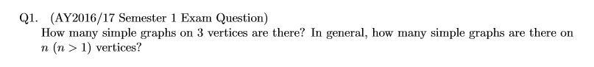
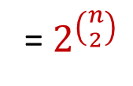


Exam Tips!
Work out some simple examples
#vertices #edges #graphs
1
0
1
= 2⁰
2
1
2
= 2¹
3
3
8
= 2³
$$n$$
$$\left({n \atop 2}\right)$$
= $2^{\left({n \atop 2}\right)}$
2^{edges}

Slide 29
Useful links
Discrete Mathematics Applications and Importance in Computer Science
http://cybercomputing.blogspot.sg/2012/06/discrete-mathematics-applications-and.html
Some Reasons Why Computer Scientists Should Study Math, and Mathematicians Should Study Computer Science
http://users.dickinson.edu/~jmac/selected-talks/math-and-cs-talk.pdf

Slide 30



