Slide 1
CS2100
Tutorial #1
C and Number Systems
(Prepared by: Aaron Tan)

Slide 2
Aaron Tan
Office: COM1-03-12
Email: tantc@comp.nus.edu.sg

Slide 3
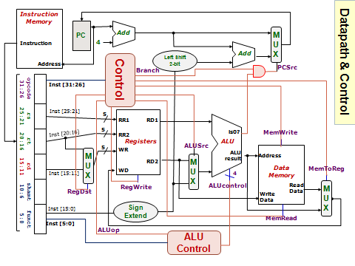
Q1.
You will learn this in week 5.
What is sign extension?

Slide 4
Q1.
Sign extension – extending the sign bit to fill in the bit representation.
Example: from 4 bits to 8 bits.
(5)₁₀
=
(0101)_{2s}
=
(00000101)_{2s}
(-3)₁₀
=
(1101)_{2s}
=
(11111101)_{2s}
Note: Sign extension works for complement systems (1’s complement and 2’s complement.)
Does it work for sign-and-magnitude system?

Slide 5

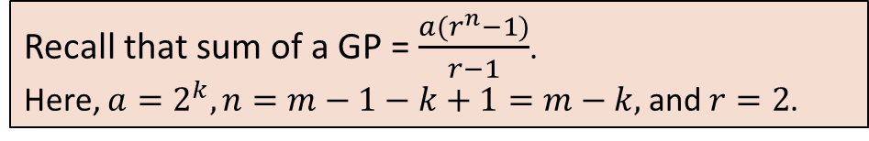
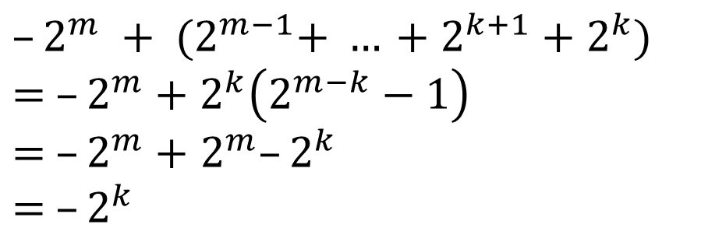
Q1.
Positive values – straightforward: (5)₁₀ = (0101)_{2s} = (00000101)_{2s}
Negative values? Why does padding 1s in front work?
(-3)₁₀ = (1101)_{2s} = (11111101)_{2s}
Value: – 2⁷ + 2⁶ + 2⁵ + 2⁴ + 2³
= –128+64+32+16+8 = –8
Value: –2³ = –8
$$–2^{k}$$
$$–2^{m} + {(2}^{m−1}+ … +2^{k+1}+2^{k})$$
$$= –2^{m}+2^{k}\left(2^{m−k}−1\right)$$
$=$ $–2^{m}+$ $2^{m}–2^{k}$
$=$ $–2^{k}$
Recall that sum of a GP = $\frac{a(r^{n}−1)}{r−1}$.
Here, $a=2^{k},n=m−1−k+1=m−k,$ and $r=2$.

Slide 6
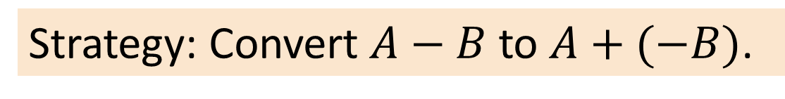
Q2.
Performing subtraction in 1’s complement.
Strategy: Convert $A−B$ to $A+(−B)$.
Why not perform subtraction directly?
(a) 0101.11 – 010.0101
0101.11 = (0101.1100)_{1s}
This is not sign extension.
010.0101 = (0010.0101)_{1s}
This is sign extension.
-010.0101 = -(0010.0101)_{1s} = (1101.1010)_{1s}
(0101.1100)_{1s}
+ (1101.1010)_{1s}
Check:
5.75 – 2.3125 = 3.4375
(1 0011.0110)_{1s}
+ 1
(0011.0111)_{1s}

Slide 7
Q2.
Performing subtraction in 1’s complement.
Strategy: Convert $A−B$ to $A+(−B)$.
(b) 010111.101 – 0111010.11
010111.101 = (0010111.101)_{1s}
This is sign extension.
0111010.11 = (0111010.110)_{1s}
This is not sign extension.
- 0111010.110 = -(0111010.110)_{1s} = (1000101.001)_{1s}
(0010111.101)_{1s}
+ (1000101.001)_{1s}
Check:
23.625 – 58.75 = -35.125
(0 1011100.110)_{1s}

Slide 8
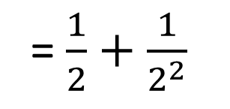
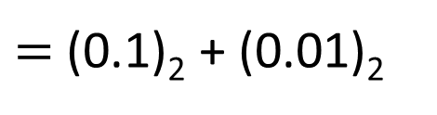
Q3.
Convert the following decimal numbers to fixed-point binary in 2’s complement, with 4 bits for the integer portion and 3 bits for the fraction portion.
(a) 1.75
0.75
= 0.5 + 0.25
= $\frac{1}{2}+\frac{1}{2^{2}}$
$=$(0.1)₂ + (0.01)₂
= (0.11)₂
Therefore 1.75 = (0001.110)₂
= (0001.110)_{2s}
or
0.75×2 = 1.5
0.5 ×2 = 1.0
end

Slide 9
Q3.
Convert the following decimal numbers to fixed-point binary in 2’s complement, with 4 bits for the integer portion and 3 bits for the fraction portion.
(b) -2.5
2.5
= (0010.100)₂
-2.5
= –(0010.100)₂
Invert bits in 0010.100 and add 0.001
1101.011
+ 1
1101.100
= (1101.100)_{2s}

Slide 10
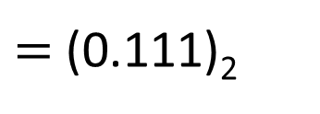
Q3.
Convert the following decimal numbers to fixed-point binary in 2’s complement, with 4 bits for the integer portion and 3 bits for the fraction portion.
(c) 3.876
0.876
= (0.1110)₂
$=$ (0.111)₂
Therefore 3.876 = (0011.111)₂
0.876×2 = 1.752
0.752×2 = 1.504
0.504×2 = 1.008
0.008×2 = 0.016
= (0011.111)_{2s}

Slide 11
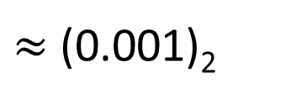
Q3.
Convert the following decimal numbers to fixed-point binary in 2’s complement, with 4 bits for the integer portion and 3 bits for the fraction portion.
(d) 2.1
= (0.0001)₂
$≈$ (0.001)₂
0.1
Therefore 2.1 = (0010.001)₂
0.1×2 = 0.2
0.2×2 = 0.4
0.4×2 = 0.8
0.8×2 = 1.6
= (0010.001)_{2s}

Slide 12
Q3.
Using the binary representations you have just derived, convert them back into decimal.
(a) 1.75
(b) -2.5
(c) 3.876
(d) 2.1
= (0001.110)_{2s}
= (0001.110)₂
= (1101.100)_{2s}
= –(0010.100)₂
= (0011.111)_{2s}
= (0011.111)₂
= (0010.001)_{2s}
= (0010.001)₂
(0001.110)₂
= 2⁰ + 2⁻¹ + 2⁻²
= 1.75
–(0010.100)₂
= –(2¹ + 2⁻¹)
= –2.5
(0011.111)₂
= 2¹ + 2⁰
+ 2⁻¹ + 2⁻² + 2⁻³
= 3.875
(0010.001)₂
= 2¹ + 2⁻³
= 2.125

Slide 13
Q4.
How would you represent the decimal value -0.078125 in the IEEE 754 single-precision representation? Express your answer in hexadecimal.
-0.078125
= -(0.000101)₂
= -( 1.01 )₂ × 2⁻⁴
Exponent: -4 + 127
= 123
= (01111011)₂
1
01111011
01000000000000000000000
Sign-bit
8-bit exponent
23-bit mantissa
1 01111011 01000000000000000000000
B
D
A
0
0
0
0
0

Slide 14
Q6.
Trace the program manually and write out its output.
55
int a = 3, *b, c, *d, e, *f;
b = &a;
*b = 5;
c = *b * 3;
d = b;
e = *b + c;
*d = c + e;
f = &e;
a = *f + *b;
*f = *d - *b;
printf("a = %d, c = %d, e = %d\n", a, c, e);
printf("*b = %d, *d = %d, *f = %d\n", *b, *d, *f);
a
35
c
e
3
5
15
20
0
b
d
f
This does NOT make d point to b!
This copies the content of b into d.
Output:
a = 55, c = 15, e = 0
*b = 55, *d = 55, *f = 0

Slide 15
END OF FILE

Slide 16
For reference.
1s complement
Given a number x which can be expressed as an n-bit binary number, its negated value can be obtained in 2s-complement representation using: -x = 2^{n} – x – 1
Example: x=12; Assume 8 bits, -x = 2⁸ – 12 – 1 = 243 = (11110011)_{1s}
Technique: invert the bits. 12 = (00001100)_{1s} → -12 = (11110011)_{1s}
2s complement
Given a number x which can be expressed as an n-bit binary number, its negated value can be obtained in 2s-complement representation using: -x = 2^{n} – x
Example: x=12; Assume 8 bits, -x = 2⁸ – 12 = 244 = (11110100)_{2s}
Technique: invert the bits then plus 1. 12 = (00001100)_{2s} → -12 = (11110100)_{2s}

Slide 17
For reference.
Important!
10.4 Comparisons
4-bit system
Positive values Negative values
Value | Sign-and-Magnitude | 1s Comp. | 2s Comp.
+7 | 0111 | 0111 | 0111
+6 | 0110 | 0110 | 0110
+5 | 0101 | 0101 | 0101
+4 | 0100 | 0100 | 0100
+3 | 0011 | 0011 | 0011
+2 | 0010 | 0010 | 0010
+1 | 0001 | 0001 | 0001
+0 | 0000 | 0000 | 0000
Value | Sign-and-Magnitude | 1s Comp. | 2s Comp.
-0 | 1000 | 1111 | -
-1 | 1001 | 1110 | 1111
-2 | 1010 | 1101 | 1110
-3 | 1011 | 1100 | 1101
-4 | 1100 | 1011 | 1100
-5 | 1101 | 1010 | 1011
-6 | 1110 | 1001 | 1010
-7 | 1111 | 1000 | 1001
-8 | - | - | 1000

