Slide 1

CS2105: UNIX Workshop Adapted from CS1010 24 Aug. 2020

Slide 2
Topics to Cover
Login to UNIX operating system
……………………………………
……………………………………
……………………………………
……………………………………
UNIX Workshop - 2

Slide 3



sunfire UNIX server
UNIX Workshop - 3
Notes:
Everybody login to sunfire server through the software "SSH Secure Shell Client" which can be downloaded from IVLE workbin.

Slide 4
Logging into UNIX System (1/3)
To login to sunfire server, you need your SoC UNIX account user-name and password.
If you don’t have it yet, create your account here:
https://mysoc.nus.edu.sg/~newacct
If you forget your password, reset it here:
https://mysoc.nus.edu.sg/~myacct/iforgot.cgi
UNIX Workshop - 4

Slide 5

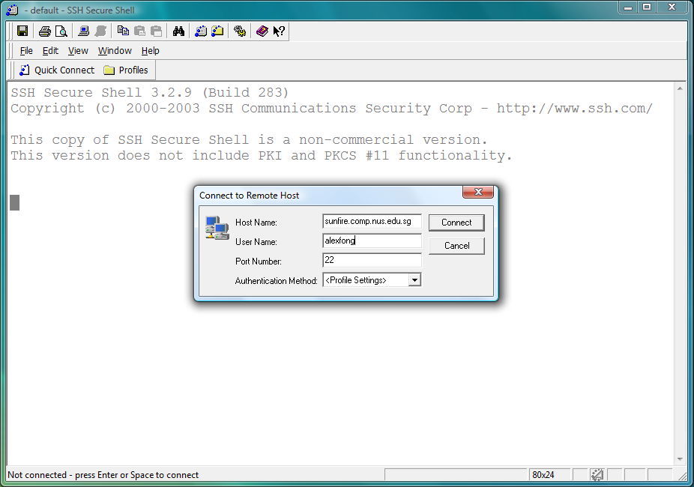
Logging into UNIX System (2/3)
1. Look for the SSH Secure Shell Client icon on your desktop, and double click on it.
Click on “Quick Connect” to get the pop-up window. Enter “sunfire.comp.nus.edu.sg” as hostname. You might need to launch NUS VPN before connecting to Sunfire (from off campus). Enter your UNIX id as User Name.
UNIX Workshop - 5

Slide 6
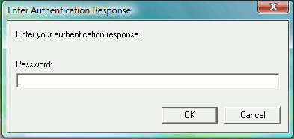
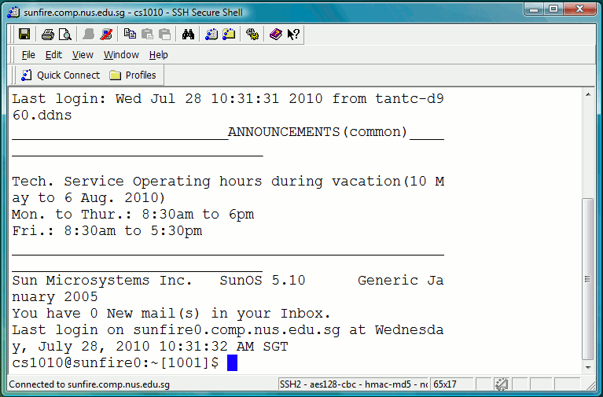
Logging into UNIX System (3/3)
3. Enter your UNIX password.
4. Once you log in successfully into your UNIX account, you will see this screen (actual display may vary).
UNIX Workshop - 6

Slide 7
Topics to Cover
Login to UNIX operating system
Basic UNIX commands
……………………………………
……………………………………
……………………………………
UNIX Workshop - 7

Slide 8
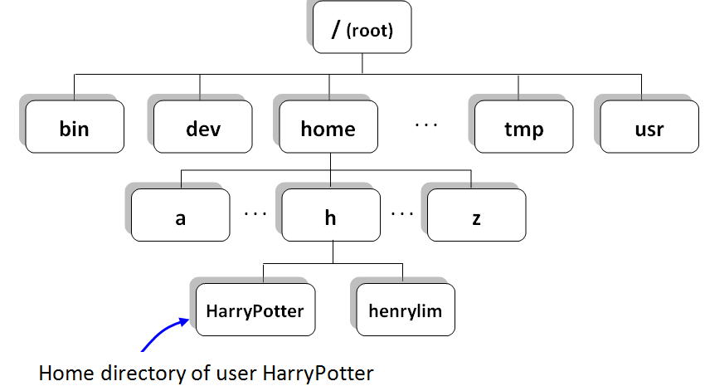
Basic UNIX commands (1/5)
UNIX file system: tree structure
UNIX Workshop - 8

Slide 9
Basic UNIX commands (2/5)
In a UNIX shell (like sunfire), you need a lot of typing but much less mouse clicking, compared with Windows operating system which you might be more familiar with.
There are a few useful commands that you need to remember which will facilitate your navigation in the UNIX world.
Practice is the best way to recognize UNIX commands. Gradually you will be more and more familiar with UNIX commands – so don’t worry too much at the beginning.
UNIX Workshop - 9

Slide 10
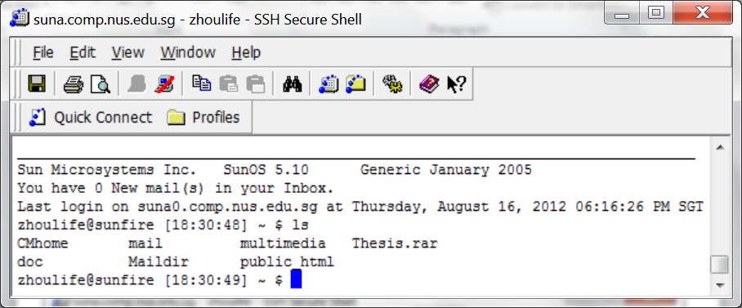
Basic UNIX commands (3/5)
ls command (means list directory contents) will enable you to see all the files and subfolders in current folder.
There are a few more complex usage of ls, but first of all, be familiar with the simplest one – just “ls”.
UNIX Workshop - 10

Slide 11
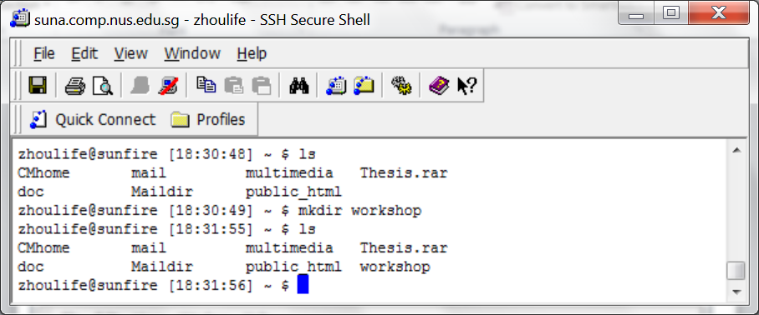
Basic UNIX commands (4/5)
mkdir (means make directory) will create a sub-directory.
rmdir (means remove directory) will delete an empty directory.
make a new directory
the new directory just created
UNIX Workshop - 11

Slide 12
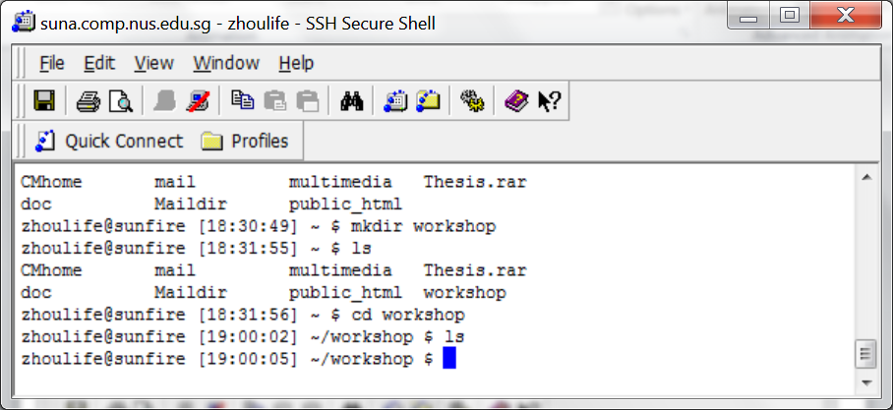
Basic UNIX commands (5/5)
cd command allows you to enter a designated directory.
cd workshop will bring you to the workshop directory.
cd .. will bring you back to the parent directory.
enter this directory
UNIX Workshop - 12

Slide 13
UNIX Commands for File Processing
cp command makes a copy of a file.
mv command moves a file to another folder.
mv command is also used to rename a file.
rm command deletes a file.
rm –r to remove a directory recursively
UNIX Workshop - 13

Slide 14
UNIX Commands for File Transfer
scp command helps transfer local file to server. You may use GUI like SSH Secure Shell/Xshell/WINSCP to achieve this with simple clicking and dragging as well.
Command is: scp -r <source-folder> <SoC-UNIX-ID>@sunfire.comp.nus.edu.sg:<target-folder>
Here <source-folder> is the path of the folder you want to upload, <SoC-UNIX-ID> is your soc unix ID, and <target-folder> is the folder on sunfire you want to copy to.
If <target-folder> exists already, <source-folder> will be copied under it as a subdirectory even if they have the same name.
Check wiki or any unix command references for more details and commands if you need

Slide 15
Topics to Cover
Login to UNIX operating system
Basic UNIX commands
Coding: Edit – Run
……………………………………
……………………………………
UNIX Workshop - 15

Slide 16
Programs: Edit and Execute
Source code
Editor
produces
hello_world.py
eg: vim hello_world.py
Unlike c/cpp/java, no compilation is needed for python because python is an interpreted language
Sample output
Execution
produces
hello world
eg: python3 hello_world.py
UNIX Workshop - 16

Slide 17
Write a Python Program using vim (1/2)
Vim is a powerful text editor
Command Mode is used to issue vim commands.
The default mode when you open vim
Insert Mode is used to type in text.
Switch back and forth between two modes:
i
<Esc>
UNIX Workshop - 17

Slide 18
Write a Python Program using vim (2/2)
Now use vim to type in the follow program:
vim hello_world.py
You can choose other editors if you know, or just edit locally and upload the new file
# this program print out "Hello World!" on the screen
import sys
sys.stdout.buffer.write(b'hello world')
sys.stdout.flush()
When finished:
Switch back to command mode: <Esc>
Save and quit vim by pressing key combination :wq
UNIX Workshop - 18

Slide 19
Executing hello_world.py
Simply execute below command, under the same directory where hello_world.py is locating:
python3 hello_world.py
And you get “hello world” outputted, without end of line.

Slide 20
Topics to Cover
Login to UNIX operating system
Basic UNIX commands
Coding: Edit – Compile – Run
File transfer between your sunfire account and your own laptop
……………………………….
UNIX Workshop - 20

Slide 21
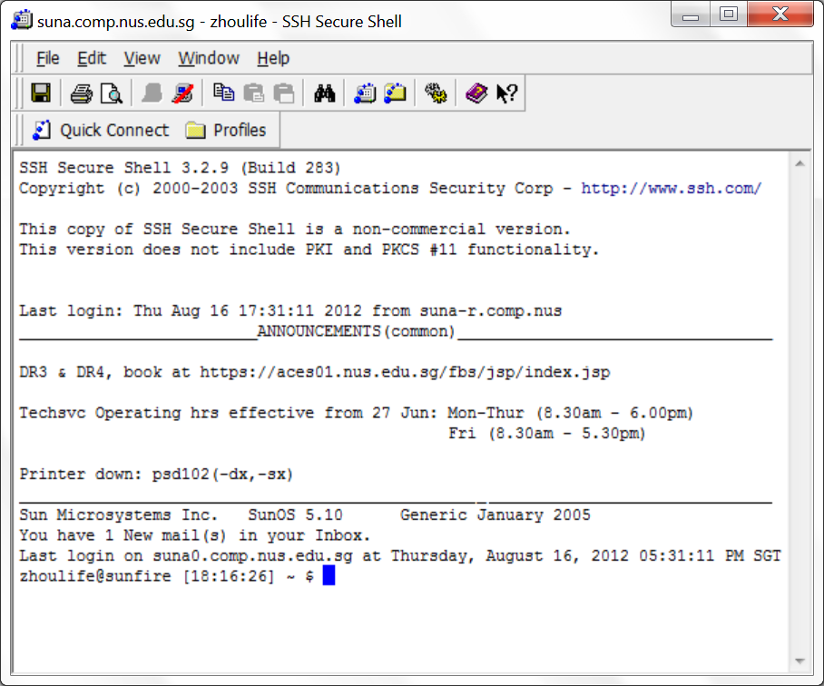
File Transfer from / to sunfire (1/2)
UNIX Workshop - 21

Slide 22
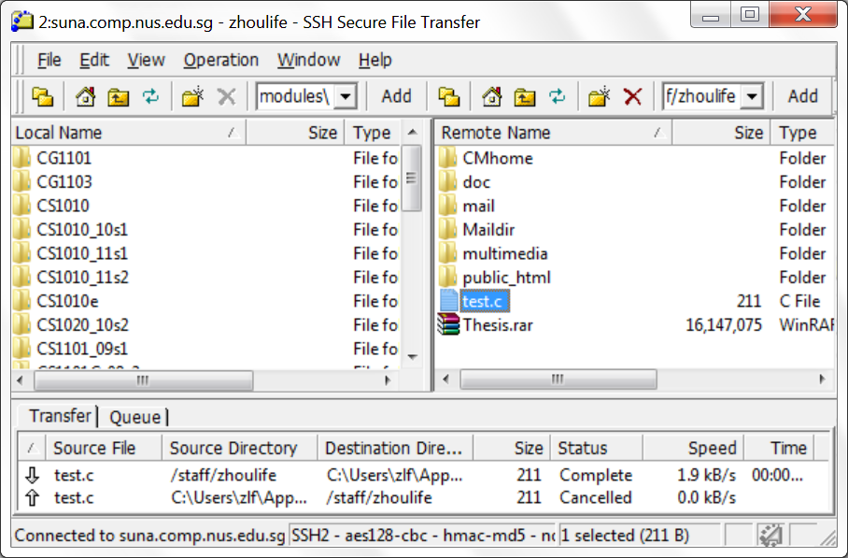
File Transfer from / to sunfire (2/2)
Click on a file, drag and drop in another panel
UNIX Workshop - 22

Slide 23
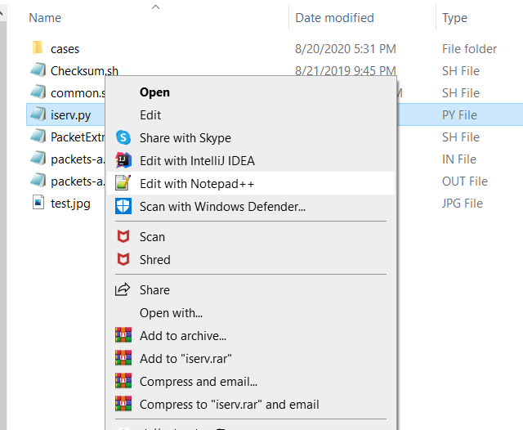
Open a Python Program in Windows System (any text editor will do)
UNIX Workshop - 23

Slide 24
Topics to Cover
Login to UNIX operating system
Basic UNIX commands
Coding: Edit – Compile – Run
File transfer between your sunfire account and your own laptop
Sample run for assignment 0 task 1
UNIX Workshop - 24

Slide 25
Connecting to sunfire
1. If you don’t have your SoC UNIX account, please create it here:
https://mysoc.nus.edu.sg/~newacct
2. If you forget your SoC password, please reset it here using your NUSNET ID and password:
https://mysoc.nus.edu.sg/~myacct/resetpass.cgi
3. Now use ssh command under any unix like system or GUI (like SSH Secure shell/Xshell) to connect to sunfire:
ssh <SoC-UNIX-ID>@sunfire.comp.nus.edu.sg

Slide 26
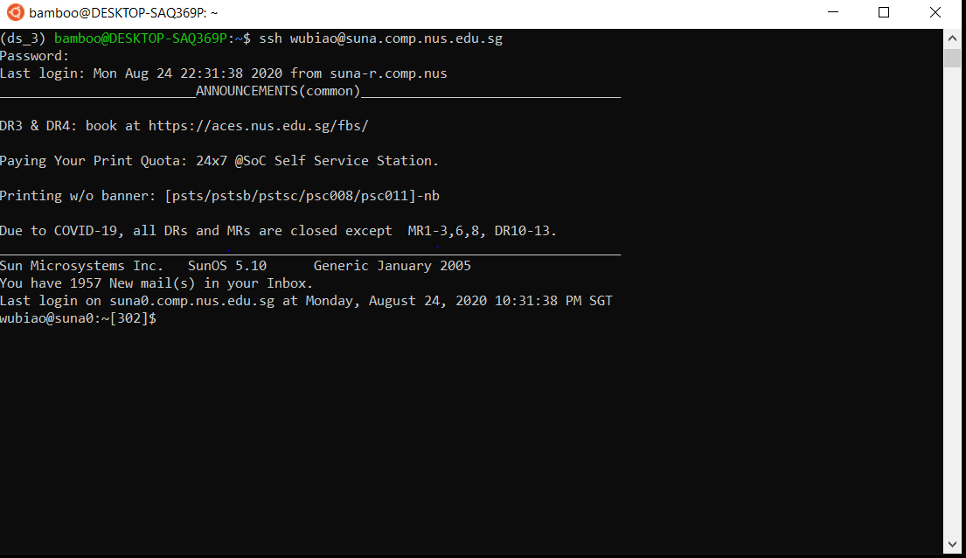
Sample connection
This is sample connection I made under windows subsystem ubuntu. Replace suna with sunfire in below screenshot as suna is for staff

Slide 27
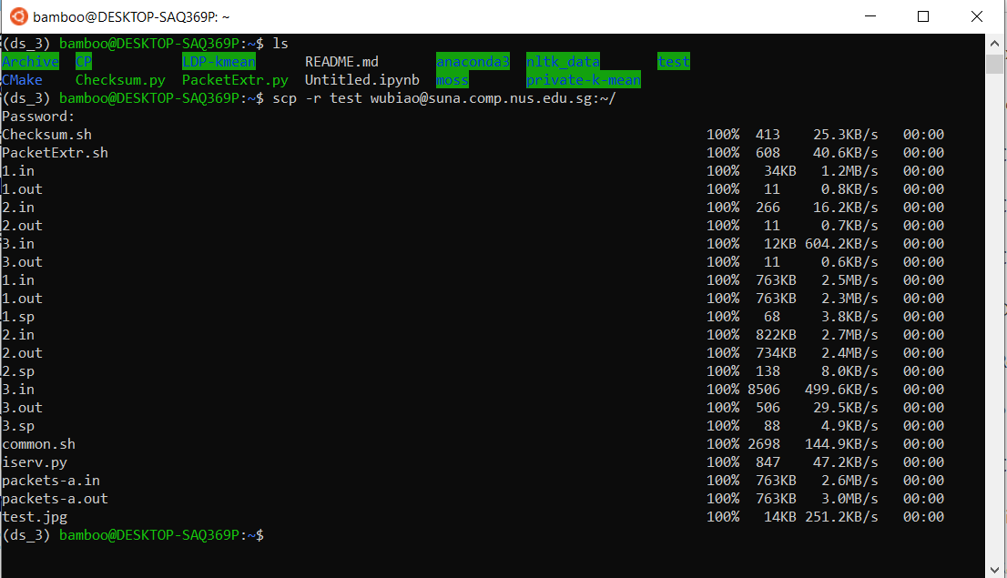
Upload folder/files
Make sure you are in your local system
Use scp to upload test folder, and your program files. In this demo it is uploaded to home directory of yours (~/) and you can change it as you like
Here you can see test folder and Checksum.py are under my current local directory

Slide 28
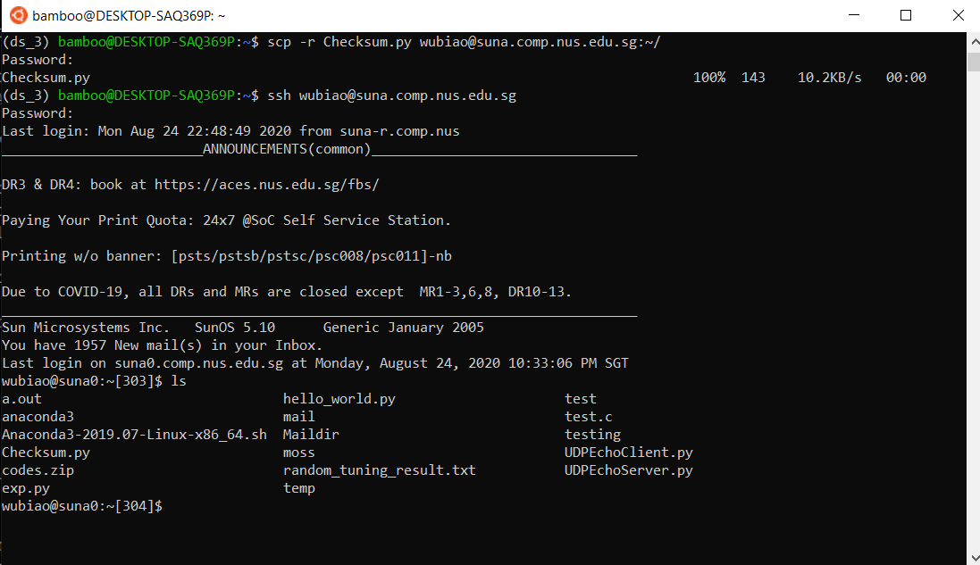
Uploading successful
Now you can see files/folders are under your sunfire home directory, after uploading Checksum.py as well

Slide 29
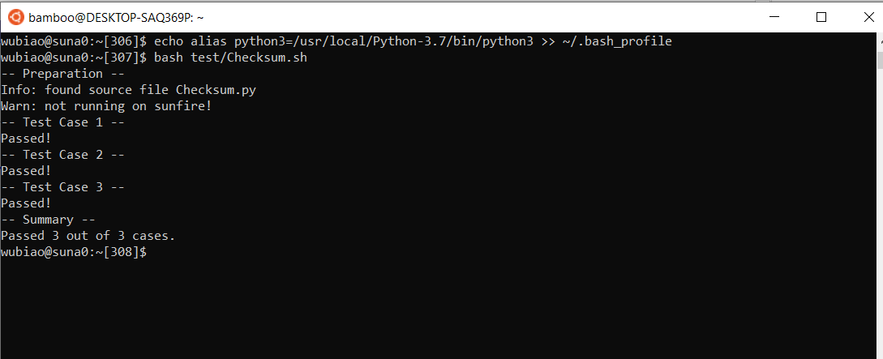
Running testing script
Setting up python3 alias. Note that it is active only after you disconnect and reconnect next time.
Run the bash script to test your code

Slide 30
Additional notes
Same procedures follow to connect to sunfire using all the command line systems, including but not limited to Cygwin/windows subsystem ubuntu/linux/SSH secure shell/Xshell/Mac command line tools etc. Just some GUI tools like SSH secure shell provides GUI operation for file transfer which might be easier

Slide 31
More references/materials
Below are suggested extra materials (not module materials) for those who want to brush and catch up with python syntax
https://docs.python.org/3/tutorial/
https://www.w3schools.com/python/ (this one has interactive IDE to test your coding on the webpage)

Slide 32
Congratulations!
You have cleared this UNIX workshop (no certificate will be issued though…)
You will gain more experience after days and weeks.
Now you may want to disconnect from sunfire.
The command is quite simple: logout
Try it and say “bye-bye”!
UNIX Workshop - 32

Slide 33
End of File

