Slide 1
CS2105 Introduction to Computer Networks Tutorial 1

Slide 2
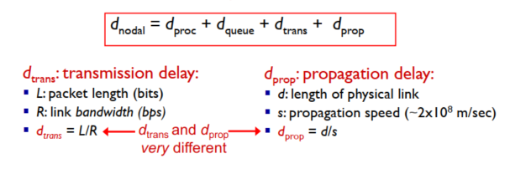
Delays
Express the propagation delay, d_{prop}, in terms of m and s. d_{prop} = m/s sec
Determine the transmission time of the packet, d_{trans}, in terms of L and R. d_{trans} = L/R sec
Ignoring processing and queuing delays, obtain an expression for the end-to-end delay d_{end-to-end}. d_{end-to-end} = d_{prop} + d_{trans} sec
d_{prop} vs d_{trans} d_{prop} = how long it takes one bit to travel from one end to the other
d_{trans} = how long it takes to get all the bits into the wire

Slide 3
Delays
d_{prop} vs d_{trans} d_{prop} = how long it takes one bit to travel from one end to the other
d_{trans} = how long it takes to get all the bits into the wire
e) Suppose d_{prop} is greater than d_{trans}. At time t = d_{trans}, where is the first bit of the packet? Flowing in the link and has not reached host B f) Suppose d_{prop} is less than d_{trans}. At time t = d_{trans}, where is the first bit of the packet? It has already reached host B

Slide 4
Delays
g) Suppose s = 2.5 x 108, L = 120 bits, and R = 56 kbps. Find the distance m so that d_{prop} equals d_{trans}.
L/R = m/s
m = L/R * s
m = 120/(56 * 1000) * (2.5 * 10⁸) = 535714.2857 meters

Slide 5
Question 2
A packet switch receives a packet and determines the outbound link to which the packet should be forwarded. When the packet arrives, one other packet is halfway done being transmitted on this outbound link and four other packets are waiting to be transmitted. Packets are transmitted continuously in order of arrival. Suppose all packets are 1,500 bytes and the link rate is 2 Mbps.
What is the queuing delay for the packet?
d_{queue} = (4.5 * 1500 * 8) / 2 * 10⁶ = 27 * 10⁻³ sec
More generally, what is the queuing delay when all packets have length L (bits), the transmission rate is R, x bits of the currently-being-transmitted packet have been transmitted, and n packets are already in the queue?
d_{queue} = (nL + (L-x)) / R

Slide 6
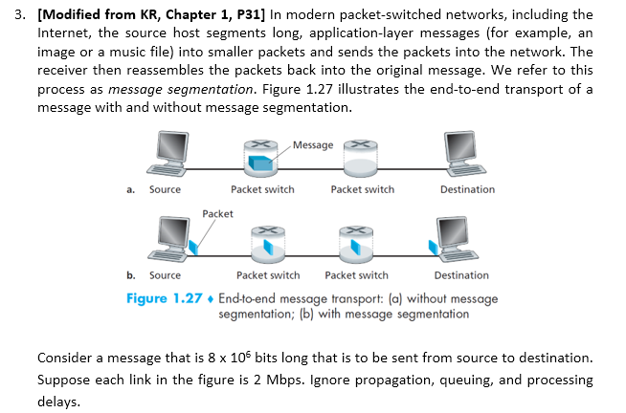
Consider sending the message from source to destination without message segmentation. How long does it take to move the message from the source host to the first packet switch (router)?
Time to send message = (8 * 10⁶) / (2 * 10⁶ ) = 4 sec
Following a), what is the total time to move the message from source host to destination host? Keeping in mind that each switch uses store-and-forward packet switching.
Store and forward -> 4 + 4 + 4 = 12 sec

Slide 7
Now suppose that the message is segmented into 800 packets, with each packet being 10,000 bits long. How long does it take to move the first packet from source host to the first switch? When the first packet is being sent from the first switch to the second switch, the second packet is being sent from the source host to the first switch. At what time will the second packet be fully received at the first switch?
Time to send 1st packet to 1st switch = 10000 / (2 * 10⁶ ) = 5 * 10⁻³ sec
Time for 2nd packet to be received at 1st switch = 5 * 10⁻³ + 5 * 10⁻³ = 10 * 10⁻³ sec
How long does it take to move the file from source host to destination host when message segmentation is used? Compare this result with your answer in part b) and comment.
No Segmentation = 12 sec
Segmentation = 15 * 10⁻³ + 799 * (5 * 10⁻³) = 4 sec

Slide 8
In addition to reducing delay, what are reasons to use message segmentation?
Bit error results in message retransmission
Convoy effect
Drawbacks of message segmentation
Packet re-ordering
Many smaller packets with each packets carry packet header. This results in overhead (to be discussed later in lecture)

Slide 9


Question 4
There are N devices to be connected. There can be either 0 or 1 link between any 2 devices.
What is the minimum number of links that can be used to connect all devices?
(N-1) e.g. Chain
What is the maximum number of links that can be used to connect all devices?
N * (N-1) / 2 e.g. Mesh
What are the pros and cons of the network topologies in part a) and b)?
Simple but single point of failure
1 Hop distance but more expensive

