Slide 1
CS2105 Tutorial 10

Slide 2
Recap: Network Security
Confidentiality: Only sender and receiver should understand the message
Authentication: Be able to prove that the message came from the sender and not from someone else
Integrity: Ensure that message is not altered
Availability: services must be accessible and available to users

Slide 3
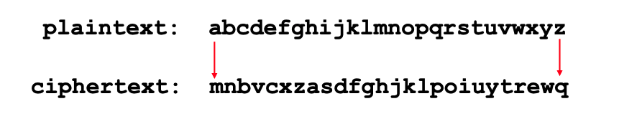
Question 1:
Using substitution cipher on Lecture 11 page 14:
Encode the message “this is a secret message”
uasi si m icbocu hciimzc
b) Decode the message “tcow ihmou”
very smart

Slide 4
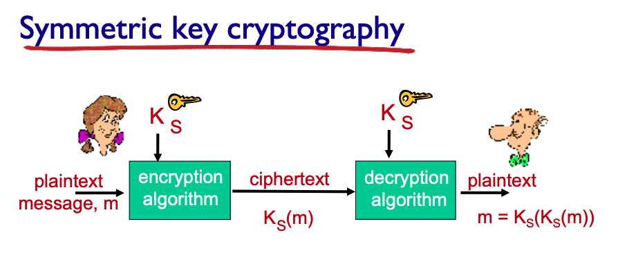
Question 2
Suppose 𝑁 people each want to communicate with 𝑁−1 other people. All communication between any two people, 𝑖 and 𝑗, is visible to all other people but no other person should be able to decode their communication. In total, how many keys are required in this group if:
a) Symmetric key encryption is used in each communication?
There are 𝑵∗(𝑵−𝟏)/𝟐pairs of people and each pair needs to share a symmetric key. The total number of keys is 𝑵 ∗ (𝑵 − 𝟏)/𝟐.
Notes:
Each line represents one symmetric key shared between the users connected by the line

Slide 5
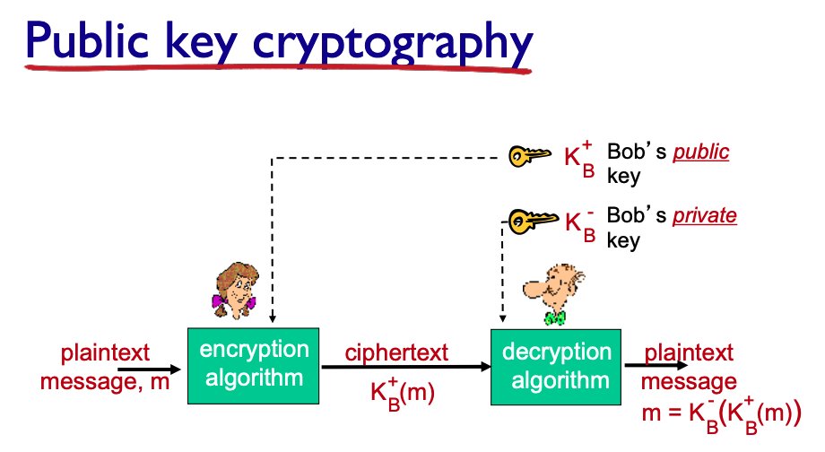
Question 2
b) Public key encryption is used in each communication?
Each person has:
One public key
One private key
With public key encryption, each person has a public key which is known to all, and a private key which is secret and known to the user only. There are thus 𝟐 ∗ 𝑵 keys

Slide 6
Question 3
In the BitTorrent P2P file distribution protocol, the seed breaks a file into blocks, and the peers redistribute the blocks to each other. Without any protection, an attacker can easily wreak havoc in a torrent by masquerading as a benevolent peer and sending bogus blocks to a small subset of peers in the torrent. These unsuspecting peers then redistribute the bogus blocks to other peers, which in turn redistribute the bogus blocks to even more peers. Thus, it is critical for BitTorrent to have a mechanism that allows a peer to verify the integrity of a block, so that it doesn’t redistribute bogus blocks.

Slide 7
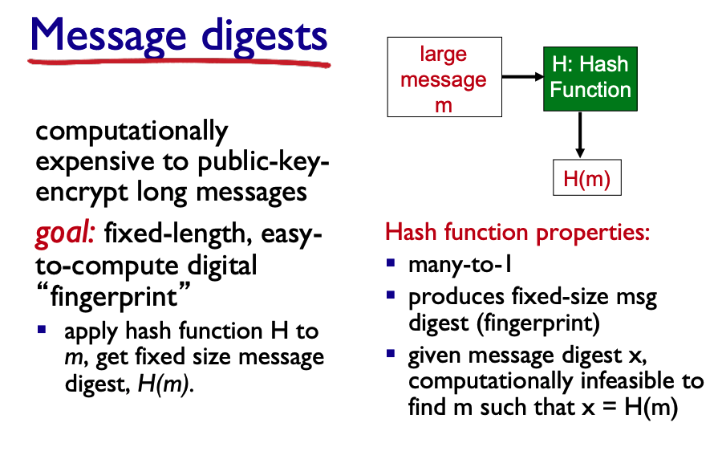
Question 3
Assume that when a peer joins a torrent, it initially gets a .torrent file from a fully trusted source. Describe a simple scheme that allows peers to verify the integrity of blocks.
E.g.
”I love CS2105” → 791237149
“I love CS2106” → 272949282
Notes:
Even if there’s just one character difference, an effective hashing algorithm would calculate a hash that is entirely different

Slide 8
Question 3
Assume that when a peer joins a torrent, it initially gets a .torrent file from a fully trusted source. Describe a simple scheme that allows peers to verify the integrity of blocks.
A file is broken into a number of blocks of identical size. For each block, a hash is calculated (e.g., using MD5 or SHA-1). The hashes for all of the blocks are saved in the .torrent file.
When a block is downloaded, a peer calculates the hash of this block and compares it to the recorded hash in the .torrent file. If the two hashes are equal, this block is error- free. Otherwise, the block is bogus and should be discarded.

Slide 9
Question 4
Suppose Alice wants to send a secure email 𝑚 to Bob, and wants to ensure its confidentiality and integrity. Alice performs the following steps (Figure 8.21 on textbook which is reproduced below):

Slide 10
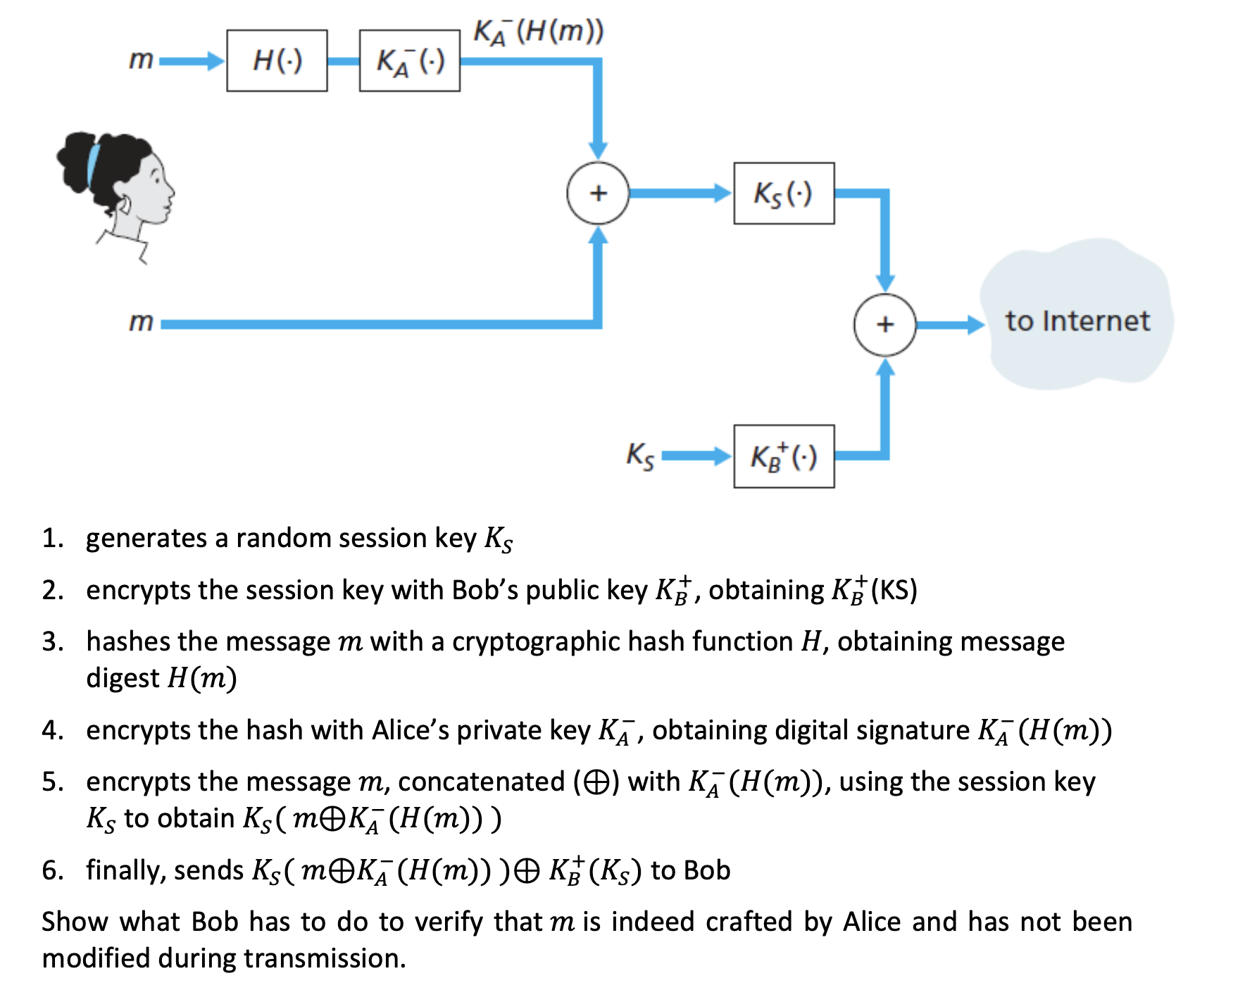
Question 4

Slide 11

Question 4
4.
3.
5.
6.
1.
2.
1.

Slide 12




Question 4
4.
3.
5.
6.
1.
2.
1.
2.

Slide 13
Question 4
4.
3.
5.
6.
1.
2.
1.
2.

Slide 14
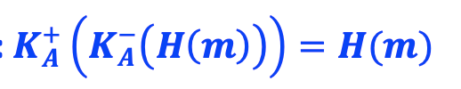
Question 4
4.
3.
5.
6.
1.
2.
1.
2.
3.

Slide 15
Question 4
4.
3.
5.
6.
1.
2.
1.
2.
3.

Slide 16
Question 4
4.
3.
5.
6.
1.
1.
2.
2.
3.
4. with 𝒎, Bob computes 𝑯(𝒎) and verifies that it is equal to 𝑯(𝒎) from step 3

Slide 17
End of The Session Thank you and See you next time :D

