Slide 1
CS2105 Introduction to Computer Networks Tutorial 2
Slide Courtesy of Gene Chua and Felix Halim
Notes:
Welcome to CS2105 Tutorial 2

Slide 2
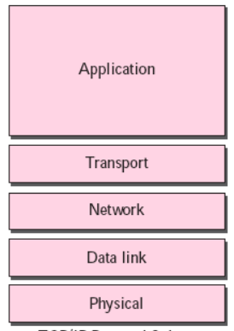
Recap
Examples of application layer protocols
HTTP
DNS
Etc…
Built on top of virtual connection established by transport layer protocols such as TCP, UDP, etc.
Applications interact with a socket established using these protocols
Different transport layer protocols used depending on properties required
Data integrity
Timing/low delay
Throughput
Security
Datagram
Packet
Frame
Bits

Slide 3
Recap
Examples of application layer protocols
HTTP
DNS
Etc…
Built on top of virtual connection established by transport layer protocols such as TCP, UDP, etc.
Applications interact with a socket established using these protocols
Different transport layer protocols used depending on properties required
Data integrity
Timing/low delay
Throughput
Security
Datagram
Packet
Frame
Bits

Slide 4
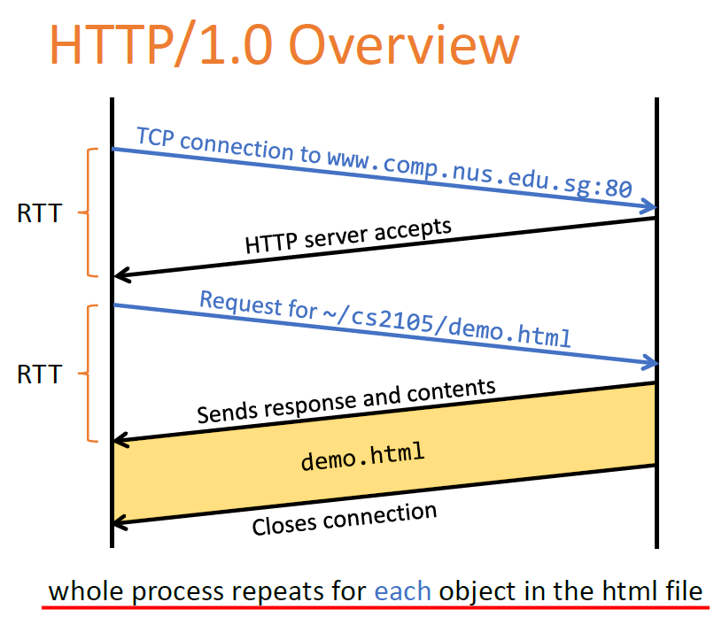
Recap: HTTP Request Method Types
Non-persistent:
Connection needs to be re-established for each object!

Slide 5
Recap
E.g. We want demo.html and doge.jpg
Non-persistent:
Connection needs to be re-established for each object!

Slide 6
Recap
E.g. We want demo.html and doge.jpg
Non-persistent:
Connection needs to be re-established for each object!
/img/doge.jpg
doge.jpg

Slide 7
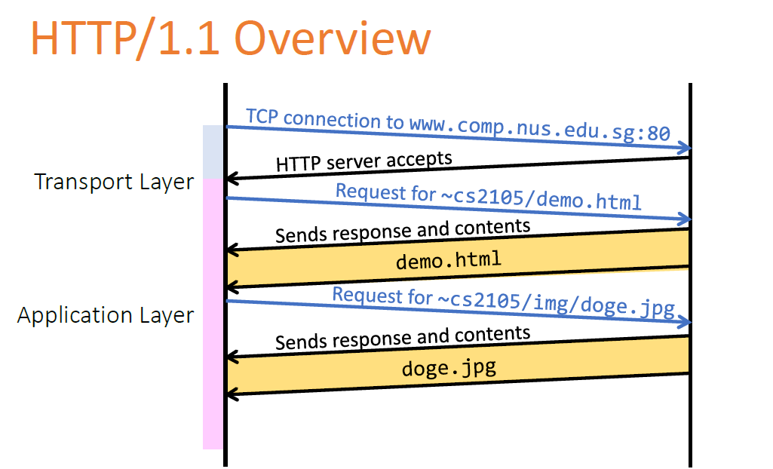
Recap
Persistent:
TCP connection only needs to be established once for multiple objects

Slide 8
Recap
RTT
Persistent:
TCP connection only needs to be established once for multiple objects
RTT
RTT

Slide 9
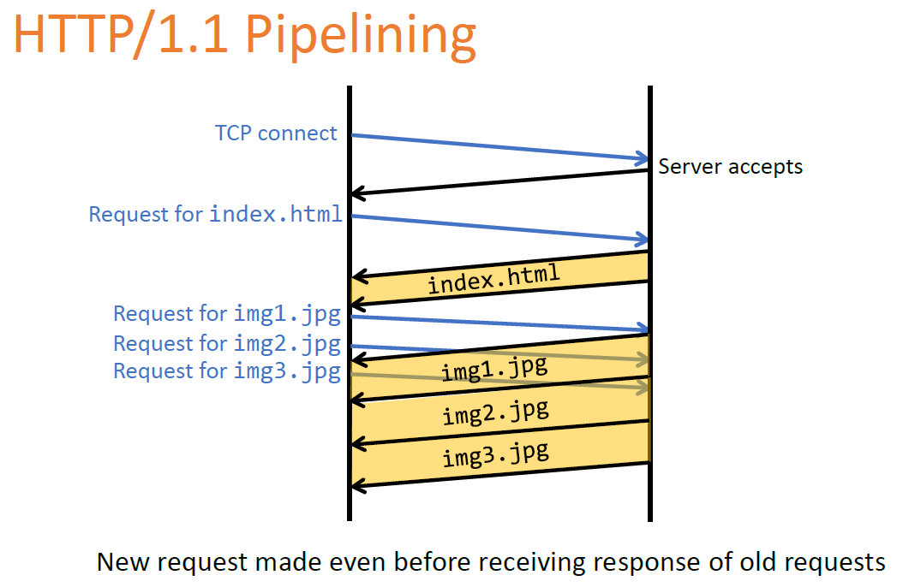
Recap
RTT
Pipelined:
No need to wait for previous responses before requesting new objects
As little as one RTT for all the referenced objects
RTT
RTT

Slide 10
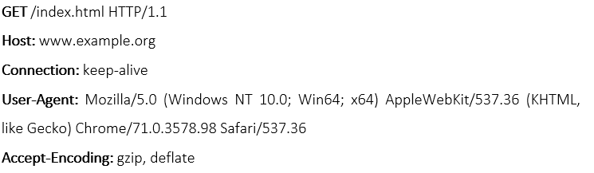
Question 1
Consider the following HTTP request message sent by a browser.
a) What is the URL of the document requested by this browser?
www.example.org/index.html

Slide 11
Question 1
Consider the following HTTP request message sent by a browser.
b) What version of HTTP is this browser running?
HTTP version 1.1

Slide 12
Question 1
Consider the following HTTP request message sent by a browser.
c) Does the browser request a non-persistent or a persistent connection?
The browser requests a persistent connection, as indicated by the header field ‘Connection: keep-alive’.

Slide 13
Question 1
Consider the following HTTP request message sent by a browser.
d) What is the IP address of the host on which the browser is running?
IP address is not shown in HTTP message. One would be able to get such information from socket.
(You will learn this in later lectures)

Slide 14
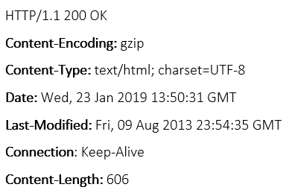
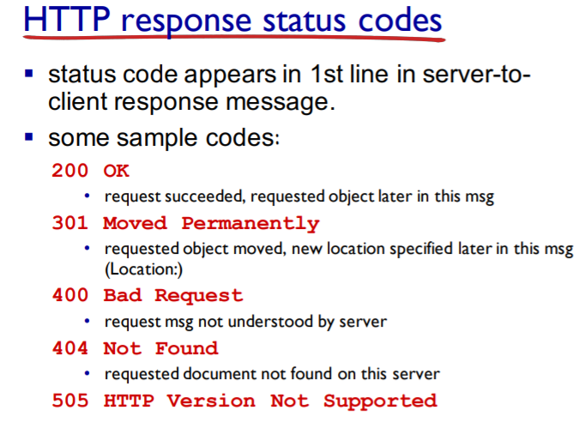
Question 2
The text below shows the header of the response message sent from the server in reply to the HTTP GET message in Q1 above. Answer the following questions.
a) Was the server able to successfully find the document or not?
The status code 200 and the phrase OK indicate that the server was able to locate the document successfully.

Slide 15
Question 2
The text below shows the header of the response message sent from the server in reply to the HTTP GET message in Q1 above. Answer the following questions.
b) What time did the server send the HTTP response message?
The HTTP response message was formed on Wed, 23 Jan 2019 13:50:31 Greenwich Mean Time.

Slide 16
Question 2
The text below shows the header of the response message sent from the server in reply to the HTTP GET message in Q1 above. Answer the following questions.
c) How many bytes are there in the document being returned?
There are 606 bytes in the document being returned.

Slide 17
Question 2
The text below shows the header of the response message sent from the server in reply to the HTTP GET message in Q1 above. Answer the following questions.
d) Did the server agree to a persistent connection?
The server agreed to a persistent connection, as indicated by the header field ‘Connection: Keep-Alive field’.

Slide 18
Question 3: True or false?
a) A user requests a Web page that consists of some text and three images. For this page, the client will send one request message and receive four response messages.
False. Download one object per request.

Slide 19
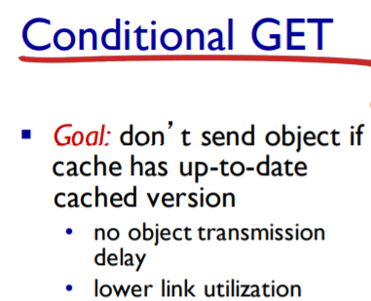
Question 3: True or false?
b) Two distinct Web pages (for example, www.mit.edu/research.html and www.mit.edu/students.html) can be sent over the same persistent connection.
True. They are on the same server.
c) The Date: header in the HTTP response message indicates when the object in the response was last modified.
False. Header field ‘Date’ indicates the server response time. The time the object is last modified is denoted by another header field ‘Last-Modified’.
d) HTTP response messages never have an empty message body.
False. E.g., conditional GET where browser’s cached copy is up-to-date.

Slide 20
Question 4
Suppose within your Web browser, you click on a link to obtain a Web page. The IP address for the associated URL is not cached in your local host, so a DNS lookup is necessary to obtain the IP address.
Suppose that n DNS servers are visited before your host receives the IP address from DNS; visiting them incurs an RTT of D_{DNS} per DNS server.
Further suppose that the Web page associated with the link contains m very small objects (in addition to the HTML page). Suppose the HTTP running is non-persistent and non-parallel. Let D_{Web} denote the RTT between the local host and the server of each object.
Assuming zero transmission time of each object, how much time elapses from when the client clicks on the link until the client receives all the objects?

Slide 21
Non Persistent Non Parallel
Basically each object takes two RTT, one for TCP connection and other for HTTP image/text file.
For More Information: https://www.geeksforgeeks.org/http-non-persistent-persistent-connection/

Slide 22
Question 4
To map from hostname to IP address: n x D_{DNS}
(note: DNS is over UDP, so no need to establish connection).
To establish TCP connection and get the HTML page = D_{Web} + D_{Web}
(2 RTT)
To establish m TCP connection and get all m objects = m x (D_{Web} + D_{Web} ) = m x 2 x D_{Web}
Total time = n x D_{DNS} + 2 x D_{Web} + m x 2 x D_{Web} = n x D_{DNS} + (m + 1) x 2 x D_{Web}

Slide 23
Question 4
To map from hostname to IP address: n x D_{DNS}
(note: DNS is over UDP, so no need to establish connection).
To establish TCP connection and get the HTML page = D_{Web} + D_{web} (2 RTT)
To establish m TCP connection and get all m objects = m x (D_{Web} + D_{Web} ) = m x 2 x D_{Web}
Total time = n x D_{DNS} + 2 x D_{Web} + m x 2 x D_{Web} = n x D_{DNS} + (m + 1) x 2 x D_{Web}

Slide 24
Question 4
To map from hostname to IP address: n x D_{DNS}
(note: DNS is over UDP, so no need to establish connection).
To establish TCP connection and get the HTML page = D_{Web} + D_{web} (2 RTT)
To establish m TCP connection and get all m objects = m x (D_{Web} + D_{Web} ) = m x 2 x D_{Web}
Total time = n x D_{DNS} + 2 x D_{Web} + m x 2 x D_{Web} = n x D_{DNS} + (m + 1) x 2 x D_{Web}

Slide 25
Question 4
To map from hostname to IP address: n x D_{DNS}
(note: DNS is over UDP, so no need to establish connection).
To establish TCP connection and get the HTML page = D_{Web} + D_{web} (2 RTT)
To establish m TCP connection and get all m objects = m x (D_{Web} + D_{Web} ) = m x 2 x D_{Web}
Total time = n x D_{DNS} + 2 x D_{Web} + m x 2 x D_{Web} = n x D_{DNS} + (m + 1) x 2 x D_{Web}

Slide 26
Question 4
To map from hostname to IP address: n x D_{DNS}
(note: DNS is over UDP, so no need to establish connection).
To establish TCP connection and get the HTML page = D_{Web} + D_{web} (2 RTT)
To establish m TCP connection and get all m objects = m x (D_{Web} + D_{Web} ) = m x 2 x D_{Web}
Total time = n x D_{DNS} + 2 x D_{Web} + m x 2 x D_{Web} = n x D_{DNS} + (m + 1) x 2 x D_{Web}

Slide 27
Question 4
To map from hostname to IP address: n x D_{DNS}
(note: DNS is over UDP, so no need to establish connection).
To establish TCP connection and get the HTML page = D_{Web} + D_{web} (2 RTT)
To establish m TCP connection and get all m objects = m x (D_{Web} + D_{Web} ) = m x 2 x D_{Web}
Total time = n x D_{DNS} + 2 x D_{Web} + m x 2 x D_{Web} = n x D_{DNS} + (m + 1) x 2 x D_{Web}

Slide 28
Question 5
Referring to the previous question, suppose that three DNS servers are visited. Further, the HTML file references five very small objects on the same server. Neglecting transmission delay, how much time elapses with:

Slide 29
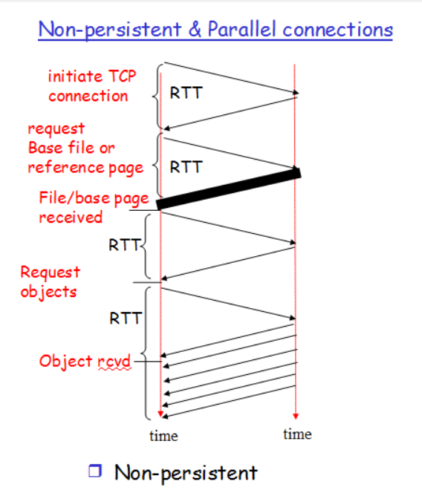
Question 5
a) Non-persistent HTTP with no parallel TCP connections?
3 x D_{DNS}+ (5 + 1) x 2 x D_{Web}
b) Non-persistent HTTP with the browser configured for five parallel connections?
3 x D_{DNS} + 2 x D_{Web} + 2 x D_{Web}
Need to fetch HTML file first (2 x D_{Web} ). Subsequently the rest 5 objects can be fetched in parallel each using a TCP connection (2 x D_{Web} ).
c) Persistent HTTP with pipelining?
3 x D_{DNS} + 2 x D_{Web} + D_{Web}
Need to fetch HTML file first (2 x D_{Web} ). The rest 5 objects can be fetched through the same TCP connection in parallel – no RTT for TCP handshake needed.

Slide 30
Question 6
Do you know what is DNS cache poisoning? Search online for a real example.

Slide 31
Question 6
DNS cache poisoning (a kind of DNS spoofing) is a computer hacking attack, whereby rogue DNS records are introduced into a DNS resolver’s cache, causing the name server to return an incorrect IP address, diverting traffic to the attacker’s computer (or any other computer). For example, DDoS (Distributed Denial of Service Attack) on a particular machine can be achieved via DNS cache poisoning.
Real example:
1. DNS Poisoning in China: (http://www.howtogeek.com/161808/htg-explains-what-is-dns-cache-poisoning/).
2. Angry Bird Website Defaced: https://arstechnica.com/security/2014/01/angry-birds-website-defaced-following-reports-it-enables-government-spying/

Slide 32
Question 8
Wireshark: HTTP GET/response interaction
Let’s begin our exploration of HTTP by downloading a very simple HTML file, and contains no embedded objects. Do the following:
1. Start up your web browser.
2. Start up the Wireshark packet sniffer. Enter “http” in the display – filter - specification window and begin Wireshark packet capture.
3. Enter the following to your browser http://gaia.cs.umass.edu/wireshark-labs/HTTP-wireshark-file1.html
4. Stop Wireshark packet capture.

Slide 33
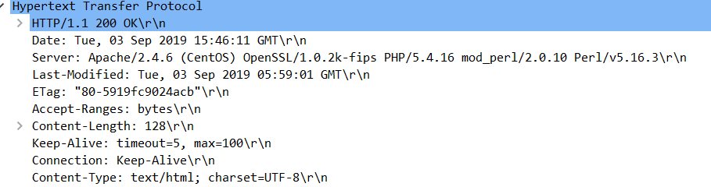
Question 8
Now answer the following questions:
What is the status code returned from the server to your browser?
200
2. When was the HTML file that you are retrieving last modified at the server?
The value is denoted by the header field ’Last - Modified’.

Slide 34
End of Tutorial

Slide 35
In HTTP, a response status code of 404 tells you ____________.
A. Web server is unavailable
B. Web server is currently busy
C. your browser needs to be updated to the latest version
D. the requested Web object is not found
E. your HTTP request is malformed

Slide 36
In HTTP, a response status code of 404 tells you ____________.
A. Web server is unavailable
B. Web server is currently busy
C. your browser needs to be updated to the latest version
D. the requested Web object is not found
E. your HTTP request is malformed

Slide 37
Which of the following statement about HTTP is FALSE?
A. HTTP typically runs on top of TCP.
B. HTTP is an application layer protocol.
C. In HTTP/1.0, the server will usually close the connection after every request.
D. In HTTP/1.1, the default connection type is persistent.
E. HTTP is only used to download HTML data from a Web server

Slide 38
Which of the following statement about HTTP is FALSE?
A. HTTP typically runs on top of TCP.
B. HTTP is an application layer protocol.
C. In HTTP/1.0, the server will usually close the connection after every request.
D. In HTTP/1.1, the default connection type is persistent.
E. HTTP is only used to download HTML data from a Web server

