Slide 1
CS2105 Introduction to Computer Networks Tutorial 3
Notes:
Welcome to Tutorial 3

Slide 2
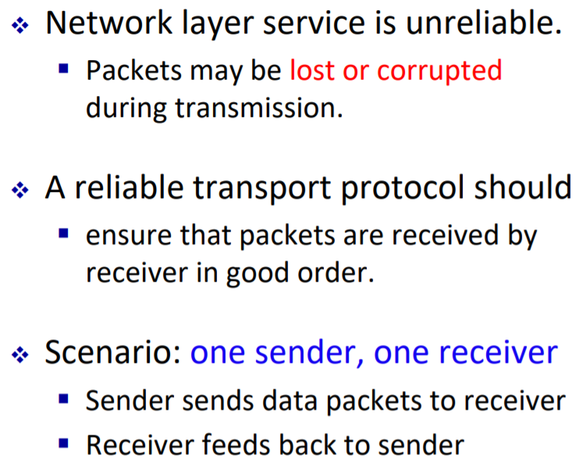
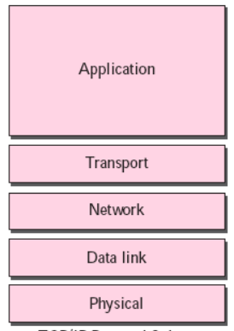
Recap: Designing reliable transport protocols
You
Someone else

Slide 3
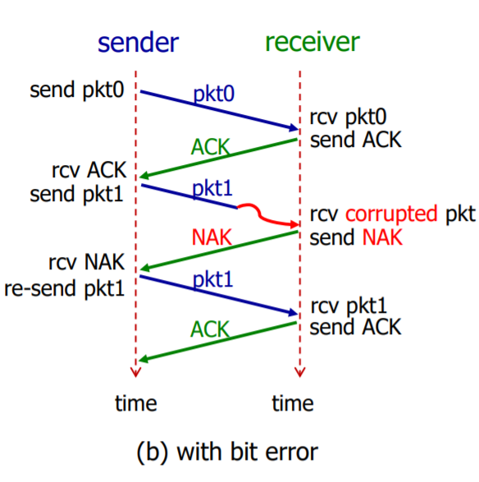
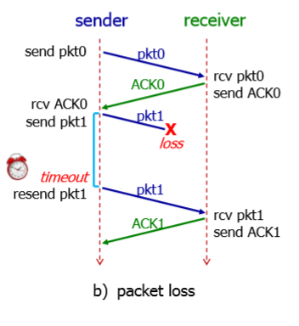
Recap: Designing reliable transport protocols

Slide 4
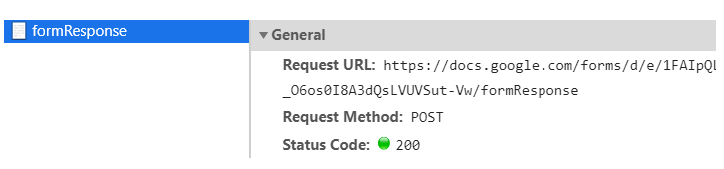
Question 1
Launch your browser and open its network diagnostic tool (e.g. press F12 if you use Chrome on Windows, or Cmd + Opt + I for Mac). Then click the “Network” tab to observe network communication.
Copy-and-paste the following URL in the address bar of your browser:
http://tiny.cc/atupaz
Enter your choice and press the “Submit” button.
a) Look at the entry named “formResponse”. What is the HTTP request method issued?
POST

Slide 5
Question 1
b) Briefly explain when HTTP POST and GET methods are used.
The POST request method requests that a web server accepts and stores the data enclosed in the body of the request message. It is often used when uploading a file or submitting a completed web form.
In contrast, the HTTP GET request method is designed to retrieve information from the server.

Slide 6
Question 2
Suppose that your department has a local DNS server for all computers in the department. You are an ordinary user (i.e., not a network/system administrator). Can you determine if an external Web site was likely accessed from a computer in your department a couple of seconds ago? Explain.
E.g. dig –t a www.abc.com
If IP address of this Web page has been queried by another computer seconds ago, your local DNS server should keep this knowledge in local DNS cache and is able to answer your query quickly. Otherwise, the query time will be long.
FYI: https://www.thegeekstuff.com/2012/02/dig-command-examples/

Slide 7
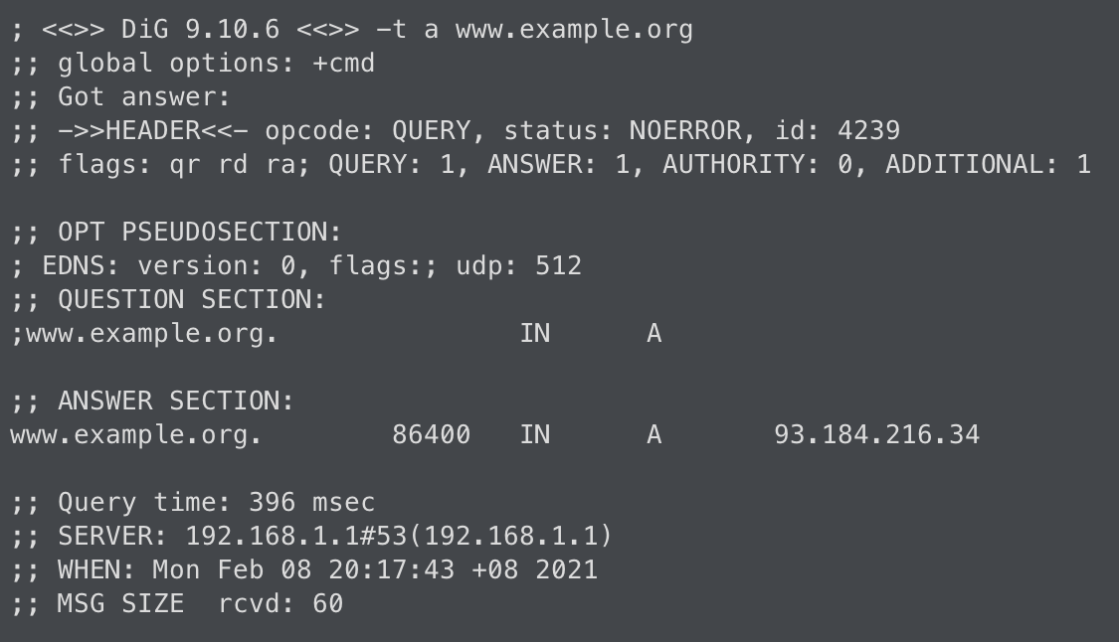
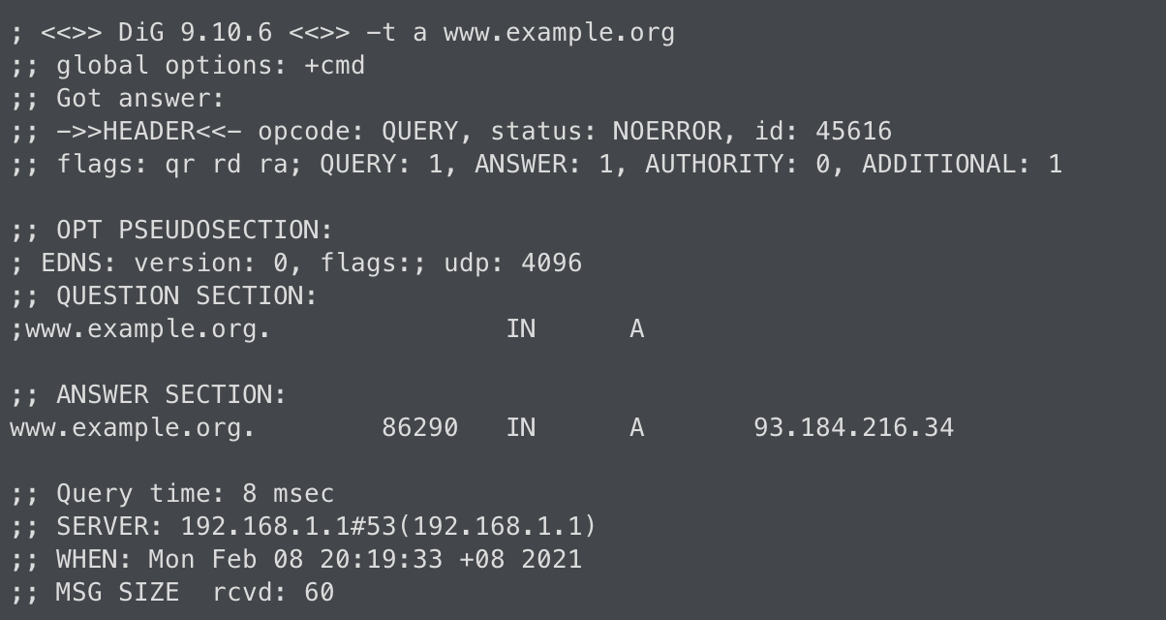
Question 2
Suppose that your department has a local DNS server for all computers in the department. You are an ordinary user (i.e., not a network/system administrator). Can you determine if an external Web site was likely accessed from a computer in your department a couple of seconds ago? Explain.

Slide 8
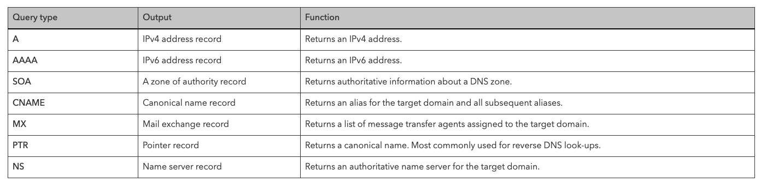
Question 2
Suppose that your department has a local DNS server for all computers in the department. You are an ordinary user (i.e., not a network/system administrator). Can you determine if an external Web site was likely accessed from a computer in your department a couple of seconds ago? Explain.
E.g. dig –t a www.abc.com

Slide 9

Question 3
You are given 4 programs: TCPEchoServer.py, TCPEchoClient.py, UDPEchoServer.py and UDPEchoClient.py. Compile them on sunfire.
a) Suppose you run TCPEchoClient before you run TCPEchoServer. What happens? Why?
When creating a local socket, client attempts to make a TCP connection to a non-existent server process. Exception will be thrown.
TCP is connection-oriented protocol
b) Suppose you run UDPEchoClient before you run UDPEchoServer. What happens? Why?
UDP client doesn’t establish connection to server when creating local socket. Thus it works fine if you start client program first and then server program (but data sent to server are all lost).
UDP is connectionless protocol

Slide 10
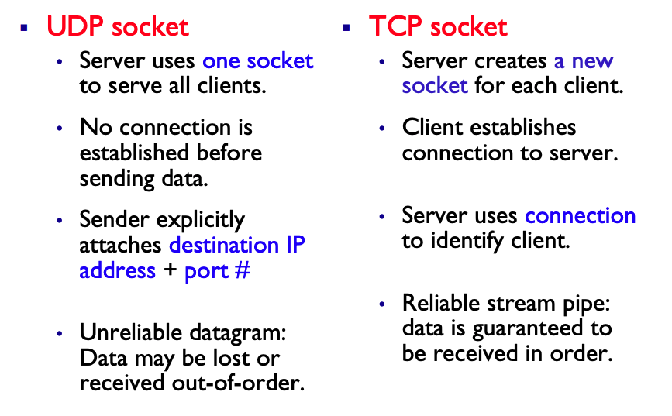
Question 4
Suppose a process in Host C has a UDP socket with port number 6789. Suppose both Host A and Host B each sends a UDP segment to Host C with destination port number 6789. Will both of these segments be directed to the same socket at Host C? If so, how will the process at Host C know that these two segments originated from two different hosts?
Yes, both segments will be directed to the same socket. Sock APIs are available for programmers to learn the IP address of the origin of a packet.

Slide 11
Question 5
a) Suppose you have the following 2 bytes: 01011100 and 01100101. What is the 1’s complement of the sum of these 2 bytes?
01011100
01100101
11000001
00111110
Sum: 11000001, checksum: 00111110

Slide 12
Question 5
b) Suppose you have the following 2 bytes: 11011010 and 01100101. What is the 1’s complement of the sum of these 2 bytes?
(Hint: if carry after 8 bit, add it to the LSB)
11011010
01100101
100111111
1
01000000
10111111
Sum: 01000000, checksum: 10111111

Slide 13
Question 6
Suppose that UDP receiver computes the checksum for the received UDP segment and finds that it matches the value carried in the checksum field. Can the receiver be absolutely certain that no bit errors have occurred? You may use Q5 as an example to explain.
If sender transmits the following two bytes: 01011100 and 01100101, and the two bits highlighted in blue flip, then checksum remains unchanged and receiver will fail to detect this error.
01011100 01111100
01100101 01000101

Slide 14
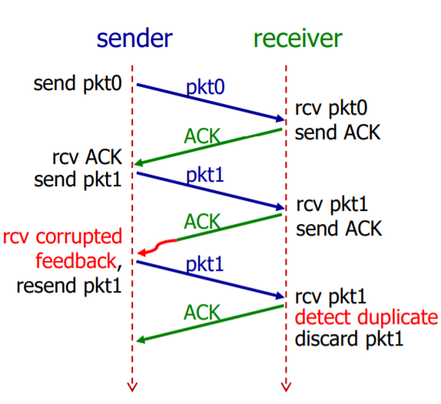
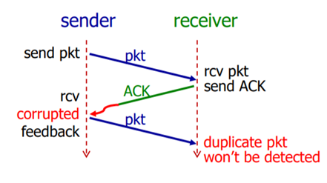
Question 7
In our rdt protocols, why did we need to introduce sequence numbers?
Sequence numbers are required for a receiver to find out whether an arriving packet contains new data or is a retransmission.
Problem
Solution

Slide 15
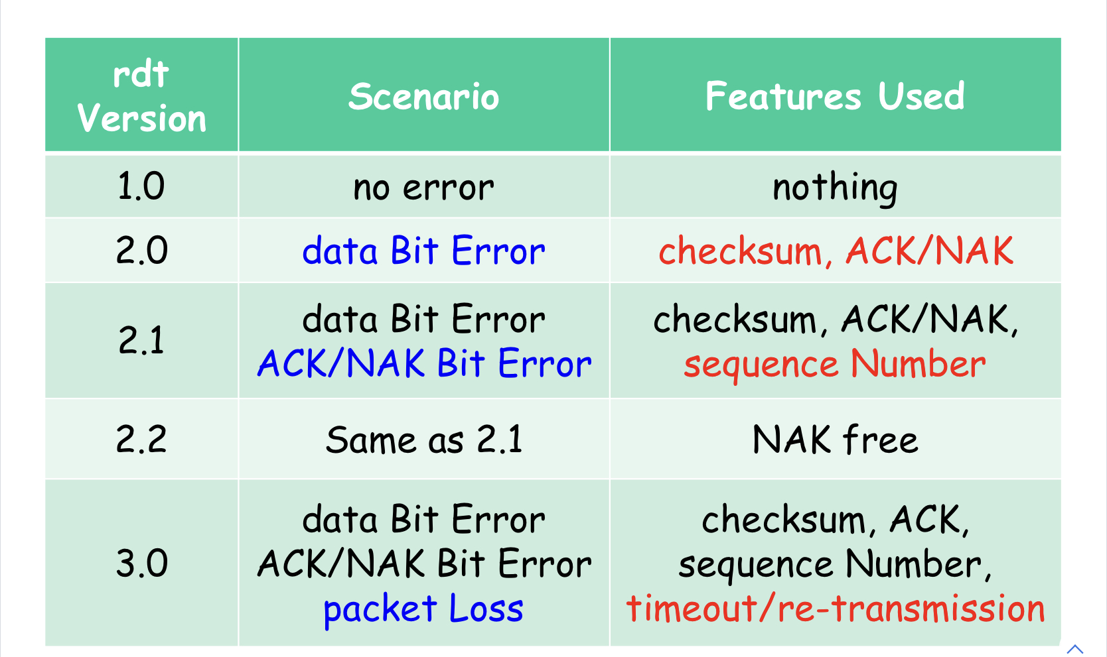
Question 7
In our rdt protocols, why did we need to introduce sequence numbers?

Slide 16
End of Tutorial

Slide 17
A Web server supports both HTTP/1.0 and HTTP/1.1. So far 100 clients have downloaded a web page from the server, which contains 1 HTML file and 2 images. Half of the clients run HTTP/1.0 and the other half run HTTP/1.1.
How many sockets has the Web server ever created?
201
200
100
101
None of the above

Slide 18
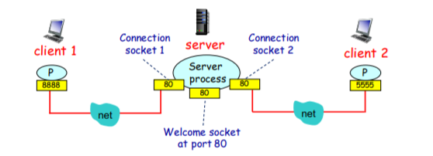
A Web server supports both HTTP/1.0 and HTTP/1.1. So far 100 clients have downloaded a web page from the server, which contains 1 HTML file and 2 images. Half of the clients run HTTP/1.0 and the other half run HTTP/1.1.
How many sockets has the Web server ever created?
201
200
100
101
None of the above
1 welcome socket created
HTTP/1.0 (non-persistent) created 150 sockets; each clients create 3 connection for 3 object (1 HTML file & 2 images)
HTTP/1.1 (persistent) created 50 socket; all 3 object download over 1 connection
Socket created = 1 + 150 + 50 = 201

